Slide 1
Built Without Hands
“We heard him [Jesus] say, I will destroy this temple that is made with hands, and within three days I will build another made without hands.” – Mark 14:58 KJB

Slide 2
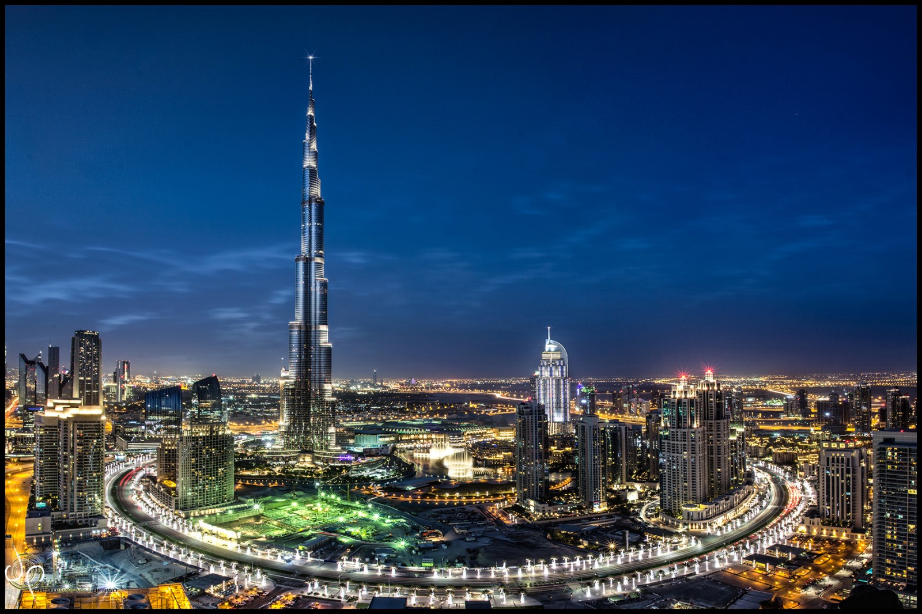
Burj Khalifa – Dubai, Arabia

Slide 3
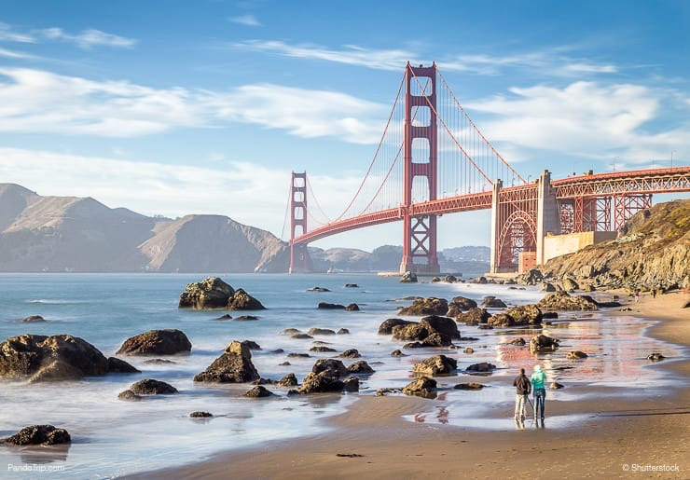
Golden Gate Bridge – San Francisco, CA - USA

Slide 4
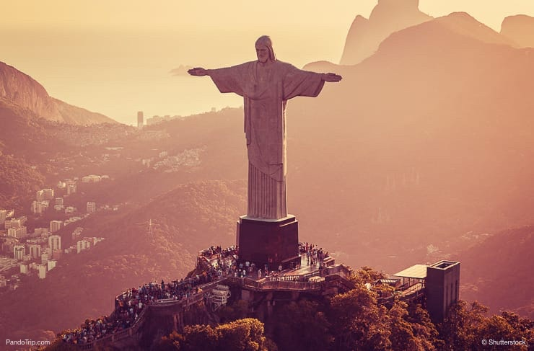
Christ the Redeemer – Rio de Janeiro, Brazil, South America

Slide 5
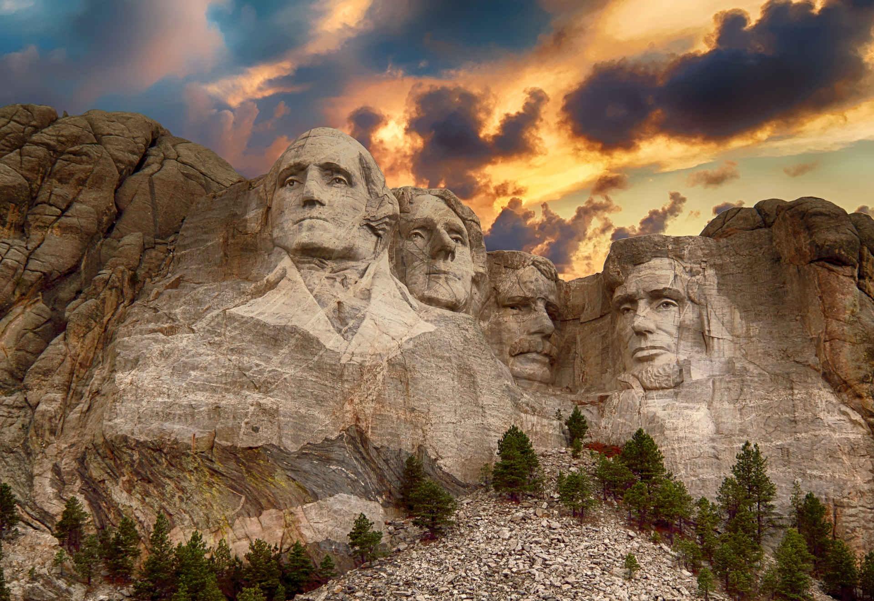
Mount Rushmore – Keystone, SD USA

Slide 6
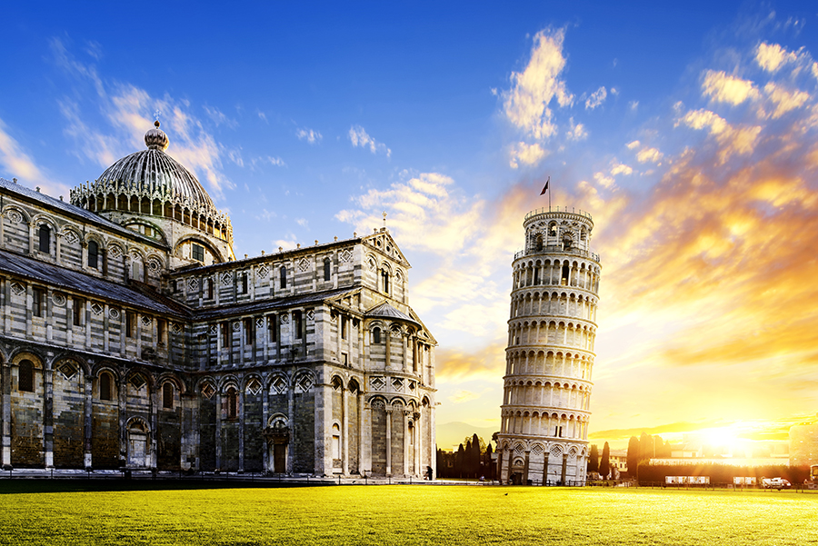
Leaning Tower Of Pisa – Pisa, Italy

Slide 7
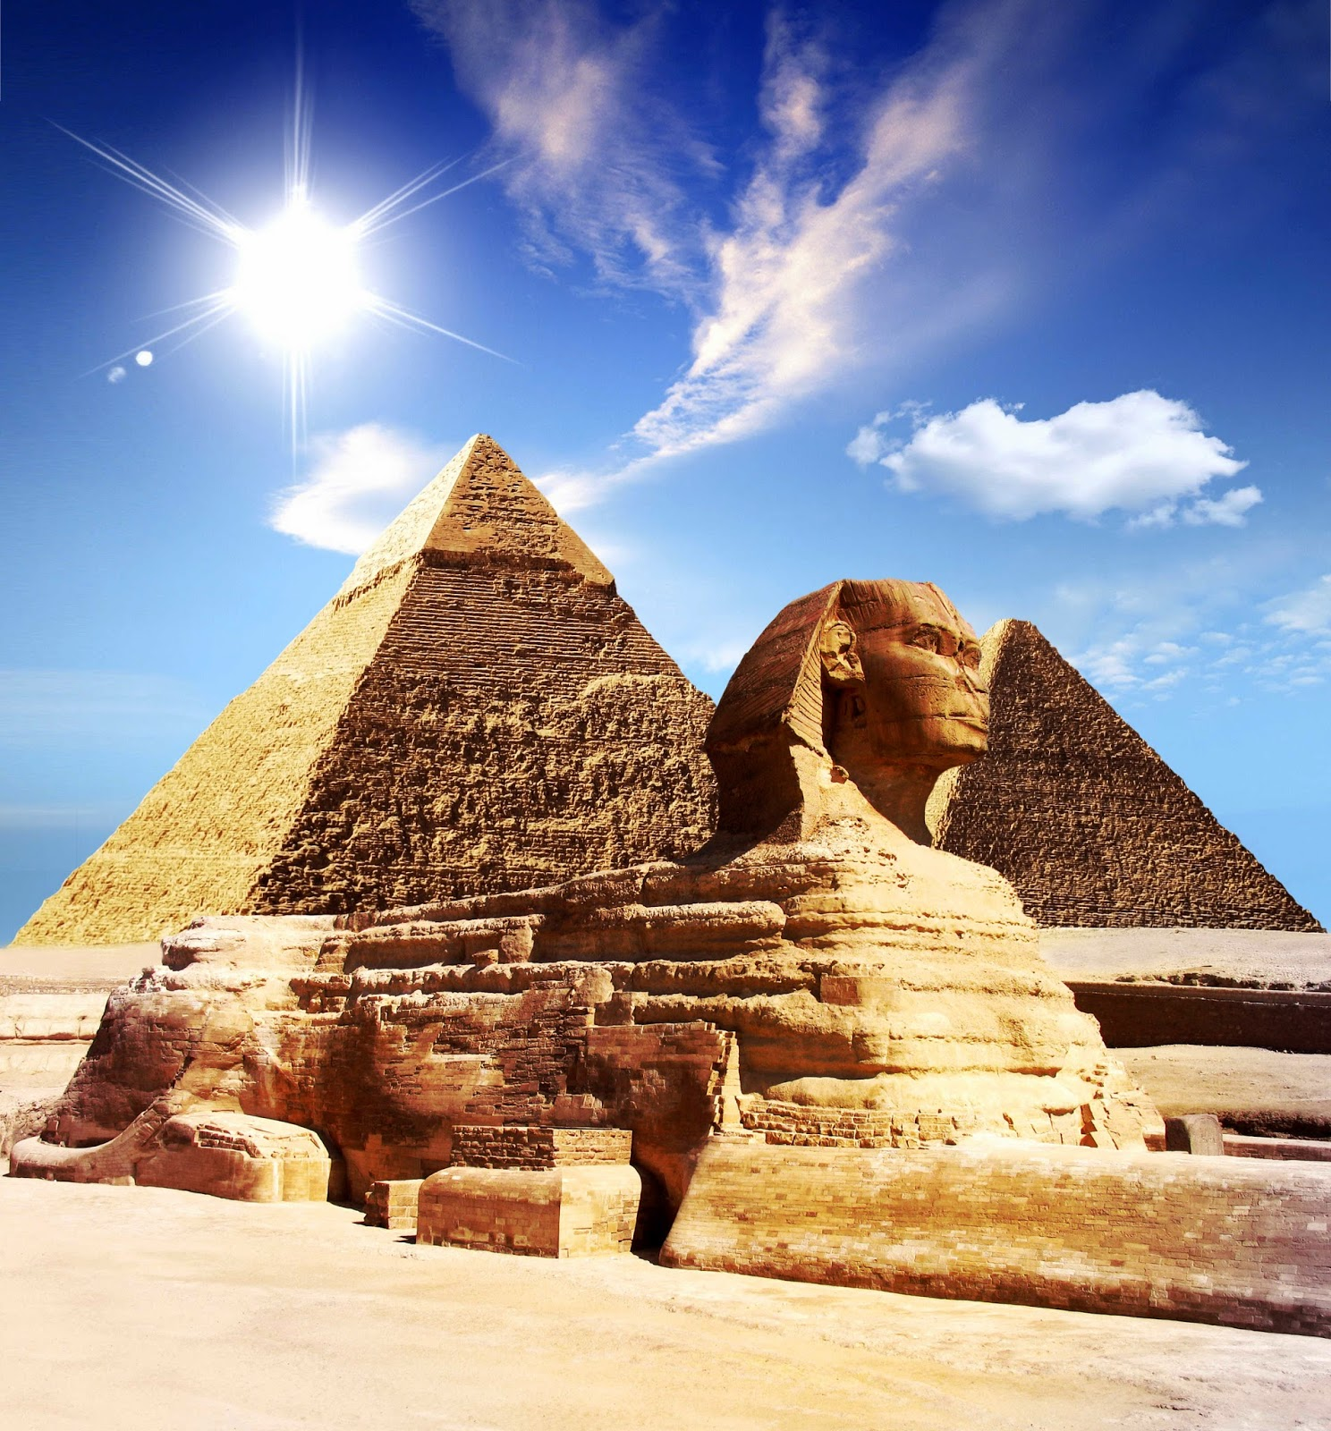
Pyramids of Giza
&
The
Sphynx
Of
Egypt,
North
Africa

Slide 8
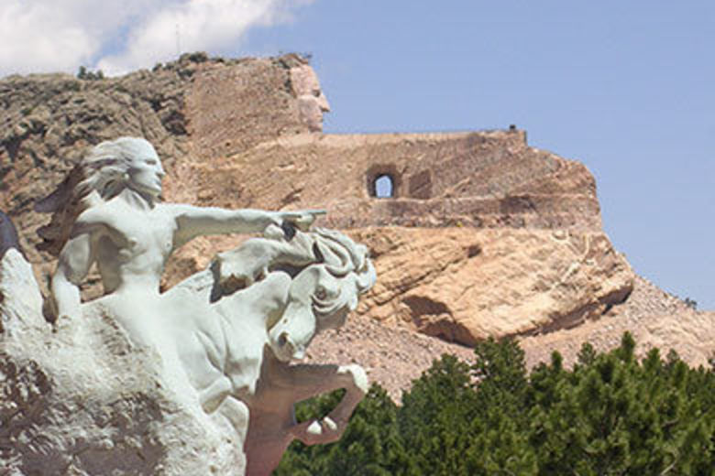
Crazy Horse - Black Hills, SD - USA

Slide 9
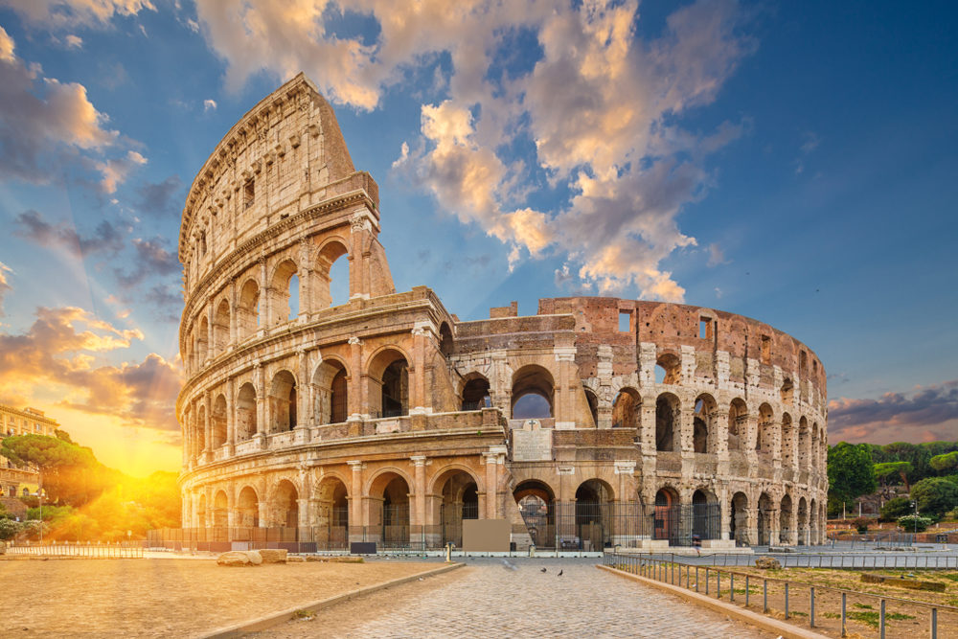
Colosseum – Rome, Italy

Slide 10
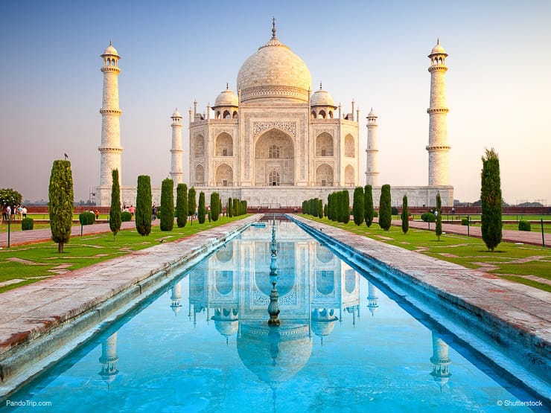
Taj Mahal – Agra, India

Slide 11
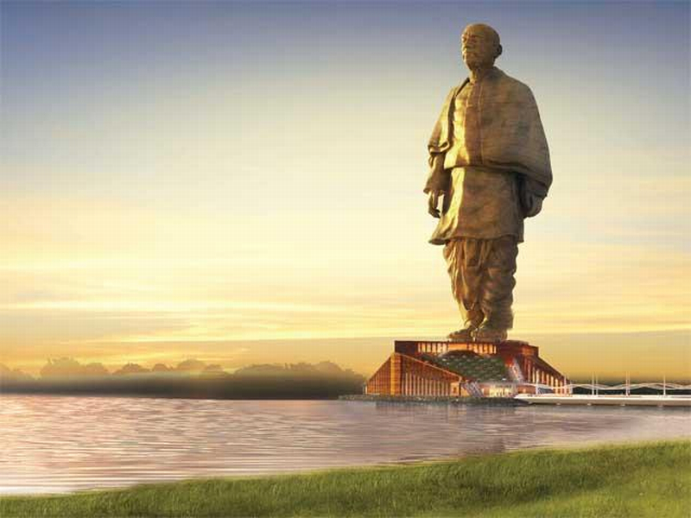
Statue Of Unity – Gujarat, India

Slide 12
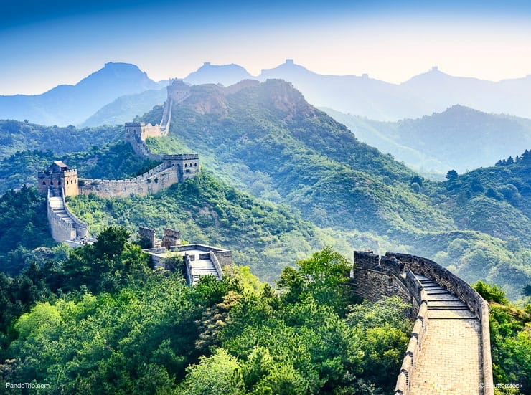
Great Wall Of China – North China

Slide 13
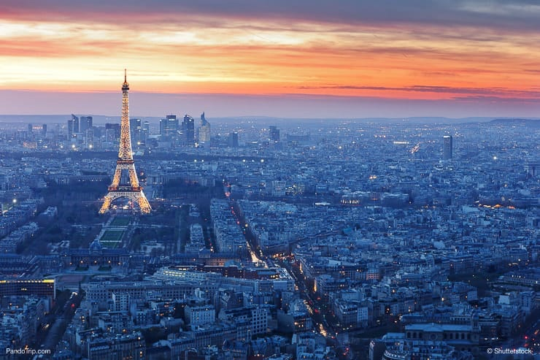
Eifell Tower – Paris, France

Slide 14
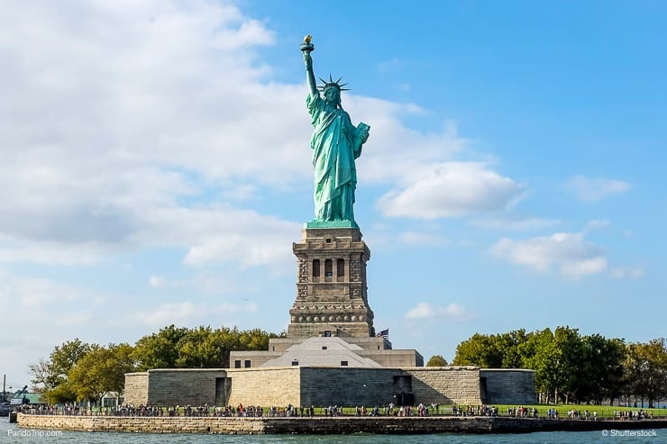
Statue Of Liberty – Liberty Island, NY – USA

Slide 15
All of those things, that we just looked at, were built by the hands of men. They were shaped and fashioned after men’s ideas.

Slide 16
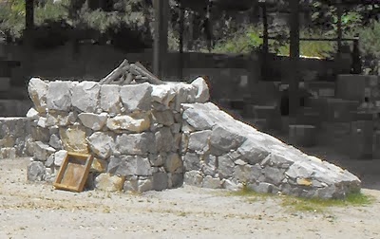
Altar – Not Hewn Stone

Slide 17
“And if thou wilt make me an altar of stone, thou shalt not build it of hewn stone: for if thou lift up thy tool upon it, thou hast polluted it.” – Exodus 20:25 KJB

Slide 18
Made By God

Slide 19
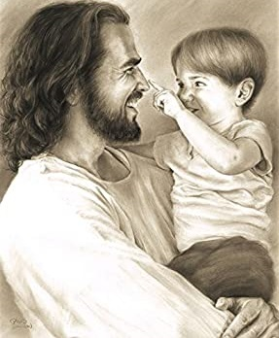
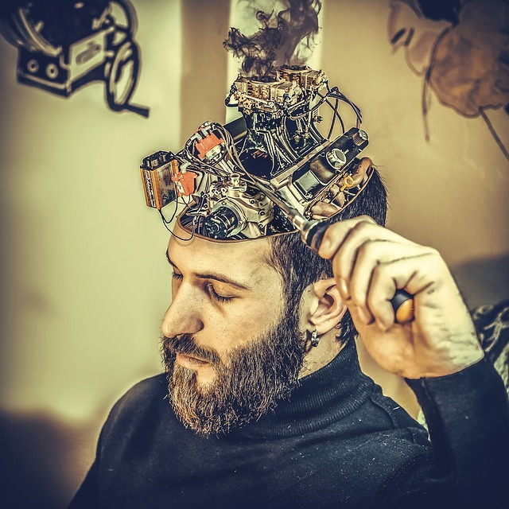
Do You Want To Let God Make You, Or Another?

Slide 20
“Him that overcometh will I make a pillar in the temple of my God, and he shall go no more out: and I will write upon him the name of my God, and the name of the city of my God, which is new Jerusalem, which cometh down out of heaven from my God: and I will write upon him my new name.” – Revelation 3:12 KJB

Slide 21
Made By God
Created by God, built without hands, by the reading and following of
His Instruction Manual,
His Blueprint, His Plans,
The Holy Bible (KJB)!

