Slide 1
Faith
&
Works

Slide 2
Belief
&
Practice

Slide 3
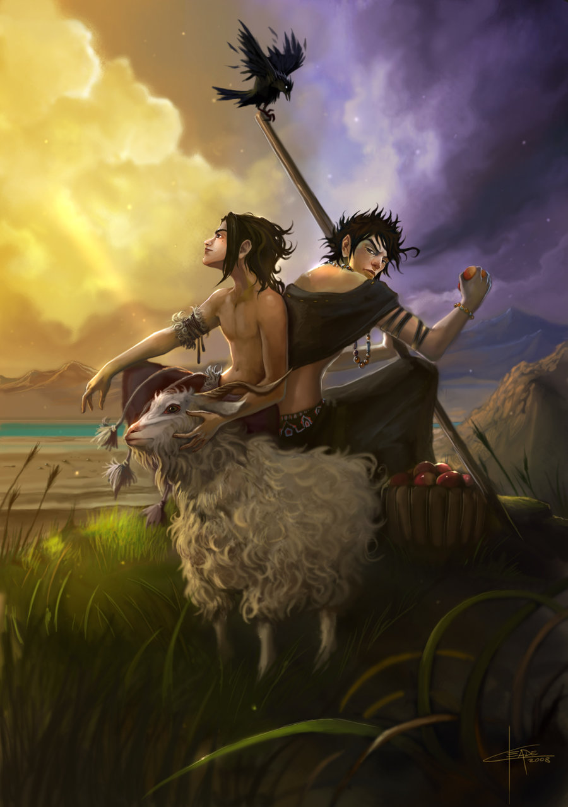
Cain
&
Abel

Slide 4
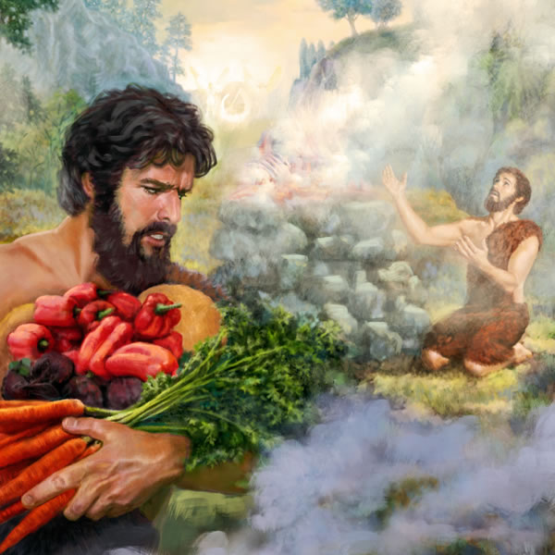

Slide 5
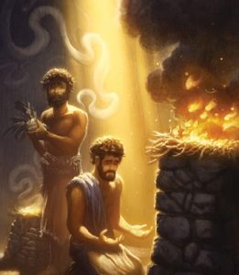

Slide 6
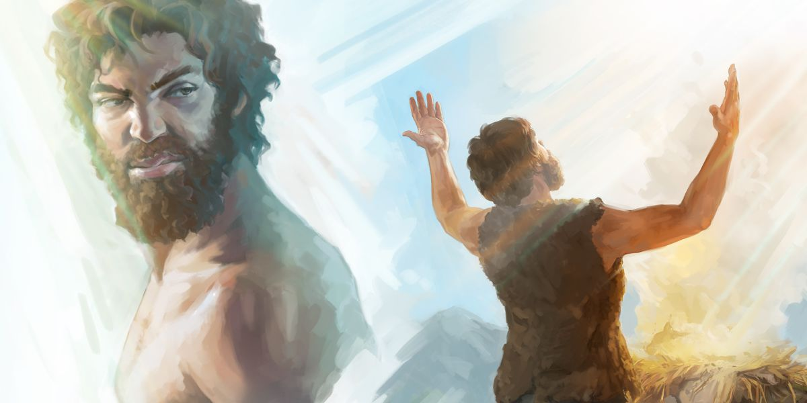

Slide 7
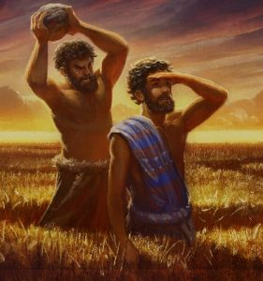

Slide 8
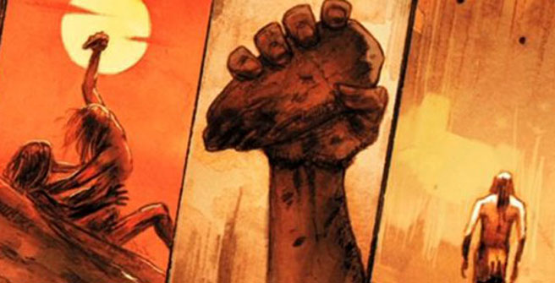

Slide 9
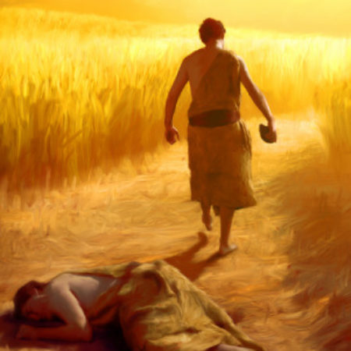

Slide 10
“He that saith he is in the light, and hateth his brother, is in darkness even until now.” – 1 John 2:9 KJB

Slide 11
“… and knoweth not whither he goeth, because that darkness hath blinded his eyes. “ – 1 John 2:11 KJB

Slide 12
“Whosoever hateth his brother is a murderer: and ye know that no murderer hath eternal life abiding in him.”
– 1 John 3:15 KJB

Slide 13
“If a man say, I love God, and hateth his brother, he is a liar: for he that loveth not his brother whom he hath seen, how can he love God whom he hath not seen?”
– 1 John 4:20 KJB

Slide 14
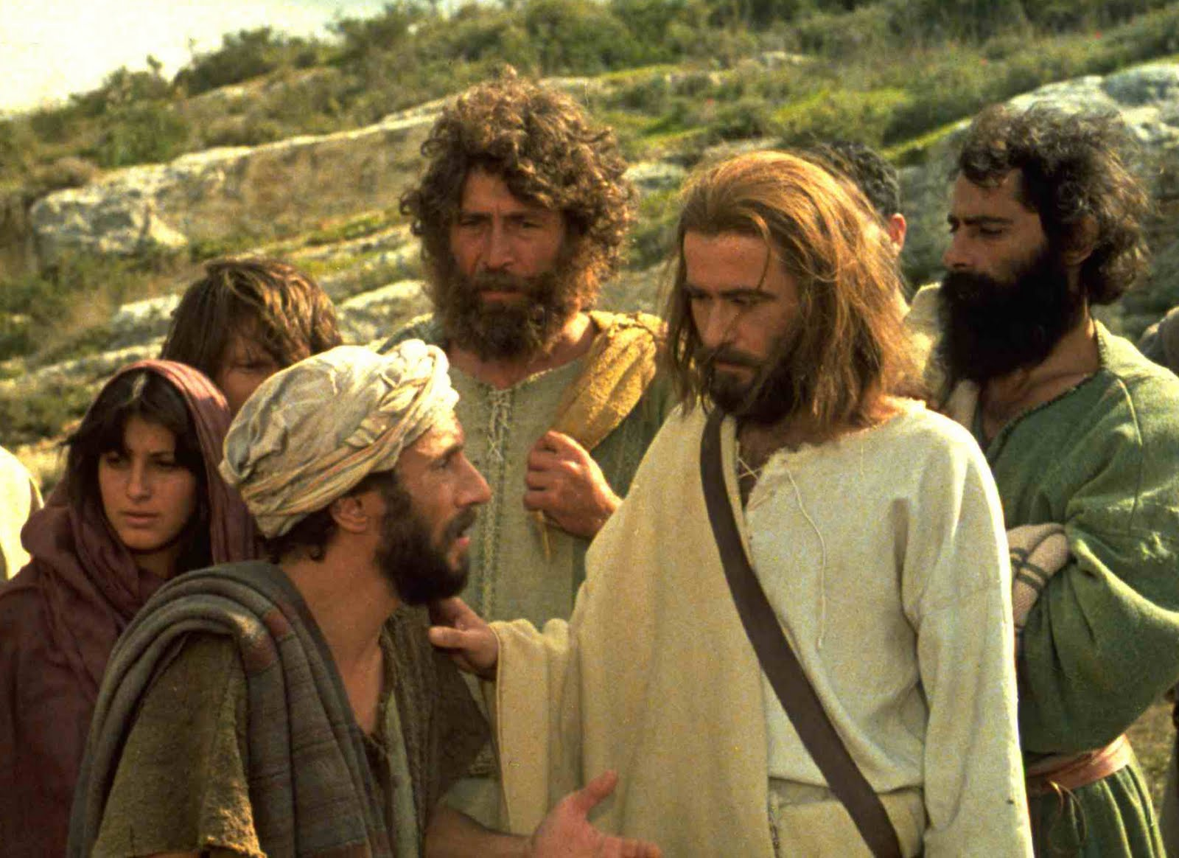

Slide 15
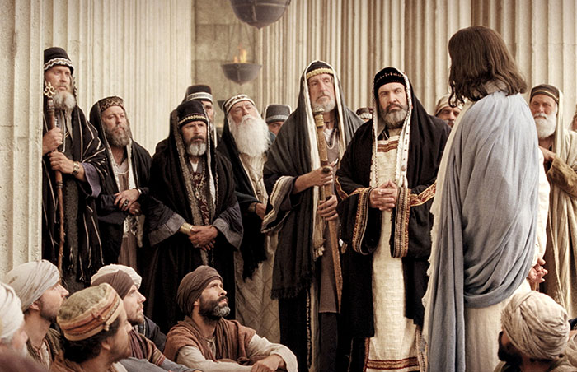

Slide 16
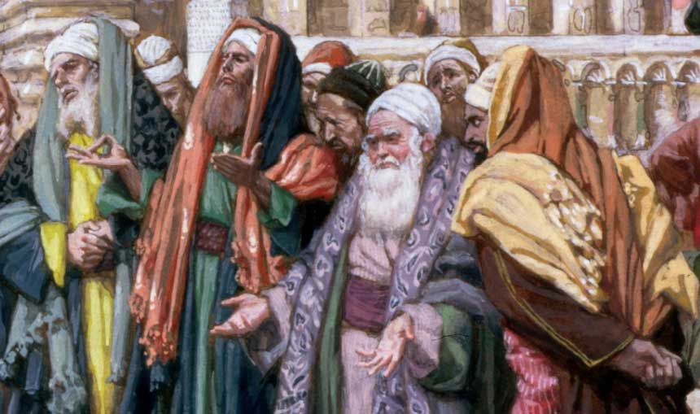

Slide 17
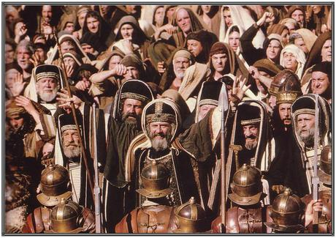
CRUCIFY HIM!!!

Slide 18
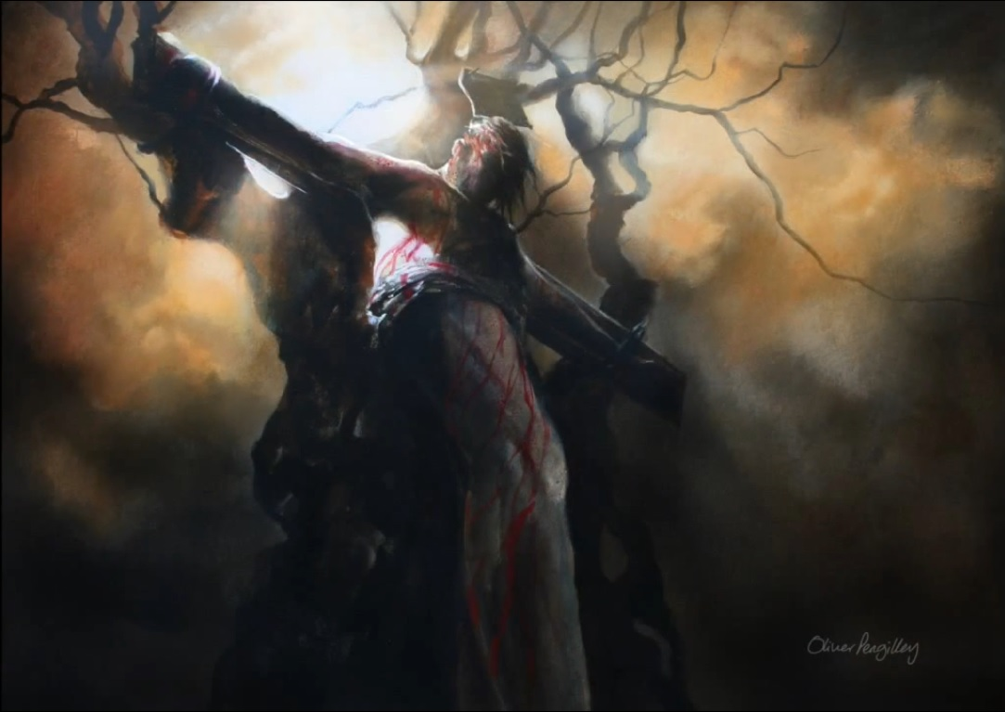
Father,
forgive them …

