Slide 1
Majestic

Slide 2
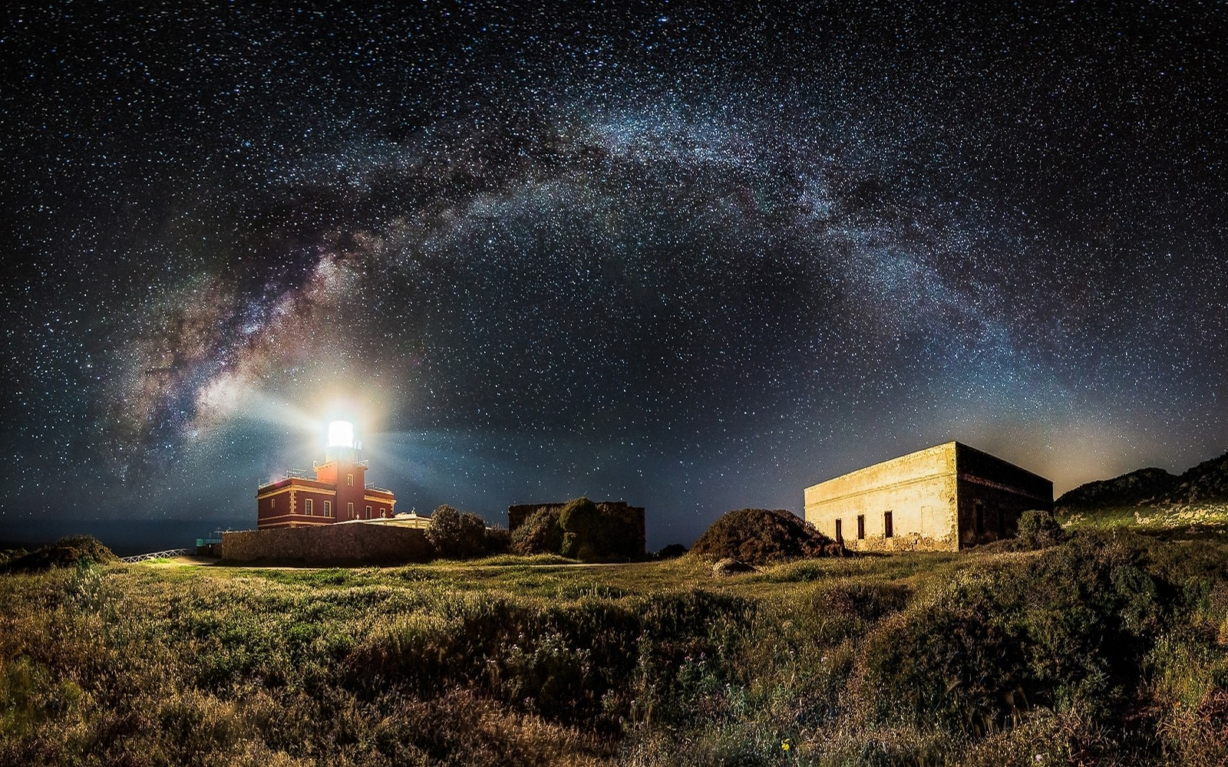
Awesome

Slide 3
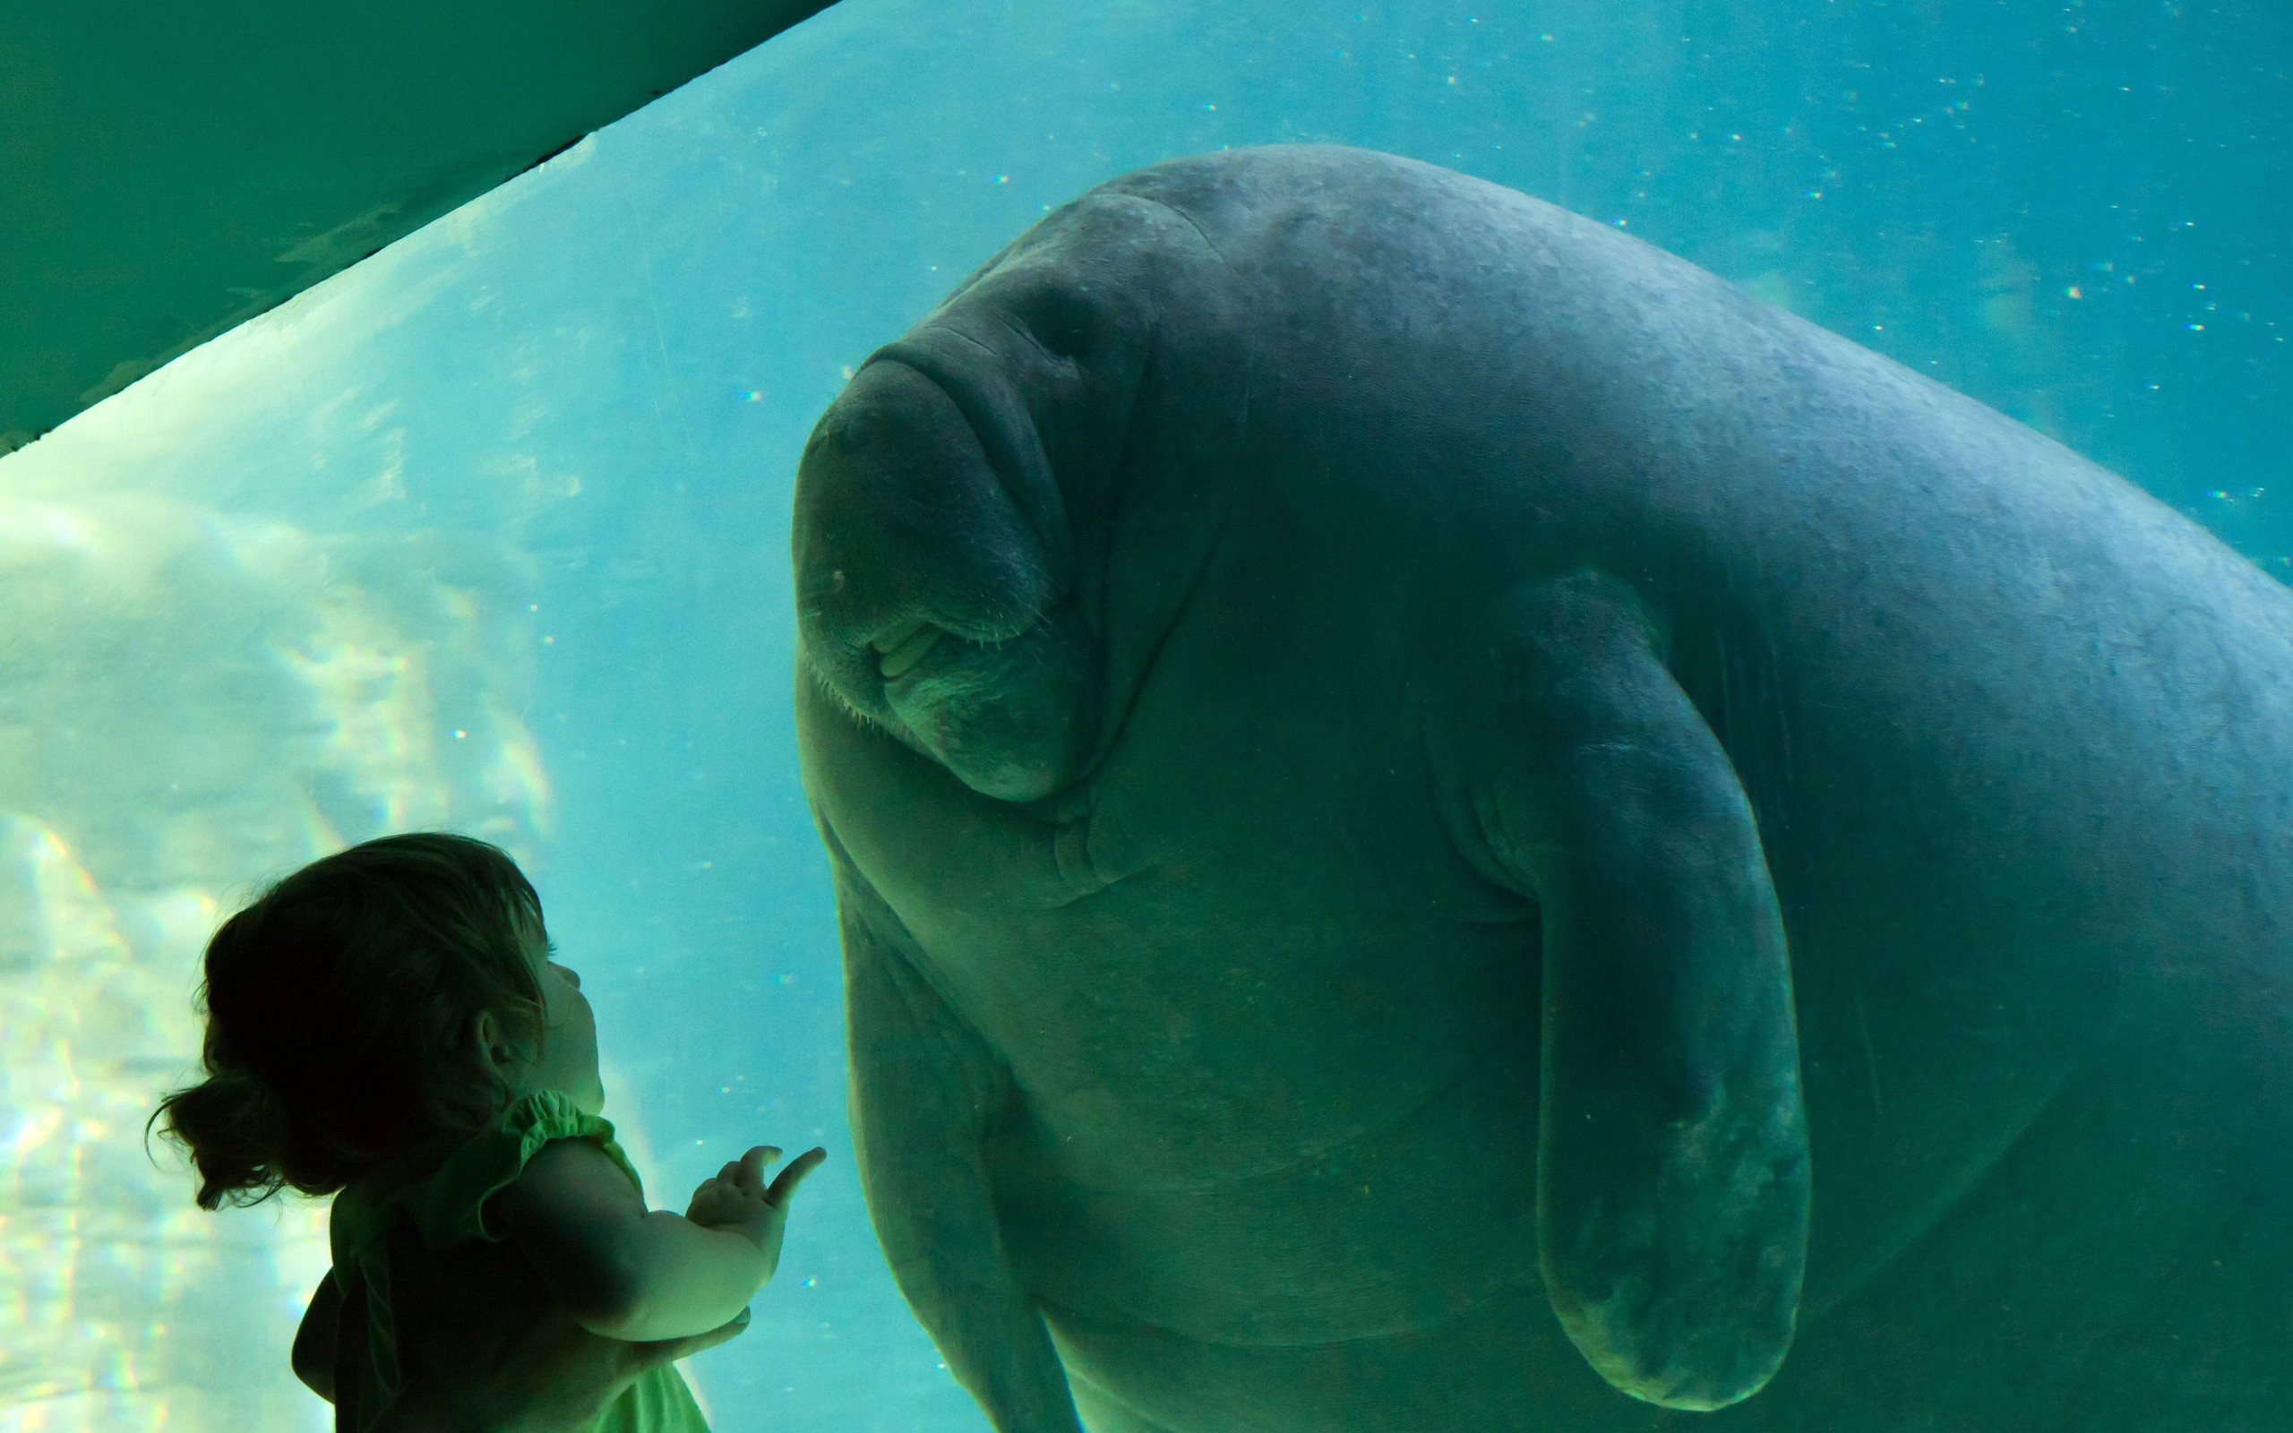
Wonder

Slide 4
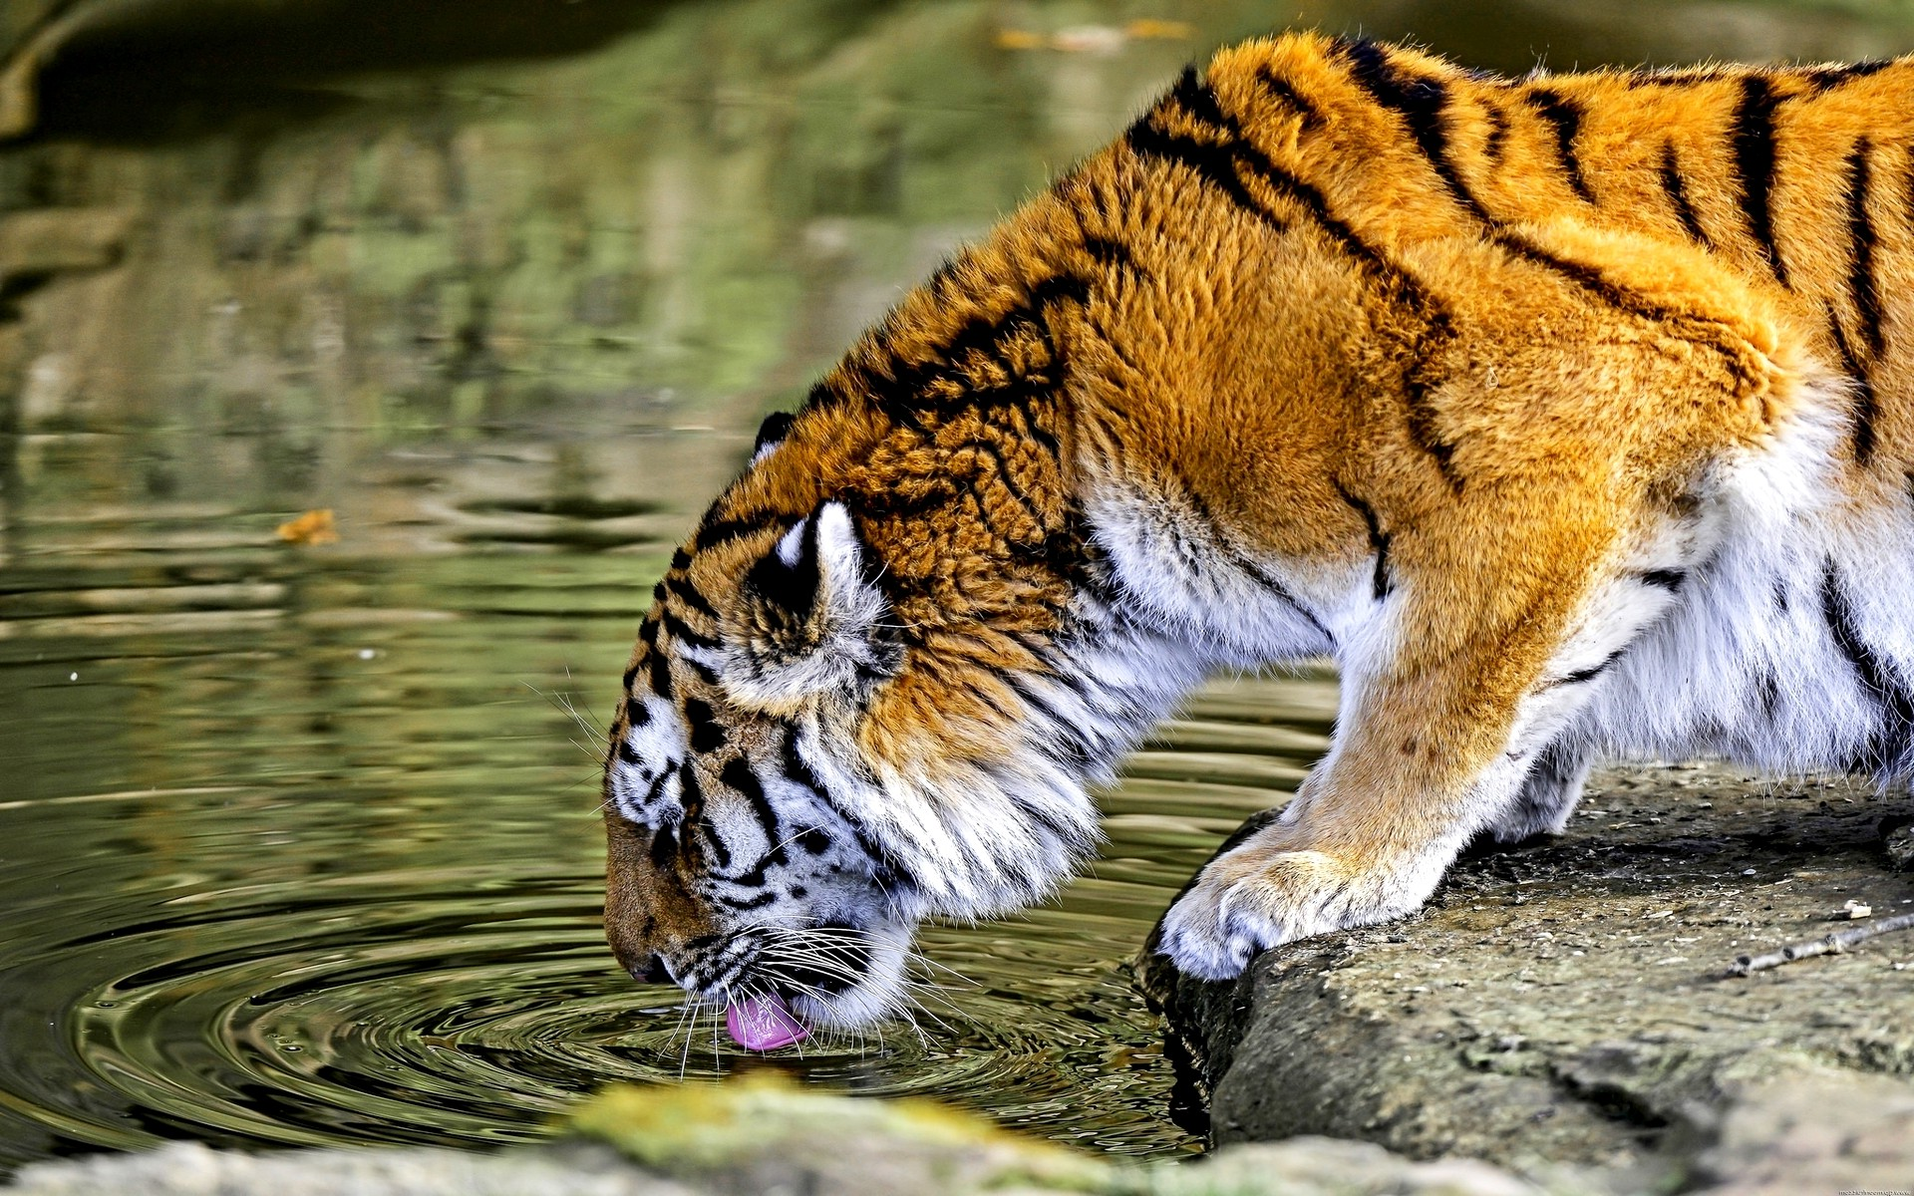
Powerful

Slide 5
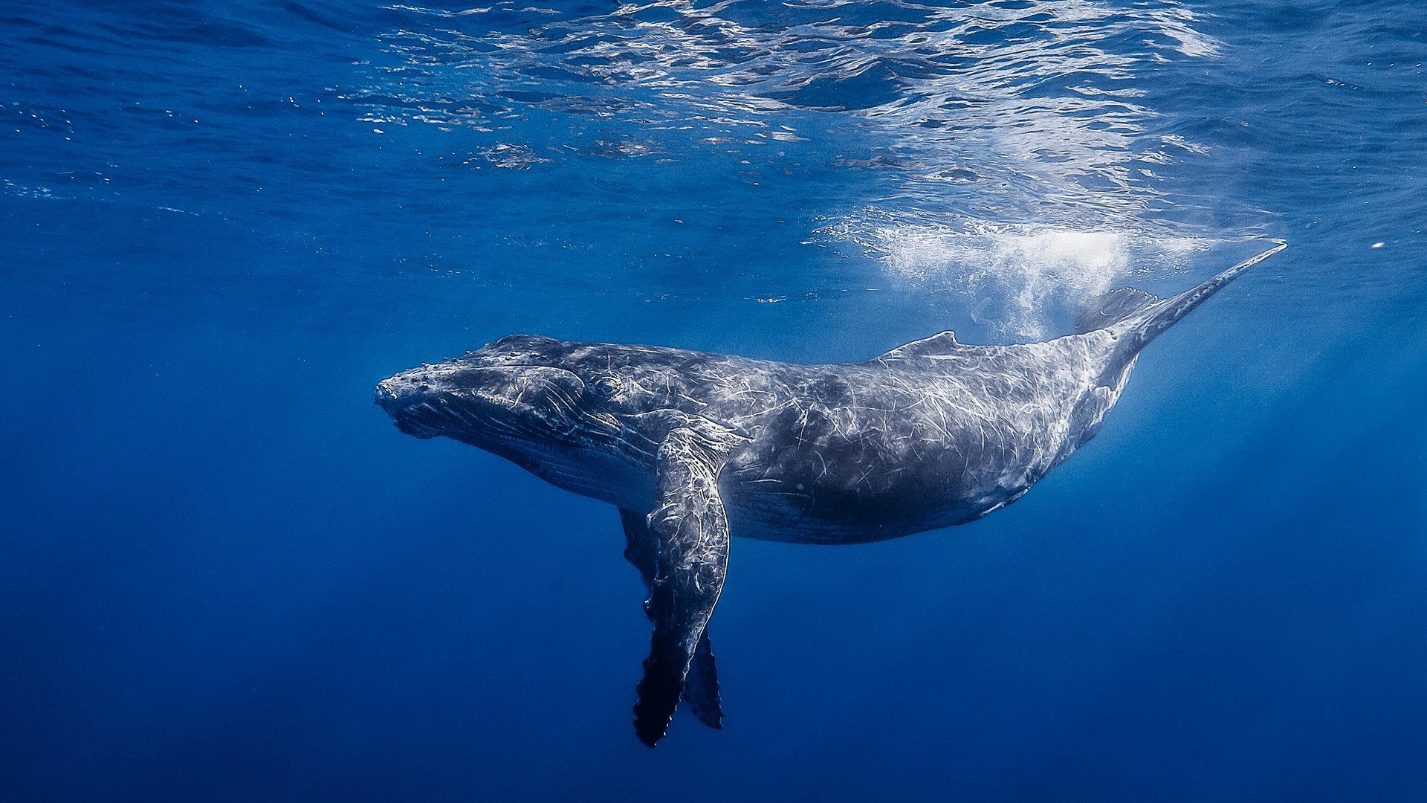
Big

Slide 6
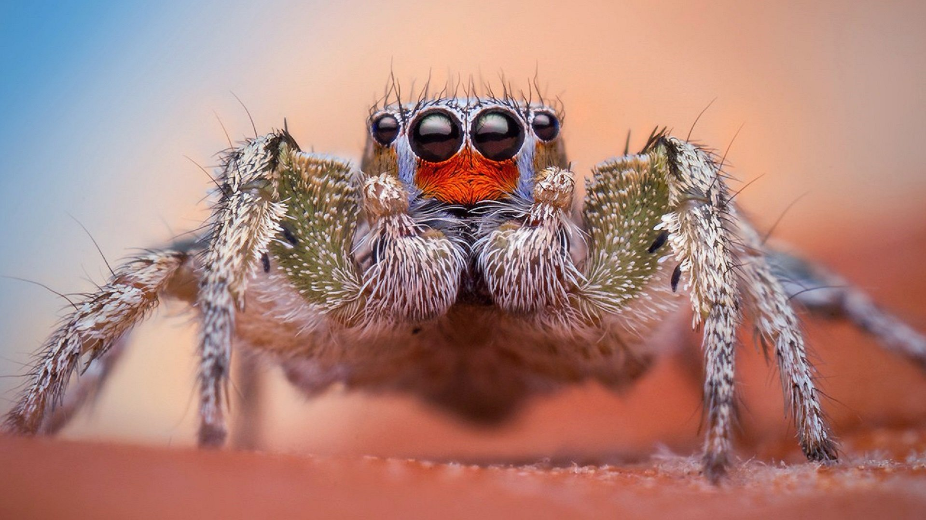
Small

Slide 7
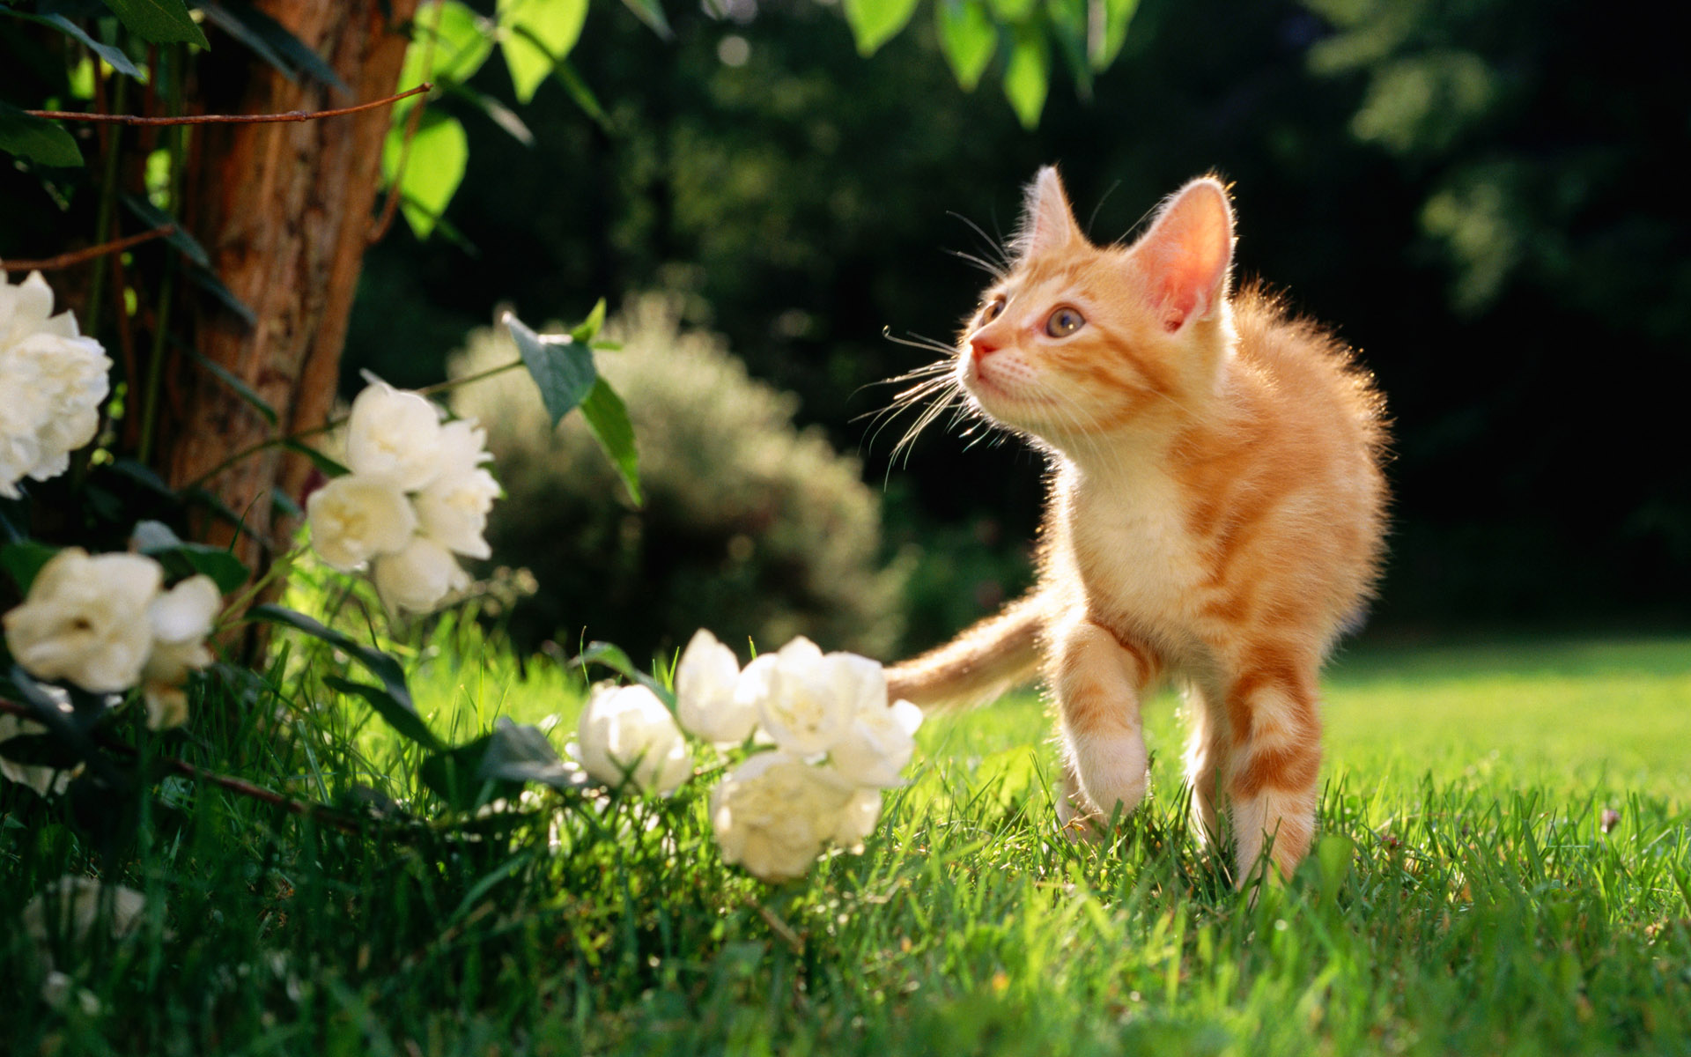
Gentle

Slide 8
Wise

Slide 9
How To Swim

Slide 10
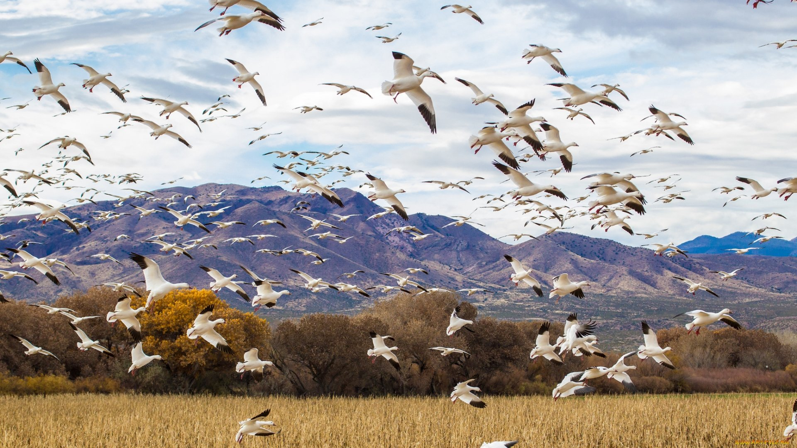
How To Fly

Slide 11
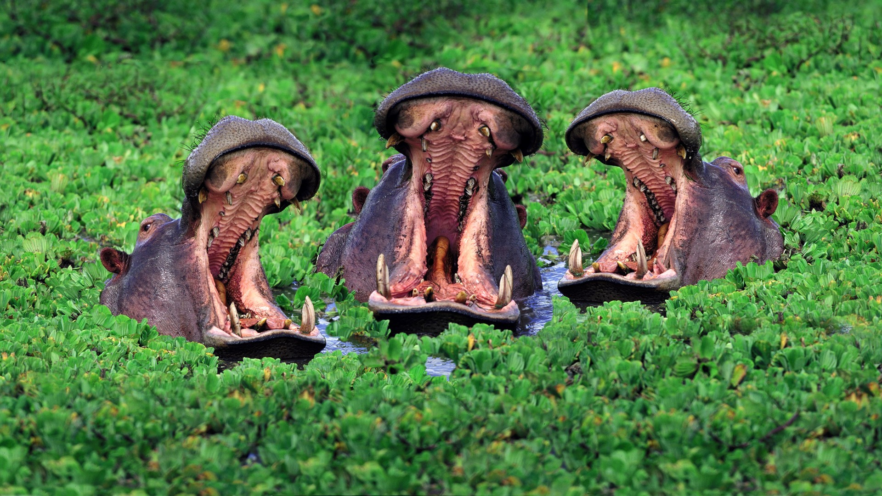
How To Sing

Slide 12
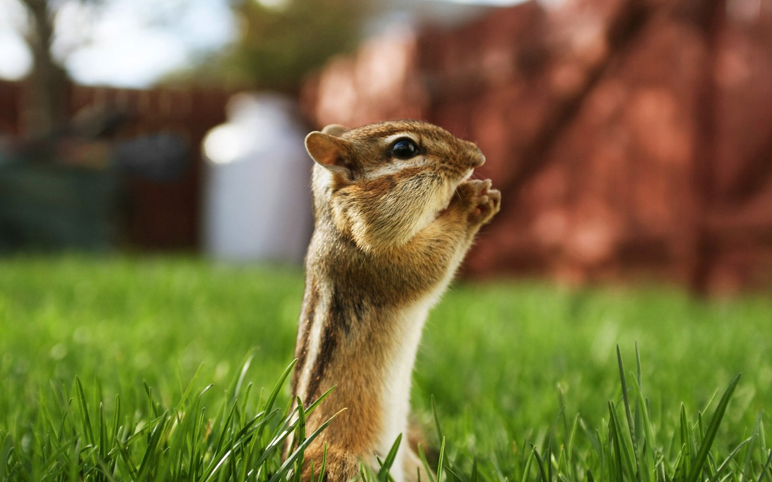
How To Pray

Slide 13
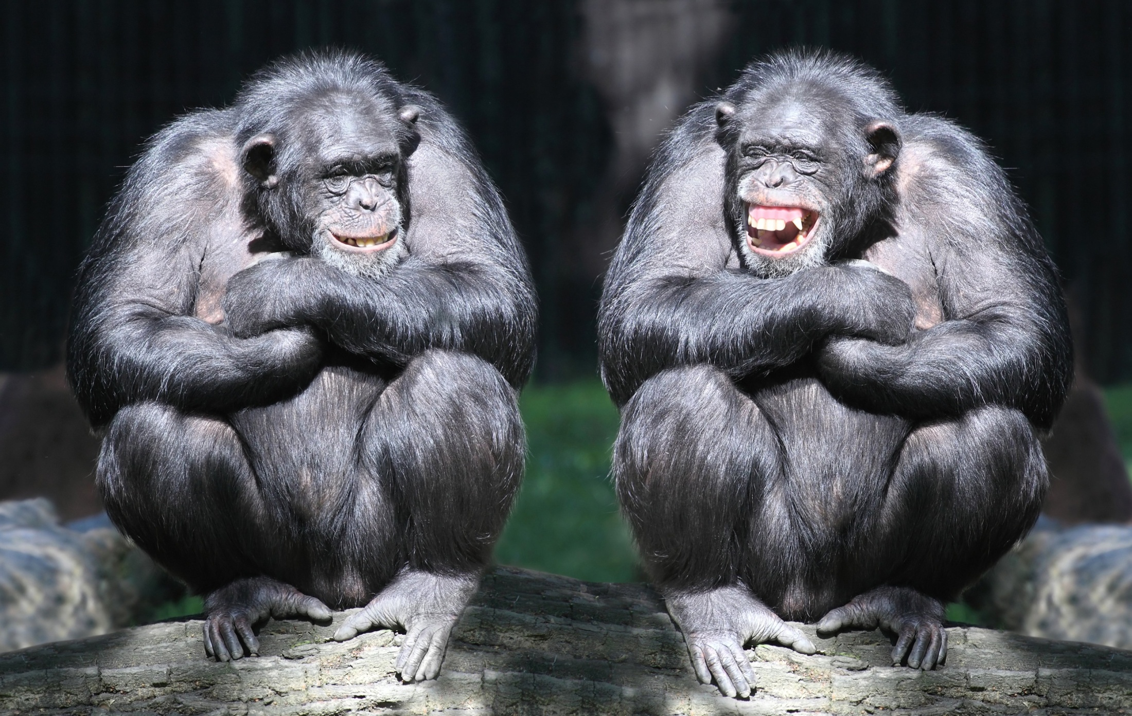
How To Have Friendship & Joy

Slide 14
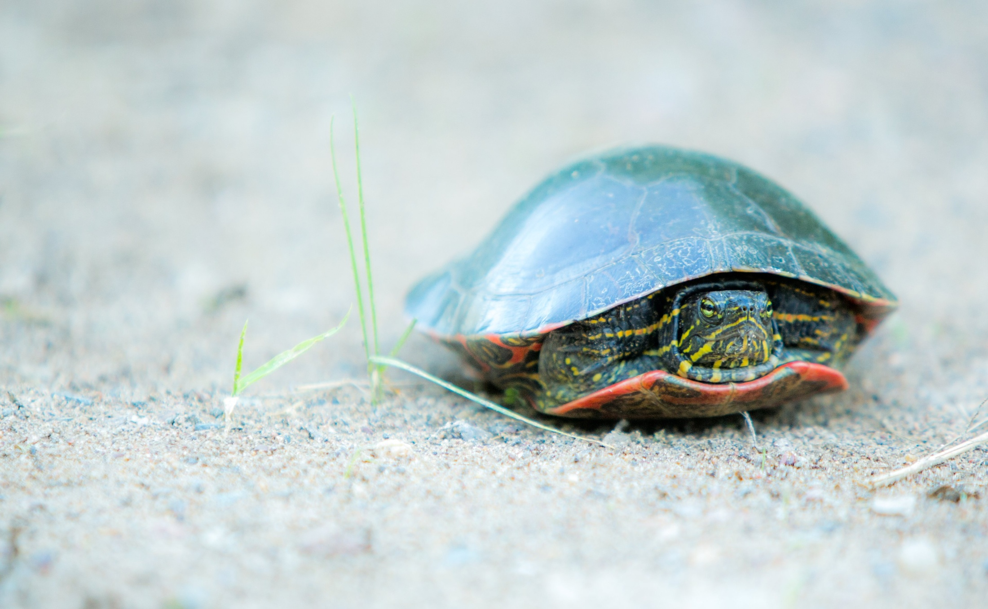
Does God Care?

Slide 15
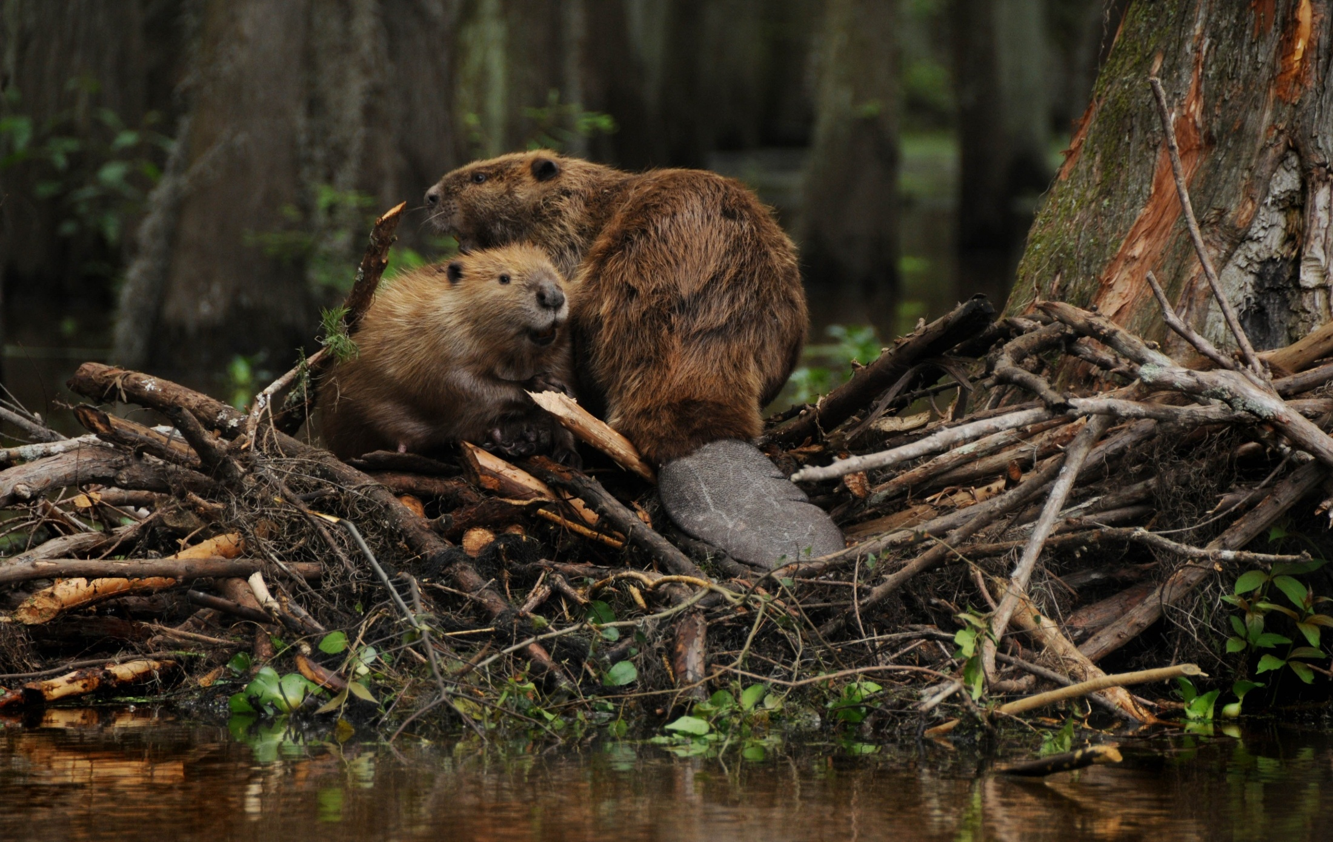
How To Work

Slide 16
How To Be A Family That Sticks Together

Slide 17
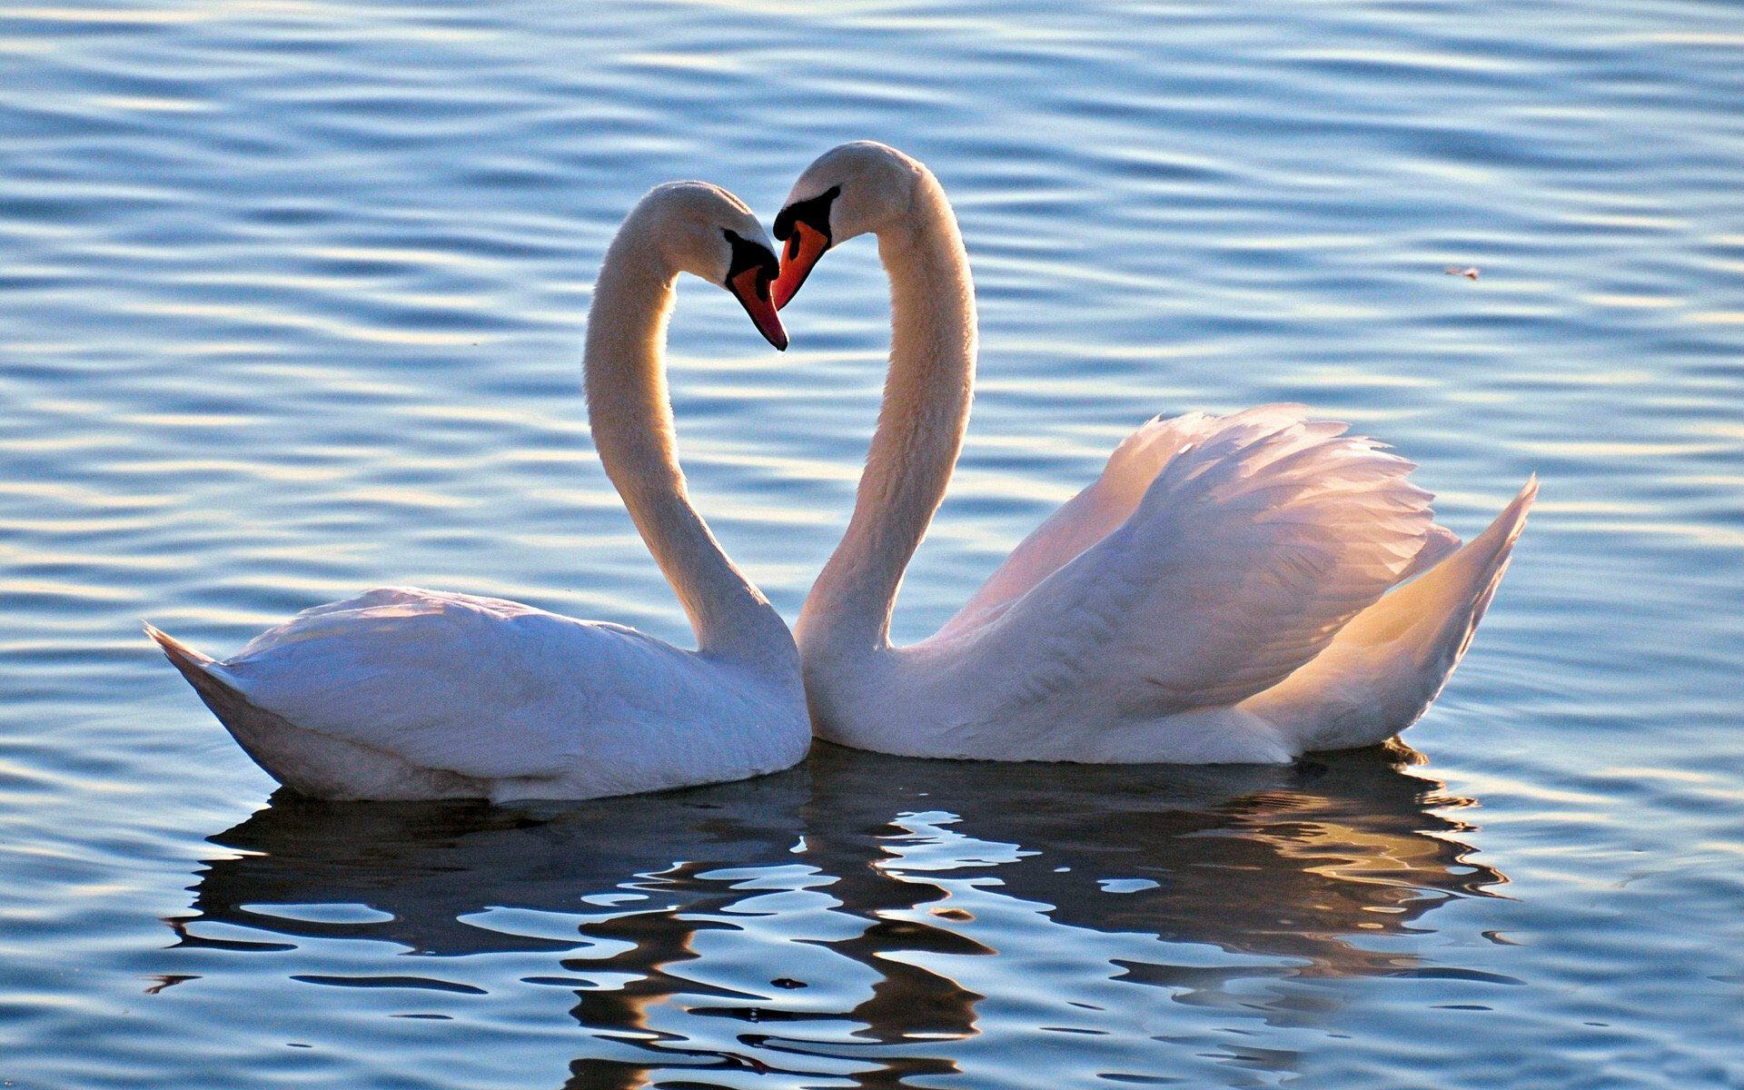
How To Love

Slide 18
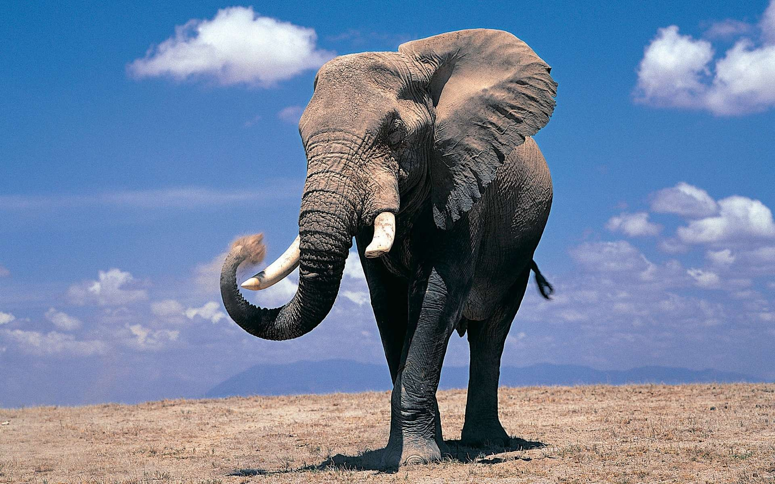
If You Have Big Problems

Slide 19
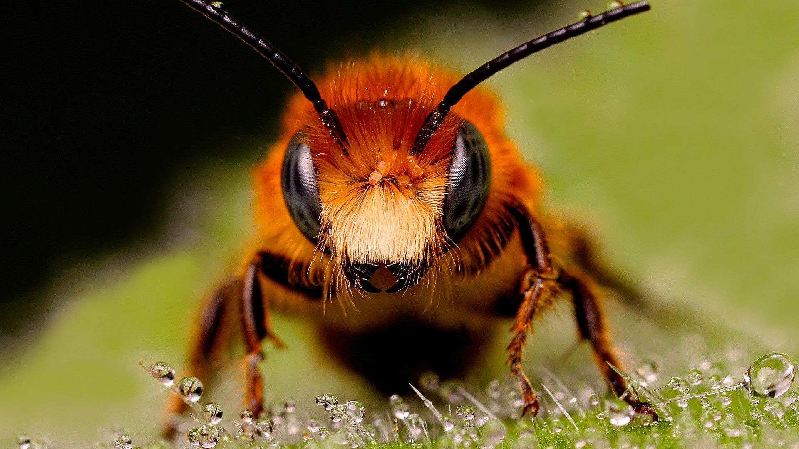
If You Have Little Worries Or Concerns

Slide 20
If You Are Attacked By The Enemy

Slide 21
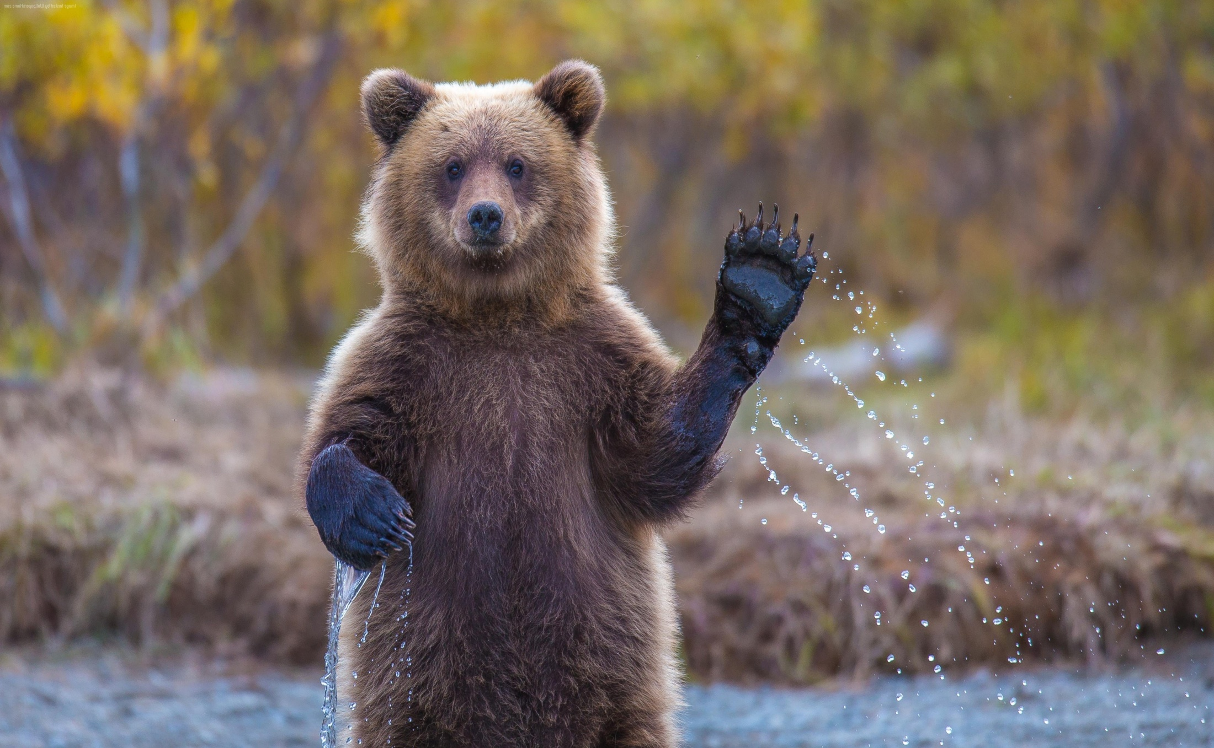
God Is Always There To Welcome You
And To Cheer You On!

