Slide 1
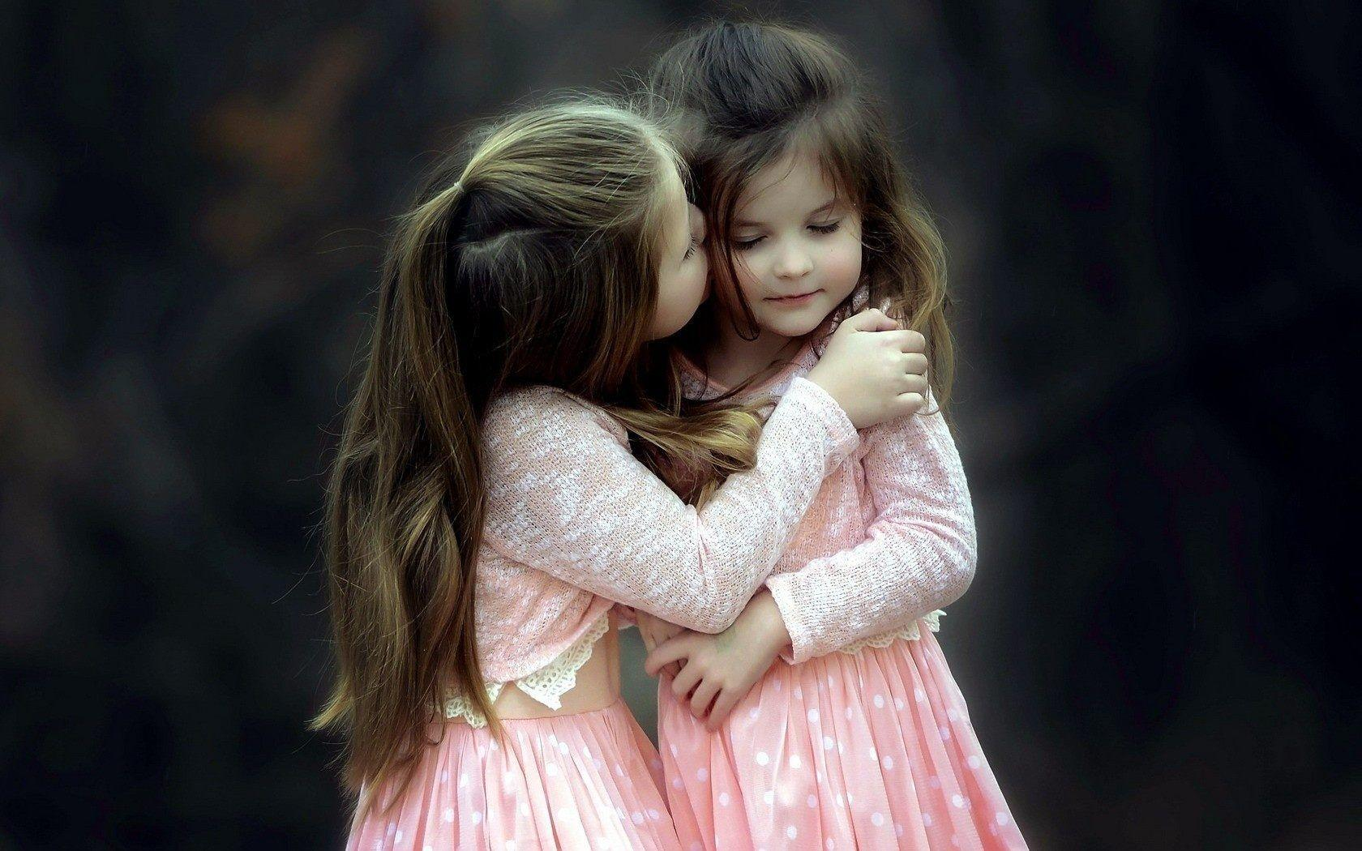
Blessing

Slide 2
“I have coveted no man's silver, or gold, or apparel.”
– Acts 20:33 KJB

Slide 3
“Yea, ye yourselves know, that these hands have ministered unto my necessities, and to them that were with me.”
– Acts 20:34 KJB

Slide 4
“I have shewed you all things, how that so labouring ye ought to support the weak, and to remember the words of the Lord Jesus, how he said, It is more blessed to give than to receive.” – Acts 20:35 KJB

Slide 5
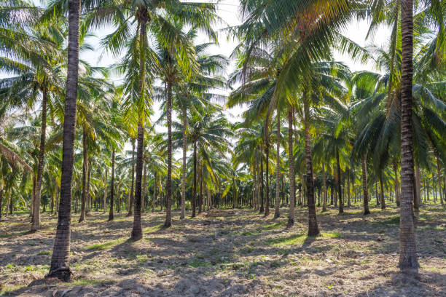

Slide 6
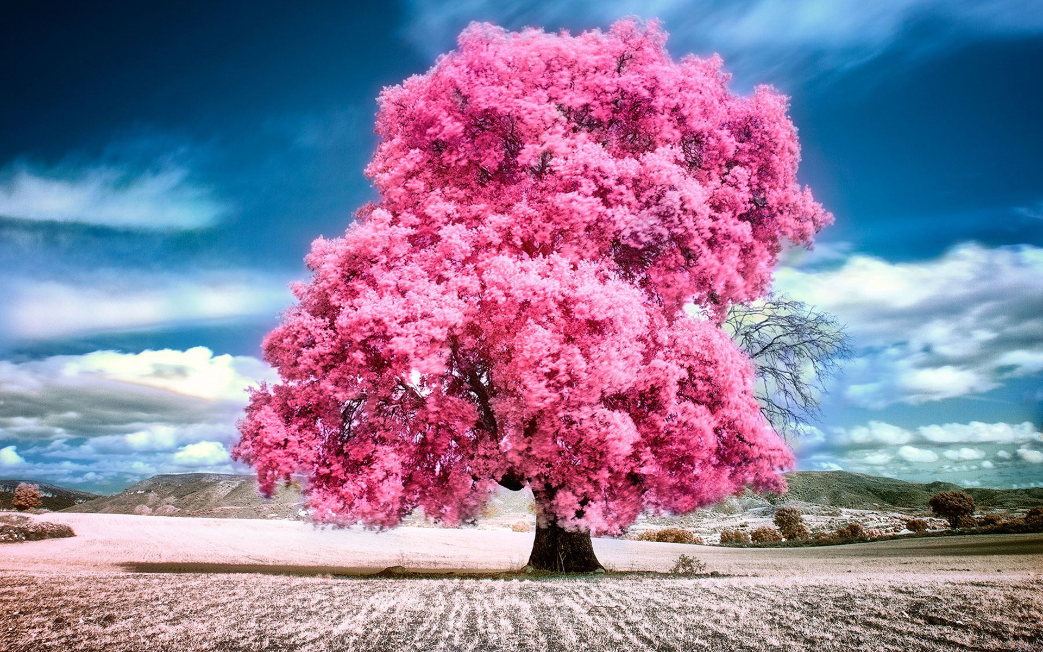

Slide 7
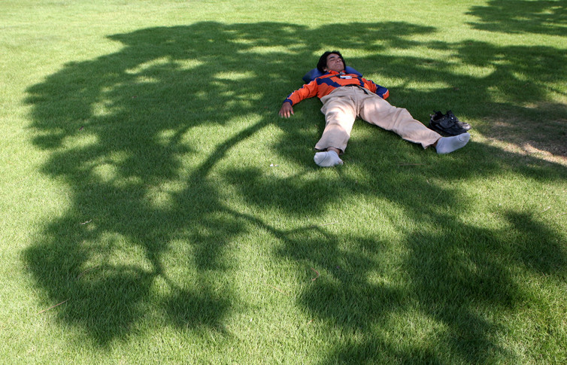

Slide 8
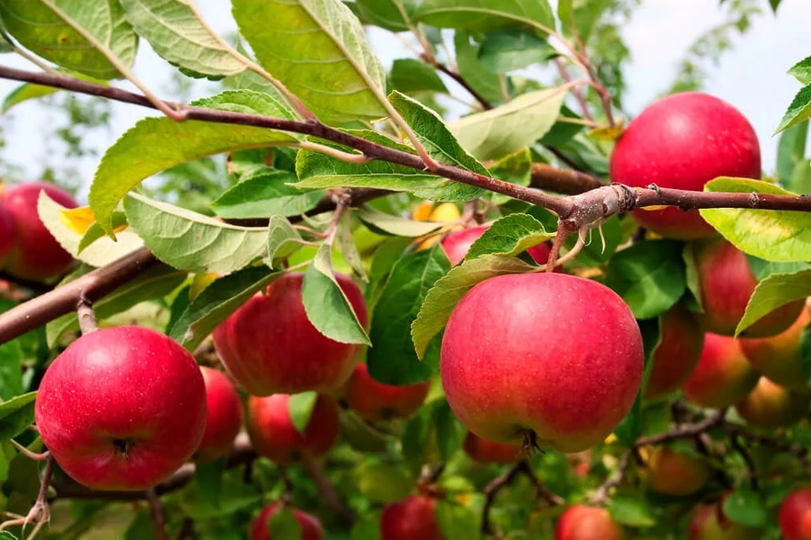

Slide 9
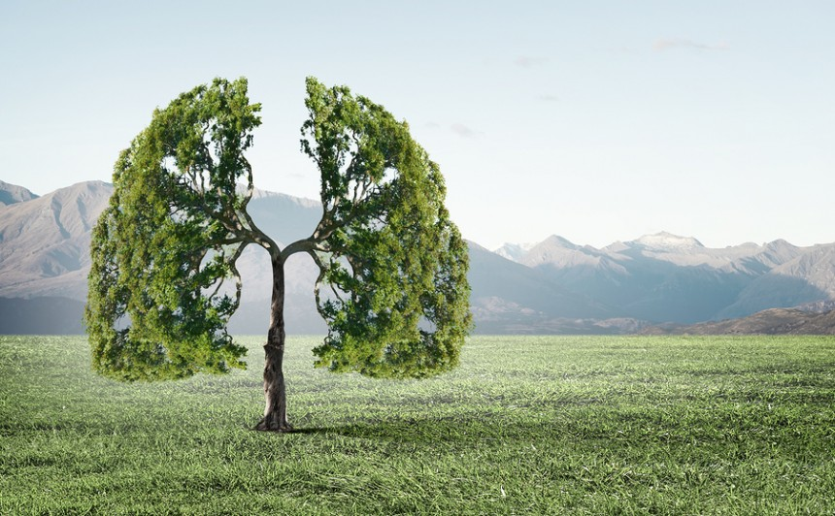

Slide 10
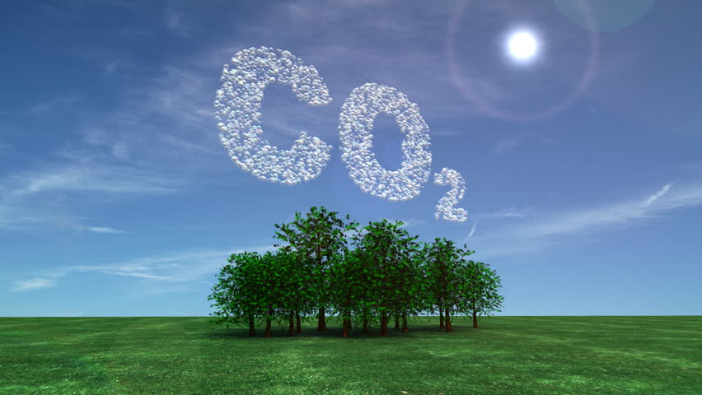

Slide 11
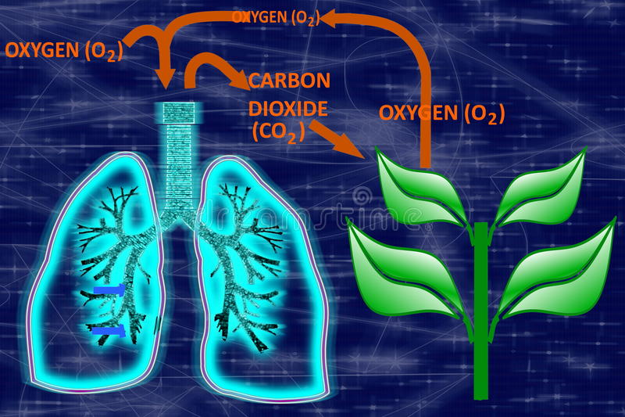

Slide 12
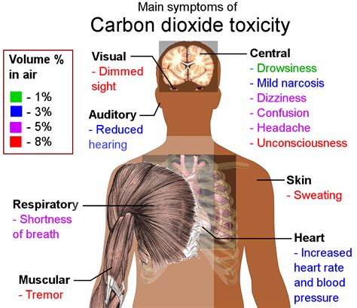

Slide 14
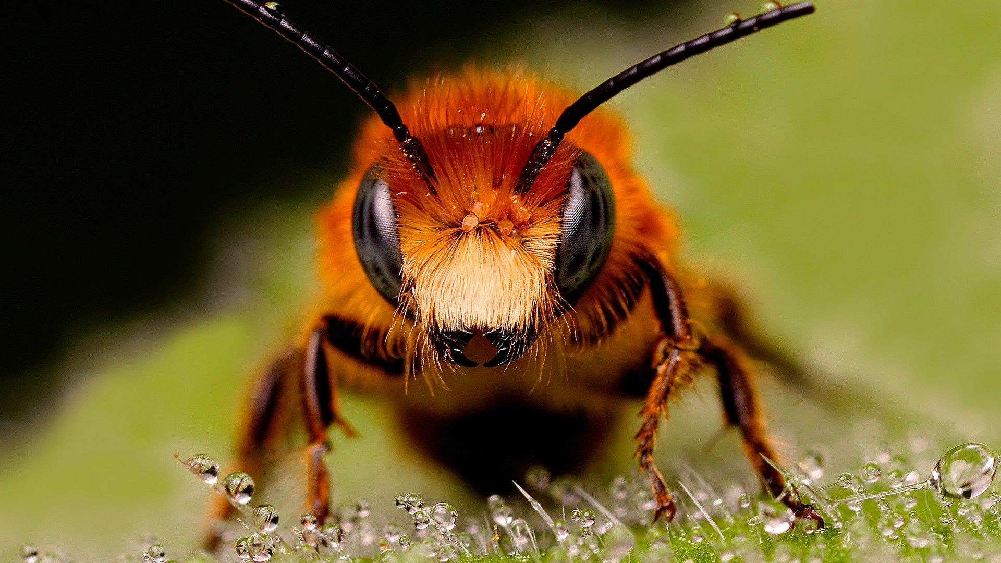

Slide 15
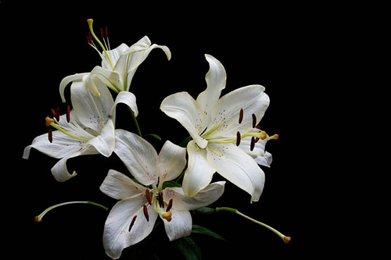

Slide 16
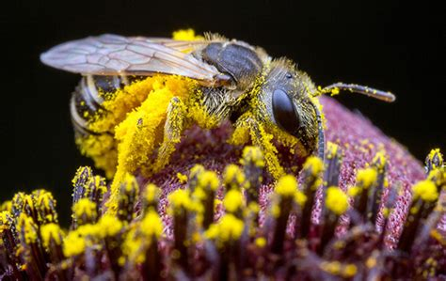

Slide 17
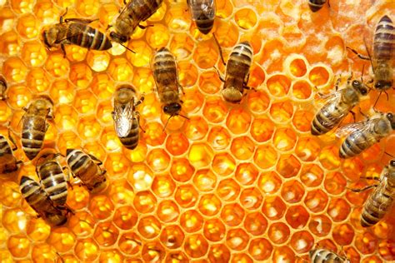

Slide 18
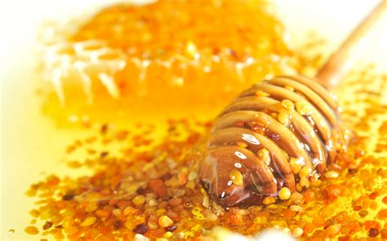

Slide 19
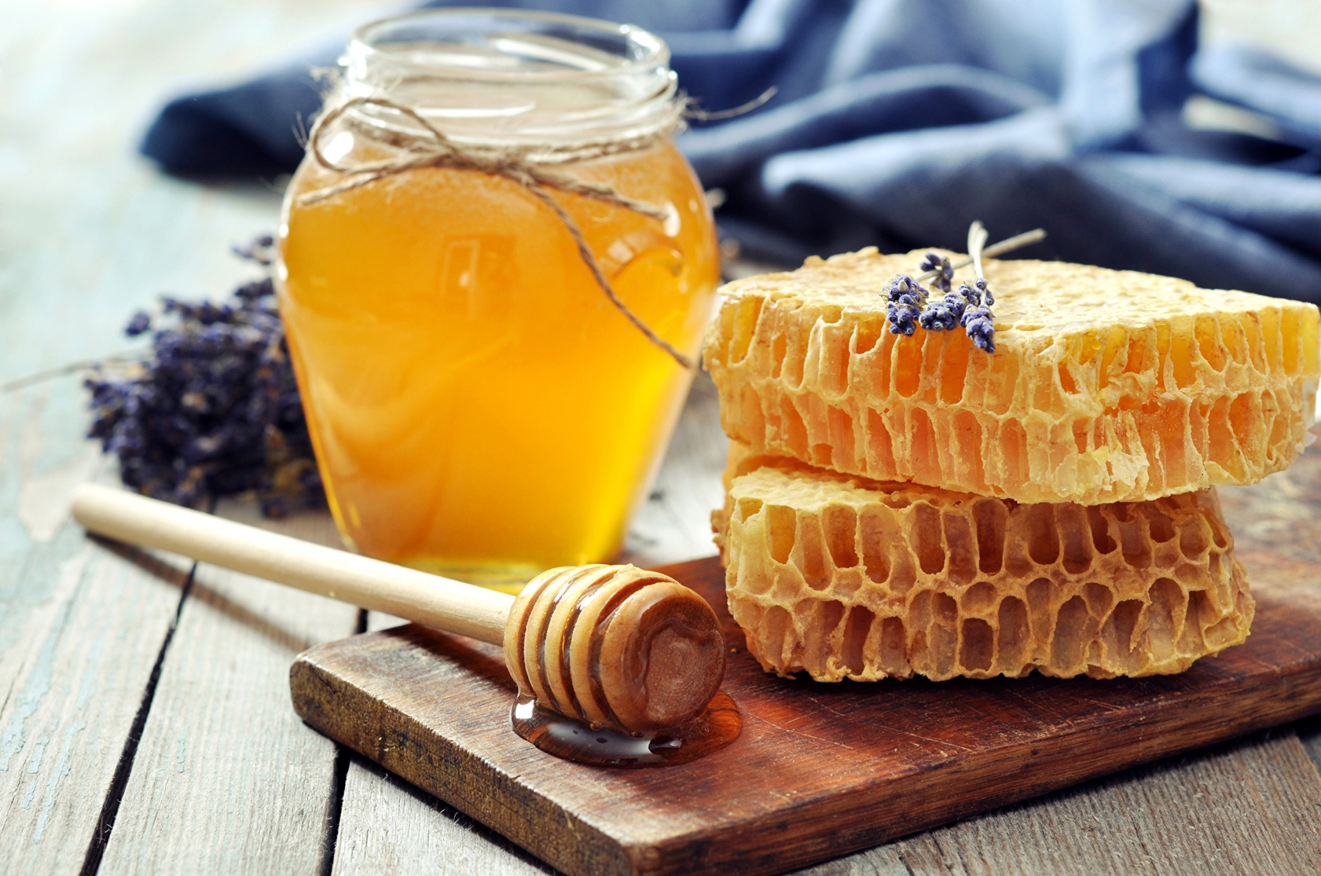

Slide 21
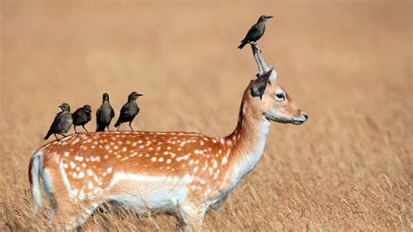

Slide 22
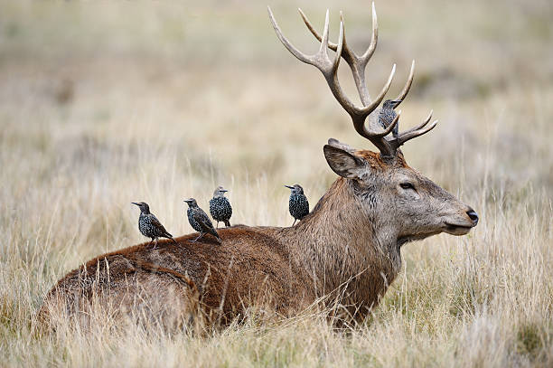

Slide 23
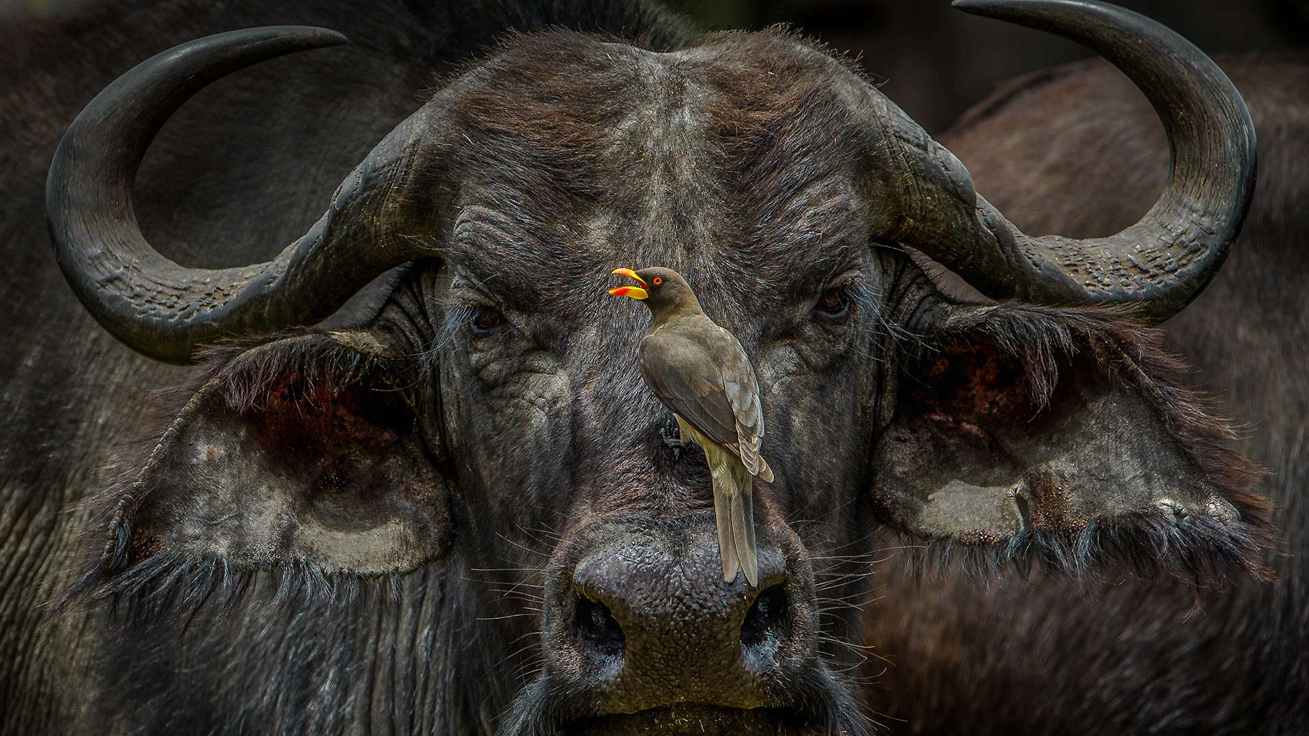

Slide 25
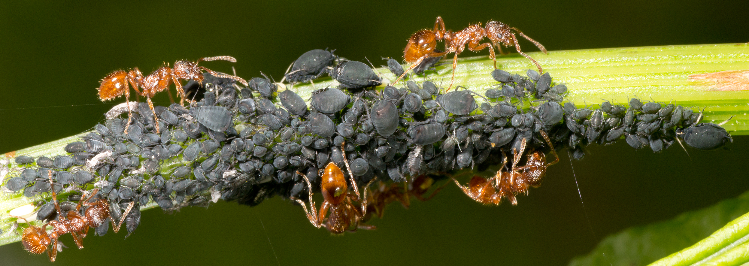

Slide 26
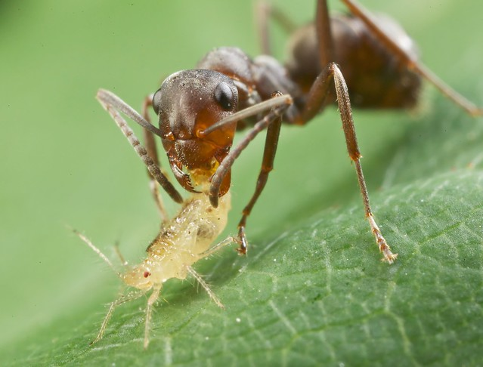

Slide 27
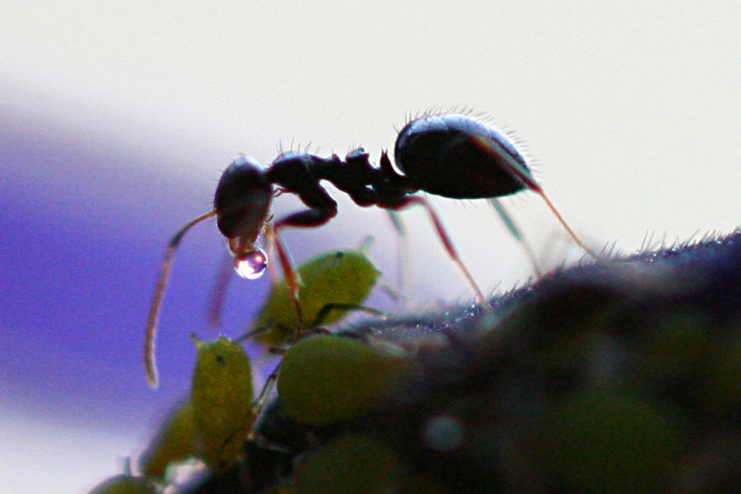

Slide 28
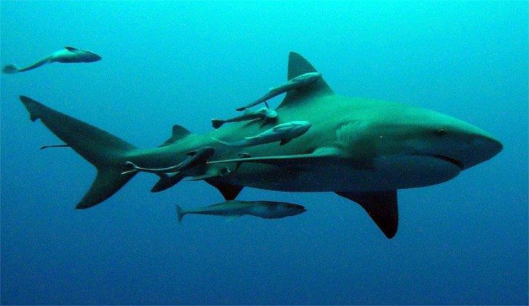

Slide 29
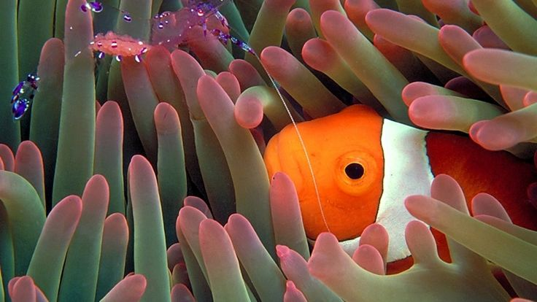

Slide 31
“In the beginning, God was revealed in all the works of creation. It was Christ that spread the heavens, and laid the foundations of the earth. It was His hand that hung the worlds in space, and fashioned the flowers of the field. "His strength setteth fast the mountains." "The sea is His, and He made it." Psalm 65:6; 95:5. It was He that filled the earth with beauty, and the air with song. …”

Slide 32
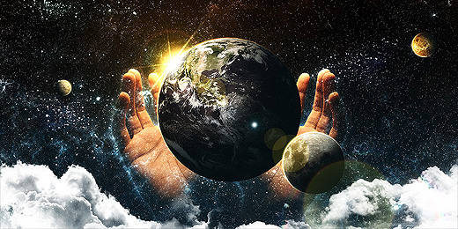

Slide 34
“… And upon all things in earth, and air, and sky, He wrote the message of the Father's love. {DA 20.1}
Now sin has marred God's perfect work, yet that handwriting remains. Even now all created things declare the glory of His excellence. There is nothing, save the selfish heart of man, that lives unto itself. …”

Slide 35
“… No bird that cleaves the air, no animal that moves upon the ground, but ministers to some other life. There is no leaf of the forest, or lowly blade of grass, but has its ministry. Every tree and shrub and leaf pours forth that element of life without which neither man nor animal could live; and man and animal, in turn, minister to the life of tree and shrub and leaf. …”

Slide 36
“… The flowers breathe fragrance and unfold their beauty in blessing [21] to the world. The sun sheds its light to gladden a thousand worlds. The ocean, itself the source of all our springs and fountains, receives the streams from every land, but takes to give. The mists ascending from its bosom fall in showers to water the earth, that it may bring forth and bud. {DA 20.2} …”

Slide 37
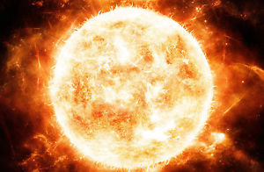

Slide 38
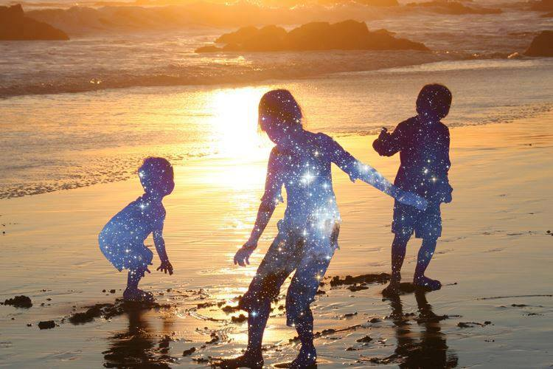

Slide 39
“… The angels of glory find their joy in giving,--giving love and tireless watchcare to souls that are fallen and unholy. Heavenly beings woo the hearts of men; they bring to this dark world light from the courts above; by gentle and patient ministry they move upon the human spirit, to bring the lost into a fellowship with Christ which is even closer than they themselves can know. {DA 21.1}”
– The Desire Of Ages, pages 20.1- 21.1

Slide 40
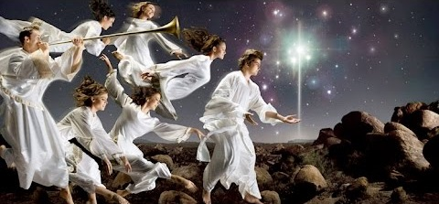

Slide 42
