Slide 1
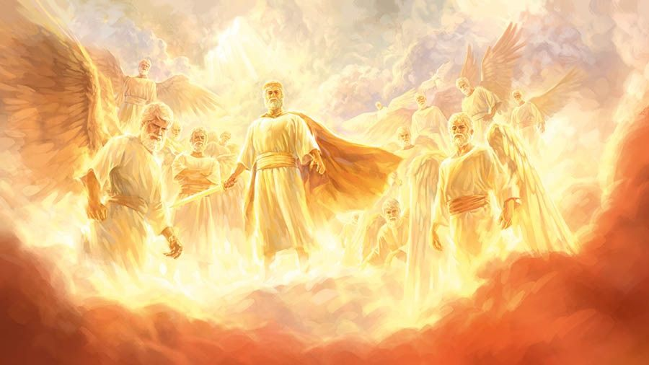
Angels of Lie-ght
http://www.pearltrees.com/awhn

Slide 2
Scripture Reading: 2 Corinthians 11:13-15 KJB
“For such are false apostles, deceitful workers, transforming themselves into the apostles of Christ.”
– 2 Corinthians 11:13 KJB

Slide 3
Scripture Reading: 2 Corinthians 11:13-15 KJB
“And no marvel; for Satan himself is transformed into an angel of light.”
– 2 Corinthians 11:14 KJB

Slide 4
Scripture Reading: 2 Corinthians 11:13-15 KJB
“Therefore it is no great thing if his ministers also be transformed as the ministers of righteousness; whose end shall be according to their works.”
- 2 Corinthians 11:15 KJB

Slide 5
We live in a world …
… of great and marvelous wonders ...

Slide 6
… a world filled with …
… Light! …

Slide 7
… but, not everything …
… that is called “Light” is true …

Slide 8
“No man, when he hath lighted a candle, putteth it in a secret place, neither under a bushel, but on a candlestick, that they which come in may see the light.” – Luke 11:33 KJB

Slide 9
“The light of the body is the eye: therefore when thine eye is single, thy whole body also is full of light; but when thine eye is evil, thy body also is full of darkness.” – Luke 11:34 KJB

Slide 10
“Take heed therefore that the light which is in thee be not darkness.”
– Luke 11:35 KJB

Slide 11
“If thy whole body therefore be full of light, having no part dark, the whole shall be full of light, as when the bright shining of a candle doth give thee light.” – Luke 11:36 KJB

Slide 12
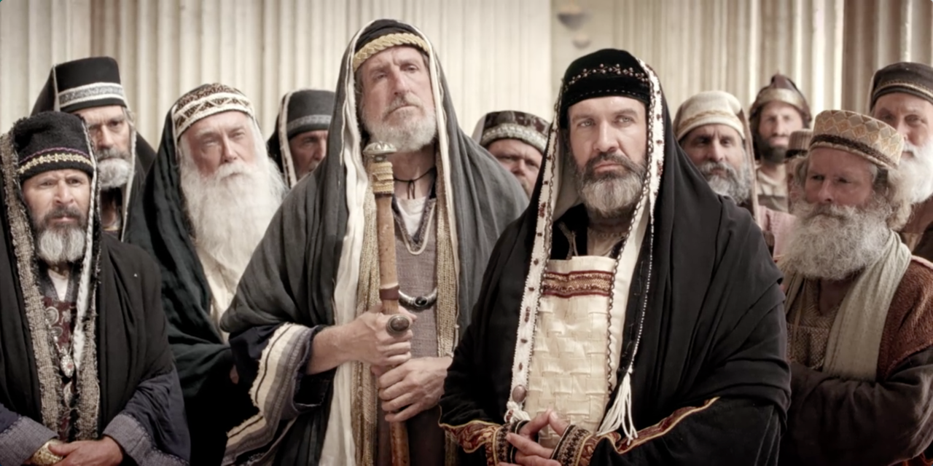
Therefore, there is that which is called “light”, but in reality is actually “darkness” in disguise, malevolence behind a mask, “evil” in “long robes” of apparent righteousness.

Slide 13
There are many fakes, many charlatans, many false prophets and false Christs that have gone out into the world.
“For there shall arise false Christs, and false prophets, and shall shew great signs and wonders; insomuch that, if it were possible, they shall deceive the very elect.” – Matthew 24:24 KJB

Slide 14
Therefore we are warned by God’s Holy Spirit:
“Beloved, believe not every spirit, but try the spirits whether they are of God: because many false prophets are gone out into the world.”
– 1 John 4:1 KJB

Slide 15
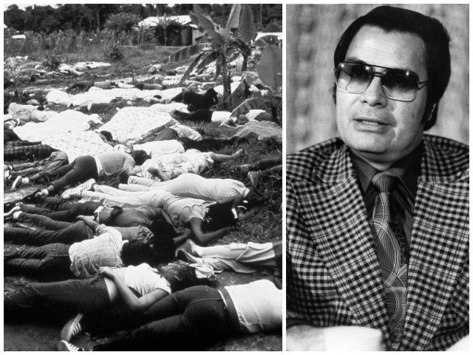
… but many did not take true heed to God’s warning, and suffered or are now suffering because of it … Jim Jones

Slide 16
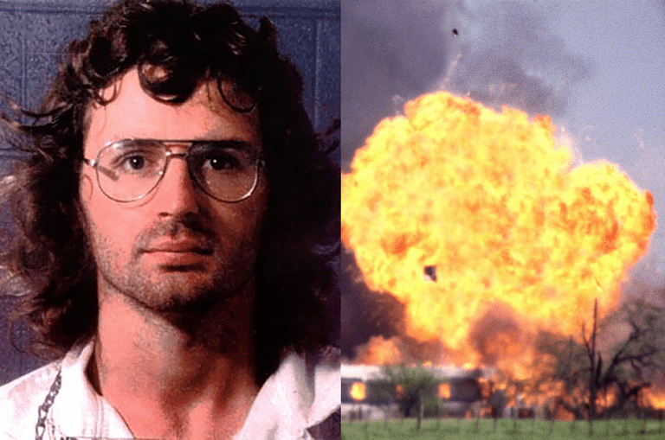
… but many did not take true heed to God’s warning, and suffered or are now suffering because of it … ‘David Koresh’

Slide 17
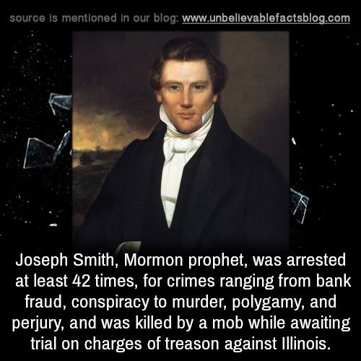
… but many did not take true heed to God’s warning, and suffered or are now suffering because of it … Joseph Smith

Slide 18
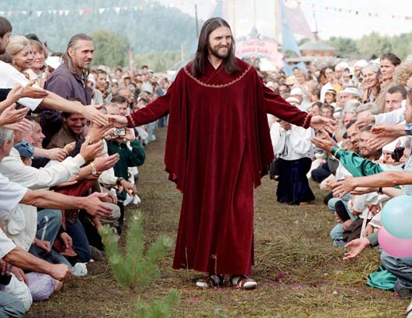
False Christs:
Sergey Anatolyevitch Torop (aka ‘Vissarion’)
living in Petropavlovka

Slide 19
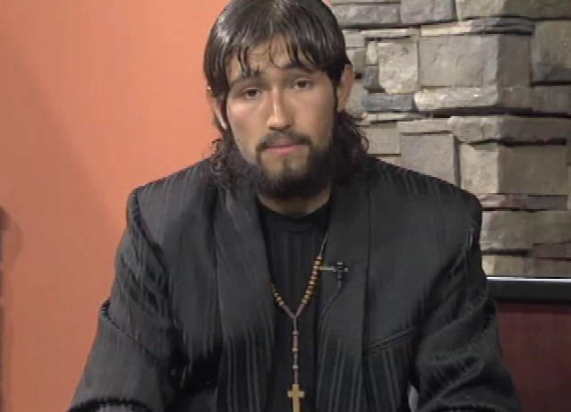
False Christs:
Oscar Ramiro Ortega-Hernandez
“It’s not just a coincidence that I look like Jesus. I am the modern day Jesus Christ that you all have been waiting for.”

Slide 20
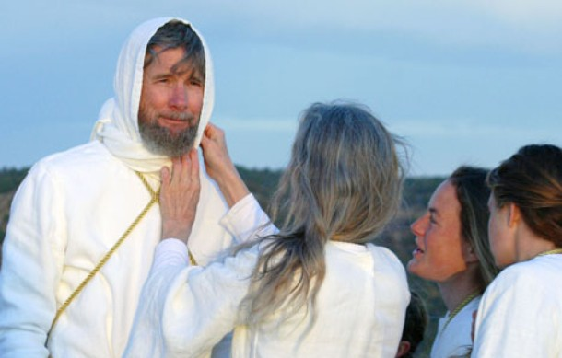
False Christs:
Wayne Bent (aka ‘Michael Travesser’)
Ex-Seventh-day Adventist (molested a 16yr old girl()

Slide 21
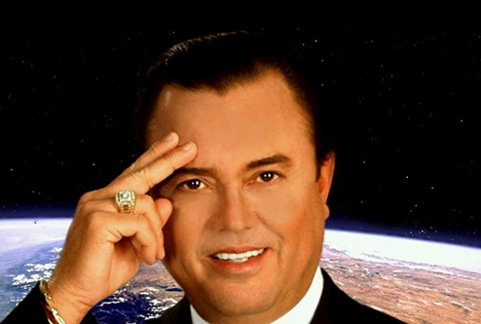
False Christs:
José Luis de Jesús Miranda
He and some followers tattooed #666 on themselves.

Slide 22
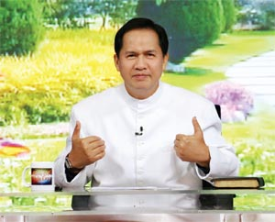
False Christs:
Apollo Quiboloy
Claims to be the Son of God, or reincarnation of Jesus.

Slide 23
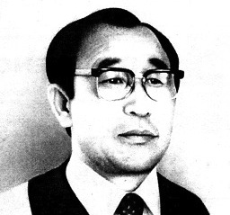
False Christs:
Ahn Sahng-Hong
Ex-Seventh-day Adventist, and claims to be the reincarnation of Jesus, and teaches that Mary is God the Mother.

Slide 24
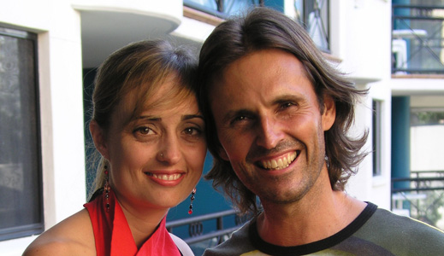
False Christs:
Allan John Miller
Claims to be the reincarnation of Jesus Christ, and that his ‘partner’ (Mary Luck) is Mary Magdalene.

Slide 25
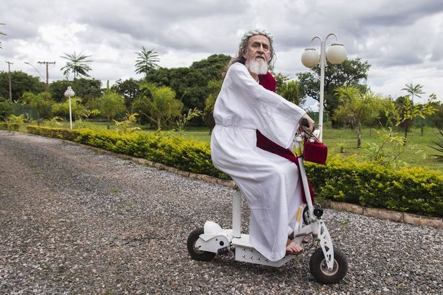
False Christs:
Inri Cristo
Claims to be the reincarnation of Jesus Christ and rides around on a mo-ped in Brasilia.

Slide 26
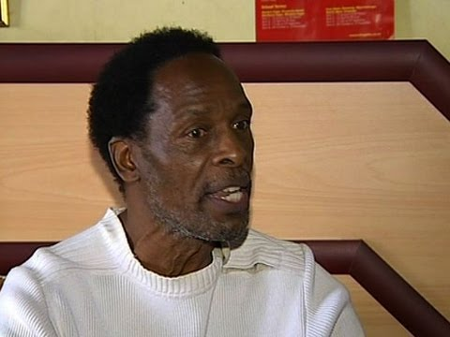
False Christs:
Moses Hlongwane
Claims to be the “black” reincarnation of Jesus and is “immortal”.

Slide 27
False Christs:
David Shayler (aka “Dolores Kane’)
Ex-MI5, uses cannabis (weed), “tranny Jesus”.

Slide 28
“Take heed to yourselves, that your heart be not deceived, and ye turn aside, and serve other gods, and worship them;”
– Deuteronomy 11:16 KJB

Slide 29
“And he said, Take heed that ye be not deceived: for many shall come in my name, saying, I am Christ; and the time draweth near: go ye not therefore after them.” – Luke 21:8 KJB

Slide 30
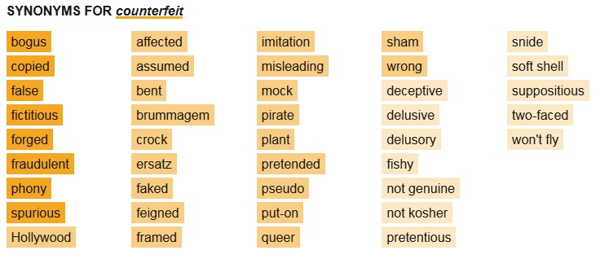
Counterfeits are everywhere!

Slide 31
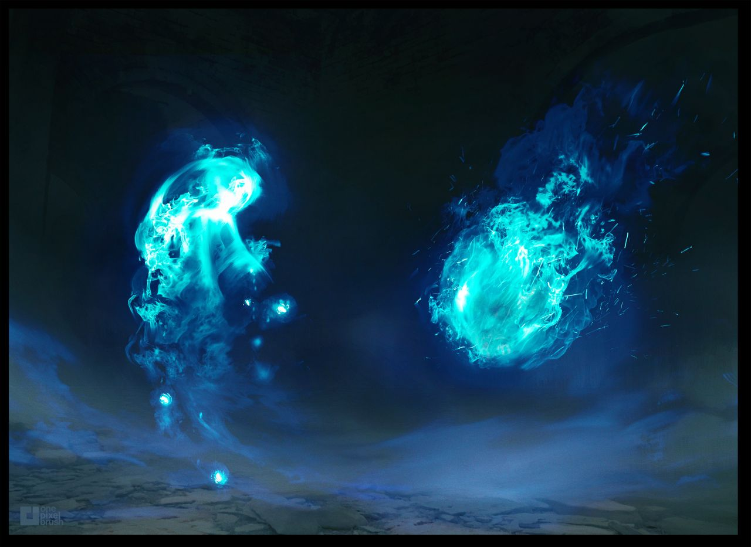
Like Will O’ The Wisps …

Slide 32
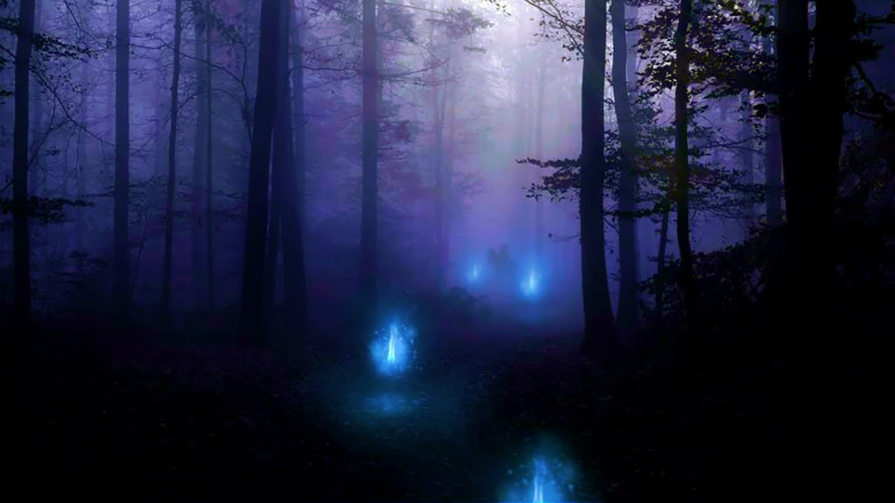
… ‘false spirits of Lie-ght’ that lead men away from the True Light (Jesus), into outer darkness …

Slide 33
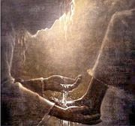
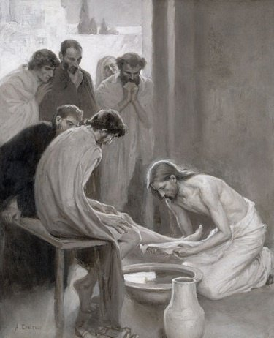
Do you know the True Light (Jesus Christ) by experience? Do you know what it means to really love & serve God?

Slide 34
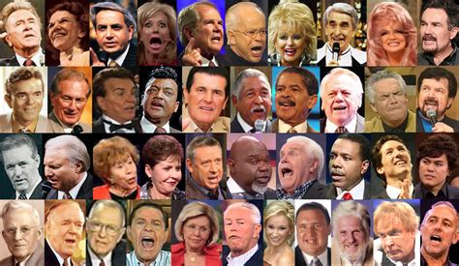
Are you able to spot the counterfeit “goods”?

Slide 35
Are you able to spot the counterfeit “goods”?
“Not every one that saith unto me, Lord, Lord, shall enter into the kingdom of heaven; but he that doeth the will of my Father which is in heaven.” – Matthew 7:21 KJB

Slide 36
Are you able to spot the counterfeit “goods”?
“Many will say to me in that day, Lord, Lord, have we not prophesied in thy name? and in thy name have cast out devils? and in thy name done many wonderful works?”
– Matthew 7:22 KJB

Slide 37
Are you able to spot the counterfeit “goods”?
“And then will I profess unto them, I never knew you: depart from me, ye that work iniquity.”
– Matthew 7:23 KJB

Slide 38
Is it a “fish” (Christian), or is it “fishy” (Counterfeit)?

Slide 39
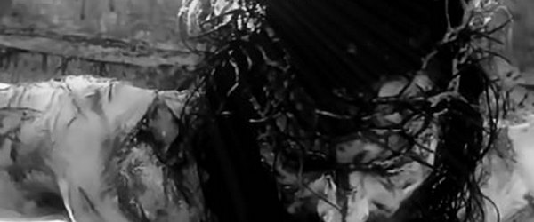
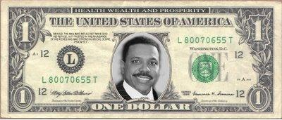
Is it of everlasting “value” or funny money (fake “Dollars”)?

Slide 40
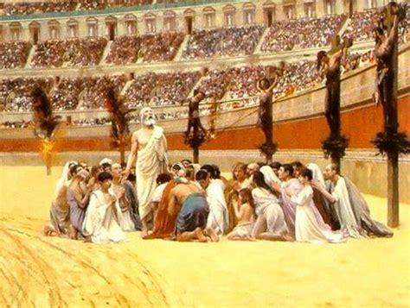
Is it persecuted for Christ’s sake, or is it protected by the state?

Slide 41
Can you tell the difference, between Christ and Anti-Christ?
Let’s take a test …

Slide 42
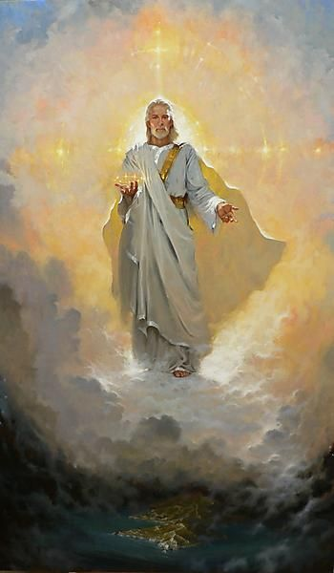
Can you tell the difference, between Christ and Anti-Christ?
Existed before in Heaven, before coming to earth

Slide 43
Can you tell the difference, between Christ and Anti-Christ?
a “mystery” surrounds his Gospel

Slide 44
Can you tell the difference, between Christ and Anti-Christ?
30 Year period

Slide 45
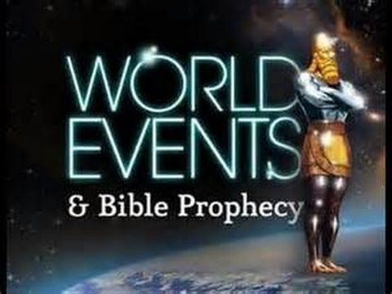
Can you tell the difference, between Christ and Anti-Christ?
Had a 3 ½ Year timeframe that is spoken of in the prophecy of Scripture, that came after the 30 year period

Slide 46
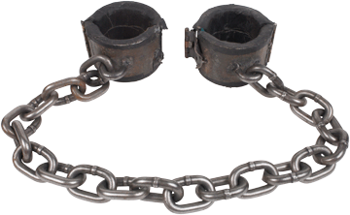
Can you tell the difference, between Christ and Anti-Christ?
At the end of that 3 ½ Year timeframe*, He was taken captive

Slide 47
Can you tell the difference, between Christ and Anti-Christ?
the Head of a Body was killed by the State, and by very zealous people who cared not what God wanted

Slide 48
Can you tell the difference, between Christ and Anti-Christ?
after a period of time would pass, the Head of the Body was to live again

Slide 49
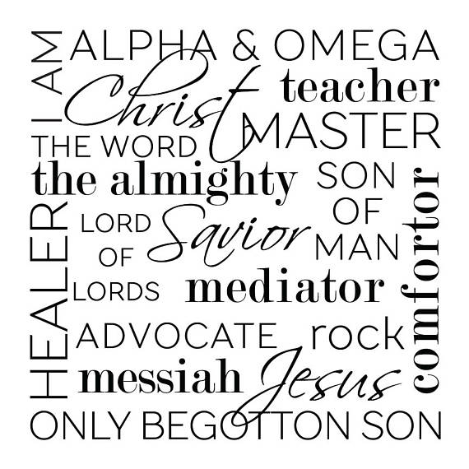
Can you tell the difference, between Christ and Anti-Christ?
part of His many titles, would include partly, “Christ ...”, “Rock ...”, “Foundation ...”, “... Root ...”, “... Branch ...”, “Prince ...”, “Son ...”, “Father ...” [having “children ...”], “King”, “Lord ...” and “God ...”

Slide 50
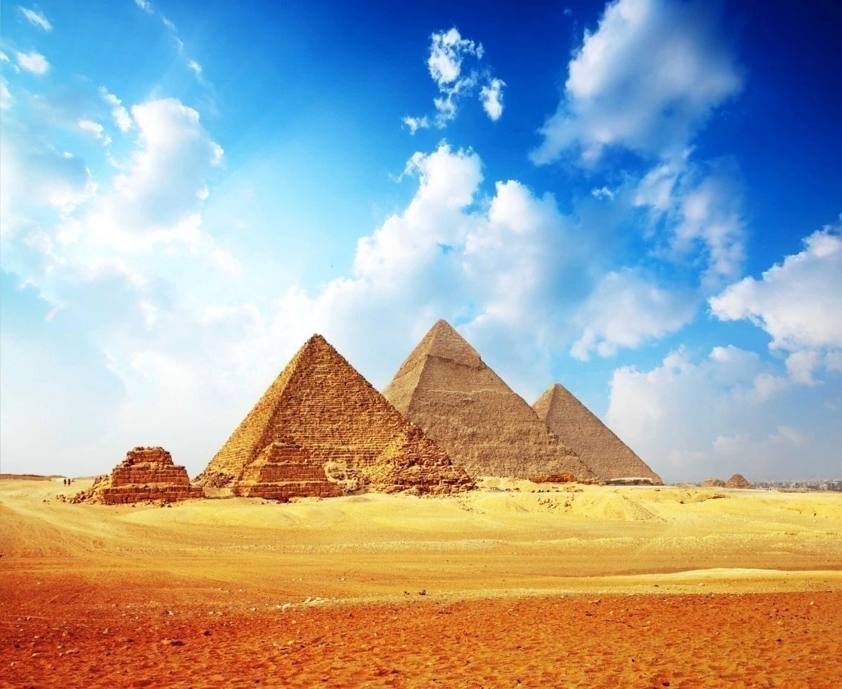
Can you tell the difference, between Christ and Anti-Christ?
would go down to Egypt

Slide 51
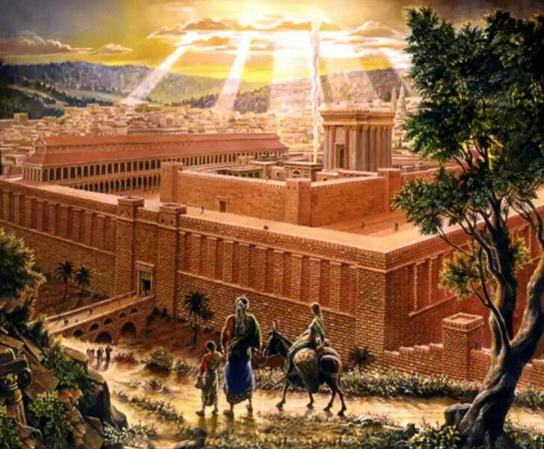
Can you tell the difference, between Christ and Anti-Christ?
would enter Jerusalem & Glorious Land

Slide 52
Can you tell the difference, between Christ and Anti-Christ?
would sit/ride atop a beast

Slide 53
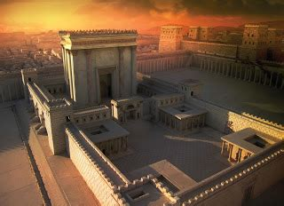
Can you tell the difference, between Christ and Anti-Christ?
would enter the Temple of God

Slide 54
Can you tell the difference, between Christ and Anti-Christ?
He would have followers of many kinds of people

Slide 55
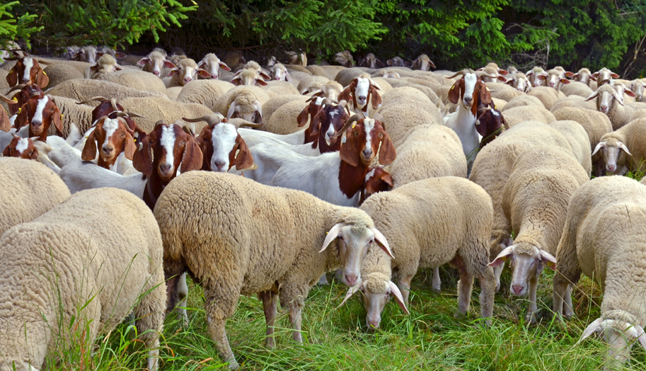
Can you tell the difference, between Christ and Anti-Christ?
would have “sheep” or a flock

Slide 56
Can you tell the difference, between Christ and Anti-Christ?
would be seen above the “waters”

Slide 57
Can you tell the difference, between Christ and Anti-Christ?
would speak “dark sayings”

Slide 58
Can you tell the difference, between Christ and Anti-Christ?
would do many “miracles”

Slide 59
Can you tell the difference, between Christ and Anti-Christ?
take up a War, or a Great Controversy

Slide 60
Can you tell the difference, between Christ and Anti-Christ?
would come with the “spirit”

Slide 61
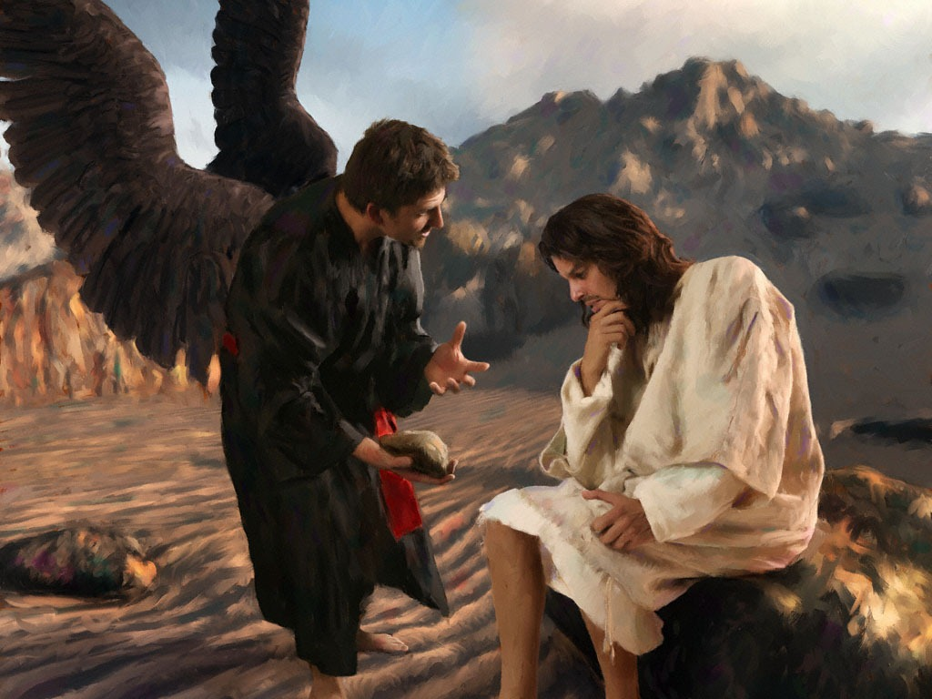
Can you tell the difference, between Christ and Anti-Christ?
would deny
“the flesh”

Slide 62
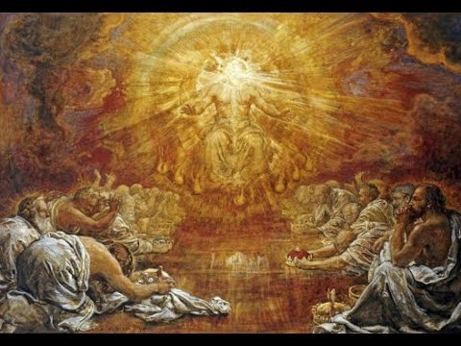
Can you tell the difference, between Christ and Anti-Christ?
a day would come when he would be “revealed”

Slide 63
Can you tell the difference, between Christ and Anti-Christ?
A question surrounds him,
“Who is like unto...” him?

Slide 64
Whose character did we just describe? Christ? Anti-Christ?

Slide 65
Christ?
If you said
“Christ”,
you’re half right …

Slide 66
While those things we just described do fit “Christ”, they also all fit “Anti-Christ”.
Let’s look again shall we, and this time a little deeper, so that we are not deceived.

Slide 67
CHRIST
ANTI-CHRIST
Existed before in Heaven, before coming to earth
Psa. 90:2, 93:2; Mic. 5:2; John 8:58, etc
Isa. 14:12; Rev. 12:7, etc
“Jesus said unto them, Verily, verily, I say unto you, Before Abraham was, I am.”
– John 8:58 KJB
“How art thou fallen from heaven, O Lucifer …” – Isaiah 14:12 KJB

Slide 68
CHRIST
ANTI-CHRIST
a “mystery” surrounds his Gospel
1 Tim. 3:16; Rom. 11:25; Eph. 6:19;
Rev. 10:7
2 Thess. 2:7, false Gospels [Gal. 1:6-9], Rev. 17:5 “MYSTERY”
“mystery of Godliness”
– 1 Timothy 3:16 KJB
“mystery of iniquity”
– 2 Thess. 2:7 KJB

Slide 69
CHRIST
ANTI-CHRIST
30 Year period
Dan. 7:25, 12:7,11-12; Rev. 11:1-2, 12:6,14, 13:5; Luke 21:24
Luke 3:23
“And Jesus himself began to be about thirty years of age …”
– Luke 3:23 KJB
AD 508 to AD 538, is 30 years, the difference in starting points of the 1,290/1,335 and 1,260 years prophecies

Slide 70
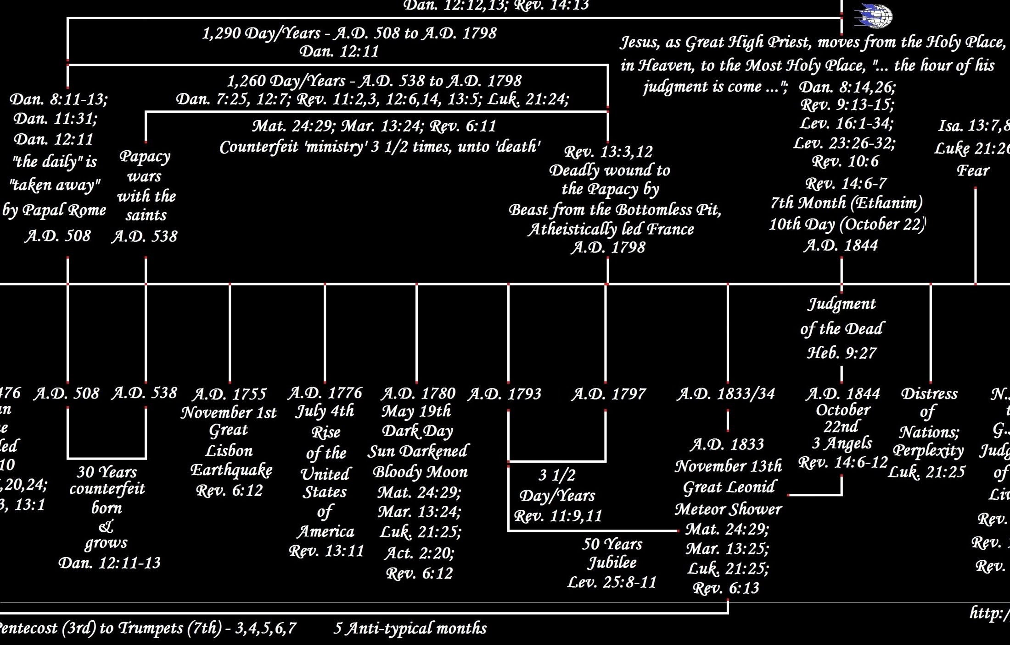
https://ia803206.us.archive.org/9/items/awhn-2300-day-years-prophecy-of-daniel-8-vs-14-and-its-sub-parts/AWHN%20-%202300%20Day-Years%20Prophecy%20of%20Daniel%208%20Vs%2014%20And%20Its%20Sub-Parts.jpg

Slide 71
CHRIST
ANTI-CHRIST
Had a 3 ½ Year timeframe that is spoken of in the prophecy of Scripture, that came after the 30 year period
Dan. 9:27; Heb. 2:3
Dan. 7:25, 12:7,11-12; Rev. 11:1-2, 12:6,14, 13:5; Luke 21:24
“And he shall confirm the covenant with many for one week: and in the midst of the week he shall cause the sacrifice and the oblation to cease …”
– Daniel 9:27 KJB
AD 538 to AD 1798, is 1,260 Years, or 3 ½ prophetic times (Ezekiel 4:6; Numbers 14:34 KJB)

Slide 72
https://ia803206.us.archive.org/9/items/awhn-2300-day-years-prophecy-of-daniel-8-vs-14-and-its-sub-parts/AWHN%20-%202300%20Day-Years%20Prophecy%20of%20Daniel%208%20Vs%2014%20And%20Its%20Sub-Parts.jpg

Slide 73
CHRIST
ANTI-CHRIST
At the end of that 3 ½ Year timeframe*,
He was taken captive
Mat. 26:46-57; Mark 14:42-53; Luke 22:47-54; John 18:2-13
Dan. 7:25, 12:7,11-12; Rev. 11:1-2, 12:6,14, 13:5; Luke 21:24
“Then came they, and laid hands on Jesus, and took him. …”
– Matthew 26:50 KJB
even as the counterfeit in AD 1798, a Pope taken captive (the end of the 1,260 and 1,290 in Daniel)

Slide 74
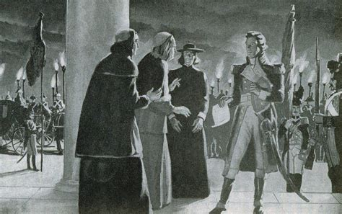
“In 1798 the French republican army under General Berthier took possession of the city of Rome, and entirely superseded the whole papal power. This was a deadly wound …” – Methodist Adam Clarke Bible commentary on Daniel 7:25

Slide 75
CHRIST
ANTI-CHRIST
the Head of a Body was killed by the State, and by very zealous people who cared not what God wanted
Matt. 27:26,50; Mark 15:15,37; Luke 23:24,25,46; John 19:16,30; Acts 2:23,36, 3:15, 4:10; 1 Cor. 2:8; 2 Cor. 13:4
the Papacy receives a “deadly wound” [Revelation 13:3,12] but the Body lives], the people were the Atheistic led state of France, under Napoleon [Revelation 11:7-8 “beast from the bottomless pit”]
“Him, being delivered by the determinate counsel and foreknowledge of God, ye have taken, and by wicked hands have crucified and slain:” - Acts 2:23 KJB
“And I saw one of his heads as it were wounded to death …” – Revelation 13:3 KJB

Slide 76
https://ia803206.us.archive.org/9/items/awhn-2300-day-years-prophecy-of-daniel-8-vs-14-and-its-sub-parts/AWHN%20-%202300%20Day-Years%20Prophecy%20of%20Daniel%208%20Vs%2014%20And%20Its%20Sub-Parts.jpg

Slide 77
CHRIST
ANTI-CHRIST
after a period of time would pass, the Head of the Body was to live again
“deadly wound” would eventually become healed and life would be given [Daniel 11:40[b.]; Revelation 13:3,12, 17:11]
Mark 16:6; John 20:9; Acts 26:23, etc
“And he saith unto them, Be not affrighted: Ye seek Jesus of Nazareth, which was crucified: he is risen; he is not here: behold the place where they laid him. – Mark 16:6 KJB
“… the first beast, whose deadly wound was healed.”
– Revelation 13:12 KJB

Slide 78
“… For this expedition for Berthier's entry into Rome and the proclamation of the Roman Republic (10-15 February, 1798), and for the captivity of Pius VI, who was carried off a prisoner to Valence, see PIUS VI [died in exile, see “(29 Aug., 1799)”]. …”
– Roman Catholic Encyclopedia; Online,
section “N”, “Napoleon I (Bonaparte)”
– https://www.newadvent.org/cathen/10687a.htm
“… The new pope (Barnaba Niccolò Maria Luigi Chiaramonti) was crowned (Papier-mâché Triple Tiara) as Pius VII on 21 March, 1800, at Venice. …” – Roman Catholic Encyclopedia,
section “P”, “Pope Pius VII”
– https://www.newadvent.org/cathen/12132a.htm

Slide 79
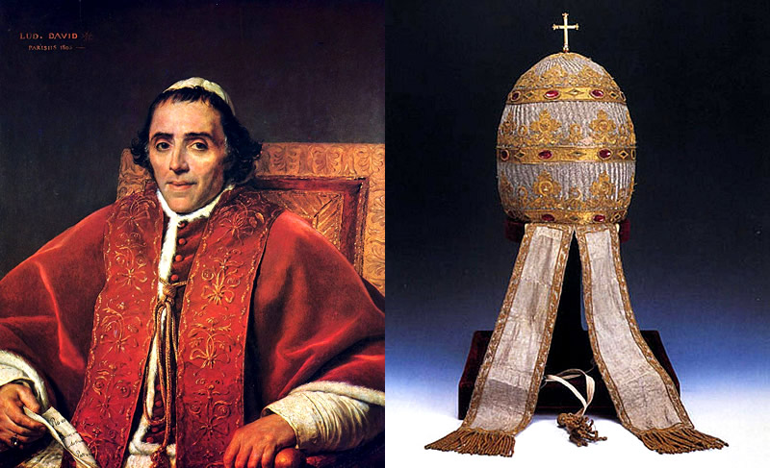
‘Pius VII’ with the Papal Papier-mâché triple Tiara of AD 1800.

Slide 80
“… The Concordat with the Holy See was signed on 17 July, 1801 …”
– Roman Catholic Encyclopedia; Online,
section “N”, “Napoleon I (Bonaparte)”
– https://www.newadvent.org/cathen/10687a.htm
Thus the Deadly wound to the Papacy, in it’s state powers, given by Secular Humanism of atheistically led France, was already, 3 ‘prophetic days’ (3 Years) later (1798-1800/1801 (inclusive/exclusive), being resurrected from the ‘political grave’, just as Jesus was raised in 3 days.

Slide 81
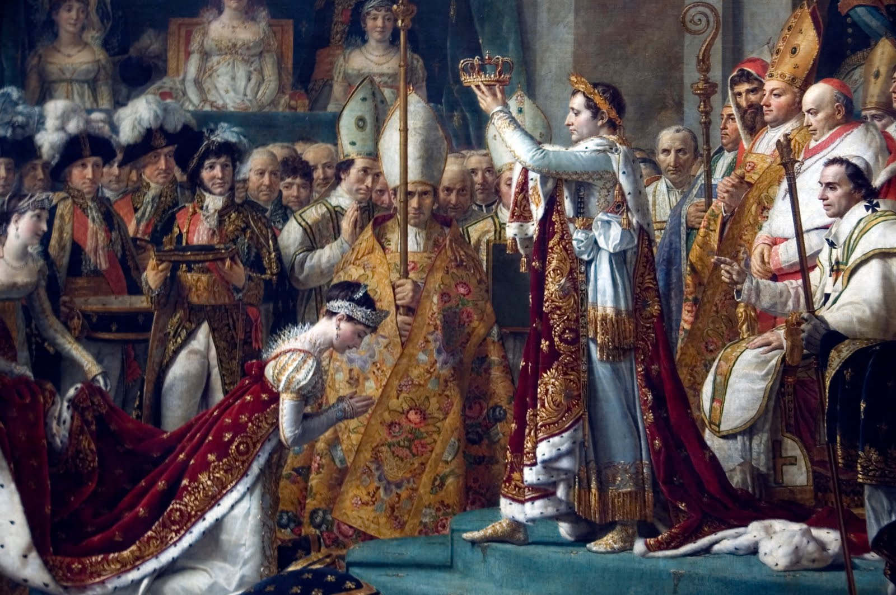
Crowning of the Emperor Napoleon & Empress Joséphine and ‘Pius VII’ looking on, in Sunday - 2 December, 1804.

Slide 82
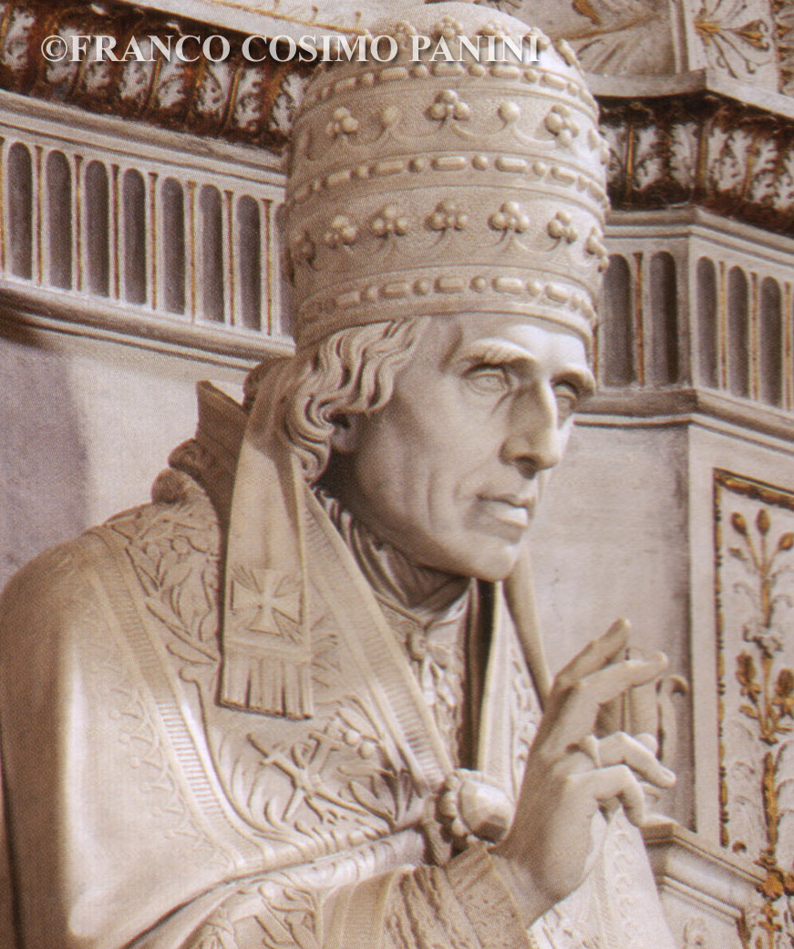
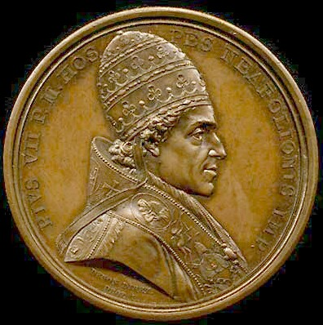
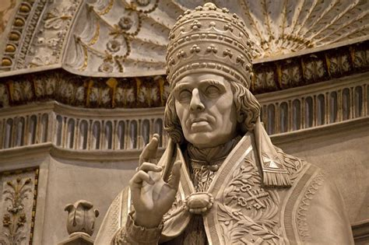
1805

Slide 83
Side Note:
Some have incorrectly taught that AD 1929 with the representative of the Roman Catholic Church signing of the Lateran Treaty (Concordat in the Lateran Palace; for Pope Pius XI by Cardinal Secretary Pietro Gasparri) with Benito Mussolini (Italian Dictator) was the healing of the deadly wound, but this is not so! The AD 1929 Concordat was the end result of the AD 1870 removal of the Papal States (Lazio (Rome), Marche, Umbria, Romagna & portions of Emilia; which had existed since at least the 8th century!) 60 years earlier (it is only a part of the great healing still going on).

Slide 84
CHRIST
ANTI-CHRIST
part of His many titles, would include partly, “Christ ...”, “Rock ...”, “Foundation ...”, “... Root ...”, “... Branch ...”, “Prince ...”, “Son ...”, “Father ...” [having “children ...”], “King”, “Lord ...” and “God ...”
“... Christ ...” [“anointed”; Eze. 28:14; 1 John 2:18,22, 4:3; 2 John 1:7], “Rock ...” [Deut. 32:31,37]; “Foundation ...” [Job 22:16; Jer. 51:24-26]; “... Root ...” [Mal. 4:1]; “... Branch ...” [Isa. 14:19; Mal. 4:1]; “Prince ...” [Matt. 9:34, 12:24; Mark 3:22; John 12:31, 14:30, 16:11; Eph. 2:2, 6:12; Col. 1:16, 2:15; Jude 1:6], “Son ...” [“son of perdition” John 17:12; 2 Thess. 2:3], “Father ...” [John 8:44] [having “children ...” [“children of disobedience” Eph. 2:2, 5:6; Col. 3:6]; “child of the devil” Acts 13:10], “King ...” [Rev. 9:11], “Lord ...” [“Baal” Num. 22:41, … Rom. 11:4] and “God ...” [“god of this world” 2 Cor. 4:4; “I am God” Eze. 28:9]
Christ: Matt. 1:1, etc.; Rock: 1 Cor. 10:4, etc.; Foundation: 1 Cor. 3:11; Root: Rev. 5:5, 22:16; Branch: Jer. 23:5, 33:15; Zec. 3:8, 6:12; Prince: Dan. 8:11,25, 9:25, 10:13,21, 11:22, 12:1; Isa. 9:6; Acts 3:15, 5:31; Rev. 1:5; Son: Matt. 16:16, etc.; Father: Isa. 9:6, 8:18, Heb. 2:13; King: Matt. 2:2, etc.; Lord [LORD]: 1 Cor. 12:3, etc.; God: Tit. 2:13, etc

Slide 85
“All names which in the scriptures are applied to Christ, by virtue of which it is established that he is over the church, all the same names are applied to the Pope.”
“Secundo probatur ratione,in Scripturis fundata; nam omnia nomina, quae in Scripturis tribuuntur Christo, unde constat eum esse supra Ecclesiam, eadem omnia tribuuntur Pontifici”

Slide 86
“All names which in the scriptures are applied to Christ, by virtue of which it is established that he is over the church, all the same names are applied to the Pope.” [Cardinal Robert Bellarmine (Full Italian name: Roberto Francesco Romolo Bellarmino (Canonized-1930 and Doctor of the Church (Jesuit))), Disputationes de Controversiis (aka: Disputationes de Controversiis Christianae Fidei adversus hujus temporis Haereticos) [Lectures Concerning the Controversies of the Christian Faith Against the Heretics of This Time], Tom. 2, “Controversia Prima,” Book 2 (De Conciliorum Auctoritate) [“On Authority of the Councils”], Chapter 17, (1628 ed.) Vol. 1, pp. 266-translated] In Latin: “Secundo probatur ratione,in Scripturis fundata; nam omnia nomina, quae in Scripturis tribuuntur Christo, unde constat eum esse supra Ecclesiam, eadem omnia tribuuntur Pontifici.” - http://cdigital.dgb.uanl.mx/la/1080015572_C/1080015573_T2/1080015573_21.pdf

Slide 87
CHRIST
ANTI-CHRIST
would go down to Egypt
Egypt represents the world & worldliness – earthliness – secular humanism (atheism), Gen. 41:56; Exo. 5:2,9, 10:15; Isa. 31:1; Dan. 11:40-43; Rev. 11:8
Hos. 11:1; Matt. 2:13-15, 19-21
“When Israel was a child, then I loved him, and called my son out of Egypt.”
– Hosea 11:1 KJB
“ … [v.42] the land of Egypt … [v.43] he shall have power over the treasures of gold and of silver, and over all the precious things of Egypt.”
– Daniel 11:42-43 KJB

Slide 88
CHRIST
ANTI-CHRIST
would enter Jerusalem & Glorious Land
Dan. 11:41,45, as it even now is conquering secular humanism/atheism (they declared war in AD 2013)
Matt. 19:1; Mark 11:11; John 3:22; etc.
“And Jesus entered into Jerusalem, and into the temple …”
– Mark 11:11 KJB
“He shall enter also into the glorious land …”
– Daniel 11:42 KJB

Slide 89
Pope Benedict XVI goes to war with 'atheist extremism' Sam Jones, John Hooper and Tom Kington
Thursday 16 September 2010 15.08 EDT - http://www.theguardian.com/world/2010/sep/16/pope-benedict-xvi-atheist-extremism
********
Is the Vatican declaring war on U.S. secularism?
Published Tuesday, December 6, A.D. 2011 | By The Motley Monk - http://the-american-catholic.com/2011/12/06/34243/

Slide 90
AD 2013 - July 4th; Francis I [the Jesuit, Jorge Bergoglio], Benedict XVI [Master of the Office of the Inquisition; Joseph Ratzinger] invoke their weapon of war, just as type foretold ( Caiaphas and Annas, Luke 3:2 KJB; after the tower in Siloam fell; Luke 13:4 KJB, as our 9 (Sept.) 11th 2001), about to finish the King of the South off [6th Head, the Beast from the bottomless pit of Revelation 11 KJB], Secular Humanism/Atheism as ruling power, and the false reliance of Israel, to turn over into the Healing of the deadly wound of the First Beast of Revelation 13:1 KJB, when persecution arises in the USA.

Slide 91
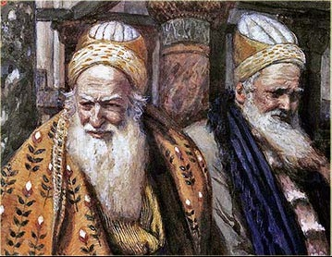
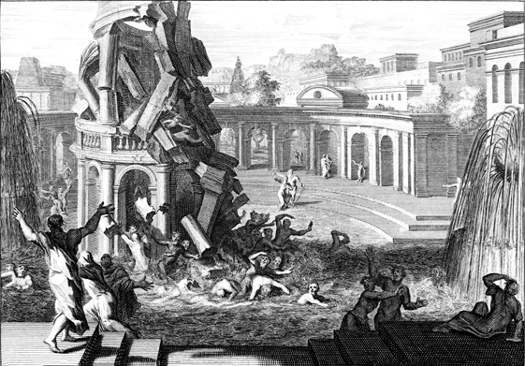
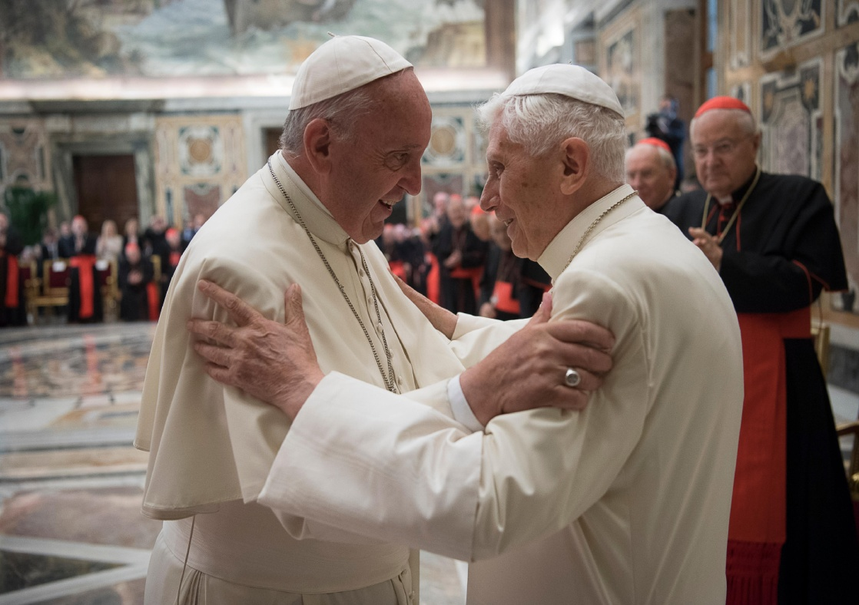
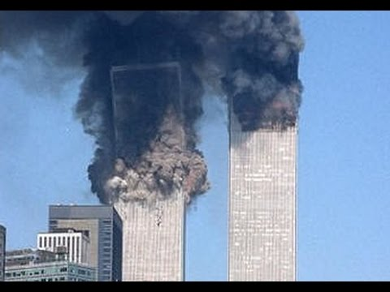
Caiaphas & Annas – Luk. 3:2
Tower Of Siloam – Luk. 13:4
“Francis I” & “Benedict XVI”
Towers of NY – 9/11 (2001)

Slide 92
On July 4th 2013, posted 7/6/2013
Defend Us in Battle: Benedict XVI and Pope Francis Consecrate the Vatican to Michael the Archangel
“… “We consecrate Vatican City State to St. Michael Archangel, asking him to defend us against evil and to banish it,” the Pope said …”
“… The Catholic Church often speaks in symbols. They open up for us, in a way which words fail, the true reality. …”
“… Friday, July 4, 2013, Pope Emeritus Benedict XVI and Pope Francis appeared together. That fact alone should have garnered the attention of the media.
The media in the United States is in a pause for the celebration of Independence Day. In addition, the western media in general is not only asleep but dismissive of the relevance of such an act due to a blindness which accompanies the descent into materialist hedonism underway in the West. …”

Slide 93
“… The fact that the “two Popes” joined one another in an act of consecration of the Vatican to St. Michael the Archangel speaks beyond the current Pope’s affirmation … It reveals the realities of the prophetic moment in which they both feel we are in. It is an invitation to all of us to enter into spiritual warfare.
In 1886 Pope Leo XIII added a prayer seeking the intercession of St Michael the Archangel which was recited at the end of every low Mass. “
“… [This was in] response to an encounter the Pope had in prayer. In that experience he saw that the Devil had unleashed a furious assault on Christ’s Church. He wanted the Church to take up spiritual arms and enter into the conflict. …”
“… acts of spiritual warfare …”
“… John Paul II regularly called the faithful back to seeking the assistance of Michael in the work of spiritual warfare. In 1994, he explicitly requested all of us to enter into the necessary spiritual warfare our age requires. …”

Slide 94
“… Pope Leo XIII certainly had a very vivid recollection of this …”
“ … Archangel defend us in battle… help in the battle against the forces of darkness and against the spirit of this world. (Pope John Paul II, Regina Caeli, 24 April 1994)”
“… Friday, July … 2013, with the appearance of the “Two Popes”, is a symbol of the importance placed by the successors of Peter on the faithful not only discerning the underlying spiritual warfare of this age but taking our place in the field of battle.
“… spiritual warfare….”
“… Our “two Popes” have invoked the big weapon in the current age of spiritual warfare. They have invited us to do the same. …” - https://johnib.wordpress.com/2013/07/06/defend-us-in-battle-benedict-xvi-and-pope-francis-consecrate-the-vatican-to-michael-the-archangel/
http://www.catholic.org/news/international/europe/story.php?id=51602

Slide 95
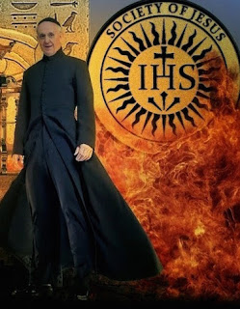
KING OF THE NORTH (Dan. 11)
Religious Humanism (Babylon)
Vs.
KING OF THE SOUTH (Dan. 11)
Secular Humanism (Egypt)

Slide 96
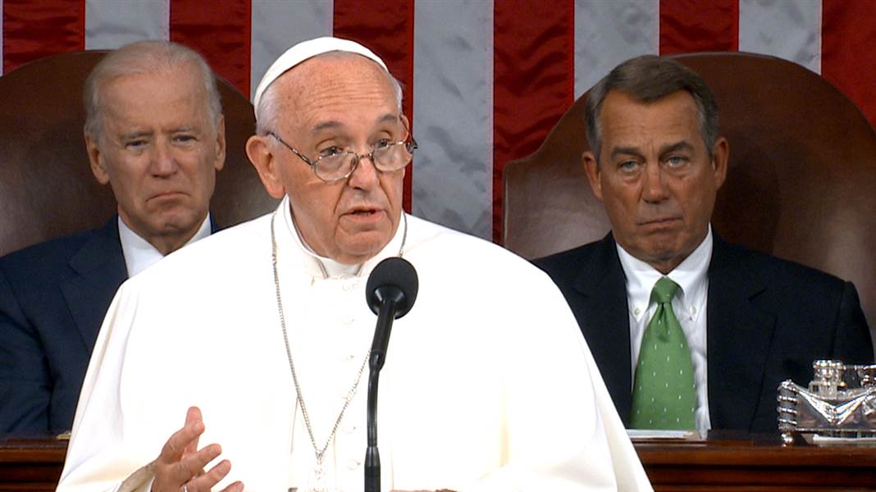
“Francis I” speaking before the United States Congress
(Thursday, Sept. 24, 2015).
Entering the Promised land, the land of freedom from tyranny of Government and Religion.

Slide 97
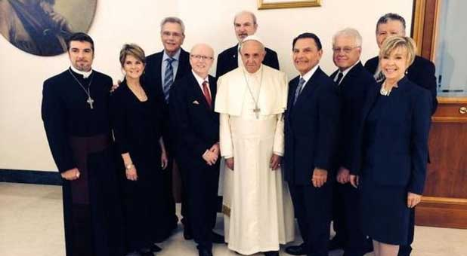
“Francis I” meeting & standing with “Evangelicals”.
Entering the Promised land, the land of freedom from tyranny of Government and Religion.

Slide 98
“Francis I” (through his Jesuits) calls for unity with Rome.
Entering the Promised land, the land of freedom from tyranny of Government and Religion.

Slide 99
CHRIST
ANTI-CHRIST
would sit/ride atop a beast
Zec. 9:9; Matt. 21:5,7; Mark 11:7; Luke 19:35; John 12:15
“sit upon a scarlet coloured beast” Rev. 17:3
“Rejoice greatly, O daughter of Zion; shout, O daughter of Jerusalem: behold, thy King cometh unto thee: he is just, and having salvation; lowly, and riding upon an ass, and upon a colt the foal of an ass.”
– Zechariah 9:9 KJB
“So he carried me away in the spirit into the wilderness: and I saw a woman sit upon a scarlet coloured beast, full of names of blasphemy, having seven heads and ten horns.” – Revelation 17:3 KJB

Slide 100
Symbol: “a woman” = God’s people - flock - church - and the city in which they reside; in this instance an impure or unclean or harlot/whorish woman, is an unfaithful or apostate church & city
Genesis 38:24; Psalms 122:3; Jeremiah 3:1,6,8,14,20, 6:2; Isaiah 47:5, 51:16; 54:5-6, 61:10, 62:5; Ezekiel 16:28, 23:5,19; Hosea 1:2, 2:2,5; 2 Corinthians 11:2; Ephesians 5:23-32; 1 Peter 2:5; Revelation 3:12, 17:18, 19:7, 21:2-3,9

Slide 101
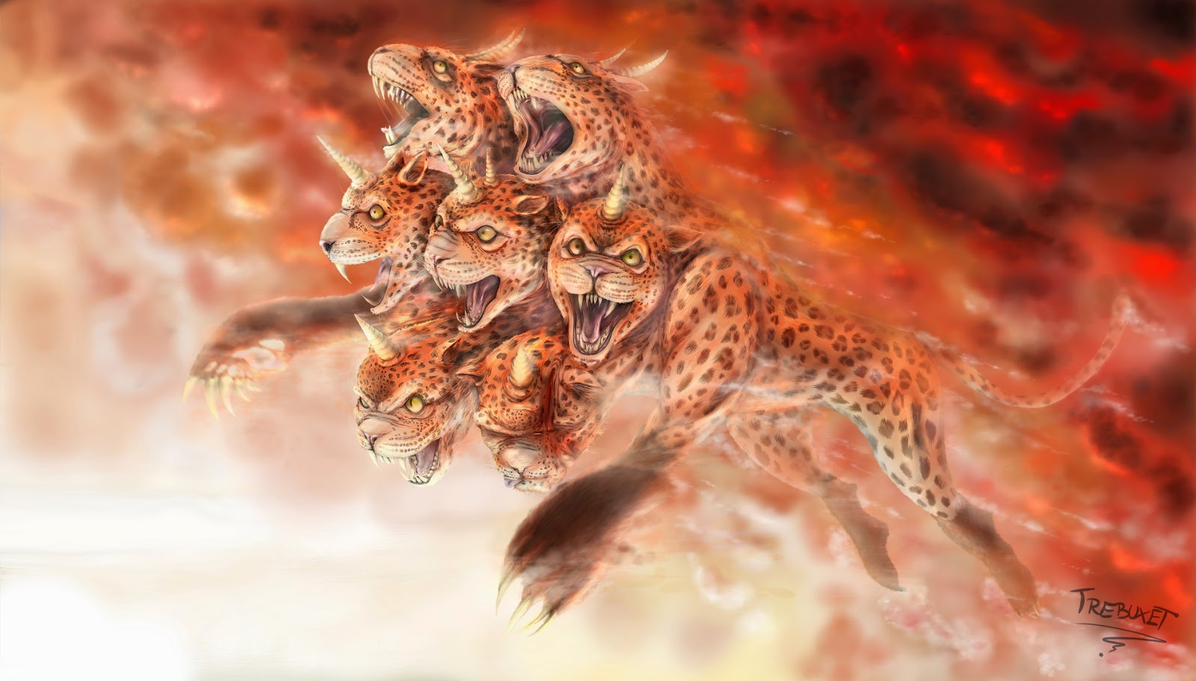
Symbol: “a beast” = state authority, government, political body, kingdom, dominion
Psalms 74:13,14; Daniel 7:6,12,17,23, 8:4; Isaiah 5:29, 27:1; Ezekiel 17:3,7, 29:3,4,5, 32:2,3,4,9, 34:8,13; Jeremiah 4:7, 48:40, 49:22, 50:17; Joel 1:6; Revelation 13;1, 16:10, 17:3,7,8,11,12, 19:19,20, 20:4,10; &c.

Slide 102
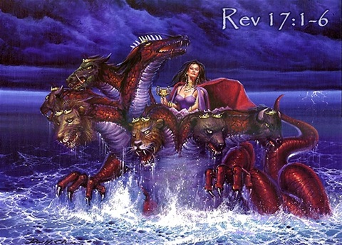
Symbol: “a woman riding a beast” = a church/city in control of or directing the state authority, an amalgamation of church/state

Slide 103
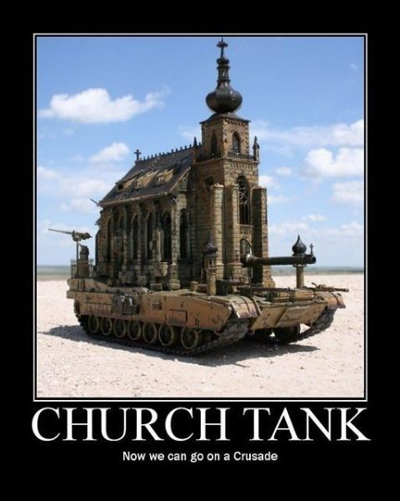
Symbol: “a woman riding a beast” = a church/city in control of or directing the state authority, an amalgamation of church/state

Slide 104
Symbol: “a woman riding a beast” = a church/city in control of or directing the state authority, an amalgamation of church/state

Slide 105
Symbol: “a woman riding a beast” = a church/city in control of or directing the state authority, an amalgamation of church/state

Slide 106
CHRIST
ANTI-CHRIST
would enter the Temple of God
Dan. 11:45; Acts 20:27-31; 2 Thess. 2:4; 1 Cor. 3:16,17, 6:19; 2 Cor. 6:16; 2 Thess. 2:7; 1 Pet. 2:5; Rev. 3:12 &c
Matt. 21:12, 24:1, 26:55; Mark 11:11,15, 12:35; John 7:14,28, 8:20, 18:20; &c.;
“Who opposeth and exalteth himself above all that is called God, or that is worshipped; so that he as God sitteth in the temple of God, shewing himself that he is God.”
– 2 Thessalonians 2:4 KJB
“And Jesus went into the temple of God …”
– Matthew 21:12 KJB

Slide 108
CHRIST
ANTI-CHRIST
He would have followers of many kinds of people
Matt. 4:25, 8:18; John 12:9,19, &c.
Dan. 11:43; Rev. 13:3
“… all the world wondered after the beast.”
– Revelation 13:3 KJB
“… behold, the world is gone after him.”
– John 12:19 KJB
“But he shall have power over the treasures of gold and of silver, and over all the precious things of Egypt: and the Libyans and the Ethiopians shall be at his steps.” – Daniel 11:43 KJB

Slide 109
CHRIST
ANTI-CHRIST
would have “sheep” or a flock
Psalms 77:20, 80:1; Ezekiel 34:11,12,31; Luke 15:6; John 10:3,14,27, 21:15,16,17, etc
Zec. 11:15-17;
John 10:26
“I am the good shepherd, and know my sheep, and am known of mine.”
– John 10:14 KJB
“Woe to the idol shepherd …” – Zechariah 11:17 KJB

Slide 110
“I AM -
the Good Shepherd”
“WOE – to the IDOL shepherd”

Slide 111
CHRIST
ANTI-CHRIST
would be seen above the “waters”
Job 9:8; Psa. 29:3; Matt. 14:25-33; Mark 6:48-51; John 6:19-21 [see also Gen. 1:2]
Rev. 17:1,15; Isa. 14:14-15; Jer. 51:13
“… the great whore that sitteth upon many waters:”
– Revelation 17:1 KJB
“… they see Jesus walking on the sea …”
– John 6:19 KJB

Slide 113
“And he saith unto me, The waters which thou sawest, where the whore sitteth, are peoples, and multitudes, and nations, and tongues.” – Revelation 17:5 KJB

Slide 114
‘Benedict XVI’ addressing the U.N. (United Nations)
“And he saith unto me, The waters which thou sawest, where the whore sitteth, are peoples, and multitudes, and nations, and tongues.” – Revelation 17:5 KJB

Slide 115
CHRIST
ANTI-CHRIST
would speak “dark sayings”
Psa. 49:4, 78:2; Pro. 1:6; Eze. 17:2; Matt. 13:34; Mark 4:13,34, “mystery[ies]” Matt. 13:11; Mark 4:11; Luke 8:10; Rom. 11:25, 16:25; 1 Cor. 2:7, 4:1, 13:2, 14:2, 15:51; Eph. 1:9, 3:3,4,9, 5:32, 6:19; Col. 1:26,27, 2:2, 4:3; 2 Thess. 2:7; 1 Tim. 3:9,16; Rev. 1:20, 10:7, 17:5,7. “riddle” in Num. 12:8; Jdg. 14:12-19. “hard questions” in 1 Kin. 10:1; 2 Chr. 9:1. “...take up a parable … a taunting proverb...” Hab. 2:6;p. To speak proverbs is to speak symbols, John 16:29 “His disciples said unto him, Lo, now speakest thou plainly, and speakest no proverb.”, thus, Prov. 25:2 “[It is] the glory of God to conceal a thing: but the honour of kings [is] to search out a matter.”
Dan. 8:23; Rom. 16:18
“And in the latter time of their kingdom, when the transgressors are come to the full, a king of fierce countenance, and understanding dark sentences, shall stand up.” – Daniel 8:23 KJB

Slide 116
CHRIST
ANTI-CHRIST
would do many “miracles”
Acts 8:10,11; Revelation 13:14, 16:14, 19:20; see also 2 Timothy 3:8, see also Job, etc
John 7:31, etc
“To whom they all gave heed, from the least to the greatest, saying, This man is the great power of God.”
– Acts 8:10 KJB
“And many of the people believed on him, and said, When Christ cometh, will he do more miracles than these which this man hath done?” – John 7:31 KJB
“… of long time he had bewitched them with sorceries.” – Acts 8:11 KJB

Slide 117
CHRIST
ANTI-CHRIST
take up a War, or a Great Controversy
Exo. 15:3; Isa. 42:13; Jer. 25:31; Hos. 4:1, 12:2; Mic. 6:2; Luke 14:32; Rev. 17:14
Dan. 7:21,24,25, 8:10,11, 9:26; Rev. 13:4, 17:14, 19:19
“I beheld, and the same horn made war with the saints, and prevailed against them; ” – Daniel 7:21 KJB
“The LORD [JEHOVAH] is a man of war: the LORD [JEHOVAH] is his name.” – Exodus 15:3 KJB
And I saw the beast, and the kings of the earth, and their armies, gathered together to make war against him that sat on the horse, and against his army. ”
– Revelation 19:19 KJB
“… for the LORD hath a controversy with the nations, he will plead with all flesh …” – Jeremiah 25:31 KJB

Slide 118
CHRIST
ANTI-CHRIST
would come with the “spirit”
“spirit of Christ”
Rom. 8:9; 1 Pet. 1:11, etc
“spirit of antichrist”
1 John 4:3
“And every spirit that confesseth not that Jesus Christ is come in the flesh is not of God: and this is that spirit of antichrist, whereof ye have heard that it should come; and even now already is it in the world.”
– 1 John 4:3 KJB
“Searching what, or what manner of time the Spirit of Christ which was in them did signify, when it testified beforehand the sufferings of Christ, and the glory that should follow.” – 1 Peter 1:11 KJB

Slide 119
CHRIST
ANTI-CHRIST
would deny “the flesh”
Matt. 4:1-11, 26:39,42; Luke 4:1-13, 22:42; Php. 2:8; Rev. 12:11
Matt. 1:1-23; Luk. 3:23-38; Rom. 1:3, 8:3; Heb. 2:16-18; 1 John 4:2,3; 2 John 1:7
“But he answered and said, It is written, Man shall not live by bread alone, but by every word that proceedeth out of the mouth of God.”
– Matthew 4:4 KJB
“And every spirit that confesseth not that Jesus Christ is come in the flesh is not of God: and this is that spirit of antichrist, whereof ye have heard that it should come; and even now already is it in the world.” – 1 John 4:3 KJB

Slide 120
CHRIST
ANTI-CHRIST
a day would come when he would be “revealed”
“to come and/or arrive” “erchomai” “ἔρχομαι” Matt. 24:30, 26:64; John 14:3; 1 Cor. 11:26; Rev. 1:7, “to appear visibly” “optanomai” “ὀπτάνομαι” Heb. 9:28, “to return” “analyō” “ἀναλύω”
Luke 12:36, “to reveal” “apokalypsis” “ἀποκάλυψις”
2 Thess. 1:7; 1 Pet. 1:7; Luke 17:29-30, “to manifest” “epiphaneia” “ἐπιφάνεια”
1 Tim. 6:14; 2 Tim. 4:8; Tit. 2:13, “make manifest” “phaneroō” “φανερόω” 1 Pet. 5:4, “come” “hēkō” “ἥκω” Rev. 2:25, “to return” “hypostrephō” “ὑποστρέφω” Luke 19:12.
“revealed” 2 Thess. 2:3,6,8
“Let no man deceive you by any means: for that day shall not come, except there come a falling away first, and that man of sin be revealed, the son of perdition;”
– 2 Thessalonians 2:3 KJB

Slide 121
CHRIST
ANTI-CHRIST
A question surrounds him, “Who is like unto...” him?
Dan. 12:1; Exo. 15:11; 1 Ki. 8:23; Psa. 71:19; see also Deut. 33:26; 2 Chr. 6:14; Job 36:22; Psa. 35:10, 86:8, 89:8, 113:5; Jer. 10:6-7; Mic. 7:18
Rev. 13:4
“And they worshipped the dragon which gave power unto the beast: and they worshipped the beast, saying, Who is like unto the beast? who is able to make war with him?”
– Revelation 13:4 KJB
MICHAEL (Who is like unto God?)
“Who is like unto the LORD our God, who dwelleth on high,” – Psalms 113:5 KJB

Slide 122
God has warned us of the enemy, and what the enemy would do.
Sheep are Christians, and thus Rome + Christianity = Papacy or Catholicity
Capitoline wolf of Rome

Slide 123
“Take heed therefore unto yourselves, and to all the flock, over the which the Holy Ghost hath made you overseers, to feed the church of God, which he hath purchased with his own blood.”
– Acts 20:28 KJB

Slide 124
“For I know this, that after my departing shall grievous wolves enter in among you, not sparing the flock.”
– Acts 20:29 KJB

Slide 125
“Also of your own selves shall men arise, speaking perverse things, to draw away disciples after them.”
– Acts 20:30 KJB

Slide 126
“Thy way, O God, is in the sanctuary: who is so great a God as our God?” – Psalms 77:13 KJB

Slide 127
Another ‘holy father’ on earth (Rev. 12:9; Matt. 23:9)

Slide 128
A ‘continual sacrifice’ on earth (Rev. 12:9)

Slide 129
A Laver on earth (Rev. 12:9) …

Slide 130
Bread on earth (Rev. 12:9) …

Slide 131
An Altar on earth (Rev. 12:9) …

Slide 132
A golden censor of Incense on earth (Rev. 12:9) …

Slide 133
7 golden Candles on earth (Rev. 12:9) …

Slide 134
A continual ministering ‘priest’ on earth (Rev. 12:9) …

Slide 135
A veil between two compartments on earth (Rev. 12:9) …

Slide 136
A veil between two compartments on earth (Rev. 12:9) …

Slide 137
A vicarius Christi (anti Chrtistos) on earth (Rev. 12:9) …

Slide 138
A vicarius Christi (anti Chrtistos); another Mediator …
12 Gem Stone Breastplate (horns of the Dragon)

Slide 139
A vicarius Christi (anti Chrtistos); another Mediator …
Who else is on the cross?

Slide 140
A vicarius Christi (anti Chrtistos); another Mediator …
12 Gem Stone Breastplate

Slide 141
Another ‘Ark’ …

Slide 142
Another ‘Ark’ …

Slide 143
Another ‘law’ …

Slide 144
Another ‘glory’ …

Slide 145
Another ‘glory’ …

Slide 146
Another ‘glory’ …
Green Halo means ‘Enlightened’ (a Jesuit)

Slide 147
Another ‘god’ on the earth …
“But since We hold upon this earth the place of God Almighty, ...” - The Great Encyclical Letters of Pope Leo XIII, Encyclical Letter June 20, 1894;
http://www.papalencyclicals.net/Leo13/l13praec.htm;

Slide 148
Outwardly beautiful, but inwardly, full of dead men’s bones (Matt. 23:27 KJB)

Slide 149
Outwardly beautiful, but inwardly, full of dead men’s bones (Matt. 23:27 KJB)

Slide 150
Outwardly beautiful, but inwardly, full of dead men’s bones (Matt. 23:27 KJB)

Slide 151
Outwardly beautiful, but inwardly, full of dead men’s bones (Matt. 23:27 KJB)

Slide 152
Outwardly beautiful, but inwardly, full of dead men’s bones (Matt. 23:27 KJB)

Slide 153
Outwardly beautiful, but inwardly, full of dead men’s bones (Matt. 23:27 KJB)

Slide 154
False Disciples, False Apostles, Deceitful Workers

Slide 155
Do we “kiss” Jesus with a “froward heart” (Proverbs 11:20 KJB)
“This people draweth nigh unto me with their mouth, and honoureth me with their lips; but their heart is far from me.” – Matthew 15:8 KJB

Slide 156
“While I was with them in the world, I kept them in thy name: those that thou gavest me I have kept, and none of them is lost, but the son of perdition; that the scripture might be fulfilled.” – John 17:12 KJB
SON OF PERDITION
“Let no man deceive you by any means: for that day shall not come, except there come a falling away (αποστασια; apostasia) first, and that man of sin be revealed, the son of perdition;” – 2 Thessalonians 2:3 KJB

Slide 157
“For such are false apostles, deceitful workers, transforming themselves into the apostles of Christ.”
– 2 Corinthians 11:13 KJB

Slide 158
“And no marvel; for Satan himself is transformed into an angel (an messenger, an ambassador, an apostle) of light.”
– 2 Corinthians 11:14 KJB

Slide 159
“Therefore it is no great thing if his ministers also be transformed as the ministers of righteousness; whose end shall be according to their works.”
- 2 Corinthians 11:15 KJB

Slide 160
False Disciples, False Apostles, Deceitful Workers
“I know thy works, and thy labour, and thy patience, and how thou canst not bear them which are evil: and thou hast tried them which say they are apostles, and are not, and hast found them liars:”
– Revelation 2:2 KJB

Slide 161
BEWARE, lest it be said to us!
“Jesus answered them, Have not I chosen you twelve, and one of you is a devil?” – John 6:70 KJB

Slide 162
Do we come to God with “another” (in the place of, an anti-christ) “offering”, as Cain, as Rome (dead, lifeless works)?
Your
Face
Here

Slide 163
Do we withhold our means (money, energy, strength, intellect, talents, time) from God, while pretending to serve God and neighbour with it?

Slide 164
Do we try to take Glory from God for ourselves, so that those among mankind praise us? Are we (personally) the next Jim Jones, leading people to their death, instead of eternal Life? Are we the next ‘pope’, leading people “away” from Jesus Christ, unto another “Christ”?, from the real Gospel to “another”?
Your Husband, Wife, Children, friends, neighbours – here.
Pope
“I”
“Myself”
Your
Face
Here

Slide 165
Is this what we are attempting to accomplish? To build up the kingdom of self?
Are we attempting to Immortalize and Deify self?
Is not this the Great KINGDOM that “I” have built? For my glory of my Majesty?
SELF

Slide 166
Is this how you desire people who have committed a trespass against you to approach you?
Your
Face
Here
Your
Enemy
Here

Slide 167
Your
Face
Here
Do you allow people to come to you with “whisperings”, telling you secrets that belong with God alone? Do you sit in God’s place?

Slide 168
Do we have another “spirit”, other than the “Holy Spirit”?

Slide 169
Your
Face
Here
Do we attempt to walk all over other people to lift up ourself?

Slide 170
Do we live by another Law of self-righteousness?

Slide 171
Do we live by another Law of self-righteousness?

Slide 172
Do we worship God in our own ‘way’ apart from His ‘way’?

Slide 173
… but the week is 7 days (Exodus 20:8-11), and so do we dishonour God in the other days – doing our own thing?

Slide 174
… do we sit in judgment over others, “Lord[ing it] over them” (Luke 22:25 KJB) as if we were another “God on earth”, taking the “place of God Almighty” on the earth?

Slide 175
Is this a picture of “ME” and “MY” homies?
Your
Face
Here
Is this a picture of the “posse of perfection”?

Slide 176
“Wherefore I take you to record this day, that I am pure from the blood of all men.” – Acts 20:26 KJB

Slide 177
“For I have not shunned to declare unto you all the counsel of God.”
– Acts 20:27 KJB

Slide 178
“Take heed therefore unto yourselves, and to all the flock, over the which the Holy Ghost hath made you overseers, to feed the church of God, which he hath purchased with his own blood.”
– Acts 20:28 KJB

Slide 179
“For I know this, that after my departing shall grievous wolves enter in among you, not sparing the flock.”
– Acts 20:29 KJB

Slide 180
“Also of your own selves shall men arise, speaking perverse things, to draw away disciples after them.”
– Acts 20:30 KJB

Slide 181
Angels of Lie-ght
Angels of Light
Which are we?

