Slide 1
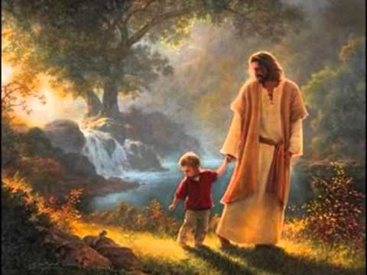
“… Walk In The Light …
“… as He is in the Light …” – 1 John 1:7 KJB

Slide 2
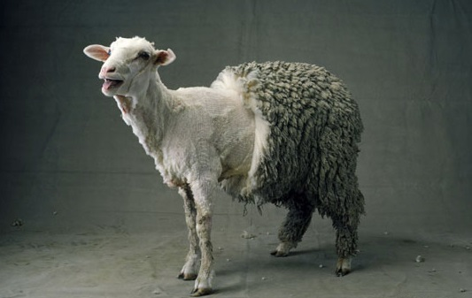
Can You Imagine A Half-Sheered Sheep?

Slide 3
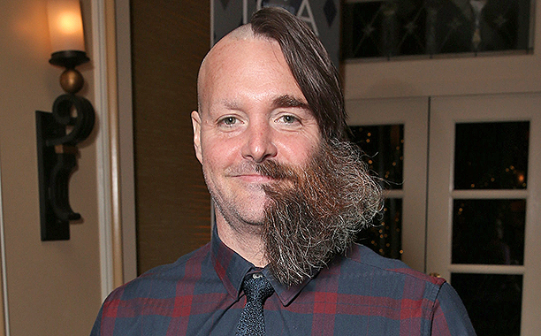
Can You Imagine A Half Shaved Man?

Slide 4
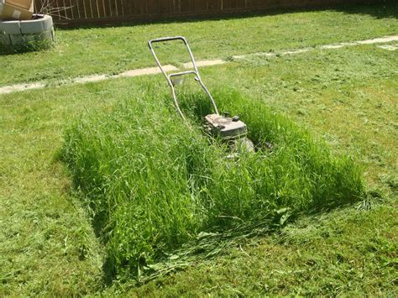
Can You Imagine A Half Mowed Yard?

Slide 5
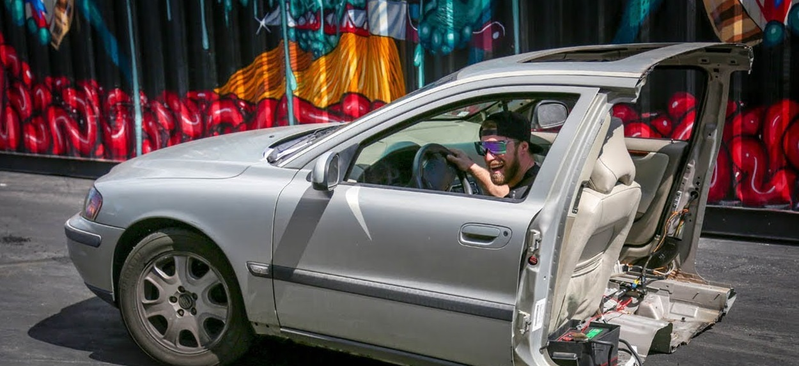
Can You Imagine Driving Half A Car?

Slide 6
Those Things Make No Sense!
Those Things If Left Unfinished
Would Look Silly!

Slide 7
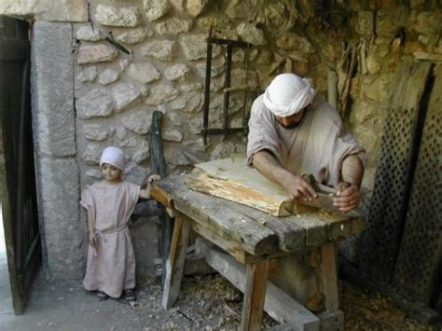
When Jesus Was A Child Working With Joseph,
Do You Think He Left His Tasks Half Way Done?

Slide 8
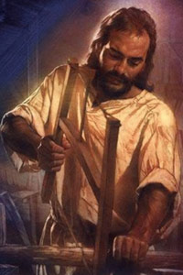
When Jesus Was Older, Do You Think He Had Learned To Complete His Tasks?

Slide 9
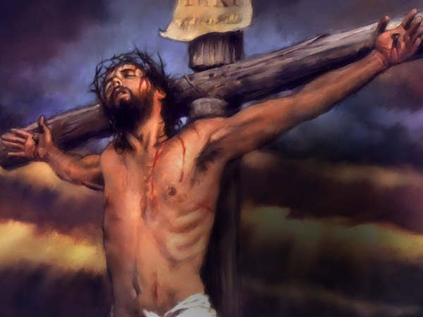
What If Jesus Only Went Half Way To The Cross?
Do You Think The Work His Father Gave Him To Do Would Have Ever Been Finished?

Slide 10
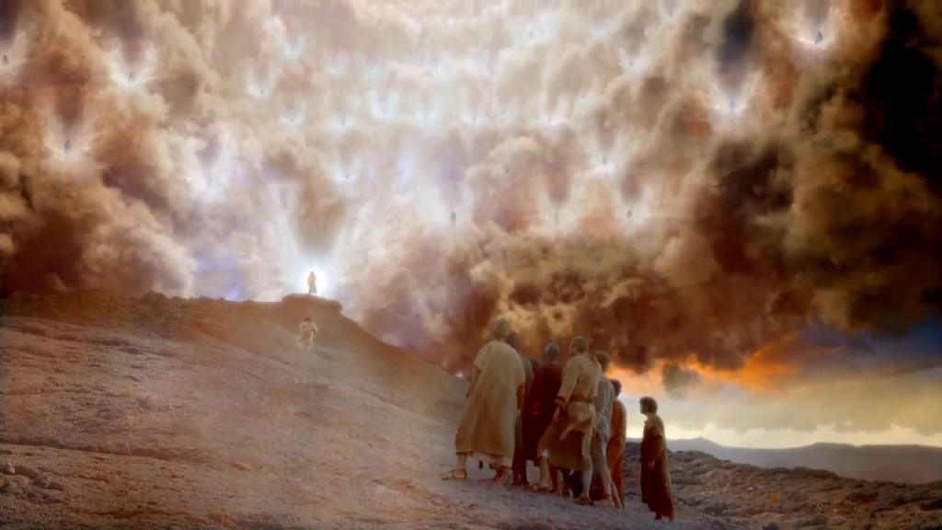
What If Jesus Decided To Not Go Back To Heaven?
Would His Father And The Angels Be Happy Or Sad?

Slide 11
What If Jesus Only Forgave Some Of Our Sins And Not All?

Slide 12
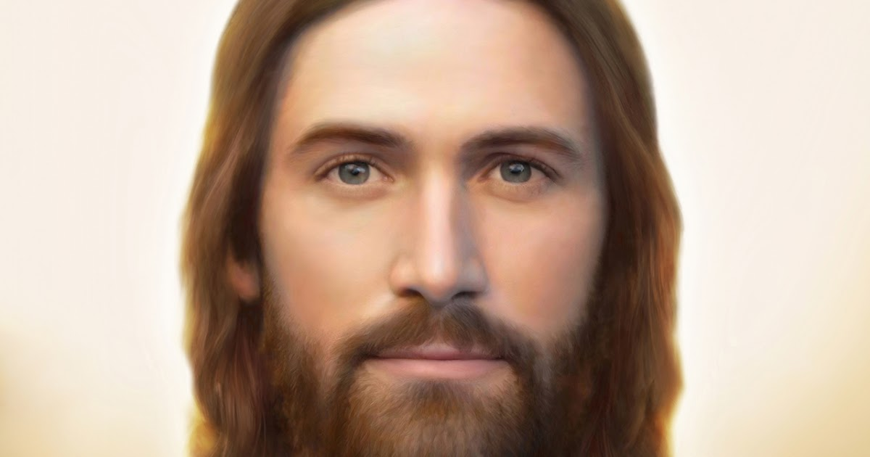
Yet, Jesus Never Went Half Way On Anything!
He Is All The Way! (John 14:6 KJB)

Slide 13
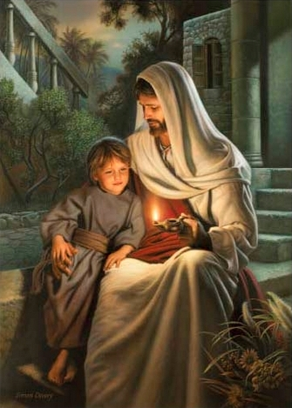
So, Are You Going All The Way With Jesus?

Slide 14
When Jesus Asks, Through Your Parents, To Help Wash The Dishes? Do You Only Wash Half And Then Stop?

Slide 15
What Would Happen If We Only Removed Part Of The Garbage?

Slide 16
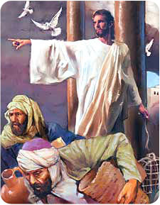
Did Jesus Only Partly Clean The Temple, His Father’s House, Or Did He Do A Thorough Work And Clean
All Of It?

Slide 17
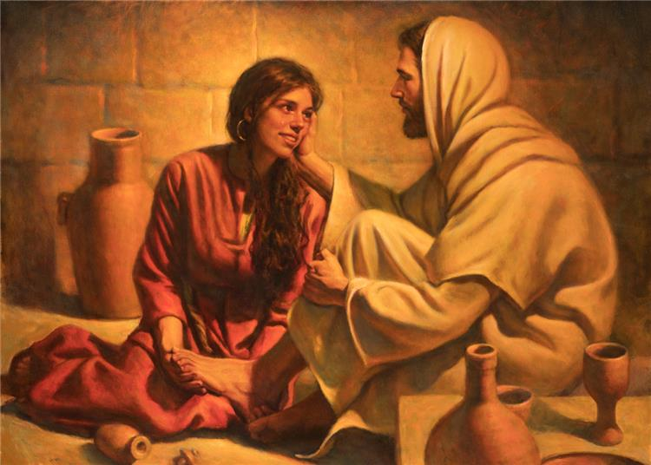
What About Repenting? Should We Only Go Part Way? Or Should We Repent All The Way?

Slide 18
What About Forgiving One Another?
Should We Forgive Only In Part?

Slide 19
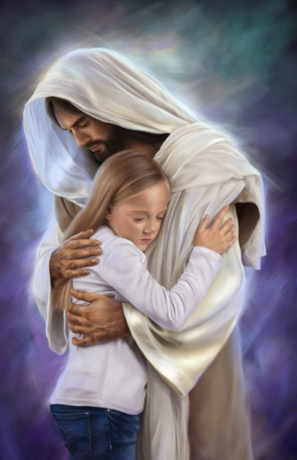
Or Should We Walk Like Jesus, And Forgive The Whole Way?

Slide 20
Are You Going All The Way With Jesus, Or, Are You Only Going
Half Way
With Jesus?

Slide 21
“From that time many of his disciples went back, and walked no more with him.” – John 6:66 KJB

Slide 22
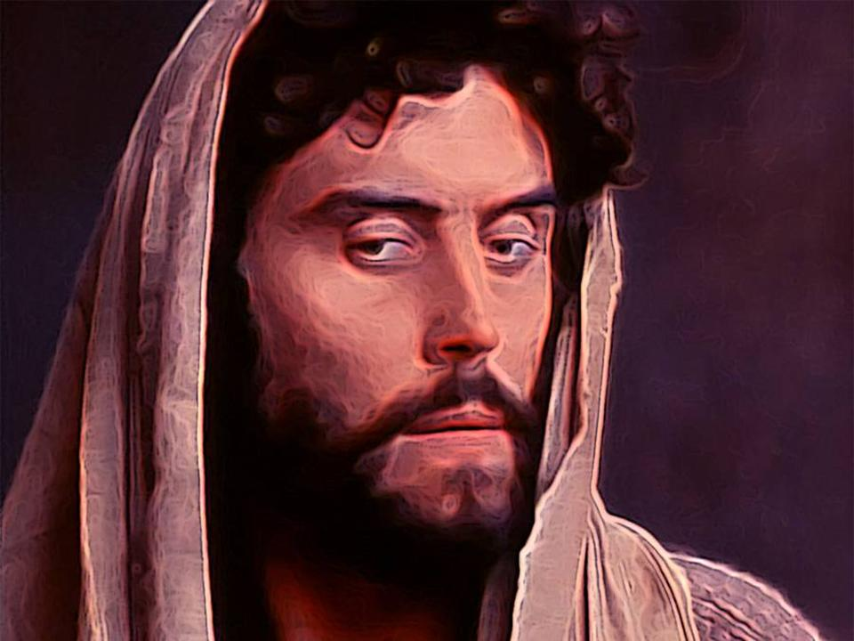
Judas
He Didn’t Walk All The Way With Jesus!

Slide 23
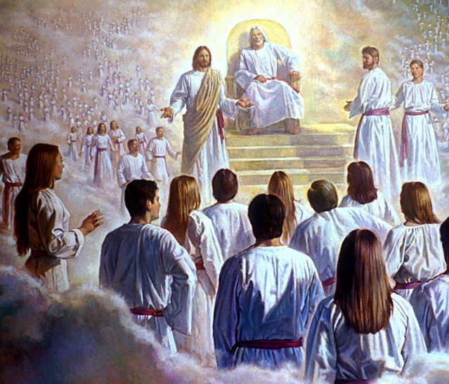
Jesus
He Walked All The Way With His Father!

Slide 24
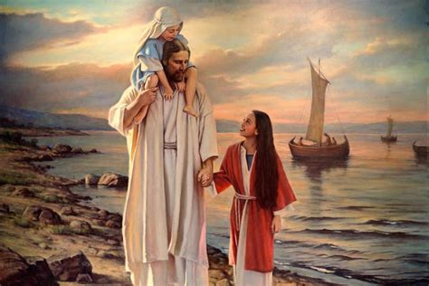
Will You Walk In The Light – All The Way?
Even As He Is In The Light?

