Slide 1
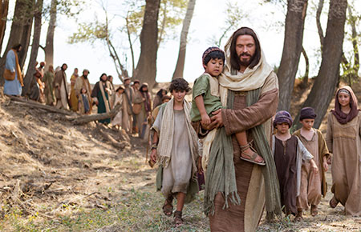
DISCIPLES
FOR JESUS

Slide 2
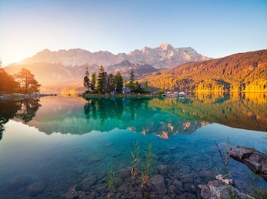
WELCOME, GOOD MORNING
CHILDREN’S CAMP SERVICE

Slide 3
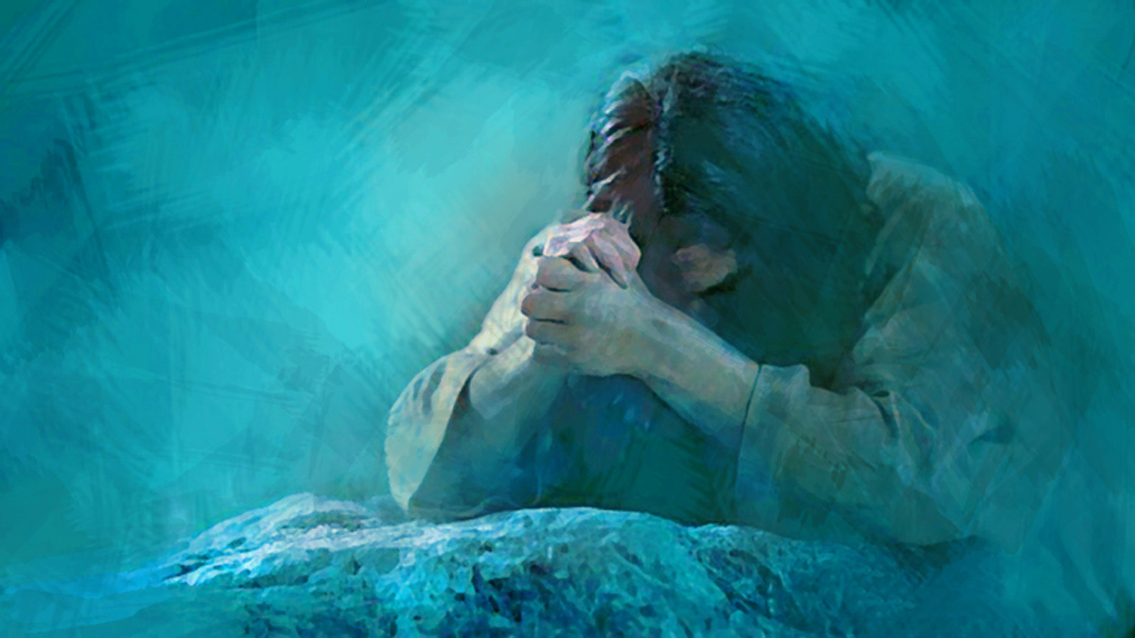
OPENING
PRAYER

Slide 4
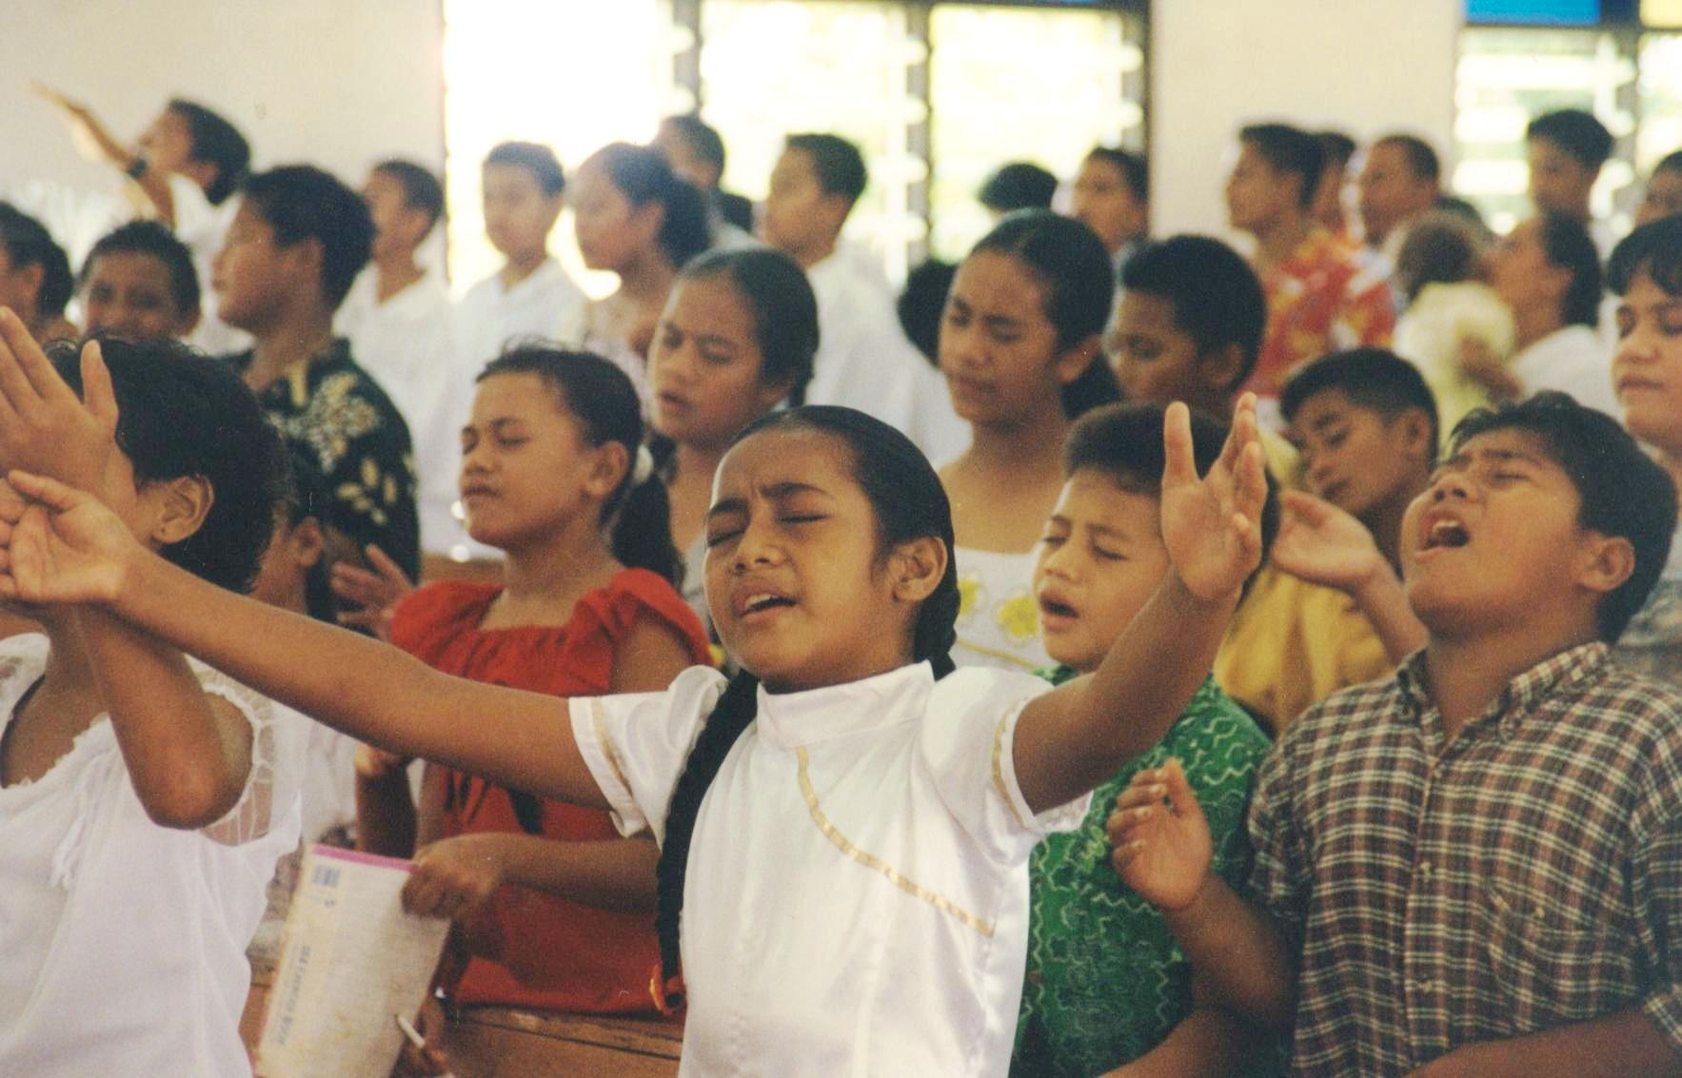
SONG
SERVICE

Slide 5
580. This Little Light Of Mine
[1A]
This little light of mine,
I’m going to let it shine, (shine)
This little light of mine,
I’m going to let it shine, (shine)

Slide 6
580. This Little Light Of Mine
[1B]
This little light of mine,
I’m going to let it shine, Let it shine,
let it shine,
let it shine.

Slide 7
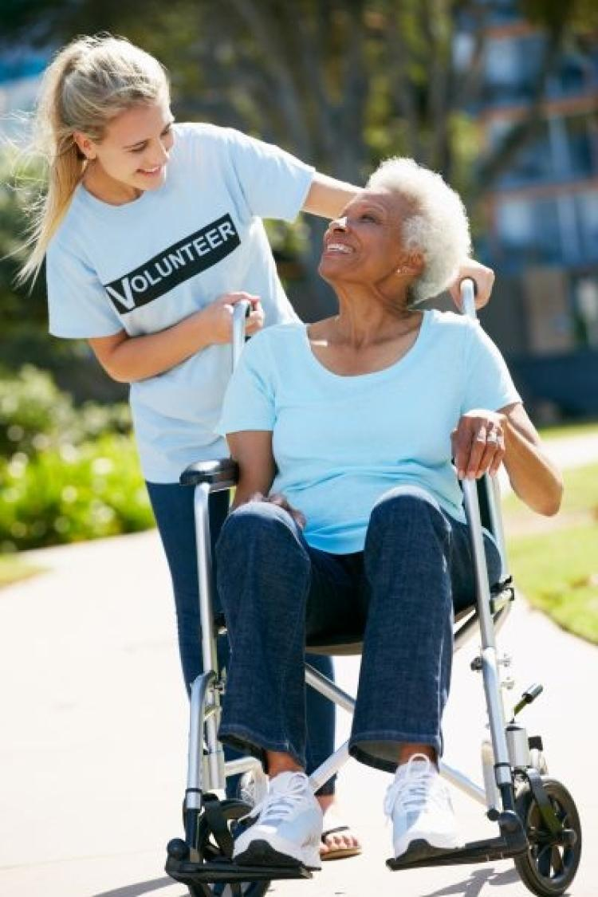
580. This Little Light Of Mine
[2A]
Every where I go, I’m going to let it shine, (shine) Every where I go, I’m going to let it shine, (shine)

Slide 8
580. This Little Light Of Mine
[2B]
Every where I go,
I’m going to let it shine, Let it shine, let it shine, let it shine.

Slide 9
580. This Little Light Of Mine
[3A]
All through the night,
I’m going to let it shine, (shine) All through the night,
I’m going to let it shine, (shine)

Slide 10
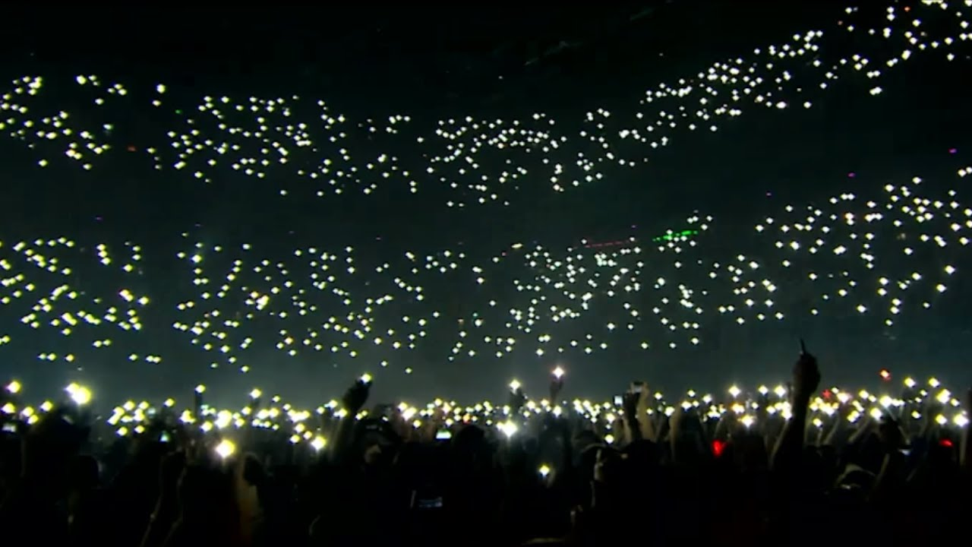
580. This Little Light Of Mine
[3B]
All through the night,
I’m going to let it shine, Let it shine, let it shine, let it shine.

Slide 11
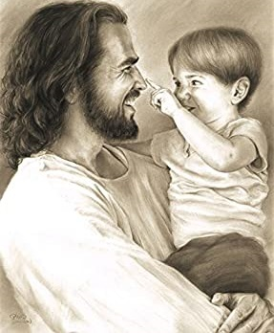
Where Could I Go, But To The LORD
[1]
Living below,
in this old sinful world.
Hardly a comfort can afford
Striving alone
to face temptation’s sword
Where could I go,
but to the LORD

Slide 12
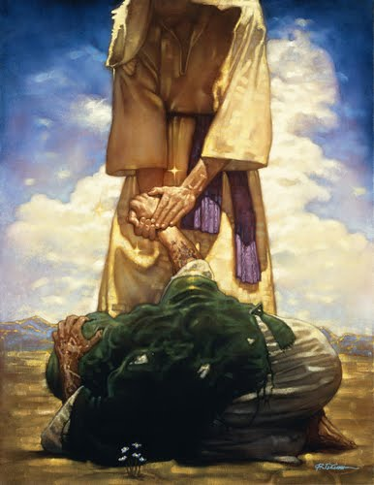
Where Could I Go, But To The LORD
[Chorus]
Where could I go,
Oh, where could I go,
Seeking a refuge
for my soul,
Needing a friend
To help me in the end,
Where could I go,
but to the LORD

Slide 13
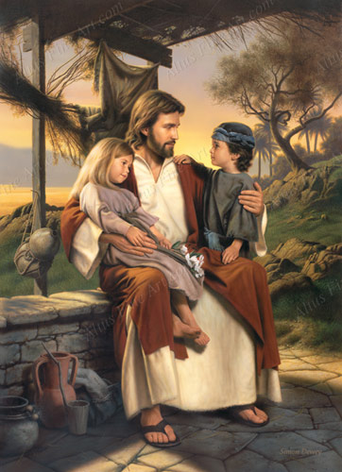
Where Could I Go, But To The LORD
[2]
Neighbours are kind,
I love them – everyone,
We get along
in sweet accord,
But when my soul
Needs Manna from above,
Where could I go,
but to the LORD

Slide 14
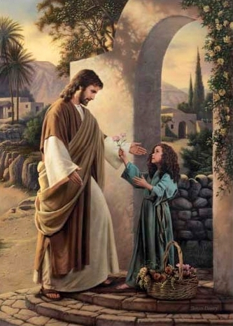
Where Could I Go, But To The LORD
[Chorus]
Where could I go,
Oh, where could I go,
Seeking a refuge
for my soul,
Needing a friend
To help me in the end,
Where could I go,
but to the LORD

Slide 15
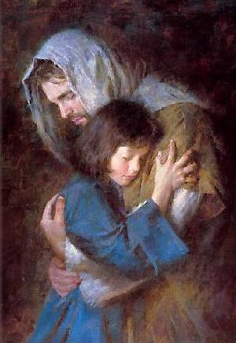
Where Could I Go, But To The LORD
[3]
Life here is grand,
With friends I love so dear,
Comfort, I get
From God’s own word,
But when I face
this chilling hand of death,
Where could I go,
but to the LORD

Slide 16
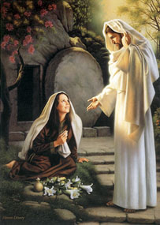
Where Could I Go, But To The LORD
[Chorus]
Where could I go,
Oh, where could I go,
Seeking a refuge
for my soul,
Needing a friend
To help me in the end,
Where could I go,
but to the LORD

Slide 17
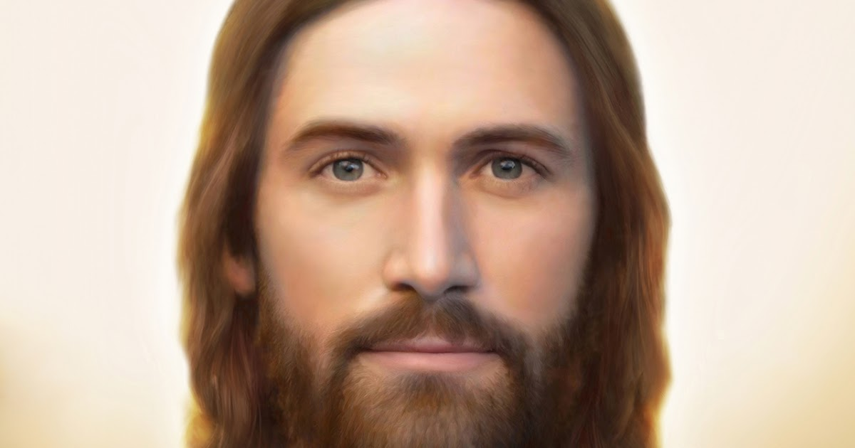
Where Could I Go, But To The LORD
[Finale]
Where could I go, but to the LORD!

Slide 18
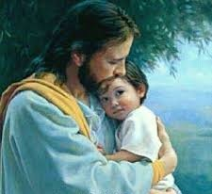
190 - Jesus Loves Me
[1]
Jesus loves me!
this I know, For the Bible
tells me so; Little ones
to Him belong They are weak
but He is strong

Slide 19
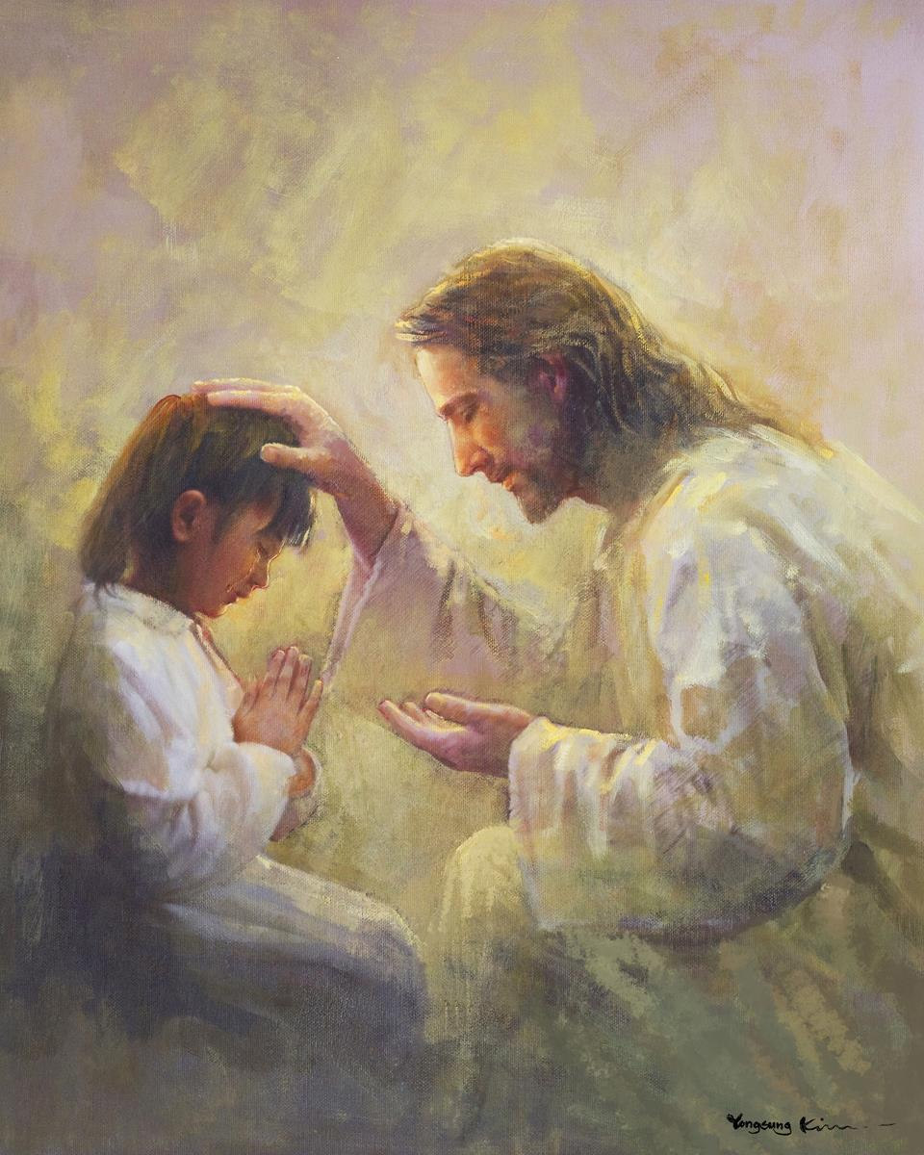
190 - Jesus Loves Me
[Refrain]
Yes,
Jesus loves me! Yes,
Jesus loves me! Yes,
Jesus loves me! The Bible
tells me so.

Slide 20
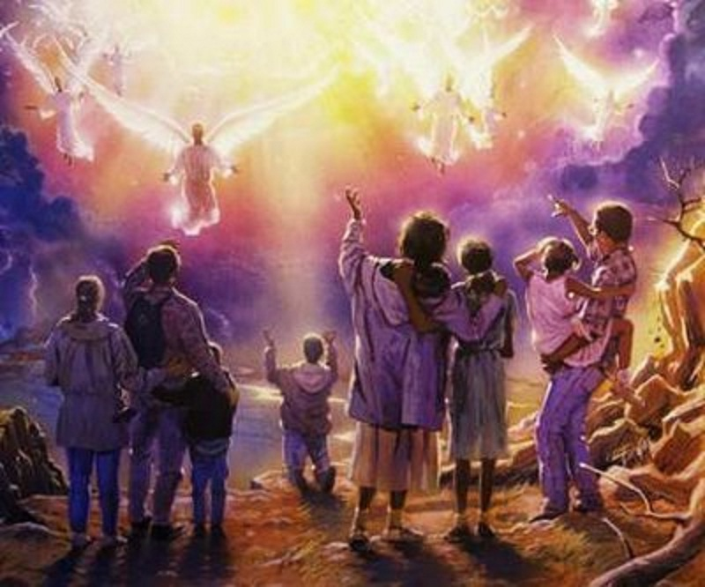
190 - Jesus Loves Me
[2]
Jesus loves me!
He who died Heaven’s gate
to open wide: He will wash
away my sin, Let His little
child come in.

Slide 21
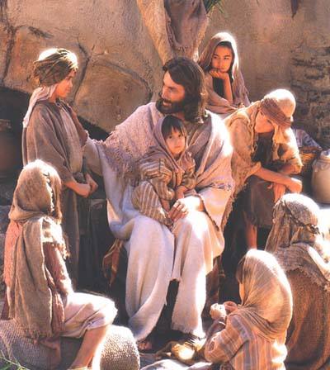
190 - Jesus Loves Me
[Refrain]
Yes,
Jesus loves me! Yes,
Jesus loves me! Yes,
Jesus loves me! The Bible
tells me so.

Slide 22
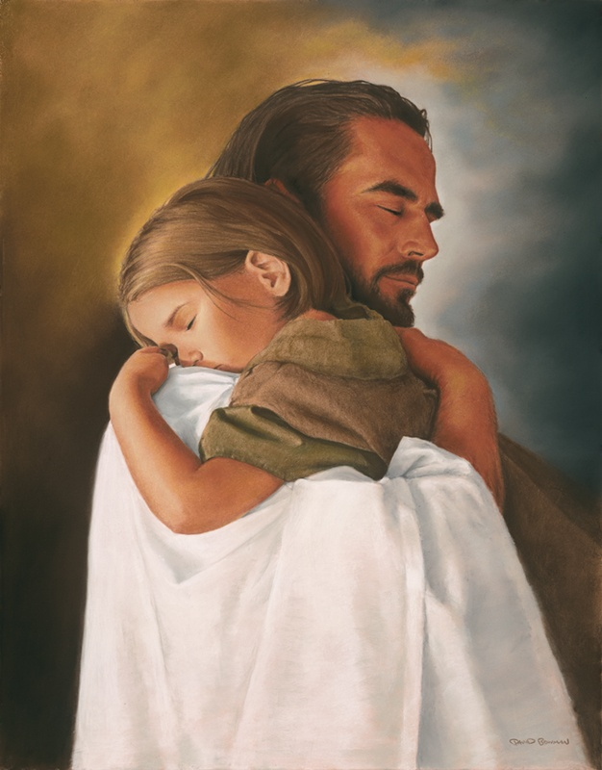
190 - Jesus Loves Me
[3]
Jesus, take this
heart of mine, Make it pure
and wholly thine; On the cross
You died for me, I will love
and live for Thee.

Slide 23
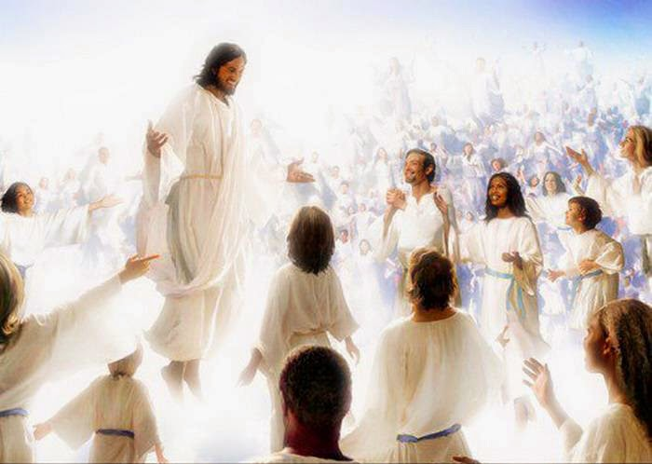
190 - Jesus Loves Me
[Refrain]
Yes,
Jesus loves me! Yes,
Jesus loves me! Yes,
Jesus loves me! The Bible
tells me so.

Slide 24
OPENING SONG
PLEASE STAND

Slide 25
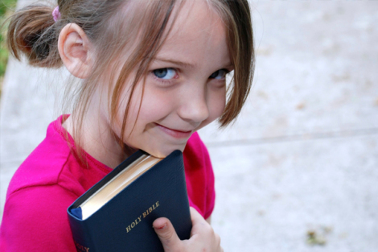
We Are His Hands
[1]
We are his hands to touch the world around us We are His feet to go where He may lead. And we are His love burning in the darkness, We are his love shining in the night

Slide 26
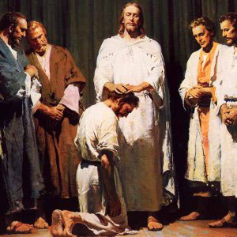
We Are His Hands
[2]
We are His eyes to see the need in others We are His voice to tell of His return, And we are His love burning in the darkness, We are His love shining in the night.

Slide 27
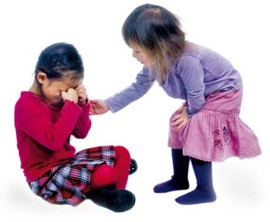
We Are His Hands
[3]
We are his hands to touch the world around us We are His feet to go where He may lead. And we are His love burning in the darkness, We are his love shining in the night

Slide 28
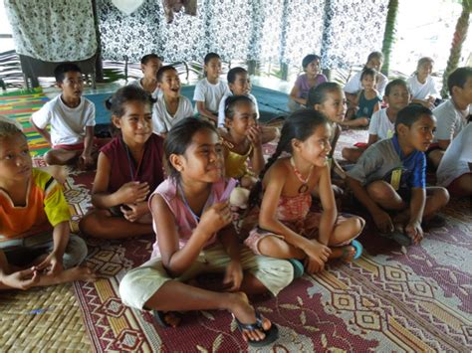
PLEASE BE
SEATED

Slide 29
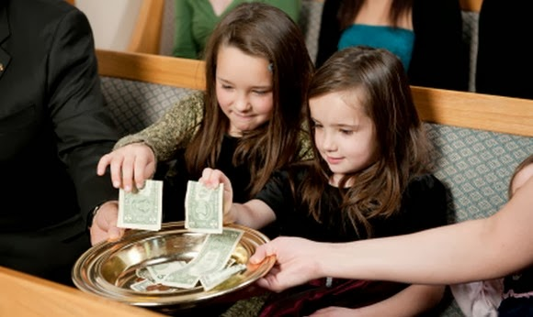
TITHES
& OFFERINGS

Slide 30
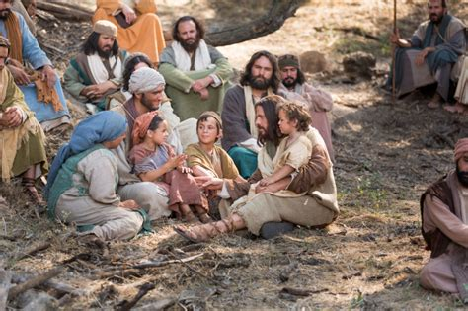
CHILDREN’S
SPECIAL LESSON TIME

Slide 31
Scripture Reading: Mark 14:49 KJB
“I was daily with you in the temple teaching, and ye took me not: but the scriptures must be fulfilled.” – Mark 14:49 KJB

Slide 32
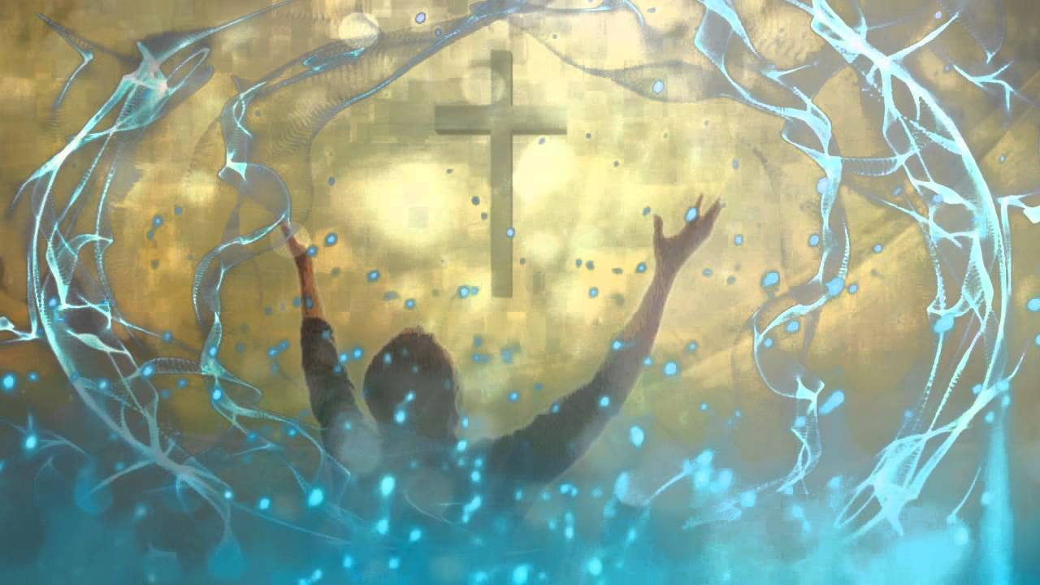
SPECIAL MUSIC
MINISTRY

Slide 33
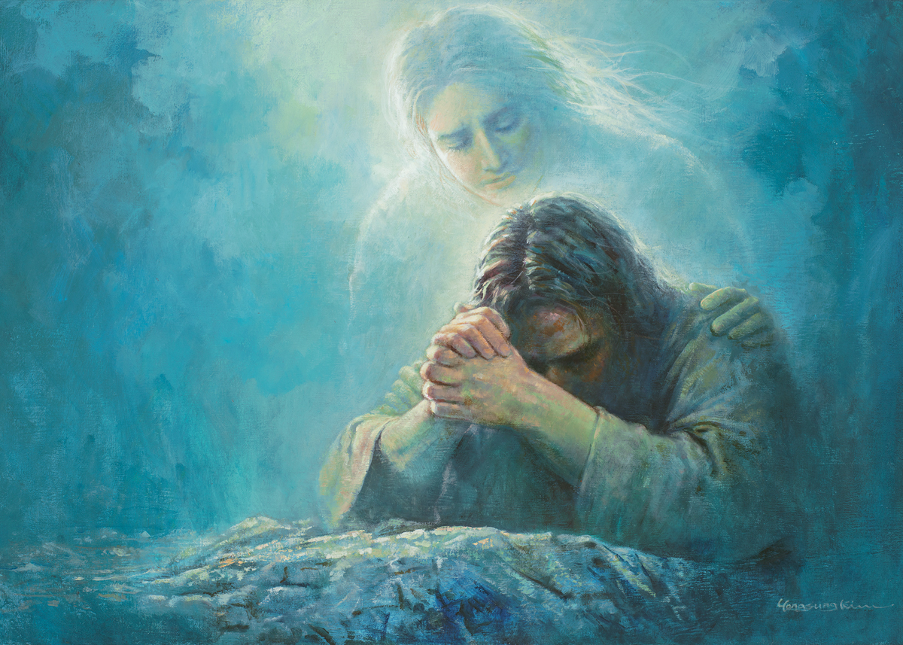
The Last Days With Jesus
http://www.pearltrees.com/awhn

Slide 34
Scripture Reading: Mark 14:49 KJB
“I was daily with you in the temple teaching, and ye took me not: but the scriptures must be fulfilled.” – Mark 14:49 KJB

Slide 35
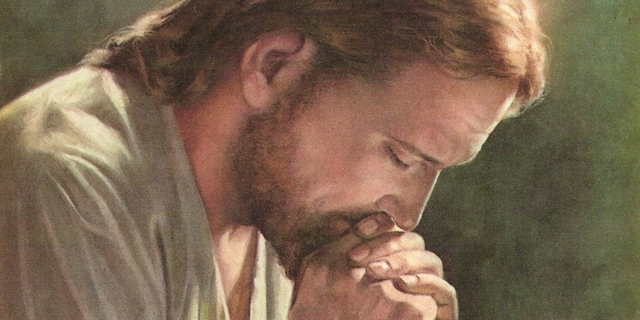
What was the final week (the last days) of Jesus like, and should we think on it carefully?

Slide 36
“… The Saviour has given marked lessons in humility to all, but especially to the gospel [246] ministers. In his humiliation, when his work upon earth was nearly finished, and he was about to return to his Father's throne whence he had come, with all power in his hands and all glory upon his head, among his last lessons to his disciples was one upon the importance of humility. While his disciples were contending as to who should be greatest in the promised kingdom, he girded himself as a servant, and washed the feet of those who called him Lord and Master. {GW92 245.3} …”

Slide 37
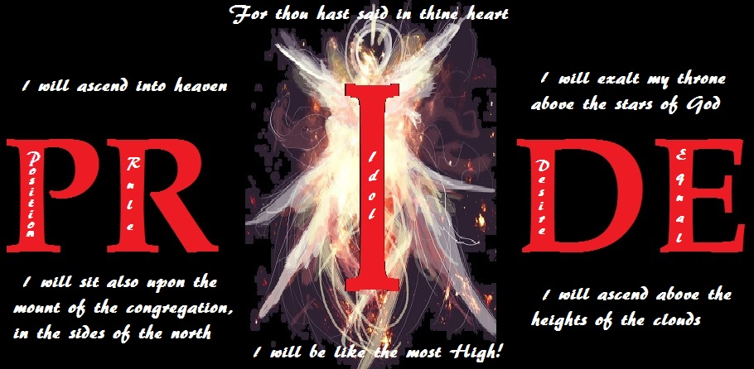
Should we ever then say, “I am the best!”, “I am the greatest!”, “I am the first!”, “I am more important!”, “I am better than so and so …”?

Slide 38
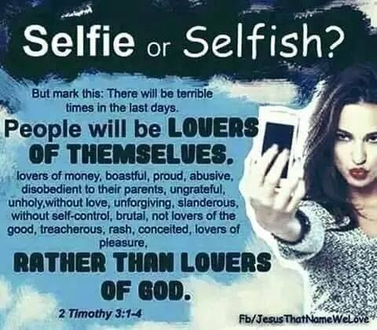
“This know also, that in the last days perilous times shall come.” – 2 Timothy 3:1 KJB

Slide 39
“For men shall be lovers of their own selves, covetous, boasters, proud, blasphemers, disobedient to parents, unthankful, unholy,”
– 2 Timothy 3:2 KJB

Slide 40
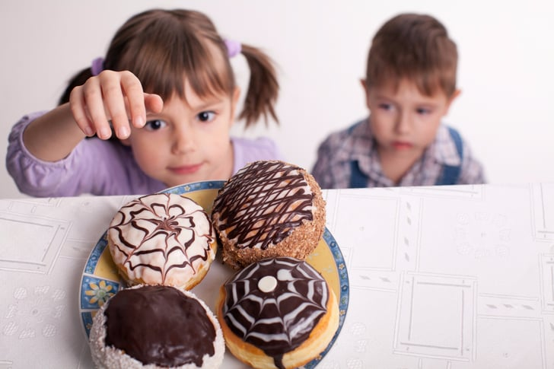
“Without natural affection, trucebreakers, false accusers, incontinent [no self-control], fierce, despisers of those that are good,”
– 2 Timothy 3:3 KJB

Slide 41
“Traitors, heady, highminded, lovers of pleasures more than lovers of God;”
– 2 Timothy 3:4 KJB

Slide 42
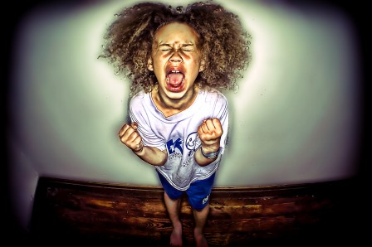
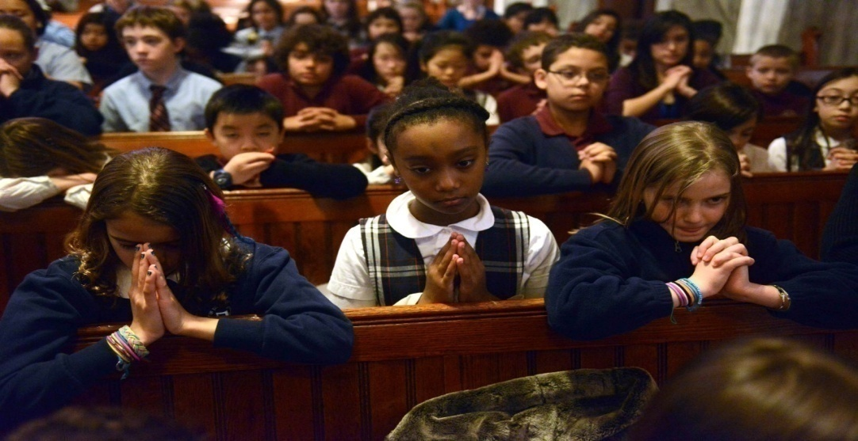
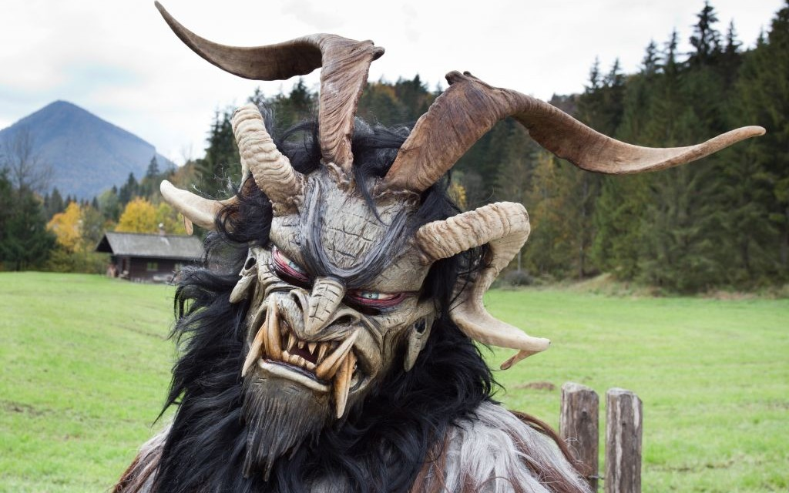
“Having a form of godliness, but denying the power thereof: from such turn away.”
– 2 Timothy 3:5 KJB

Slide 43
ME! ME! ME!
ME! ME! ME!
ME! ME! ME! ME! ME! ME!

Slide 44
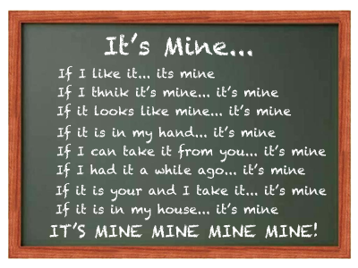

Slide 45
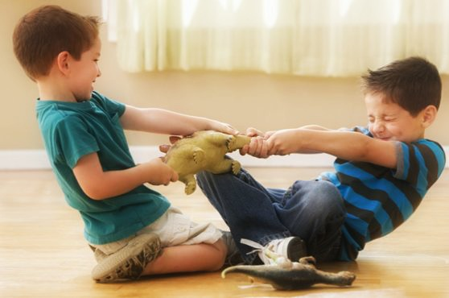
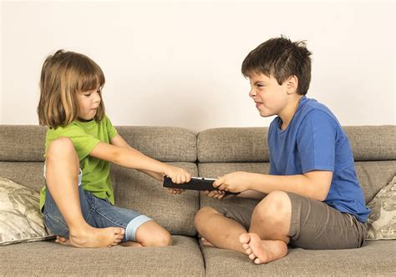
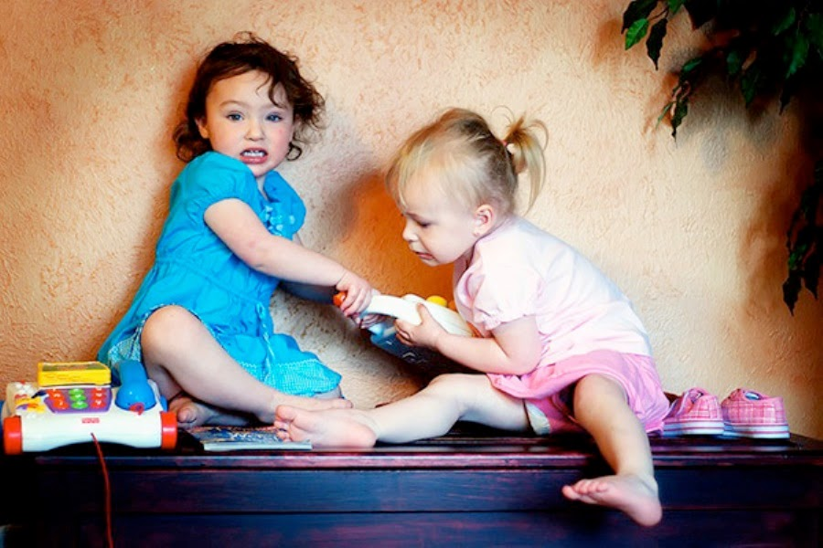

Slide 46
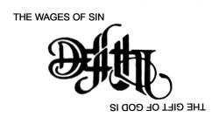
Do you really want what’s yours? The Bible says that, “… the wages of sin is death …”

Slide 47
Yet, instead, if you let go of selfishness, you can have the gift of God, which is “eternal Life” through Jesus Christ! [See Romans 6:23 KJB]

Slide 48
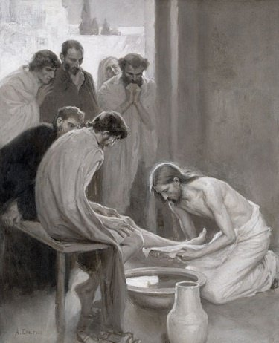
Jesus, by His life, taught that humility, or humbleness (being little in your own sight) is what makes up the character of those who shall enter into paradise, or Heaven.
Are you willing to serve God and others? Or do you only serve yourself, and your own interests?

Slide 49
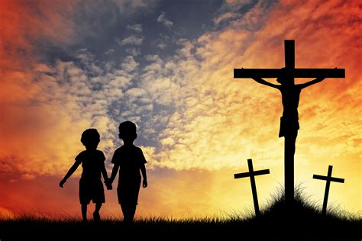
Do you recognize that Jesus owns you and everything? That everything belongs to Him?
That He has shares His very life with us!

Slide 50
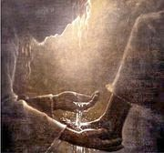
“… His ministry was nearly completed; he had only a few more lessons to impart. And that they might never forget the humility of the pure and spotless Lamb of God, the great and efficacious Sacrifice for man humbled himself to wash the feet of his disciples. {GW92 246.1} …”

Slide 51
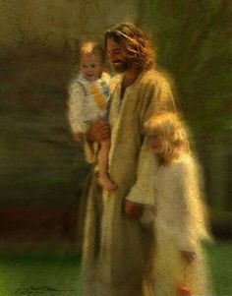
Can we learn a most important lesson so that we do not make the error of the devil?

Slide 52
“… It will do you good, and our ministers generally, frequently to review the closing scenes in the life of our Redeemer. Here, beset with temptations as he was, we may all learn lessons of the utmost importance to us. It would be well to spend a thoughtful hour each day reviewing the life of Christ from the manger to Calvary. We should take it point by point, and let the imagination vividly grasp each scene, especially the closing ones of his earthly life. …”

Slide 53
“… By thus contemplating his teachings and sufferings, and the infinite sacrifice made by him for the redemption of the race, we may strengthen our faith, quicken our love, and become more deeply imbued with the spirit which sustained our Saviour. If we would be saved at last, we must learn the lesson of penitence and faith at the foot of the cross. . . . Everything noble and generous in man will respond to the contemplation of Christ upon the cross. {GW92 246.1} …” – Gospel Workers (1892), pages 245.3 – 246.1

Slide 54
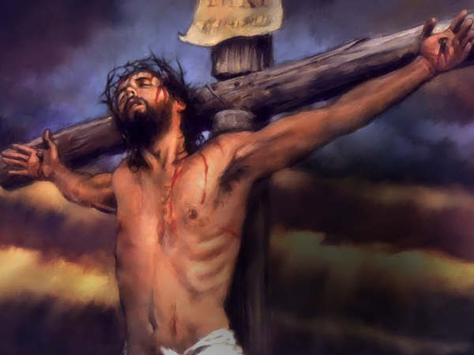
Have you really taken the time to think about Him? About this?

Slide 56
Where was Jesus on the last Sabbath before the final events? Anyone know? (Raise your hand.)

Slide 57
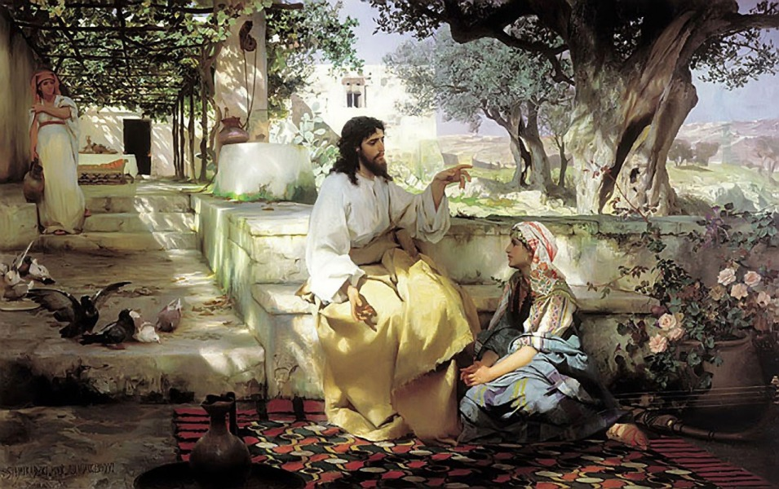
Jesus was doing visitation on Sabbath
“Then Jesus six days before the passover came to Bethany, where Lazarus was which had been dead, whom he raised from the dead.” – John 12:1 KJB

Slide 58
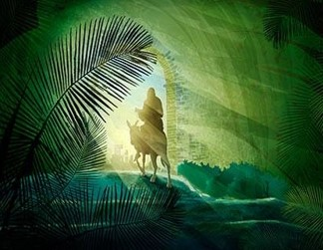
On the First Day Of The Week, what did Jesus do?
Who knows? (Raise Your Hand.)

Slide 59
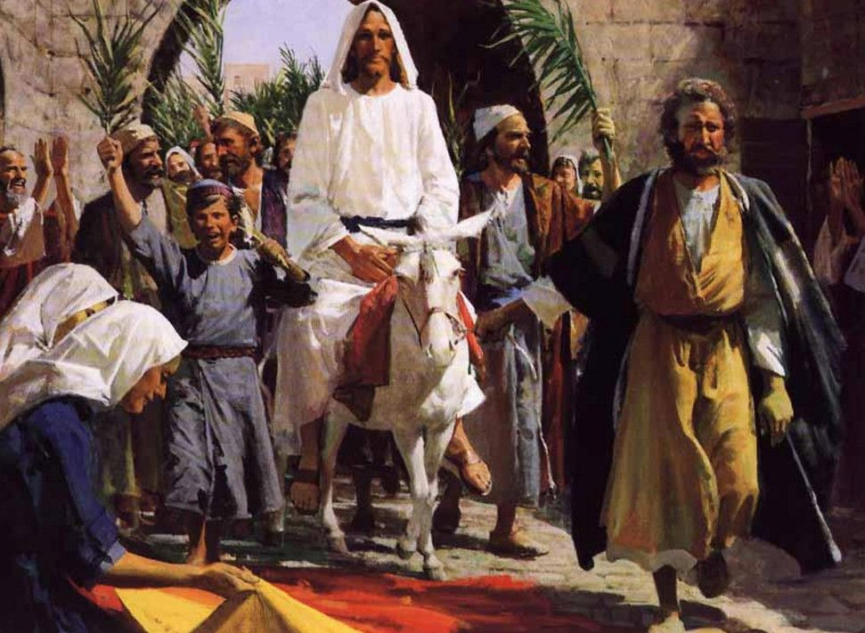
He began to fulfill His final mission according to Prophecy, by riding Triumphantly into Jerusalem!

Slide 60
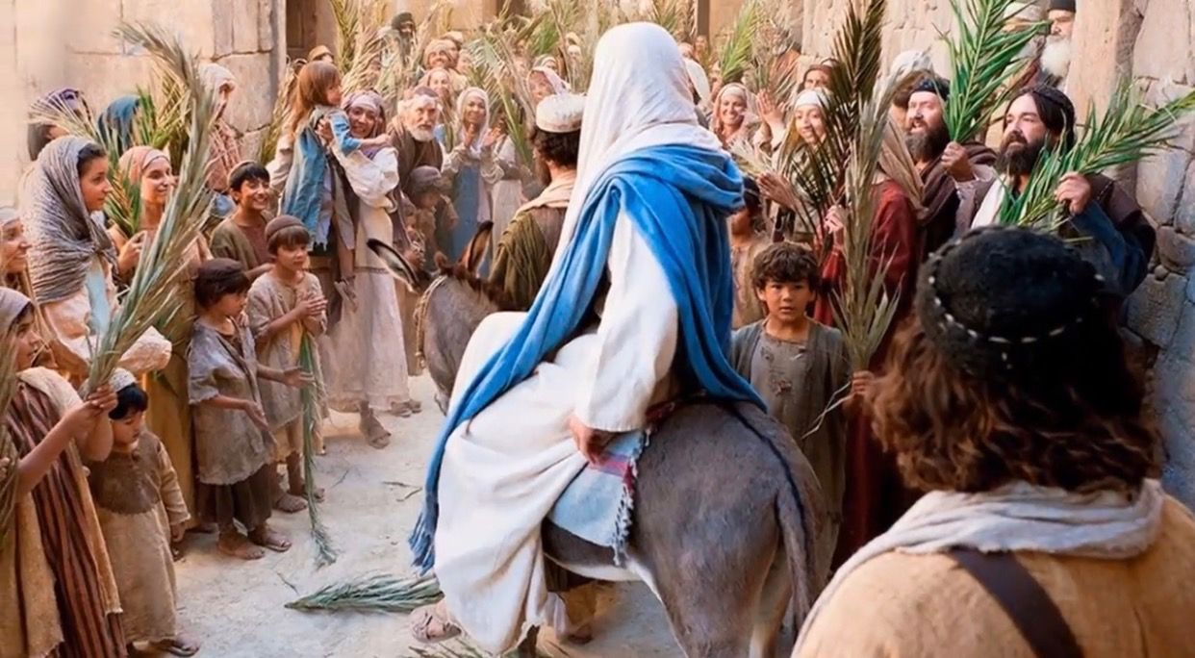
Thousands hailed Him as their Messiah, their King, and Saviour, shouting, “Hosanna!”, and “Blessed is he that cometh in the name of the Lord!” – Mark 11:9 KJB [also see John 12:12,13; Matthew 21:10; Mark 11:11 KJB]

Slide 61
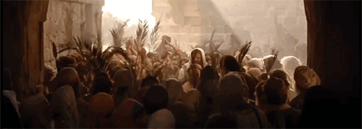
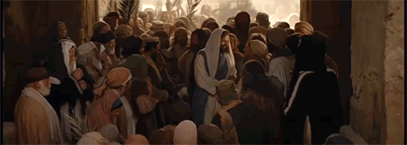

Slide 62
Just a few days later, many of those same ‘holy’, ‘pious’, and ‘religious’ people, ‘having a form of godliness’ would shout, “Crucify Him!” – Mark 15:13-14 KJB

Slide 63
Are your thoughts, words and actions, right now, today, shouting, “Hosanna,” and “Blessed”, or are they shouting, “Crucify Him!” – DECIDE! PURPOSE IN YOUR HEART!

Slide 64
Are you FOLLOWING JESUS?

Slide 65
Or, Are you FLAILING JESUS?

Slide 66
One the Second Day of the Week, what did Jesus do? Who knows? (Raise your hand.)

Slide 67
Jesus saw what was happening at the Temple, and filled with Love for His Father, corrected the people.
[Matthew 21:12,13,17; Mark 11:12,15,16,17,19]

Slide 68
Does Jesus love to dwell in a clean house, with clean rooms, with a clean courtyard?

Slide 69
Do you think that the Holy Spirit, or Angels love to dwell amongst this?

Slide 70
Or, how about this?

Slide 71
Does Jesus care about the cleanliness of the soul Temple, the Mind & Body?

Slide 72
Does Jesus care about what happens in His Father’s House? Does Jesus care what goes on in your heart, a Temple of God? What Thoughts are there? What Speech? What Actions?

Slide 73
Are these the thoughts that are present with you?

Slide 74
Or, are these the Thoughts, Speech and Actions that are present with you?

Slide 75
Which expression on Jesus’ face would you rather see? This one (Happy)? Or …

Slide 76
… This one (Angry)? You must decide. You must choose whom you are following.

Slide 77
On the Third Day Of The Week, what did Jesus do?
Who knows? (Raise Your Hand.)

Slide 78
Jesus tried to help those who were spiritually blind, and brought healing to those in need, but could not heal those who did not recognize their need.
[Matthew 21:18,23; Mark 11:20,27] [Matthew 26:1-2; Mark 14:1; Luke 21:37-38, 22:1] [Matthew 23:37-39; Luke 13:32-35] [Luke 13:32,33] [Matthew 26:55; Mark 14:49; Luke 19:47, 22:53; John 18:20]

Slide 79
Do you seek to help those in need? Or do you say, “It is not my fault.”, “It is not my mess.”, “It is not my problem.”?

Slide 80
Are you like this?

Slide 81
Or, are you like this?

Slide 82
What if when the Father asked,
“Who will go for us?”
Jesus had said,
“Sin, what a mess!
I didn’t make it, so I’m not helping clean it up.”

Slide 83
We should be like the Jesus who loves – Rescuing!

Slide 84
We should be like the Jesus who loves – Helping!

Slide 85
We should be like the Jesus who loves – Comforting!

Slide 86
We should be like the Jesus who loves – Caring!

Slide 87
We should be like the Jesus who loves – Healing!

Slide 88
We should be like the Jesus who loves – Sharing all His love!

Slide 89
One the Fourth & Fifth Days of the Week, what did Jesus do? Who knows?
(Raise your hand.)

Slide 90
“[Vs. 32] And he said unto them, Go ye, and tell that fox, Behold, I cast out devils, and I do cures to day and to morrow, and the third day I shall be perfected. [Vs. 33] Nevertheless I must walk to day, and to morrow, and the day following: for it cannot be that a prophet perish out of Jerusalem. ”
– Luke 13:32-33 KJB

Slide 91
Jesus was more concerned about doing His Father’s will, and pleasing Him, than worrying about what others thought He ought to do, should have said, or done. He was always about His Father’s work!

Slide 92
Are people coming to know the love of Jesus through your life and actions, or are people seeing that you do not really know Love (God) by your words and deeds?

Slide 93
On the Sixth Day Of The Week, what did Jesus do?
Who knows? (Raise Your Hand.)

Slide 94
Jesus spent quality time with His family and fellowshipped. [see Luke 22:15 KJB]

Slide 95
Is this your family time?

Slide 96
Or, is this your family time?

Slide 97
Jesus was found in prayer at Gethsemane. Do you pray like Jesus prayed, or do you fall asleep when it is time to pray to God and read His word?

Slide 98
Jesus was arrested, mocked, beat up, and spat upon and yet He did not return evil for evil, nor did He say harsh words in return when He was called names not of His character.

Slide 99
Have you every been hit? Have you ever been called names, or made fun of? What did you do? Was it like Jesus’ character of forgiveness, and love? Or did you hit back, say mean things back?

Slide 100
Jesus was nailed to a Cross, that He might die, yet He still prayed for their forgiveness.

Slide 101
When people say mean things, do mean things, it hurts our bodies (like whips & nails), it hurts our heads and hearts (like thorns and spear), but we should always keep in mind the man [Jesus] of Calvary. Forgive. Pray. Endure. Love.

Slide 102
How many of you are sorry for your sins, and want Jesus to forgive you, right now? RAISE YOUR HAND AND SAY, “LORD JESUS, FORGIVE ME, SAVE ME!”

Slide 103
On the Seventh Day (The Sabbath of the LORD, the Lord’s Day) Of The Week, what did Jesus do?
Who knows? (Raise Your Hand.)

Slide 104
He rested, after having completed His work, which His Father gave Him to do. Self was not alive.

Slide 105
Do you rest on Sabbath, or do you let the old man/child of sin run around without restraint?

Slide 106
On the next First Day Of The Week, what did Jesus do?
Who knows? (Raise Your Hand.)

Slide 107
When His Father called Him, He arose from the dead, and said, “Here am I. I am the resurrection and the life.”

Slide 108
Do you rejoice, like the angels in Heaven, over what Jesus did for you? Do you like to sing the praises of God, for His marvelous gift, in Christ Jesus, for you?

Slide 109
Then everyone who desires to spend their days with Jesus, stand to their feet and shout, “I love you Jesus, and want to follow you always!”, and sing our closing hymn.

Slide 110
I Have Decided To Follow Jesus
I have decided
to FOLLOW Jesus,
I have decided
to FOLLOW Jesus,
I have decided
to FOLLOW Jesus,
No turning back,
No turning back …

Slide 111
I Have Decided To Follow Jesus
Though none go
with me,
still I will FOLLOW,
Though none go
with me,
still I will FOLLOW,
Though none go
with me,
still I will FOLLOW,
No turning back,
No turning back …

Slide 112
I Have Decided To Follow Jesus
The Cross before me,
the world behind me,
The Cross before me,
the world behind me,
The Cross before me,
the world behind me,
No turning back,
No turning back …

Slide 113
I Have Decided To Follow Jesus
Jesus, I do love thee,
And I will FOLLOW,
Jesus, I do love thee,
And I will FOLLOW,
Jesus, I do love thee,
And I will FOLLOW,
No turning back,
No turning back …

Slide 114
I Have Decided To Follow Jesus
I have decided
to FOLLOW Jesus,
I have decided
to FOLLOW Jesus,
I have decided
to FOLLOW Jesus,
No turning back,
No turning back!

Slide 115
CLOSING
PRAYER

