Slide 1
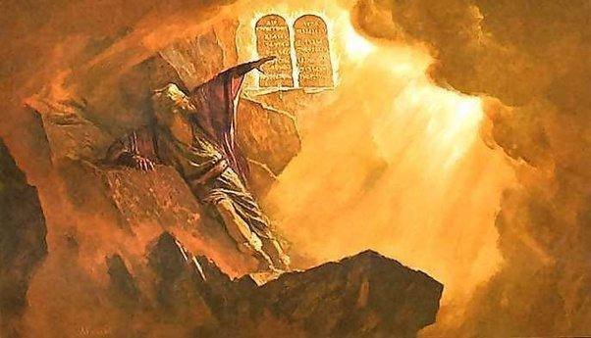
“No Plans”
http://www.pearltrees.com/awhn

Slide 2
Scripture Reading: Matthew 6:25 KJB
Scripture Reading: Luke 12:30-32 KJB
“Therefore I [Jesus] say unto you, Take no thought for your life, what ye shall eat, or what ye shall drink; nor yet for your body, what ye shall put on. Is not the life more than meat, and the body than raiment?”
– Matthew 6:25 KJB

Slide 3
Scripture Reading: Matthew 6:25 KJB
Scripture Reading: Luke 12:30-32 KJB
“For all these things do the nations of the world seek after: and your Father knoweth that ye have need of these things.” – Luke 12:30 KJB

Slide 4
Scripture Reading: Matthew 6:25 KJB
Scripture Reading: Luke 12:30-32 KJB
“But rather seek ye the kingdom of God; and all these things shall be added unto you.” – Luke 12:31 KJB

Slide 5
Scripture Reading: Matthew 6:25 KJB
Scripture Reading: Luke 12:30-32 KJB
“Fear not, little flock; for it is your Father's good pleasure to give you the kingdom.” – Luke 12:32 KJB

Slide 6
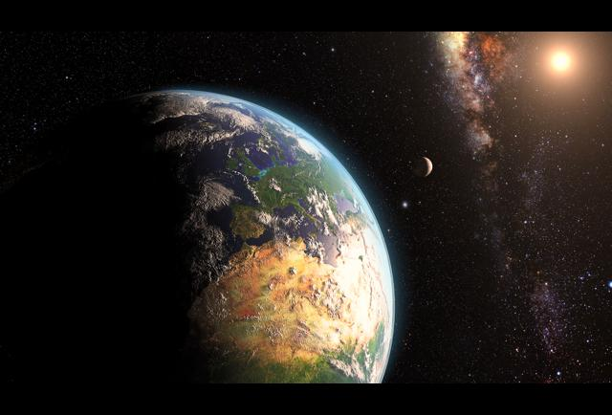
There are all kinds of plans in the world:

Slide 7
Daily, Weekly, Monthly & Yearly Plans:

Slide 8
Diet Plans:

Slide 9
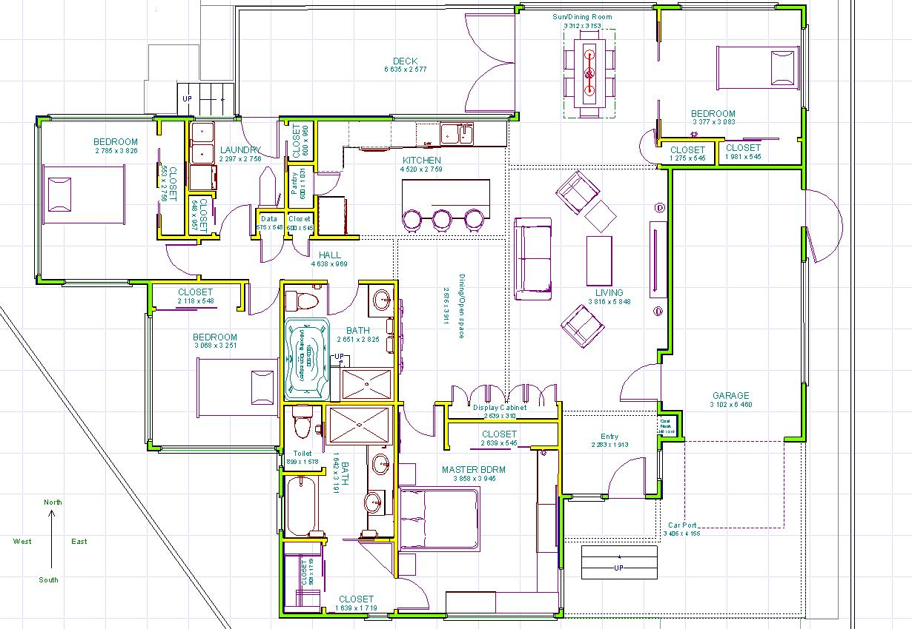
Floor Plans:

Slide 10
Vacation Plans:

Slide 11
Marketing Plans:

Slide 12
Financial Plans:

Slide 13
Business Plans:

Slide 14
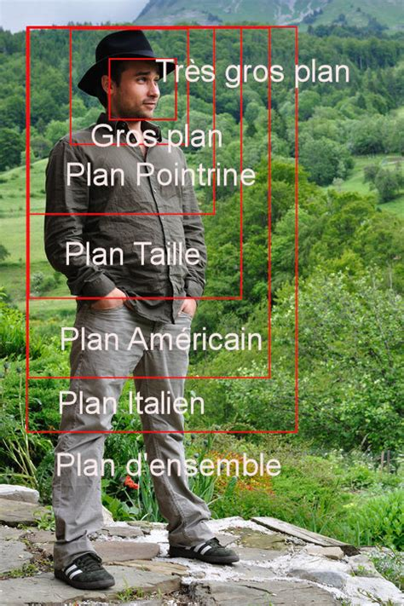
Photographic
Plans:

Slide 15
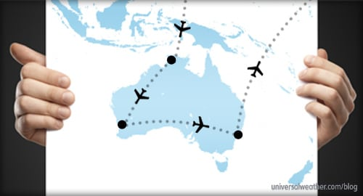
Flight Plans:

Slide 16
Wedding Plans:

Slide 17
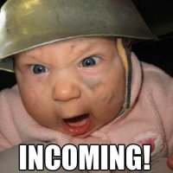
War Plans:

Slide 18
Retirement Plans:

Slide 19
How to build a Rocket Stove Plans:

Slide 20
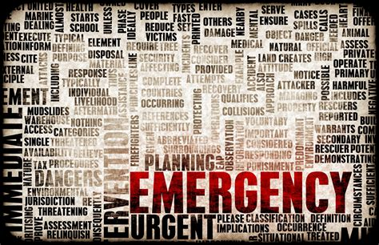
Emergency Plans:

Slide 21
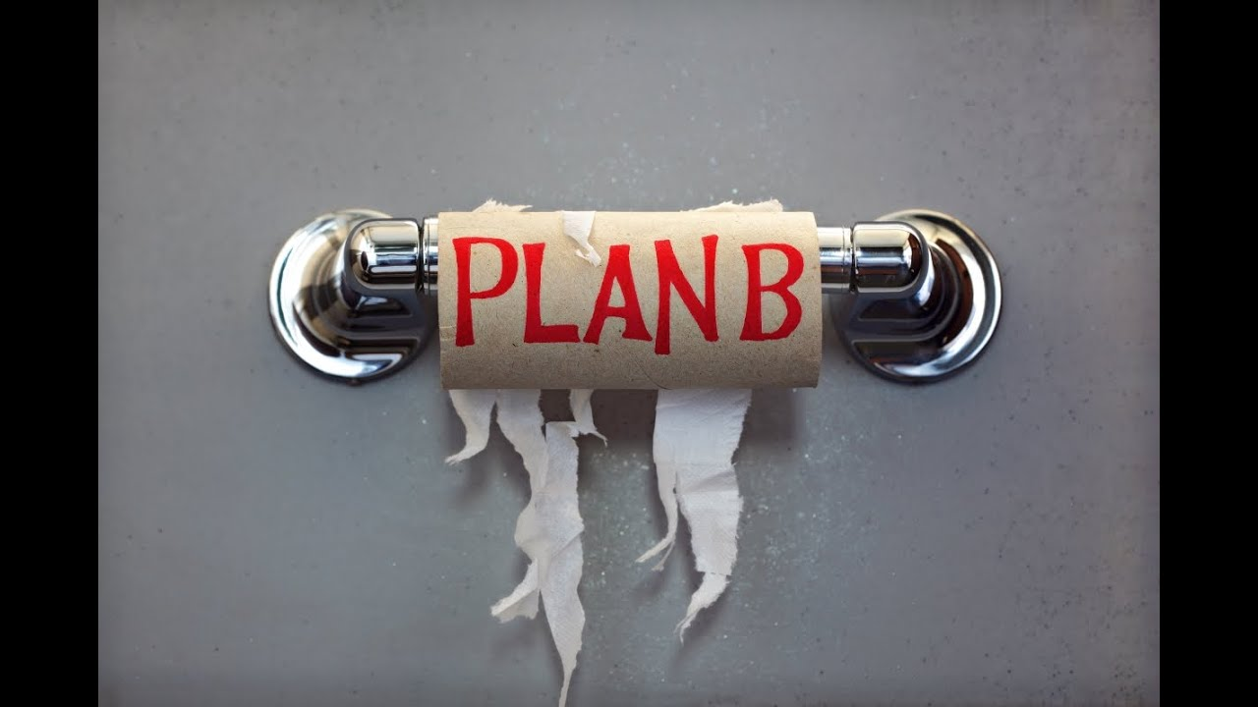
Contingency Plans:

Slide 22
Plans about Plans:

Slide 23
Plans to make Plans:

Slide 24
Well-planned Plans:

Slide 25
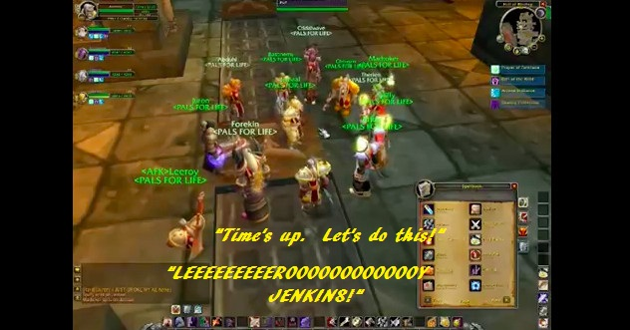
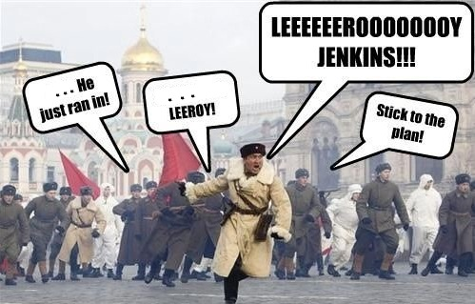
Not so well-planned Plans: (aka Leroy Jenkins):

Slide 26
In case you don’t know what a Leroy Jenkins Plan (iow. A very, very Bad plan) looks like:

Slide 27
Top Secret Plans:

Slide 28
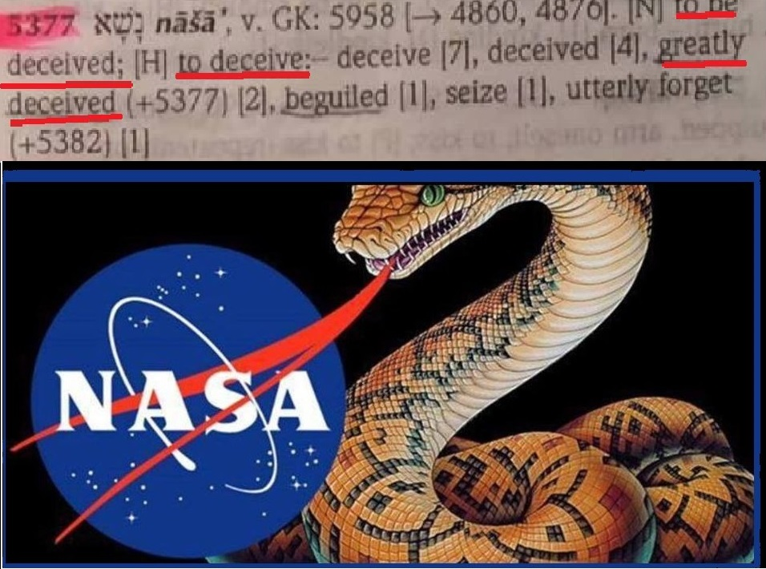
Strong’s H5377 nasa-(Naw-shaw)-type Plans:
“… the woman said, The serpent beguiled me, and I did eat. ” – Genesis 3:13 KJB
Never
Accept
Serpent
Assertions

Slide 29
Planned-demic Plans:

Slide 30
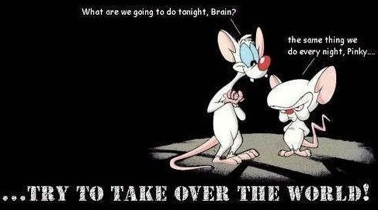
World Domination Plans:

Slide 31
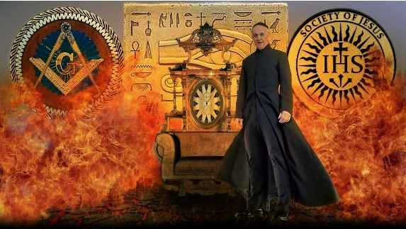
Chiesa del Gesù conspiratorial Plans:

Slide 32
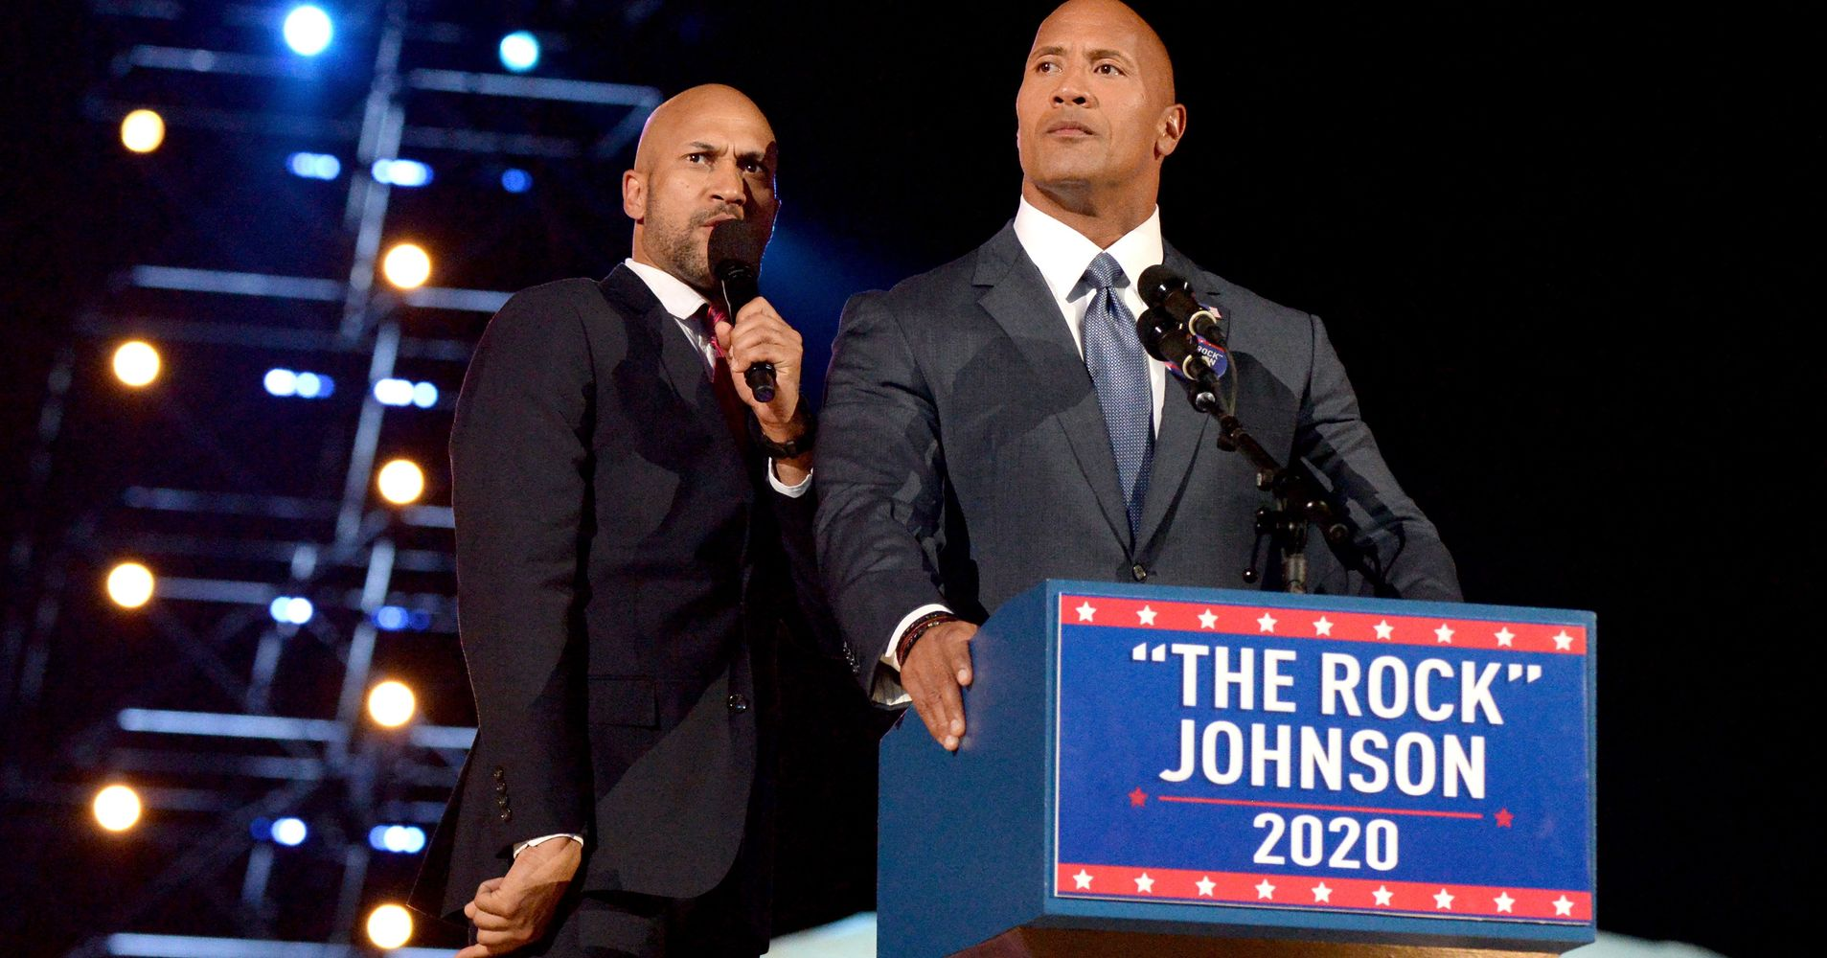
The self-styled “Rock’s” Plans:

Slide 33
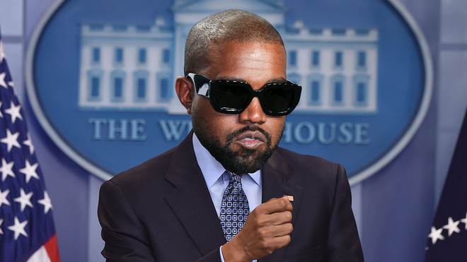
Kanye’s Plans:

Slide 34
Your Plans:

Slide 35
My Plans:

Slide 36
2020 Plans:
2020, a bit different that last year, dontcha’ think?

Slide 37
But, What about God’s Plans?:

Slide 38
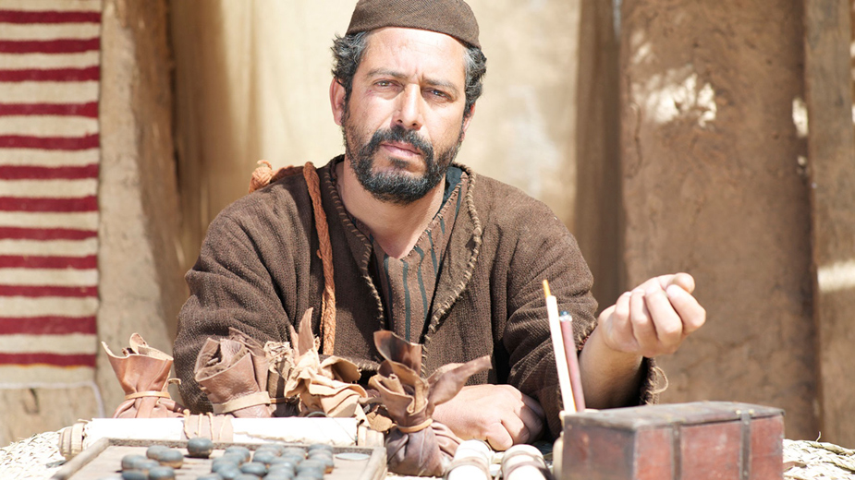
Let’s look at the context of our Scripture Reading, starting with Matthew’s witness:

Slide 39
“No man can serve two masters: for either he will hate the one, and love the other; or else he will hold to the one, and despise the other. Ye cannot serve God and mammon.” – Matthew 6:24 KJB

Slide 40
“Therefore I say unto you, Take no thought for your life, what ye shall eat, or what ye shall drink; nor yet for your body, what ye shall put on. Is not the life more than meat, and the body than raiment?”
– Matthew 6:25 KJB

Slide 41
“Behold the fowls of the air: for they sow not, neither do they reap, nor gather into barns; yet your heavenly Father feedeth them. Are ye not much better than they?”
– Matthew 6:26 KJB

Slide 42
“Which of you by taking thought can add one cubit unto his stature?” – Matthew 6:27 KJB

Slide 43
“And why take ye thought for raiment? Consider the lilies of the field, how they grow; they toil not, neither do they spin:”
– Matthew 6:28 KJB

Slide 44
“And yet I say unto you, That even Solomon in all his glory was not arrayed like one of these.”
– Matthew 6:29 KJB

Slide 45
“Wherefore, if God so clothe the grass of the field, which to day is, and to morrow is cast into the oven, shall he not much more clothe you, O ye of little faith?”
– Matthew 6:30 KJB

Slide 46
“Therefore take no thought, saying, What shall we eat? or, What shall we drink? or, Wherewithal shall we be clothed?” – Matthew 6:31 KJB

Slide 47
“(For after all these things do the Gentiles seek:) for your heavenly Father knoweth that ye have need of all these things.”
– Matthew 6:32 KJB

Slide 48
“But seek ye first the kingdom of God, and his righteousness; and all these things shall be added unto you.” – Matthew 6:33 KJB

Slide 49
“Take therefore no thought for the morrow: for the morrow shall take thought for the things of itself. Sufficient unto the day is the evil thereof.” – Matthew 6:34 KJB

Slide 50
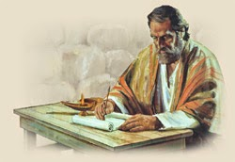
Now, let’s look at Luke’s Testimony:

Slide 51
“So is he that layeth up treasure for himself, and is not rich toward God.” – Luke 12:21 KJB

Slide 52
“And he said unto his disciples, Therefore I say unto you, Take no thought for your life, what ye shall eat; neither for the body, what ye shall put on.” – Luke 12:22 KJB

Slide 53
“The life is more than meat, and the body is more than raiment.”
– Luke 12:23 KJB

Slide 54
“Consider the ravens: for they neither sow nor reap; which neither have storehouse nor barn; and God feedeth them: how much more are ye better than the fowls?” – Luke 12:24 KJB

Slide 55
“And which of you with taking thought can add to his stature one cubit?” – Luke 12:25 KJB

Slide 56
“If ye then be not able to do that thing which is least, why take ye thought for the rest?”
– Luke 12:26 KJB

Slide 57
“Consider the lilies how they grow: they toil not, they spin not; and yet I say unto you, that Solomon in all his glory was not arrayed like one of these.” – Luke 12:27 KJB

Slide 58
“If then God so clothe the grass, which is to day in the field, and to morrow is cast into the oven; how much more will he clothe you, O ye of little faith?” – Luke 12:28 KJB

Slide 59
“And seek not ye what ye shall eat, or what ye shall drink, neither be ye of doubtful mind.”
– Luke 12:29 KJB

Slide 60
“For all these things do the nations of the world seek after: and your Father knoweth that ye have need of these things.” – Luke 12:30 KJB

Slide 61
“But rather seek ye the kingdom of God; and all these things shall be added unto you.” – Luke 12:31 KJB

Slide 62
“Fear not, little flock; for it is your Father's good pleasure to give you the kingdom.” – Luke 12:32 KJB

Slide 63
“Sell that ye have, and give alms; provide yourselves bags which wax not old, a treasure in the heavens that faileth not, where no thief approacheth, neither moth corrupteth.” – Luke 12:33 KJB

Slide 64
“For where your treasure is, there will your heart be also.”
– Luke 12:34 KJB

Slide 65
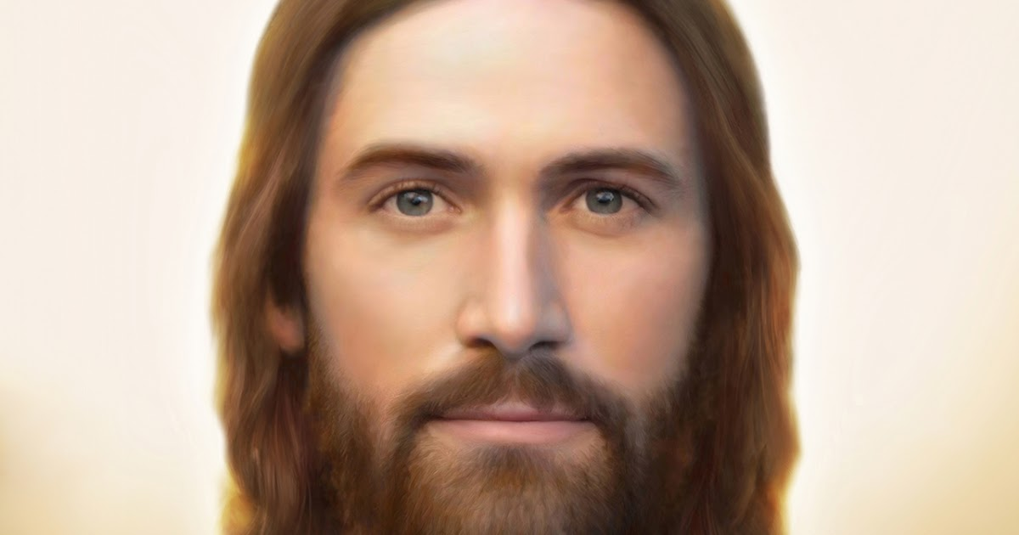
Jesus was talking about the soul (person) sanctuary.

Slide 66
… but let’s consider another sanctuary (Exodus 25, 30 & 33-37), and come back to what Jesus was talking about.

Slide 67
“And the LORD spake unto Moses, saying,” – Exodus 25:1 KJB

Slide 68
“Speak unto the children of Israel, that they bring me an offering: of every man that giveth it willingly with his heart ye shall take my offering.” – Exodus 25:2 KJB

Slide 69
“And this is the offering which ye shall take of them; gold, and silver, and brass,” – Exodus 25:3 KJB

Slide 70
“And blue, and purple, and scarlet, and fine linen, and goats' hair,”
– Exodus 25:4 KJB

Slide 71
“And rams' skins dyed red, and badgers' skins, and shittim wood,” – Exodus 25:5 KJB

Slide 72
“Oil for the light, spices for anointing oil, and for sweet incense,” – Exodus 25:6 KJB

Slide 73
“Onyx stones, and stones to be set in the ephod, and in the breastplate.” – Exodus 25:7 KJB

Slide 74
“And let them make me a sanctuary; that I may dwell among them.” – Exodus 25:8 KJB

Slide 75
“According to all that I shew thee, after the pattern of the tabernacle, and the pattern of all the instruments thereof, even so shall ye make it.” – Exodus 25:9 KJB

Slide 76
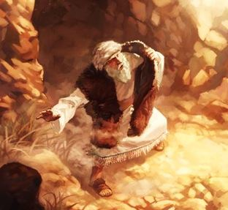
What was that “pattern” (Heavenly “plan”) that Moses was shown?

Slide 77
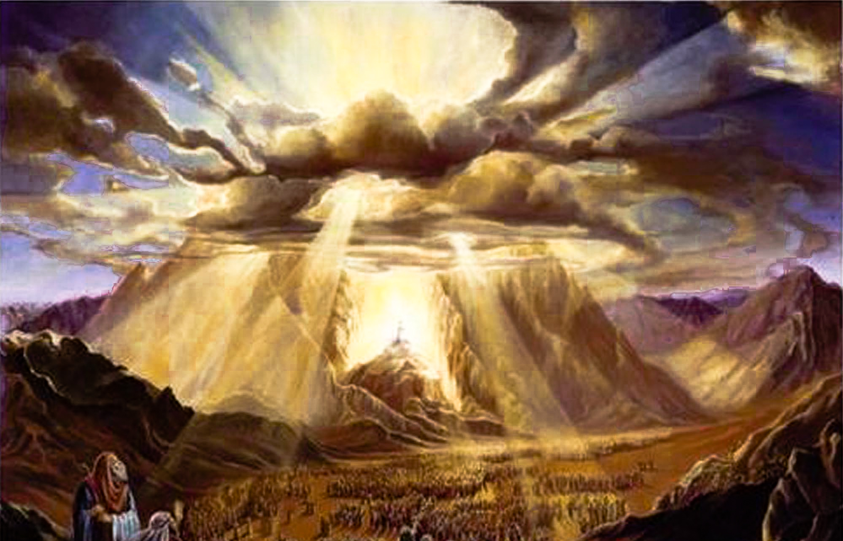
Let’s keep reading:

Slide 78
“And the LORD spake unto Moses, saying,” – Exodus 30:11 KJB

Slide 79
“When thou takest the sum of the children of Israel after their number, then shall they give every man a ransom for his soul unto the LORD, when thou numberest them; that there be no plague among them, when thou numberest them.” – Exodus 30:12 KJB

Slide 80
“This they shall give, every one that passeth among them that are numbered, half a shekel after the shekel of the sanctuary: (a shekel is twenty gerahs:) an half shekel shall be the offering of the LORD.”
– Exodus 30:13 KJB

Slide 81
“Every one that passeth among them that are numbered, from twenty years old and above, shall give an offering unto the LORD.”
– Exodus 30:14 KJB

Slide 82
“The rich shall not give more, and the poor shall not give less than half a shekel, when they give an offering unto the LORD, to make an atonement for your souls.”
– Exodus 30:15 KJB

Slide 83
“And thou shalt take the atonement money of the children of Israel, and shalt appoint it for the service of the tabernacle of the congregation; that it may be a memorial unto the children of Israel before the LORD, to make an atonement for your souls.”
– Exodus 30:16 KJB

Slide 84
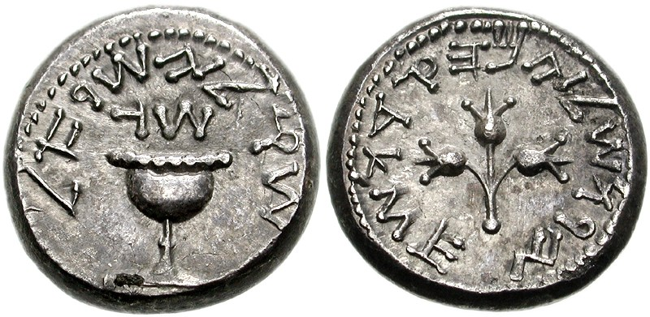
A requirement by God. (Ancient)

Slide 85
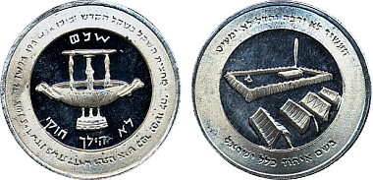
A requirement by God. (Modern)

Slide 86
“And Moses spake unto all the congregation of the children of Israel, saying, This is the thing which the LORD commanded, saying,” – Exodus 35:4 KJB

Slide 87
“Take ye from among you an offering unto the LORD: whosoever is of a willing heart, let him bring it, an offering of the LORD; gold, and silver, and brass,”
– Exodus 35:5 KJB

Slide 88
“And blue, and purple, and scarlet, and fine linen, and goats' hair,”
– Exodus 35:6 KJB

Slide 89
“And rams' skins dyed red, and badgers' skins, and shittim wood,” – Exodus 35:7 KJB

Slide 90
“And oil for the light, and spices for anointing oil, and for the sweet incense,” – Exodus 35:8 KJB

Slide 91
“And onyx stones, and stones to be set for the ephod, and for the breastplate.” – Exodus 35:9 KJB

Slide 92
“And every wise hearted among you shall come, and make all that the LORD hath commanded;”
– Exodus 35:10 KJB

Slide 93
“The tabernacle, his tent, and his covering, his taches, and his boards, his bars, his pillars, and his sockets,” – Exodus 35:11 KJB

Slide 94
“The ark, and the staves thereof, with the mercy seat, and the vail of the covering,” – Exodus 35:12 KJB

Slide 95
“The table, and his staves, and all his vessels, and the shewbread,”
– Exodus 35:13 KJB

Slide 96
“The candlestick also for the light, and his furniture, and his lamps, with the oil for the light,”
– Exodus 35:14 KJB

Slide 97
“And the incense altar, and his staves, and the anointing oil, and the sweet incense, and the hanging for the door at the entering in of the tabernacle,”
– Exodus 35:15 KJB

Slide 98
“The altar of burnt offering, with his brasen grate, his staves, and all his vessels, the laver and his foot,” – Exodus 35:16 KJB

Slide 99
“The hangings of the court, his pillars, and their sockets, and the hanging for the door of the court,” – Exodus 35:17 KJB

Slide 100
“The pins of the tabernacle, and the pins of the court, and their cords,” – Exodus 35:18 KJB

Slide 101
“The cloths of service, to do service in the holy place, the holy garments for Aaron the priest, and the garments of his sons, to minister in the priest's office.”
– Exodus 35:19 KJB

Slide 102
“And all the congregation of the children of Israel departed from the presence of Moses.”
– Exodus 35:20 KJB

Slide 103
“And they came, every one whose heart stirred him up, and every one whom his spirit made willing, and they brought the LORD'S offering to the work of the tabernacle of the congregation, and for all his service, and for the holy garments.” – Exodus 35:21 KJB

Slide 104
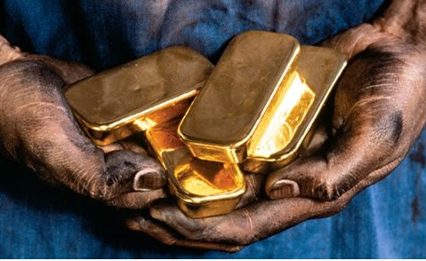
A Freewill offering of faith & love to God our Father in Heaven is GOLDEN.

Slide 105
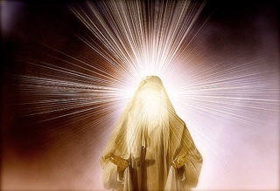
Yet, in between all those things, Moses was shown something greater in connection:

Slide 106
“And Moses said unto the LORD, See, thou sayest unto me, Bring up this people: and thou hast not let me know whom thou wilt send with me. Yet thou hast said, I know thee by name, and thou hast also found grace in my sight.”
– Exodus 33:12 KJB

Slide 107
“Now therefore, I pray thee, if I have found grace in thy sight, shew me now thy way, that I may know thee, that I may find grace in thy sight: and consider that this nation is thy people.” – Exodus 33:13 KJB

Slide 108
“And he said, My presence shall go with thee, and I will give thee rest.” – Exodus 33:14 KJB

Slide 109
“And he said unto him, If thy presence go not with me, carry us not up hence.” – Exodus 33:15 KJB

Slide 110
“For wherein shall it be known here that I and thy people have found grace in thy sight? is it not in that thou goest with us? so shall we be separated, I and thy people, from all the people that are upon the face of the earth.”
– Exodus 33:16 KJB

Slide 111
“And the LORD said unto Moses, I will do this thing also that thou hast spoken: for thou hast found grace in my sight, and I know thee by name.” – Exodus 33:17 KJB

Slide 112
“And he said, I beseech thee, shew me thy glory.” – Exodus 33:18 KJB

Slide 113
“And he said, I will make all my goodness pass before thee, and I will proclaim the name of the LORD before thee; and will be gracious to whom I will be gracious, and will shew mercy on whom I will shew mercy.”
– Exodus 33:19 KJB

Slide 114
“And he said, Thou canst not see my face: for there shall no man see me, and live.” – Exodus 33:20 KJB

Slide 115
“And the LORD said, Behold, there is a place by me, and thou shalt stand upon a rock:”
– Exodus 33:21 KJB

Slide 116
“And it shall come to pass, while my glory passeth by, that I will put thee in a clift of the rock, and will cover thee with my hand while I pass by:” – Exodus 33:22 KJB

Slide 117
“And I will take away mine hand, and thou shalt see my back parts: but my face shall not be seen.”
– Exodus 33:23 KJB

Slide 118
“And the LORD said unto Moses, Hew thee two tables of stone like unto the first: and I will write upon these tables the words that were in the first tables, which thou brakest.” – Exodus 34:1 KJB

Slide 119
“And be ready in the morning, and come up in the morning unto mount Sinai, and present thyself there to me in the top of the mount.” – Exodus 34:2 KJB

Slide 120
“And no man shall come up with thee, neither let any man be seen throughout all the mount; neither let the flocks nor herds feed before that mount.” – Exodus 34:3 KJB

Slide 121
“And he hewed two tables of stone like unto the first; and Moses rose up early in the morning, and went up unto mount Sinai, as the LORD had commanded him, and took in his hand the two tables of stone.”
– Exodus 34:4 KJB

Slide 122
“And the LORD descended in the cloud, and stood with him there, and proclaimed the name of the LORD.” – Exodus 34:5 KJB

Slide 123
“And the LORD passed by before him, and proclaimed, The LORD, The LORD God, merciful and gracious, longsuffering, and abundant in goodness and truth,”
– Exodus 34:6 KJB

Slide 124
“Keeping mercy for thousands, forgiving iniquity and transgression and sin, and that will by no means clear the guilty; visiting the iniquity of the fathers upon the children, and upon the children's children, unto the third and to the fourth generation.” – Exodus 34:7 KJB

Slide 125
“And Moses made haste, and bowed his head toward the earth, and worshipped.”
– Exodus 34:8 KJB

Slide 126
“And he said, If now I have found grace in thy sight, O Lord, let my Lord, I pray thee, go among us; for it is a stiffnecked people; and pardon our iniquity and our sin, and take us for thine inheritance.” – Exodus 34:9 KJB

Slide 127
Did you see what Moses received?

Slide 128
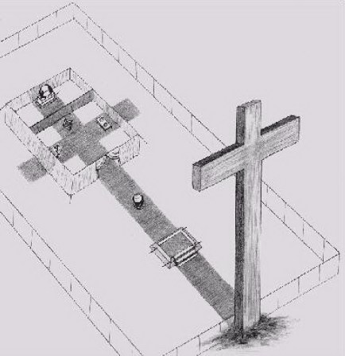
GOD’s PLAN

Slide 129
You might be asking,
“Then why did you title the study”:
“NO PLANS”
???

Slide 130
Do you remember the Scripture Reading and the context?

Slide 131
Consider:
“[Page 208] These adversaries of Christ had no arguments with which to meet the truths He brought home to their consciences. They could only cite their customs and traditions, and these seemed weak and vapid when compared with the arguments Jesus had drawn from the word of God and the unceasing round of nature. Had the rabbis felt any desire to receive light, they would have been convinced that Jesus spoke the truth. …”

Slide 132
“… But they evaded the points He made concerning the Sabbath, and sought to stir up anger against Him because He claimed to be equal with God. The fury of the rulers knew no bounds. Had they not feared the people, the priests and rabbis would have slain Jesus on the spot. But the popular sentiment in His favor was strong. Many recognized in Jesus the friend who had healed their diseases and comforted their sorrows, and they justified His healing of the sufferer at Bethesda. So for the time the leaders were obliged to restrain their hatred. …”

Slide 133
“… Jesus repelled the charge of blasphemy. My authority, He said, for doing the work of which you accuse Me, is that I am the Son of God, one with Him in nature, in will, and in purpose. In all His works of creation and providence, I co-operate with God. “The Son can do nothing of Himself, but what He seeth the Father do.” The priests and rabbis were taking the Son of God to task for the very work He had been sent into the world to do. By their sins they had separated themselves from God, and in their pride were moving independently of Him. …”

Slide 134
“… They felt sufficient in themselves for all things, and realized no need of a higher wisdom to direct their acts. But the Son of God was surrendered to the Father's will, and dependent upon His power. So utterly was Christ emptied of self that He made no plans for Himself. He accepted God's plans for Him, and day by day the Father unfolded His plans. So should we depend upon God, that our lives may be the simple outworking of His will. …”

Slide 135
“… When Moses was about to build the sanctuary as a dwelling place for God, he was directed to make all things according to the pattern shown him in the mount. Moses was full of zeal to do God's work; the most talented, skillful men were at hand to carry out his suggestions. …”

Slide 136
“… Yet he was not to make a bell, a pomegranate, a tassel, a fringe, a curtain, or any vessel of the sanctuary, except according to the pattern shown him. God called him into the mount, and revealed to him the heavenly things. The Lord covered him with His own glory, that he might see[Page 208-209]the pattern, and according to it all things were made. So to Israel, whom He desired to make His dwelling place, He had revealed His glorious ideal of character. …”

Slide 137
“... The pattern was shown them in the mount when the law was given from Sinai, and when the Lord passed by before Moses and proclaimed, “The Lord, The Lord God, merciful and gracious, long-suffering, and abundant in goodness and truth, keeping mercy for thousands, forgiving iniquity and transgression and sin.” Exodus 34:6,7 …”

Slide 138
“… Israel had chosen their own ways. They had not builded according to the pattern; but Christ, the true temple for God's indwelling, molded every detail of His earthly life in harmony with God's ideal. He said, “I delight to do Thy will, O My God: yea, Thy law is within My heart.” Psalm 40:8. So our characters are to be builded “for an habitation of God through the Spirit.” Ephesians 2:22. And we are to “make all things according to the pattern,” even Him who “suffered for us, leaving us an example, that ye should follow His steps.” Hebrews 8:5; 1 Peter 2:21. …”

Slide 139
“… The words of Christ teach that we should regard ourselves as inseparably bound to our Father in heaven. Whatever our position, we are dependent upon God, who holds all destinies in His hands. He has appointed us our work, and has endowed us with faculties and means for that work. So long as we surrender the will to God, and trust in His strength and wisdom, we shall be guided in safe paths, to fulfill our appointed part in His great plan. …”

Slide 140
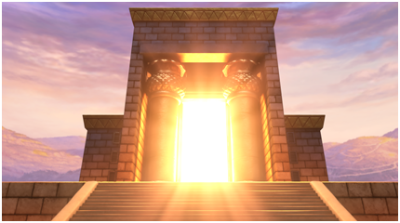
The Sanctuary points to the Father, through Christ.

Slide 141
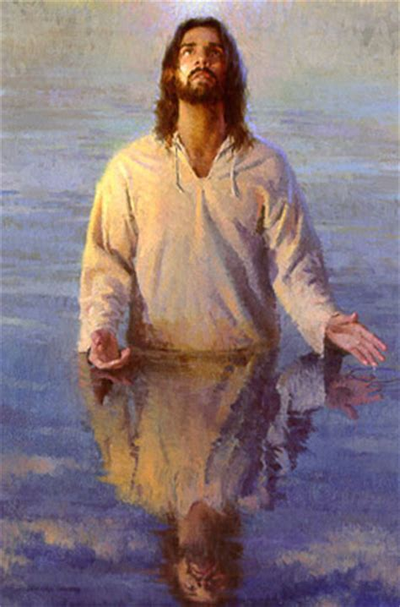
It was the Father which gave the Lamb:
“For God so loved the world, that he gave his only begotten Son, that whosoever believeth in him should not perish, but have everlasting life.”
– John 3:16 KJB

Slide 142
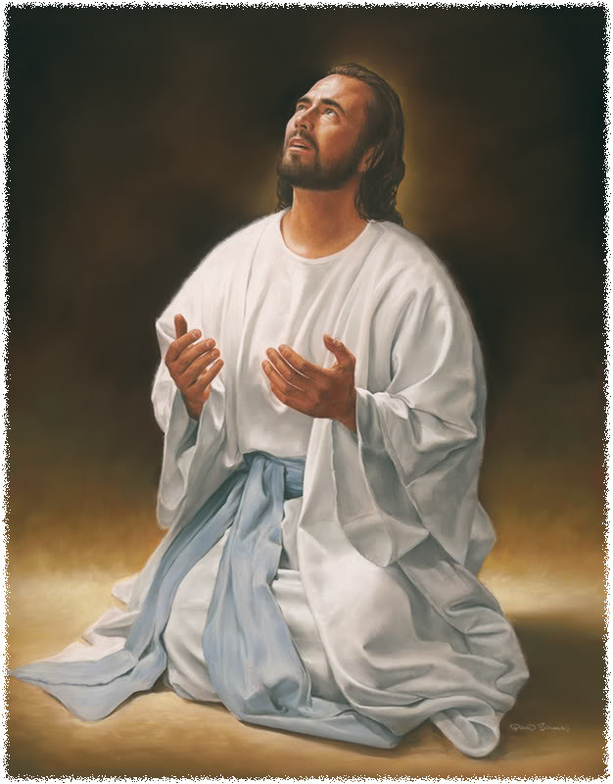
It was the Father which gave the Light:
“… for the Lord God giveth them light …” – Revelation 22:5 KJB
“… the Lamb is the light thereof …”
– Revelation 21:23 KJB

Slide 143
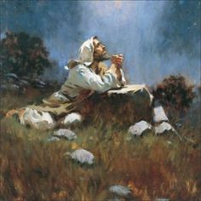
It was the Father which Sacrificed:
“For unto us a child is born, unto us a son is given …”
– Isaiah 9:6 KJB

Slide 144
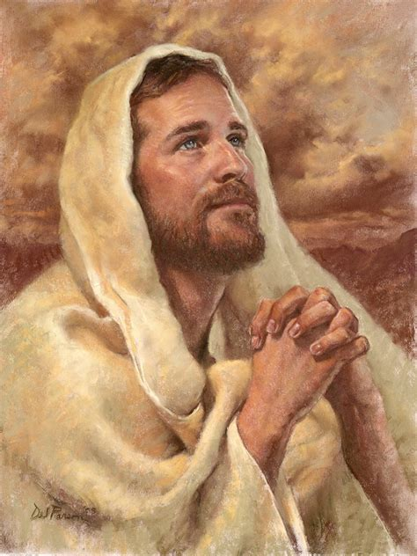
It was the Father which provided Bread:
“… Jesus said, … my Father giveth you the true bread from heaven.”
– John 6:32 KJB

Slide 145
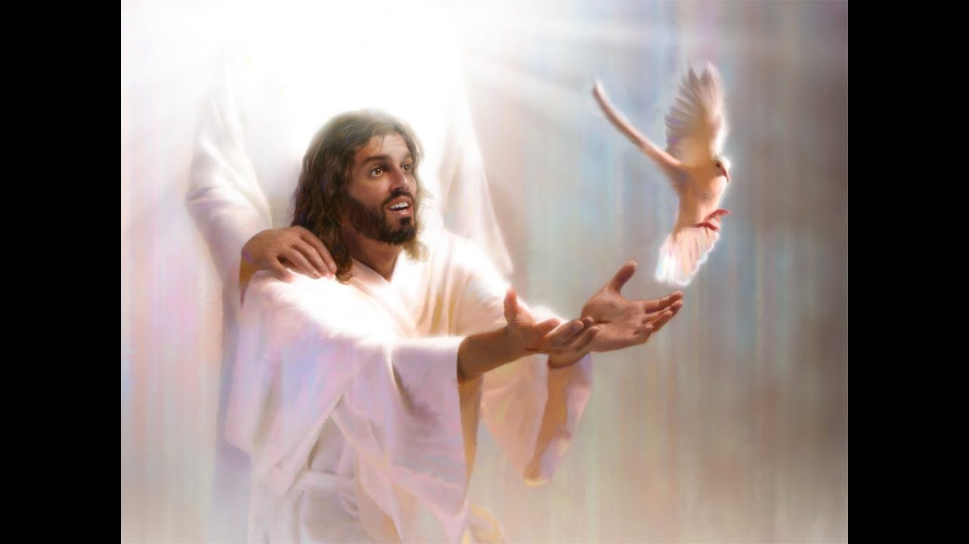
It was the Father which Washed & Clothes us:
“… but ye are washed … in the name of the Lord Jesus, and by the Spirit of our God …” – 1 Corinthians 6:11 KJB

Slide 146
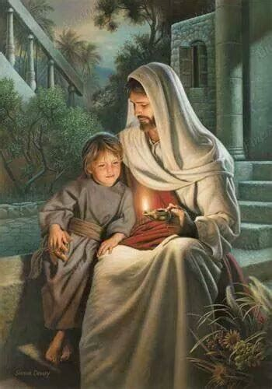
It was the Father which provided/planned for everything:
“Fear not, little flock; for it is your Father's good pleasure to give you the kingdom.”
– Luke 12:32 KJB

Slide 147
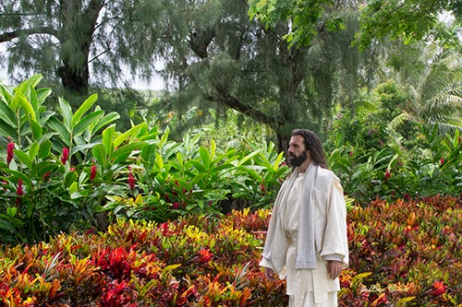
God says, “THIS IS MY PLAN, FOR YOU.”

Slide 148
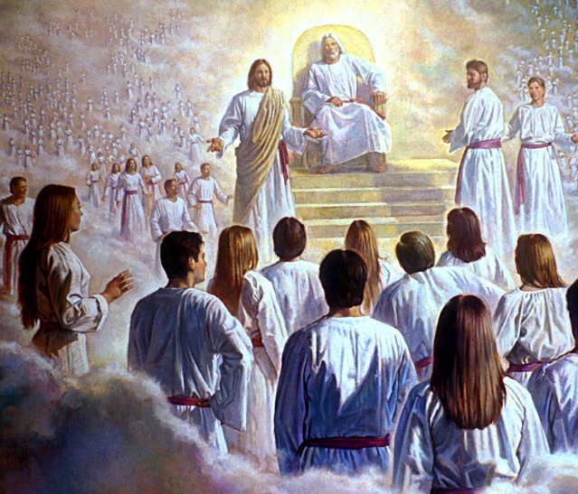
The entire life of Jesus, points to the Father.

Slide 149
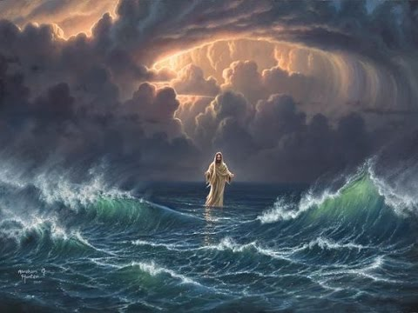
All that Jesus ever did, was to show us the love of the Father.

Slide 150
All that Jesus ever did, was to show us the love of the Father.
“Then said Jesus unto them, When ye have lifted up the Son of man, then shall ye know that I am he, and that I do nothing of myself; but as my Father hath taught me, I speak these things.” – John 8:28 KJB

Slide 151
All that Jesus ever did, was to show us the love of the Father.
“I can of mine own self do nothing: as I hear, I judge: and my judgment is just; because I seek not mine own will, but the will of the Father which hath sent me.” – John 5:30 KJB

Slide 152
All that Jesus ever did, was to show us the love of the Father.
“Then said I, Lo, I come: in the volume of the book it is written of me,” – Psalms 40:7 KJB
“I delight to do thy will, O my God: yea, thy law is within my heart.” – Psalms 40:8 KJB

Slide 153
All that Jesus ever did, was to show us the love of the Father.
“Thy kingdom come. Thy will be done in earth, as it is in heaven.” – Matthew 6:10 KJB

Slide 154
All that Jesus ever did, was to show us the love of the Father.
“… nevertheless not my will, but thine, be done.” – Luke 22:42 KJB
“… O my Father, if this cup may not pass away from me, except I drink it, thy will be done.”
– Matthew 26:42 KJB

Slide 155
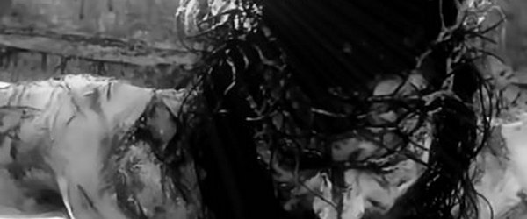
Jesus, at Calvary – The Place of the Skull
Jesus showed where His Head (Skull) Heart really and always was – Upon His Father’s Plan, the Father’s Will.

Slide 156
Yet, where is our Heart, our Head, the place of our Skull?
“I know thy works, that thou art neither cold nor hot: I would thou wert cold or hot.”
– Revelation 3:15 KJB

Slide 157
“… But the one who depends upon his own wisdom and power is separating himself from God. Instead of working in unison with Christ, he is fulfilling the purpose of the enemy of God and man. …” – The Desire Of Ages, Pages 208-209, Ellen G. White

Slide 158
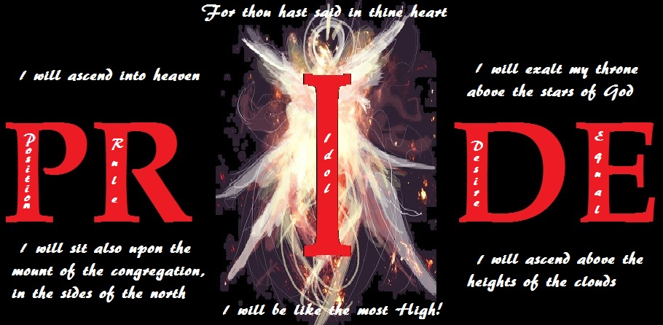
MY PLANS
Are really “I” Plans.

Slide 159
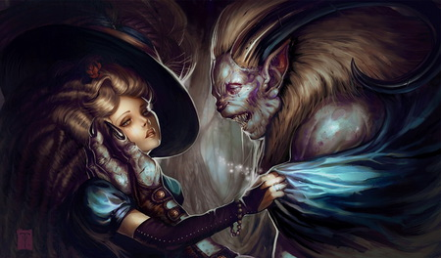
“I” plans … “My” plans …
… for MARRIAGE.

Slide 160
“I” plans … “My” plans …
… for dealing with people that are mean to me.

Slide 161
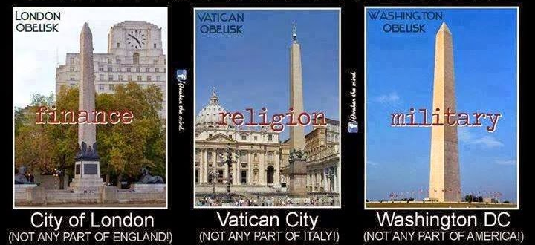
“I” plans … “My” plans …
… for how I manage my finances, religion and social (foreign & domestic policies) life
(are we giving the ‘finger’ to God?).

Slide 162
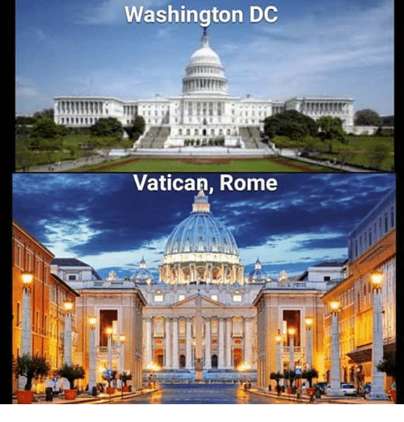
“I” plans … “My” plans …
… for how I manage my home.

Slide 163
“I” plans … “My” plans …
… for who I associate with and listen to
(or befriend, or talk to, or have social distance with).

Slide 164
“I” plans … “My” plans …
… for what I see and watch.

Slide 165
“I” plans … “My” plans …
… for what I eat.

Slide 166
“I” plans … “My” plans …
… and eat …

Slide 167
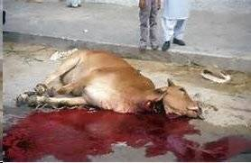
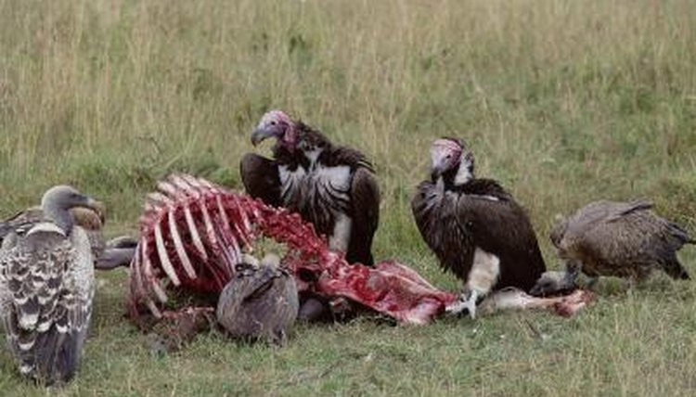
“I” plans … “My” plans …
… and eat …

Slide 168
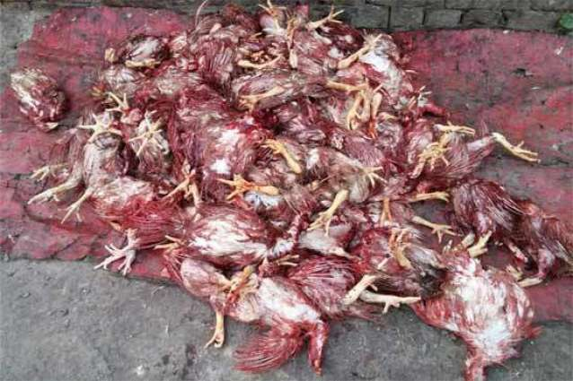
“I” plans … “My” plans …
… and eat …

Slide 169
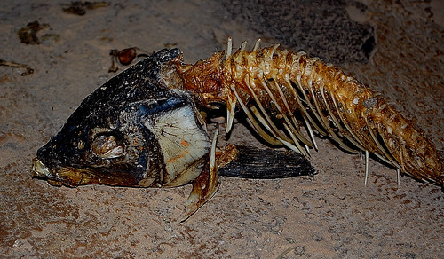
“I” plans … “My” plans …
… and eat …

Slide 170
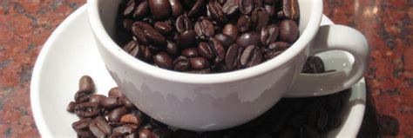
“I” plans … “My” plans …
… and drink …

Slide 171
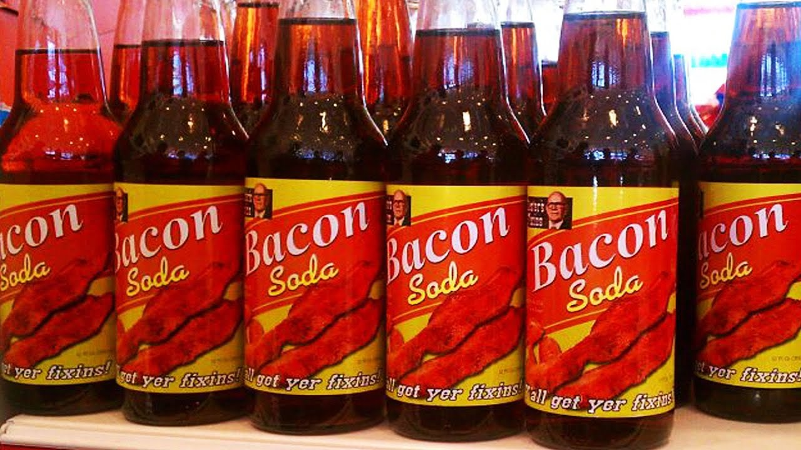
“I” plans … “My” plans …
… and drink …

Slide 172
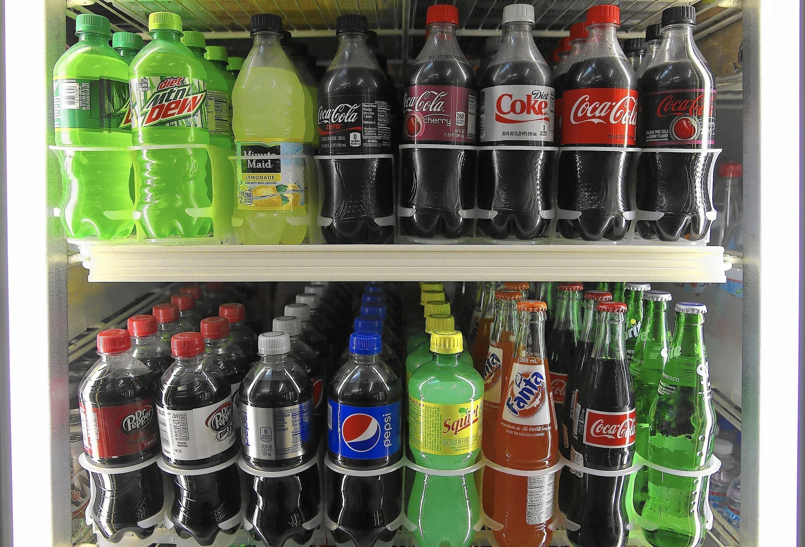
“I” plans … “My” plans …
… and drink …

Slide 173
“I” plans … “My” plans …
… and drink …

Slide 174
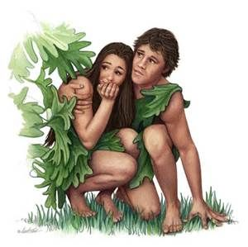
“I” plans … “My” plans …
… for how I dress.

Slide 175
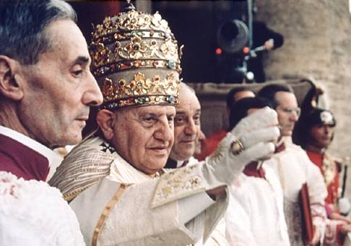
“I” plans … “My” plans …
… for how I worship.

Slide 176
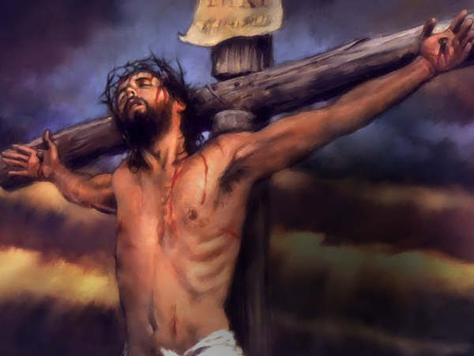
We have to decide! (Now, Today) You & I must choose, either to do God’s will and glorify Him, with “Thy Plans” O LORD, having “No Plans” of our own wills …
… or we choose to have our own ways, our own plans, those “My Plans” which are only “I” Plans exclusive of God’s Plans … it CANNOT BE BOTH!!!

Slide 177
By God’s grace and Holy Spirit, let’s overcome our plans, and stick with God’s plans…
“He that overcometh, the same shall be clothed in white raiment; and I will not blot out his name out of the book of life, but I will confess his name before my Father, and before his angels.”
– Revelation 3:5 KJB

Slide 178
O LORD, have mercy upon me a sinner …
… and teach me to say by my very life,
“Thy Will [thy Plan] be done …”

