Slide 1
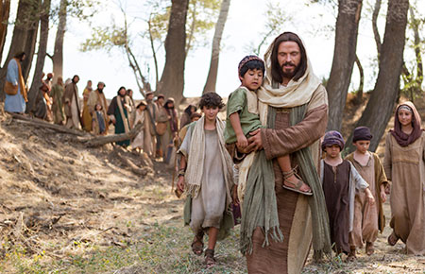
DISCIPLES
FOR JESUS

Slide 2
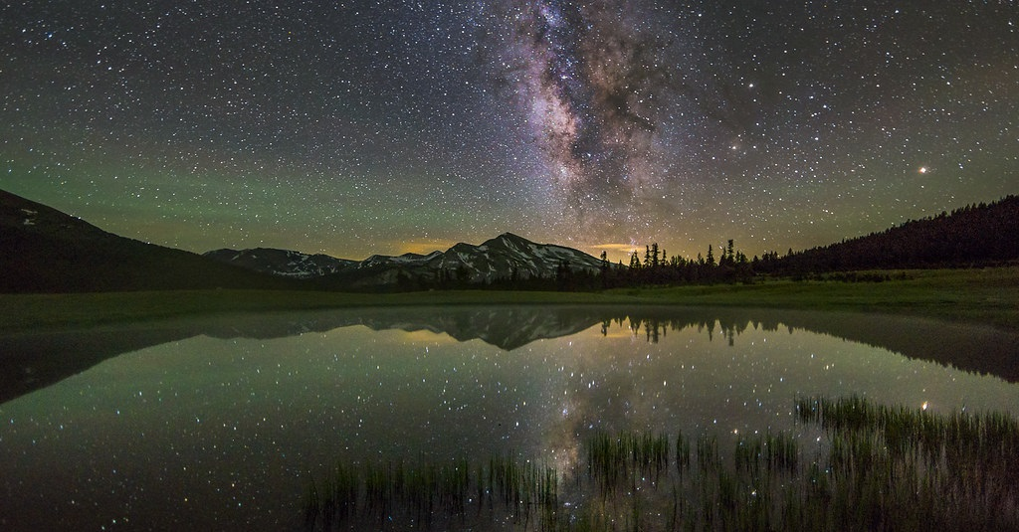
WELCOME, GOOD EVENING
CHILDREN’S CAMP VESPERS

Slide 3
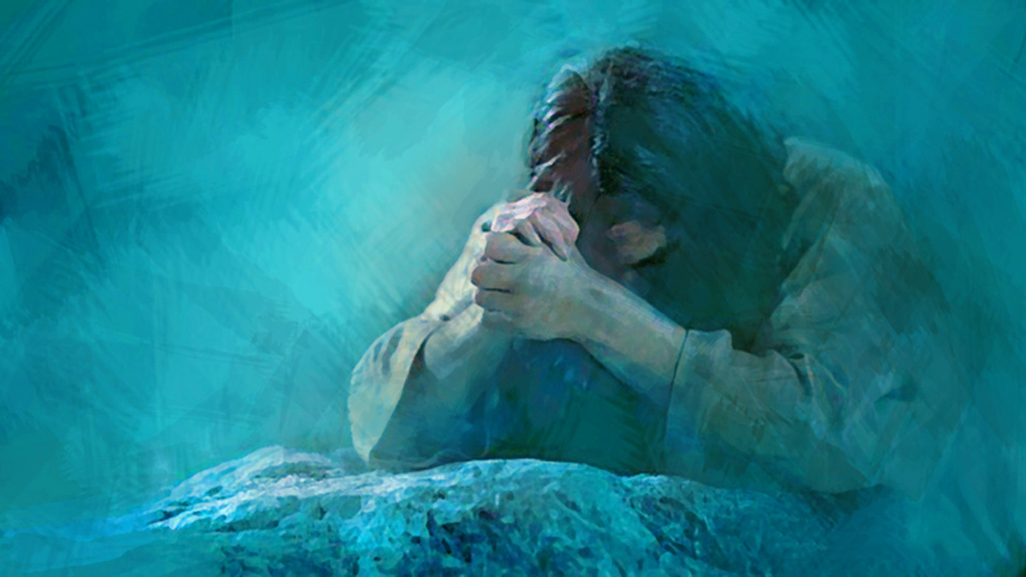
OPENING
PRAYER

Slide 4
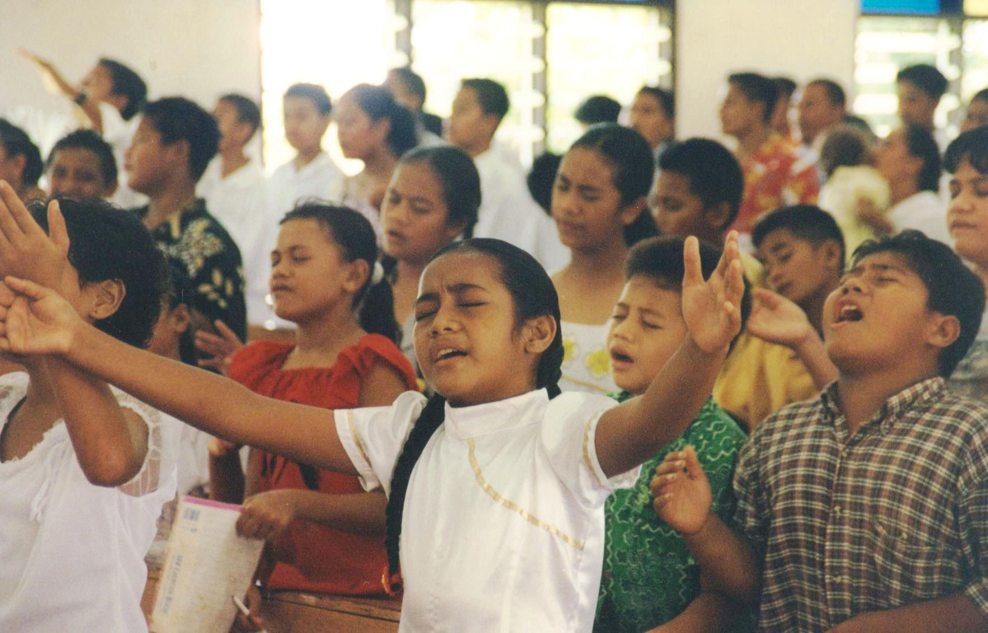
SONG
SERVICE

Slide 5
580. This Little Light Of Mine
[1A]
This little light of mine,
I’m going to let it shine, (shine)
This little light of mine,
I’m going to let it shine, (shine)

Slide 6
580. This Little Light Of Mine
[1B]
This little light of mine,
I’m going to let it shine, Let it shine,
let it shine,
let it shine.

Slide 7
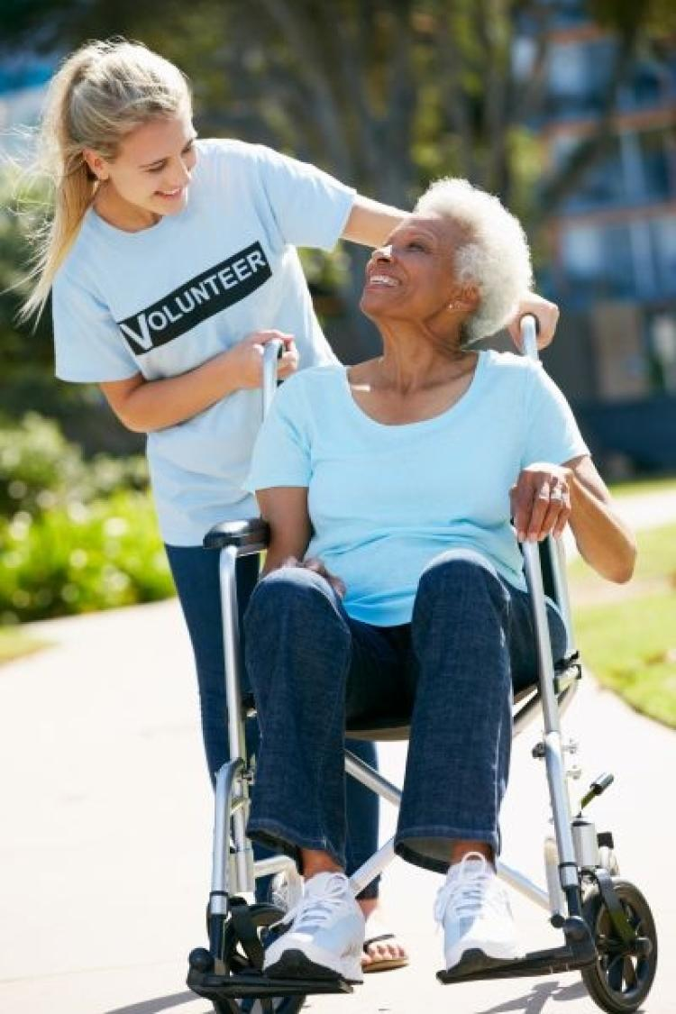
580. This Little Light Of Mine
[2A]
Every where I go, I’m going to let it shine, (shine) Every where I go, I’m going to let it shine, (shine)

Slide 8
580. This Little Light Of Mine
[2B]
Every where I go,
I’m going to let it shine, Let it shine, let it shine, let it shine.

Slide 9
580. This Little Light Of Mine
[3A]
All through the night,
I’m going to let it shine, (shine) All through the night,
I’m going to let it shine, (shine)

Slide 10
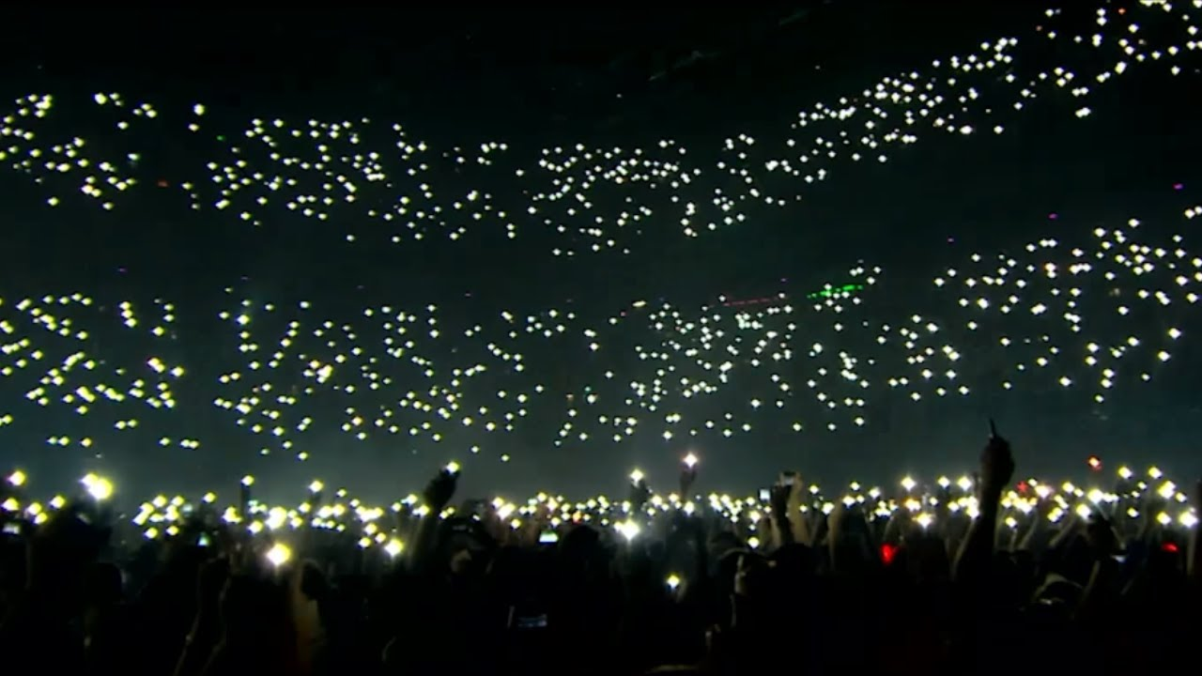
580. This Little Light Of Mine
[3B]
All through the night,
I’m going to let it shine, Let it shine, let it shine, let it shine.

Slide 11
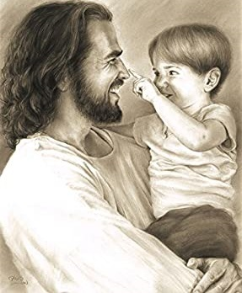
Where Could I Go, But To The LORD
[1]
Living below,
in this old sinful world.
Hardly a comfort can afford
Striving alone
to face temptation’s sword
Where could I go,
but to the LORD

Slide 12
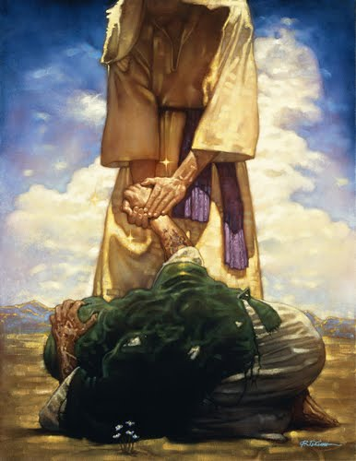
Where Could I Go, But To The LORD
[Chorus]
Where could I go,
Oh, where could I go,
Seeking a refuge
for my soul,
Needing a friend
To help me in the end,
Where could I go,
but to the LORD

Slide 13
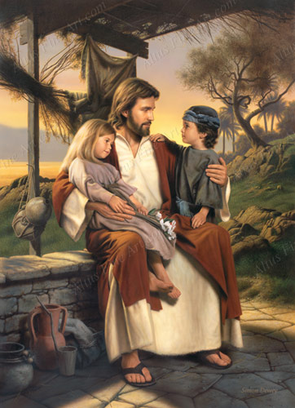
Where Could I Go, But To The LORD
[2]
Neighbours are kind,
I love them – everyone,
We get along
in sweet accord,
But when my soul
Needs Manna from above,
Where could I go,
but to the LORD

Slide 14
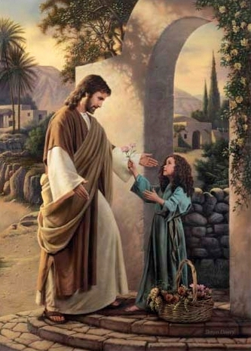
Where Could I Go, But To The LORD
[Chorus]
Where could I go,
Oh, where could I go,
Seeking a refuge
for my soul,
Needing a friend
To help me in the end,
Where could I go,
but to the LORD

Slide 15
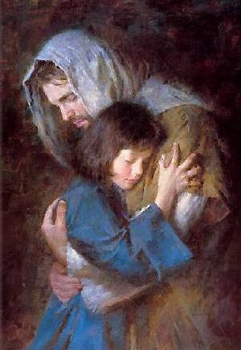
Where Could I Go, But To The LORD
[3]
Life here is grand,
With friends I love so dear,
Comfort, I get
From God’s own word,
But when I face
this chilling hand of death,
Where could I go,
but to the LORD

Slide 16
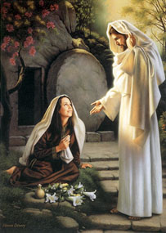
Where Could I Go, But To The LORD
[Chorus]
Where could I go,
Oh, where could I go,
Seeking a refuge
for my soul,
Needing a friend
To help me in the end,
Where could I go,
but to the LORD

Slide 17
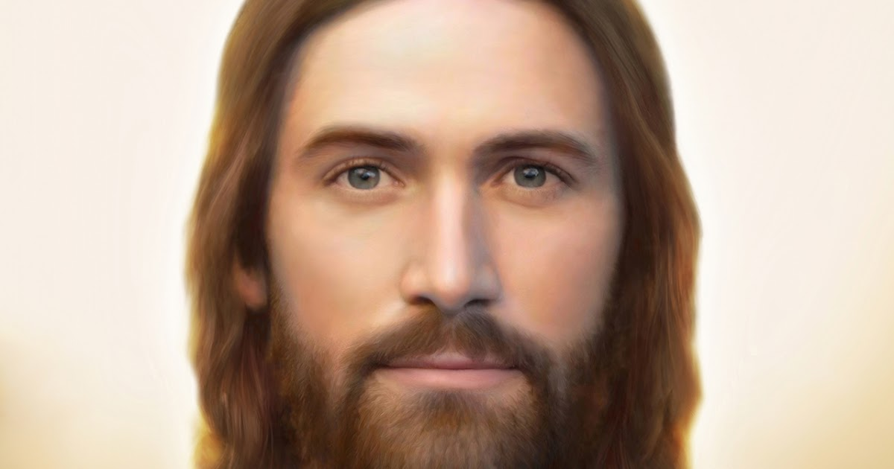
Where Could I Go, But To The LORD
[Finale]
Where could I go, but to the LORD!

Slide 18
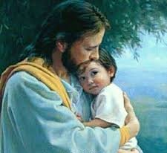
190 - Jesus Loves Me
[1]
Jesus loves me!
this I know, For the Bible
tells me so; Little ones
to Him belong They are weak
but He is strong

Slide 19
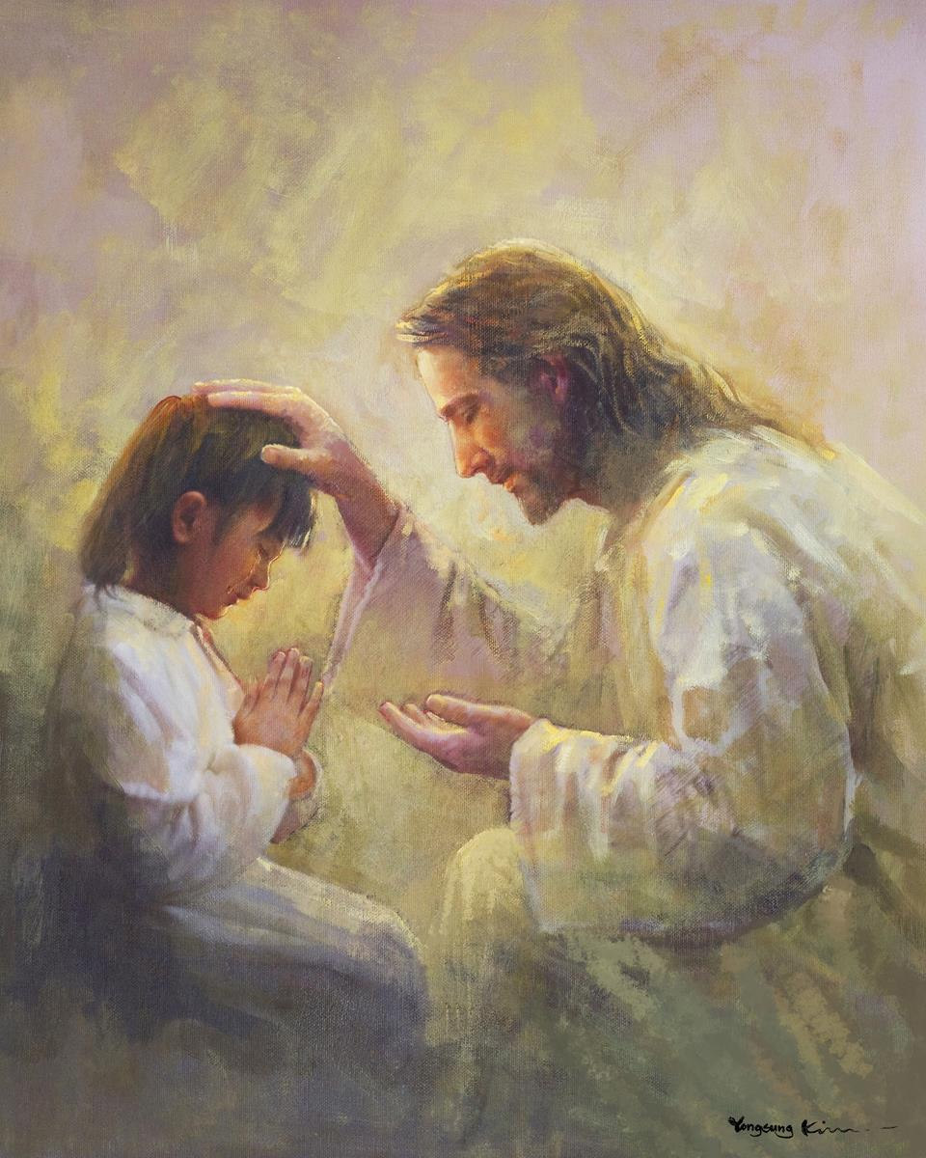
190 - Jesus Loves Me
[Refrain]
Yes,
Jesus loves me! Yes,
Jesus loves me! Yes,
Jesus loves me! The Bible
tells me so.

Slide 20
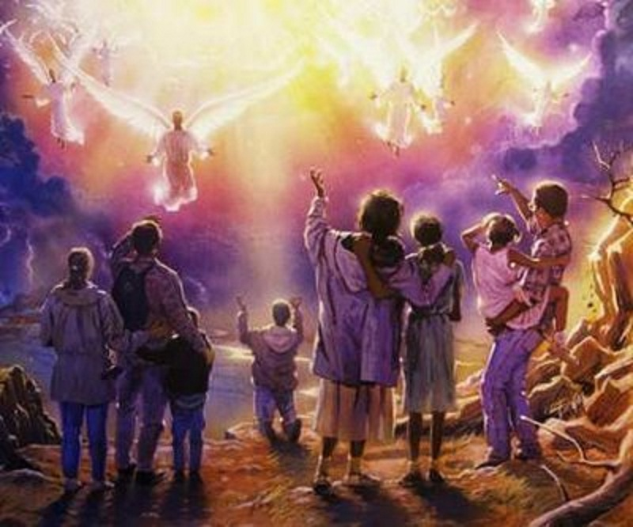
190 - Jesus Loves Me
[2]
Jesus loves me!
He who died Heaven’s gate
to open wide: He will wash
away my sin, Let His little
child come in.

Slide 21
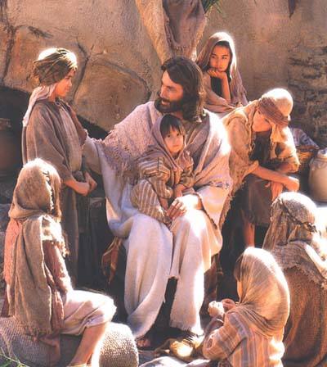
190 - Jesus Loves Me
[Refrain]
Yes,
Jesus loves me! Yes,
Jesus loves me! Yes,
Jesus loves me! The Bible
tells me so.

Slide 22
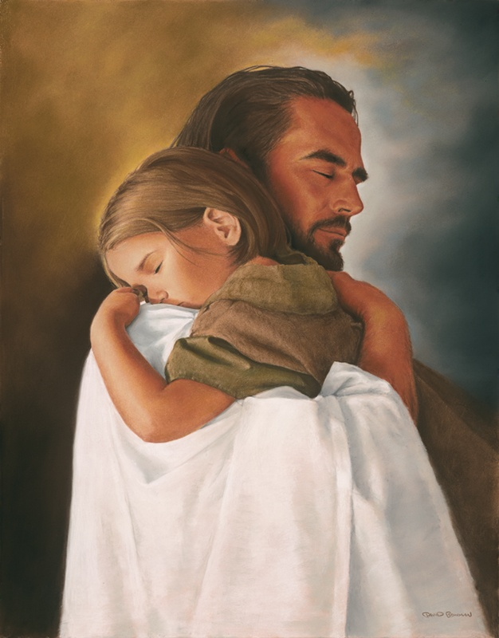
190 - Jesus Loves Me
[3]
Jesus, take this
heart of mine, Make it pure
and wholly thine; On the cross
You died for me, I will love
and live for Thee.

Slide 23
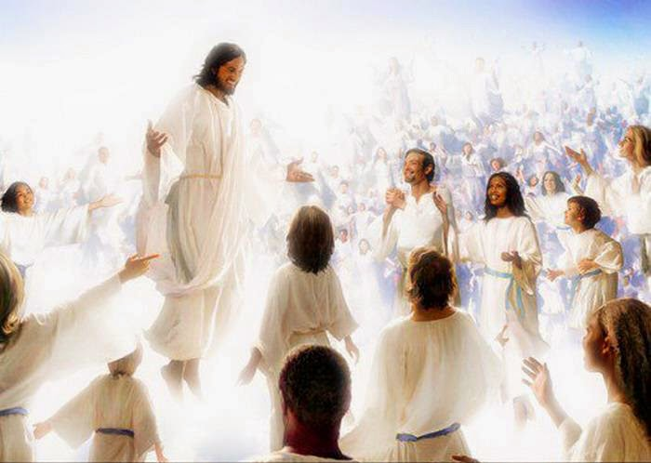
190 - Jesus Loves Me
[Refrain]
Yes,
Jesus loves me! Yes,
Jesus loves me! Yes,
Jesus loves me! The Bible
tells me so.

Slide 24
OPENING SONG
PLEASE STAND

Slide 25
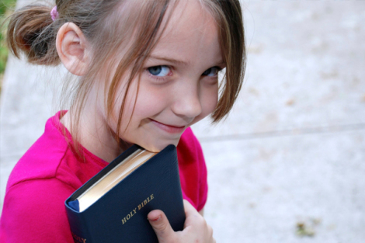
We Are His Hands
[1]
We are his hands to touch the world around us We are His feet to go where He may lead. And we are His love burning in the darkness, We are his love shining in the night

Slide 26
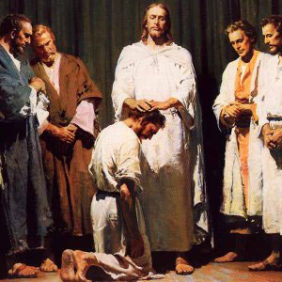
We Are His Hands
[2]
We are His eyes to see the need in others We are His voice to tell of His return, And we are His love burning in the darkness, We are His love shining in the night.

Slide 27
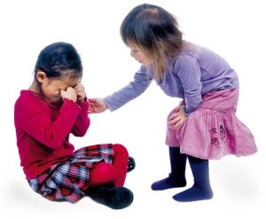
We Are His Hands
[3]
We are his hands to touch the world around us We are His feet to go where He may lead. And we are His love burning in the darkness, We are his love shining in the night

Slide 28
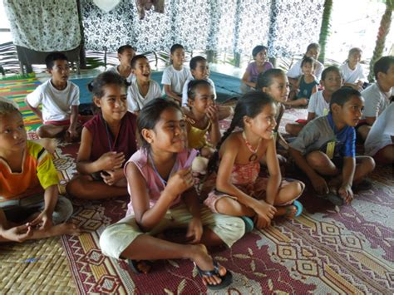
PLEASE BE
SEATED

Slide 29
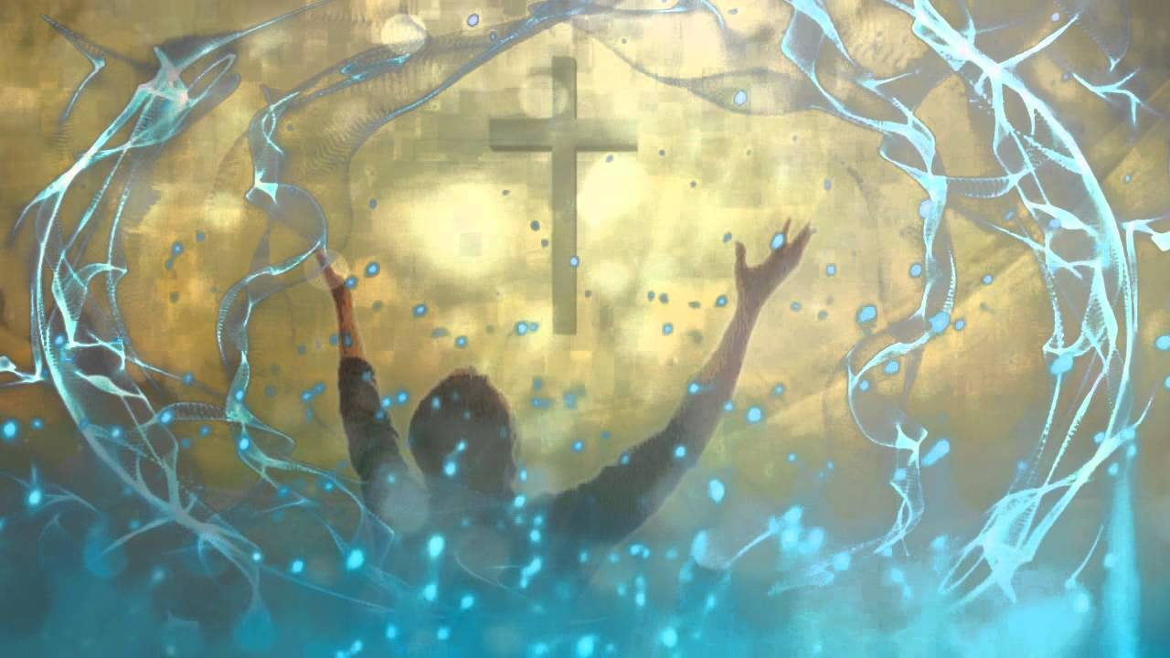
SPECIAL MUSIC
MINISTRY

Slide 30
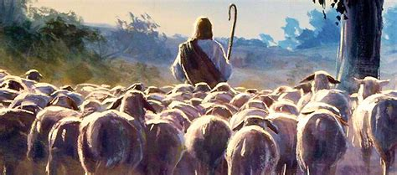
Follow the Leader [Jesus]
http://www.pearltrees.com/awhn

Slide 31
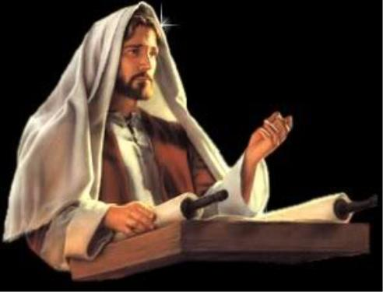
Follow the Leader [Jesus]
“[Jesus] … stood up for to read.” – Luke 4:16 KJB, let’s all stand.

Slide 32
Scripture Reading: Luke 9:23 KJB
“And he [Jesus] said to them all, If any man will come after me, let him deny himself, and take up his cross daily, and follow me.” – Luke 9:23 KJB

Slide 33
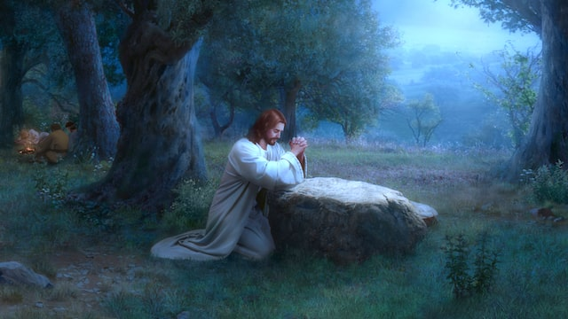
Follow the Leader [Jesus]
Jesus “kneeled down” [Luke 22:41 KJB] for prayer … let’s all (who are able to) kneel.

Slide 34
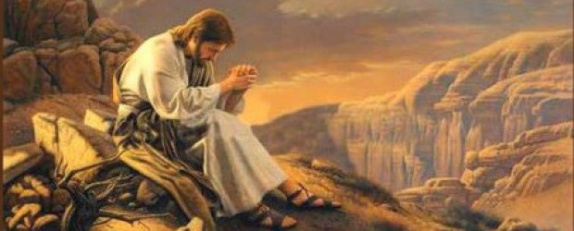
Follow the Leader [Jesus]
Jesus “prayed” [Mark 1:35 KJB] … let’s pray.

Slide 35
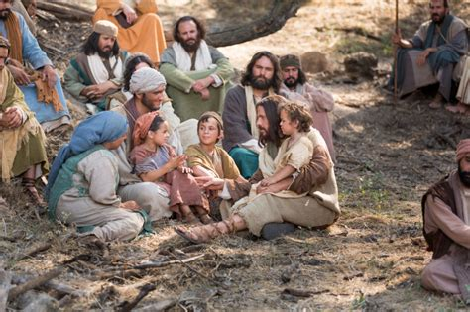
Follow the Leader [Jesus]
Jesus “sat down” [John 8:42 KJB] … let’s sit.

Slide 36
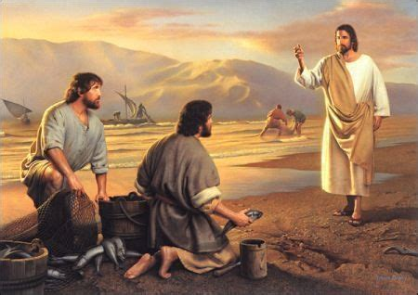
“And Jesus, walking by the sea of Galilee, saw two brethren, Simon called Peter, and Andrew his brother, casting a net into the sea: for they were fishers.” – Matthew 4:18 KJB

Slide 37
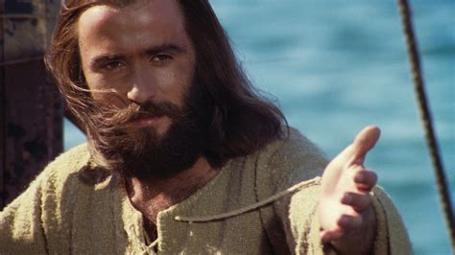
Follow the Leader [Jesus]
What did Jesus say to Peter and Andrew? Who knows? (Raise your hand.)

Slide 38
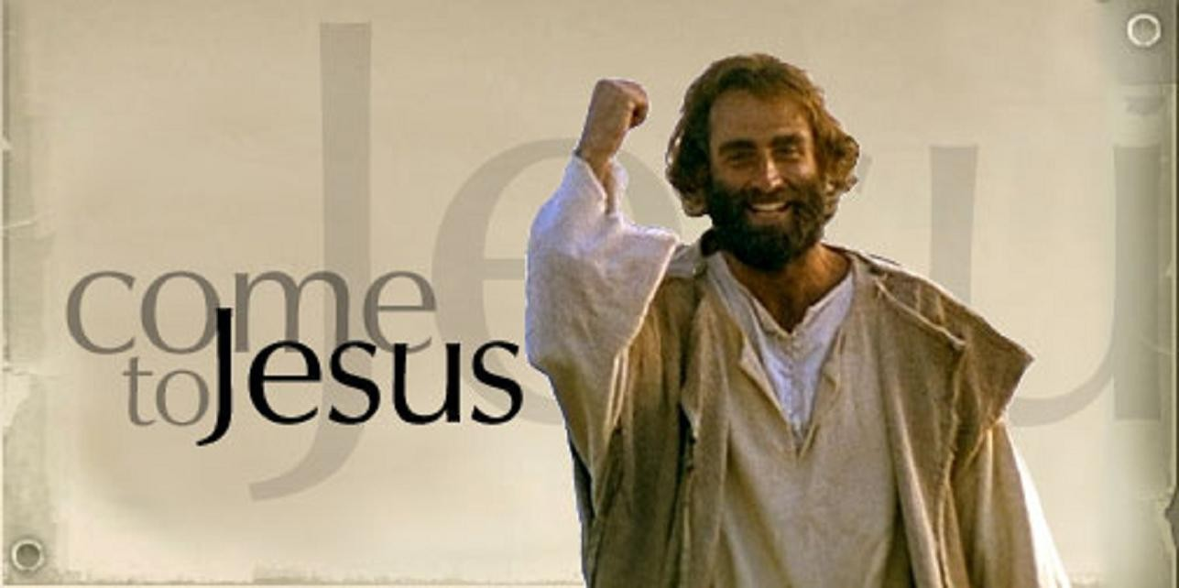
Follow the Leader [Jesus]
“And he saith unto them, Follow me, and I will make you fishers of men.” – Matthew 4:19 KJB

Slide 39
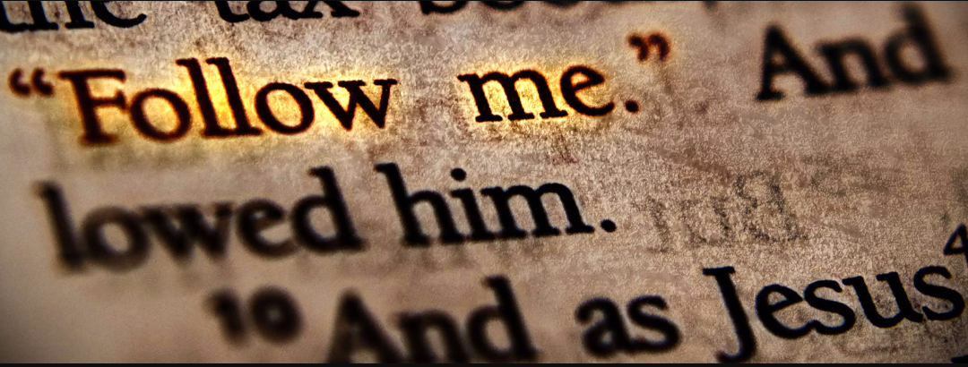
Follow the Leader [Jesus]
“For even hereunto were ye called: because Christ also suffered for us, leaving us an example, that ye should follow his steps:”
– 1 Peter 2:21 KJB

Slide 40
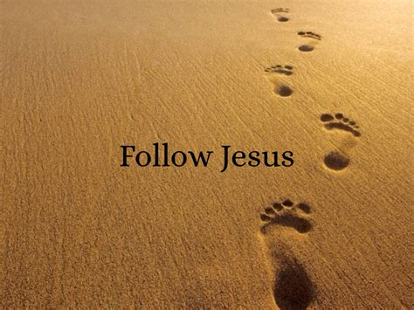
Follow the Leader [Jesus]
What do we need to do?
(all together!)

Slide 41
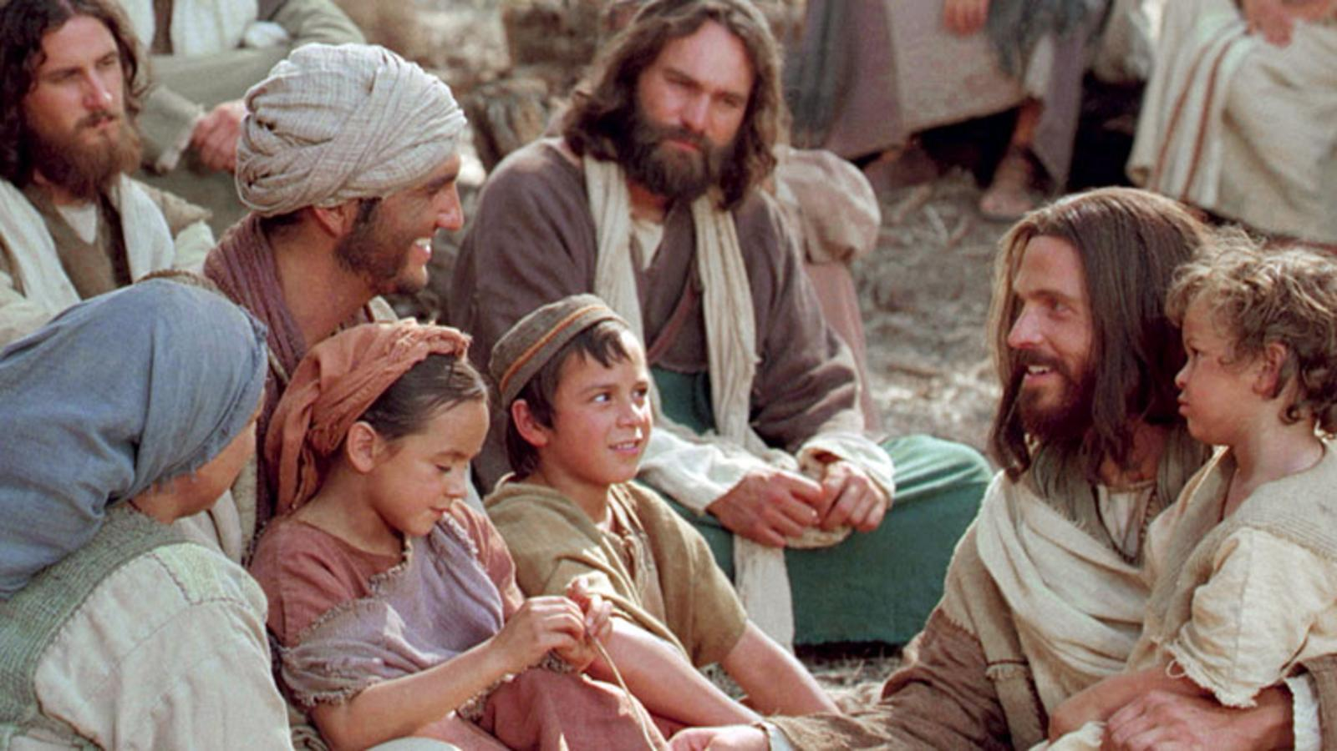
Follow the Leader [Jesus]
Let’s think about some things Jesus did!

Slide 42
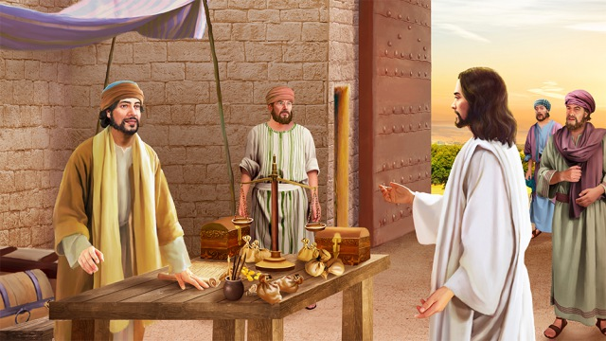
Follow the Leader [Jesus]
Jesus, while walking some more, and visiting people, saw another man at work, who was it? Who knows?
(Raise your hand.)

Slide 43
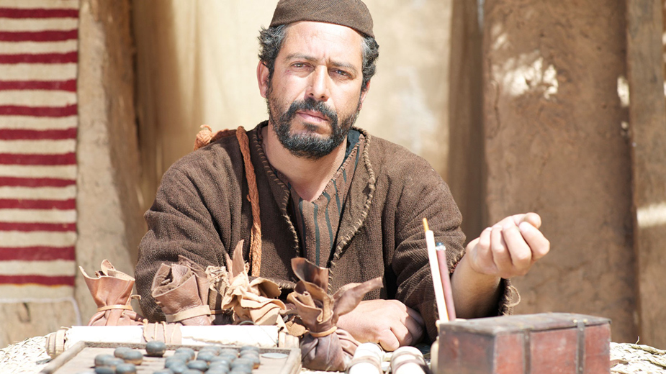
Follow the Leader [Jesus]
Matthew Levi

Slide 44
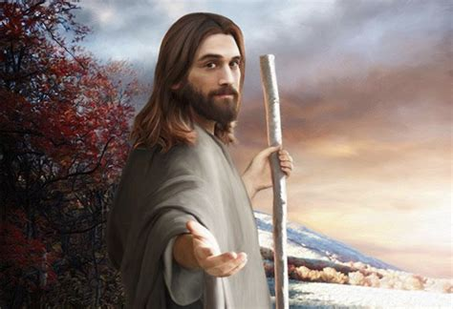
Follow the Leader [Jesus]
Jesus called others to “follow” Him. Should we also ask others to follow Him then?

Slide 45
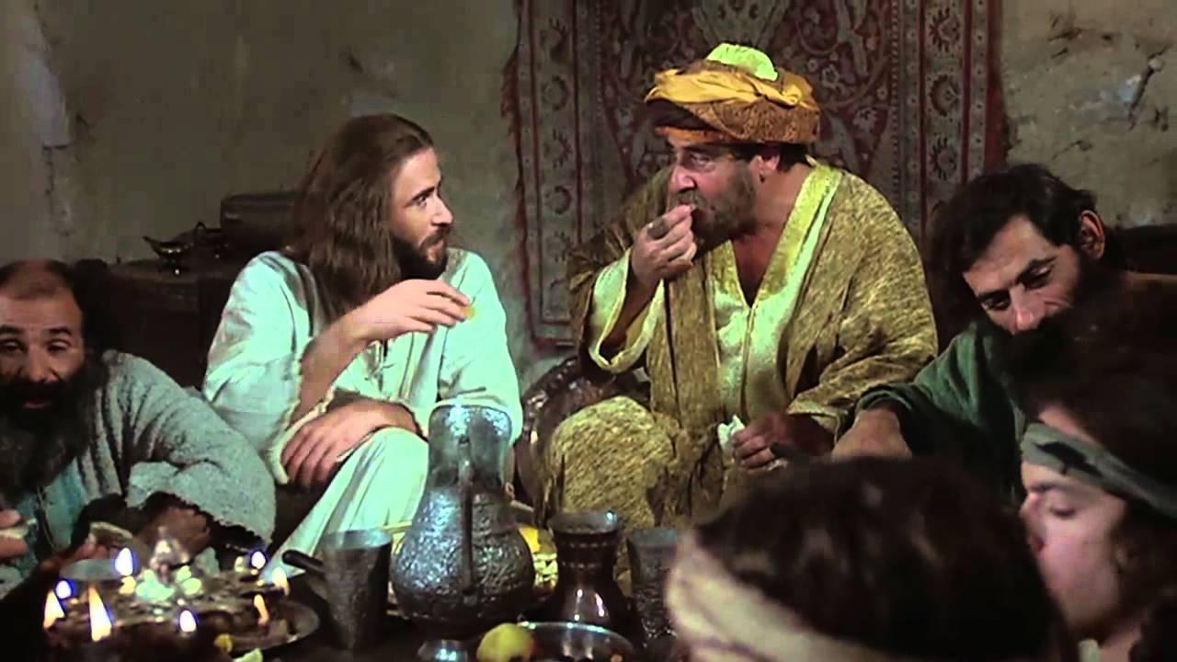
Follow the Leader [Jesus]
Did Jesus ask older people to follow him?

Slide 46
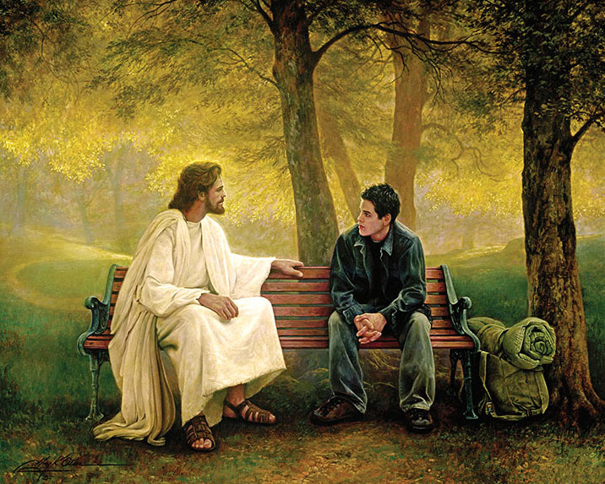
Follow the Leader [Jesus]
Did Jesus ask younger people to follow him?

Slide 47
Follow the Leader [Jesus]
“But Jesus said, Suffer little children, and forbid them not, to come unto me: for of such is the kingdom of heaven.” – Matthew 19:14 KJB

Slide 48
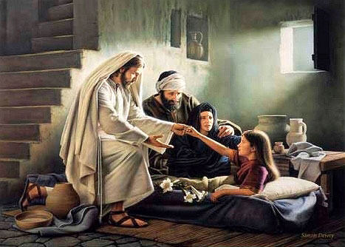
Follow the Leader [Jesus]
Did Jesus bring healing those who are sick, and to help them up? [see Mark 5:41 KJB]

Slide 49
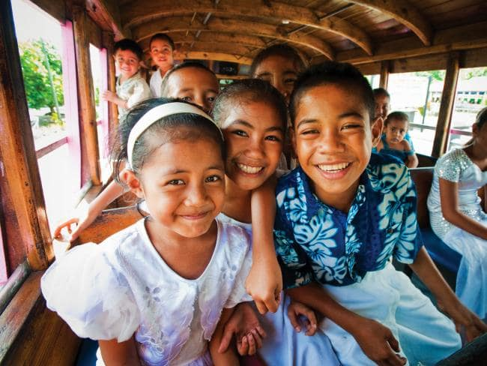
Follow the Leader [Jesus]
Should we help others, and lift them up when they are down? [see 1 Corinthians 12:28 KJB]

Slide 50
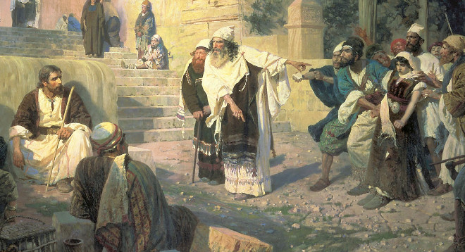
Follow the Leader [Jesus]
What are some of the ways we can help others?

Slide 51
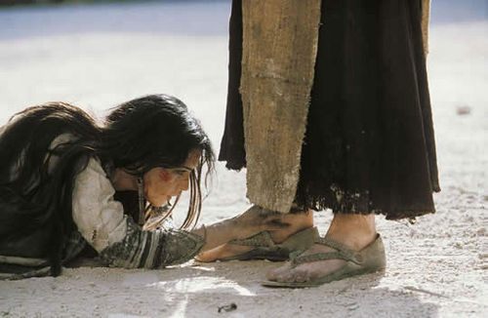
Follow the Leader [Jesus]
Can we give hope to others by telling them of God’s love in Christ Jesus, and not condemn them?

Slide 52
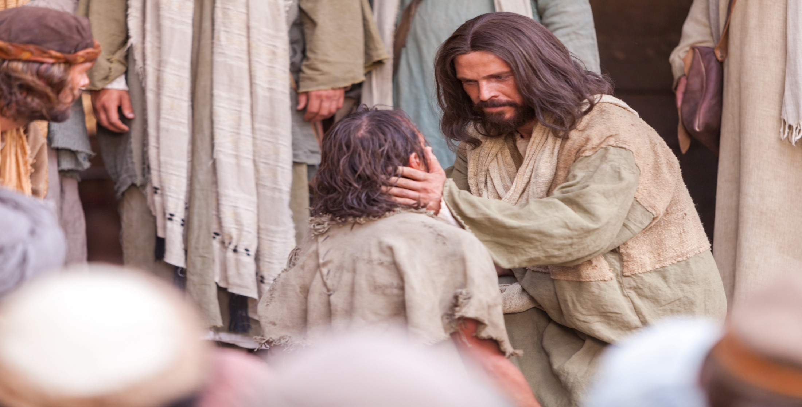
Follow the Leader [Jesus]
Can we be kind and compassionate to others as Jesus?

Slide 53
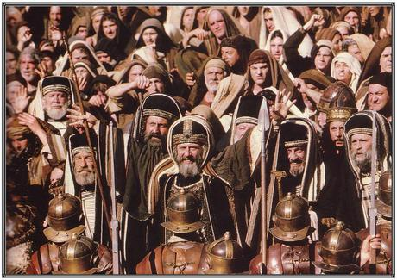
Follow the Leader [Jesus]
Can we even be kind to the unthankful and the evil? [see Luke 6:35 KJB]

Slide 54
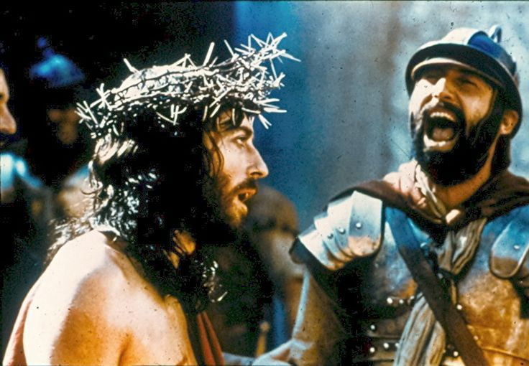
Follow the Leader [Jesus]
Can we take mockery, insult and injury from others, and not retaliate with bad words, mean looks, or violence?

Slide 55
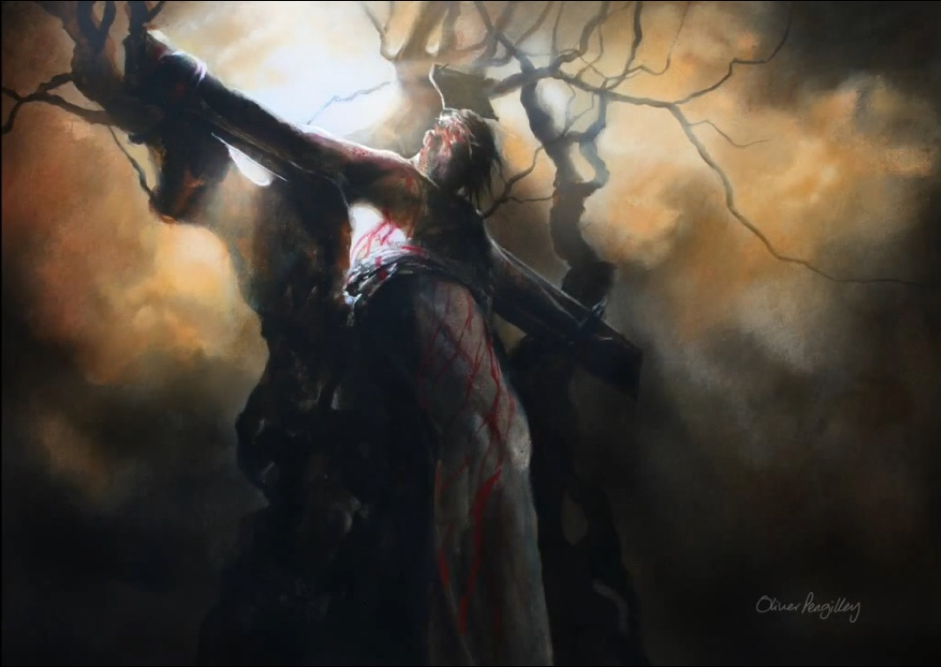
Follow the Leader [Jesus]
Father, forgive them …
… for they know not what they do.
[Luke 23:34 KJB]
Can we “… Love [our] enemies, bless them that curse [us], do good to them that hate [us], and pray for them which despitefully use [us], and persecute [us]”? [Matthew 5:44 KJB]

Slide 56
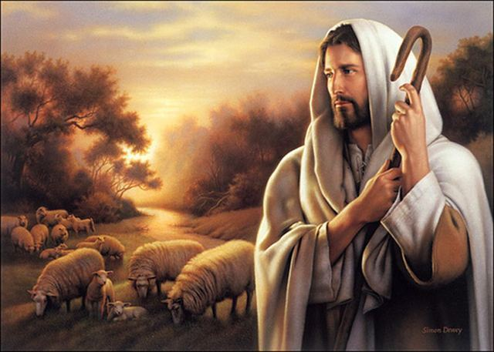
Follow the Leader [Jesus]
Can we take care of the creatures that God gives to us as gifts? Like puppies, kitties, and other things?

Slide 57
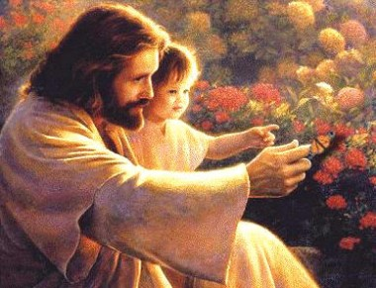
Follow the Leader [Jesus]
Can we spend time with our little brothers and/or sisters, and show them about God’s love?

Slide 58
Follow the Leader [Jesus]
Can we spend time thinking about our Father which is in Heaven, and how awesome God is?

Slide 59
Follow the Leader [Jesus]
Can we tell others of Our Father which is in Heaven as Jesus?

Slide 60
Follow the Leader [Jesus]
Can we spend time gardening as Jesus did?

Slide 61
Follow the Leader [Jesus]
Can we be filled with the Holy Spirit as Jesus?
“But the fruit of the Spirit is love, joy, peace, longsuffering, gentleness, goodness, faith, Meekness, temperance: against such there is no law.” – Galatians 5:22-23 KJB

Slide 62
Follow the Leader [Jesus]
Can we keep the Sabbath Holy as Jesus did?

Slide 63
Follow the Leader [Jesus]
Should we play sports on the Sabbath?

Slide 64
Follow the Leader [Jesus]
Should we go to a restaurant on Sabbath and make other people serve us?

Slide 65
Follow the Leader [Jesus]
Can we go for a nature walk like Jesus on the Sabbath? [see Matthew 12:1; Mark 2:23; Luke 6:1 KJB]

Slide 66
Follow the Leader [Jesus]
Can we tell others about God’s sacred Law as Jesus?

Slide 67
Follow the Leader [Jesus]
How many of you, want to follow Jesus with all your heart, soul, mind & strength? [see Mark 12:30 KJB]

Slide 68
Follow the Leader [Jesus]
“And when they had sung an hymn, they went out …” – Matthew 26:30 KJB

Slide 69
I Have Decided To Follow Jesus
I have decided
to FOLLOW Jesus,
I have decided
to FOLLOW Jesus,
I have decided
to FOLLOW Jesus,
No turning back,
No turning back …

Slide 70
I Have Decided To Follow Jesus
Though none go
with me,
still I will FOLLOW,
Though none go
with me,
still I will FOLLOW,
Though none go
with me,
still I will FOLLOW,
No turning back,
No turning back …

Slide 71
I Have Decided To Follow Jesus
The Cross before me,
the world behind me,
The Cross before me,
the world behind me,
The Cross before me,
the world behind me,
No turning back,
No turning back …

Slide 72
I Have Decided To Follow Jesus
Jesus, I do love thee,
And I will FOLLOW,
Jesus, I do love thee,
And I will FOLLOW,
Jesus, I do love thee,
And I will FOLLOW,
No turning back,
No turning back …

Slide 73
I Have Decided To Follow Jesus
I have decided
to FOLLOW Jesus,
I have decided
to FOLLOW Jesus,
I have decided
to FOLLOW Jesus,
No turning back,
No turning back!

Slide 74
CLOSING
PRAYER

