Slide 1
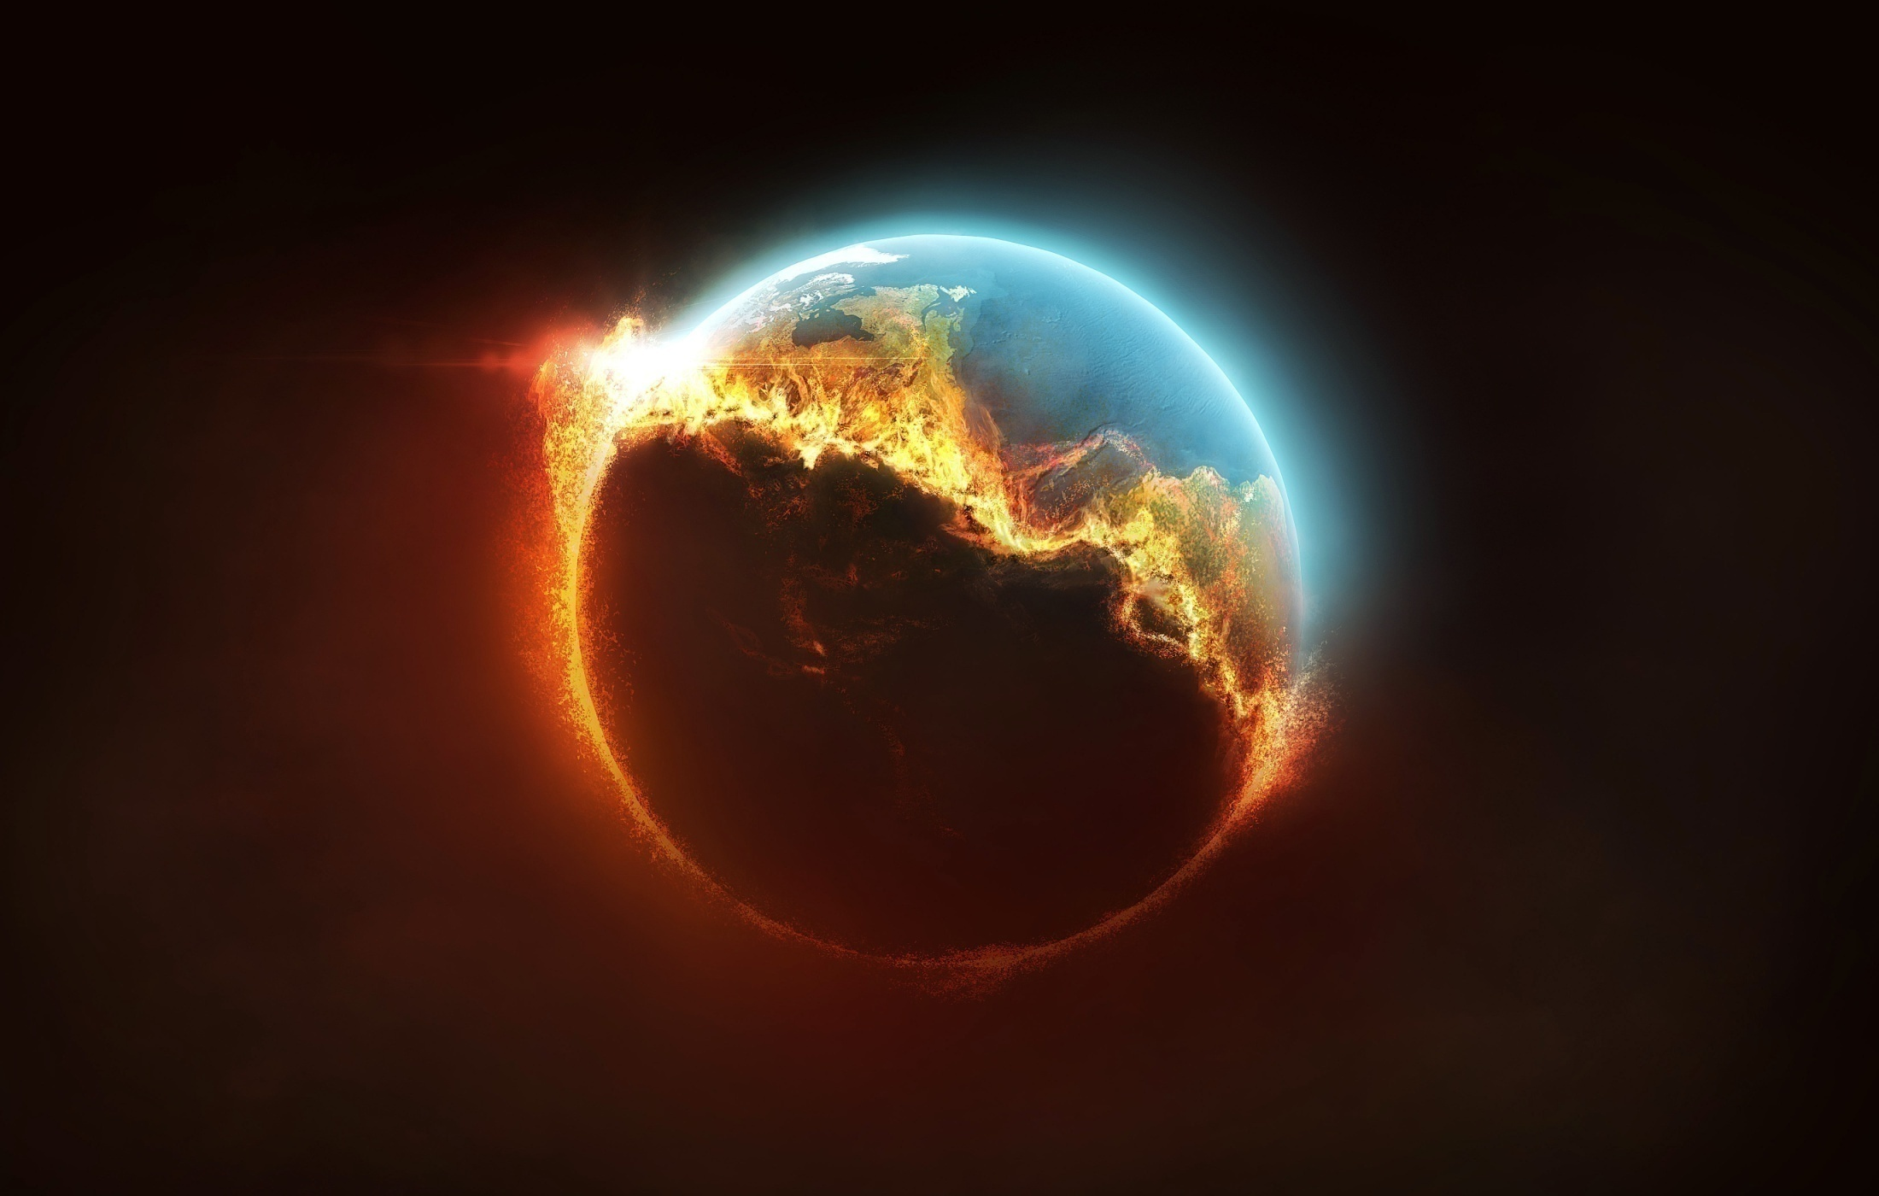
Dominion
http://www.pearltrees.com/awhn

Slide 2
Scripture Reading: Gen. 1:26-28 KJB
“And God said, Let us make man in our image, after our likeness: and let them have dominion over the fish of the sea, and over the fowl of the air, and over the cattle, and over all the earth, and over every creeping thing that creepeth upon the earth.”
– Genesis 1:26 KJB

Slide 3
Scripture Reading: Gen. 1:26-28 KJB
“So God created man in his own image, in the image of God created he him; male and female created he them.” – Genesis 1:27 KJB

Slide 4
Scripture Reading: Gen. 1:26-28 KJB
“And God blessed them, and God said unto them, Be fruitful, and multiply, and replenish [fill] the earth, and subdue it: and have dominion over the fish of the sea, and over the fowl of the air, and over every living thing that moveth upon the earth.”
– Genesis 1:28 KJB

Slide 5
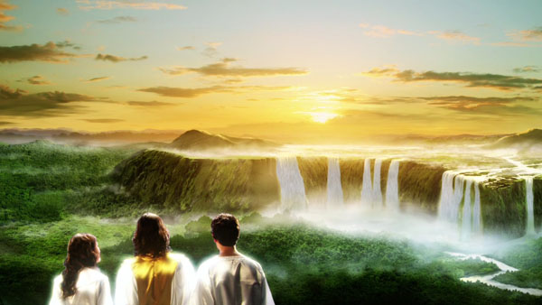

Slide 6
“And God saw every thing that he had made, and, behold, it was very good. And the evening and the morning were the sixth day.”
– Genesis 1:31 KJB

Slide 7
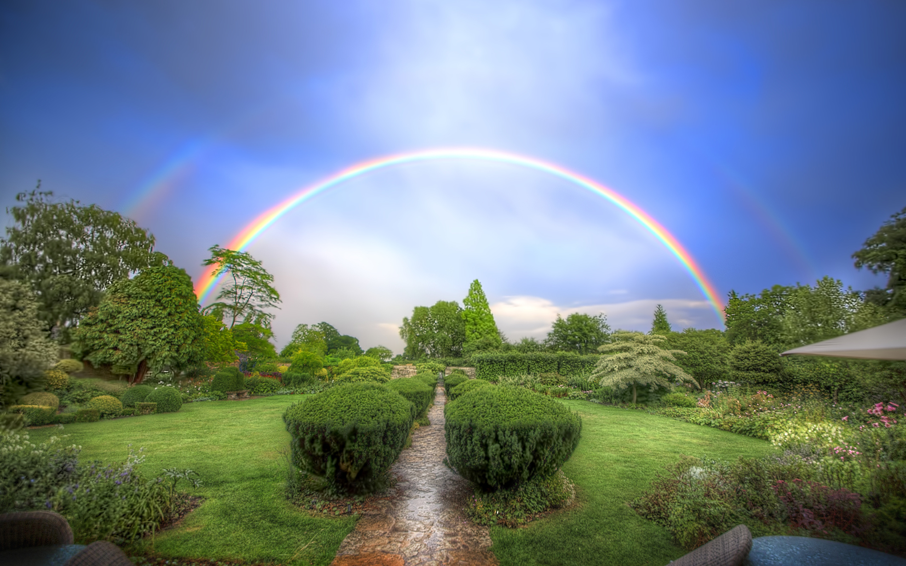

Slide 8
“Thus the heavens and the earth were finished, and all the host of them.”
– Genesis 2:1 KJB

Slide 9
“And on the seventh day God ended his work which he had made; and he rested on the seventh day from all his work which he had made.”
– Genesis 2:2 KJB

Slide 10
“And God blessed the seventh day, and sanctified it: because that in it he had rested from all his work which God created and made.”
– Genesis 2:3 KJB

Slide 11
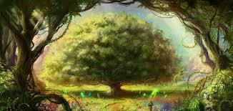

Slide 12
Let’s take a closer look at the 6th day.

Slide 13
“And the LORD God formed man of the dust of the ground, and breathed into his nostrils the breath of life; and man became a living soul.”
– Genesis 2:7 KJB

Slide 14
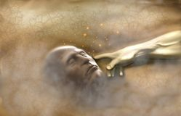

Slide 15
Adam was formed from the “dust”, a symbol of humility, lowliness of mind/heart, one submitted to its Maker.
A symbol, that God can take of the “dust”, the most base, and exalt it, whereas though Lucifer began in the highest seat, through pride, self-exaltation, fell to the lowest place (Luke 14:8-11 KJB).

Slide 16
“And the LORD God planted a garden eastward in Eden; and there he put the man whom he had formed.”
– Genesis 2:8 KJB

Slide 18
“And out of the ground made the LORD God to grow every tree that is pleasant to the sight, and good for food; the tree of life also in the midst of the garden, and the tree of knowledge of good and evil.”
– Genesis 2:9 KJB

Slide 21
“And a river went out of Eden to water the garden; and from thence it was parted, and became into four heads.” – Genesis 2:10 KJB

Slide 22
Just as Jesus said of the inward Garden, coming from the ground, the “Rock”, which was to always flow outward, and feed others with love:
“But whosoever drinketh of the water that I shall give him shall never thirst; but the water that I shall give him shall be in him a well of water springing up into everlasting life.”
– John 14:4 KJB

Slide 23
“The name of the first is Pison: that is it which compasseth the whole land of Havilah, where there is gold;”
– Genesis 2:11 KJB

Slide 24
The “gold” of “faith” which worketh by “love”:
“That the trial of your faith, being much more precious than of gold that perisheth, though it be tried with fire, might be found unto praise and honour and glory at the appearing of Jesus Christ:” – 1 Peter 1:7 KJB

Slide 25
The “gold” of “faith” which worketh by “love”:
“Whom having not seen, ye love; in whom, though now ye see him not, yet believing, ye rejoice with joy unspeakable and full of glory:”
– 1 Peter 1:8 KJB

Slide 26
“And the gold of that land is good: there is bdellium and the onyx stone.” – Genesis 2:12 KJB

Slide 27
Bdellium, the colour of mana, the symbol of the word of God:
“And the manna was as coriander seed, and the colour thereof as the colour of bdellium.”
– Numbers 11:7 KJB

Slide 28
Onxy, the symbol of the names of the children of Israel/God (Jesus) (Matthew 2:13-15,19-21; Hosea 11:1 KJB); those like God in character:
“And thou shalt take two onyx stones, and grave on them the names of the children of Israel:” – Exodus 28:9 KJB

Slide 29
“And the name of the second river is Gihon: the same is it that compasseth the whole land of Ethiopia.”
– Genesis 2:13 KJB

Slide 30
“And the name of the third river is Hiddekel: that is it which goeth toward the east of Assyria. And the fourth river is Euphrates.”
– Genesis 2:14 KJB

Slide 31
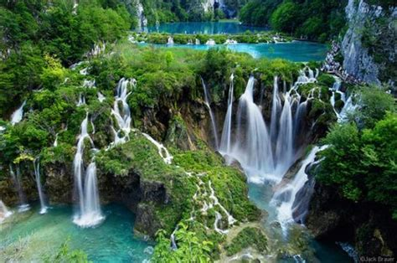

Slide 32
“And the LORD God took the man, and put him into the garden of Eden to dress it and to keep it.”
– Genesis 2:15 KJB

Slide 33
Eden was to be the outward expression of the inward Garden that God had made of man’s heart (Song of Solomon 5:1 KJB), that God was to alway (all the way) and always (all the time) walk in!

Slide 34
“And the LORD God commanded the man, saying, Of every tree of the garden thou mayest freely eat:”
– Genesis 2:16 KJB

Slide 35
“But of the tree of the knowledge of good and evil, thou shalt not eat of it: for in the day that thou eatest thereof thou shalt surely die.”
– Genesis 2:17 KJB

Slide 36
“And the LORD God said, It is not good that the man should be alone; I will make him an help meet for him.”
– Genesis 2:18 KJB

Slide 37
“And out of the ground the LORD God formed every beast of the field, and every fowl of the air; and brought them unto Adam to see what he would call them: and whatsoever Adam called every living creature, that was the name thereof.”
– Genesis 2:19 KJB

Slide 38
“And Adam gave names to all cattle, and to the fowl of the air, and to every beast of the field; but for Adam there was not found an help meet for him.” – Genesis 2:20 KJB

Slide 39
“And the LORD God caused a deep sleep to fall upon Adam, and he slept: and he took one of his ribs, and closed up the flesh instead thereof;”
– Genesis 2:21 KJB

Slide 40
“And the rib, which the LORD God had taken from man, made he a woman, and brought her unto the man.”
– Genesis 2:22 KJB

Slide 41
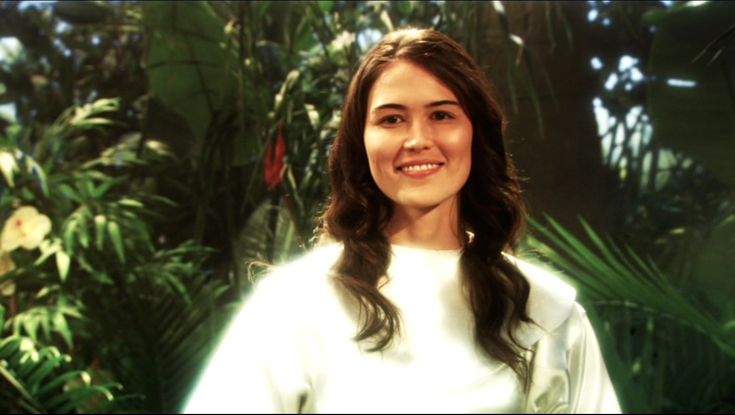

Slide 42
“And Adam said, This is now bone of my bones, and flesh of my flesh: she shall be called Woman, because she was taken out of Man.”
– Genesis 2:23 KJB

Slide 43
“Therefore shall a man leave his father and his mother, and shall cleave unto his wife: and they shall be one flesh.” – Genesis 2:24 KJB

Slide 44
“And they were both naked, the man and his wife, and were not ashamed.” – Genesis 2:25 KJB

Slide 45
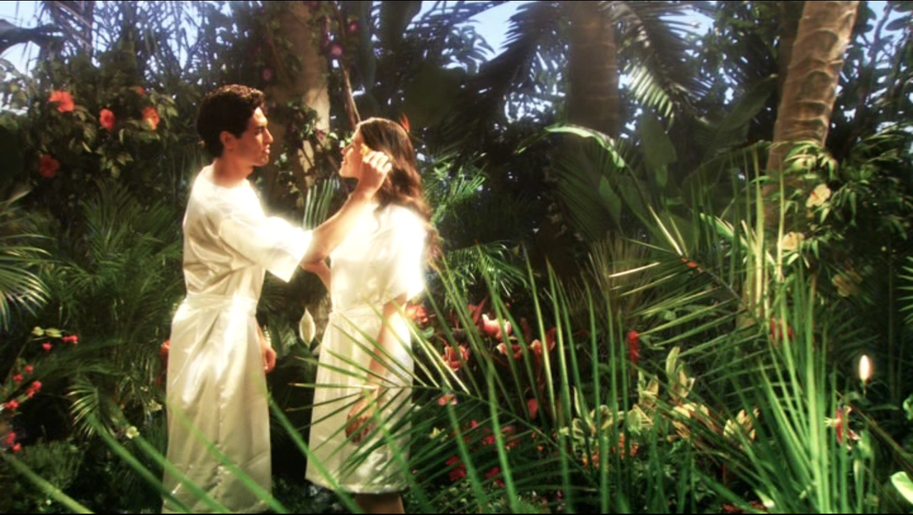

Slide 46
Everything, up to this point, was “good”, “very good”, and “finished” (brought to perfection).

Slide 47
Adam and Eve were as “gods” (Genesis 3:5, meaning, a Lord, not Deity; Psalms 82:6; John 10:34, “I have said, Ye are gods …”), as Kings, as rulers over a kingdom, as stewards under the LORD of Lords, and KING of Kings, children of the Most High – yes, those who had “Dominion”.

Slide 48
“What is man, that thou art mindful of him? and the son of man, that thou visitest him?” – Psalms 8:4 KJB

Slide 49
“For thou [JEHOVAH Elohiym] hast made him a little lower than the angels, and hast crowned him [the man; Adam] with glory and honour.”
– Psalms 8:5 KJB

Slide 50
“Thou madest him [the man; Adam] to have dominion over the works of thy hands; thou hast put all things under his feet:”
– Psalms 8:6

Slide 51
“All sheep and oxen, yea, and the beasts of the field;” – Psalms 8:7 KJB

Slide 52
Does that include the “most subtil beast of the field”, the “serpent” (Genesis 3:1 KJB)?

Slide 53
“The fowl of the air, and the fish of the sea, and whatsoever passeth through the paths of the seas.”
– Psalms 8:8 KJB

Slide 54
“The fowl of the air, and the fish of the sea, and whatsoever passeth through the paths of the seas.”
– Psalms 8:8 KJB

Slide 55
Does that include the “Dragon” (Revelation 12:9, 20:2), the “fiery flying serpent” (Isaiah 14:29 KJB), the “serpent” (Genesis 3:1 KJB), even “Leviathan” (Isaiah 27:1; Job 41:1) in the sea?

Slide 56
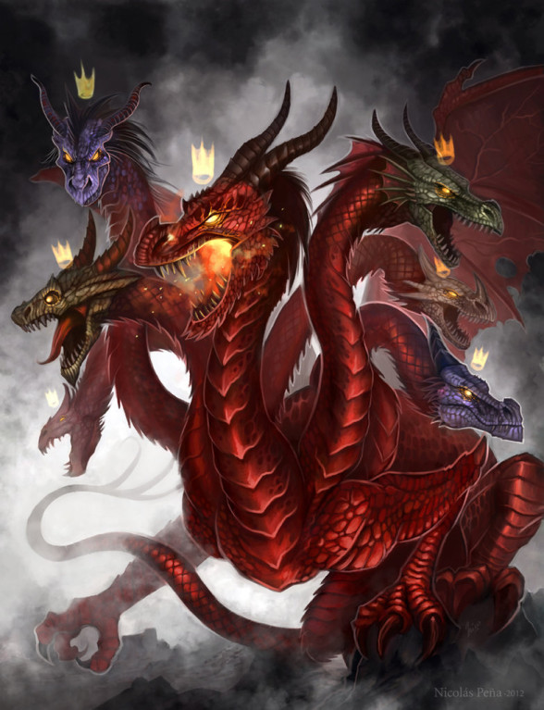

Slide 58
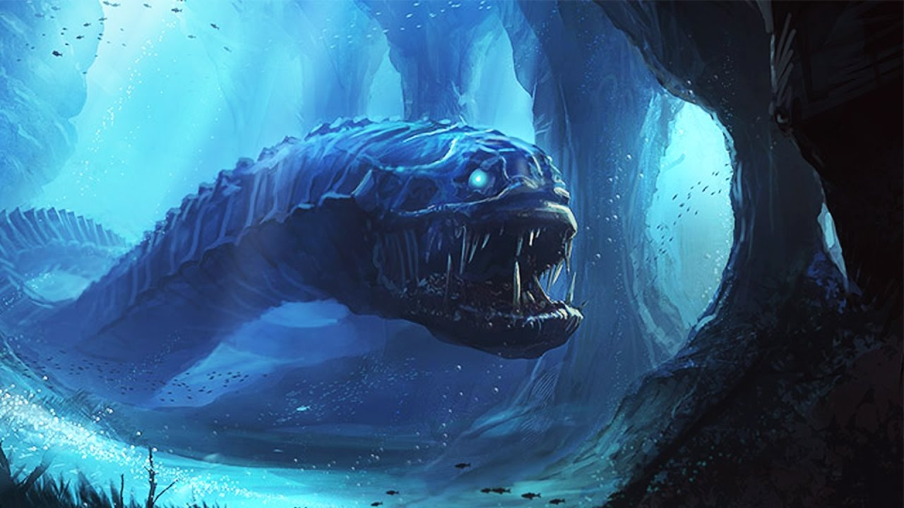

Slide 59
Adam was given “Dominion” “over all the earth” (Genesis 1:26 KJB), yes?

Slide 60
Adam was formed of the “dust of the ground” (Genesis 2:7 KJB), yes?

Slide 61
Then Adam’s Kingdom (his King’s Dominion), first began with rulership/control over His own ‘self’ (the earth he was formed from), as being submitted to the greater KING (JEHOVAH), right?
Adam, had in the beginning, when as made in the “image of God” – ‘self’ control (in stewardship).

Slide 62
JEHOVAH Elohiym, even Jesus, has ‘self-control’, right?
Is God filled file Fear or with Faith and Love?
Sin, satan and selfishness has no “Dominion” over God, right? And, therefore, does not bow down to those things, right?

Slide 63
“Again, the devil taketh him up into an exceeding high mountain, and sheweth him all the kingdoms of the world, and the glory of them;”
– Matthew 4:8 KJB
(see also Luke 4:5 KJB)

Slide 64
“And saith unto him, All these things will I give thee, if thou wilt fall down and worship me.” – Matthew 4:9 KJB
(see also Luke 4:6-7 KJB)

Slide 65
“Then saith Jesus unto him, Get thee hence, Satan: for it is written, Thou shalt worship the Lord thy God, and him only shalt thou serve.”
– Matthew 4:10 KJB
(see also Luke 4:8 KJB)

Slide 66
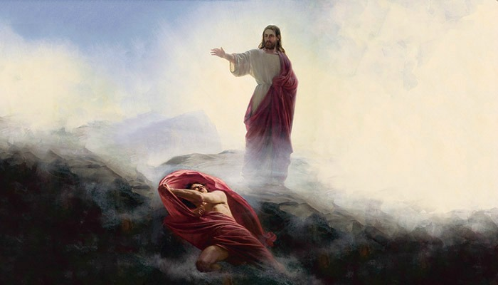

Slide 67
Then Adam had the same in the beginning, before submitting to sin, satan and selfishness – other cruel rulers.

Slide 68
... But what happened when Adam submitted (bowed down to, subjected himself to) to another ruler, another KING, other than the LORD God?

Slide 69
He lost ‘self control’, lost “all” control, over thinking, speech and actions, and was to be controlled by another, ruled by passions (anger, malice, jealousy, envy, sensuality, pride, etc), slave to the lust of the flesh, lust of the eyes and the pride of life. No longer without ‘fear’ in perfect ‘love’:
Watch …

Slide 70
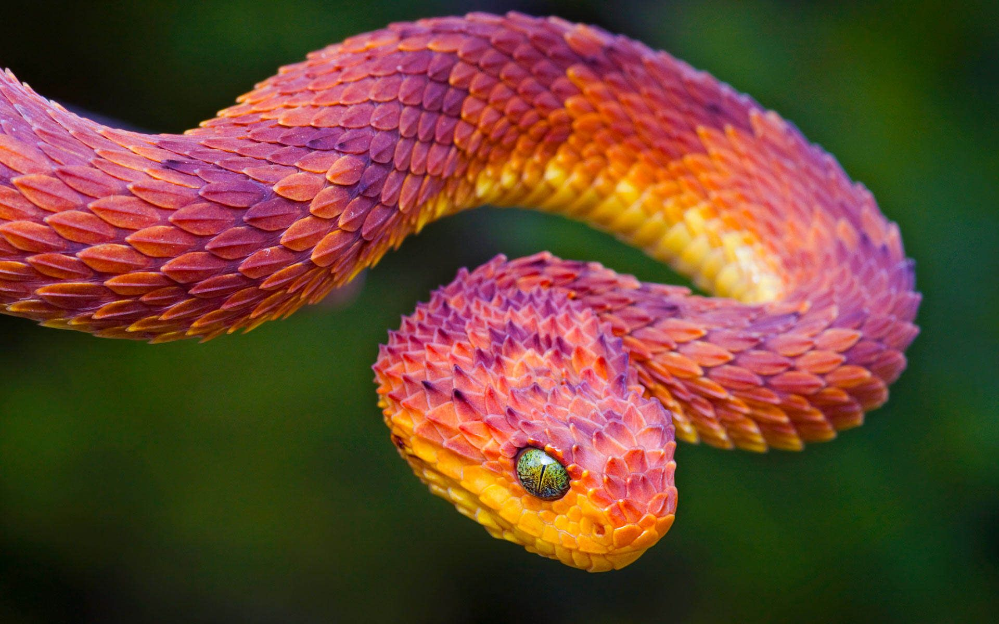

Slide 71
“Now the serpent was more subtil than any beast of the field which the LORD God had made. And he said unto the woman, Yea, hath God said, Ye shall not eat of every tree of the garden?” – Genesis 3:1 KJB

Slide 73
The “woman” (a symbol of the church; Jeremiah 6:2; Revelation 12:1-2,4-5), entered into conversation with the temptation …
… though she was to be ruler over it, and to command it to depart …

Slide 74
“And the woman said unto the serpent, We may eat of the fruit of the trees of the garden:” – Genesis 3:2 KJB

Slide 75
“But of the fruit of the tree which is in the midst of the garden, God hath said, Ye shall not eat of it, neither shall ye touch it, lest ye die.”
– Genesis 3:3 KJB

Slide 76
“And the serpent said unto the woman, Ye shall not surely die:”
– Genesis 3:4 KJB

Slide 77
“For God doth know that in the day ye eat thereof, then your eyes shall be opened, and ye shall be as gods, knowing good and evil.”
– Genesis 3:5 KJB

Slide 78
“And when the woman saw that the tree was good for food, and that it was pleasant to the eyes, and a tree to be desired to make one wise, she took of the fruit thereof, and did eat, and gave also unto her husband with her; and he did eat.” – Genesis 3:6 KJB

Slide 79
Adam, entered into conversation with the temptation (His wife, the new medium of the serpent) …
… though he was to be ruler over it, and to command it to depart …

Slide 80
“And the eyes of them both were opened, and they knew that they were naked; and they sewed fig leaves together, and made themselves aprons.” – Genesis 3:7 KJB

Slide 81
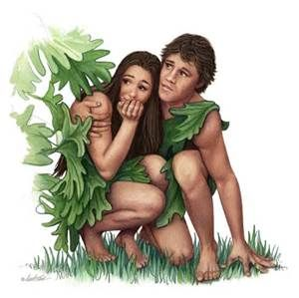

Slide 82
“And they heard the voice of the LORD God walking in the garden in the cool of the day: and Adam and his wife hid themselves from the presence of the LORD God amongst the trees of the garden.” – Genesis 3:8 KJB

Slide 83
“And the LORD God called unto Adam, and said unto him, Where art thou?”
– Genesis 3:9 KJB

Slide 84
“And he said, I heard thy voice in the garden, and I was afraid, because I was naked; and I hid myself.”
– Genesis 3:10 KJB

Slide 85
Adam’s light went out, and now it was dark …
… fear of the dark, and fear of the light …

Slide 86
“And this is the condemnation, that light is come into the world, and men loved darkness rather than light, because their deeds were evil.”
– John 3:19 KJB

Slide 87
“For every one that doeth evil hateth the light, neither cometh to the light, lest his deeds should be reproved.”
– John 3:20 KJB

Slide 88
In submitting to the “devil” (who was cast out into the earth, down to the ground), Adam and his wife, then placed themselves in a position far below even this!
They became sinners subject to a sinner (satan)!

Slide 89
“… Eve had been perfectly happy by her husband's side in her Eden home; but, like restless modern Eves, she was flattered with the hope of entering a higher sphere than that which God had assigned her. In attempting to rise above her original position, she fell far below it. A similar result will be reached by all who are unwilling to take up cheerfully their life duties in accordance with God's plan. …”
– Adventist Home, page 115.2

Slide 90
“And he said, Who told thee that thou wast naked? Hast thou eaten of the tree, whereof I commanded thee that thou shouldest not eat?”
– Genesis 3:11 KJB

Slide 91
“And the man said, The woman whom thou gavest to be with me, she gave me of the tree, and I did eat.”
– Genesis 3:12 KJB

Slide 92
“And the LORD God said unto the woman, What is this that thou hast done? And the woman said, The serpent beguiled me, and I did eat.”
– Genesis 3:13 KJB

Slide 93
“And the LORD God said unto the serpent, Because thou hast done this, thou art cursed above all cattle, and above every beast of the field; upon thy belly shalt thou go, and dust shalt thou eat all the days of thy life:”
– Genesis 3:14 KJB

Slide 94
“And I will put enmity between thee and the woman, and between thy seed and her seed; it shall bruise thy head, and thou shalt bruise his heel.” – Genesis 3:15 KJB

Slide 95
Thus, through the promised “seed” (Genesis 3:15 KJB) of Righteousness, Jesus Christ (Galatians 3:16 KJB), Adam the first was to gain all “Dominion” back, through that Adam the second (1 Corinthians 15:45-47 KJB).

Slide 96
“And there was war in heaven: Michael and his angels fought against the dragon; and the dragon fought and his angels,” – Revelation 12:7 KJB
A battle for the Kingdom of the Heart!

Slide 97
Jesus said:
“Neither shall they say, Lo here! or, lo there! for, behold, the kingdom of God is within you.” – Luke 17:21 KJB

Slide 98
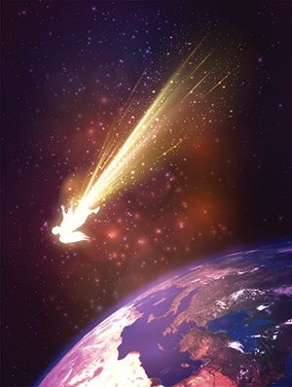

Slide 99
“And prevailed not; neither was their place found any more in heaven.”
– Revelation 12:8 KJB
No more place in the Heart for the satan, sin and selfishness!
No place for fear, only love!

Slide 100
“There is no fear in love; but perfect love [God] casteth out fear [the devil]: because fear hath torment. He that feareth is not made perfect in love.”
– 1 John 4:18 KJB

Slide 101
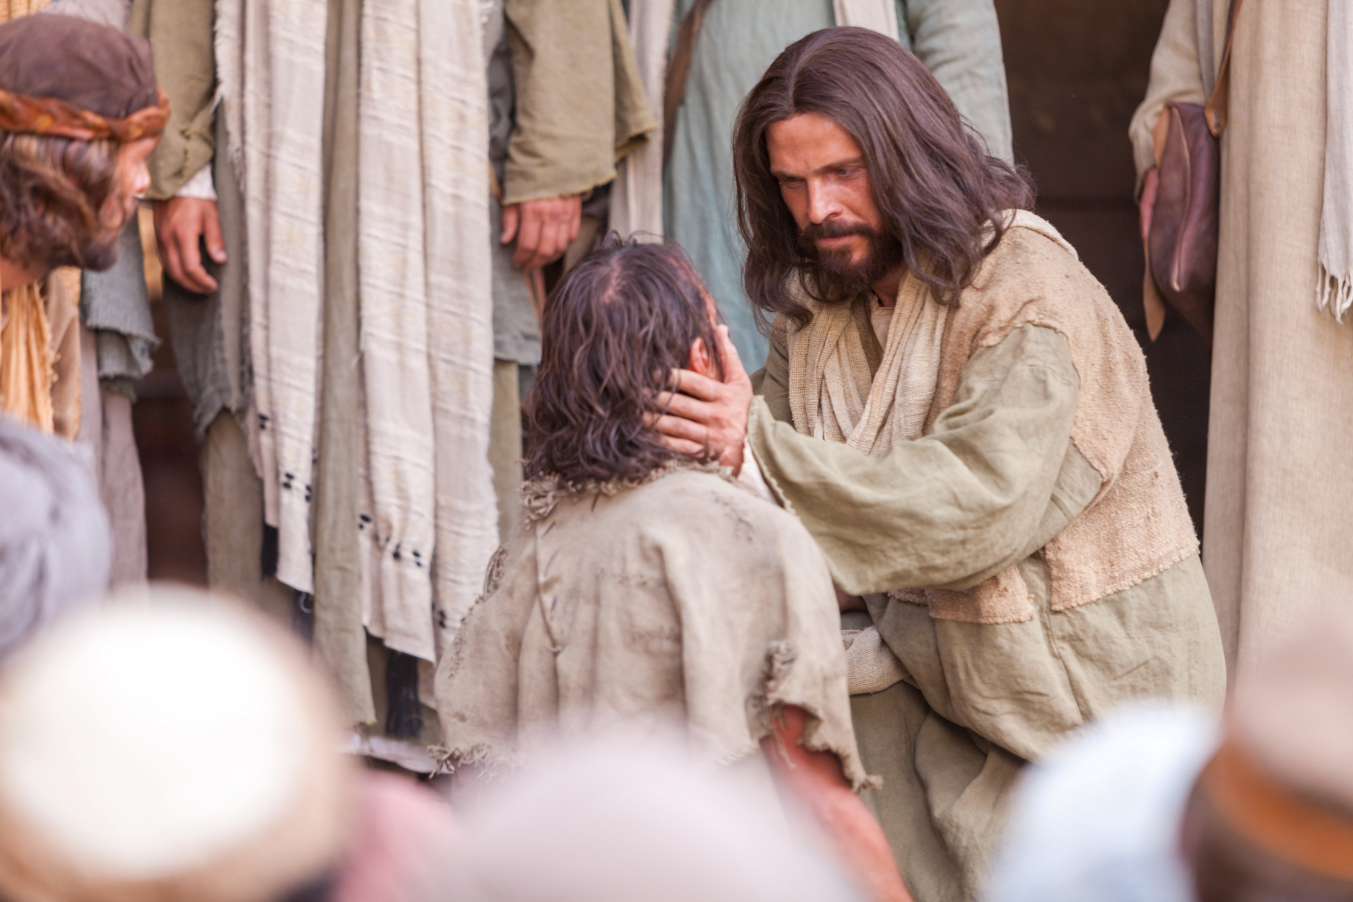

Slide 102
“And the great dragon was cast out, that old serpent, called the Devil, and Satan, which deceiveth the whole world: he was cast out into the earth, and his angels were cast out with him.” – Revelation 12:9 KJB
It is why Jesus said that devils could be cast out in His name (character; “Heal the sick, cleanse the lepers, raise the dead, cast out devils: freely ye have received, freely give.” - Matthew 10:8 KJB)!

Slide 103
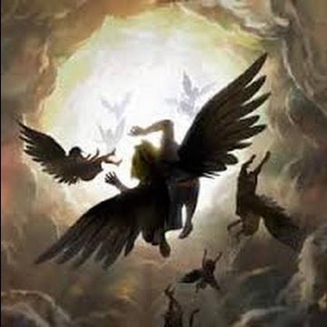

Slide 104
“And I heard a loud voice saying in heaven, Now is come salvation, and strength, and the kingdom of our God, and the power of his Christ: for the accuser of our brethren is cast down, which accused them before our God day and night.” – Revelation 12:10 KJB

Slide 105
“And they overcame him by the blood of the Lamb, and by the word of their testimony; and they loved not their lives unto the death.”
– Revelation 12:11 KJB

Slide 106
Didn’t you ever wonder why, vss 7-11 came after vss 1-6 of Revelation 12, wherein Christ Jesus had been born, lived, died, resurrected and ascended to Heaven?!

Slide 107
Because through the Life, death and resurrection and ascension of Jesus, satan is cast out of the heart Garden!
“And the seventy returned again with joy, saying, Lord, even the devils are subject unto us through thy name.”
– Luke 10:17 KJB
“And he said unto them, I beheld Satan as lightning fall from heaven.”
– Luke 10:18 KJB

Slide 108
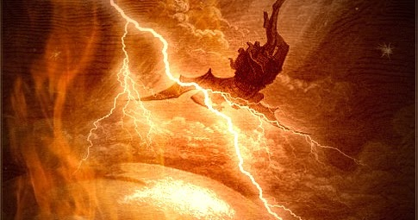

Slide 109
“For God hath not given us the spirit of fear; but of power, and of love, and of a sound mind.” – 2 Timothy 1:7 KJB

Slide 110
“(For the weapons of our warfare are not carnal, but mighty through God to the pulling down of strong holds;)”
– 2 Corinthians 10:4 KJB

Slide 111
“Casting down imaginations, and every high thing that exalteth itself against the knowledge of God, and bringing into captivity every thought to the obedience of Christ;”
– 2 Corinthians 10:5 KJB

Slide 112
“And having in a readiness to revenge all disobedience, when your obedience is fulfilled.”
– 2 Corinthians 10:6 KJB

Slide 113
“Let this mind be in you, which was also in Christ Jesus:”
– Philippians 2:5 KJB

Slide 114
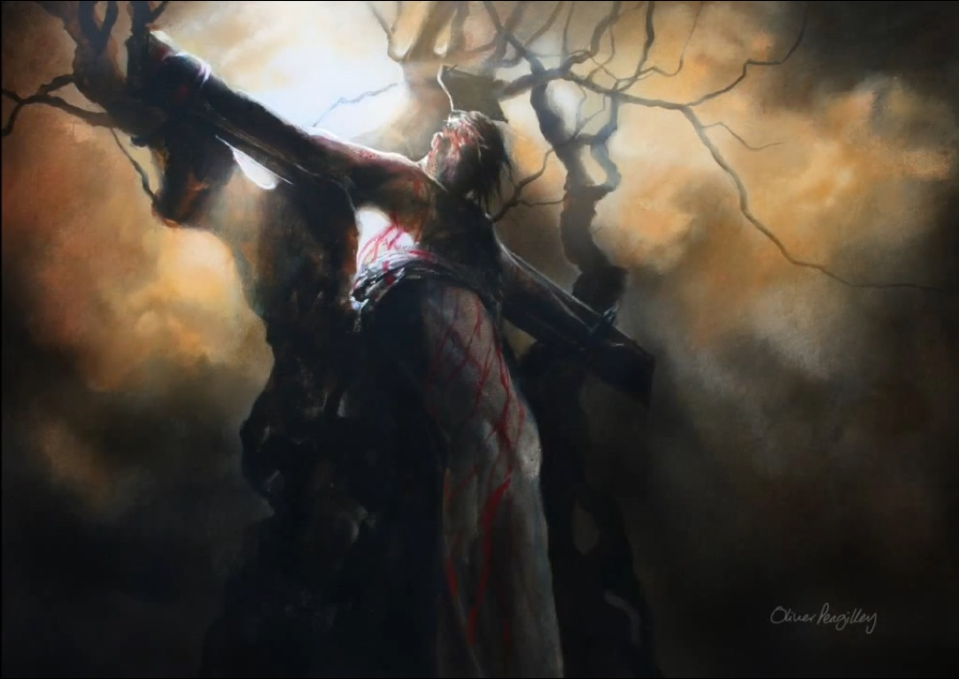

Slide 115
Through the whole Bible, God has been saying to us since then:
“Fear not …”
“Do not be afraid …”
… always in connection with,
E/Immanuel – God with us,
for He says,
“I AM with thee …”

Slide 116
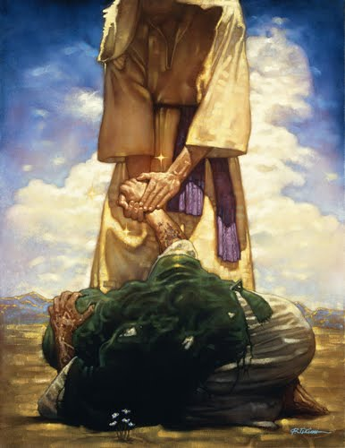

Slide 117
“Fear not, little flock; for it is your Father's good pleasure to give you the kingdom.” – Luke 12:32 KJB

Slide 118
A free gift of His perfect loving Mercy.

Slide 119
“And thou, O tower of the flock, the strong hold of the daughter of Zion, unto thee shall it come, even the first dominion; the kingdom shall come to the daughter of Jerusalem.”
– Micah 4:8 KJB

Slide 120
“I saw in the night visions, and, behold, one like the Son of man came with the clouds of heaven, and came to the Ancient of days, and they brought him near before him.”
– Daniel 7:13 KJB

Slide 121
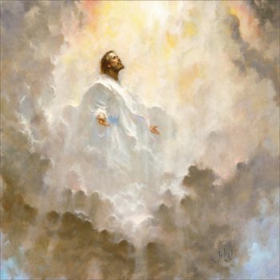

Slide 122
“And there was given him dominion, and glory, and a kingdom, that all people, nations, and languages, should serve him: his dominion is an everlasting dominion, which shall not pass away, and his kingdom that which shall not be destroyed.”
– Daniel 7:14 KJB

Slide 123
“And the kingdom and dominion, and the greatness of the kingdom under the whole heaven, shall be given to the people of the saints of the most High, whose kingdom is an everlasting kingdom, and all dominions shall serve and obey him.”
– Daniel 7:27 KJB

Slide 124
“For he hath put all things under his feet. …” – 1 Corinthians 15:27 KJB

Slide 125
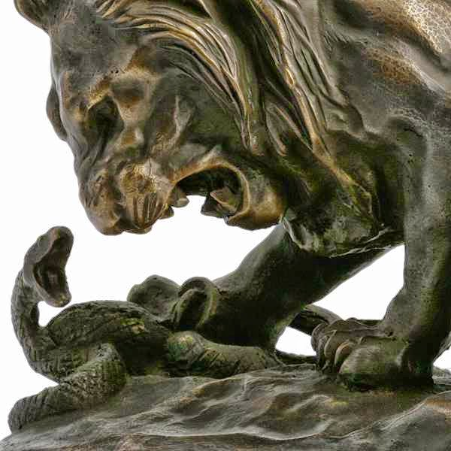

Slide 126
“… and gave him to be the head over all things to the church,”
– Ephesians 1:22 KJB

Slide 127
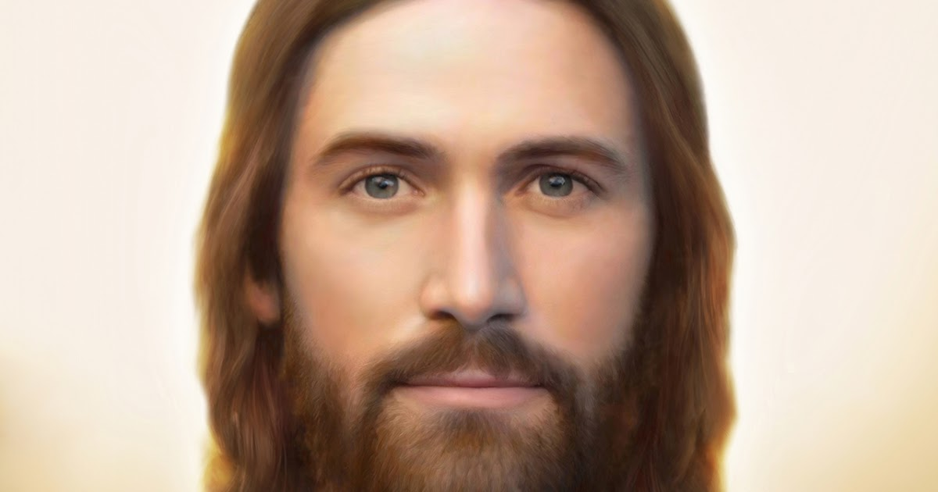

Slide 128
“… her seed; it shall bruise thy head …” – Genesis 3:15 KJB

Slide 129
All the Head, the thinking of the devil, will be crushed.

Slide 130
All the Head, the thinking of the devil, will be crushed.

Slide 131
All the Head, the thinking of the devil, will be crushed.

Slide 132
“And the God of peace shall bruise [crush completely and forever] Satan under your feet shortly. The grace of our Lord Jesus Christ be with you. Amen.” – Romans 16:20 KJB

Slide 133
“Now ye are full, now ye are rich, ye have reigned as kings without us: and I would to God ye did reign, that we also might reign with you.”
– 1 Corinthians 4:8 KJB

Slide 134
Perfect Faith
which worketh by
Perfect Love
is restored!

Slide 135
“For this is the love of God, that we keep his commandments: and his commandments are not grievous.”
– 1 John 5:3 KJB

Slide 136
“For whatsoever is born of God overcometh the world: and this is the victory that overcometh the world, even our faith.” – 1 John 5:4 KJB

Slide 137
“And hath made us kings and priests unto God and his Father; to him be glory and dominion for ever and ever. Amen.” – Revelation 1:6 KJB

Slide 138
“Submit yourselves therefore to God. Resist the devil, and he will flee from you.” – James 4:7 KJB

Slide 139
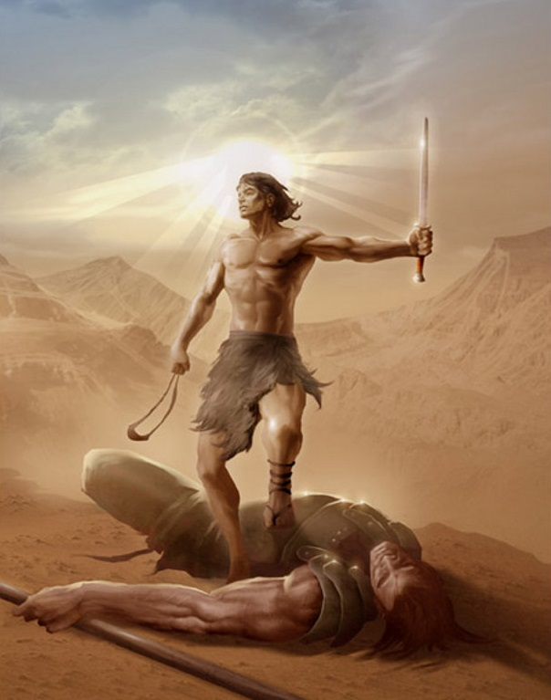
Like David, you will stand before the giant Goliath, and fear nothing, because you know the Almighty God guides your heart and hand.

Slide 140
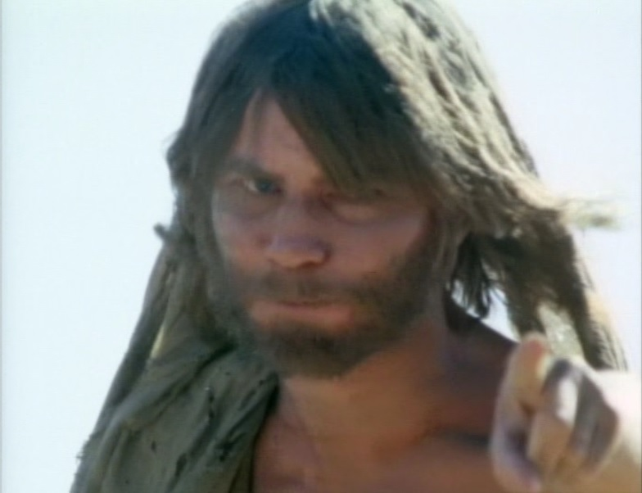
Like John the Baptist you will be able to stand before Kings unafraid …
… because you have experienced the presence of the KING of Kings.

Slide 141
Like Daniel, you will be able to face the pit and its terrible lions of jealousy, doubt and fear…

Slide 142
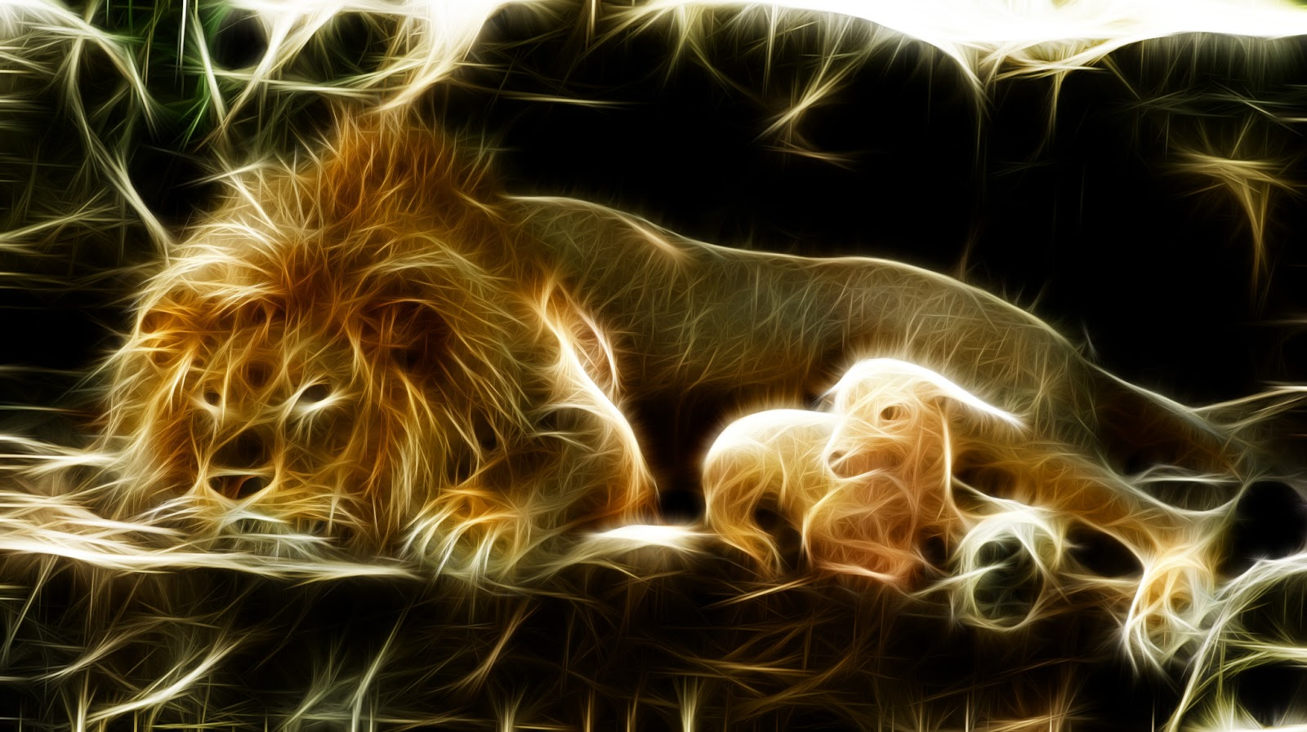
… because you have known the Love, the Light and the Lion of the tribe of Juda.

Slide 143
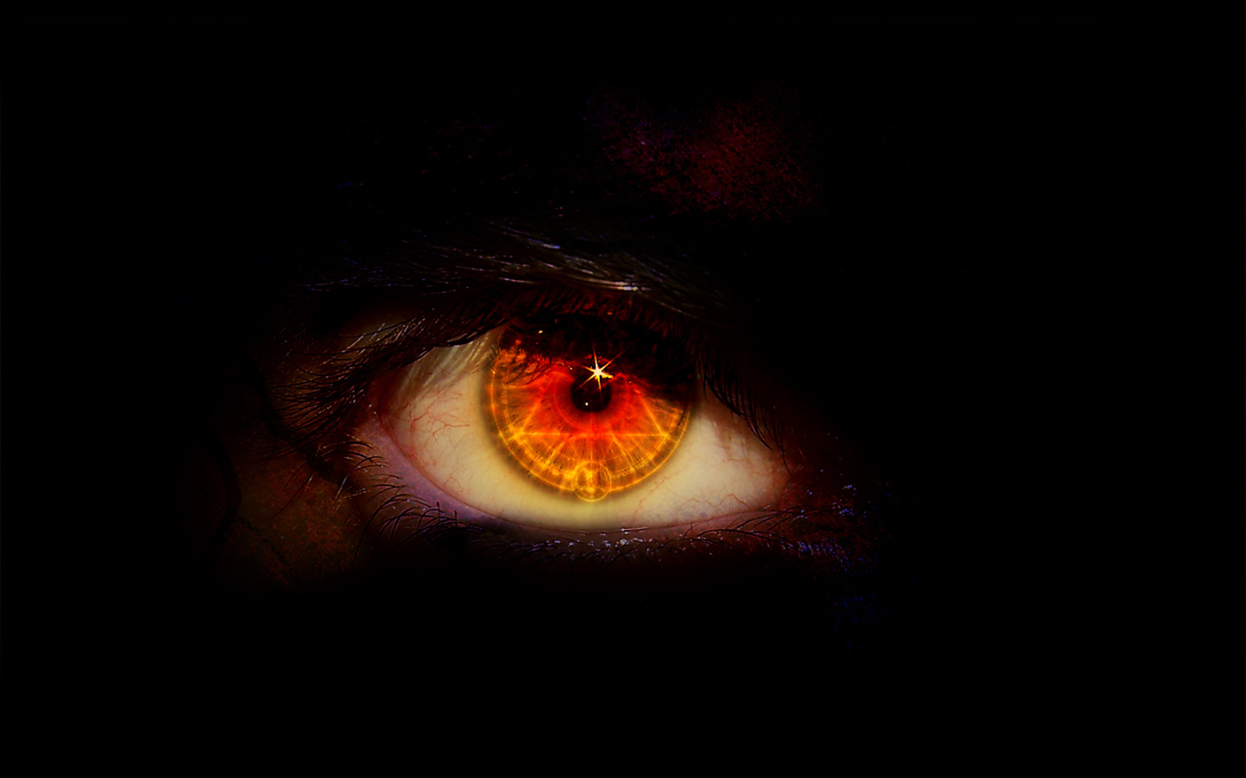
Like Jesus you will be able to stand before “Legion”, and all the forces of Hell, unafraid …
… because your hand, your heart, is in God’s.

Slide 144
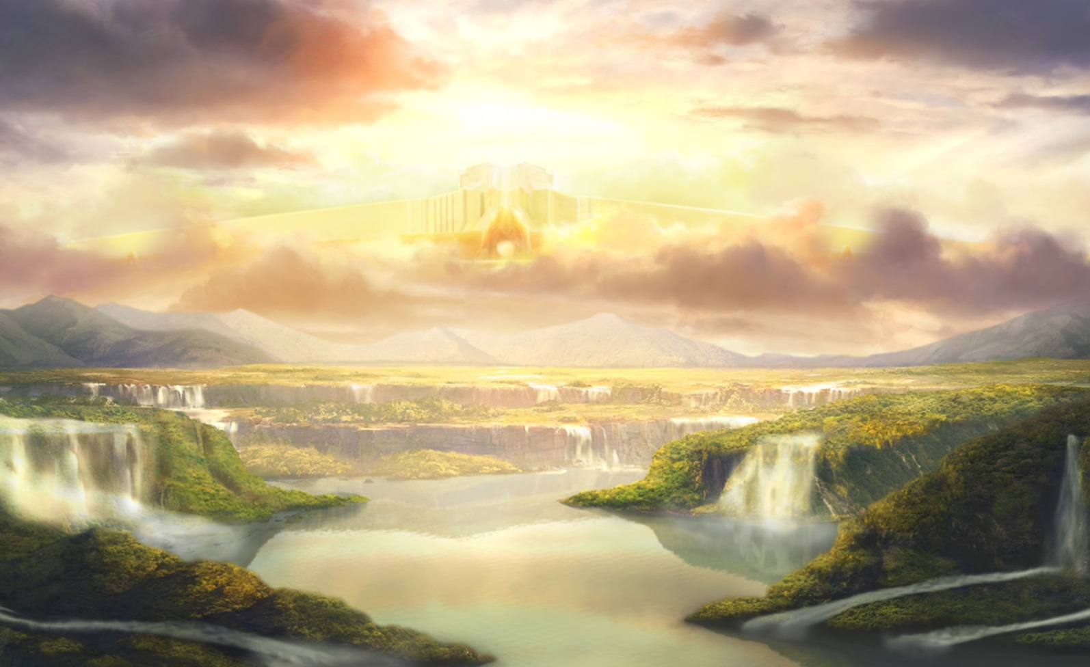
… for the Dominion of the Heart of the Kingdom of Heaven, of Eden, is restored to you in Christ Jesus.
… only, Do you believe?

