Slide 1
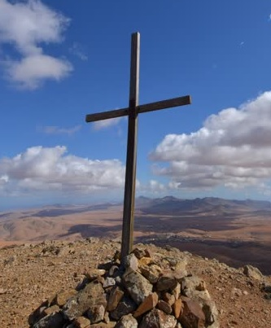
Sticks & Stones
http://www.pearltrees.com/awhn

Slide 2
Scripture Reading: Num. 15:32-36 KJB
“And while the children of Israel were in the wilderness, they found a man that gathered sticks upon the sabbath day.”
– Numbers 15:32 KJB

Slide 3
Scripture Reading: Num. 15:32-36 KJB
“And they that found him gathering sticks brought him unto Moses and Aaron, and unto all the congregation.”
– Numbers 15:33 KJB

Slide 4
Scripture Reading: Num. 15:32-36 KJB
“And they put him in ward, because it was not declared what should be done to him.”
– Numbers 15:34 KJB

Slide 5
Scripture Reading: Num. 15:32-36 KJB
“And the LORD said unto Moses, The man shall be surely put to death: all the congregation shall stone him with stones without the camp. ” – Numbers 15:35 KJB

Slide 6
Scripture Reading: Num. 15:32-36 KJB
“And all the congregation brought him without the camp, and stoned him with stones, and he died; as the LORD commanded Moses.”
– Numbers 15:36 KJB

Slide 7
What is the Sabbath day, that this man had violated?

Slide 8
In Exodus 20:8-11 KJB we read:
“Remember the sabbath day, to keep it holy.”
– Exodus 20:8 KJB

Slide 9
In Exodus 20:8-11 KJB we read:
“Six days shalt thou labour, and do all thy work: ”
– Exodus 20:9 KJB

Slide 10
In Exodus 20:8-11 KJB we read:
“But the seventh day is the sabbath of the LORD thy God: in it thou shalt not do any work, thou, nor thy son, nor thy daughter, thy manservant, nor thy maidservant, nor thy cattle, nor thy stranger that is within thy gates:” – Exodus 20:10 KJB

Slide 11
In Exodus 20:8-11 KJB we read:
“For in six days the LORD made heaven and earth, the sea, and all that in them is, and rested the seventh day: wherefore the LORD blessed the sabbath day, and hallowed it.” – Exodus 20:11 KJB

Slide 12
What was the punishment, that we just read about in Numbers 15, for breaking this Commandment of God?

Slide 13
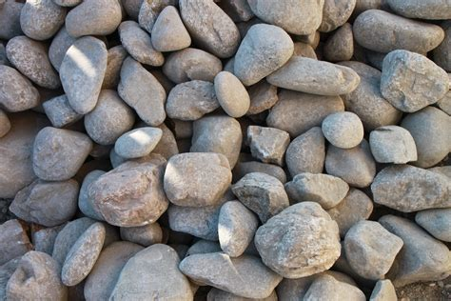
Death by Stoning

Slide 14
Breaking God’s Commandment, especially
the 4th Commandment
(Exodus 20:8-11 KJB),
is a very serious matter, according to the Bible, wouldn’t you say?

Slide 15
“… but that was in the Old Testament. What about in the New Testament?”

Slide 16
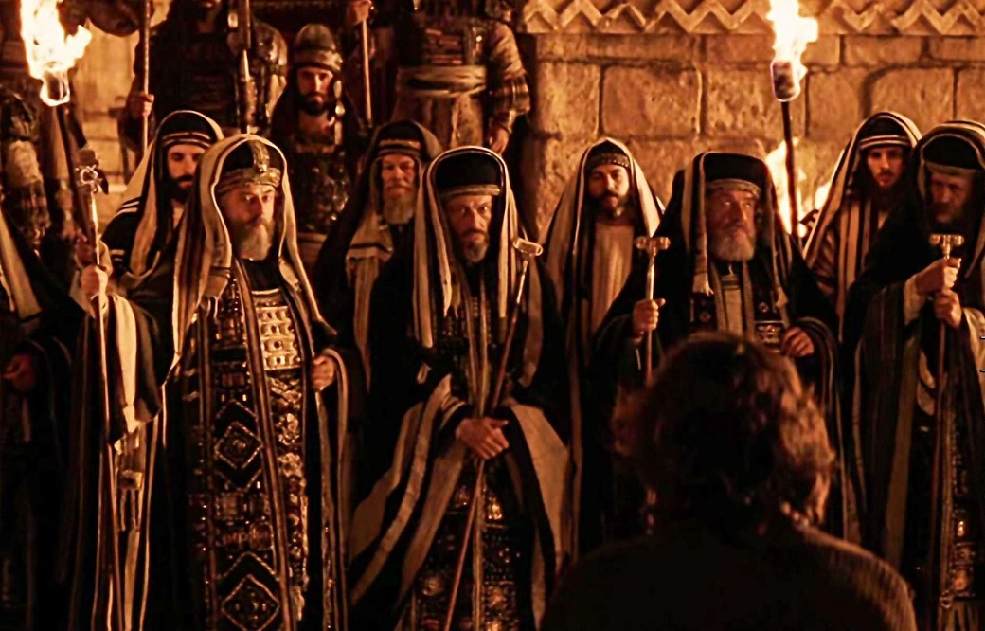
In the New Testament …
… there was a very “religious” group ...

Slide 17
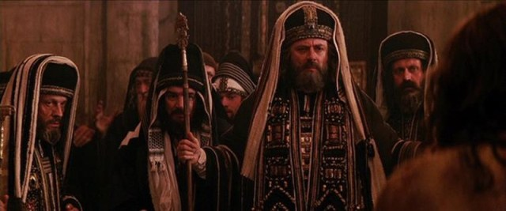
… who were continually transgressing …
… God’s Law to keep their vain traditions.

Slide 18
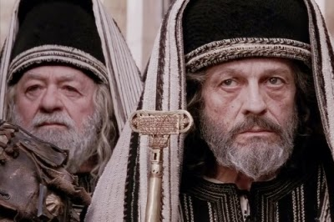
To justify themselves …
… in their wicked course …

Slide 19
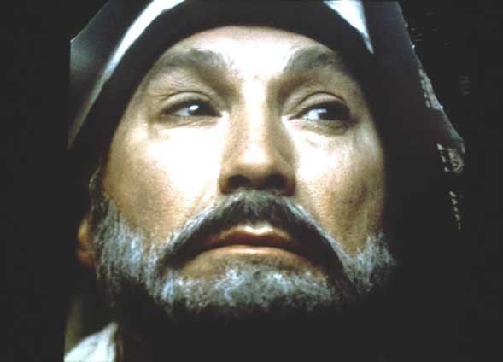
… they continually plotted to trap Jesus …
… by subtil questions that they didn’t really want answers for.

Slide 20
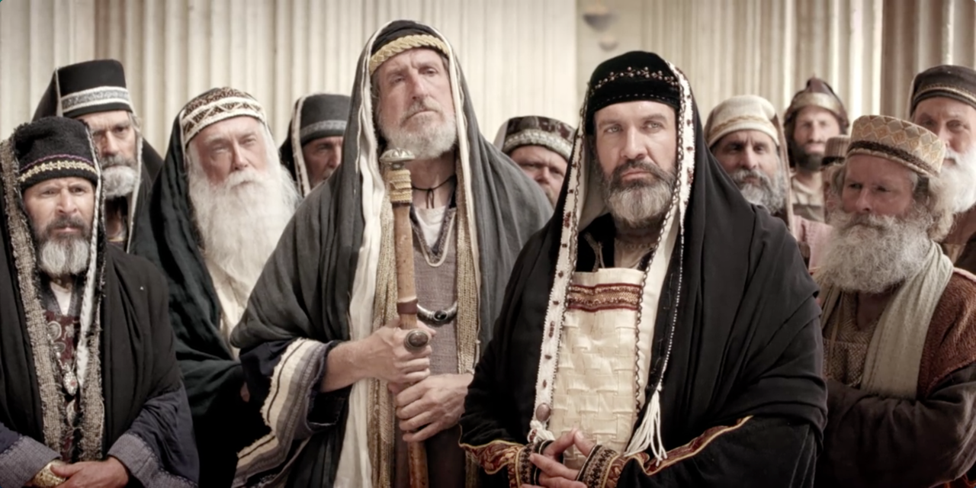
As it was in the days of Jesus …
… so it is even today.

Slide 21
The Pharisees and scribes of today:
There is a ‘question’ that Commandment-keepers, or Sabbath-keepers (especially, Seventh-day Adventists) are commonly asked by such very “religious” persons:

Slide 22
The Pharisees and scribes of today:
“Do you stone the sabbath-breaker …?”

Slide 23
What has been the answer of God’s people to this?
God's people have usually answered this accusatory and subtil question with, “No, we no longer stone the Sabbath breaker, for we are under the New Covenant, and therefore, that law (Numbers 15:30-36 KJB) no longer applies to us today.”

Slide 24
Well, why do you, who claim to be Jesus’ disciples …
… not do as Moses, even God, commanded be done?

Slide 25
The Pharisees and scribes continue:
“… for you do not keep all of the law, and pick and choose what you want, being hypocrites and judges of yourselves, for it is written, that if you keep not one point, you are guilty of all.”

Slide 26
The answer of “No.” to the question, will only give accusatory ammunition to those who oppose the Truth; and while that answer seems best at first consideration, it is actually, incorrect.

Slide 27
The true answer to, “Do you stone the Sabbath breaker?”, according to the scripture, is “Yes, all being a matter of Who, What, Where, When, Why and How. Let me show you from the Bible.”

Slide 28
Sins of Ignorance, No Knowledge Numbers 15:22-29 KJB
“And if ye have erred, and not observed all these commandments, which the LORD hath spoken unto Moses,”
– Numbers 15:22 KJB

Slide 29
Sins of Ignorance, No Knowledge
“Even all that the LORD hath commanded you by the hand of Moses, from the day that the LORD commanded Moses, and henceforward among your generations;” – Numbers 15:23 KJB

Slide 30
Sins of Ignorance, No Knowledge
“Then it shall be, if ought be committed by ignorance without the knowledge of the congregation, that all the congregation shall offer one young bullock for a burnt offering, for a sweet savour unto the LORD, with his meat offering, and his drink offering, according to the manner, and one kid of the goats for a sin offering.” – Numbers 15:24 KJB

Slide 31
Sins of Ignorance, No Knowledge
“And the priest shall make an atonement for all the congregation of the children of Israel, and it shall be forgiven them; for it is ignorance: and they shall bring their offering, a sacrifice made by fire unto the LORD, and their sin offering before the LORD, for their ignorance:”
– Numbers 15:25 KJB

Slide 32
Sins of Ignorance, No Knowledge
“And it shall be forgiven all the congregation of the children of Israel, and the stranger that sojourneth among them; seeing all the people were in ignorance.”
– Numbers 15:26 KJB

Slide 33
Sins of Ignorance, No Knowledge
“And if any soul sin through ignorance, then he shall bring a she goat of the first year for a sin offering.” – Numbers 15:27 KJB

Slide 34
Sins of Ignorance, No Knowledge
“And the priest shall make an atonement for the soul that sinneth ignorantly, when he sinneth by ignorance before the LORD, to make an atonement for him; and it shall be forgiven him.” – Numbers 15:28 KJB

Slide 35
Sins of Ignorance, No Knowledge
“Ye shall have one law for him that sinneth through ignorance, both for him that is born among the children of Israel, and for the stranger that sojourneth among them.” – Numbers 15:29 KJB

Slide 36
Sins of Presumption, Full Knowledge Numbers 15:30-31 KJB
“But the soul that doeth ought presumptuously, whether he be born in the land, or a stranger, the same reproacheth the LORD; and that soul shall be cut off from among his people.”
– Numbers 15:30 KJB

Slide 37
Sins of Presumption, Full Knowledge
“Because he hath despised the word of the LORD, and hath broken his commandment, that soul shall utterly be cut off; his iniquity shall be upon him.”
– Numbers 15:31 KJB

Slide 39
Sins of Presumption, Judgment Numbers 15:32-36 KJB
“And while the children of Israel were in the wilderness, they found a man that gathered sticks upon the sabbath day.”
– Numbers 15:32 KJB

Slide 40
Sins of Presumption, Judgment
“And they that found him gathering sticks brought him unto Moses and Aaron, and unto all the congregation.”
– Numbers 15:33 KJB

Slide 41
Sins of Presumption, Judgment
“And they put him in ward, because it was not declared what should be done to him.”
– Numbers 15:34 KJB

Slide 42
Sins of Presumption, Judgment
“And the LORD said unto Moses, The man shall be surely put to death: all the congregation shall stone him with stones without the camp.” – Numbers 15:35 KJB

Slide 43
Sins of Presumption, Judgment
“And all the congregation brought him without the camp, and stoned him with stones, and he died; as the LORD commanded Moses.”
– Numbers 15:36 KJB

Slide 45
The judgment for willful disobedience was given directly by God (Son of the Father; Jesus) Himself.
It applies to “the children of Israel”, and all, native born or stranger, within their “camp” (Numbers 15:35,36 KJB), property, “borders”, and/or “gates”, see Exodus 20:10 KJB.

Slide 46
Notice, that this event was during the time that they were “in the wilderness” where they found one among them, “a man”, that “gathered sticks upon the sabbath day”.

Slide 47
It was the solemn duty of the whole faithful congregation to remove the person from the “camp” and place them “without” [outside] the “camp”.

Slide 48
It was then the more solemn duty of the whole faithful congregation, by the direction of God's judgment, to “stone” that presumptuous law-breaker “with stones”, and “put to death”, “cut off”, so that the “iniquity shall be upon” the person forever.

Slide 49
Does any of this apply today for the life of the Christian under the New Covenant and in the New Testament?

Slide 50
Yes, for first there is the Natural peoples of Israel, after the flesh, and then, there is the Spiritual peoples of Israel, after the spirit.
“Howbeit that was not first which is spiritual, but that which is natural; and afterward that which is spiritual.”
– 1 Corinthians 15:46 KJB

Slide 51
“All scripture is given by inspiration of God, and is profitable for doctrine, for reproof, for correction, for instruction in righteousness:”
– 2 Timothy 3:16 KJB

Slide 52
“That the man of God may be perfect, throughly furnished unto all good works.”
– 2 Timothy 3:17 KJB

Slide 53
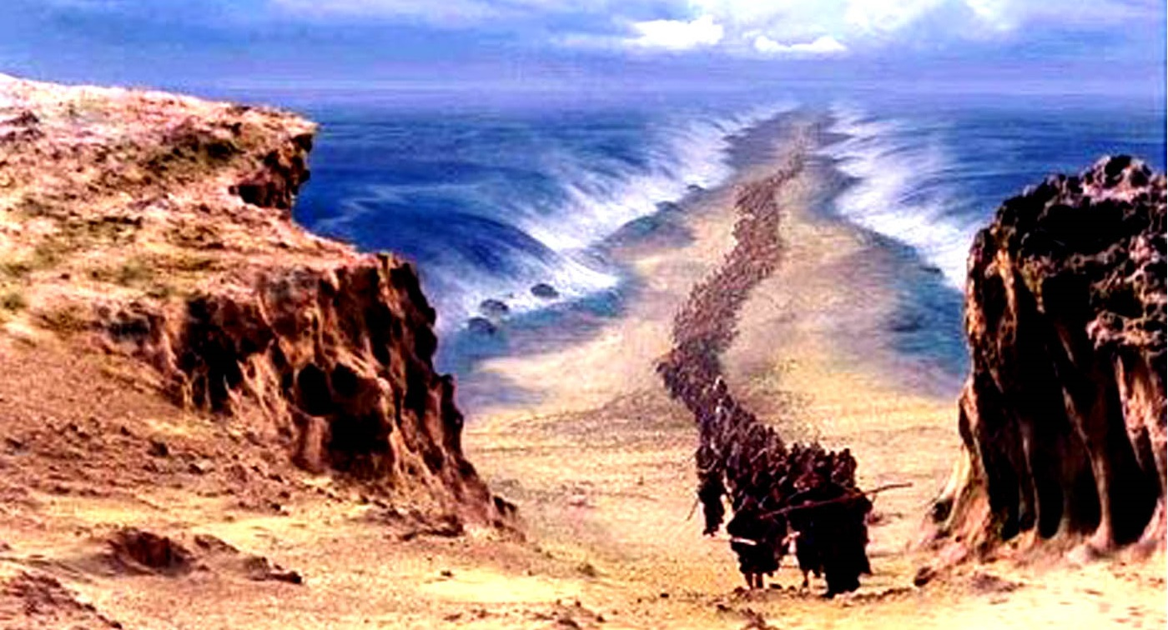
ISRAEL (natural)
of old, after the flesh …

Slide 54
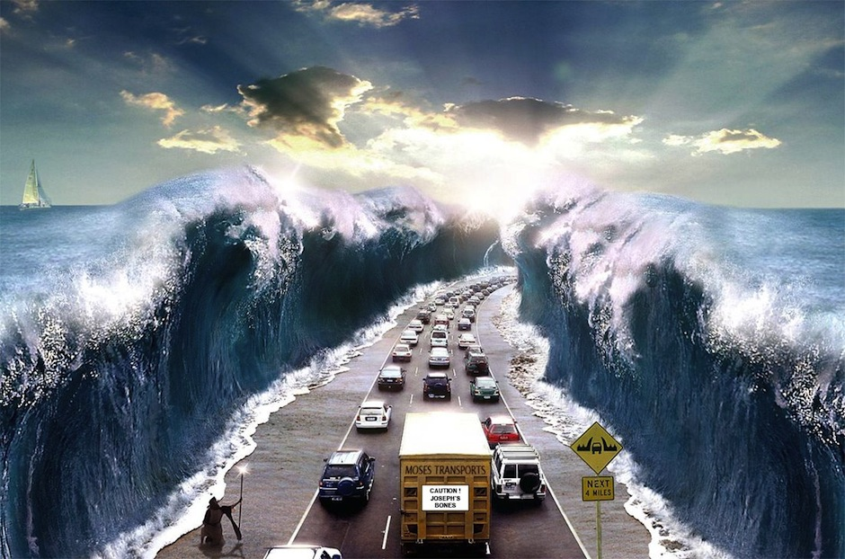
ISRAEL (spiritual)
of today, after the spirit (Christians) …

Slide 55
Who, according to scripture, is the real Israel, and who are his children?

Slide 56
“And when they were departed, behold, the angel of the Lord appeareth to Joseph in a dream, saying, Arise, and take the young child and his mother, and flee into Egypt, and be thou there until I bring thee word: for Herod will seek the young child to destroy him. ” – Matthew 2:13 KJB

Slide 57
“When he arose, he took the young child and his mother by night, and departed into Egypt:”
– Matthew 2:14 KJB

Slide 58
“And was there until the death of Herod: that it might be fulfilled which was spoken of the Lord by the prophet, saying, Out of Egypt have I called my son.”
– Matthew 2:14 KJB

Slide 59
“But when Herod was dead, behold, an angel of the Lord appeareth in a dream to Joseph in Egypt,” – Matthew 2:19 KJB

Slide 60
“Saying, Arise, and take the young child and his mother, and go into the land of Israel: for they are dead which sought the young child's life.” – Matthew 2:20 KJB

Slide 61
“And he arose, and took the young child and his mother, and came into the land of Israel.”
– Matthew 2:21 KJB

Slide 62
Who did Matthew, under inspiration of the Holy Ghost, cite from the Old Testament prophets?
Who did Matthew, under inspiration of the Holy Ghost, state was the true fulfillment?

Slide 63
“When Israel was a child, then I loved him, and called my son out of Egypt.” – Hosea 11:1 KJB
Jesus, is the true fulfillment.

Slide 64
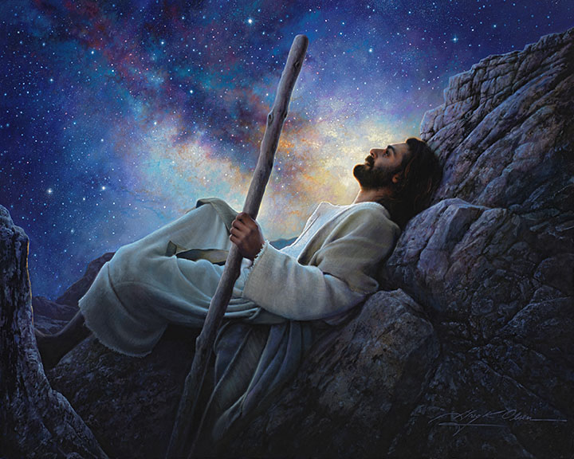

Slide 65
Who, then are His children, His ‘12 tribes’?

Slide 66
“And again, I will put my trust in him. And again (that is, Paul, citing from scripture “again”), Behold I and the children which God (the Father) hath given me (Jesus).” – Hebrews 2:13 KJB
(Read Hebrews 2:10-18 KJB)

Slide 67
Where was Paul, under inspiration of the Holy Ghost, citing from in the Old Testament prophets, and who did he say was the true fulfillment?

Slide 68
“And he shall pass through Judah; he shall overflow and go over, he shall reach even to the neck; and the stretching out of his wings shall fill the breadth of thy land, O Immanuel.” – Isaiah 8:8 KJB

Slide 69
“Associate yourselves, O ye people, and ye shall be broken in pieces; and give ear, all ye of far countries: gird yourselves, and ye shall be broken in pieces; gird yourselves, and ye shall be broken in pieces.”
– Isaiah 8:9 KJB

Slide 70
“Take counsel together, and it shall come to nought; speak the word, and it shall not stand: for God is with us.” – Isaiah 8:10 KJB

Slide 71
“For the LORD spake thus to me with a strong hand, and instructed me that I should not walk in the way of this people, saying,”
– Isaiah 8:11 KJB

Slide 72
“Say ye not, A confederacy, to all them to whom this people shall say, A confederacy; neither fear ye their fear, nor be afraid.”
– Isaiah 8:12 KJB

Slide 73
“Sanctify the LORD of hosts himself; and let him be your fear, and let him be your dread.”
– Isaiah 8:13 KJB

Slide 74
“And he shall be for a sanctuary; but for a stone of stumbling and for a rock of offence to both the houses of Israel, for a gin and for a snare to the inhabitants of Jerusalem.” – Isaiah 8:14 KJB
Isaiah 8:14 KJB is cited again in the New Testament by Paul [Romans 9:32,33 KJB] and Peter [1 Peter 2:8 KJB] as applying directly to Jesus, who is Immanuel, God with us.

Slide 75
“And many among them shall stumble, and fall, and be broken, and be snared, and be taken.”
– Isaiah 8:15 KJB

Slide 76
“Bind up the testimony, seal the law among my disciples.”
– Isaiah 8:16 KJB

Slide 77
“And I will wait upon the LORD, that hideth his face from the house of Jacob, and I will look for him.”
– Isaiah 8:17 KJB

Slide 78
“Behold, I and the children whom the LORD hath given me are for signs and for wonders in Israel from the LORD of hosts, which dwelleth in mount Zion.”
– Isaiah 8:18 KJB

Slide 79
“And when they shall say unto you, Seek unto them that have familiar spirits, and unto wizards that peep, and that mutter: should not a people seek unto their God? for the living to the dead?”
– Isaiah 8:19 KJB

Slide 80
“To the law and to the testimony: if they speak not according to this word, it is because there is no light in them. ” – Isaiah 8:20 KJB

Slide 81
Look:
“… Behold I and the children which God hath given me.”
– Hebrews 2:13 KJB
“… my disciples.” – Isaiah 8:16 KJB
“Behold, I and the children whom the LORD hath given me …”
– Isaiah 8:18 KJB

Slide 82
Look:
“my disciple/s” – Matthew 26:18; Mark 14:14; Luke 14:26,27,33, 22:11; John 8:31, 13:35, 15:8 KJB
“children” – “Little children, yet a little while I am with you. Ye shall seek me: and as I said unto the Jews, Whither I go, ye cannot come; so now I say to you.”
– John 13:33 KJB

Slide 83
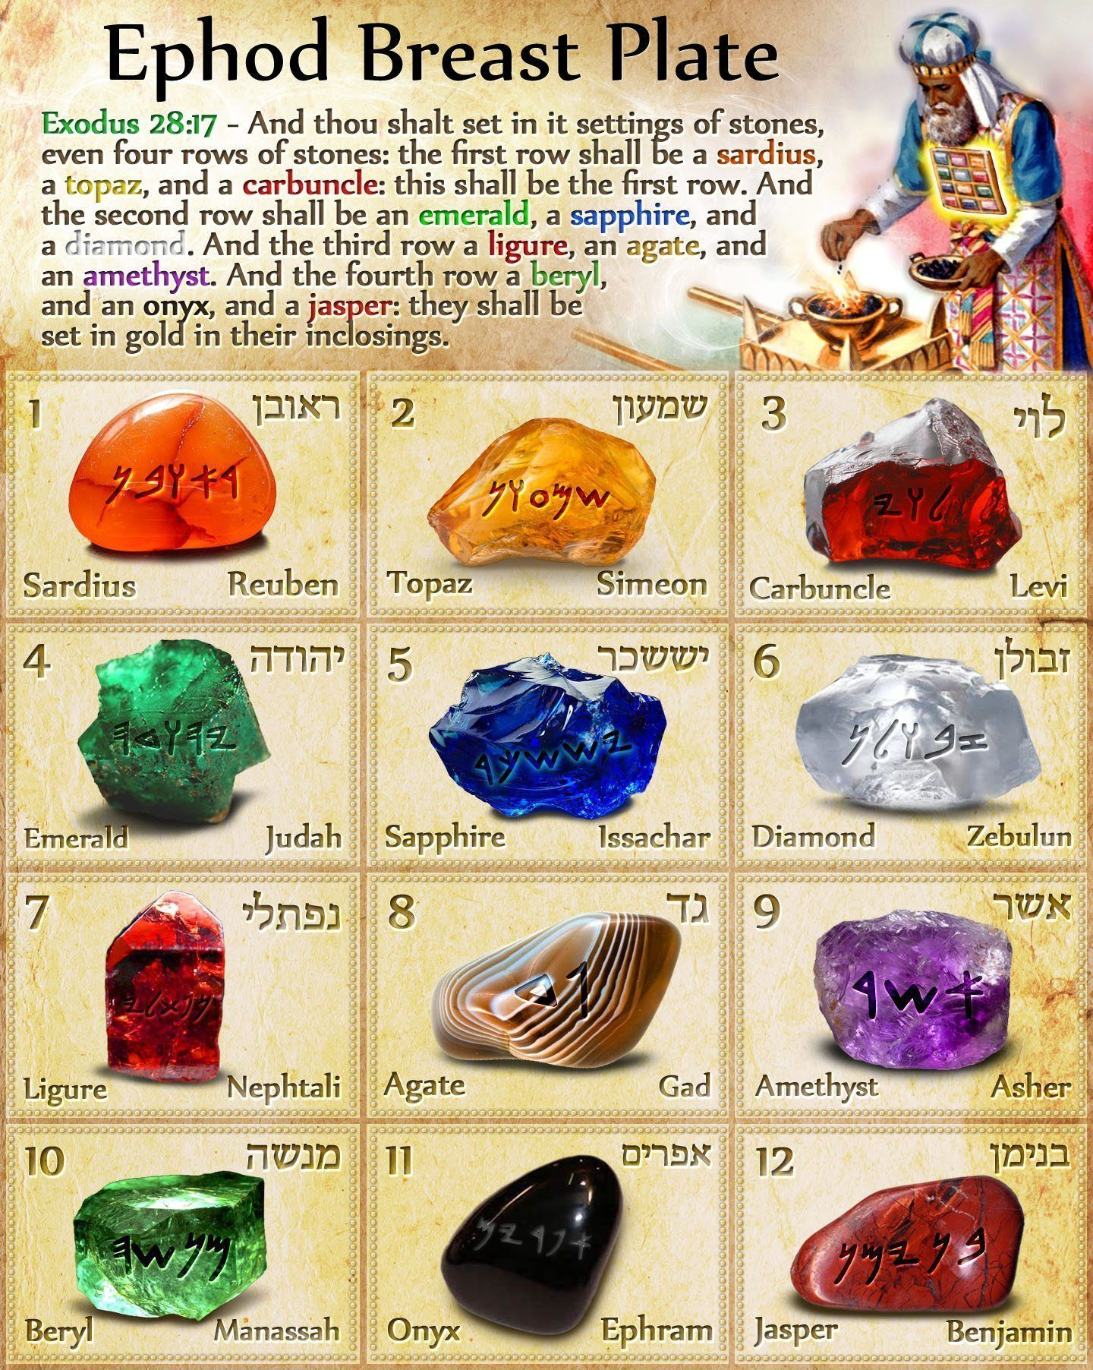
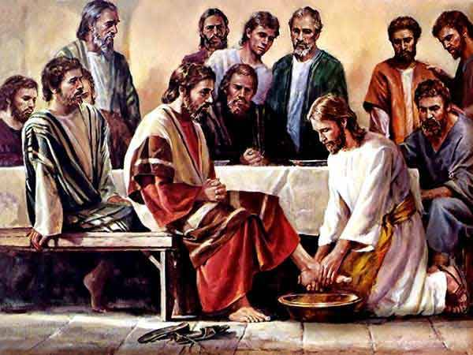
12 Tribes of Israel …
… 12 Apostles of Jesus.

Slide 84
Look:
'Israel' after the flesh, as a 'nation', is left desolate (Matthew 23:38; Luke 13:35), to bear no more fruit ever again (Matthew 21:19), cursed, withered away (Mark 11:21), dried up from the roots (Mark 11:20), "twice dead" (Jude 1:12), and the axe having already been laid at their root (Matthew 3:10; Luke 3:9), cutting them down and to be thrown into the fire to come. Yet, individuals can still be saved by grace through faith in Christ Jesus.

Slide 85
Look:
Jesus is Israel (Matthew 2:13-15; Hosea 11:1; his children are his disciples; Hebrews 2:13; Isaiah 8:16,18; John 13:33), the true "overcomer" (John 16:33; Revelation 3:21), the real "Prince" with God (Isaiah 9:6; Daniel 8:11,25, 9:25, 10:13,21, 11:22, 12:1; Acts 3:15, 5:31; Revelation 1:5), being Lord over His own house, whose house are we (Psalms 98:3; Hebrews 3:6; Jeremiah 31:33), who himself is the "elect" (Isaiah 42:1; Matthew 12:18; 1 Peter 2:6) of the Father, in whom all the promises of God find their realization (2 Corinthians 1:20).
Mat 2:13-15; Hos 11:1; Jer 31:33; Rom 9:6-8; Heb 2:13; Isa 8:16,18; Jhn 13:33, 16:33, 17:12, 18:9, 21:5; 1 Cor 15:46; 2 Cor 1:20; Gal 6:16; Heb 3:6, 8:8,10; Rev 3:21

Slide 86
Are, Christians (Spiritual Israel), presently going through “the wilderness” of this earth, being pilgrims, or strangers, having no permanent home here, looking instead for the borders and land of the Heavenly Canaan (Exodus 20:12 KJB)?
Are they to keep the sabbath of the LORD, the 7th day here also?

Slide 87
Christians are to keep the sabbath of the LORD, the 7th day, holy in the New Covenant.

Slide 88
“Thus saith the LORD, Keep ye judgment, and do justice: for my salvation is near to come, and my righteousness to be revealed.”
– Isaiah 56:1 KJB

Slide 89
Who is this “salvation” that comes?
“And she shall bring forth a son, and thou shalt call his name JESUS: for he shall save his people from their sins.” – Matthew 1:21 KJB
“For mine eyes have seen thy salvation,” – Luke 2:30 KJB
“And all flesh shall see the salvation of God.” – Luke 3:6 KJB

Slide 90
What/who is this “righteousness” that is revealed?
“But now the righteousness of God without the law is manifested, being witnessed by the law and the prophets;”
– Romans 3:21 KJB
“Even the righteousness of God which is by faith of Jesus Christ unto all and upon all them that believe: for there is no difference:” – Romans 3:22 KJB

Slide 91
“The Lord GOD which gathereth the outcasts of Israel saith, Yet will I gather others to him, beside those that are gathered unto him.” – Isaiah 56:8 KJB

Slide 92
Look:
“And other sheep I have, which are not of this fold: them also I must bring, and they shall hear my voice; and there shall be one fold, and one shepherd. ” – John 10:16 KJB
See also: John 21:15-17 KJB, “lambs” (young and spiritually young, babes in Christ), “sheep” (Jewish believers), “sheep” (Gentile believers)

Slide 93
So, Isaiah 56:1,8 KJB are about Jesus Christ in the New Testament, and those who would follow Him.
Let’s go back and look at the immediate context (vss. 2-7) in between those two verses, and see what it says about sabbath keeping in the New Covenant.

Slide 94
“Blessed is the man that doeth this, and the son of man that layeth hold on it; that keepeth the sabbath from polluting it, and keepeth his hand from doing any evil.” – Isaiah 56:2 KJB

Slide 95
“Neither let the son of the stranger, that hath joined himself to the LORD, speak, saying, The LORD hath utterly separated me from his people: neither let the eunuch say, Behold, I am a dry tree.” – Isaiah 56:3 KJB

Slide 96
“For thus saith the LORD unto the eunuchs that keep my sabbaths, and choose the things that please me, and take hold of my covenant;” – Isaiah 56:4 KJB

Slide 97
“Even unto them will I give in mine house and within my walls a place and a name better than of sons and of daughters: I will give them an everlasting name, that shall not be cut off.” – Isaiah 56:5 KJB

Slide 98
“Also the sons of the stranger, that join themselves to the LORD, to serve him, and to love the name of the LORD, to be his servants, every one that keepeth the sabbath from polluting it, and taketh hold of my covenant;” – Isaiah 56:6 KJB

Slide 99
“Even them will I bring to my holy mountain, and make them joyful in my house of prayer: their burnt offerings and their sacrifices shall be accepted upon mine altar; for mine house shall be called an house of prayer for all people.”
– Isaiah 56:7 KJB

Slide 100
As we have seen, in the previous texts of the Old Testament, that there were sins of Ignorance, and sins of Presumption.
Is it the same in the New Testament?

Slide 101
As we have seen, in the previous texts of the Old Testament, there were sins of Ignorance, and sins of Presumption.
Is it the same in the New Testament?

Slide 102
Sins of Ignorance, No Knowledge
“But he that knew not, and did commit things worthy of stripes, shall be beaten with few stripes. For unto whomsoever much is given, of him shall be much required: and to whom men have committed much, of him they will ask the more.” – Luke 12:48 KJB

Slide 103
Sins of Presumption, Judgment
“And that servant, which knew his lord's will, and prepared not himself, neither did according to his will, shall be beaten with many stripes.” – Luke 12:47 KJB

Slide 104
God is Merciful and Just, and no respecter of persons, the same yesterday, today and forever:
Exodus 20:5-6, 34:6-7; Leviticus 19:15,35-37; Deuteronomy 5:9-10, 16:18-20, 25:15, 32:4; 2 Samuel 14:14; Psalms 102:27; Isaiah 45:21; Malachi 3:6; Acts 10:34, 22:14; Hebrews 1:12, 13:8; Revelation 15:3

Slide 105
What was the final penalty for unrepentant sin in the Old Testament texts?

Slide 106
Eternal Death
“Behold, all souls are mine; as the soul of the father, so also the soul of the son is mine: the soul that sinneth, it shall die.”
– Ezekiel 18:4 KJB

Slide 107
Eternal Death
“The soul that sinneth, it shall die. The son shall not bear the iniquity of the father, neither shall the father bear the iniquity of the son: the righteousness of the righteous shall be upon him, and the wickedness of the wicked shall be upon him.”
– Ezekiel 18:20 KJB

Slide 108
What is the final penalty for unrepentant sin in the New Testament texts?

Slide 109
Eternal Death
“For the wages of sin is death; but the gift of God is eternal life through Jesus Christ our Lord.”
– Romans 6:23 KJB

Slide 110
Eternal Death
“Of how much sorer punishment, suppose ye, shall he be thought worthy, who hath trodden under foot the Son of God, and hath counted the blood of the covenant, wherewith he was sanctified, an unholy thing, and hath done despite unto the Spirit of grace?” – Hebrews 10:29 KJB

Slide 111
So, for individual presumptuous sabbath-breaking, the penalty was death by stoning, but what about for a whole city of presumption?

Slide 112
“But if ye will not hearken unto me to hallow the sabbath day, and not to bear a burden, even entering in at the gates of Jerusalem on the sabbath day; then will I kindle a fire in the gates thereof, and it shall devour the palaces of Jerusalem, and it shall not be quenched.” – Jeremiah 17:27 KJB

Slide 113
“Behold, I will command, saith the LORD, and cause them to return to this city; and they shall fight against it, and take it, and burn it with fire: and I will make the cities of Judah a desolation without an inhabitant.” – Jeremiah 34:22 KJB

Slide 114
So, the question then comes to those who teach, preach and keep God’s sabbath, the 7th day, and especially asked of the Seventh-day Adventists, “Are Christians to stone the sabbath breaker? …”

Slide 115
The scribes and Pharisees, asked Jesus a similar question about the woman caught in adultery [whose punishment in the OT texts was also stoning to death - Leviticus 20:10 KJB; Deuteronomy 22:21-24; Ezekiel 16:38-40, 23:47; and also John 8:5 KJB]:

Slide 116
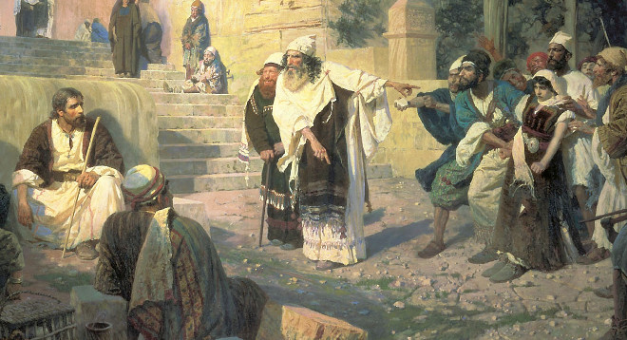
Woman caught in the act of adultery.
Moses commanded that such …

Slide 117
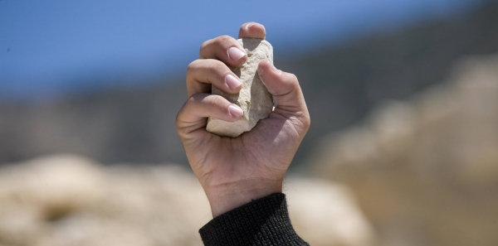
… should be stoned to death …
… Jesus, what do you say …

Slide 118
“Jesus stooped down, and with his finger wrote on the ground, as though he heard them not.”

Slide 119
“So when they continued asking him, he lifted up himself, and said unto them, He that is without sin among you, let him first cast a stone at her.” – John 8:7 KJB

Slide 120
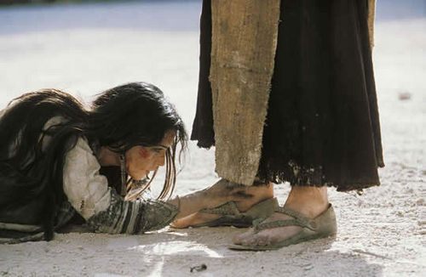

Slide 121
Jesus in the OT, said, Stone the sabbath-breaker (the same punishment for adultery), and in the NT, Jesus said, something different, so what gives?
Is there a contradiction, or did Jesus change His mind?

Slide 122
All the texts are true, and in harmony with one another, for there are no actual contradictions in the inspired and preserved word of God which, in the English language, is the King James Bible.

Slide 123
“... the word of God came, and the scripture cannot be broken;”
– John 10:35 KJB
“For God is not the author of confusion …”
– 1 Corinthians 14:33 KJB

Slide 124
“… wisdom … which the Holy Ghost teacheth; comparing spiritual things with spiritual.”
– 1 Corinthians 2:13 KJB
“For precept must be upon precept, precept upon precept; line upon line, line upon line; here a little, and there a little:” – Isaiah 28:10 KJB

Slide 125
“... One saying of the Saviour must not be made to destroy another. … {GC88 370.2}...” – The Great Controversy (1888, 1911), Chapter XX [20], A Great Religious Awakening, page 370.2

Slide 126
Jesus did say, “... He that is without sin among you, let him first cast a stone ...”, but He does not negate that which He gave previously in the OT texts in the statutes and judgments, for Jesus also said:

Slide 127
“Think not that I am come to destroy the law, or the prophets: I am not come to destroy, but to fulfil.” – Matthew 5:17 KJB

Slide 128
“For verily I say unto you, Till heaven and earth pass, one jot or one tittle shall in no wise pass from the law, till all be fulfilled.”
– Matthew 5:18 KJB

Slide 129
“Whosoever therefore shall break one of these least commandments, and shall teach men so, he shall be called the least in the kingdom of heaven: but whosoever shall do and teach them, the same shall be called great in the kingdom of heaven. ” – Matthew 5:19 KJB

Slide 130
“… Till heaven and earth pass …”
“Heaven and earth shall pass away, but my words shall not pass away.” – Matthew 24:35; Mark 13:31; Luke 21:33 KJB

Slide 131
“… Till heaven and earth pass …”
“And it is easier for heaven and earth to pass, than one tittle of the law to fail.” – Luke 16:17 KJB

Slide 132
“… Till heaven and earth pass …”
When will the heaven and earth pass away?
Not until the 2nd (heaven; Isa. 34:4; Rev. 6:14 KJB) and 3rd (earth; Rev. 20:11-15 KJB) coming of Christ Jesus:

Slide 133
“… Till heaven and earth pass …”
“But the day of the Lord will come as a thief in the night; in the which the heavens shall pass away with a great noise, and the elements shall melt with fervent heat, the earth also and the works that are therein shall be burned up.”
– 2 Peter 3:10 KJB

Slide 134
“… Till heaven and earth pass …”
“And I saw a new heaven and a new earth: for the first heaven and the first earth were passed away; and there was no more sea.”
– Revelation 21:1 KJB

Slide 135
How then can Numbers 15:32-36 KJB, John 8:7 KJB and Matthew 5:17-19 KJB be in harmony and not in direct contradiction to each other and to other texts?

Slide 136
Simple.
In the Condition & Timing;
in other words, the “... matter of Who, What, Where, When, Why and How ...”
Let’s read John 8:7 KJB again …

Slide 137
Do you see the “condition”:
“So when they continued asking him, he lifted up himself, and said unto them, He that is without sin among you, let him first cast a stone at her.” – John 8:7 KJB

Slide 138
Do you see the “condition”:
“So when they continued asking him, he lifted up himself, and said unto them, He that is without sin among you, let him first cast a stone at her.” – John 8:7 KJB

Slide 139
So in order to meet Jesus’ requirement to cast a stone at a transgressor of God’s Law, we must first be “without sin”.
Does anyone, presently, on earth meet such a requirement?

Slide 140
Presently, we all on this earth have sinned, and have a record of sin, and thus, we are not “without sin”:

Slide 141
“They are all gone aside, they are all together become filthy: there is none that doeth good, no, not one.” – Psalms 14:3 KJB
“… thine iniquity is marked before me, saith the Lord GOD.” – Jeremiah 2:22 KJB
“… Jews and Gentiles, that they are all under sin;” – Romans 3:9 KJB
“… There is none righteous, no, not one:”
– Romans 3:10 KJB

Slide 142
“They are all gone out of the way, they are together become unprofitable; there is none that doeth good, no, not one.”
– Romans 3:12 KJB
“For all have sinned, and come short of the glory of God;” – Romans 3:23 KJB
“… all have sinned:” – Romans 5:12 KJB

Slide 143
However, is there a time coming when the saints of God will be completely “without sin”, even the record of sin having been blotted out?

Slide 144
Oh, yes … when Christ Jesus makes the final atonement in the Most Holy Place and blots out all the record of the sins of the saints.
They will then be “without sin” on earth, and shortly thereafter, taken to heaven, where no sin shall enter.

Slide 145
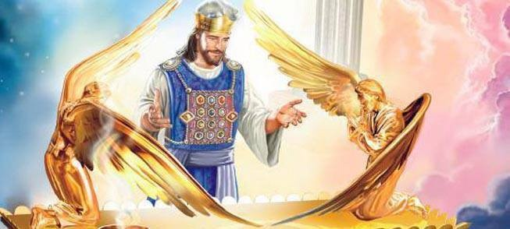
Jesus will blot out our sins …
… when He makes the final atonement.

Slide 146
“For on that day shall the priest make an atonement for you, to cleanse you, that ye may be clean from all your sins before the LORD.” – Leviticus 16:30 KJB

Slide 147
“And he shall make an atonement for the holy sanctuary, and he shall make an atonement for the tabernacle of the congregation, and for the altar, and he shall make an atonement for the priests, and for all the people of the congregation.”
– Leviticus 16:33 KJB

Slide 148
“And this shall be an everlasting statute unto you, to make an atonement for the children of Israel for all their sins once a year. And he did as the LORD commanded Moses.”
– Leviticus 16:34 KJB

Slide 149
“… blot out my transgressions.”
– Psalms 51:1 KJB
“… blot out all mine iniquities.”
– Psalms 51:9 KJB
“… sins may be blotted out, when the times of refreshing shall come from the presence of the Lord; …” – Acts 3:19 KJB

Slide 150
“Now unto him that is able to keep you from falling, and to present you faultless before the presence of his glory with exceeding joy,”
– Jude 1:24 KJB

Slide 151
“... Herein is the mystery of redemption, that … a thankless race of rebels … through the manifestation of [God’s] matchless love, … might stand before Him repentant, forgiven, guiltless, as if they had never sinned. …” – Bible Echo; November 25, 1895; par. 5

Slide 152
“… Every sin of which they had been guilty was forgiven, and they stood before God as chosen and true, as innocent, as perfect, as though they had never sinned. …” – The Advent Review & Sabbath Herald; August 29, 1893; par. 3

Slide 153
“… through the righteousness of Christ we shall stand before God pardoned, and as though we had never sinned. …” – Signs Of The Times; April 10, 1893; par. 4

Slide 154
The saints at the blotting out of sin will be “without sin”, and then they must enter the “New Jerusalem” above [Galatians 4:26 KJB], which is the “camp of the saints” [Revelation 20:9 KJB, see also Numbers 15:33-35 KJB], and there enter into the Judgment, for 1,000 years, wherein they will compare the deeds of the wicked, like sabbath breakers, with the Law of God, the Bible.

Slide 155
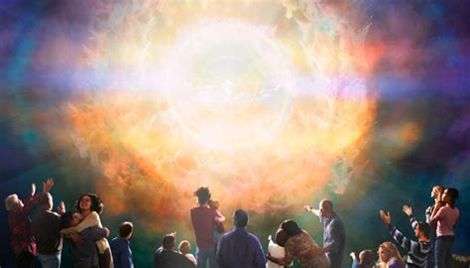

Slide 156
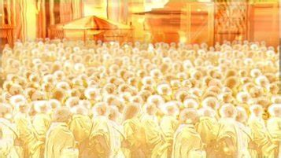

Slide 157
After the 1,000 years in Heaven, and the comparing of the deeds with the Bible, the saints will agree with the judgments of God already laid down, or written, therein.
They will “Amen” His judgments and so execute them.

Slide 159
“Let us hear the conclusion of the whole matter: Fear God, and keep his commandments: for this is the whole duty of man (Heb. Adam).”
– Ecclesiastes 12:13 KJB

Slide 160
“For God shall bring every work into judgment, with every secret thing, whether it be good, or whether it be evil.”
– Ecclesiastes 12:14 KJB

Slide 161
“I said in mine heart, God shall judge the righteous and the wicked: for there is a time there for every purpose and for every work.” – Ecclesiastes 3:17 KJB

Slide 162
“He that rejecteth me, and receiveth not my words, hath one that judgeth him: the word that I have spoken, the same shall judge him in the last day.”
– John 12:48 KJB

Slide 163
“Do ye not know that the saints shall judge the world? and if the world shall be judged by you, are ye unworthy to judge the smallest matters?” – 1 Corinthians 6:2 KJB

Slide 164
“Know ye not that we shall judge angels? how much more things that pertain to this life?”
– 1 Corinthians 6:3 KJB

Slide 165
When will those who are “without sin” judge?

Slide 166
During the 1,000 Years …
“Until the Ancient of days came, and judgment was given to the saints of the most High; and the time came that the saints possessed the kingdom.”
– Daniel 7:22 KJB

Slide 167
During the 1,000 Years …
[1] “Until ...”, that is the AD 538 unto the AD 1798, and/or the AD 508 unto the AD 1798-1843/44
[2] “... the Ancient of Days came ...”, that is, the Father came to the Most Holy Place from the Holy Place [Daniel 7:9,10; Revelation 3:7,8 KJB] in AD 1844, October 22, aka: the 10th Day of the 7th Month [Leviticus 23:27-32; Revelation 9:13-15; 14:6-7 KJB, the Hour [of His judgment], Day [10th, atonement], Month [Ethanim [aka Tishri], 7th; 1 Kings 8:2] and Year [AD 1844; Daniel 8:13-14, 12:12, etc]

Slide 168
During the 1,000 Years …
[3] “... and judgment was given to the saints of the Most High ...”, as seen in Revelation 20:4 KJB, during the 1,000 years. The text DOES NOT SAY, 'judgment was given in favour of the saints'. That is private interpretation [translation], and even subtraction and addition to the text which we are forbidden to do (2 Peter 1:20 KJB) under severe penalties.
[4] “... and the time came that the saints possessed the kingdom.”, which “time” is after the 1,000 years of Revelation 20:1-6, Isaiah 24:22 and Genesis 2:1-3 KJB.

Slide 169
During the 1,000 Years …
“But the judgment shall sit, and they shall take away his dominion, to consume and to destroy it unto the end.” – Daniel 7:26 KJB

Slide 170
During the 1,000 Years …
“And I saw thrones, and they sat upon them, and judgment was given unto them (see Daniel 7:22 KJB): and I saw the souls of them that were beheaded for the witness of Jesus, and for the word of God, and which had not worshipped the beast, neither his image, neither had received his mark upon their foreheads, or in their hands; and they lived and reigned with Christ a thousand years.”
– Revelation 20:4 KJB

Slide 171
During the 1,000 Years …
Once the Judgment in Heaven takes place by those “without sin”, during the 1,000 years, then New Jerusalem will have to come down to earth afterward, wherein all of the wicked will be raised “without the camp” [Numbers 15:35,36 KJB], then the stoning of the sabbath breaker (adulterer, etc) takes place and even the burning by fire, yea, fiery stones fall upon them and destroy them:

Slide 172
End of the 1,000 Years …
“And they [finally impenitent] shall be gathered together, as prisoners are gathered in the pit, and shall be shut up in the prison, and after many days shall they be visited.”
– Isaiah 24:22 KJB

Slide 173
End of the 1,000 Years …
“And when the thousand years are expired, Satan shall be loosed out of his prison,”
– Revelation 20:7 KJB

Slide 174
End of the 1,000 Years …
“For without are dogs, and sorcerers, and whoremongers, and murderers, and idolaters, and whosoever loveth and maketh a lie.” – Revelation 22:15 KJB

Slide 175
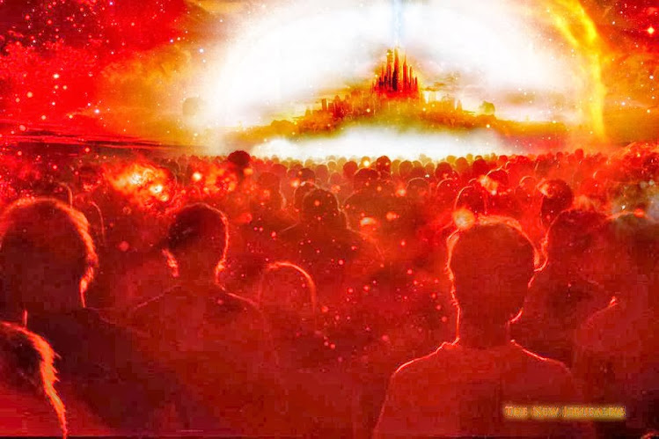

Slide 176
End of the 1,000 Years …
“And they went up on the breadth of the earth, and compassed the camp of the saints (see Numbers 15:35-56 KJB) about, and the beloved city: and fire came down from God out of heaven, and devoured them.”
– Revelation 20:9 KJB

Slide 177
End of the 1,000 Years …
“At the brightness that was before him his thick clouds passed, hail stones and coals of fire.”
– Psalms 18:12 KJB

Slide 178
End of the 1,000 Years …
“The LORD also thundered in the heavens, and the Highest gave his voice; hail stones and coals of fire.” – Psalms 18:13 KJB

Slide 179
End of the 1,000 Years …
“But the same day that Lot went out of Sodom it rained fire and brimstone from heaven, and destroyed them all.”
– Luke 17:26 KJB

Slide 180
End of the 1,000 Years …
“… of judgment and fiery indignation, which shall devour the adversaries.” – Hebrews 10:27 KJB

Slide 181
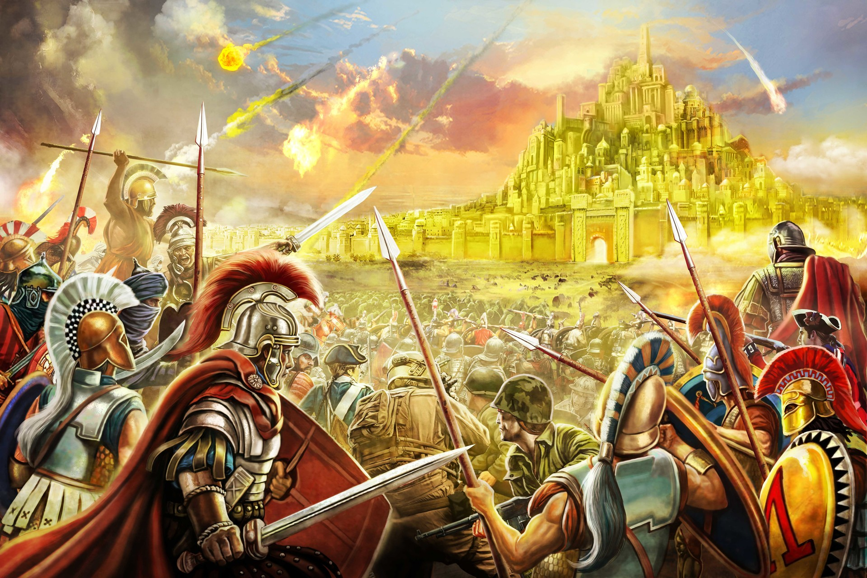

Slide 182
So we see that the Saints, will come to a period in time when they will be without sin, and then consider the cases of those who professed, but are found wanting, and so the Saints will agree with the judgments written in the word of God, and “Amen” the punishment therein as just.

Slide 183
This will mean that every Saint in Heaven, will have given their agreement, in harmony with God’s Law, for the destruction of the finally impenitent by brimstone and fire outside of the camp (city) of the Saints (New Jerusalem) when it comes to rest upon the earth.

Slide 184
They, in harmony with the command of God, are in effect “stoning” the sabbath-breakers, who having rejected the mercies of God in Christ Jesus, and the power to overcome all things, have chosen to presumptuously and willingly continue in their known sin, being worthy of the second death.

Slide 185
This will be the duty of every Saint.
There may even be some of those whom you know among that group.
Family, friends, neighbours, husband, wife, or even children.
All will personally know the wages of sin is death, and God means its eternal end.

Slide 186
“Praise ye the LORD. Sing unto the LORD a new song, and his praise in the congregation of saints.”
– Psalms 149:1 KJB

Slide 187
“Let Israel rejoice in him that made him: let the children of Zion be joyful in their King.”
– Psalms 149:2 KJB

Slide 188
“Let them praise his name in the dance: let them sing praises unto him with the timbrel and harp.”
– Psalms 149:3 KJB

Slide 189
“For the LORD taketh pleasure in his people: he will beautify the meek with salvation.”
– Psalms 149:4 KJB

Slide 190
“Let the saints be joyful in glory: let them sing aloud upon their beds.” – Psalms 149:5 KJB

Slide 191
“Let the high praises of God be in their mouth, and a twoedged sword in their hand;”
– Psalms 149:6 KJB

Slide 192
“To execute vengeance upon the heathen, and punishments upon the people;” – Psalms 149:7 KJB

Slide 193
“To bind their kings with chains, and their nobles with fetters of iron;” – Psalms 149:8 KJB

Slide 194
“To execute upon them the judgment written: this honour have all his saints. Praise ye the LORD.” – Psalms 149:9 KJB

Slide 195
“... During the thousand years between the first and the second resurrection the judgment of the wicked takes place. The apostle Paul points to this judgment as an event that follows the second advent. "Judge nothing before the time, until the Lord come, who both will bring to light the hidden things of darkness, and will make manifest the counsels of [661] the hearts." 1 Corinthians 4:5. …”

Slide 196
“… Daniel declares that when the Ancient of Days came, "judgment was given to the saints of the Most High." Daniel 7:22. At this time the righteous reign as kings and priests unto God. John in the Revelation says: "I saw thrones, and they sat upon them, and judgment was given unto them." "They shall be priests of God and of Christ, and shall reign with Him a thousand years." Revelation 20:4, 6. …”

Slide 197
“… It is at this time that, as foretold by Paul, "the saints shall judge the world." 1 Corinthians 6:2. In union with Christ they judge the wicked, comparing their acts with the statute book, the Bible, and deciding every case according to the deeds done in the body. Then the portion which the wicked must suffer is meted out, according to their works; and it is recorded against their names in the book of death. {GC 660.4} …”

Slide 198
“… Satan also and evil angels are judged by Christ and His people. Says Paul: "Know ye not that we shall judge angels?" Verse 3. And Jude declares that "the angels which kept not their first estate, but left their own habitation, He hath reserved in everlasting chains under darkness unto the judgment of the great day." Jude 6. {GC 661.1} …”

Slide 199
“… At the close of the thousand years the second resurrection will take place. Then the wicked will be raised from the dead and appear before God for the execution of "the judgment written.” … "They shall be gathered together, as prisoners are gathered in the pit, and shall be shut up in the prison, and after many days shall they be visited." Isaiah 24:22. {GC 661.2} ...”
– The Great Controversy (1911); pages 660.4-661.2

Slide 200
“… The wicked receive their recompense in the earth. … All are punished "according to their deeds." {SW, March 14, 1905 par. 12}
“… In the cleansing flames the wicked are at last destroyed … The full penalty of the law has been visited; the demands of justice have been met; and Heaven and earth, beholding, declare the righteousness of Jehovah. {SW, March 14, 1905 par. 13} ...”
– Southern Watchman; March 14, 1905; par. 12-13

Slide 201
To transgress the commandment of our Father in Heaven, even the sabbath of the LORD, the 7th day (Exodus 20:8-11 KJB), is very a “grave” matter, for it involves The Son, Jesus, carrying our whole load of sins, breaking His heart, and so He died the death we deserved for rebellion against His love.
Sin always involves:

Slide 202
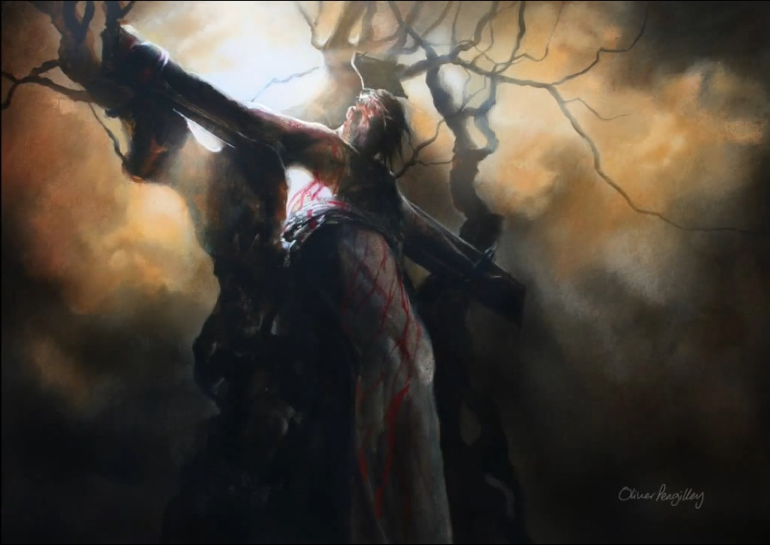
STICKS

Slide 203
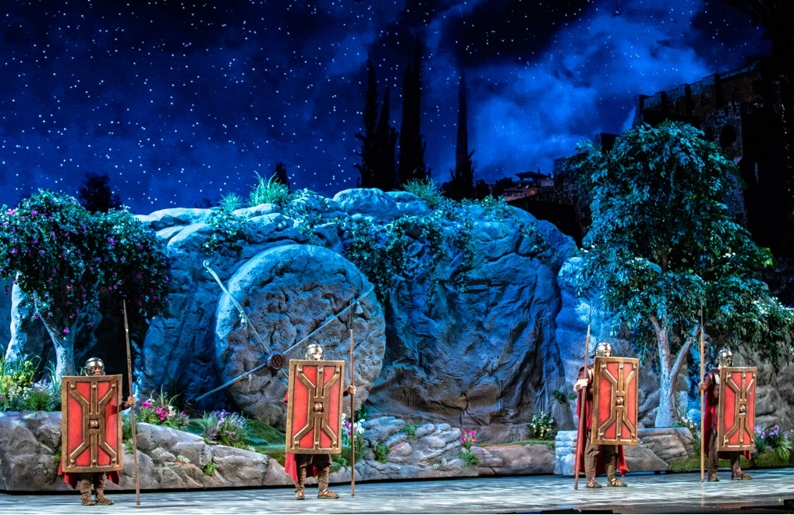
STONES

