Slide 2
3 John 1:2
'Beloved, I wish above all things that thou mayest prosper and be in health, even as thy soul prospereth.'

Slide 3
Health Status of AS
33.6% Are Diabetic
21.8% Pre-Diabetic

Slide 5
What is Diabetes?
Diabetes is the condition in which the body does not properly process food for use as energy.

Slide 6
Notes:
Most of the food we eat is turned into glucose, or sugar, for our bodies to use for energy. The pancreas, an organ that lies near the stomach, makes a hormone called insulin to help glucose get into the cells of our bodies. When you have diabetes, your body either doesn't make enough insulin or can't use its own insulin as well as it should.

Slide 7
Notes:
Type 2 diabetes may account for about 90 percent to 95 percent of all diagnosed cases of diabetes. Risk factors for Type 2 diabetes include older age, obesity, family history of diabetes, prior history of gestational diabetes, impaired glucose tolerance, physical inactivity, and race/ethnicity.

Slide 8
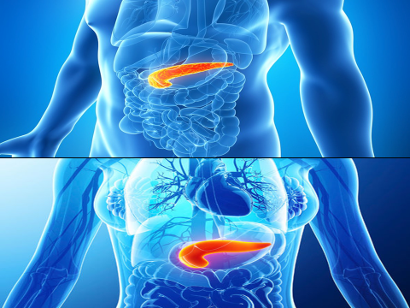

Slide 11
Unhealthy Eating Overweight Lack of Exercise Family History
Notes:
You will notice that of the 4 major risk factors for diabetes, 3 out of 4 are lifestyle related, or modifiable factors. So the good news is, we have a huge opportunity to avoid, control and even reverse some of these factors.

Slide 12
Notes:
Insulin Resistance is when your body isn’t responding to insulin the way it should. So either your body isn’t producing enough, or your body isn’t able to efficiently use the insulin that you do have. And what do you see here are the reasons behind that? HIGH FAT DIET. This is something that few people realize about Diabetes. It’s not just the excess sugar in our diet but also the excess FAT.

Slide 13
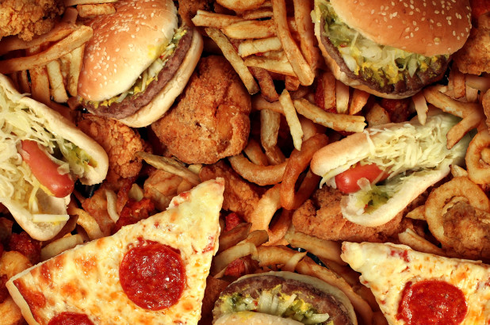
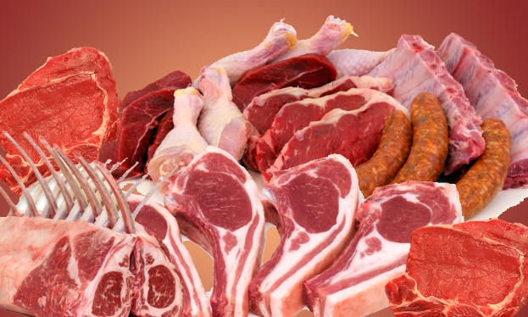
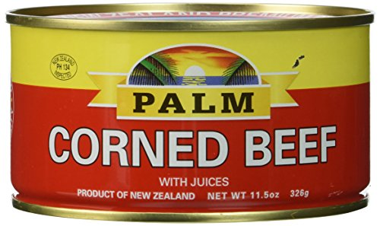
Diabetes
Notes:
What are the key sources of fat in the local diet?

Slide 14
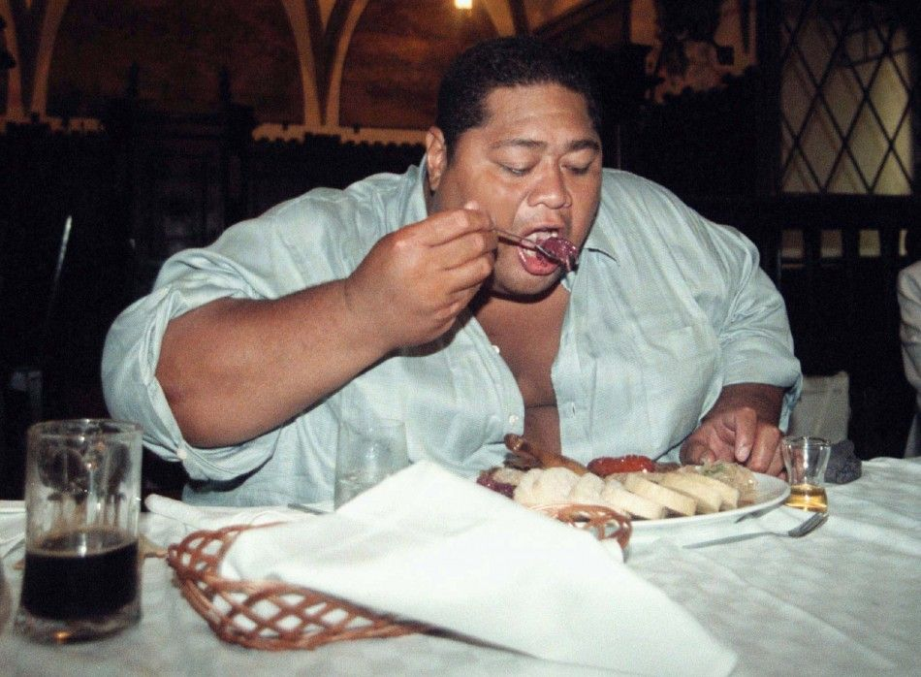
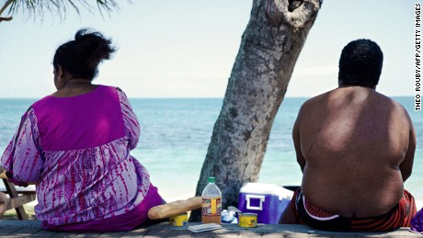
Notes:
American Samoa is ranked highest in the world in obesity, diabetes, and other chronic or lifestyle diseases. Is this the picture of health God intended for us? And it’s not just American Samoa but the Pacific as a whole. When Samoa isn’t #1 in obesity, it’s usually another Pacific Nation. So we’re all in this together guys. And unfortunately, if you’re not originally from here, well you’ll be guilty by association as you eat the same types of foods and live the same unhealthy habits that are prevalent here.

Slide 15
Diabetes
Thirst
Toilet
Tired
Thinner
Test!
Notes:
The symptoms can include:
Feeling thirstier than usual
Having to pee more often
Feeling hungrier than normal
Numb or tingling feet
You might also feel more tired than usual, get infections on your skin, or notice that cuts and sores take a long time to heal.
Blurred vision

Slide 16
Diabetes
Notes:
Heart disease is the leading cause of early death among people with diabetes. Adults with diabetes are two to three times more likely than people without diabetes to die of heart disease or have a stroke. Also, about 74% of people with diabetes have high blood pressure, a risk factor for heart disease. Nerve damage (neuropathy). Excess sugar can injure the walls of the tiny blood vessels (capillaries) that nourish your nerves, especially in your legs. This can cause tingling, numbness, burning or pain that usually begins at the tips of the toes or fingers and gradually spreads upward.
Left untreated, you could lose all sense of feeling in the affected limbs. Damage to the nerves related to digestion can cause problems with nausea, vomiting, diarrhea or constipation. For men, it may lead to erectile dysfunction.
Kidney damage (nephropathy). The kidneys contain millions of tiny blood vessel clusters (glomeruli) that filter waste from your blood. Diabetes can damage this delicate filtering system. Severe damage can lead to kidney failure or irreversible end-stage kidney disease, which may require dialysis or a kidney transplant.
Eye damage (retinopathy). Diabetes can damage the blood vessels of the retina (diabetic retinopathy), potentially leading to blindness. Diabetes also increases the risk of other serious vision conditions, such as cataracts and glaucoma.

Slide 17
3 John 1:2
'Beloved, I wish above all things that thou mayest prosper and be in health, even as thy soul prospereth.'

Slide 18
Revelation 7:2-3
And I saw another angel ascending from the east, having the seal of the living God: and he cried with a loud voice to the four angels, to whom it was given to hurt the earth and the sea…
Notes:
You may be wondering why we’ve been talking about health all these nights, because this is a PROPHESY Seminar, not a health workshop. But I want to share this passage in Revelation, the book we’ve been studying over the last 2 weeks. Let’s read these passages together.

Slide 19
Revelation 7:2-3
…Saying, Hurt not the earth, neither the sea, nor the trees, till we have sealed the servants of our God in their foreheads.
Notes:
Before Jesus comes, he is going to SEAL his people. Now, God’s seal contains his Name. Would you put your name or seal on something that was…subpar or broken down? Do you think God wants to seal his people in a broken down mental, physical, or spiritual state? Now, before He can seal us, he is trying to prepare us to be sealed, to be prepared for his coming. So, the health message in practicing temperance, converting our minds and our bodies by GOD’S GRACE, and through our daily choices and habits is also going to help prepare us to receive God’s seal. Jesus is telling us guys, GET READY, GET READY, GET READY. Tomorrow we’re going to learn more about this topic from Sister Losa, as she talks about how God’s Health Plan in the Bible will help you fight Diabetes.W

