Slide 1
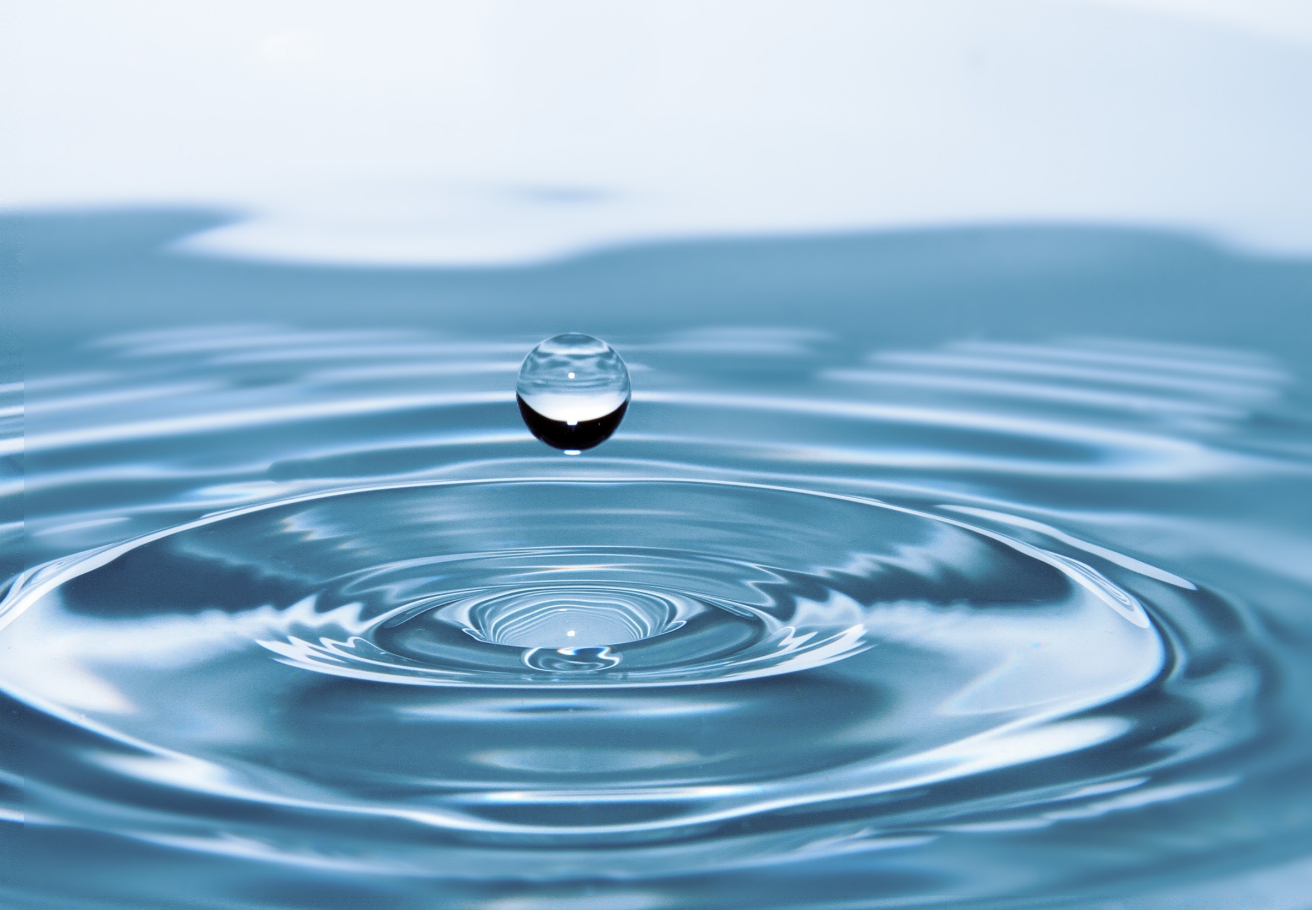
ater
NEWSTART
Notes:
Good Evening everyone. Welcome to our Spotlight on Health. Tonight we are going to be learning about Water and why it is important for your health.

Slide 2
Romans 12:1 ...I beseech you therefore, brethren, by the mercies of God, that ye present your bodies a living sacrifice, holy, acceptable unto God, which is your reasonable service.
Notes:
We have set aside time to talk about health each night and maybe you are wondering WHY. Not just so we can live longer, or just so we can feel or look good. No, It is because the Bible tells us in Romans 12 verse 1 that we are living sacrifices and we are to present ourselves to God as holy and acceptable.

Slide 3
1 Corinthians 10:31 ...'Whether therefore ye eat, or drink, or whatsoever ye do, do all to the glory of God.'
Notes:
Let’s read 1 Corinthians 10:31 together please…..
The Bible says that whether we eat or DRINK, we are to do ALL to the glory of God. Friends, are we glorifying God in what we Drink?

Slide 4
Notes:
Why is water so important? Did you know that about 60% of your body is made of water?
Look at these vital components of your body and how much water they contain. Water is one of the basic components of all living things. So water is VERY important.

Slide 5
Water cleanses inside and out
Notes:
Water is an all-purpose cleanser both inside and out of the body. It is an effective agent for washing away dirt, germs, and bacteria. All our tissues, vital fluids, and secretions contain a large percentage of water.

Slide 6
Notes:
A glass of water acts as a bath for the digestive system, cleansing and refreshing it. If we could follow the stream of water into the hidden places of our bodies, we would see it washing away the poisons in the blood that are circulating through the kidneys. The kidneys must work harder if the body doesn't get enough water.

Slide 7
Notes:
Other beverages are unable to purify like water. Soda and coffee can no more clean the inside of your body than they can the outside. All the chemical processes in the body require an adequate supply of water in order to keep the body functioning at peak efficiency. If water is not available, the body suffers and cannot do its work properly.

Slide 8
Dehydration
Increases: Stroke
Heart Disease
Headaches
Hypoglycemia
Tiredness
Fainting
Notes:
A lack of water dehydrates the fluids, tissues, and cells of the body. It causes the blood to thicken, increasing the risks of stroke and heart disease. Dehydration can mimic hypoglycemia, causing headaches, tiredness, and fainting spells.

Slide 9
Notes:
Our bodies lose at least ten cups of water every day. The food we eat only provides two to four cups of water, so we need to drink eight glasses each day to replace the difference. And in a hot climate like ours, where we are constantly losing water in our sweat, it is very important to drink plenty of water.

Slide 10
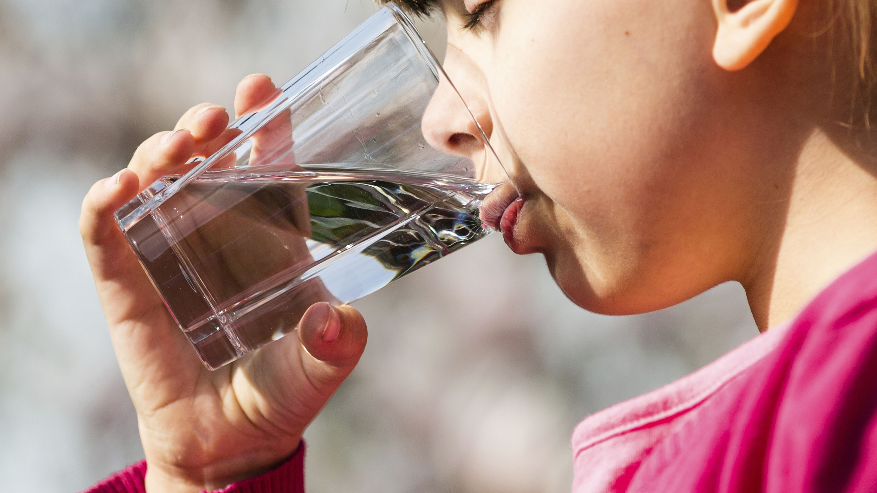
Notes:
Pure plain water is the best way to replace the fluid you need. Sugary drinks take more water to break down the sugar in a drink than the drink itself provides. Caffeine and alcohol both cause the body to lose water. You need an extra glass of water for every high-sugar, caffeinated, or alcoholic beverage you drink.

Slide 11
Notes:
As much as we need to drink water, one time that we should NOT drink water is with meals. Drinking with meals dilutes the gastric juice and slows the digestive process. The best time to drink water is between meals—20 minutes before a meal, and not until 2 hours after a meal—to obtain maximum digestion of your meal. When you are ill, drink plenty of water. This replaces any fluid lost during a fever and insures that every part of your body will function well.

Slide 12
Notes:
Water regulates the body's temperature. So if you feel hot, drink plenty of water. Frequent bathing also helps our largest organ—the skin—to eliminate toxins effectively. Water is the essence of life.

