Slide 1
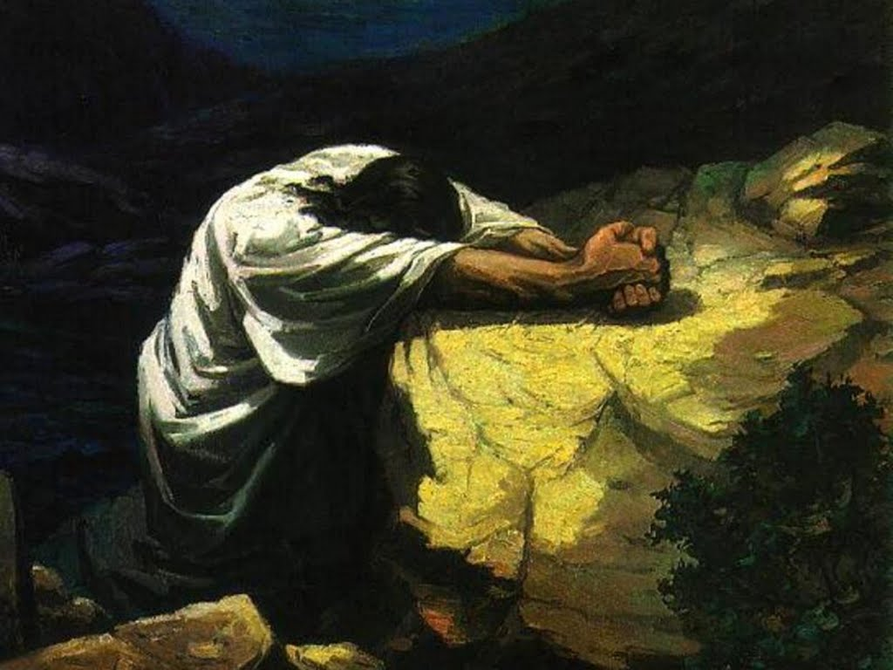
Trust in God
Notes:
Perhaps you have been trying to improve your lifestyle, but you realize that your efforts to change the habits that may have impaired your health have been fruitless. Have you considered that the power to change may need to come from without rather than within? Here at Maranatha, we believe the only Higher Power that is worthy of our complete trust is God, the Creator of the universe, our forever Friend.

Slide 2
“Thou wilt keep him in perfect peace, whose mind is stayed on thee: because he trusteth in thee.” – Isaiah 26:3 KJB
Notes:
The prophet Isaiah says: “Thou wilt keep him in perfect peace, whose mind is stayed on thee: because he trusteth in thee.” In other words, if you put your trust in the Lord no matter what the situation may be, He will keep your mind in perfect peace.

Slide 3
“Gratitude, rejoicing, benevolence, trust in God's love and care—these are health's greatest safeguard” – The Ministry of Healing, page 281.3
Notes:
In the book, Ministry of Healing we read: “Gratitude, rejoicing, benevolence, trust in God's love and care—these are health's greatest safeguard.”

Slide 4
“It is better to trust in the LORD than to put confidence in man.” – Psalms 118:8 KJB
Notes:
Psa 118:8 It is better to trust in the LORD than to put confidence in man.

Slide 5
We read in Counsels on Health:
“Not a few in this Christian age and Christian nation resort to evil spirits, rather than trust to the power of the living God. …”

Slide 7
“… The mother watching by the sickbed of her child, exclaims, “I can do no more. Is there no physician who has power to restore my child?” …”

Slide 8
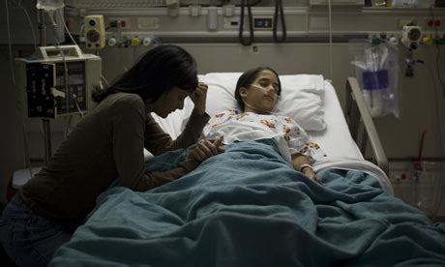

Slide 9
“… She is told of the wonderful cures performed by some clairvoyant or magnetic healer …”

Slide 11
“… and she trusts her dear one to his charge, placing it as verily in the hands of Satan as if he were standing by her side. …”

Slide 13
“… In many instances the future life of the child is controlled by a satanic power which it seems impossible to break.” – Counsels on Health, page 454.3

Slide 14
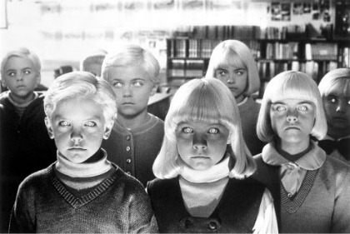

Slide 15
“O wretched man that I am! who shall deliver me from the body of this death? I thank God through Jesus Christ our Lord. So then with the mind I myself serve the law of God; but with the flesh the law of sin.” – Romans 7:24-25 KJB
Notes:
Paul realized the battle was not his, but Christ’s. He realized his own helpless condition – his sickness, if you will. When you come to this point, then you are on the road to recovery – on the road to a NEWSTART! When you recognize that some of your past habits may have contributed to your sickness, then it’s time to “trust.” Trust in the deliverance offered by Jesus Christ. Trust in the power of a God who created you – a God who loves you, and who even died for you. When we feel we cannot change our bad habits, then trust that God can! Hand over control and trust in His power to give you the strength to make the right decisions. The result? Jesus said, “I am come that they might have life, and that they might have it more abundantly.” (John 10:10).

Slide 16
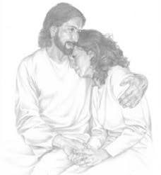
“Casting all your care upon him; for he careth for you.” – 1 Peter 5:7 KJB
Notes:
Peter expresses his trust in God this way: “Casting all your anxiety upon Him for He cares for you.” (1 Peter 5:7). Anxiety (or worry) is a state of mistrust and has led to many dire and evil consequences from drug addiction to suicide. It can cause high blood pressure, heart disease and even cancer. Resentment, hate, and anger cause anxiety. Anxiety and resentment may indicate a lack of the necessary trust that leads to a peaceful and content existence (see Matthew 6:25-34). Anxiety is gripping our nation due to natural disasters, economic insecurity, broken families, and social deterioration. This is the time to cast your anxiety upon God and trust Him. Won’t you consider giving Him a chance to show you what He can do? He’s waiting to give you strength and comfort like you’ve never had before.

