Slide 1
emperance
NEWSTART
Notes:
Good Evening Everyone. Welcome again to our Health Spotlight again tonight. So if you’ve been here with us for our health segment from the beginning, you’ve noticed we’ve covered a different topic each night. To help us remember what we’ve covered so far, we have this acronym…NEWSTART. This will help us remember the 8 Laws of Health. So let’s review the 4 Laws of Health we’ve heard about so far…N for Nutrition, E for exercise, W for water, S for sunlight. And tonight’s topic is TEMPERANCE. So be sure you make it to the continuation of our Spotlight on Health each of the coming nights so we can learn about the rest.

Slide 2
2 Peter 1:5-6 And beside this, giving all diligence, add to your faith virtue; and to virtue knowledge;
And to knowledge temperance; and to temperance patience; and to patience godliness;
Notes:
The Bible tells us that we should give ALL DILIGENCE to Temperance. This text tells us that in addition to faith, and virtue, that once we know better, we must do better. Once we know about temperance God expects us to practice temperance.

Slide 3
Temperance
Middle English: from Anglo-Norman French temperaunce, from Latin temperantia ‘moderation’, from temperare ‘restrain’.
Notes:
What is temperance? The word TEMPERANCE can be interchanged with words like moderation and restrain. When we discuss TEMPERANCE you can also think of it as SELF CONTROL. Some Bible translations use “self control” for “temperance,” but it is more than self-control. It is a God-given sense to use all He has given us, only as He directs. All of our appetites and desires come under the control of true temperance. This is the real challenge.

Slide 4
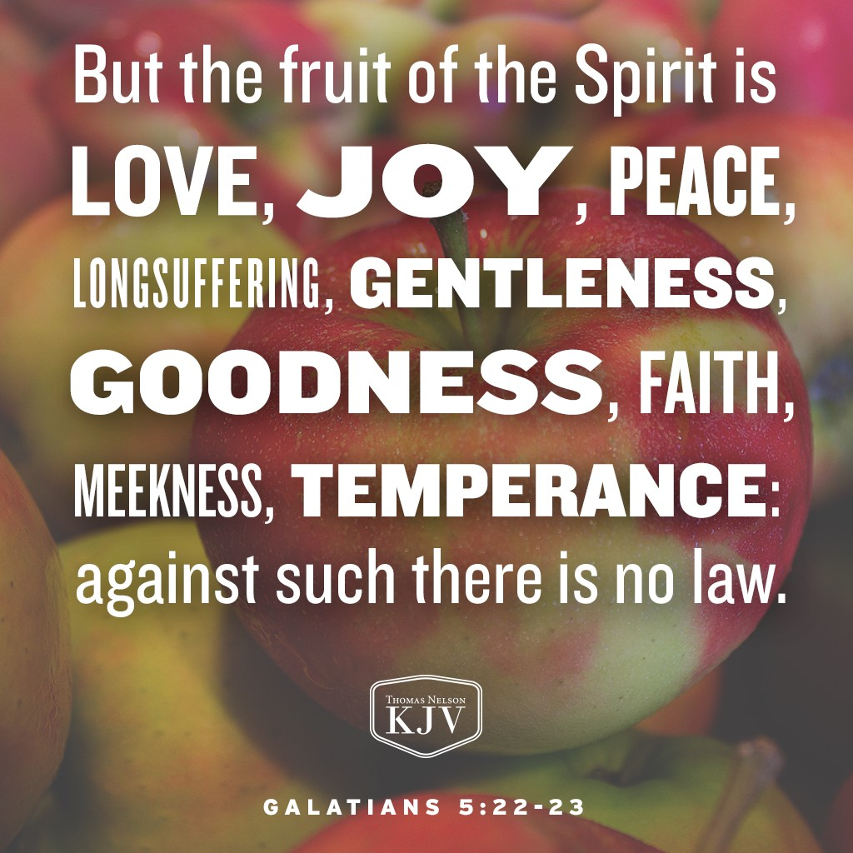
Notes:
Galations 5 verses 22 and 23 tell us that TEMPERANCE is a fruit of the Spirit. We need the Holy Spirit in order to be Temperate, and only by the power and direction of the Holy Spirit can we bring our desires and appetites under control.

Slide 5
Notes:
The Christian will be temperate in all things,--in eating, in drinking, in dress, and in every phase of life. Not for a short while, not so you can go on a fad diet, not for a temporary reward, but for the imperishable crown that the Father has in store for us.

Slide 6
Notes:
If you think being TEMPERATE isn’t important, look at what the Bible says about he who overcomes. Maybe the hardest thing that you have to overcome is YOURSELF. Jesus tells us in Revelation 3:21 that if we can overcome by His grace, He will grant us to sit with Him on His throne.

Slide 7
We have no right to indulge in anything that will result in a condition of mind that hinders the Spirit of God from impressing us with the sense of our duty.” Counsels on Health, 432.
Notes:
Here, the servant of the Lord tells us in Counsels on Health that practicing Temperance is to ensure that nothing hinders the mind from the impressions from the Spirit of God. Temperance isn’t just about keeping our bodies healthy, but it is to keep our minds clear and vigilant. We need to keep our minds open to hear the voice of the Holy Spirit as He speaks to us. That is why Temperance is so important. All of the other health laws we’ve discussed previously culminate or highlight TEMPERANCE. What are some of the things that can alter our minds?

Slide 8
Notes:
Can food alter our minds? What happens to us when we overeat? The adult stomach will comfortably accommodate only one quart of food and drink. Eat more than this, and it will stretch abnormally large. Blood supplying the needs of the body, especially the brain, will divert to the stomach for a prolonged period. This results in a sleepy feeling after a big meal. This also leads to becoming cranky, tired, or not able to think clearly. Temperance would prevent all this.

Slide 9
Proverbs 23:13
When thou sittest to eat…consider diligently what is before thee: And put a knife to thy throat, if thou be a man given to appetite.
Notes:
The Bible tells us to CONSIDER DILIGENTLY what you eat, and DO NOT GIVE IN TO APPETITE.

Slide 10
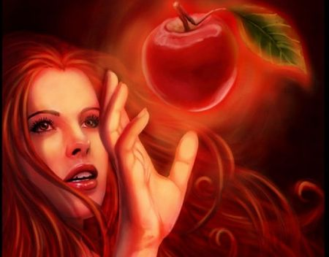
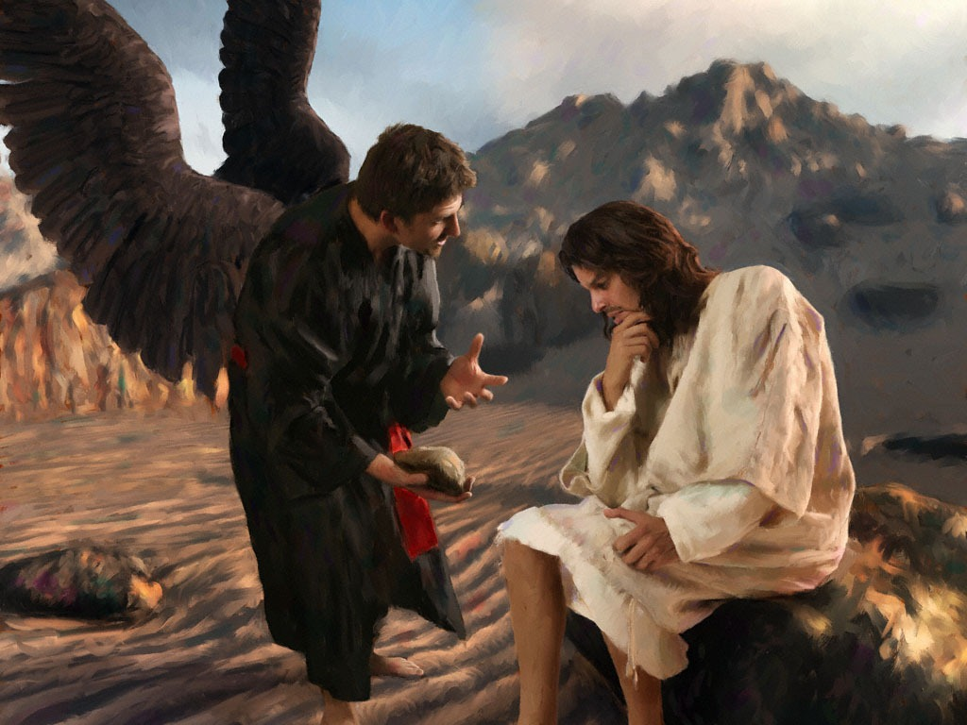
Is it a big deal?
Notes:
Sometimes we tend to downplay the importance of temperance and appetite. But let’s think back to some important lessons from the Bible. What was the first temptation of man? Eve was tempted to eat the forbidden fruit. What was the consequence of her decision? Well as we all know, it was the fall of the entire human race into sin. Which has effected us 6,000 years later. What about the 1st temptation of Christ? Satan knew that Jesus had been fasting for 40 days and it would be an easy thing for Him to feed Himself. But Thank God that Jesus overcame, because the result is the Redemption of the human race.
Do you still think temperance isn’t a big deal?

Slide 11
The controlling power of appetite will prove the ruin of thousands when if they had conquered on this point they would have moral power to gain victory over every other temptation of Satan. But those who are slaves to appetite will fail in perfecting Christian character.
Maranatha p. 62
Notes:
In the book Maranatha we are told that if we overcome our appetites, we will have the moral power to resist the Devil’s tempation.

Slide 12
Notes:
What are some other things that can alter our minds?

Slide 13
Proverbs 20:1
Wine is a mocker, strong drink is raging: and whosoever is deceived thereby is not wise.
Notes:
The Bible tells us in Proverbs 20:1 that alcohol is a mocker, and those who partake of it are NOT wise. We know that God communicates with us in our minds. If our minds are drunken or compromised by alcohol we cannot hear His voice.

Slide 14
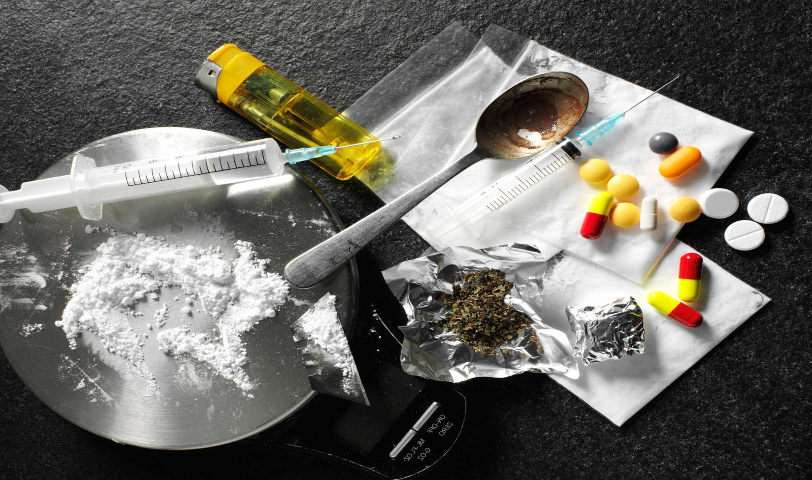
Notes:
What are some of the other things that can alter our minds? We know that drugs and alcohol can have intoxicating effects on our minds, but what about other things that we do? Like spending all day and night playing video games, social media, and other forms of entertainment? Can we hear the Holy Spirit when we are online 24/7?

Slide 15
Romans 13:14
But put ye on the Lord Jesus Christ, and make not provision for the flesh, to fulfil the lusts thereof.
Notes:
More than our physical appetites, temperance deals with our minds and morals. Practicing temperance rewards us with mental and moral vigor. As Paul said, “put on the Lord Jesus Christ, and make no provision for the flesh, to fulfill its lusts” (Romans 13:14 NKJV). Temperance is a “fruit of the Spirit” and we must seek God for it. I hope you’ve learned about TEMPERANCE and how important it is in your daily walk with God. And it is a challenge to you to practice TEMPERANCE in all aspects of your life.

