Slide 1
unlight
NEWSTART
Notes:
Good Evening Everyone!! Tonight is night number 5 of our Health series. And tonight we are going to learn about SUNLIGHT.
Without sunlight, life as we know it could not exist. Fruits and vegetables that receive the direct rays of the sun grow much better than those that are exposed to artificial light. This also applies to humans. Those that do not get enough sunshine experience poorer health. Those who are daily exposed to the vitalizing effect of the sun's rays have a healthy complexion and more vibrant health.
The sun unlocks the vitamins in food. Without the sun's rays, we could not get the full value from our food. Sunlight keeps our blood warm and pure and supplies life-giving energy to every organ of our bodies. Our brains are fed by sunshine-enhanced blood; our body is strengthened by the sun's energy.
Here are other wonderful benefits of sunlight:

Slide 2
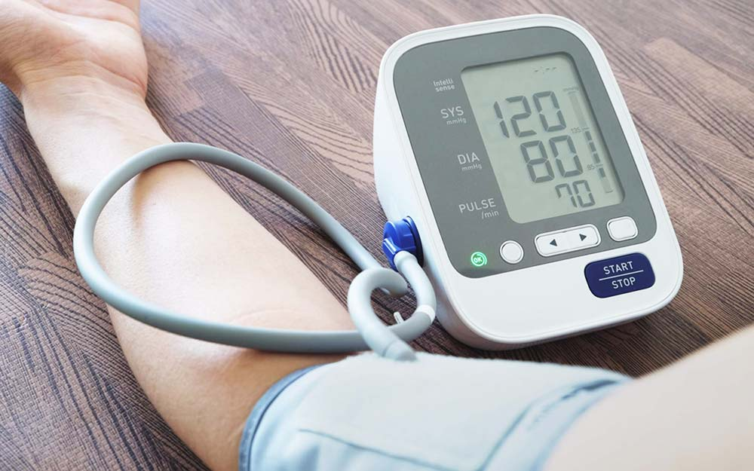
Benefits of Sunshine
Lowers blood pressure
Notes:
Sunlight strengthens the cardiovascular system. It improves the circulation, lowers the heart rate, and normalizes the blood pressure and blood sugar.

Slide 3
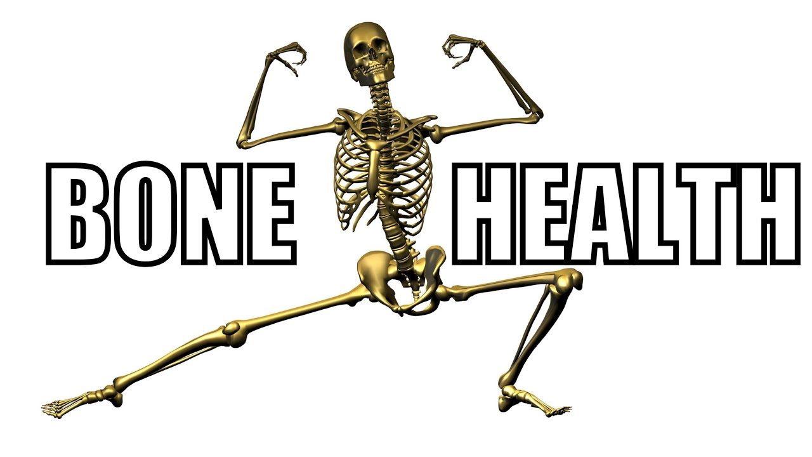
Benefits of Sunshine
2. Improves bone health
Notes:
Sunlight converts cholesterol into vitamin D, lowering the blood cholesterol. Vitamin D provides a host of advantages to the body, including better calcium absorption, which in turn helps prevent osteoporosis and tooth decay, makes stronger denser bones, and speeds bone repair.

Slide 4
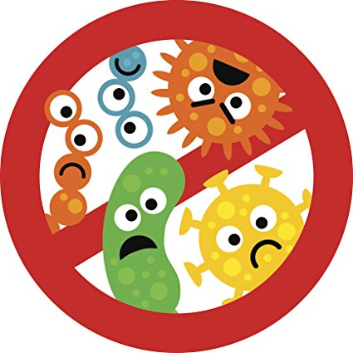
Benefits of Sunshine
3. Kills germs.
Notes:
Sunshine is the most natural and effective antiseptic available to us. Sunshine is also one of the most effective healing agents known. The sick are greatly benefited by the sun due to its healing properties. Sunlight enhances waste elimination by improving liver function; it is an effective treatment for jaundice. It relieves the kidneys of some of their burden by eliminating wastes through the skin when you sweat..

Slide 5
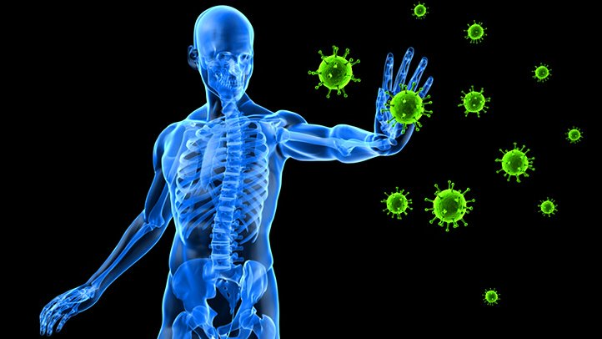
Benefits of Sunshine
4. Boosts the immune system.
Notes:
Sunlight kills many germs and enhances the immune system by raising the number and effectiveness of the white blood cells which destroy germs. Lightly tanned skin resists germs and infection much better than untanned skin. Many skin diseases respond well to controlled doses of sunlight. For a clean, fresh bed, expose bedding to sunlight. It's better to let the sunlight into your homes and risk a little faded furniture than to keep the shades drawn at all times. The health of the occupants is more precious than any expensive furniture.

Slide 6
Benefits of Sunshine
5. Improves sleep quality
Notes:
Sunlight improves sleep. Natural light exposure in daytime increases melatonin output at night.

Slide 7
Benefits of Sunshine
6. Boosts growth in children
Notes:
Just like plants, human growth is also stimulated by the sun. Sunlight help boosts growth in children.

Slide 8
Benefits of Sunshine
7. Eases mild depression
Notes:
Sunlight soothes the nervous system and is important in treating depression. It gives a sense of well-being by increasing endorphin production in the brain

Slide 9
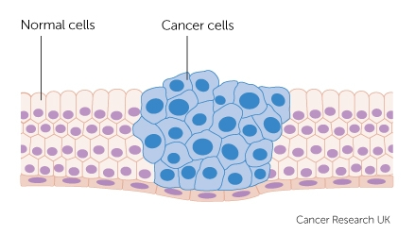
Benefits of Sunshine
8. Reduces risk of some cancers such as colon and breast cancer
Notes:
Sunlight converts cholesterol into vitamin D, lowering the blood cholesterol. Vitamin D provides a host of advantages to the body, including prevention of many types of cancer.

Slide 10
Getting it right
Optimum time to get sunlight is in the Morning, before 10am.
Notes:
10-20 minutes of morning sunshine can improve bone health, lower blood pressure, and boost the immune system.

Slide 11
Safety in the Sun
Seek shade, especially during midday hours.
This includes between 10 am
to 4 pm

Slide 12
Safety in the Sun
Be extra careful around surfaces that reflect the sun’s rays, like sand, water, and concrete.

Slide 13
Safety in the Sun
Wear sun protection gear like a hat with a wide brim and sunglasses to protect your face and eyes.

Slide 14
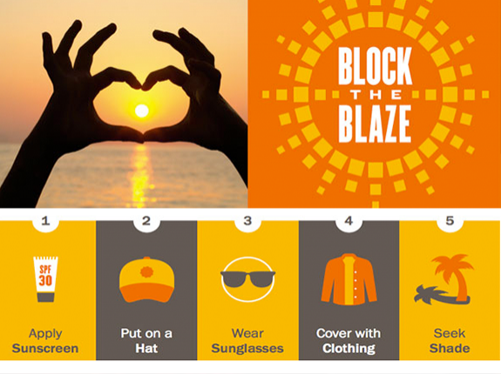
Safety in the Sun
Wear a long-sleeved shirt and pants or a long skirt for additional protection when possible.

Slide 15
Notes:
Just as the Sun has healing properties, fosters growth, improves mental and physical health, Jesus, the Sun of Righteousness will arise unto those who fear His name with healing in His wings. Just as we need sunlight for optimal physical health, we need Jesus the Sun of Righteousness for spiritual health, for He has healing in His wings when we OBEY Him.

Slide 16
Notes:
For more information on this topic, or any of the previous topics on health please visit our website at SDAMARANATHACHURCH.ORG

