Slide 1
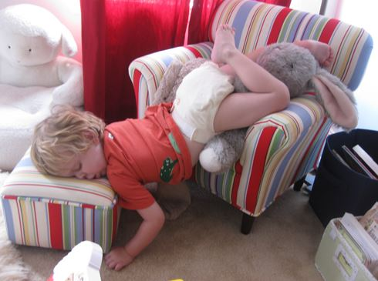
REST

Slide 2
“Come unto me, all ye that labour and are heavy laden, and I will give you rest. Take my yoke upon you, and learn of me; for I am meek and lowly in heart: and ye shall find rest unto your souls.” –
Matthew 11:28-29 KJB

Slide 3
Importance of Rest
Healthy brain function and emotional well being.

Slide 4
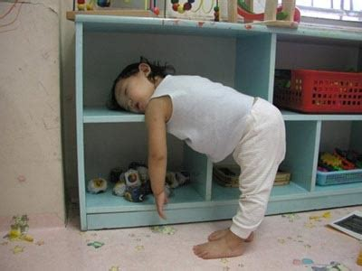
Importance of Rest
Supports healthy growth and development

Slide 5
Importance of Rest
Adequate rest can result in physical trans-formation.

Slide 6
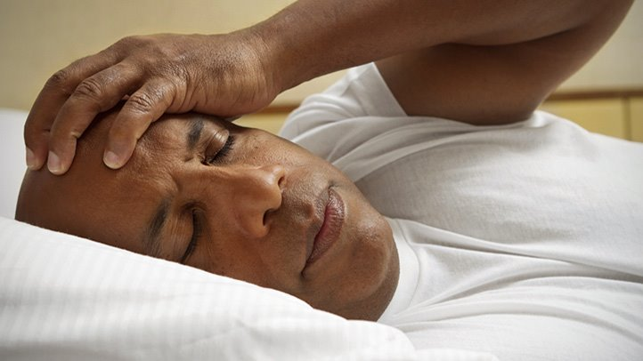
Lack of Rest
Sleep deficiency increases risk of:

Slide 7
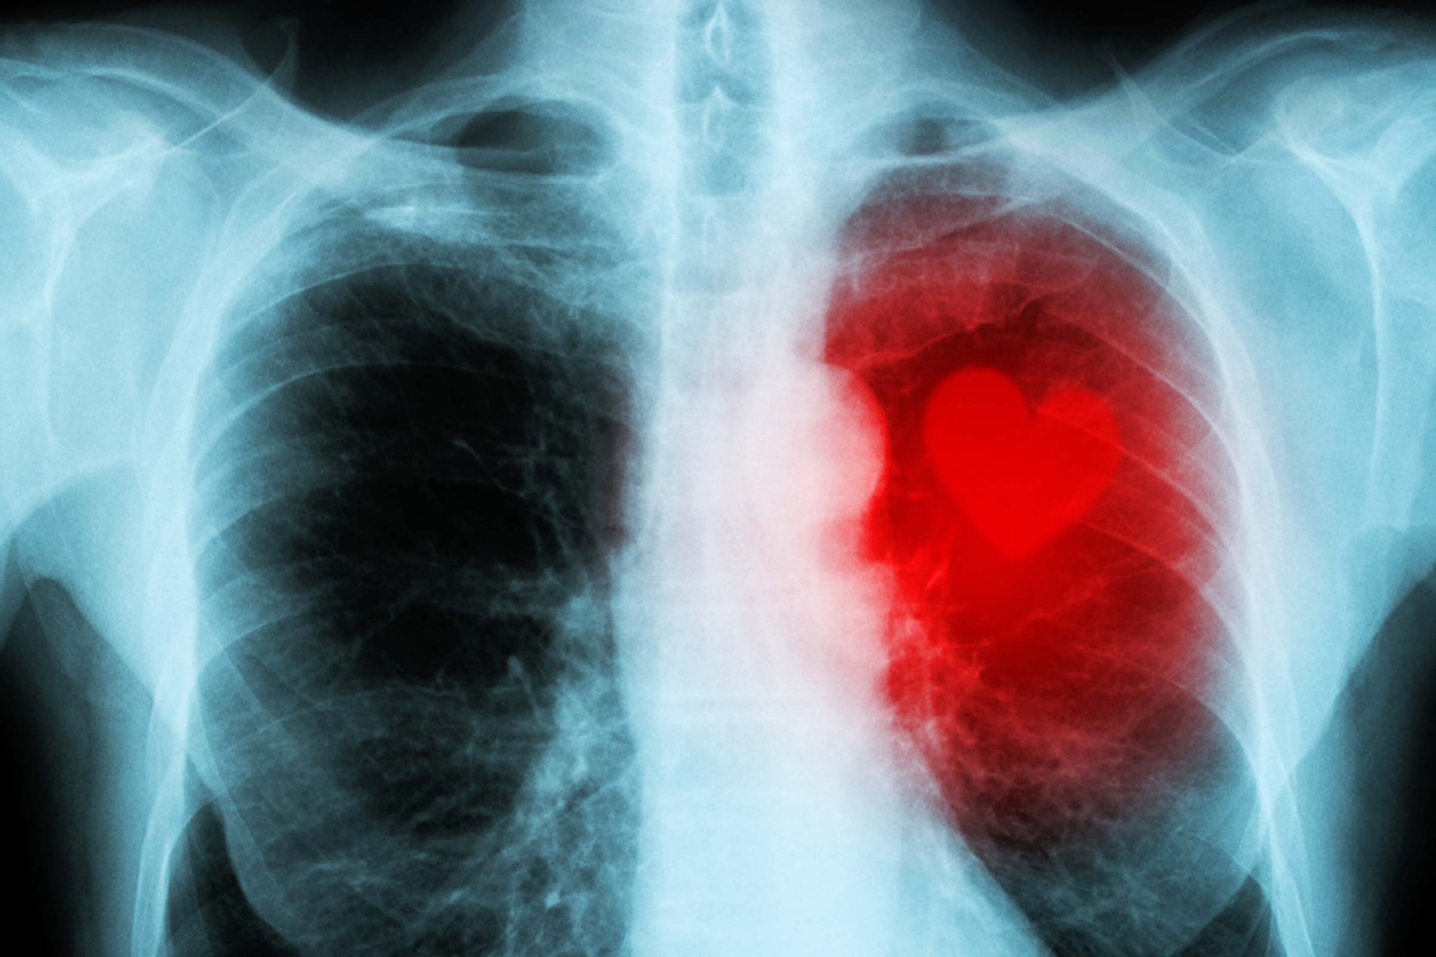
Lack of Rest
1. Heart disease …

Slide 8
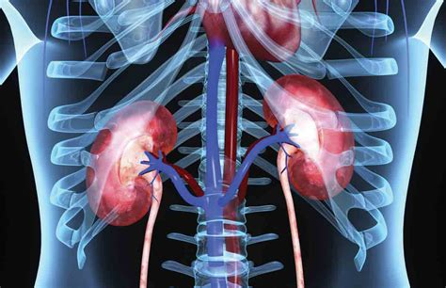
Lack of Rest
2. Kidney disease …

Slide 9
Lack of Rest
3. High blood pressure …

Slide 10
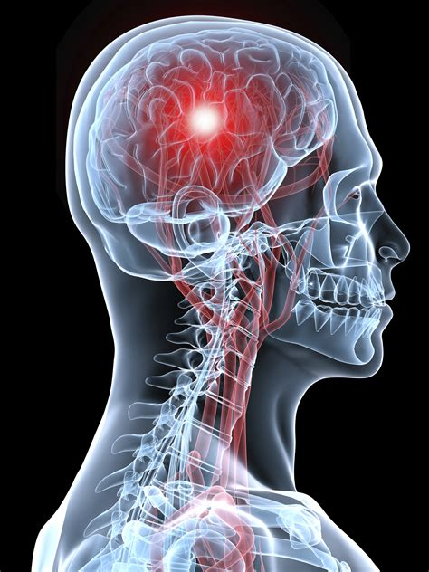
Lack of Rest
4. Stroke …

Slide 11
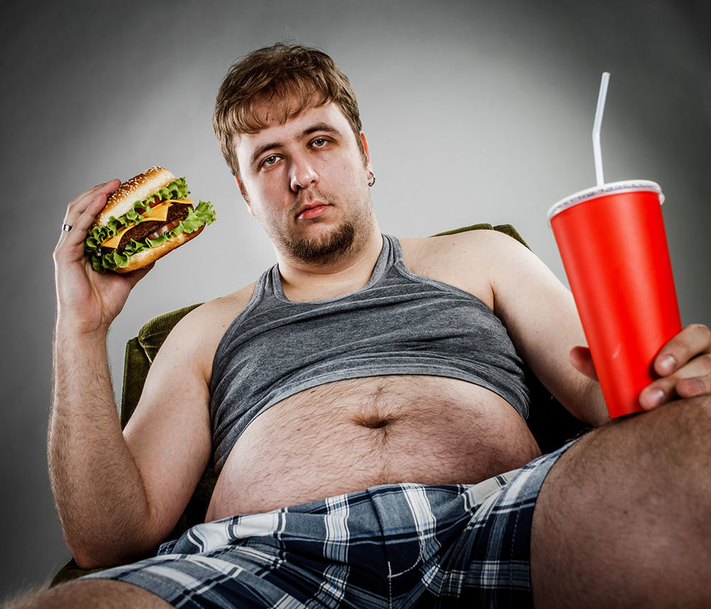
Lack of Rest
… and,
5. Obesity.

Slide 12
Adequate Rest
Ages 5-9:
11-13 hours per night.

Slide 13
Adequate Rest
Ages 13-18:
8-10 hours per night

Slide 14
Adequate Rest
Adults:
Between 7-8 hours per night.

Slide 15
Sleep Deprivation
Impairs judgment, causing values & priorities to change

Slide 16
Sleep Deprivation
Continual loss of sleep can result in:
1. Exhaustion,
2. Depression,
3. Delusions,
4. Paranoia, and
5. Hallucinations.

Slide 17
Sleep Deprivation
Losing as little 3 hours of sleep in a single night can cut the effectiveness of your immune system in half.

Slide 18
Sleep Deprivation
Can decrease insulin sensitivity.

Slide 19
Sleep Deprivation
Sleep deprivation slows reaction time. This can interfere with work, school, driving.

Slide 20
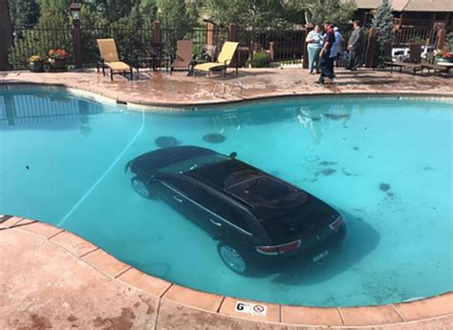
Sleep Deprivation
An estimated 30% of fatal car accidents caused by sleep deprivation.

Slide 21
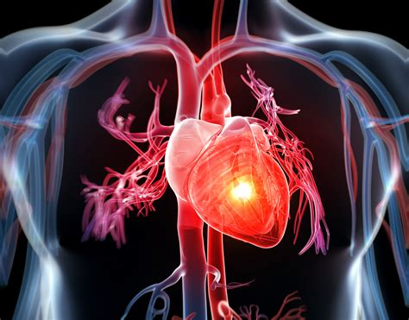
Sleep Deprivation
Divesting of all work on a regular basis reduces inflammation and the risk of heart disease.

Slide 22
Tips to getting enough Sleep
Having a healthy sleep Routine:
Going to bed and waking up at the same time.

Slide 23
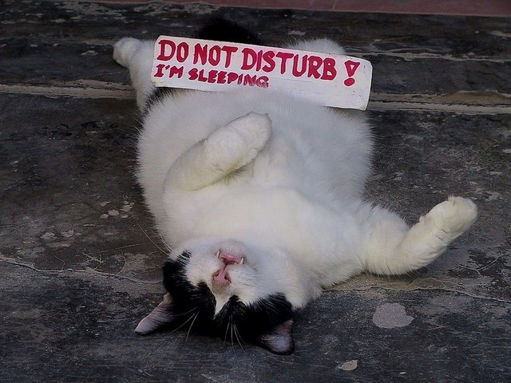
Tips to getting enough Sleep
Use the hour before bedtime for quiet time.

Slide 24
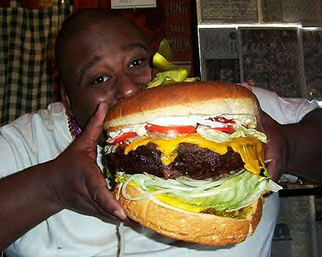
Tips to getting enough Sleep
Avoid heavy meals at least a couple of hours before bedtime.

Slide 25
Tips to getting enough Sleep
Keep the same sleep routine on weekdays and weekends.

Slide 26
Tips to getting enough Sleep
Spend time outdoors and being physically active every day.

