Slide 1
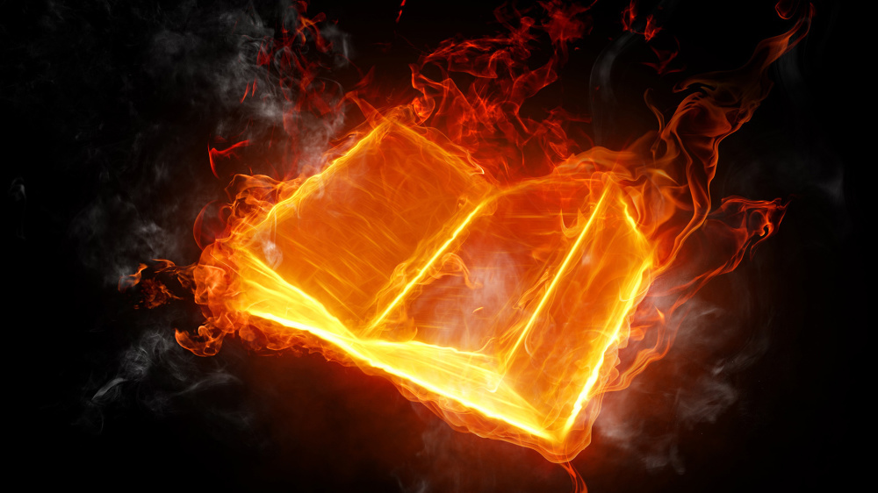
Questions
&
(Bible)
Answers

Slide 2
Question 1
“When Jesus died, where did He go, for some teach He went to Hell and preached, or did He go to Heaven?”

Slide 3
Answer 1
“ … shall he be brought to the grave, and shall remain in the tomb.”
– Job 21:32 KJB

Slide 4
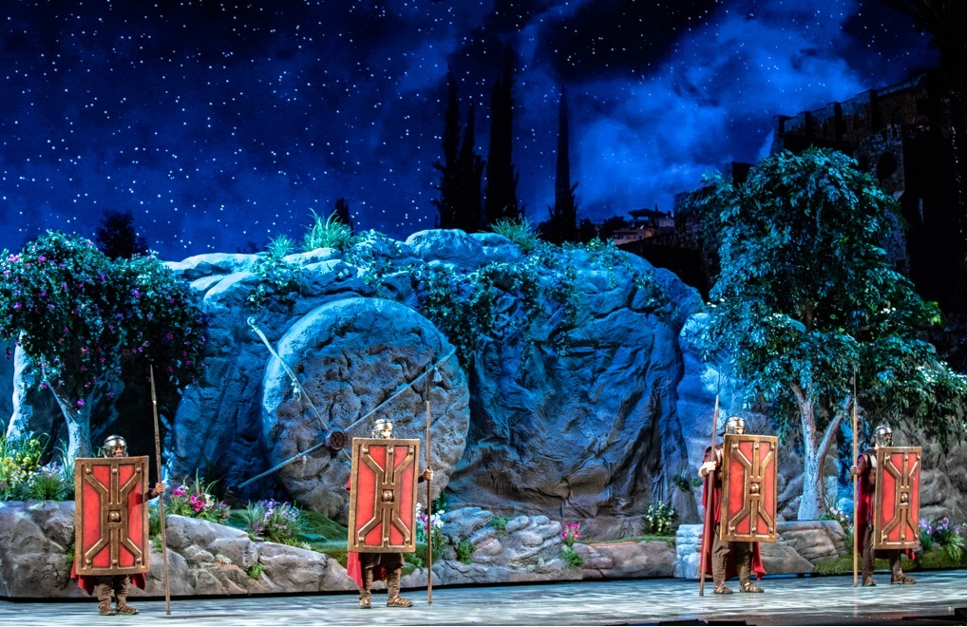
Jesus was sealed in the tomb, resting the 7th day in Redemption, as He had at Creation.

Slide 5
Answer 1
… but Jesus had given a specific time prophecy:
“Jesus answered and said unto them, Destroy this temple, and in three days I will raise it up.” – John 2:19 KJB

Slide 6
Answer 1
“Command therefore that the sepulchre be made sure until the third day, lest his disciples come by night, and steal him away, and say unto the people, He is risen from the dead: so the last error shall be worse than the first” – Matthew 27:64 KJB

Slide 7
Answer 1
“He is not here: for he is risen, as he said. Come, see the place where the Lord lay.” – Matthew 28:6 KJB

Slide 8
Answer 1
“And go quickly, and tell his disciples that he is risen from the dead; and, behold, he goeth before you into Galilee; there shall ye see him: lo, I have told you.” – Matthew 28:7 KJB

Slide 9
Answer 1
“… all the days of my appointed time (*) will I wait (in the grave, Job 14:13), till my change come.”
– Job 14:14 KJB
(* 3 days in Jesus’ case (Mat. 27:63 KJB); 6th day, Sabbath the 7th day and 1st day.)

Slide 10
Answer 1
“Thou shalt call, and I will answer thee: …” – Job 14:15 KJB

Slide 11
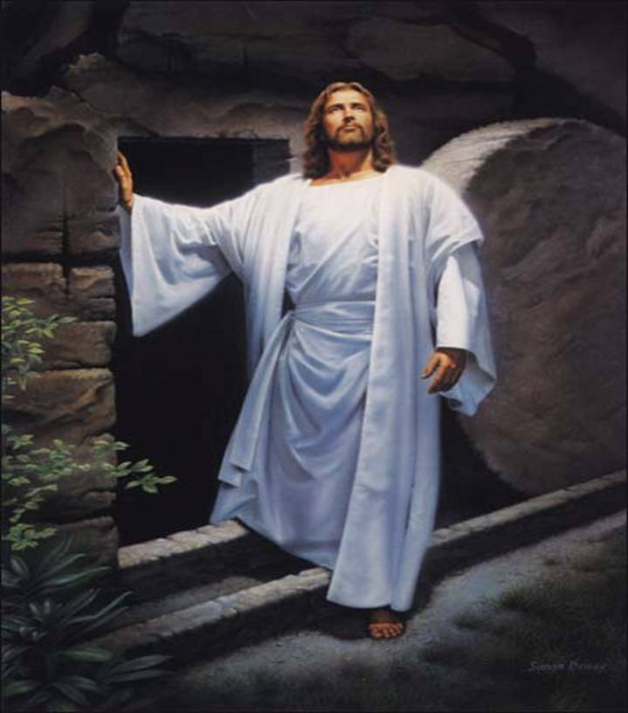
I AM, the Resurrection …
… and the LIFE.

Slide 12
Answer 1
“Jesus saith unto her, Touch me not; for I am not yet ascended to my Father: but go to my brethren, and say unto them, I ascend unto my Father, and your Father; and to my God, and your God.” – John 20:17 KJB

Slide 13
Question 2
“In the presentation on death, the Bible texts seemed to teach that those who die sleep in the grave and no one has entered Heaven yet, but what about Enoch, Elijah, Moses and some others mentioned, aren’t they in Heaven right now?”

Slide 14
Answer 2
Yes.
Enoch, Elijah, Moses, the “firstfruits” (specially resurrected persons around Jerusalem; Matthew 51-53 KJB) and Jesus are all in Heaven right now according to scripture (KJB), but none of them are dead. They are all very much alive, either translated alive or resurrected and gone up to Heaven (3rd).

Slide 15
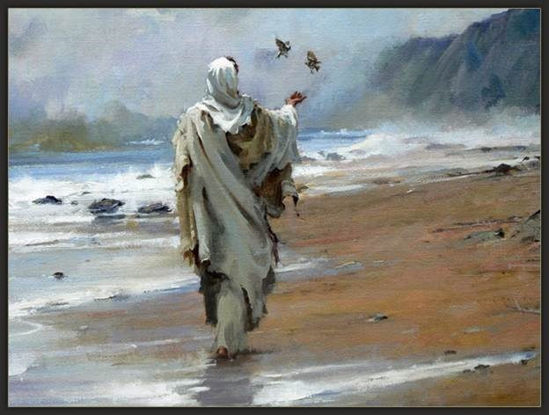

Slide 16
Answer 2
Enoch (translated)
“And Enoch walked with God: and he was not; for God took him.” – Genesis 5:24 KJB
“By faith Enoch was translated that he should not see death; and was not found, because God had translated him: for before his translation he had this testimony, that he pleased God.” – Hebrews 11:5 KJB

Slide 17
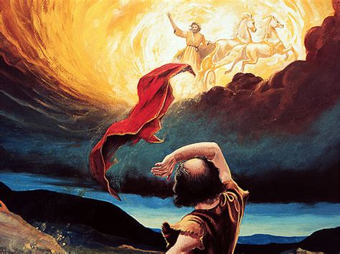

Slide 18
Answer 2
Elijah (translated)
Read: 2 Kings 2:1-23 KJB
“And it came to pass, as they still went on, and talked, that, behold, there appeared a chariot of fire, and horses of fire, and parted them both asunder; and Elijah went up by a whirlwind into heaven.” – 2 Kings 2:11 KJB

Slide 19
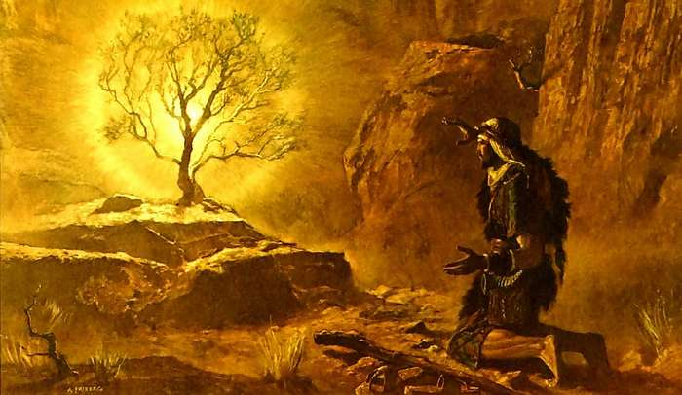

Slide 20
Answer 2
Moses (died, resurrected, taken up)
“Nevertheless death reigned from Adam to Moses, even over them that had not sinned after the similitude of Adam's transgression, who is the figure of him that was to come.”
– Romans 5:14 KJB

Slide 21
Answer 2
Moses (died, resurrected, taken up)
“So Moses the servant of the LORD died there in the land of Moab, according to the word of the LORD.”
– Deuteronomy 34:5 KJB
“And he buried him in a valley in the land of Moab, over against Bethpeor: but no man knoweth of his sepulchre unto this day.”
– Deuteronomy 34:6 KJB
“And Moses was an hundred and twenty years old when he died …” – Deuteronomy 34:7 KJB

Slide 22
Answer 2
Moses (died, resurrected, taken up)
“Yet Michael the archangel, when contending with the devil he disputed about the body of Moses, durst not bring against him a railing accusation, but said, The Lord rebuke thee.” – Jude 1:9 KJB

Slide 23
Answer 2
Moses (died, resurrected, taken up)
“Jesus said unto her, I am the resurrection, and the life: he that believeth in me, though he were dead, yet shall he live:”
– John 11:25 KJB

Slide 24
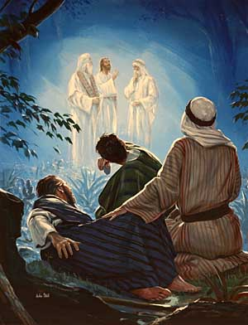

Slide 25
Answer 2
Moses (died, resurrected, taken up)
Read: Matthew 16:28, 17:1-12; Mark 9:1-13;
Luke 9:27-36; 2 Peter 1:16-18 KJB
“And, behold, there talked with him two men, which were Moses and Elias:”
– Luke 9:30 KJB
“Who appeared in glory …”
– Luke 9:31 KJB

Slide 26
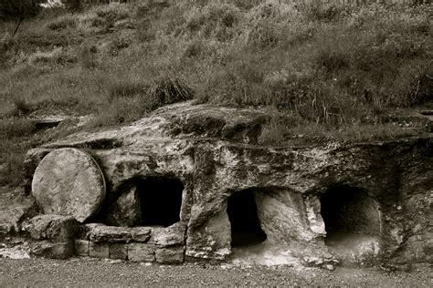

Slide 27
Answer 2
‘Firstfruits’ (died, resurrected, taken up)
Read: Isaiah 26:19; Psalms 68:8,17-22; Ephesians 4:8-10; 1 Corinthians 15:20-23; Leviticus 23:15-22; Matthew 27:50-53, 28:1-4; Psalms 24:1-10, 98:1-3; Colossians 2:15 KJB.
“Thy dead men shall live, together with my dead body shall they arise. Awake and sing, ye that dwell in dust: for thy dew is as the dew of herbs, and the earth shall cast out the dead.”
– Isaiah 26:19 KJB

Slide 28
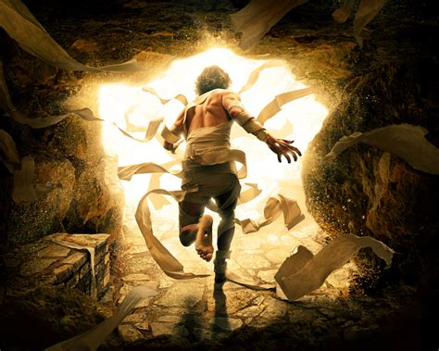

Slide 29
Answer 2
‘Firstfruits’ (died, resurrected, taken up)
“Jesus, when he had cried again with a loud voice, yielded up the ghost.” – Matthew 27:50 KJB

Slide 30
Answer 2
‘Firstfruits’ (died, resurrected, taken up)
“And, behold, the veil of the temple was rent in twain from the top to the bottom; and the earth did quake, and the rocks rent;”
– Matthew 27:51 KJB

Slide 31
Answer 2
‘Firstfruits’ (died, resurrected, taken up)
“And the graves were opened; and many bodies of the saints which slept arose,” – Matthew 27:52 KJB

Slide 32
Answer 2
‘Firstfruits’ (died, resurrected, taken up)
“And came out of the graves after his resurrection, and went into the holy city, and appeared unto many.” – Matthew 27:53 KJB

Slide 33
Answer 2
‘Firstfruits’ (died, resurrected, taken up)
“And came out of the graves after his resurrection, and went into the holy city, and appeared unto many.” – Matthew 27:53 KJB

Slide 34
Answer 2
‘Firstfruits’ (died, resurrected, taken up)
“Wherefore he saith, When he ascended up on high, he led captivity captive, and gave gifts unto men.” – Ephesians 4:8 KJB

Slide 35
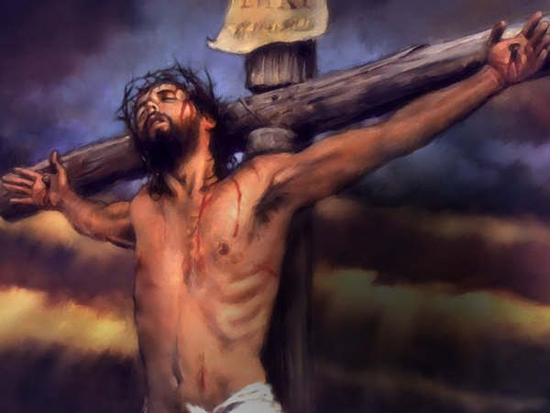

Slide 37
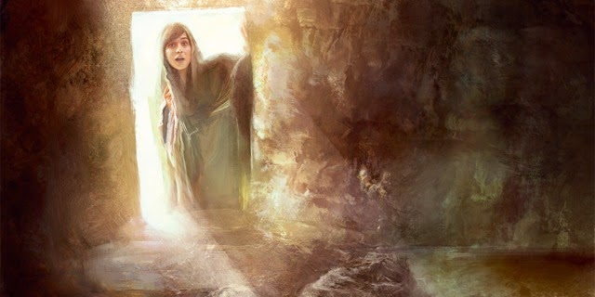

Slide 38
Answer 2
Jesus (died, resurrected, ascended)
“Jesus, when he had cried again with a loud voice, yielded up the ghost.” – Matthew 27:50 KJB

Slide 39
Answer 2
Jesus (died, resurrected, ascended)
“And when Joseph (of Arimathaea) had taken the body, he wrapped it in a clean linen cloth,” – Matthew 27:59 KJB

Slide 40
Answer 2
Jesus (died, resurrected, ascended)
“And laid it in his own new tomb, which he had hewn out in the rock: and he rolled a great stone to the door of the sepulchre, and departed.” – Matthew 27:60 KJB

Slide 41
Answer 2
Jesus (died, resurrected, ascended)
“In the end of the sabbath, as it began to dawn toward the first day of the week, came Mary Magdalene and the other Mary to see the sepulchre.”
– Matthew 28:1 KJB

Slide 42
Answer 2
Jesus (died, resurrected, ascended)
“And he (the angel Gabriel) saith unto them, Be not affrighted: Ye seek Jesus of Nazareth, which was crucified: he is risen; he is not here: behold the place where they laid him.” – Mark 16:6 KJB

Slide 43
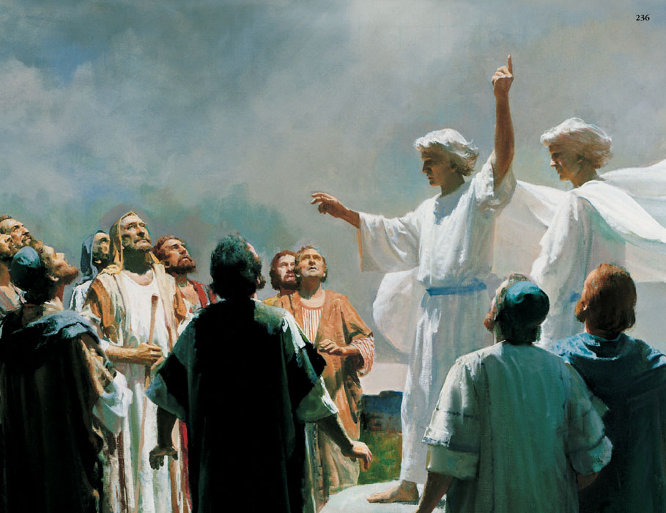

Slide 44
Answer 2
Jesus (died, resurrected, ascended)
“And when he (Jesus) had spoken these things, while they beheld, he was taken up; and a cloud received him out of their sight.”
– Acts 1:9 KJB

Slide 45
Answer 2
So, as we read, the ones mentioned, such as Enoch, Elijah, Moses, ‘Firstfruits’ and Jesus, aren’t dead, but all very much living and alive, glorified and have entered Heaven.

Slide 46
Answer 2
Yet, those who have died, and have not yet been resurrected and glorified, are asleep in the first death, waiting in the graves for their call, from Jesus at His return, to Life.

Slide 47
Answer 2
Examples of those who still sleep in the grave, would be, Adam, Abel, Abraham, Isaac, Jacob/Israel, Peter, James, John, Stephen, Paul, and so many millions of others.

Slide 48
Answer 2
“Then Abraham gave up the ghost, and died in a good old age, an old man, and full of years; and was gathered to his people.”
– Genesis 25:8 KJB

Slide 49
Answer 2
“Art thou (Jesus) greater than our father Abraham, which is dead? and the prophets are dead: whom makest thou thyself?”
– John 8:53 KJB

Slide 50
Answer 2
“These all died in faith, not having received the promises, but having seen them afar off, and were persuaded of them, and embraced them, and confessed that they were strangers and pilgrims on the earth.” – Hebrews 11:13 KJB

Slide 51
Answer 2
“But now they desire a better country, that is, an heavenly: wherefore God is not ashamed to be called their God: for he hath prepared for them a city.”
– Hebrews 11:16 KJB

Slide 52
Those are the submitted Questions and the Bible’s Answers for tonight.
Thank you, Bible study is our joy and it is our pleasure to carry out it’s instructions.

Slide 53
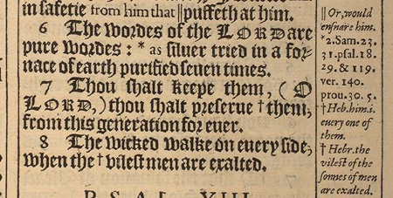
“The words of the LORD are pure words: as silver tried in a furnace of earth, purified seven times.” – Psalms 12:6 KJB
“Thou shalt keep them, O LORD, thou shalt preserve them from this generation for ever.” – Psalms 12:7 KJB

