Slide 1
Questions
&
(Bible)
Answers

Slide 2
Question 1
“If there really is a National Sunday Law (NSL) soon to come, doesn’t Romans 13 teach we are to not resist that Law, but to obey it, for otherwise it would be to resist God?”

Slide 3
Answer 1
“Let every soul be subject unto the higher powers (authorities). For there is no power but of God: the powers that be are ordained of God.” – Romans 13:1 KJB

Slide 4
Answer 1
“And Jesus came and spake unto them, saying, All power is given unto me in heaven and in earth.”
– Matthew 28:18 KJB

Slide 5
Answer 1
“Whosoever therefore resisteth the power, resisteth the ordinance of God: and they that resist shall receive to themselves damnation.”
– Romans 13:2 KJB

Slide 6
Answer 1
“For rulers are not a terror to good works, but to the evil. Wilt thou then not be afraid of the power? do that which is good, and thou shalt have praise of the same:”
– Romans 13:3 KJB

Slide 7
Answer 1
“For he is the minister of God to thee for good. But if thou do that which is evil, be afraid; for he beareth not the sword in vain: for he is the minister of God, a revenger to execute wrath upon him that doeth evil.”
– Romans 13:4 KJB

Slide 8
Answer 1
“Wherefore ye must needs be subject, not only for wrath, but also for conscience sake.” – Romans 13:5 KJB

Slide 9
Answer 1
“For for this cause pay ye tribute also: for they are God's ministers, attending continually upon this very thing.”
– Romans 13:6 KJB

Slide 10
Answer 1
“Render therefore to all their dues: tribute to whom tribute is due; custom to whom custom; fear to whom fear; honour to whom honour.” – Romans 13:7 KJB

Slide 11
Answer 1
God’s word says we are to Fear Him above all:
“Let us hear the conclusion of the whole matter: Fear God, and keep his commandments: for this is the whole duty of man (Hebrew: Adam).” – Ecclesiastes 12:13 KJB

Slide 12
Answer 1
Honour God above all:
“Wherefore the LORD God of Israel saith … them that honour me I will honour, and they that despise me shall be lightly esteemed.”
– 1 Samuel 2:30 KJB

Slide 13
Answer 1
Honour God above all:
“Honour thy father (above; Mat. 6:9 KJB) and thy mother (above; Gal. 4:26 KJB): that thy days may be long upon the land which the LORD thy God giveth thee.” – Exodus 20:12 KJB

Slide 14
Answer 1
Honour God’ commandments above the commandments of men:
“The LORD is well pleased for his righteousness' sake; he will magnify the law, and make it honourable.”
– Isaiah 42:21 KJB

Slide 15
Answer 1
Honour God’ commandments above the commandments of men:
“If thou turn away thy foot from the sabbath, from doing thy pleasure on my holy day; and call the sabbath a delight, the holy of the LORD, honourable; and shalt honour him, not doing thine own ways, nor finding thine own pleasure, nor speaking thine own words:”
– Isaiah 58:13 KJB

Slide 16
Answer 1
Honour God’ commandments above the commandments of men:
“Then Peter and the other apostles answered and said, We ought to obey God rather than men.” – Acts 5:29 KJB

Slide 17
Answer 1
What about the text which says to Honour the King?
“Honour all men. Love the brotherhood. Fear God. Honour the king.” – 1 Peter 2:17 KJB

Slide 18
Answer 1
Notice that the text in context (1 Pet. 2:16-17 KJB) says, “… as the servants of God … Fear God …”
God comes first, before human kings, authorities and laws.

Slide 19
Answer 1
God is the KING of Kings. He is the supreme King above all kings, thrones, dominions, principalities and powers:
“KING of Kings”
(1 Tim. 6:15; Rev. 17:14, 19:16 KJB)

Slide 20
Answer 1
Also, for those who live in the united States, the “President” (or Supreme Court, Senate or House) is not a “King”, but is (or supposed to be) a duly elected representative of the people in the Executive Branch of Government, subject to the people, subject to the united States Constitution and its proper Amendments.

Slide 21
Answer 1
“Congress shall make no law respecting an establishment of religion, or prohibiting the free exercise thereof; or abridging the freedom of speech, or of the press; or the right of the people peaceably to assemble, and to petition the government for a redress of grievances.” – 1st Amendment of the united States Constitution (highest human authority).

Slide 22
Answer 1
Notice these words:
“They have set up kings, but not by me: they have made princes, and I knew it not: of their silver and their gold have they made them idols, that they may be cut off.” – Hosea 8:4 KJB

Slide 23
Answer 1
Who gave their power (authority) to the Beast?
“… the dragon gave him (the Beast, Rev. 13:1 KJB) his power, and his seat, and great authority.”
– Revelation 13:2 KJB

Slide 24
Answer 1
Why? Because the Beast (Rev. 13:1 KJB) worships the Dragon (Rev. 12:1 KJB):
“And the devil said unto him, All this power will I give thee, and the glory of them: for that is delivered unto me; and to whomsoever I will I give it.
If thou therefore wilt worship me, all shall be thine.” – Luke 4:6-7 KJB

Slide 25
Answer 1
What about, “Obey them that have the rule over you, and submit yourselves …”
(Hebrews 13:17 KJB)?

Slide 26
Answer 1
It (Heb. 13:17 KJB) is in the context of:
“Remember them which have the rule over you, who have spoken unto you the word of God: whose faith follow, considering the end of their conversation.” – Hebrews 13:7 KJB

Slide 27
Answer 1
Hebrews 13:17 KJB is speaking about following the conduct of good (not evil) ministers and elders in the church (not political Governments).
Do not let others deceive you when they abuse this text.

Slide 28
Answer 1
“Owe no man any thing, but to love one another: for he that loveth another hath fulfilled the law.”
– Romans 13:8 KJB

Slide 29
Answer 1
“For this, Thou shalt not commit adultery, Thou shalt not kill, Thou shalt not steal, Thou shalt not bear false witness, Thou shalt not covet; and if there be any other commandment, it is briefly comprehended in this saying, namely, Thou shalt love thy neighbour as thyself.” – Romans 13:9 KJB

Slide 30
Answer 1
“Love worketh no ill to his neighbour: therefore love is the fulfilling of the law.” – Romans 13:10 KJB

Slide 31
Answer 1
“And that, knowing the time, that now it is high time to awake out of sleep: for now is our salvation nearer than when we believed.”
– Romans 13:11 KJB

Slide 32
Answer 1
“The night is far spent, the day is at hand: let us therefore cast off the works of darkness, and let us put on the armour of light.”
– Romans 13:12 KJB

Slide 33
Answer 1
“Let us walk honestly, as in the day; not in rioting and drunkenness, not in chambering and wantonness, not in strife and envying.”
– Romans 13:13 KJB

Slide 34
Answer 1
“But put ye on the Lord Jesus Christ, and make not provision for the flesh, to fulfil the lusts thereof.”
– Romans 13:14 KJB

Slide 35
Answer 1
Final warning:
“My son, fear thou the LORD and the king (Jesus, the Christians King, whose kingdom is not of this world; John 18:36 KJB): and meddle not with them that are given to change (Daniel 7:25 KJB):” – Proverbs 24:21 KJB
(Obama’s ‘change’, ‘we are change’, ‘loose (unleash) change’, ‘solidarity’, are all Jesuit run)

Slide 36
Question 2
“Should Christians fight back or resist the National Sunday Law and confiscation of property and destruction of life with weapons, such as guns, knives, and physical violence, for Jesus said, “… he that hath no sword, let him sell his garment, and buy one”?

Slide 37
Answer 2
“Then said he unto them, But now, he that hath a purse, let him take it, and likewise his scrip: and he that hath no sword, let him sell his garment, and buy one.” – Luke 22:36 KJB

Slide 38
Answer 2
“For I say unto you, that this that is written must yet be accomplished in me, And he was reckoned among the transgressors: for the things concerning me have an end.”
– Luke 22:37 KJB

Slide 39
Answer 2
“And they said, Lord, behold, here are two swords (*). And he said unto them, It is enough.” – Luke 22:38 KJB
(*Simon Peter, being one, and the other likely being Simon the Zealot; the two Simons. Any system whichtoday?)
What did Jesus mean?

Slide 40
Answer 2
Did the disciples understand Jesus’ words about the selling of the garment and the buying of a sword?

Slide 41
Answer 2
No.
The disciples still misunderstood Jesus’ spiritual meanings with physical meanings, even after so long a time with Him. Jesus was not talking about physical weapons.

Slide 42
Answer 2
John 1:19-25 (John the Baptist as Elijah)
John 2:19-22 (Temple of His body)
John 3:1-21 (Nicodemus, Born Again)
John 4:7-15 (Woman a the Well, Water)
John 4:31-34 (Meat to Eat, Water to Drink)
John 5:6-7 (Will you be made whole, Pool)
John 6:50-52 (Eat my Flesh, Word)
John 7:38-39 (Water out of the belly, Spirit)
Matthew 16:5-12 (Leaven, Bread)

Slide 43
Answer 2
The disciples were to trade in their old ‘garments’ of self-righteousness, and take up His righteousness, the sword of the word of God.

Slide 44
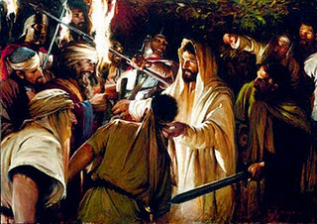
Betrayed!

Slide 45
Answer 2
“And, behold, one of them (Peter; John 18:10 KJB) which were with Jesus stretched out his hand, and drew his sword, and struck a servant of the high priest's, and smote off his ear.”
– Matthew 26:51 KJB

Slide 46
Answer 2
“Then said Jesus unto him, Put up again thy sword (*) into his place: for all they that take the sword shall perish with the sword.”
– Matthew 26:52 KJB
(* Did Jesus say, “My sword”, or “thy sword”?)

Slide 47
Answer 2
“Thinkest thou that I cannot now pray to my Father, and he shall presently give me more than twelve legions of angels?” – Matthew 26 :53 KJB

Slide 48
Answer 2
Jesus also said:
“Blessed are they which are persecuted for righteousness' sake: for theirs is the kingdom of heaven.” – Matthew 5:10 KJB

Slide 49
Answer 2
Jesus also said:
“Blessed are ye, when men shall revile you, and persecute you, and shall say all manner of evil against you falsely, for my sake.”
– Matthew 5:11 KJB

Slide 50
Answer 2
Jesus also said:
“But I say unto you, That ye resist not evil: but whosoever shall smite thee on thy right cheek, turn to him the other also.”
– Matthew 5:39 KJB

Slide 51
Answer 2
Jesus also said:
“Ye have heard that it hath been said, Thou shalt love thy neighbour, and hate thine enemy. ” – Matthew 5:43 KJB

Slide 52
Answer 2
Jesus also said:
“But I say unto you, Love your enemies, bless them that curse you, do good to them that hate you, and pray for them which despitefully use you, and persecute you; ”
– Matthew 5:44 KJB

Slide 53
Answer 2
Jesus also said:
“That ye may be the children of your Father which is in heaven: for he maketh his sun to rise on the evil and on the good, and sendeth rain on the just and on the unjust.”
– Matthew 5:45 KJB

Slide 54
Answer 2
Jesus also said:
“Be ye therefore perfect, even as your Father which is in heaven is perfect.”
– Matthew 5:48 KJB

Slide 55
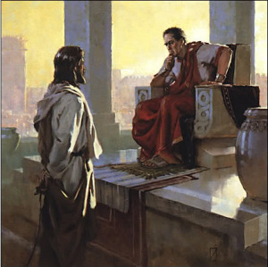
My Kingdom is not of this world

Slide 56
Answer 2
“Jesus answered, My kingdom is not of this world: if my kingdom were of this world, then would my servants fight, that I should not be delivered to the Jews: but now is my kingdom not from hence.” – John 18:36 KJB

Slide 57
Answer 2
“He was oppressed, and he was afflicted, yet he opened not his mouth: he is brought as a lamb to the slaughter, and as a sheep before her shearers is dumb, so he openeth not his mouth.” – Isaiah 53:7 KJB

Slide 58
Answer 2
“Yea, for thy sake are we killed all the day long; we are counted as sheep for the slaughter.” – Psalms 44:22 KJB

Slide 59
Answer 2
“The disciple is not above his master, nor the servant above his lord.”
– Matthew 10:24 KJB

Slide 60
Answer 2
“It is enough for the disciple that he be as his master, and the servant as his lord. If they have called the master of the house Beelzebub, how much more shall they call them of his household?” – Matthew 10:25 KJB

Slide 61
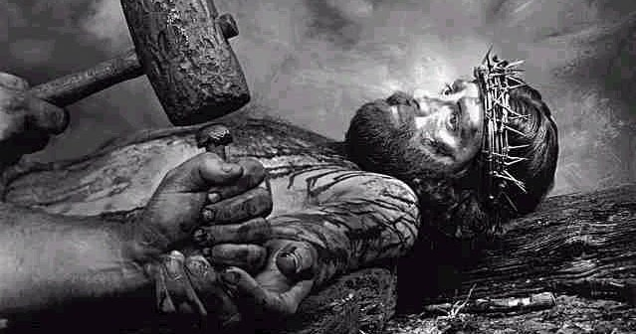
Romans 13 – God’s Ministers.
Jesus was made to be sin for us …

Slide 62
Those are the submitted Questions and the Bible’s Answers for tonight.
Thank you, Bible study is our joy and it is our pleasure to carry out it’s instructions.

Slide 63
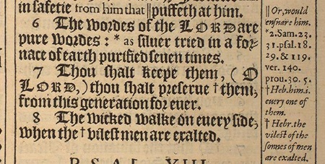
“The words of the LORD are pure words: as silver tried in a furnace of earth, purified seven times.” – Psalms 12:6 KJB
“Thou shalt keep them, O LORD, thou shalt preserve them from this generation for ever.” – Psalms 12:7 KJB

