Slide 1
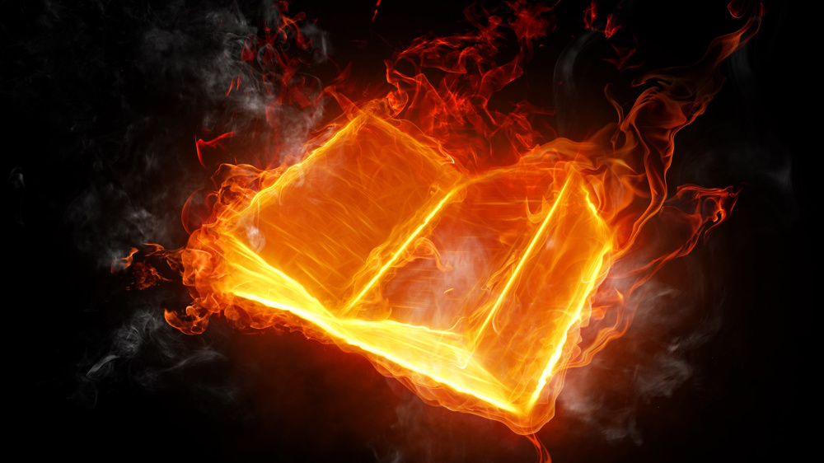
Questions
&
(Bible)
Answers

Slide 2
Question 1
“Will the crew going to Mars be able to see Christ’s second coming?”

Slide 3
Answer 1
Some think that only a select group of people will see Jesus coming, but …

Slide 4
Answer 1
… we are warned in scripture (2 Tim. 3:13 KJB), that in the last days, Numerous Anomalistic Scams Abound, which are Not Anything, Simply Aether; while others are Not Always Scientifically Accurate (1 Tim. 6:20 KJB), and from some who are deceived or deceiving, it’s, ‘Never A Straight Answer’ …

Slide 5
Answer 1
… but thanks be to God!, for His word, the scripture (KJB), which always gives the straight testimony, the pure truth (John 17:17 KJB), for God cannot lie.

Slide 6
Answer 1
Sin is quarantined to planet earth (Luk. 15:4,7 KJB).
The devil (called, ‘the god of this world’ (2 Cor. 4:4 KJB)) is stuck here since Calvary (A.D. 31), unable to return to Heaven by any means.

Slide 7
Answer 1
Some are attempting to climb into Heaven some other way, than “the way” (John 14:6 KJB), such as at the Tower of Babel (Gen. 11:4 KJB):

Slide 8
Answer 1
“Verily, verily, I say unto you, He that entereth not by the door into the sheepfold, but climbeth up some other way, the same is a thief and a robber.” – John 10:1 KJB

Slide 9
Answer 1
“Therefore rejoice, ye heavens, and ye that dwell in them. Woe to the inhabiters of the earth and of the sea! for the devil is come down unto you, having great wrath, because he knoweth that he hath but a short time.” – Revelation 12:12 KJB

Slide 10
Answer 1
“For we brought nothing into this world, and it is certain we can carry nothing out.”
– 1 Timothy 6:7 KJB

Slide 11
Answer 1
Therefore, a word of caution:
Never
Accept
Serpent
Assertions
but always believe the word of God (KJB).

Slide 12
Answer 1
We have already seen in a previous presentation, that the coming of Jesus, will not be invisible, secret or obscure, but will be Visible, Loud, Glorious and Triumphant.

Slide 13
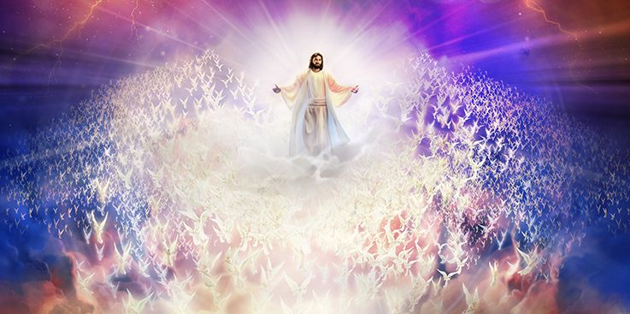
“the Lord cometh with ten thousands of his saints to execute judgment upon all …”

Slide 14
Answer 1
“The earth shall quake before them; the heavens shall tremble: the sun and the moon shall be dark, and the stars shall withdraw their shining:”
– Joel 2:10 (see also Joel 3:15) KJB
(Planets in the immediate vicinity, the 2nd Heaven, including Mars, act as reflective stars by the light of the sun (Sol))

Slide 15
Answer 1
“For the stars of heaven and the constellations thereof shall not give their light: the sun shall be darkened in his going forth, and the moon shall not cause her light to shine.” – Isaiah 13:11 KJB

Slide 16
Answer 1
“And the LORD shall utter his voice before his army: for his camp is very great: for he is strong that executeth his word: for the day of the LORD is great and very terrible; and who can abide it?” – Joel 2:11 KJB

Slide 17
Answer 1
“… The LORD shall roar from on high, and utter his voice from his holy habitation; he shall mightily roar upon his habitation; he shall give a shout, as they that tread the grapes, against all the inhabitants of the earth. …”
– Jeremiah 25:30 KJB

Slide 18
Answer 1
“The LORD also shall roar out of Zion, and utter his voice from Jerusalem; and the heavens and the earth shall shake: but the LORD will be the hope of his people, and the strength of the children of Israel.” – Joel 3:16 KJB

Slide 19
Answer 1
“… the powers that are in heaven shall be shaken.” – Mark 13:25 KJB
“… for the powers of heaven shall be shaken.” – Luke 21:27 KJB

Slide 20
Answer 1
“Whose voice then shook the earth: but now he hath promised, saying, Yet once more I shake not the earth only, but also heaven.” – Hebrews 12:26 KJB

Slide 21
Answer 1
“The earth shall reel to and fro like a drunkard, and shall be removed like a cottage; and the transgression thereof shall be heavy upon it; and it shall fall, and not rise again.” – Isaiah 24:20 KJB

Slide 22
Answer 1
“Behold, he cometh with clouds; and every eye shall see him, and they also which pierced him: and all kindreds of the earth shall wail because of him. Even so, Amen.”
– Revelation 1:7 KJB

Slide 23
Answer 1
So, do you believe the word of God over what men tell you, or what you think you know to be true?
I hope and pray you do.

Slide 24
Question 2
“What is a language the speaking when we receive a holy spirit from God?”

Slide 25
Answer 2
What I think the questioner is asking, is in regards the gift of the Holy Ghost, such as the speaking of ‘tongues’, or languages of earth, to spread the Gospel, as seen in Acts chapter 2 at Pentecost and elsewhere.

Slide 26
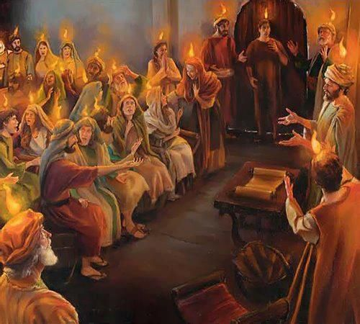

Slide 27
Answer 2
“And when the day of Pentecost was fully come, they were all with one accord in one place.”
– Acts 2:1 KJB

Slide 28
Answer 2
“And suddenly there came a sound from heaven as of a rushing mighty wind, and it filled all the house where they were sitting.”
– Acts 2:2 KJB

Slide 29
Answer 2
“And there appeared unto them cloven tongues like as of fire, and it sat upon each of them.”
– Acts 2:3 KJB

Slide 30
Answer 2
“And they were all filled with the Holy Ghost, and began to speak with other tongues, as the Spirit gave them utterance.”
– Acts 2:4 KJB

Slide 31
Answer 2
“And there were dwelling at Jerusalem Jews, devout men, out of every nation under heaven.”
– Acts 2:5 KJB

Slide 32
Answer 2
“Now when this was noised abroad, the multitude came together, and were confounded, because that every man heard them speak in his own language.”
– Acts 2:6 KJB

Slide 33
Answer 2
“And they were all amazed and marvelled, saying one to another, Behold, are not all these which speak Galilaeans?” – Acts 2:7 KJB

Slide 34
Answer 2
“And how hear we every man in our own tongue, wherein we were born?” – Acts 2:8 KJB

Slide 35
Answer 2
“Parthians, and Medes, and Elamites, and the dwellers in Mesopotamia, and in Judaea, and Cappadocia, in Pontus, and Asia,”
– Acts 2:9 KJB

Slide 36
Answer 2
“Phrygia, and Pamphylia, in Egypt, and in the parts of Libya about Cyrene, and strangers of Rome, Jews and proselytes,”
– Acts 2:10 KJB

Slide 37
Answer 2
“Cretes and Arabians, we do hear them speak in our tongues the wonderful works of God.”
– Acts 2:11 KJB

Slide 38
Answer 2
Does everybody get the same gift(s)? Or should everyone speak in tongues (languages of earth) at all times when the Holy Spirit is received?

Slide 39
Answer 2
“And God hath set some in the church, first apostles, secondarily prophets, thirdly teachers, after that miracles, then gifts of healings, helps, governments, diversities of tongues (languages).”
– 1 Corinthians 12:8 KJB

Slide 40
Answer 2
“Are all apostles? are all prophets? are all teachers? are all workers of miracles?” – 1 Corinthians 12:9 KJB
What is Paul’s implied answer?

Slide 41
Answer 2
“Have all the gifts of healing? do all speak with tongues? do all interpret?”
– 1 Corinthians 12:10 KJB
What is Paul’s implied answer?

Slide 42
Answer 2
Notice in Acts 4, that the Holy Ghost is poured out, but because all the persons spoke the same language there, no gift of tongues (languages) was present or needed:

Slide 43
Answer 2
“And when they had prayed, the place was shaken where they were assembled together; and they were all filled with the Holy Ghost, and they spake the word of God with boldness.” – Acts 4:31 KJB

Slide 44
Answer 2
For more information, and an entire study on “the gift of tongues” as given by the Holy Spirit in scripture (KJB), please read our online PDF resource,
“Understanding Tongues”
https://sdamaranathachurch.org/resources/library-of-resources

Slide 45
Question 3
“Is it wrong to love someone when everyone else are against you loving that person?”

Slide 46
Answer 3
The Bible (KJB) says:
“And thou shalt love the LORD thy God with all thine heart, and with all thy soul, and with all thy might.” – Deuteronomy 6:5 KJB
“Thou shalt not avenge, nor bear any grudge against the children of thy people, but thou shalt love thy neighbour as thyself: I am the LORD.” – Leviticus 19:18 KJB

Slide 47
Answer 3
… yet, I think that the questioner is really asking about relationship ‘love’; that is, the matters of person to person intimacy.

Slide 48
Answer 3
... so, the answer to the question, will depend on what foundation the ‘love’ is based upon; either:
God’s word (KJB), or
self

Slide 49
Answer 3
Majority opinion does not matter.
God’s word (KJB) is final authority, and if God’s word does not sanction the relationship, end it now.

Slide 50
Answer 3
You need to personally and prayerfully study the scripture (KJB) to know whether or not you have clear “Thus saith the Lord …”, and “It is written …”, even in the mouth of two or three witnesses therein, for what you are doing.

Slide 51
Answer 3
For to take the affections of another, without God’s permission, is theft from Him; it is stealing, and a violation of God’s Commandment. It is sin.

Slide 52
Answer 3
Some final advice, do not confuse ‘lust’ (desire or passion) with scriptural ‘love’. Scriptural love is self-sacrificial to the glory of God.

Slide 53
Answer 3
Lust when conceived brings forth sin, and sin when finished brings death (James 1:15 KJB), and it is death unto everlasting shame and contempt – just ask Judas who also hung on a tree.

Slide 54
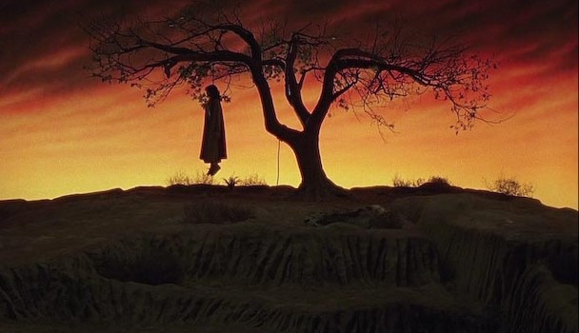

Slide 55
Answer 3
Scriptural love also brings death, but it is always death to self, and to the glory of God – just ask Jesus upon the tree at Calvary.

Slide 56
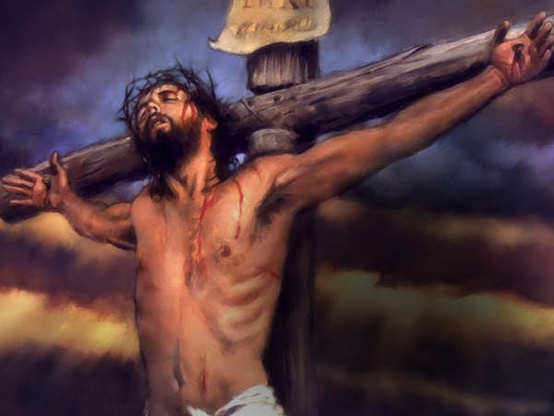

Slide 57
Answer 3
The woman at the well (John 4 KJB) was seeking ‘love’, seeking ‘intimacy’ and ‘relationship’ in all the wrong persons. What she needed, first, was Jesus Christ, and relationship to Him, and everything else would be added to her.

Slide 58
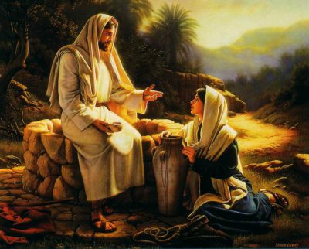

Slide 59
Question 4
“How do I know I’m forgiven?, Is it something only I can feel without anybody knowing or some(one) can tell I’m forgiven?”

Slide 60
Answer 4
You know, because you have been convicted by the Holy Spirit, confessed your sin(s), repented and forsaken it/them, and most importantly, you must BELIEVE God forgave you …

Slide 61
Answer 4
“To wit, that God was in Christ, reconciling the world unto himself, not imputing their trespasses unto them; and hath committed unto us the word of reconciliation.”
– 2 Corinthians 5:19 KJB

Slide 62
Answer 4
“If we confess our sins, he is faithful and just to forgive us our sins, and to cleanse us from all unrighteousness.”
– 1 John 1:9 KJB

Slide 63
Answer 4
“And he said unto her, Thy sins are forgiven.” – Luke 7:48 KJB
God promised in Christ Jesus, and He cannot lie (Heb. 6:18 KJB)

Slide 64
Answer 4
Forgiveness from God is by FAITH.
It is not by FLESH, nor FEELING.
Do not wait to feel forgiven, but BELIEVE God’s word that you are forgiven in Christ Jesus right now.
Be free, and go and sin no more.

Slide 65
Answer 4
Will others know that you are forgiven? YES!
Those who are forgiven cannot but try to help others to see the forgiveness they received from God in Christ Jesus, and so share it with others.

Slide 66
Answer 4
Don’t believe me? Ask:
David,
Nebuchadnezzar,
Peter,
John,
Paul,
and millions of others.

Slide 67
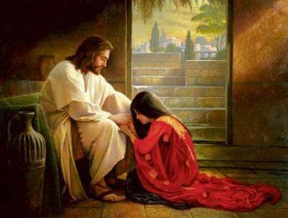
Forgiven.

Slide 68
Those are the submitted Questions and the Bible’s Answers for tonight.
Thank you, Bible study is our joy and it is our pleasure to carry out it’s instructions.

Slide 69
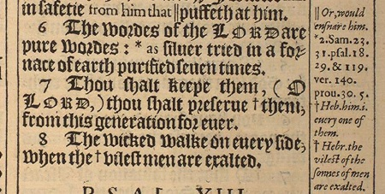
“The words of the LORD are pure words: as silver tried in a furnace of earth, purified seven times.” – Psalms 12:6 KJB
“Thou shalt keep them, O LORD, thou shalt preserve them from this generation for ever.” – Psalms 12:7 KJB

