Slide 1
Questions
&
(Bible)
Answers

Slide 2
Question (Previous)
“There are so many SABBATHS! (Sat & Sun)
How do I know which is the True Sabbath?”

Slide 3
Answer (Previous)
The presentation we just had should have answered this Question now. There is no such thing in scripture (KJB) as the ‘Sunday sabbath’, it is a myth and a counterfeit to the true, a tradition of men in the place of God’s Commandments
(Exo. 20:8-11 KJB).

Slide 4
Answer (Previous)
The 7th day is the Sabbath of the LORD thy God, and no other day of the week (1-6). Not one text of scripture (KJB) will ever be witnessed to say otherwise.

Slide 5
Answer (Previous)
If there are any further questions on this or if the one who asked the question is still not sure, please feel free to ask another question or come see me personally.

Slide 6
Answer (Previous)
You may also find an entire series of presentations on the subject on our webpage here –
https://sdamaranathachurch.org/resources/library-of-resources

Slide 7
Question 1
“What happened to the garden of Eden?”

Slide 8
Answer 1
Let’s take a look at the origin of the “garden” in “Eden” on earth.

Slide 10
Answer 1
“And the LORD God planted a garden eastward in Eden; and there he put the man whom he had formed.”
– Genesis 2:8 KJB

Slide 11
Answer 1
Does the text say God created a ‘garden’ in Eden on earth?

Slide 12
Answer 1
No.
The text stated that God “planted” a “garden” in “Eden” on earth, and never says God ‘created’ the ‘garden’ in ‘Eden’.

Slide 13
Answer 1
This raises the question, “Where, then, did God get the “garden” that was being “planted” in “Eden” on earth”?

Slide 14
Answer 1
… God took it from the 3rd Heaven (2 Cor. 12:2 KJB), aka “paradise” (2 Cor. 12:4 KJB) where God dwells, and planted it on earth, like a transplant done in gardening today.

Slide 15
Answer 1
“I (Jesus) am the true vine, and my Father is the husbandman.”
– John 15:1 KJB

Slide 16
Answer 1
There is an Heavenly Eden, and garden therein, that existed with God before the earthly was “planted”.
Notice God speaking about Lucifer and his origins and fall in Ezekiel.

Slide 17
Answer 1
“Thou (Lucifer) hast been in Eden the garden of God; every precious stone was thy covering, … and gold: the workmanship of thy tabrets and of thy pipes was prepared in thee in the day that thou wast created.”
– Ezekiel 28:13 KJB

Slide 18
Answer 1
Ezekiel 28:13 KJB is not speaking about the earthly Eden or garden. The entire context is of the origin of Lucifer’s fall from the original Heavenly Eden and garden.

Slide 19
Answer 1
Ezekiel 28 KJB speaks of Lucifer’s perfection before his self-exaltation in pride, and descent into sin and being cast out of the Heavenly Eden and garden (“paradise”; Luke 23:43 KJB) therein.

Slide 20
Answer 1
“Thou (Lucifer) art the anointed cherub that covereth; and I have set thee so: thou wast upon the holy mountain of God; thou hast walked up and down in the midst of the stones of fire.” – Ezekiel 28:14 KJB

Slide 21
Answer 1
“Thou wast perfect in thy ways from the day that thou wast created, till iniquity was found in thee.”
– Ezekiel 28:15 KJB

Slide 22
Answer 1
“By the multitude of thy merchandise they have filled the midst of thee with violence, and thou hast sinned: therefore I will cast thee as profane out of the mountain of God: and I will destroy thee, O covering cherub, from the midst of the stones of fire.”
– Ezekiel 28:16 KJB

Slide 23
Answer 1
Now that we have seen that there are two gardens, two Edens; an original Heavenly and a secondary earthly, which was a small transplant of the first. Let’s now look at what happened to the earthly “garden” that God “planted”.

Slide 24
Answer 1
After Adam and Eve’s sin, and their removal from the earthly Garden of Eden, notice what scripture says:

Slide 25
Answer 1
“So he (God/Jesus) drove out the man; and he placed at the east of the garden of Eden Cherubims, and a flaming sword which turned every way, to keep the way of the tree of life.” – Genesis 3:24 KJB

Slide 26
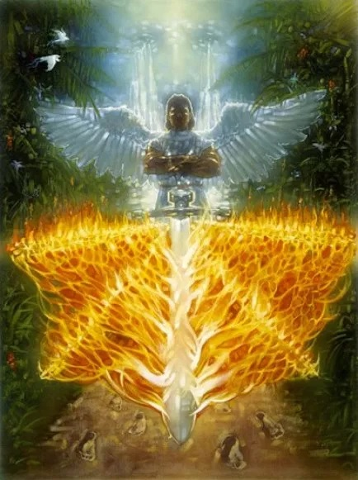

Slide 27
Answer 1
God protected the earthly Garden of Eden from entry by sinners of mankind, lest they would take of the fruit of the Tree of Life and live forever. This shows that the earthly Garden still existed on earth after Adam’s fall.

Slide 28
Answer 1
In Genesis 4:1-15 KJB, we see Cain and Abel coming to the gates of the earthly garden of Eden, to present their offering to God, who remained in the earthly Garden. Then in Genesis 4:16 KJB, we see Cain leaving the presence of the LORD in that area and wandering.

Slide 29
Answer 1
“And Cain went out from the presence of the LORD, and dwelt in the land of Nod, on the east of Eden.”
– Genesis 4:16 KJB

Slide 30
Answer 1
In Genesis 4-6 KJB, we see the wickedness of mankind increasing as time progressed, and so much so, that God sent the Flood which destroyed all land dwelling flesh, wherein is the breath of life from the face of the earth, and the vegetation.

Slide 31
Answer 1
So, was the earthly Garden of Eden destroyed during the Flood of Noah?

Slide 32
Answer 1
No.
God, uprooted it, and transplanted it back to the Heavenly Eden, from which it came, for scripture never states it was destroyed, and it was never witnessed on earth by men afterward, but we do see it again.

Slide 33
Answer 1
Impossible?
The Bible says:
“For with God nothing shall be impossible.” – Luke 1:37 KJB

Slide 34
Answer 1
“He that hath an ear, let him hear what the Spirit saith unto the churches; To him that overcometh will I give to eat of the tree of life, which is in the midst of the paradise of God.”
– Revelation 2:7 KJB

Slide 35
Answer 1
“is” in the midst of the “paradise of God”.
Present tense.
Even the “tree of life” that Adam and Eve knew, and will see again, when they are resurrected.

Slide 36
Answer 1
“In the midst of the street of it, and on either side of the river, was there the tree of life, which bare twelve manner of fruits, and yielded her fruit every month: and the leaves of the tree were for the healing of the nations.”
– Revelation 22:2 KJB

Slide 37
Answer 1
“Blessed are they that do his commandments, that they may have right to the tree of life, and may enter in through the gates into the city.”
– Revelation 22:14 KJB

Slide 38
Answer 1
God will bring it back with New Jerusalem and transplant it once again, into the Earth made new, and Adam and Eve will walk under the shade of the Tree of Life, eat of its fruit, and dwell in the garden they had called home.

Slide 39
Answer 1
“And by the river upon the bank thereof, on this side and on that side, shall grow all trees for meat, whose leaf shall not fade, neither shall the fruit thereof be
consumed …”

Slide 40
Answer 1
“… it shall bring forth new fruit according to his months, because their waters they issued out of the sanctuary: and the fruit thereof shall be for meat, and the leaf thereof for medicine.”
– Ezekiel 47:12 KJB

Slide 41
Question 2
“Is re-baptism Biblical?”

Slide 42
Answer 2
Yes, depending upon the specific circumstance or right principle as outlined in the scripture, as we read in Acts 19 KJB.

Slide 43
Answer 2
“And it came to pass, that, while Apollos was at Corinth, Paul having passed through the upper coasts came to Ephesus: and finding certain disciples,” – Acts 19:1 KJB

Slide 44
Answer 2
“He said unto them, Have ye received the Holy Ghost since ye believed? And they said unto him, We have not so much as heard whether there be any Holy Ghost.” – Acts 19:2 KJB

Slide 45
Answer 2
“And he said unto them, Unto what then were ye baptized? And they said, Unto John's baptism.”
– Acts 19:3 KJB

Slide 46
Answer 2
“Then said Paul, John verily baptized with the baptism of repentance, saying unto the people, that they should believe on him which should come after him, that is, on Christ Jesus.”
– Acts 19:4 KJB

Slide 47
Answer 2
“When they heard this, they were baptized in the name of the Lord Jesus. ” – Acts 19:5 KJB

Slide 48
Answer 2
These “disciples” had truth, and were walking in what they knew, after being baptized by John. Yet, they had not the fullness of the truth. However, when more light came to them, and they understood the greater light, they were re-baptized into that fullness.

Slide 49
Answer 2
There are some today who may have been ‘sprinkled’ (aka ‘aspersion’), or ‘poured’ (aka ‘infusion’) upon, as child or adult. That is not scriptural baptism. True baptism is full immersion in water through faith in Christ Jesus, but God winks at ignorance, and is merciful. Yet, God sends more light, and makes known His will so that men will choose to obey.

Slide 50
Answer 2
I, as a one-time Roman Catholic of many years, had such unscriptural baptism. Yet, when God showed me the truth in due time, and brought conviction by the Holy Ghost, I choose to follow the example of Jesus Christ and be Baptized by full immersion and keep all of God’s commandments (by His grace through faith).

Slide 51
Answer 2
For others, that may have been fully immersed in water, but have not known the present truths for this time, such as the binding claims of the 4th Commandment, in regards God’s Holy 7th Day the Sabbath, or other doctrines, as the 3 Angels messages …

Slide 52
Answer 2
… and who were once blind and or ignorant to these things, and now see by God’s grace; should consider what God would have them do in regards re-baptism into the fullness of the truth. For transgression of God’s 4th Commandment, ought to be confessed, repented of, forsaken …

Slide 53
Answer 2
… and then washed in the waters of re-baptism (as it symbolized death to sin; Romans 6:1-8; 1 John 3:4 KJB). But the Holy Ghost forces no one, but only pleads with Love. If you have a love of the truth, you will do the right thing, when He asks.

Slide 54
Answer 2
A similar example found in scripture, are the two disciples of John the Baptist, namely, John (later Apostle) and Andrew (Simon’s brother, also later Apostle). They would have been baptized by John the Baptist, being his disciples, and later into Jesus – the Messiah or Christ.

Slide 55
Question 3 (part A)
“Is the anti-christ human?”

Slide 56
Answer 3 (part A)
In the NT texts (Mat. – Rev.) there are only 4 verses which uses “antichrist”:
1 John 2:18,22, 4:3; 2 John 1:7 KJB
And only 1 verse using “antichrists”:
1 John 2:18 KJB

Slide 57
Answer 3 (part A)
There is even one OT text, found in an so-called LXX*, Leviticus 6:22, which reads:
“… ὁ χριστὸς ἀντ᾽ …”
“… the anointed in the place of …”

Slide 58
Answer 3 (part A)
For the word “antichrist” is made up of two koine (common) Greek words:
Anti – in the place of, or against
Christos – Christ or anointed

Slide 59
Answer 3 (part A)
The word in Latin with the same meaning would read:
Vicarius (Vicar) – in the place of
Christi – Christ or anointed

Slide 60
Answer 3 (part A)
These two definitions of the prefix “anti-” are found in Paul’s definition:
“Who opposeth and exalteth himself above all that is called God, or that is worshipped; so that he as God sitteth in the temple of God, shewing himself that he is God.” – 2 Thessalonians 2:4 KJB

Slide 61
Answer 3 (part A)
So is “antichrist” “human”?
Yes and No.
Satan is the ultimate “antichrist” (desiring worship which belongs to God alone, and who was “anointed” (Eze. 28:14 KJB)) and he is a fallen angel, not of the race of man-kind at all.

Slide 62
Answer 3 (part A)
There is also the “Beast” of Revelation 13:1-2 KJB, which is also the same as “antichrist” when Daniel, Revelation and 2 Thessalonians 2 are compared. This “Beast” is a religio-political Kingdom or system, and on the whole it too seeks the place of the Son of God on a greater (or macro) level.

Slide 63
Answer 3 (part A)
There are also the individuals of mankind that also fulfill the definition of “antichrist”, as John says:
“For many deceivers are entered into the world, who confess not that Jesus Christ is come in the flesh. This is a deceiver and an antichrist.” – 2 John 1:7 KJB

Slide 64
Question 3 (part B)
“Is the anti-christ an individual?”

Slide 65
Answer 3 (part B)
Again, the answer would be “Yes and No, depending on where one is looking in scripture (KJB) or how one is asking in relation to those things.”

Slide 66
Answer 3 (part B)
Satan, the ultimate “antichrist”, is indeed an “individual”.
Even the “Beast” of Revelation 13:1-2 KJB is singular.

Slide 67
Answer 3 (part B)
Yet, John also speaks of multiple persons that fulfill the role:
“Little children, it is the last time: and as ye have heard that antichrist shall come, even now are there many antichrists; whereby we know that it is the last time.” – 1 John 2:18 KJB

Slide 68
Answer 3 (part B)
Paul spoke of the same:
“Take heed therefore unto yourselves, and to all the flock, over the which the Holy Ghost hath made you overseers, to feed the church of God, which he hath purchased with his own blood.”
– Acts 20:28 KJB

Slide 69
Answer 3 (part B)
“For I know this, that after my departing shall grievous wolves enter in among you, not sparing the flock.”
– Acts 20:20 KJB

Slide 70
Answer 3 (part B)
“Also of your own selves shall men arise, speaking perverse things, to draw away disciples after them.”
– Acts 20:30 KJB

Slide 71
Answer 3 (part B)
“And no marvel; for Satan himself is transformed into an angel of light.”
– 2 Corinthians 11:14 KJB

Slide 72
Answer 3 (part B)
“Therefore it is no great thing if his ministers also be transformed as the ministers of righteousness; whose end shall be according to their works.”
– 2 Corinthians 11:15 KJB

Slide 73
Answer 3 (part B)
Are there any “overseers” (GNT TR - “επισκοπους”; Bishops/Elders) that claim to be of the church of Jesus, hold the title Vicarius Christi, and say that they are ‘in the place of Christ’ on earth now?

Slide 74
Answer 3 (part B)
“But since We hold upon this earth the place of God Almighty, ...”
– The Great Encyclical Letters of Pope Leo XIII, Encyclical Letter June 20, 1894
https://www.papalencyclicals.net/Leo13/l13praec.htm

Slide 75
Answer 3 (part B)
“Vicar of Christ (Latin Vicarius Christi). ... thus, Innocent III appeals for his power to remove bishops to the fact that he is Vicar of Christ (cap. "Inter corporalia", 2, "De trans. ep."). ... and states that it is the Roman Pontiff who is "the successor of Peter and the Vicar of Jesus Christ" (cap. "Licet", 4, ibid.). The title Vicar of God used for the pope by Nicholas III (c. "Fundamenta ejus", 17, "De elect.", in 6) is employed as an equivalent for Vicar of Christ" -Online Catholic Encyclopedia, Vicar of Christ
http://www.newadvent.org/cathen/15403b.htm

Slide 76
Answer 3 (part B)
In plain English:
“All names which in the scriptures are applied to Christ, by virtue of which it is established that he is over the church, all the same names are applied to the Pope.” – Cardinal Robert Bellarmine, S.J.

Slide 77
Answer 3 (part B)
​ In Latin reading – “Secundo probatur ratione, in Scripturis fundata, nam omnia nomina, quae in Scripturis tribuuntur Christi, unde constat eum esse supra Ecclesiam, eadem omnia tribuuntur Pontifici.”
- Cardinal Robert Bellarmine SJ. (Jesuit) Canonized 1930. Disputationes de Contoversiis Christianae Fidei adversus hujus temporis Haereticos, Tom. 2, Controversia Prima, De Conciliorum Auctoritate, Chap. 17 (1628 ed.), Vol. 1, page 269
https://web.archive.org/web/20180113020257/http://cdigital.dgb.uanl.mx/la/1080015572_C/1080015573_T2/1080015573_21.PDF

Slide 78
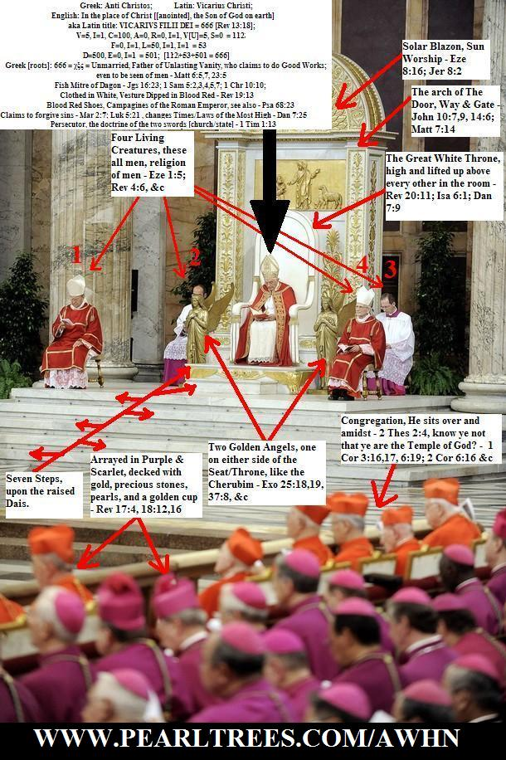
Tell me if you see anyone fulfilling the role of sitting in the temple of God (church), in purple, scarlet and gold, between the angels, on a great white throne in the place of Jesus.

Slide 79
Question 4
In the scripture (it) says that “love covers a multitude of sins.” How is the Law compare(d) to the above scripture?

Slide 80
Question 4 (reword)
What I think that this question is attempting to ask is, If the blood of Jesus, the sacrifice by love, covers our sins, and we are forgiven, then what use is God’s Ten Commandments?

Slide 81
Answer 4
The blood of Jesus Christ’s sacrifice, does NOT cover one known unconfessed & unforsaken sin. Jesus’ sacrifice and blood atonement is never a cloak to cover such.

Slide 82
Answer 4
“If I had not come and spoken unto them, they had not had sin: but now they have no cloke (cover) for their sin.”
– John 15:22 KJB

Slide 83
Answer 4
To teach that the blood of Jesus Christ, covers such known and unforsaken sin, is to practice the greatest hypocrisy, it is to be as a wolf in sheeps clothing.

Slide 84
Answer 4
“And above all things have fervent charity among yourselves: for charity shall cover the multitude of sins.”
– 1 Peter 4:8 KJB

Slide 85
Answer 4
“Hatred stirreth up strifes: but love covereth all sins.”
– Proverbs 10:12 KJB

Slide 86
Answer 4
“Whosoever committeth sin transgresseth also the law: for sin is the transgression of the law.” – 1 John 3:4 KJB

Slide 87
Answer 4
“Let him know, that he which converteth the sinner from the error of his way shall save a soul from death, and shall hide (*) a multitude of sins.”
– James 5:20 KJB
(*G2572: καλυψει; ‘cover’, same as 1 Pet. 4:8)

Slide 88
Answer 4
We know what “sin” is by God’s “Law” (the Ten Commandments), and as Romans 6:23 KJB states, “the wages of sin is death”.

Slide 89
Answer 4
“What shall we say then? Is the law sin? God forbid. Nay, I had not known sin, but by the law: for I had not known lust, except the law had said, Thou shalt not covet.”
– Romans 7:7 KJB

Slide 90
Answer 4
“Whom God hath set forth to be a propitiation through faith in his blood, to declare his righteousness for the remission of sins that are past, through the forbearance of God;” – Romans 3:25 KJB

Slide 91
Answer 4
Confessed and forsaken sin (past) is “covered” or “forgiven” by the blood of Jesus.
“… Blessed is he whose transgression is forgiven, whose sin is covered.”
– Psalms 32:1 KJB
(see also Rom. 4:7 KJB)

Slide 92
Answer 4
“Thou hast forgiven the iniquity of thy people, thou hast covered all their sin. Selah.” – Psalms 85:2 KJB

Slide 93
Answer 4
Forgiven sin, is not sin blotted out.
For to cover sin, means that the sin still exists to be blotted out, and once blotted out, no longer needs to be covered.

Slide 94
Answer 4
Forgiven (covered, remitted) sin can be unforgiven, uncovered, unremitted and thus re-instated in full.
Read Matthew 18:21-35 KJB
Day of Atonement; Leviticus 16 KJB

Slide 95
Answer 4
“If we confess our sins, he is faithful and just to forgive us our sins, and to cleanse us from all unrighteousness (*).” – 1 John 1:9 KJB
(*All unrighteousness is sin (1 John 5:17; and sin is the transgression of the Law; 1 John 3:4 KJB)

Slide 96
Answer 4
If any have any further questions on the difference between forgiven (covered, remitted) sin versus blotted out sin, please ask, as there are many more texts to consider for further clarity.

Slide 97
Answer 4
If any have any further questions on the difference between forgiven (covered, remitted) sin versus blotted out sin, please ask, as there are many more texts to consider for further clarity.

Slide 98
Question 5 (part A)
“Shine the light on the 10 Commandment(s) the Law of Moses …”

Slide 99
Answer 5 (part A)
The Ten Commandments (God’s Holy Law) are never called “the Law of Moses” in scripture. (KJB)
The “Law of Moses” was everything that was given after God spoke and wrote the Ten Commandments.

Slide 100
Answer 5 (part A)
“These words the LORD spake unto all your assembly in the mount out of the midst of the fire, of the cloud, and of the thick darkness, with a great voice: and he added no more. And he wrote them in two tables of stone, and delivered them unto me.”
– Deuteronomy 5:22 KJB

Slide 101
Answer 5 (part A)
“For it is written in the law of Moses, Thou shalt not muzzle the mouth of the ox that treadeth out the corn. Doth God take care for oxen?”
– 1 Corinthians 9:9 KJB

Slide 102
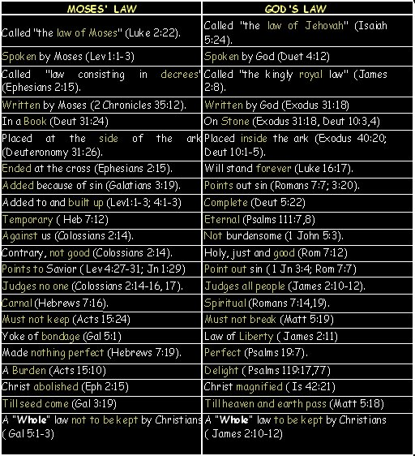

Slide 103
Question 5 (part B)
“Also he (?) share of the New Creation.”

Slide 104
Answer 5 (part B)
Yes, the Ten Commandments (God’s “My Law”), even the 4th Commandment are in the New Creation, for instance read:
Jeremiah 31:31-34; Ezekiel 11:19-20, 36:25-29, 37:26-28; Isaiah 56:1-8; 2 Corinthians 3:1-18; Hebrews 8:8-13, 10:16 KJB.

Slide 105
Answer 5 (part B)
“For in Jesus Christ neither circumcision availeth any thing, nor uncircumcision; but faith which worketh by love.” – Galatians 5:6 KJB
“For in Christ Jesus neither circumcision availeth any thing, nor uncircumcision, but a new creature.”
– Galatians 6:15 KJB
“Circumcision is nothing, and uncircumcision is nothing, but the keeping of the commandments of God.” – 1 Corinthians 5:7 KJB

Slide 106
Answer 5 (part B)
“For as the new heavens and the new earth, which I will make, shall remain before me, saith the LORD, so shall your seed and your name remain.”
– Isaiah 66:22 KJB

Slide 107
Answer 5 (part B)
“And it shall come to pass, that from one new moon to another, and from one sabbath to another, shall all flesh come to worship before me, saith the LORD.” – Isaiah 66:23 KJB

Slide 108
Answer 5 (part B)
The Ten Commandments are seen in the NT, NC (briefly listed).
01. Mt. 4:10 06. Rom. 13:9
02. 1 Jn. 5:21 07. Rom. 13:9
03. Col. 3:8 08. Rom. 13:9
04. Heb. 4:9 09. Rom. 13:9
05. Eph. 6:2 10. Rom. 13:9

Slide 109
Question 5 (part C)
“He said, Keep the 10 Commandment(s) in the Heart and how could you write it in your heart?”

Slide 110
Answer 5 (part C)
We do not write it (God’s Law, Ten Commandments) in the heart, that is the prerogative of the Holy Ghost, but we must co-operate with Him, since God is love and does not force, and the mind or heart is two fleshy tables which have freedom of will or choice.

Slide 111
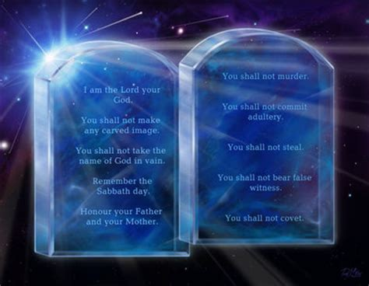

Slide 112
Answer 5 (part C)
“But this shall be the covenant that I will make with the house of Israel; After those days, saith the LORD, I will put my law in their inward parts, and write it in their hearts; and will be their God, and they shall be my people.” – Jeremiah 31:33 KJB
See Hebrews 8:10, 10:16, etc.

Slide 113
Answer 5 (part C)
The Law of God is not merely to be in the heart (spirit), but also in the ‘hand’ or actions (truth or deed), as per:
Exodus 13:16; Deuteronomy 6:8, 11:18; John 4:23-24; Revelation 12:17, 14:12, 22:14, etc.

Slide 114
Question 5 (part D)
“Shine the Light on your (being) Born Again?”

Slide 115
Answer 5 (part D)
Being “born again” is not the end of the road, but the beginning of the journey. It is not the fullness of adulthood (Eph. 4:15 KJB), but the newness of childhood, desiring the sincere milk of the word (1 Pet. 2:2 KJB).

Slide 116
Answer 5 (part D)
A person who is “born again” is not exempt from temptation into sin, nor free from the danger of the loss of eternal life; for example see:
King Saul (OT)
Ananias and Sapphira (NT)

Slide 117
Answer 5 (part D)
A “born again” person is to be separated from all sin (1 John 3:4 KJB):
“Whosoever is born of God doth not commit sin; for his seed remaineth in him: and he cannot sin, because he is born of God.” – 1 John 3:9 KJB

Slide 118
Answer 5 (part D)
“Whosoever committeth sin transgresseth also the law: for sin is the transgression of the law.”
– 1 John 3:4 KJB

Slide 119
Answer 5 (part D)
“And ye know that he was manifested to take away our sins; and in him is no sin.” – 1 John 3:5 KJB

Slide 120
Answer 5 (part D)
“Whosoever abideth in him sinneth not: whosoever sinneth hath not seen him, neither known him.”
– 1 John 3:6 KJB

Slide 121
Answer 5 (part D)
“Little children, let no man deceive you: he that doeth righteousness (*) is righteous, even as he (Jesus) is righteous.”
– 1 John 3:7 KJB
(*See Psalms 119:142,172; Isaiah 51:7; Romans 8:4 KJB)

Slide 122
Answer 5 (part D)
If you are asking for my personal testimony of being “born again”, please come see me afterwards. I’ll tell you somewhat about what I once was, and how Jesus Christ delivered me.

Slide 123
Those are the submitted Questions and the Bible’s Answers for tonight.
Thank you, Bible study is our joy and it is our pleasure to carry out it’s instructions.

Slide 124
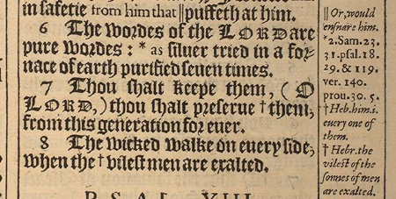
“The words of the LORD are pure words: as silver tried in a furnace of earth, purified seven times.” – Psalms 12:6 KJB
“Thou shalt keep them, O LORD, thou shalt preserve them from this generation for ever.” – Psalms 12:7 KJB

