Slide 1
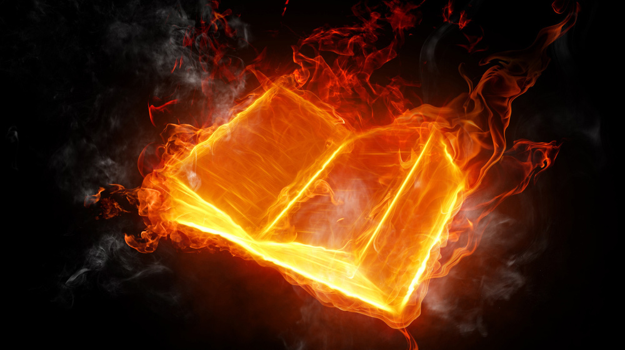
Questions
&
(Bible)
Answers

Slide 2
Question 1
“When do we need faith? (explain please)”

Slide 3
Answer 1
Every moment, of every day.
Yes, even right now, as it is written:

Slide 4
Answer 1
“For I am not ashamed of the gospel of Christ: for it is the power of God unto salvation to every one that believeth; to the Jew first, and also to the Greek.”
– Romans 1:16 KJB

Slide 5
Answer 1
“For therein is the righteousness of God revealed from faith to faith: as it is written, The just shall live by faith.” – Romans 1:17 KJB
(see also, Hab. 2:4; 2 Cor. 5:7; Gal. 3:11; Heb. 10:38 KJB)

Slide 6
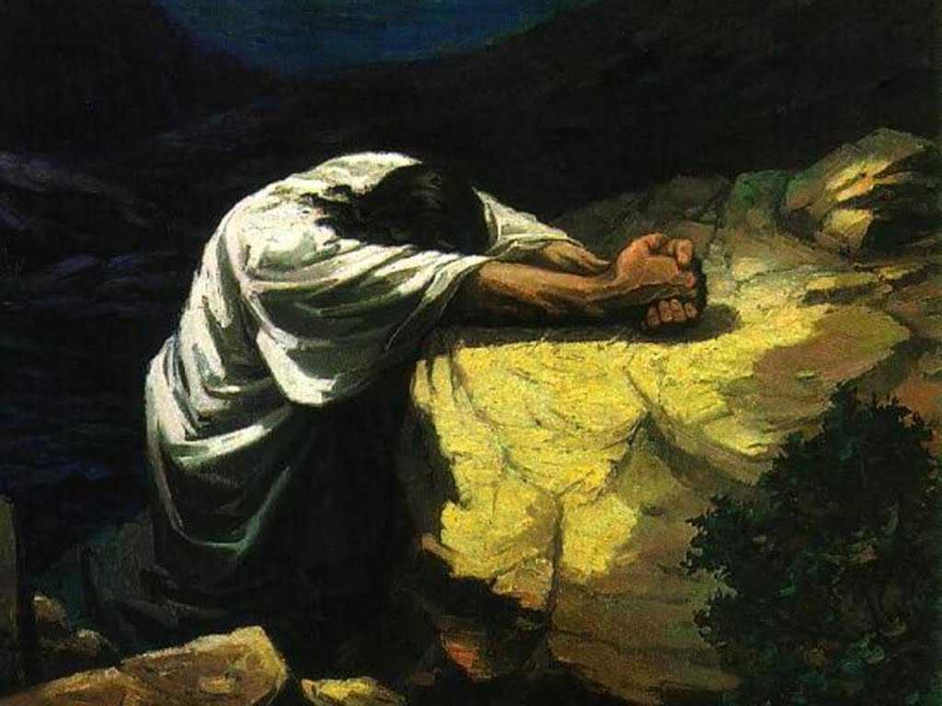

Slide 7
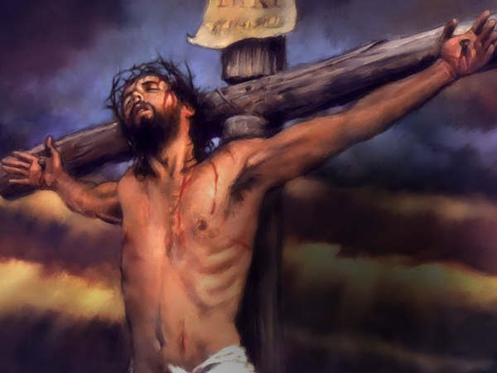
“Father, …
“… into thy hands I commend my spirit:”- Luke 23:46 KJB

Slide 8
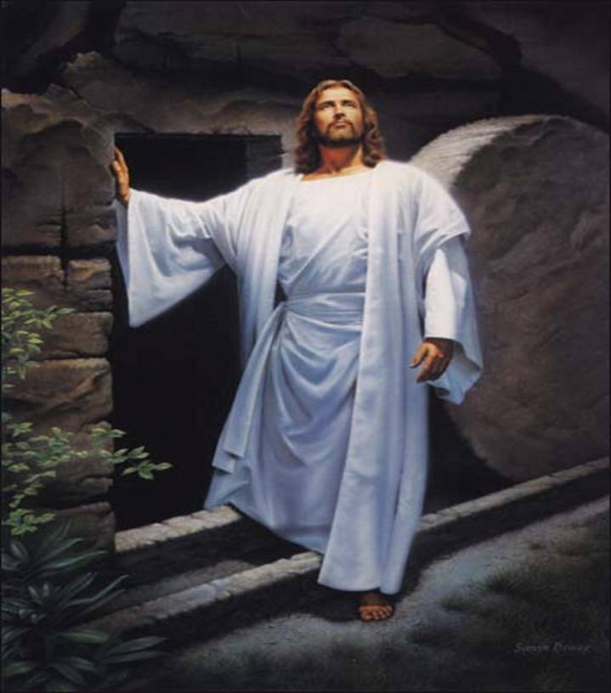

Slide 9
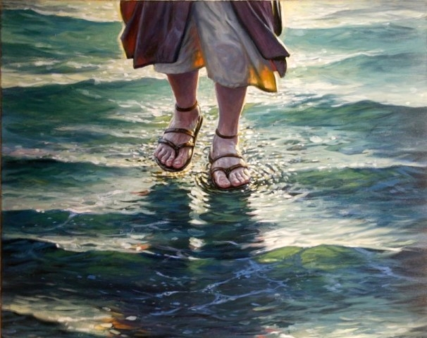

Slide 10
Answer 1
“As the living Father hath sent me, and I live by the Father: so he that eateth me, even he shall live by me.” – John 6:57 KJB

Slide 11
Answer 1
“So then faith cometh by hearing, and hearing by the word of God.”
– Romans 10:17 KJB

Slide 12
Answer 1
“For God so loved the world, that he gave his only begotten Son, that whosoever believeth in him should not perish, but have everlasting life.” – John 3:16 KJB

Slide 13
Answer 1
“… for whatsoever is not of faith is sin.” – Romans 14:23 KJB

Slide 14
Answer 1
“… Have faith in God.”
– Mark 11:22 KJB
Yes, even right now.

Slide 15
Answer 1
“For whatsoever is born of God overcometh the world: and this is the victory that overcometh the world, even our faith.”
– 1 John 5:4 KJB

Slide 16
Answer 1
“Here is the patience of the saints: here are they that keep the commandments of God, and the faith of Jesus.”
– Revelation 14:12 KJB

Slide 17
Question 2
“How do you convince the people who go (to) church on Sunday to be a(n) SDA?”

Slide 18
Answer 2
Ultimately, I (we) don’t. It is the prerogative of the Holy Ghost to bring conviction, as it is written:

Slide 19
Answer 2
“Nevertheless I tell you the truth; It is expedient for you that I go away: for if I go not away, the Comforter will not come unto you; but if I depart, I will send him unto you.” – John 16:7 KJB

Slide 20
Answer 2
“And when he is come, he will reprove the world of sin, and of righteousness, and of judgment:”
– John 16:8 KJB

Slide 21
Answer 2
Which is why the sin against the Holy Ghost/Spirit (Mat. 12:31-31; Mar. 3:29 KJB) is so eternally dangerous.

Slide 22
Answer 2
However, that doesn’t mean that I (we) don’t have a part to play in it.
For our very lives (the conduct thereof: preaching, teaching, healing, publishing), are a living witness to the Truth and Faith of Jesus Christ.

Slide 23
Answer 2
“And this gospel of the kingdom shall be preached in all the world for a witness unto all nations; and then shall the end come.”
– Matthew 24:14 KJB

Slide 24
Answer 2
“… that, if any obey not the word, they also may without the word be won by the conversation (godly conduct or living) …”
– 1 Peter 3:1 KJB

Slide 25
Answer 2
For it is by this, that is truly made known, that what we preach, teach and publish, is the Truth that will set them free, when others see the life and faith of Christ Jesus lived out day by day in us, and the Holy Ghost will show it unto them ...

Slide 26
Answer 2
… for what the Father does in the believer of His Son, by and through the Holy Ghost/Spirit, will be as the AMEN (2nd witness) to the life of Jesus.
“… because as he (Jesus) is, so are we in this world.” – 1 John 4:17 KJB

Slide 27
Question 3
“Why do we need to keep a command of God? (explain please)”

Slide 28
“The cross is a revelation to our dull senses of the pain that, from its very inception, sin
has brought to the heart of God. Every departure from the right, every deed of cruelty, every failure of humanity to reach His ideal, brings grief to Him.”

Slide 29
Answer 3
“We love him, because he first loved us.” – 1 John 4:19 KJB
“For this is the love of God, that we keep his commandments: and his commandments are not grievous.” – 1 John 5:3 KJB

Slide 30
Answer 3
“Whosoever committeth sin transgresseth also the law: for sin is the transgression of the law.”
– 1 John 3:4 KJB

Slide 31
Answer 3
“Then when lust hath conceived, it bringeth forth sin: and sin, when it is finished, bringeth forth death.”
– James 1:15 KJB

Slide 32
Answer 3
“For the wages of sin is death; but the gift of God is eternal life through Jesus Christ our Lord.”
– Romans 6:23 KJB

Slide 33
Answer 3
Transgression (the not keeping) of God’s Law or Commandments is actually rebellion against Love, and breaks God’s own heart, causing Him pain and sadness, for what has Love (God) ever done, or asked, in error that we would refuse Him.

Slide 34
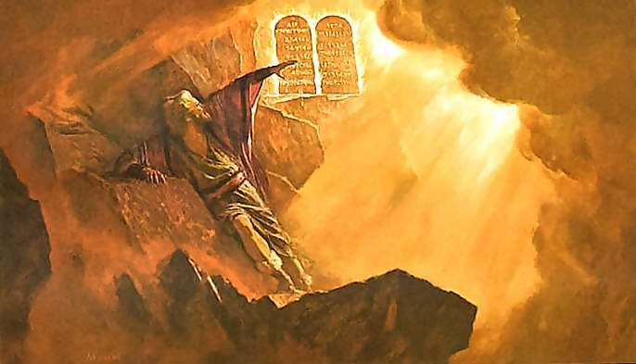
God wrote the Ten Commandments
by the Finger of His Holy Spirit

Slide 35
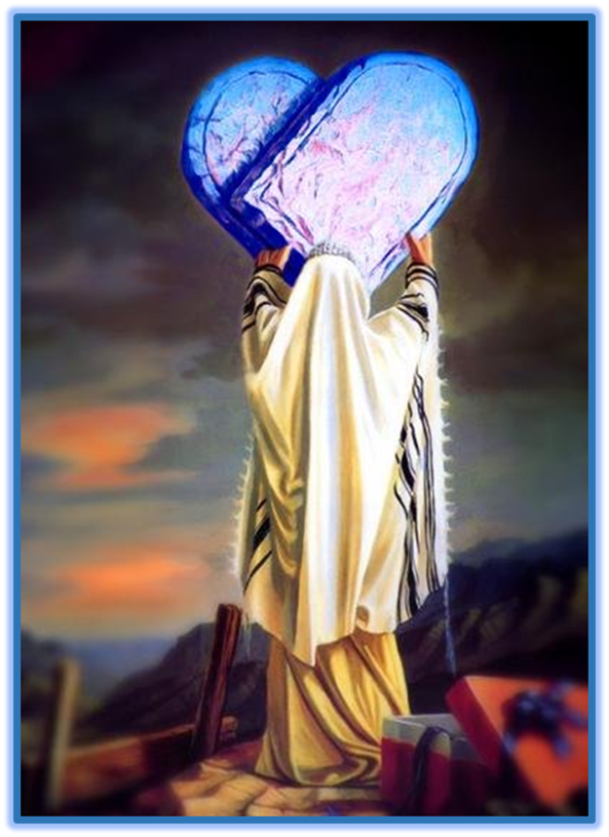
The Law of God, the Ten Commandments, are a written transcript of God’s very own perfect and eternal character of fiery Love.

Slide 36
Answer 3
“… I pray thee, if I have found grace in thy sight, shew me now thy way, that I may know thee, that I may find grace in thy sight …”
– Exodus 33:13 KJB

Slide 37
Answer 3
“And he said, My presence shall go with thee, and I will give thee rest.” – Exodus 33:14 KJB
“Come unto me, all ye that labour and are heavy laden, and I will give you rest.” – Matthew 11:28 KJB

Slide 38
Answer 3
“And he said, I beseech thee, shew me thy glory.” – Exodus 33:18 KJB

Slide 39
Answer 3
“And he said, I will make all my goodness pass before thee, and I will proclaim the name of the LORD before thee; and will be gracious to whom I will be gracious, and will shew mercy on whom I will shew mercy.”
– Exodus 33:19 KJB

Slide 40
Answer 3
“And he said, Thou canst not see my face: for there shall no man see me, and live.” – Exodus 33:20 KJB

Slide 41
Answer 3
“And the LORD said, Behold, there is a place by me, and thou shalt stand upon a rock:” – Exodus 33:21 KJB

Slide 42
Answer 3
“And it shall come to pass, while my glory passeth by, that I will put thee in a clift of the rock, and will cover thee with my hand while I pass by:”
– Exodus 33:22 KJB

Slide 43
Answer 3
“And I will take away mine hand, and thou shalt see my back parts: but my face shall not be seen.”
– Exodus 33:23 KJB

Slide 44
Answer 3
“And the LORD said unto Moses, Hew thee two tables of stone like unto the first: and I will write upon these tables the words that were in the first tables, which thou brakest.”
– Exodus 34:1 KJB

Slide 45
Answer 3
“And he hewed two tables of stone like unto the first; and Moses rose up early in the morning, and went up unto mount Sinai, as the LORD had commanded him, and took in his hand the two tables of stone.”
– Exodus 34:4 KJB

Slide 46
Answer 3
“And the LORD descended in the cloud, and stood with him there, and proclaimed the name of the LORD.”
– Exodus 34:5 KJB

Slide 47
Answer 3
“And the LORD passed by before him, and proclaimed, The LORD, The LORD God, merciful and gracious, longsuffering, and abundant in goodness and truth,”
– Exodus 34:6 KJB

Slide 48
Answer 3
“Keeping mercy for thousands, forgiving iniquity and transgression and sin, and that will by no means clear the guilty; visiting the iniquity of the fathers upon the children, and upon the children's children, unto the third and to the fourth generation.”
– Exodus 34:7 KJB

Slide 49
Answer 3
“And Moses made haste, and bowed his head toward the earth, and worshipped.” – Exodus 34:8 KJB

Slide 50
Answer 3
Did you notice what God proclaimed as central to His name or perfect character of Love, in regards mercy and justice?
Where did we see and hear it before?
It’s found in the very heart of the Ten Commandments.

Slide 51
Answer 3
“… I the LORD thy God am a jealous God, visiting the iniquity of the fathers upon the children unto the third and fourth generation of them that hate me;” – Exodus 20:5 KJB

Slide 52
Answer 3
“And shewing mercy unto thousands of them that love me, and keep my commandments.” – Exodus 20:6 KJB
“If ye love me, keep my commandments.” – John 14:15 KJB

Slide 53
Answer 3
“Thou shalt not take the name of the LORD thy God in vain; for the LORD will not hold him guiltless that taketh his name in vain.” – Exodus 20:7 KJB

Slide 54
Answer 3
Each of the Ten Commandments are an eternal Promise of God, in Christ Jesus, in the New and Everlasting Covenant!

Slide 55
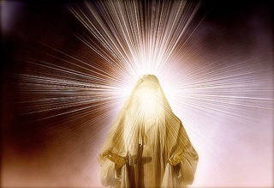

Slide 56
Question 4
“Are all sins (the same) to God (or) (Are some sins worse than others?”

Slide 57
Answer 4
“God does not regard all sins as of equal magnitude; there are degrees of guilt in His estimation, as well as in that of man; but however trifling this or that wrong act may seem in the eyes of men, no sin is small in the sight of God.”

Slide 58
Answer 4
“Man's judgment is partial, imperfect, but God estimates all things as they really are. The drunkard is despised and is told that his sin will exclude him from heaven; while pride, selfishness, and covetousness too often go unrebuked.”

Slide 59
Answer 4
“But these are sins that are especially offensive to God, for they are contrary to the benevolence of His character, to that unselfish love which is the very atmosphere of the unfallen universe.”

Slide 60
Answer 4
“He who falls into some of the grosser sins may feel a sense of his shame and poverty and his need of the grace of Christ; but pride feels no need, and so it closes the heart against Christ and the infinite blessings He came to give.”

Slide 61
Answer 4
For instance, there are ‘natural’ sins and ‘unnatural’ sins:
Natural – lying (like a child; Gen. 8:21 KJB) or lust/covetousness
Unnatural – homosexuality (against nature; Rom. 1:18-32 KJB) or a woman who forgets their child (Isa. 49:15 KJB)

Slide 62
Answer 4
For instance, there are ‘ignorant’ sins and ‘presumptuous’ sins:
Ignorant – Did not know or Understand better (Numbers 15:22-29; Luke 12:48 KJB)
Presumptuous – Knew & Understood better (Numbers 15:30-36; Luke 12:47 KJB)

Slide 63
Answer 4
For instance, there are sins that can be ‘forgiven’ and the sin which ‘cannot be forgiven’:
Forgiveness – Every sin except one (Mark 3:28 KJB)
Without Forgiveness – The sin against the Holy Ghost (Mark 3:29 KJB)

Slide 64
Answer 4
“These six things doth the LORD hate: yea, seven are an abomination unto him:” – Proverbs 6:16 KJB

Slide 65
Answer 4
“A proud look, a lying tongue, and hands that shed innocent blood,”
– Proverbs 6:17 KJB

Slide 66
Answer 4
“An heart that deviseth wicked imaginations, feet that be swift in running to mischief,”
– Proverbs 6:18 KJB

Slide 67
Answer 4
“A false witness that speaketh lies, and he that soweth discord among brethren.” – Proverbs 6:19 KJB

Slide 68
Answer 4
“Keep back thy servant also from presumptuous sins; let them not have dominion over me: then shall I be upright, and I shall be innocent from the great transgression.”
– Psalms 19:13 KJB
The sin against the Holy Spirit (Psalms 51:11 KJB).

Slide 69
Answer 4
“All unrighteousness is sin: and there is a sin not unto death.”
– 1 John 5:17 KJB

Slide 70
Answer 4
Yet, even so, every sin (1 John 3:4 KJB), great or small, physical and spiritual, presumptuous or ignorant, natural or unnatural, brings death (Romans 6:23 KJB), and the sin against the Holy Ghost, brings eternal death.

Slide 71
Those are the submitted Questions and the Bible’s Answers for tonight.
Thank you, Bible study is our joy and it is our pleasure to carry out it’s instructions.

Slide 72
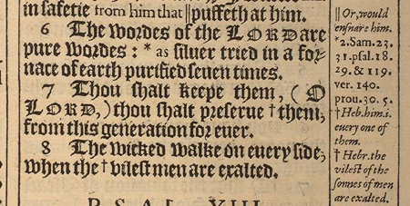
“The words of the LORD are pure words: as silver tried in a furnace of earth, purified seven times.” – Psalms 12:6 KJB
“Thou shalt keep them, O LORD, thou shalt preserve them from this generation for ever.” – Psalms 12:7 KJB

