Slide 1
Questions
&
(Bible)
Answers

Slide 2
Question 1
“Is it Biblical to wear wedding-bands on women/men? What does the Bible say?”

Slide 3
Answer 1
Let us go to the first marriage in the scripture (KJB) to answer this question, and then see the golden thread of truth circling the whole Bible from beginning to end.

Slide 4
Answer 1
“And the LORD God said, It is not good that the man should be alone; I will make him an help meet for him. ”
– Genesis 2:18 KJB

Slide 5
Answer 1
“And the LORD God caused a deep sleep to fall upon Adam, and he slept: and he took one of his ribs, and closed up the flesh instead thereof;”
– Genesis 2:21 KJB

Slide 6
Answer 1
“And the rib, which the LORD God had taken from man, made he a woman, and brought her unto the man.”
– Genesis 2:22 KJB

Slide 7
Answer 1
“And Adam said, This is now bone of my bones, and flesh of my flesh: she shall be Woman, because she was taken out of Man.”
– Genesis 2:23 KJB

Slide 8
Answer 1
“Therefore shall a man leave his father and his mother, and shall cleave unto his wife: and they shall be one flesh.”
– Genesis 2:24 KJB

Slide 9
Answer 1
Adam (man) is the “husband” (Eph. 5:23 KJB), which word comes from two words, “House” – “band/bond”, or that which binds the household (marriage) together, not a circlet of gold, silver or other.
https://www.etymonline.com/word/husband

Slide 10
Answer 1
“And they were both naked, the man and his wife, and were not ashamed.”
– Genesis 2:25 KJB
It says, “naked”, & not wearing extra minerals (silver, gold, &c).

Slide 11
Answer 1
Now the text saying, “naked” refers to their flesh, and not that God did not provide clothes of righteousness for them. Under our clothes, we are naked, just as they were.

Slide 12
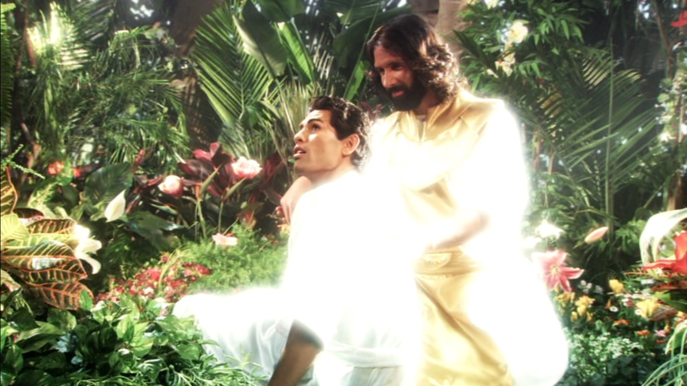

Slide 13
Answer 1
They were “naked” (referring to their perfect flesh), but were clothed with garments of light, and “unashamed”, for they had not yet sinned, but after which, they lost those garments.

Slide 14
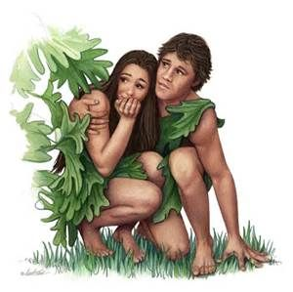

Slide 15
Answer 1
For God, when He created mankind, clothed Adam & Eve with the garments of purest light and glory, covering their perfect fleshly ‘naked’-ness.

Slide 17
Answer 1
“What is man, that thou art mindful of him? and the son of man, that thou visitest him?”
– Psalms 8:4 KJB

Slide 18
Answer 1
“For thou hast made him a little lower than the angels, and hast crowned him with glory and honour.”
– Psalms 8:5 KJB

Slide 19
Answer 1
For God Himself is clothed with glory, light and majesty, and so clothes His children with such, being a faithful loving Father.

Slide 20
Answer 1
“Deck thyself now with majesty and excellency; and array thyself with glory and beauty.” – Job 40:10 KJB

Slide 21
Answer 1
“Bless the LORD, O my soul. O LORD my God, thou art very great; thou art clothed with honour and majesty.”
– Psalms 104:1 KJB

Slide 22
Answer 1
“Who coverest thyself with light as with a garment: who stretchest out the heavens like a curtain:” – Psalms 104:2 KJB

Slide 23
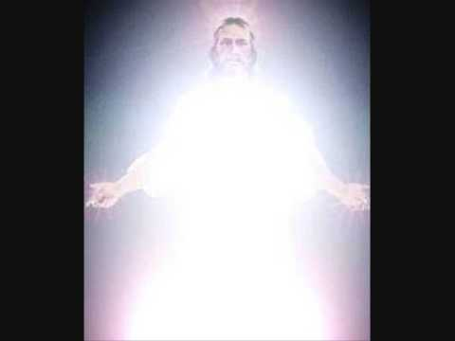

Slide 24
Answer 1
God’s Sanctuary in the wilderness was also plain upon the external, but covered with gold inwardly, representing God’s perfect character.

Slide 25
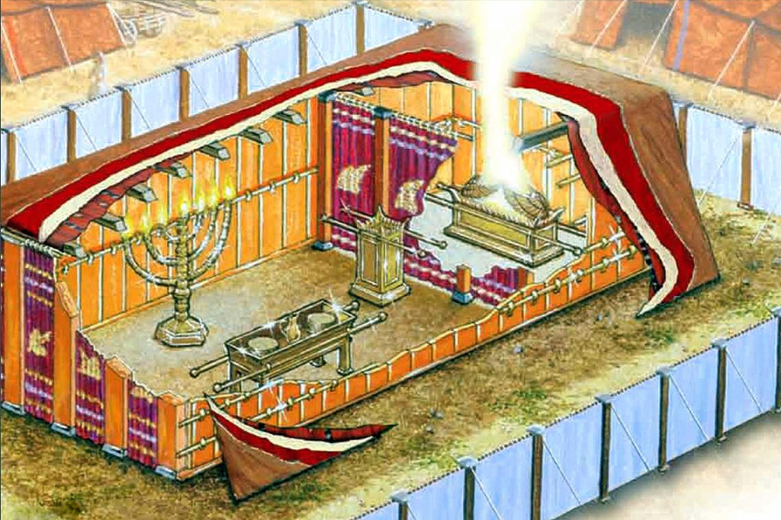

Slide 26
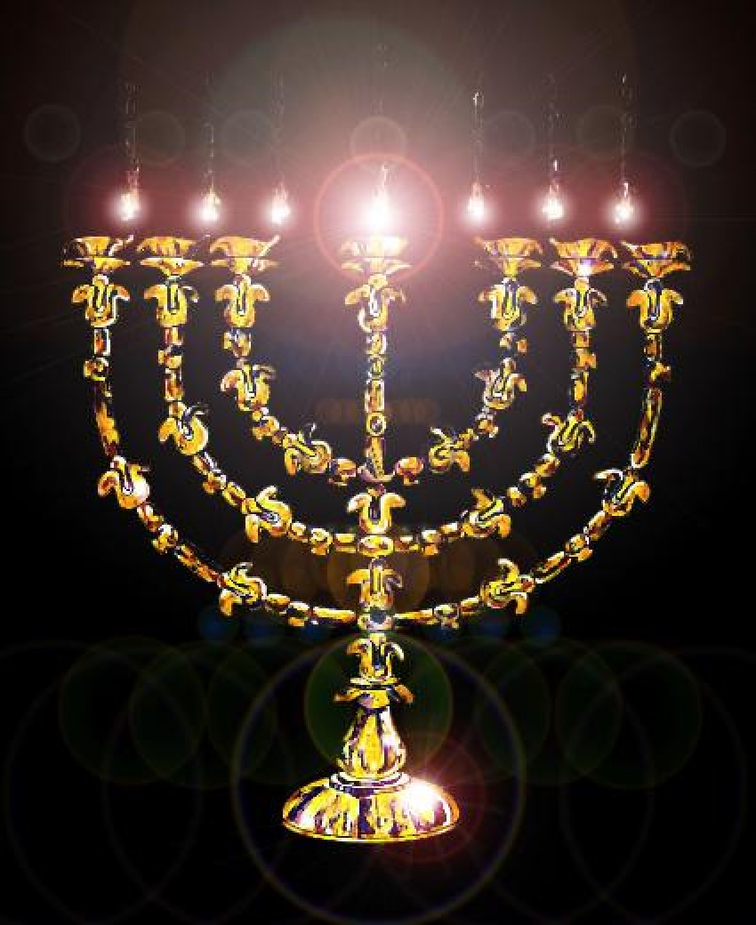

Slide 27
Answer 1
God’s very own token of promise of His eternal Covenant (Isa. 56:4,6 KJB), His marriage vow (Jer. 3:14, 31:23 KJB), was placed inside the Sanctuary. Internal.

Slide 29
Answer 1
In the New Testament texts, we find the very same principle.
Not the outward adorning, or the outward sign of promise, but that of the heart, internal. In Spirit (thought) and in Truth (deed).

Slide 30
Answer 1
“Likewise, ye wives, be in subjection to your own husbands; that, if any obey not the word, they also may without the word be won by the conversation of the wives;” – 1 Peter 3:1 KJB

Slide 31
Answer 1
“While they behold your chaste conversation coupled with fear.”
– 1 Peter 3:2 KJB

Slide 32
Answer 1
“Whose adorning let it not be that outward adorning of plaiting the hair, and of wearing of gold, or of putting on of apparel;”
– 1 Peter 3:3 KJB

Slide 33
Answer 1
“But let it be the hidden man of the heart, in that which is not corruptible, even the ornament of a meek and quiet spirit, which is in the sight of God of great price.” – 1 Peter 3:4 KJB

Slide 34
Answer 1
Finally, in the Revelation of Jesus Christ, let’s see the conclusion of the whole matter, on marriage and the adornment in regards the vows, promise, or covenant made between the Husband and wife.

Slide 35
Answer 1
“And there appeared a great wonder in heaven; a woman clothed with the sun, and the moon under her feet, and upon her head a crown of twelve stars:” – Revelation 12:1 KJB

Slide 36
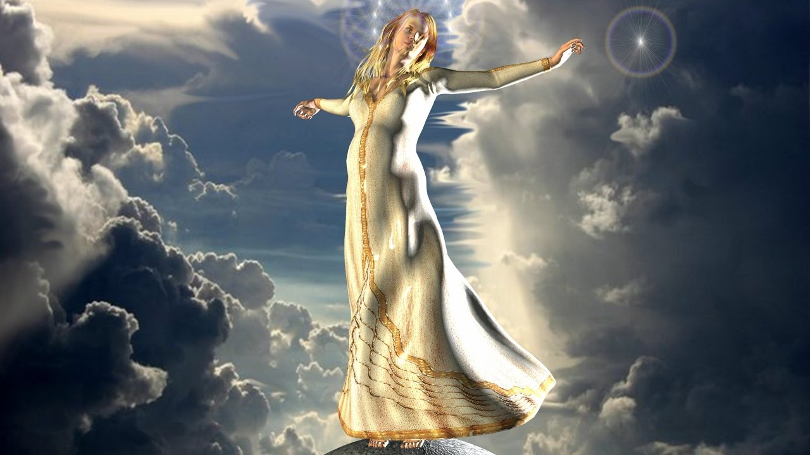

Slide 37
Answer 1
In contrast to God’s faithful bride, who wears the glory of God’s light and has the covenant in her heart (the commandments of God), there is also seen the unfaithful and adulterous woman, though she wears gold outwardly.

Slide 38
Answer 1
“And the woman was arrayed in purple and scarlet colour, and decked with gold and precious stones and pearls, having a golden cup in her hand full of abominations and filthiness of her fornication:” – Revelation 17:4 KJB

Slide 40
Answer 1
Did the outward adornment and/or outward profession of a vow, promise or covenant, keep the Jews of old or the woman of Revelation 17 faithful?
Did the outward circumcision, or gold adorning keep them chaste?

Slide 41
Answer 1
“Wherefore do ye spend money for that which is not bread? …”
– Isaiah 55:2 KJB
Does spending one penny for a circlet of gold, silver or other keep people faithful to their vows to one another and before God? Has it ever?

Slide 42
Answer 1
“... the use of temples, and these dedicated to particular saints, and ornamented on occasions with branches of trees; incense, lamps, and candles; votive offerings on recovery from illness; holy water; asylums; holydays and seasons, …”

Slide 43
Answer 1
“… use of calendars, processions, blessings on the fields; sacerdotal vestments, the tonsure, the ring in marriage, turning to the East, images at a later date, perhaps the ecclesiastical chant, the Kyrie Eleison, (3) …”

Slide 44
Answer 1
“… are all of pagan origin, and sanctified by their adoption in the (Roman Catholic) Church. ..." - An Essay on the Development of Christian Doctrine, by Cardinal John Henry Newman, p. 373 -https://books.google.as/books?id=RN66gZdNnqoC&printsec=frontcover

Slide 45
Those are the submitted Questions and the Bible’s Answers for tonight.
Thank you, Bible study is our joy and it is our pleasure to carry out it’s instructions.

Slide 46
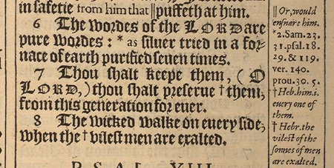
“The words of the LORD are pure words: as silver tried in a furnace of earth, purified seven times.” – Psalms 12:6 KJB
“Thou shalt keep them, O LORD, thou shalt preserve them from this generation for ever.” – Psalms 12:7 KJB

