Slide 1
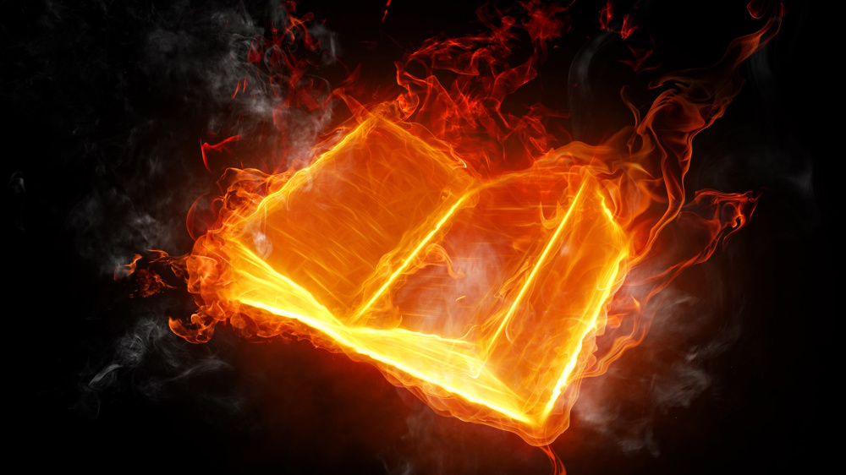
Questions
&
(Bible)
Answers

Slide 2
Question 1
What is the Answer to the World Wide Crisis?

Slide 3
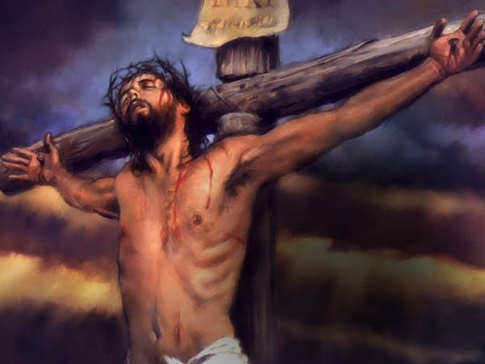
Answer 1
The Everlasting Gospel
John 3:16 KJB

Slide 4
Answer 1
“The next day John seeth Jesus coming unto him, and saith, Behold the Lamb of God, which taketh away the sin of the world.” – John 1:29 KJB

Slide 5
Answer 1

Slide 6
Answer 1

Slide 7
Answer 1
“And this gospel of the kingdom shall be preached in all the world for a witness unto all nations; and then shall the end come.”
– Matthew 24:14 KJB

Slide 8
Answer 1
“Looking for and hasting unto the coming of the day of God, wherein the heavens being on fire shall be dissolved, and the elements shall melt with fervent heat?”
– 2 Peter 3:12 KJB

Slide 9
Question 2
Who are you in
Jesus Christ?

Slide 10
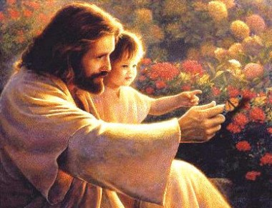
Answer 2
1 Peter 1:18-19 KJB
A blood-bought Child of God, the KING of Kings and LORD of Lords.
Redeemed & Created Anew

Slide 11
Answer 2
“Therefore if any man be in Christ, he is a new creature: old things are passed away; behold, all things are become new.” – 2 Corinthians 5:17 KJB

Slide 12
Answer 2
John 8:32,36 KJB
FREE

Slide 13
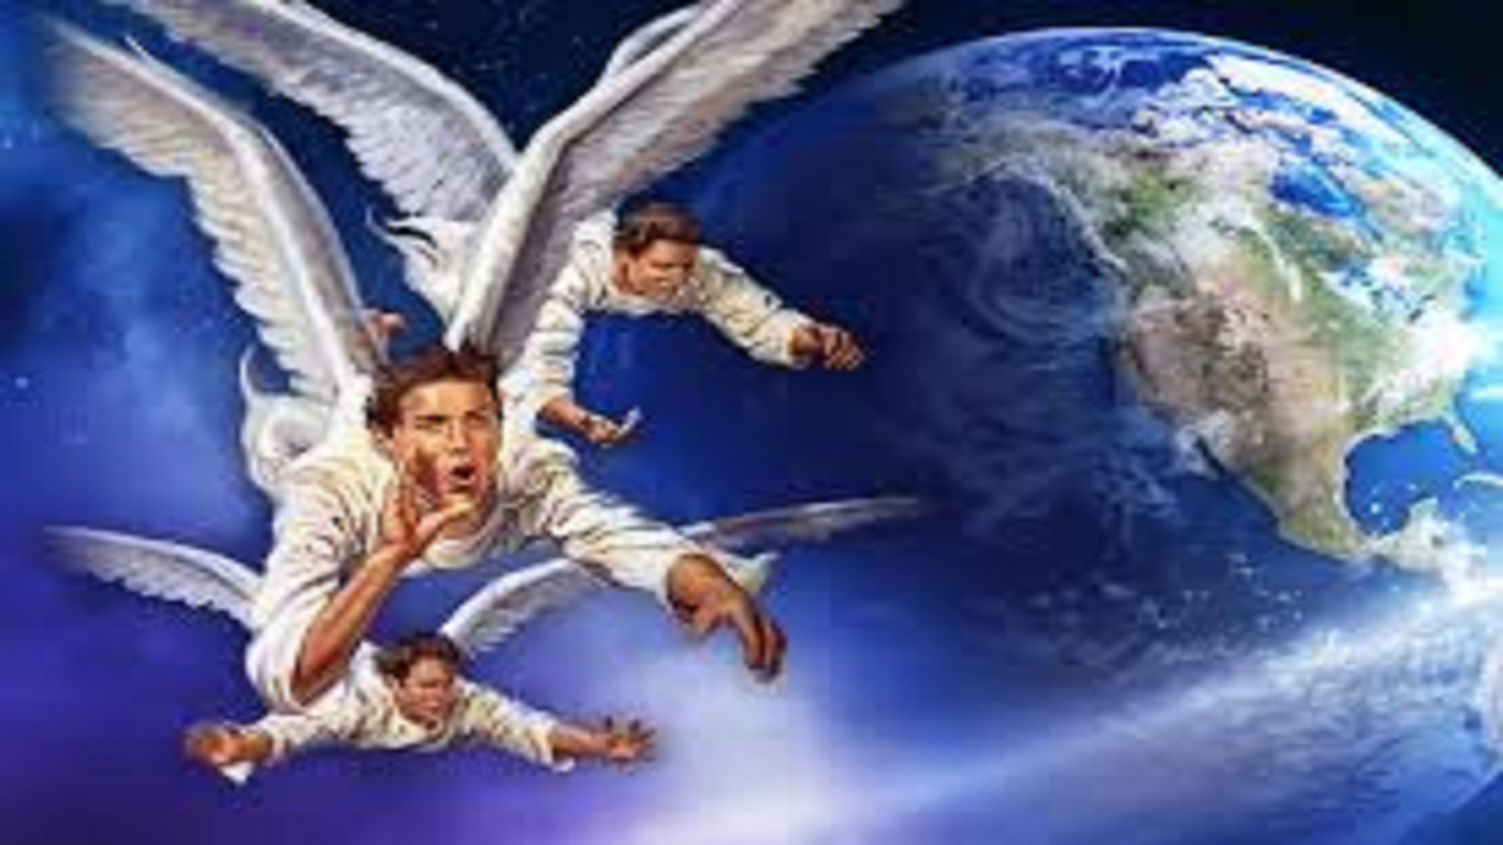
Answer 2
Revelation 14:6-12 KJB
The LAST ELIJAH Messengers
Heralding the 2nd Advent of Jesus

Slide 14
Question 3
There are so many SABBATHS! (Sat & Sun)
How do I know which is the True Sabbath?

Slide 15
Answer 3
We have a presentation coming on this very important subject of God’s Holy Day, the Sabbath of the LORD (JEHOVAH Elohiym), therefore, please keep coming …

Slide 16
Answer 3
… and we will re-present this question on the day following that presentation. If there is anything further needed in answer, we will address it at that time and after as needed.

Slide 17
Answer 3
However, I will point to two passages that will begin your journey until then:
Genesis 2:1-3;
Exodus 20:8-11 KJB

Slide 18
Those are the submitted Questions and the Bible’s Answers for tonight.
Thank you, Bible study is our joy and it is our pleasure to carry out it’s instructions.

Slide 19
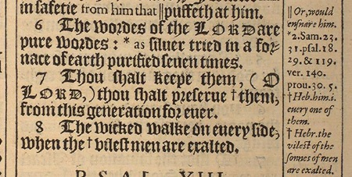
“The words of the LORD are pure words: as silver tried in a furnace of earth, purified seven times.” – Psalms 12:6 KJB
“Thou shalt keep them, O LORD, thou shalt preserve them from this generation for ever.” – Psalms 12:7 KJB

