Slide 1
NUTRITION
Notes:
WHAT IS NUTRITION?
Nutrition is the study of food & how it works in our bodies. Nutrition includes all the stuff that’s in our food such as vitamins, protein, fat and more.

Slide 2
“Whether therefore ye eat, or drink, or whatsoever ye do, do all to the glory of God.” –
1 Corinthians 10:31 KJB
Notes:
“Whether therefore ye eat, or drink, or whatsoever ye do, do all to the glory of God. ” – 1 Corinthians 10:31
People these days aren’t very careful with what they put into their bodies, but little do they know that diseases and illnesses are linked back to what they have been eating.

Slide 3
“The food that we eat gets broken down into blood. …”

Slide 4
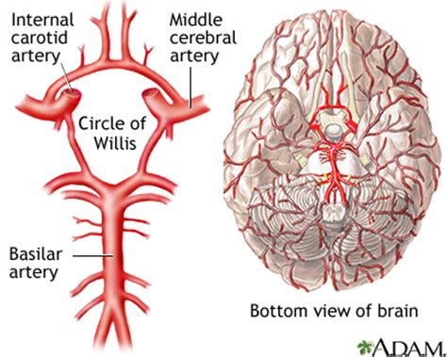
“… That blood feeds our brain. …”

Slide 5
“… Our brain houses our mind. …”

Slide 6
“… Our mind is where we use our thoughts. …”

Slide 7
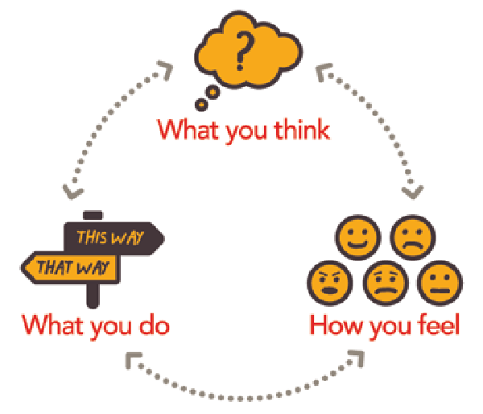
“… Our thoughts produces actions. …”

Slide 8
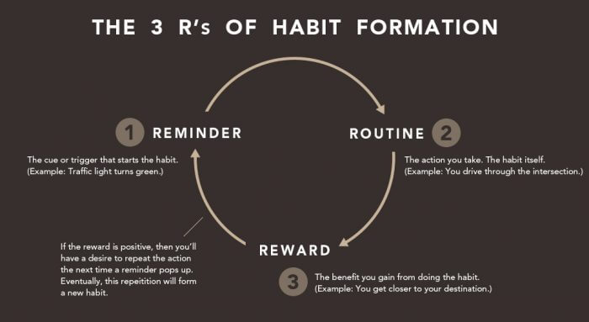
“… Our actions repeated form habits. …”

Slide 9
“… Our habits develop our character. …”

Slide 10
“… Our character determines our destiny.”

Slide 11
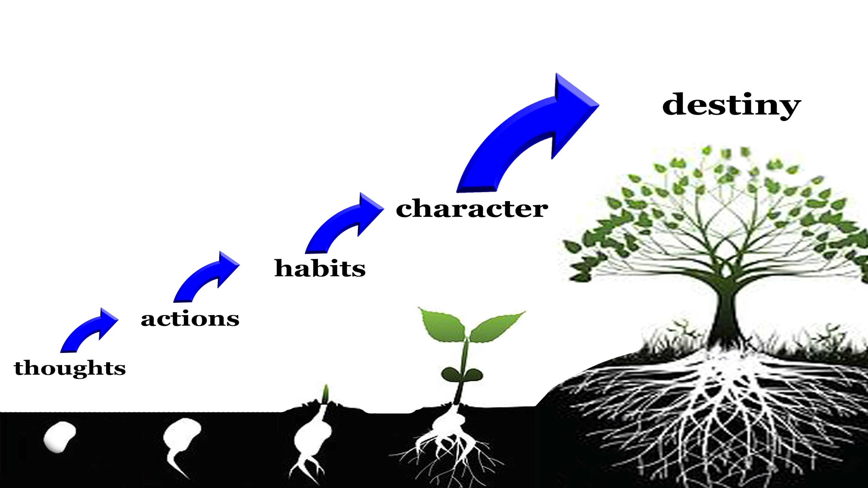
Notes:
Here is a general picture of what we have just discussed.

Slide 12
“… his name [is] Immanuel. Butter and honey shall he eat, that he may know to refuse the evil, and choose the good. …”
– Isaiah 7:14-15
Notes:
“… his name [is] Immanuel. Butter and honey shall he eat, that he may know to refuse the evil, and choose the good. …”
– Isaiah 7:14-15
DIET DOES AFFECT THE MIND.
We are told that the diet of Christ when he became human like us would help determine his growing and knowing how to refuse evil and do good.

Slide 13
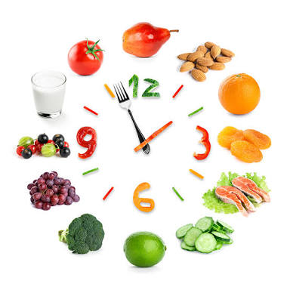
10 Tips for Healthful Eating
1. Eat a variety of fruits, grains, vegetables, legumes, seeds, and nuts
(See: A Vegan
Vegetarian
Lifestyle)

Slide 14
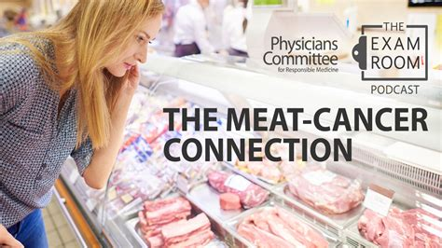
10 Tips for Healthful Eating
2. Avoid animal protein.

Slide 15
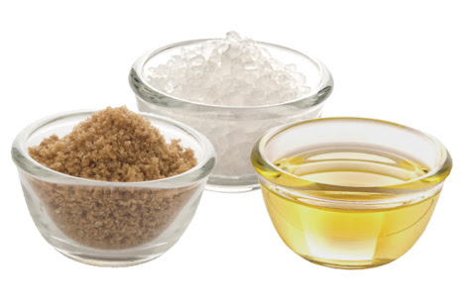
10 Tips for Healthful Eating
3. Limit fat, sugar, and salt.

Slide 16
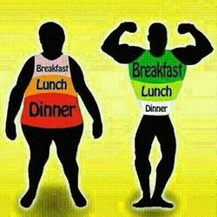
10 Tips for Healthful Eating
4. Eat a good breakfast, a moderate lunch, and a light supper.

Slide 17
10 Tips for Healthful Eating
5. Don't eat too late at night.

Slide 18
10 Tips for Healthful Eating
6. Don't eat between meals—allow five hours between meals.

Slide 19
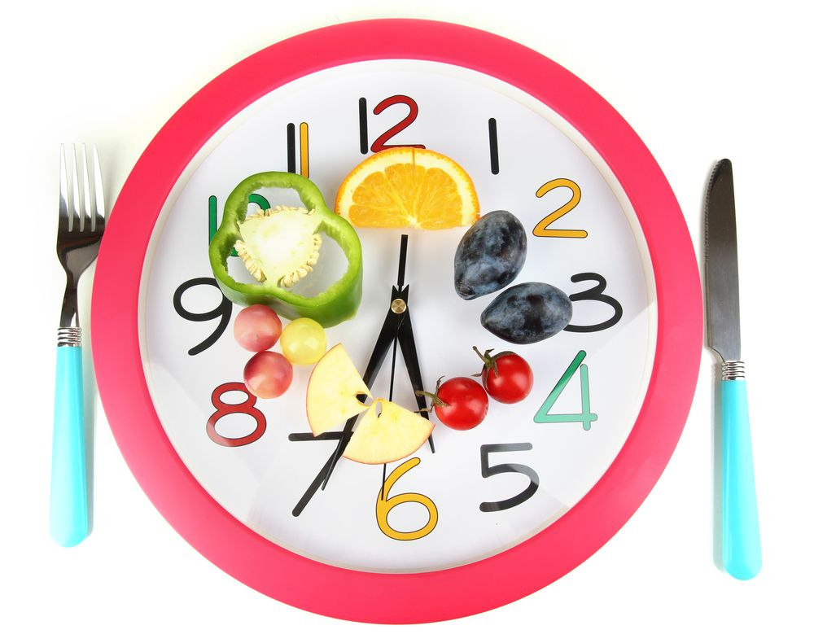
10 Tips for Healthful Eating
7. Eat at regular times.

Slide 20
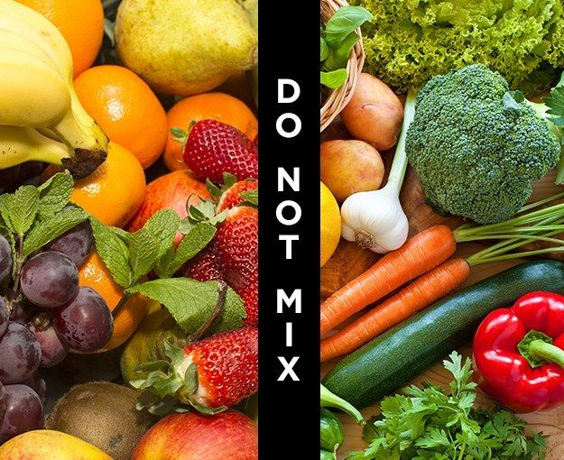
10 Tips for Healthful Eating
8. Watch your combination of foods —don't mix fruit and veggies.
(some exceptions)
Notes:
Fruits are mostly water and easier to digest (faster) in the stomach.
Veggies are more fibrous, and therefore take longer than fruit to digest.
Mixing fruits and veggies can produce fermentation in the gut (stomach), as the fruit is quickly digested, while the veggies are digested partially, which can lead to excess ‘gas’ (bloating), and also affect the brain and thinking.
(some exceptions: Apples, Bananas, etc.)

Slide 21
10 Tips for Healthful Eating
9. Avoid refined grains. “The whiter the bread, the quicker you’re dead …”

Slide 22
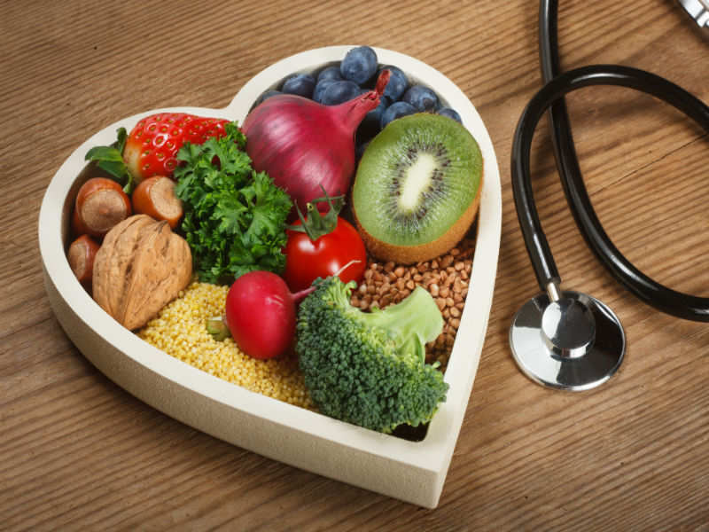
10 Tips for Healthful Eating
10. Choose foods that will build good blood.
Notes:
Today the world is getting sicker and sicker, and dying due to poor nutrition. Yet the answer to the problem is very simple. I want to share with you a small clip regarding a community of believers in the middle east who have experienced the truth regarding “the truth from the Word of God” on the subject of nutrition.

Slide 23
Vegan Village Video
Notes:
(AFTER VIDEO PLAYS, give CONCLUSION: )
Family and friends, isn’t that beautiful what we have just witnessed regarding the power of the word of God on the topic of Nutrition? It is my prayer that God would move upon our hearts to accept the diet He has provided for us from the beginning.

