Slide 1
God's Free Health Plan
Your guide to having abundant health & a long life

Slide 2
Medical Care $
A 2017 study, published in the (JAMA) revealed:
that health care spending in the U.S.A. rose nearly a trillion dollars from 1996-2015.

Slide 3
What does the Bible have to do with health?

Slide 4
“Beloved, I pray that you may prosper in all things & be in health, just as your soul prospers.” - 3 John 1:2 NKJV

Slide 5
Why did God give health rules to his people?

Slide 6
“And the LORD commanded us to do all these statutes, to fear the LORD our God, for our good always, that he might preserve us alive, as it is at this day.” – Deuteronomy 6:24 KJB

Slide 7
“And ye shall serve the LORD your God, and he shall bless thy bread, and thy water; and I will take sickness away from the midst of thee.” – Exodus 23:25 KJB

Slide 8
The Bible is the source for everything health-related

Slide 9
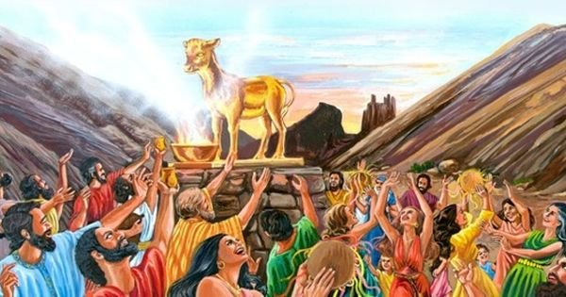
Health in Physical, Mental & Spiritual, matters

Slide 10
“… eat ye that which is good …” – Isaiah 55:2 KJB

Slide 11
“Whether therefore ye eat, or drink, or whatsoever ye do, do all to the glory of God. ” – 1 Corinthians 10:31 KJB

Slide 12
“Then saith Jesus unto him, Get thee hence, Satan: for it is written, Thou shalt worship the Lord thy God, and him only shalt thou serve.” – Matthew 4:10 KJB

Slide 13
You don’t have to be like this poor miserable soul...

Slide 14
“Wine is a mocker, strong drink is raging: and whosoever is deceived thereby is not wise.” – Proverbs 20:1 KJB

Slide 15
“ … the unrighteous shall not inherit the kingdom of God … Be not deceived: neither fornicators, nor idolaters, nor adulterers … shall inherit the kingdom of God.” – 1 Corinthians 6:9,10 KJB

Slide 16
“Know ye not that ye are the temple of God, and that the Spirit of God dwelleth in you? If any man defile the temple of God, him shall God destroy; for the temple of God is holy, which temple ye are.” – 1 Corinthians 3:16-17 KJB

Slide 17
What solemn reminder is given to those who ignore God’s principles?

Slide 18
“Be not deceived; God is not mocked: for whatsoever a man soweth, that shall he also reap.” – Galatians 6:7 KJB

Slide 19
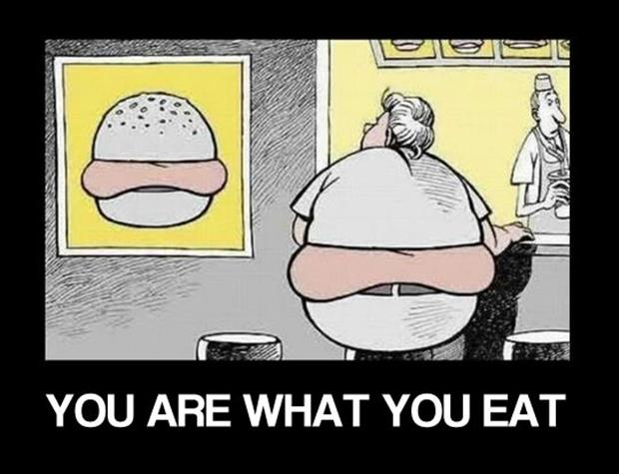
Are you eating for strength and health?

Slide 20
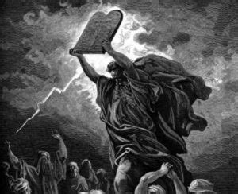
Breaking God’s Law, causes one’s own destruction

Slide 21
You reap what you sow

