Slide 1
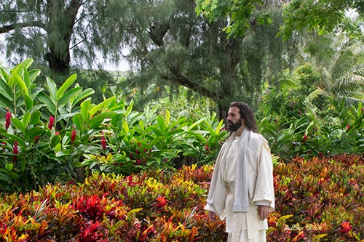
God is a Gardener

Slide 2
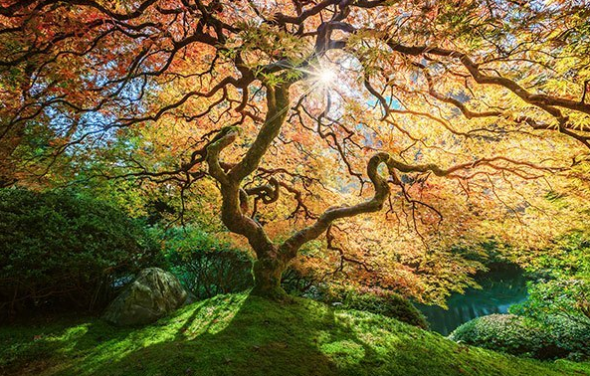
What kind of Trees does God plant?

Slide 3
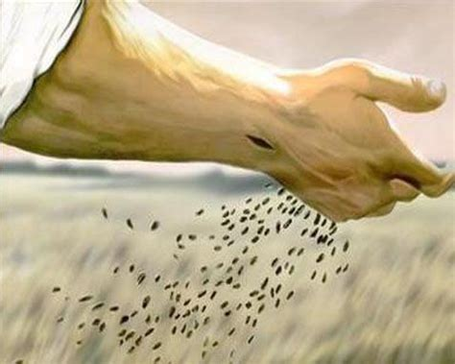
What kind of Seeds does He use?

Slide 4
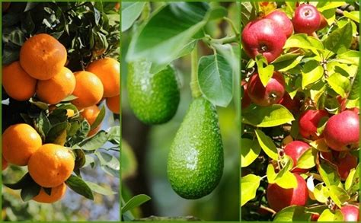
Does God plant Fruit Trees?
What kind of Fruit Trees?

Slide 5
“But the fruit of the Spirit is love, joy, peace, longsuffering, gentleness, goodness, faith, Meekness, temperance …”
– Galatians 5:22-23 KJB

Slide 6
“(For the fruit of the Spirit is in all goodness and righteousness and truth;)”
– Ephesians 5:9 KJB

Slide 7
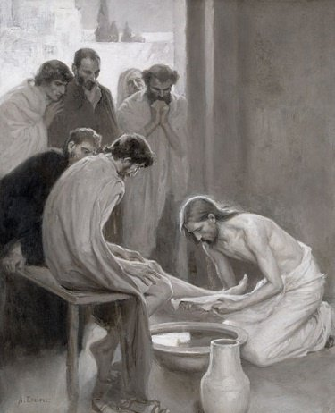
LOVE

Slide 8
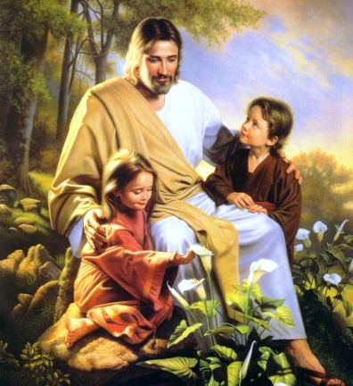
JOY

Slide 9
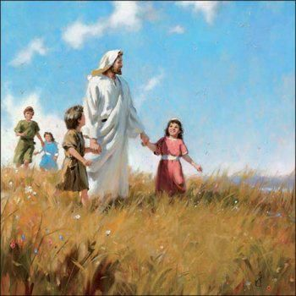
PEACE

Slide 10
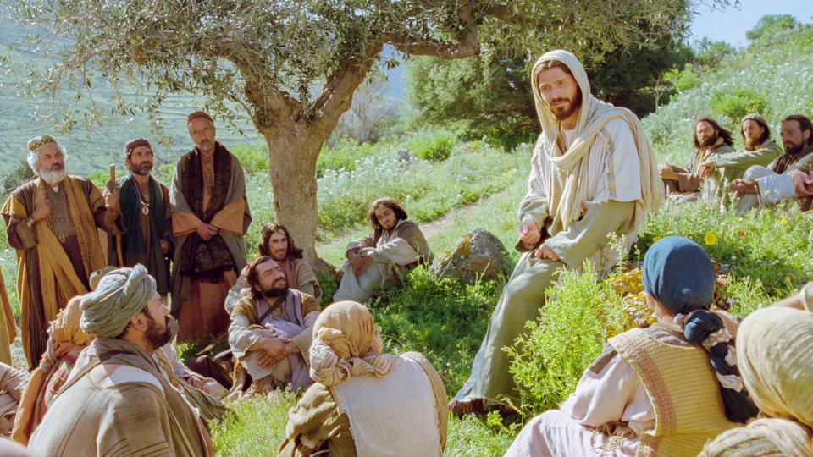
“And he looked up, and said, I see men as trees, walking.” – Mark 8:24 KJB

Slide 11
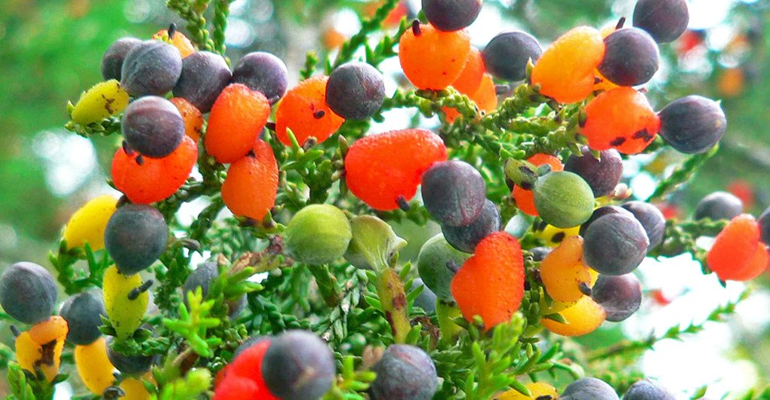
What king of Fruit do you bear?
What kinds of seeds are you planting as you talk and live?

Slide 12
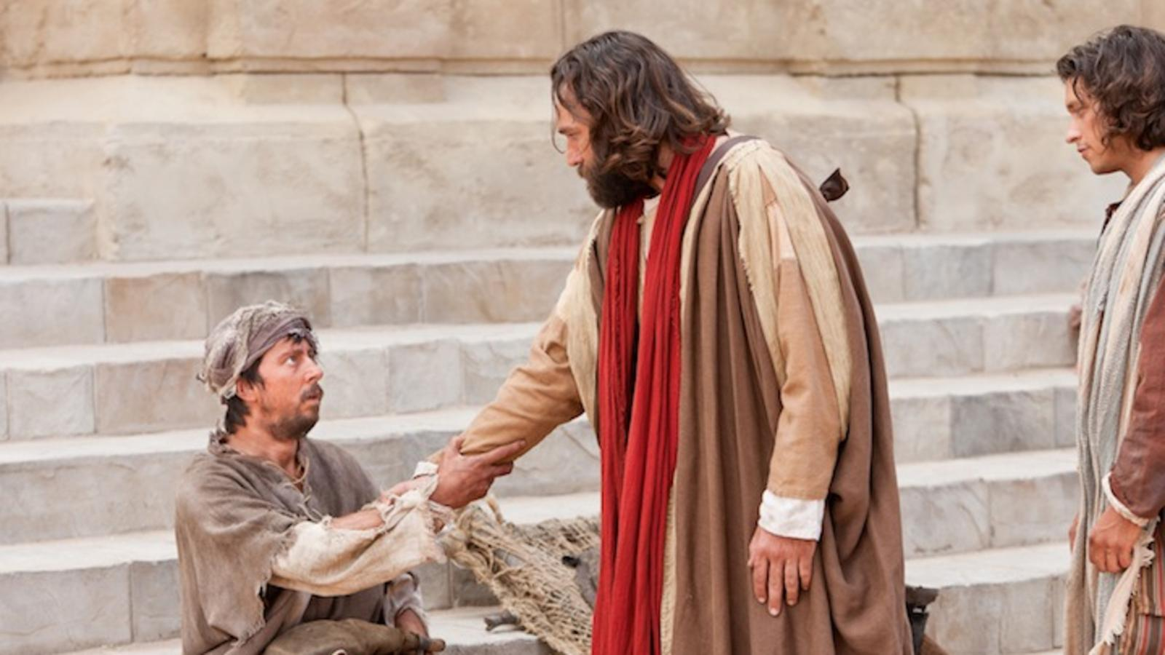
KINDNESS

Slide 13
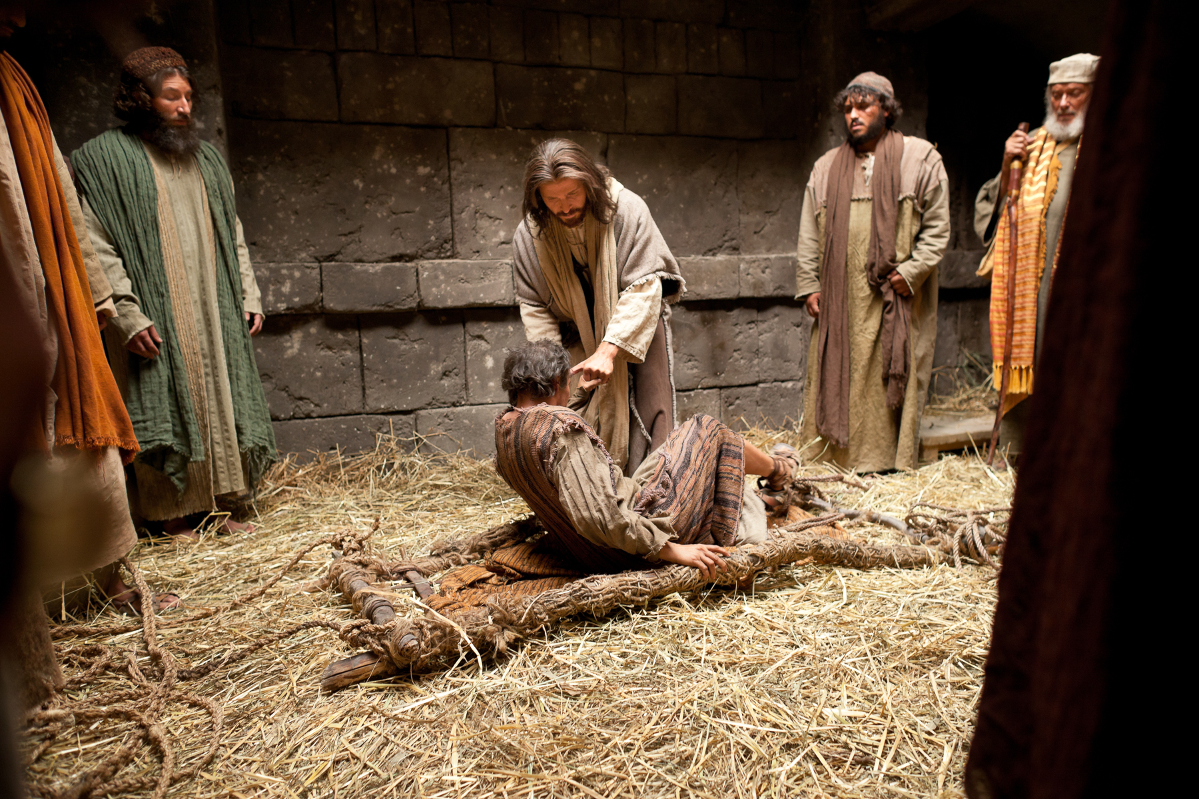
FORGIVENESS

Slide 14
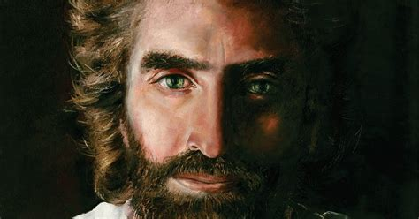
PATIENCE

Slide 15
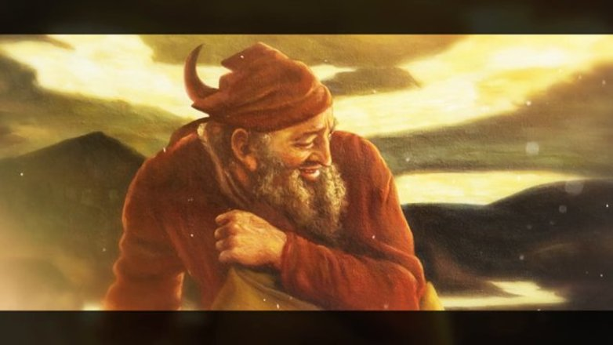
The devil is also a gardener.

Slide 16
“… all bitterness, and wrath, and anger, and clamour, and evil speaking … with all malice …”
– Ephesians 4:31 KJB

Slide 17
“… fornication, uncleanness, inordinate affection, evil concupiscence, and covetousness, which is idolatry … children of disobedience … anger, wrath, malice, blasphemy, filthy communication out of your mouth …” – Colossians 3:5,6,7 KJB

Slide 18
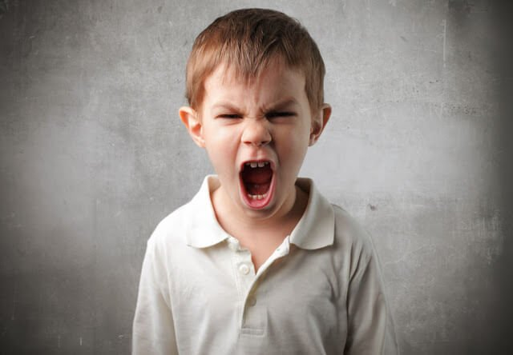
ANGER

Slide 19
BITTERNESS

Slide 20
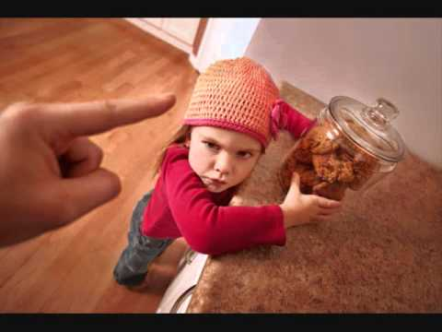
DISOBEDIENCE

Slide 21
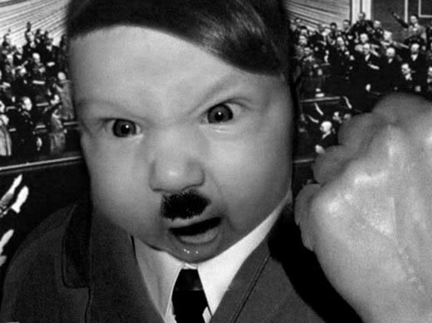
EVIL SPEAKING

Slide 22
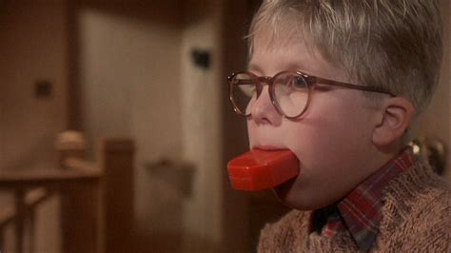
FILTHY COMMUNICATION

Slide 23
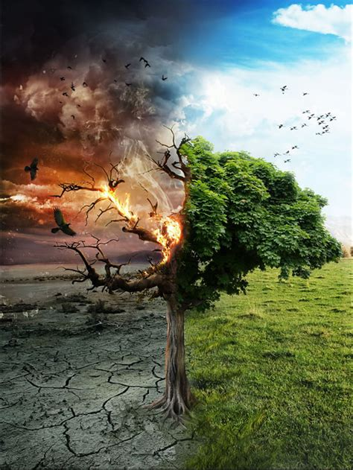
What kind of Tree are you, and who planted it?

Slide 24
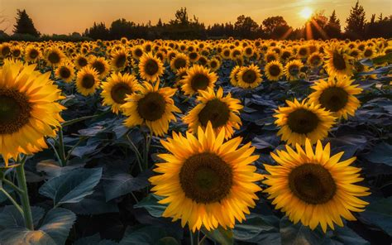
May you all be brightness and sunshine in the life of someone today.

