Slide 1
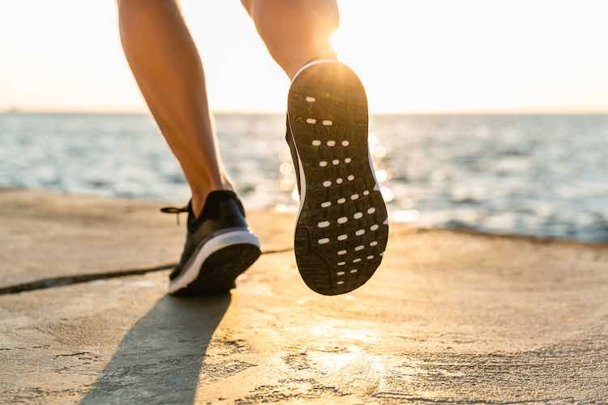
xercise
NEWSTART
Notes:
According to recent studies ranking the most obese places in the world, Who can guess what country has the number one spot IN THE WORLD? Hint: It’s a tiny island, not really a country. You guessed it. American Samoa. The recent study conducted in 2018 cited a staggering statistic that 80% of American Samoa's population is overweight or obese. This statistic can be confirmed by American Samoa also leading the world in rates of Diabetes, Hypertension, Cancer, and Kidney Disease that leads to increasing numbers of dialysis patients in American Samoa.
What if I told you that there is cure to this obesity epidemic? Also What if I told you that the wonder drug or medicine needed for this problem comes directly from the Word of God. If I told you what this cure is you may think this is crazy, but it is true. It is something so simple, even in the US this simple cure isn’t being fully done. Yes I said done. Because the wonder drug, the medicine, the cure is something you as an individual DO. (any ideas what it could be)
Fewer than 5% of adults in the US exercise for at least 30 minutes a day More than 80 million Americans are categorize as “inactive”
Being inactive is one of the great contributing factors to obesity. If being inactive is the cause then what do you suppose is the cure?

Slide 2
1 Corinthians 6:19-20
“What? know ye not that your body is the temple of the Holy Ghost which is in you, which ye have of God, and ye are not your own? …”

Slide 3
1 Corinthians 6:19-20
“… For ye are bought with a price: therefore glorify God in your body, and in your spirit, which are God's.”

Slide 4
Benefits of Exercise
Improves mood
and decreases depression

Slide 5
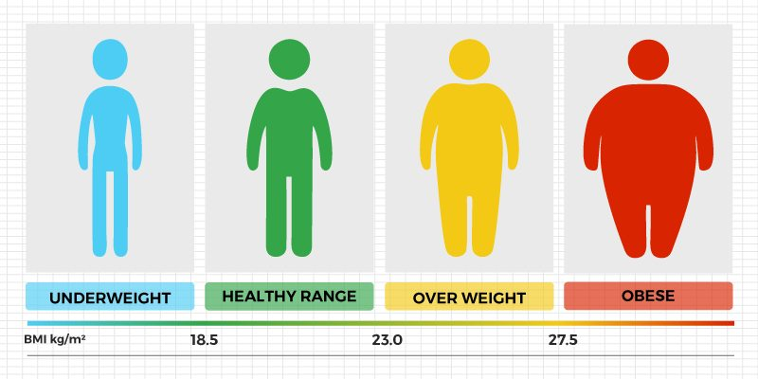
Benefits of Exercise
Helps maintain a healthy weight.

Slide 6
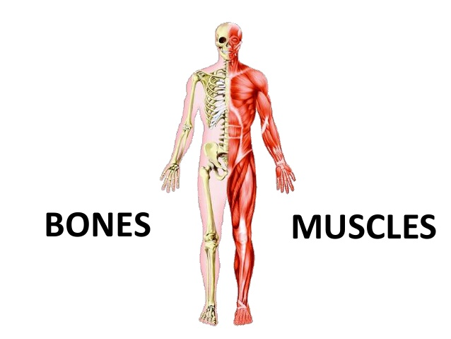
Benefits of Exercise
Develops muscles and stimulates bones.

Slide 7
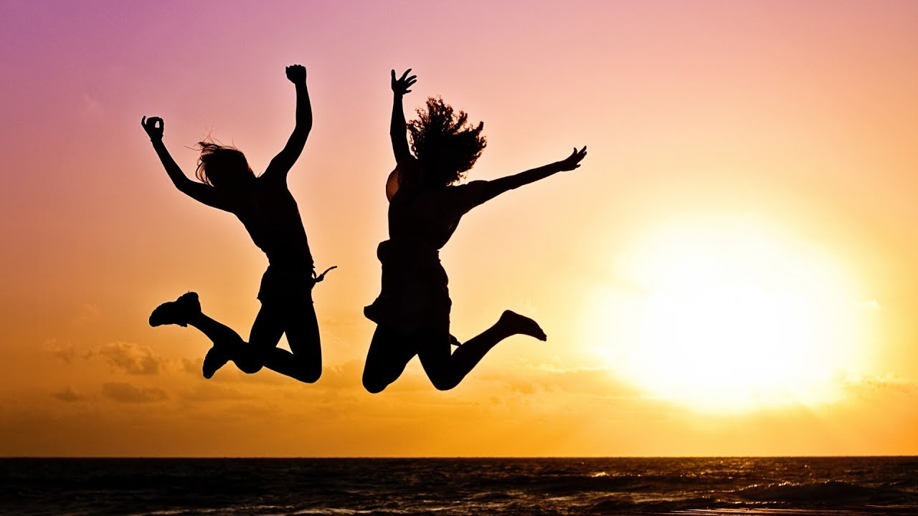
Benefits of Exercise
Increases energy levels.

Slide 8
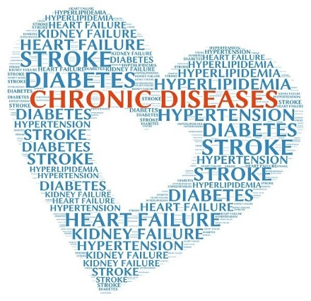
Benefits of Exercise
Reduces the risk of chronic diseases such as diabetes, heart disease, and cancer.

Slide 9
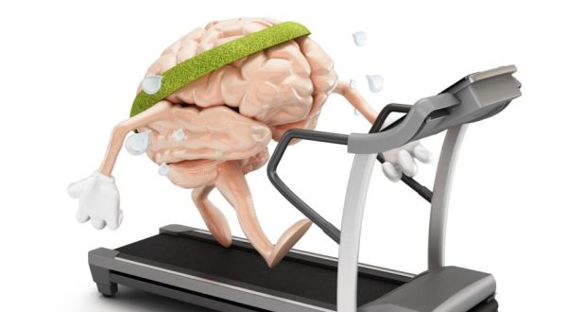
Benefits of Exercise
Improves brain health and memory.

Slide 10
Benefits of Exercise
Improves sleep quality and helps relaxation.

Slide 11
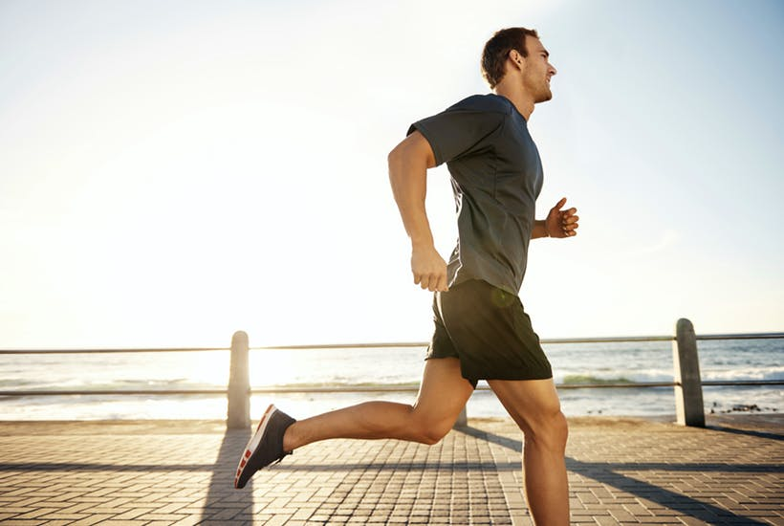
4 Types of Exercise
Aerobic:
Activities involving endurance, improving cardiovascular health.
Notes:
Regular aerobic exercise improves your cardiovascular fitness by increasing your capacity to use oxygen. It does this by increasing your heart’s capacity to send blood (and hence oxygen) to the muscles. This is mainly achieved through an increase in the size of the heart’s pumping chambers (ventricles), which means that your heart doesn’t have to beat as fast to deliver the same amount of blood.
This includes, walking, jogging, running or swimming.

Slide 12
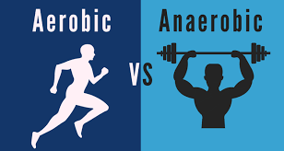
Anaerobic:
a higher intensity and power version of exercise to improve performance
improve strength, speed and power.
Notes:
Anaerobic exercise is any activity that breaks down glucose for energy without using oxygen. Generally, these activities are of short length with high intensity. The idea is that a lot of energy is released within a small period of time, and your oxygen demand surpasses the oxygen supply.
Exercises and movements that require short bursts of intense energy are examples of anaerobic exercises.
These include:
weightlifting
jumping or jumping rope
sprinting
high-intensity interval training (HIIT)
biking

Slide 13
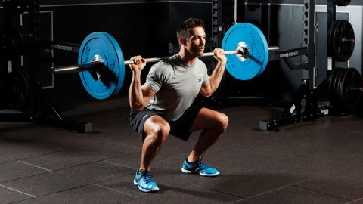
Strength Training:
Exercises involving weights; develop muscle mass and increases strength.
Notes:
Strength training is an important part of exercise, but you don’t have to go to the gym to do it. Body weight exercises such as push ups, pull ups, squats and lunges are also effective forms of strength training without use of any equipment.

Slide 14
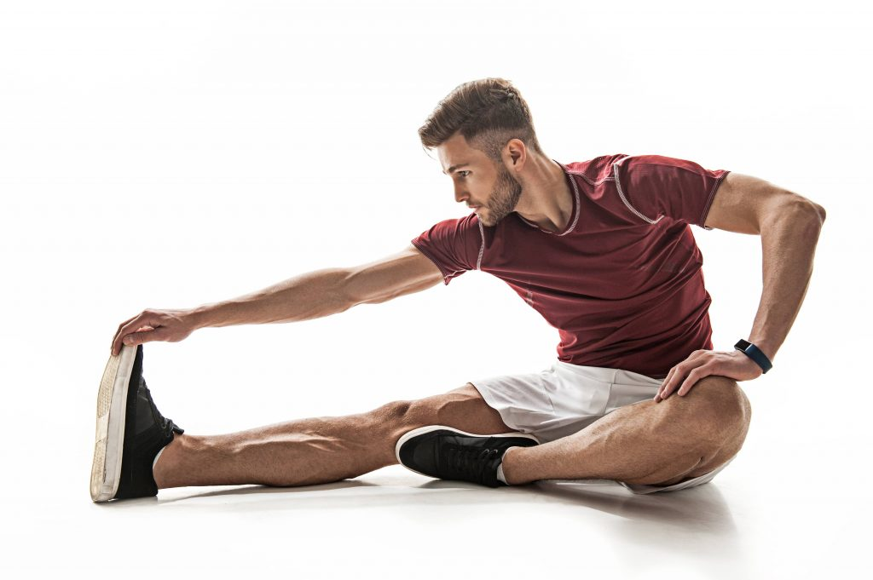
Stretching:
Increasing muscle flexibility
Notes:
Increases blood flow to muscles:
Improves Flexibility:
Calms & Relieves Tension:

Slide 15
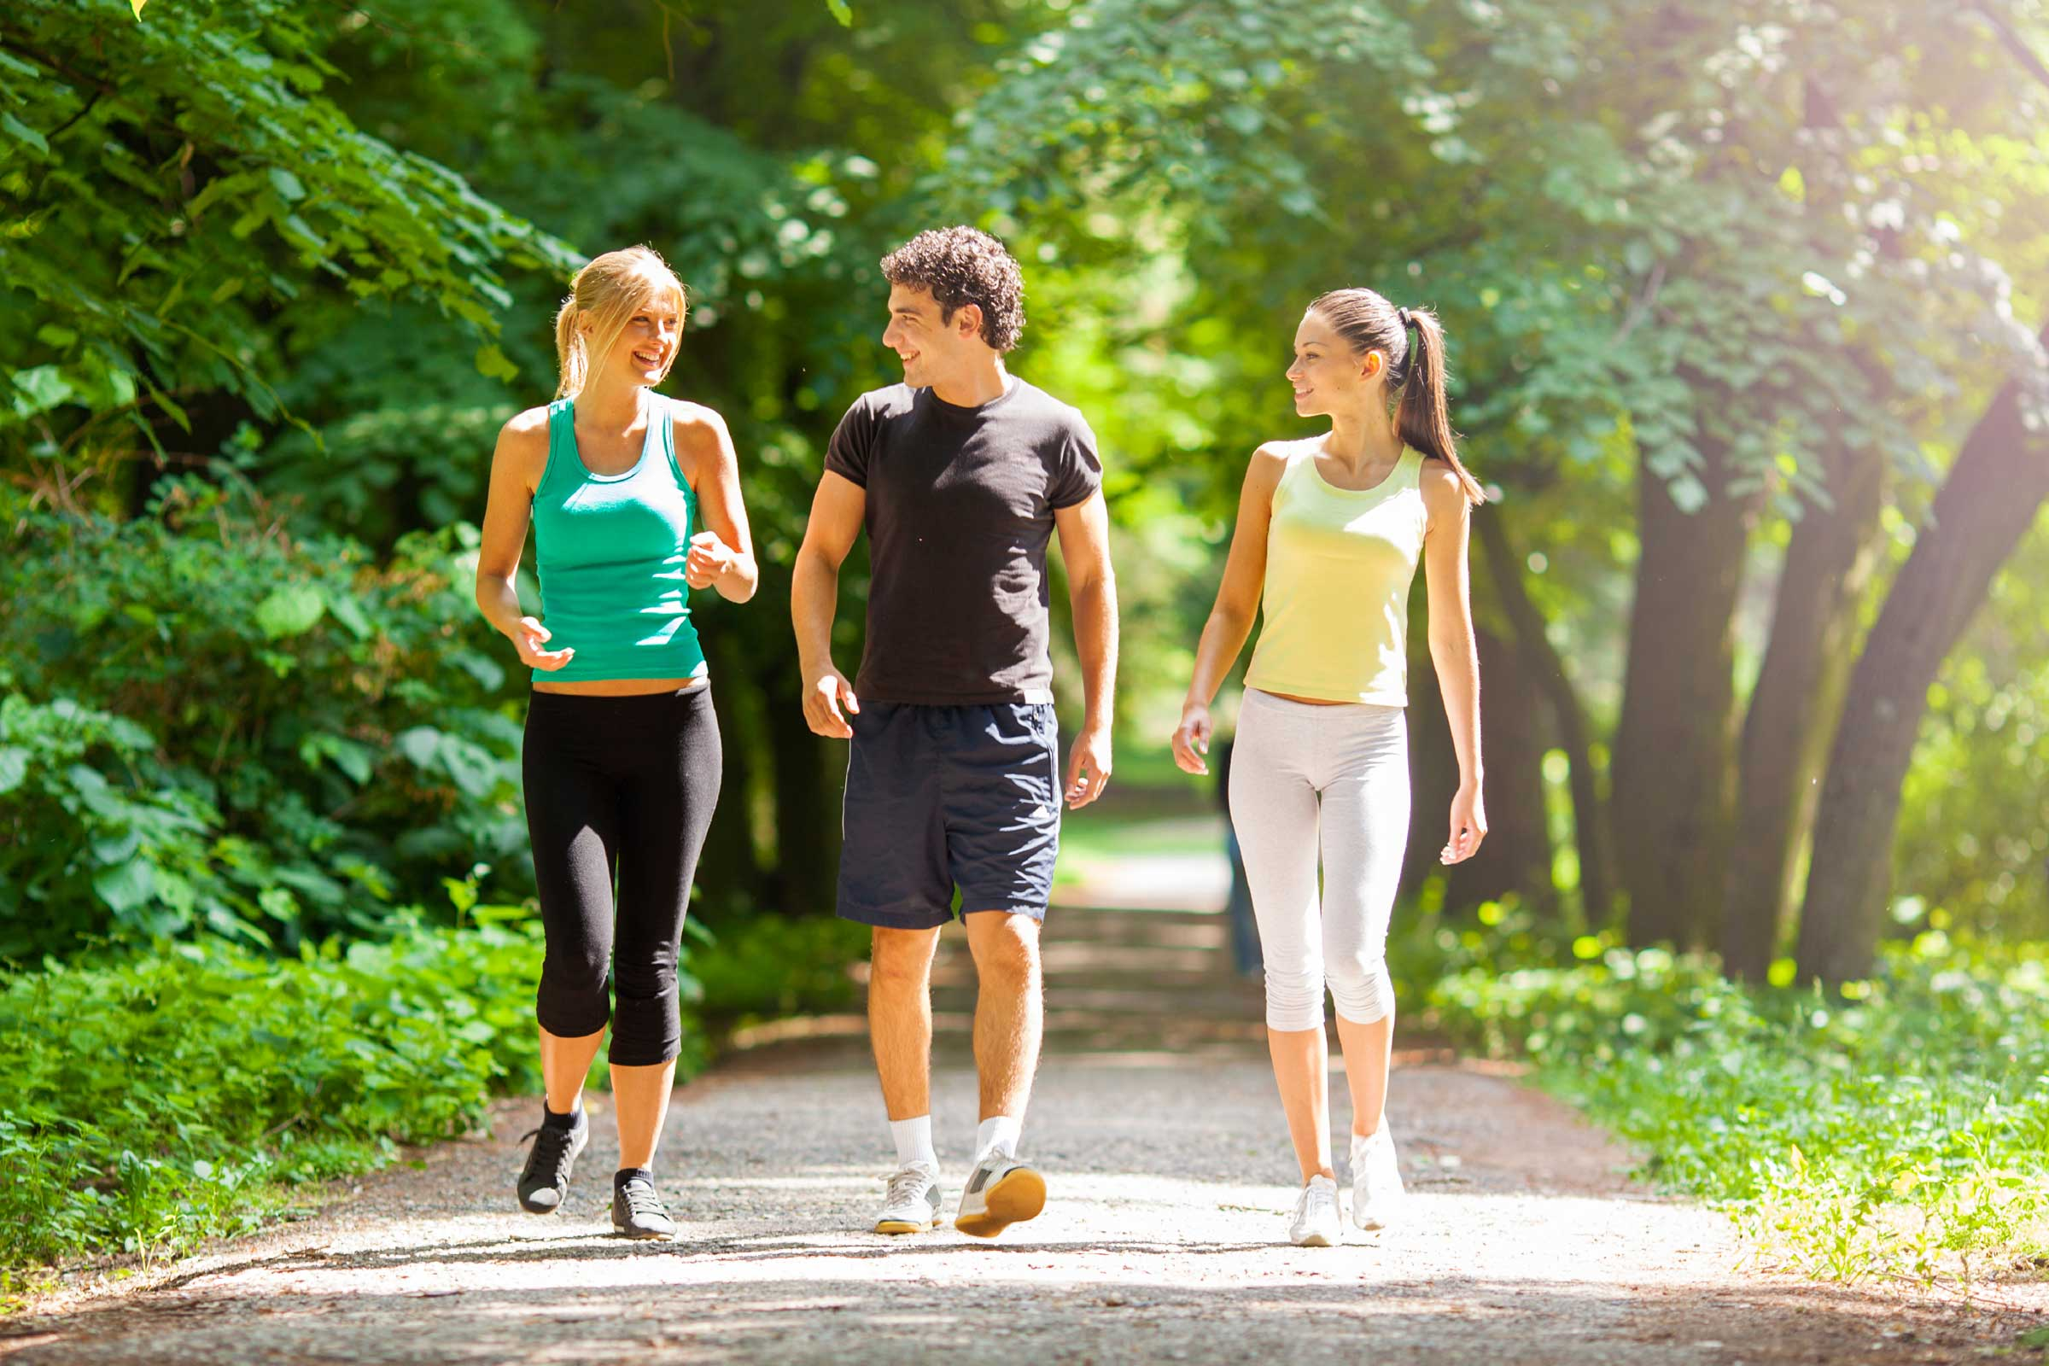
Tips for Exercising
30 minutes of moderate to vigorous exercise per day

Slide 16
Tips for Exercising
At least 5 times per week

Slide 17
Tips for Exercising
Exercise is very important for every human body.

Slide 18
Tips for Exercising
A lack of exercise greatly impairs and reduces bodily functions.
Notes:
So, what is one of the best forms of exercise that everyone can do?

Slide 19
Benefits of Walking
Walking, although one of the simplest exercises, has several surprising advantages:

Slide 20
Benefits of Walking
1. Walking uses almost all of the body's 206 bones and almost all of the body's 604 muscles.

Slide 21
Benefits of Walking
2. Almost everyone can do it without having to learn new skills.

Slide 22
Benefits of Walking
3. It does not require any expensive equipment.

Slide 23
Benefits of Walking
4. It is easy on the joints.

Slide 24
Benefits of Walking
5. The pace is easy to adjust.

Slide 25
Benefits of Walking
6. It can be done anywhere—from shopping malls to the great outdoors.

Slide 26
Benefits of Walking
7. You can get fresh air and sunshine at the same time if you are walking outside.

Slide 27
Benefits of Walking
8. Walking lends itself to socializing—make walking fun by including family, friends, or your dog.

Slide 28
Get Moving!!!

