Slide 1
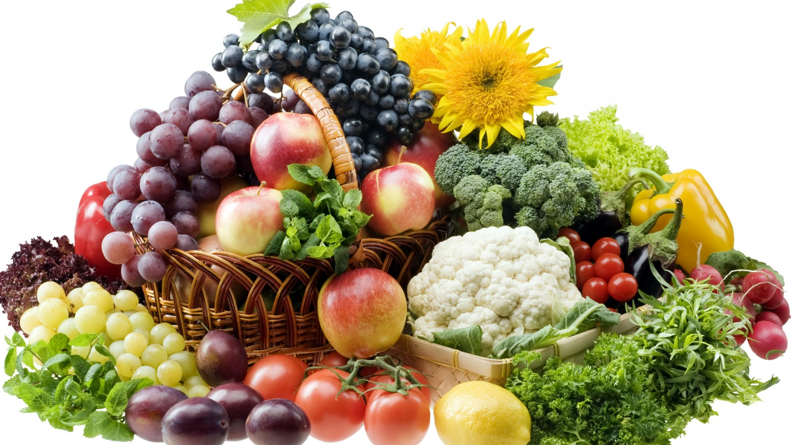
Diabetes – Part 2; The Heavenly Solution
Notes:
Diabetes – Part 2; The Heavenly Solution.

Slide 2
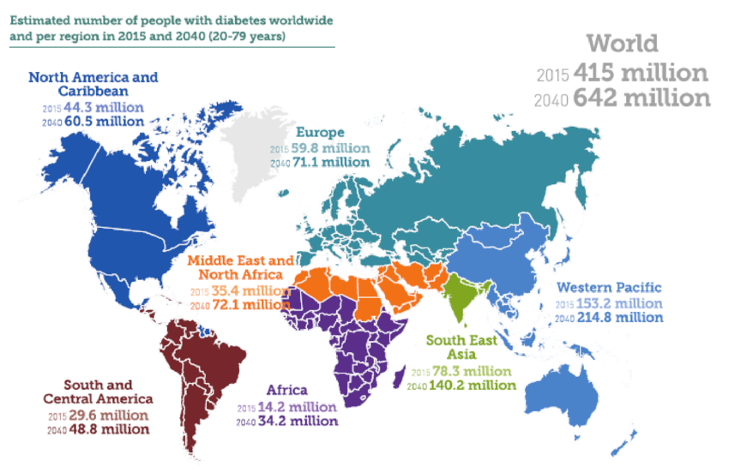
We know that many millions are suffering and dying right now.
Notes:
We know that many millions are suffering and dying right now. Consider this chart which shows the “Estimated number of people with diabetes worldwide and per region in 2015 and projected to the year 2040.

Slide 3
What can be done, right now?
Listen to your faithful Creator who made your body, mind and whole being; for God knows the good and the right way.
Notes:
What can be done right now?
Listen to your faithful Creator who made your body, mind and whole being; for God knows the good and the right way.

Slide 4
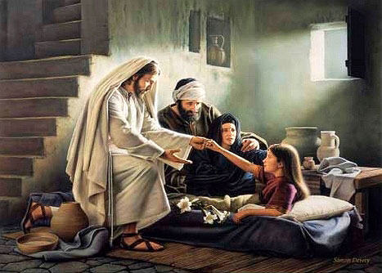
He will cleanse, and abundantly pardon.
He will restore, renew and redeem!
Notes:
Admit there has been fault and ignorance. Take ownership back from excuses and enabling bad habits. Jesus Christ, will raise thee up from the grasp of disease, decay and death. He will cleanse, and abundantly pardon. He will restore, renew and redeem!

Slide 5
What can be done, right now?
“Remember now thy Creator in the days of thy youth, while the evil days come not, nor the years draw nigh, when thou shalt say, I have no pleasure in them;” – Ecclesiastes 12:1 KJB
Notes:
“Remember now thy Creator in the days of thy youth, while the evil days come not, nor the years draw nigh, when thou shalt say, I have no pleasure in them;” – Ecclesiastes 12:1 KJB

Slide 6
What can be done, right now?
“… If thou wilt diligently hearken to the voice of the LORD thy God, and wilt do that which is right in his sight, and wilt give ear to his commandments, and keep all his statutes, …”
Notes:
“… If thou wilt diligently hearken to the voice of the LORD thy God, and wilt do that which is right in his sight, and wilt give ear to his commandments, and keep all his statutes, …”

Slide 7
What can be done, right now?
“… I will put none of these diseases upon thee, which I have brought upon the Egyptians: for I am the LORD that healeth thee.”
– Exodus 15:26 KJB
Notes:
“… I will put none of these diseases upon thee, which I have brought upon the Egyptians: for I am the LORD that healeth thee.”
– Exodus 15:26 KJB

Slide 8
But a person may say, “…
“… I love sugar, salt and fat, and my taste buds and stomach crave for these things, and I have lived this way for so long, how can I give them up?”
Notes:
But a person may say, “…
“… I love sugar, salt and fat, and my taste buds and stomach crave for these things, and I have lived this way for so long, how can I give them up?”

Slide 9
God asks in response, “…
“… Who hath made man's mouth?...” – Exodus 4:11 KJB
Notes:
God asks in response, “…
“… Who hath made man's mouth?...” – Exodus 4:11 KJB
Have they really ‘lived”? Or is it not rather many have suffered a long time with health complications, sickness, disease?
God says, I will teach you how to live and what is good for food, that your life may be fat (full), and your living sweet, and your witness as the salt that preserves.

Slide 10
God asks in response, “…
“But thou … hear what I say unto thee; Be not thou rebellious like that rebellious house: open thy mouth, and eat that I give thee.” – Ezekiel 2:8 KJB
Notes:
“But thou … hear what I say unto thee; Be not thou rebellious like that rebellious house: open thy mouth, and eat that I give thee.” – Ezekiel 2:8 KJB

Slide 11
“O taste and see that the LORD is good …
“…blessed is the man that trusteth in him.”
Notes:
Psalms 34:8 - O taste and see that the LORD is good: blessed is the man that trusteth in him.

Slide 12
The Solution
“And God said, Behold, I have given you every herb bearing seed, which is upon the face of all the earth, and every tree, in the which is the fruit of a tree yielding seed; to you it shall be for meat (food). ” – Genesis 1:29 KJB
Notes:
The Solution:
“And God said, Behold, I have given you every herb bearing seed, which is upon the face of all the earth, and every tree, in the which is the fruit of a tree yielding seed; to you it shall be for meat (food). ” – Genesis 1:29 KJB

Slide 13
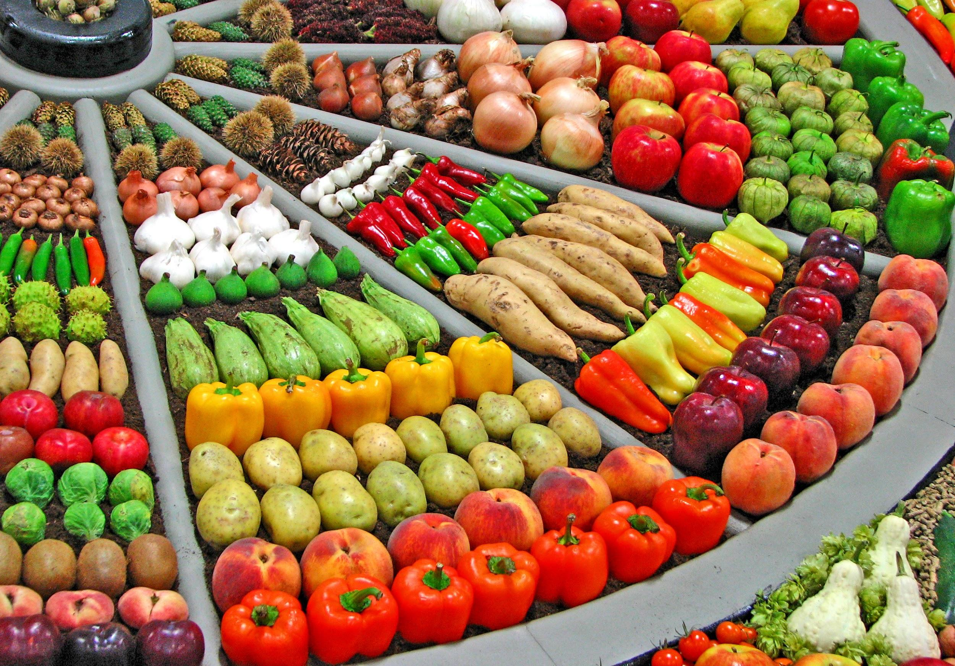
Fruits & Veggies (no flesh):
Notes:
Fruits, Veggies and High Fiber diets. Eliminate all animal flesh and animal byproducts: This includes, no Beef, no Chicken, no Pork, no Fish, and No Animal Eggs, Milk, Cheese or Dairy. All of those things bring disease and decay. You can replace with organic Non-GMO Tofu, Almond Milk, Soy Milk, Rice Milk, Oat Milk, etc. There are also Egg-replacers such as Ener-G and Flax-seed. In fact, a good breakfast for Diabetics is a High Fiber Oatmeal with some fruits and nuts (for those without allergies).

Slide 14
The Solution
Drink at least 1 ounce of water daily for every 2 pounds that you weigh.
Drink at least 2 cups of water when you wake up in the morning.
Do not drink within ½ hour before meals and 1 hour after meals.
Notes:
Drink at least 1 ounce of water daily for every 2 pounds that you weigh.
Drink at least 2 cups of water when you wake up in the morning.
Do not drink within ½ hour before meals and 1 hour after meals.

Slide 15
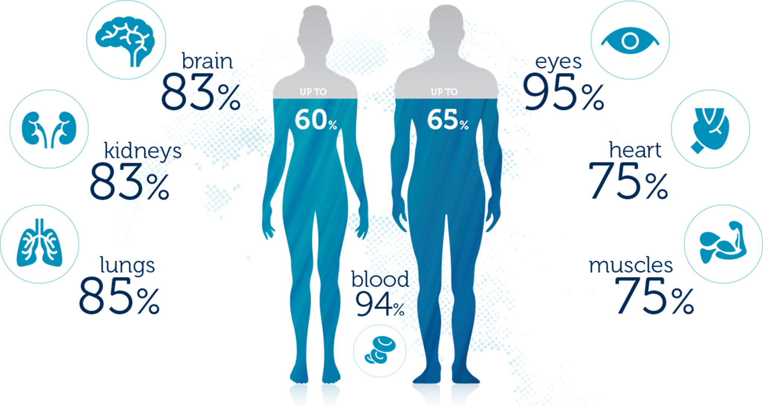
Water:
Further information may be found at - https://www.ucheepines.org/diabetes-type-ii-treatment-protocol/
Notes:
Water:
%’s.
Further information may be found at - https://www.ucheepines.org/diabetes-type-ii-treatment-protocol/

Slide 16
The Solution
Drink at least 1 ounce of water daily for every 2 pounds that you weigh.
Drink at least 2 cups of water when you wake up in the morning.
Do not drink within ½ hour before meals and 1 hour after meals.
No caffeine or soft (soda) drinks.
Notes:
Drink at least 1 ounce of water daily for every 2 pounds that you weigh.
Drink at least 2 cups of water when you wake up in the morning.
Do not drink within ½ hour before meals and 1 hour after meals.

Slide 17
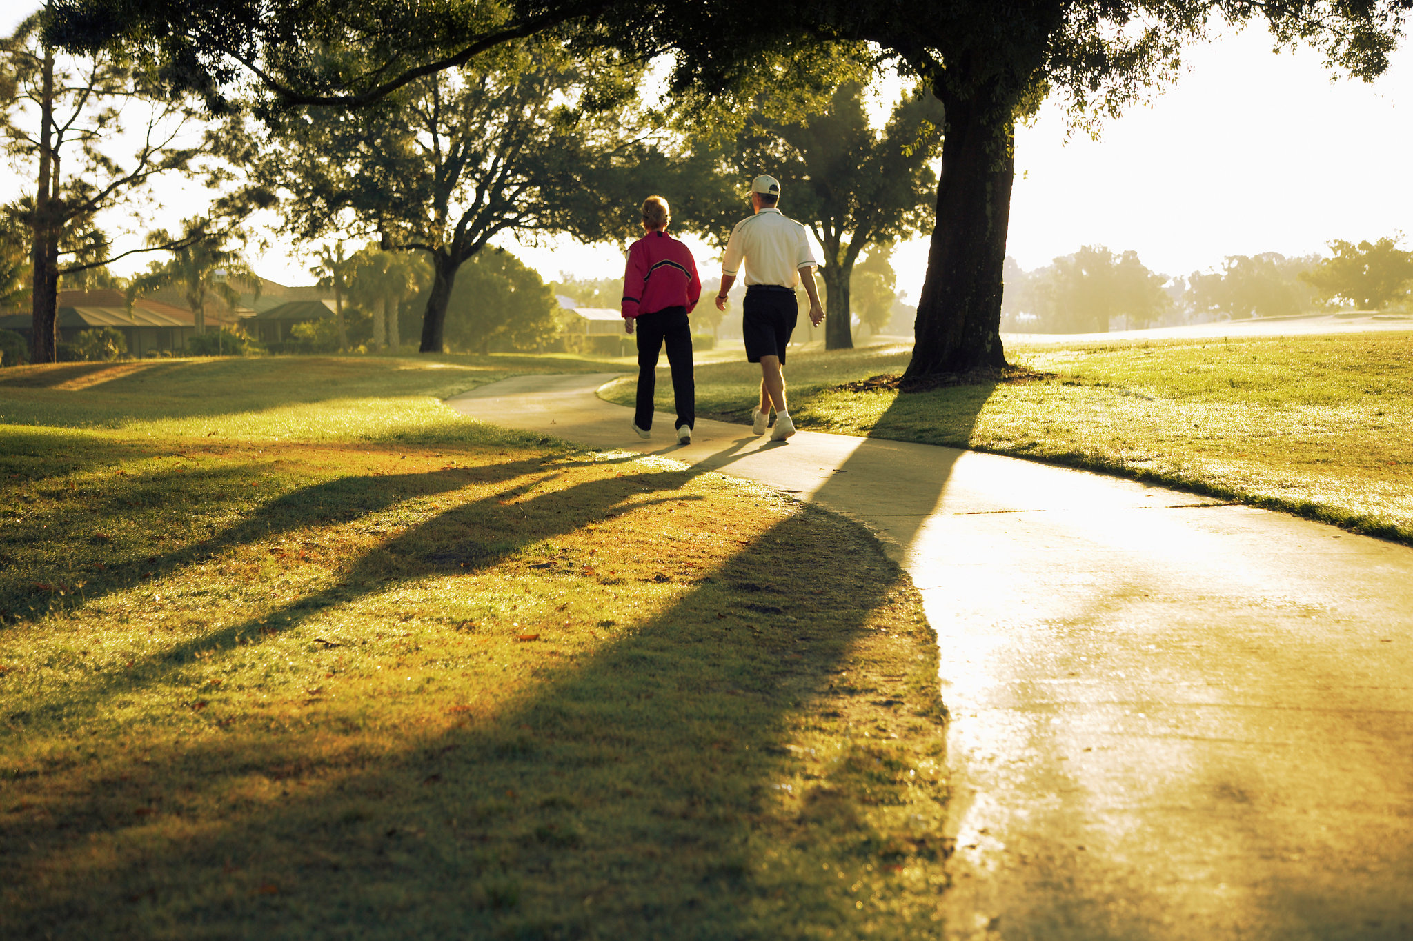
Exercise:
Notes:
Exercise:
You need a simple daily exercise routine. Walk more.

Slide 18
The Solution
Take a walk after each meal, even if you can only walk for 10-15 minutes.
A thirty-minute walk would be great. One research study showed that each minute of moderate intensity exercise immediately after a meal reduces the after-meal glucose spike by 3 points.
Notes:
Take a leisurely walk after each meal, even if you can only walk for 10-15 minutes.
A thirty-minute walk would be great. One research study showed that each minute of moderate intensity exercise immediately after a meal reduces the after-meal glucose spike by 3 points.

Slide 19
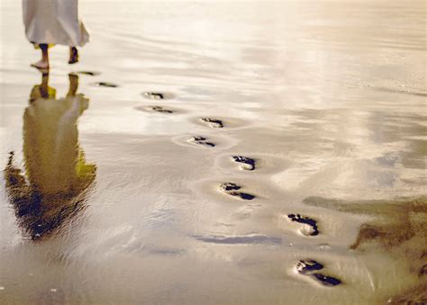
Follow Jesus, the Way, the Truth & THE LIFE
Notes:
Follow Jesus, the Way, the Truth & THE LIFE

Slide 20
You can, with Christ Jesus!
“I can do all things through Christ which strengtheneth me.” – Philippians 4:13 KJB
Notes:
Follow Jesus, the Way, the Truth & THE LIFE
How many are ready today, to say with me:
“I can do all things through Christ which strengtheneth me.” – Philippians 4:13 KJB
Say it again, “I can … through Christ …”
Again, “I CAN … THROUGH CHRIST …”
Amen.

Slide 21
TO FIND OUT MORE, GO TO:
https://sdamaranathachurch.org/resources/healing-health-diet-more

