Slide 1
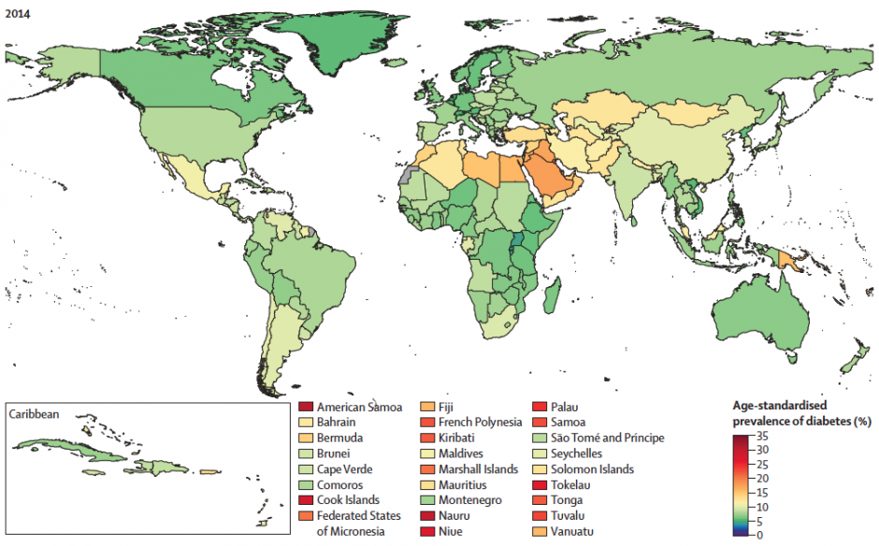
Diabetes – Part 1; The Global Epidemic
Notes:
Diabetes – Part 1; The Global Epidemic
American Samoa is in the Deep Deep Red as of 2014, being at 35% or greater.

Slide 2
What is Diabetes?
diabetes [di″ah-be´tēz] –
“a general term referring to any of various disorders characterized by excessive urination (polyuria); when used alone, the term refers to diabetes mellitus.” – Medical Dictionary
Notes:
What is Diabetes?
diabetes [di″ah-be´tēz] -
“a general term referring to any of various disorders characterized by excessive urination (polyuria); when used alone, the term refers to diabetes mellitus.” – Medical Dictionary

Slide 3
Notes:
If you are doing the Pee Pee dance a bit too often, and not just for a lack of a place to ‘rest’, it may be due to the onset of the symptoms of Diabetes, or full blown Diabetes may already be wreaking havock with your body, resulting in needing to seek a restroom at more times in the day.

Slide 4
What is Diabetes Mellitus?
diabetes mellitus (commonly known as ‘diabetes’)-
“a broadly applied term used to [describe common problems] in the oxidation (decay) and utilization of glucose (blood sugar) …”
Notes:
diabetes mellitus (commonly known as ‘diabetes’)-
“a broadly applied term used to [describe common problems] in the oxidation (decay) and utilization of glucose (blood sugar) …”

Slide 5
What is Diabetes Mellitus?
diabetes mellitus (commonly known as ‘diabetes’)-
“… which may be secondary to a malfunction of the beta cells of the pancreas, whose function is the production and release of insulin.” – Medical Dictionary
Notes:
“… which may be secondary to a malfunction of the beta cells of the pancreas, whose function is the production and release of insulin.” – Medical Dictionary

Slide 6
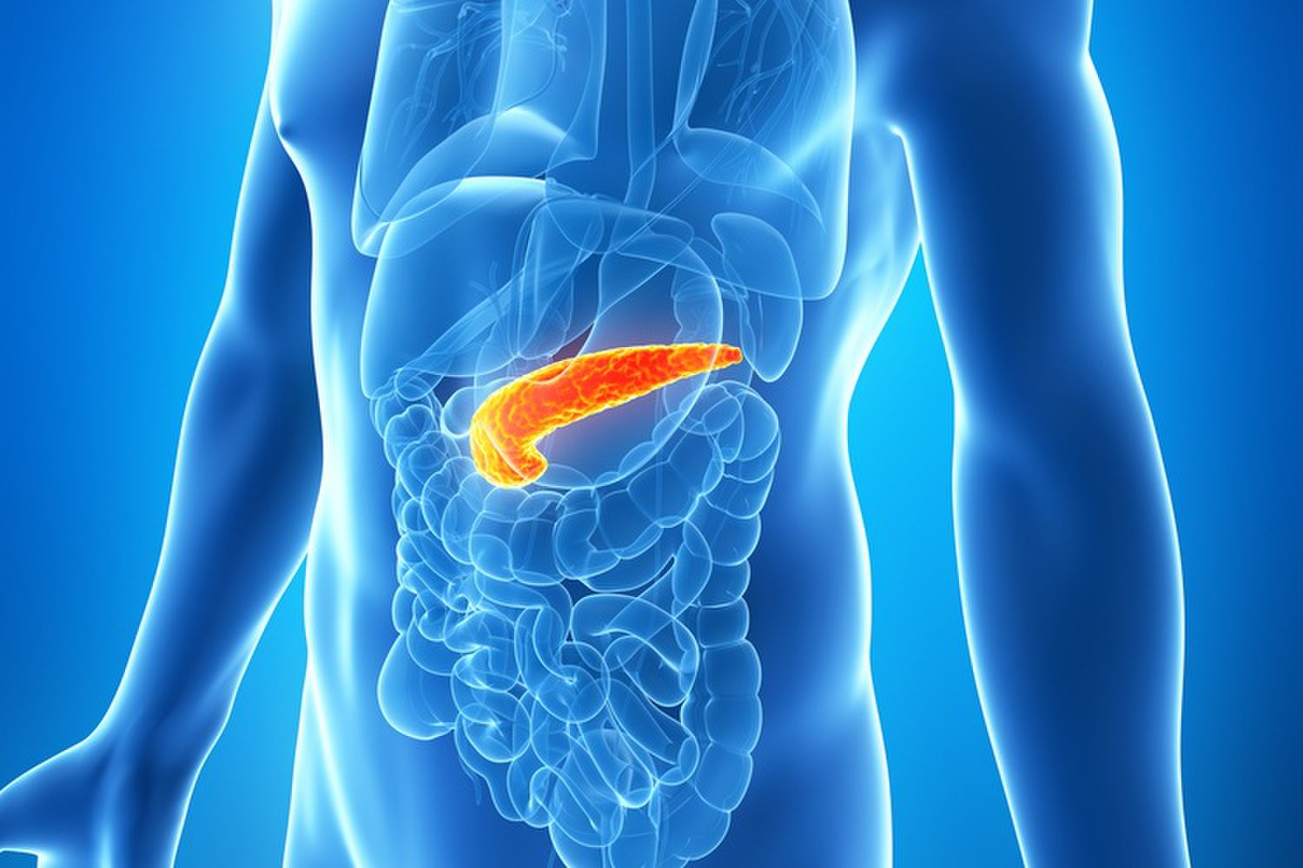
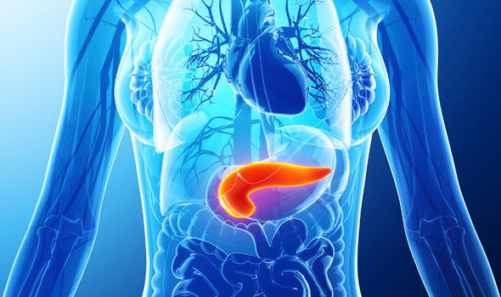
Notes:
Have a look at the Pancreas as it is found in the human body. In both Males and Females, the Pancreas is found just below the lungs, and just above the large intestine, and slightly offset to the Left of Center and towards the Front Side of the Body.

Slide 7
Notes:
What is the Pancreas?
The Pancreas is a gland deep in the abdomen that performs two key functions.
[1] Aids digestion – by secreting enzymes into the small intestine to help break down protein, carbohydrates & fats
[2] Regulates metabolism – by secreting the hormone insulin and glucagon into the bloodstream to maintain proper glucose (or blood sugar) levels.

Slide 8
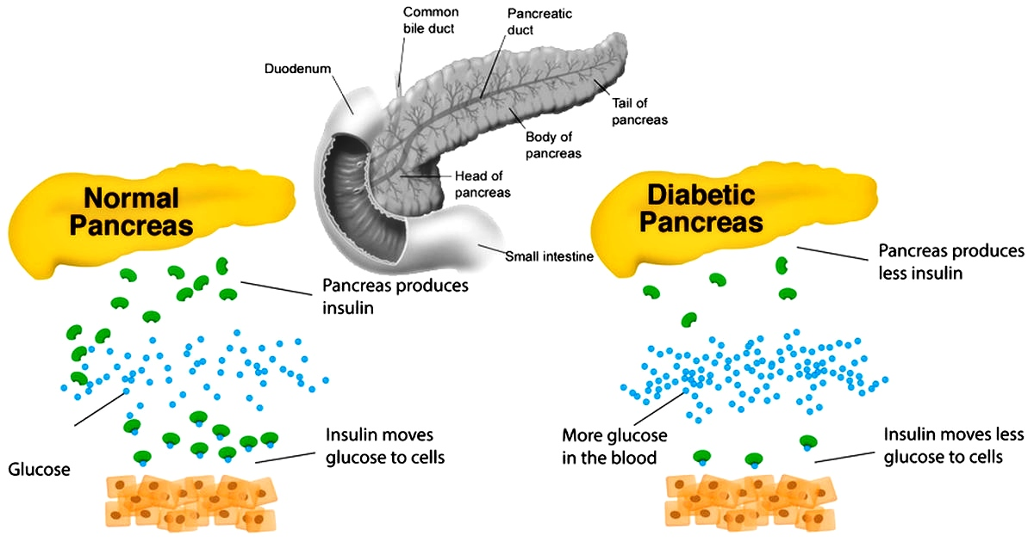
Notes:
Here is an image to help show what a Normal (Healthy) Pancreas does, in comparison to an Abnormal (Unhealthy) Pancreas. Notice that an unhealthy Pancreas produces less Insulin, and that is one of the causes that more glucose (blood sugar) circulates in the blood. Another reason is too much fat in the cells take up the room needed for the glucose.

Slide 9
There are different types of Diabetes
Differing Types:
1. Type I
2. Type II
3. Gestational (Pregnancy)
4. Central Diabetes Insipidus
5. Diabetes (L.A.D.A.)
6. Diabetes (M.O.D.Y.)
7. Double Diabetes
8. Etc. (Type 3, Steroid, Brittle, Secondary, Juvenile ….)
Notes:
There are different types of Diabetes, that affect people differently.
The Differing types are:
1. Type One
2. Type Two
3. Gestational (Pregnancy)
4. Central Diabetes Insipidus
5. Diabetes (L.A.D.A) – Latent Autoimmune Diabetes of Adulthood
6. Diabetes (M.O.D.Y.) – Maturity Onset Diabetes of the Young
7. Double Diabetes
8. etc. (Type 3, Steroid Induced, Brittle Diabetes, Secondary Diabetes, Juvenile Diabetes …)

Slide 10
A Look at the Type I
Type I – “… is an autoimmune disease that causes the insulin producing beta cells in the pancreas to be destroyed, preventing the body from being able to produce enough insulin to adequately regulate blood glucose levels.” – Diabetes.Co.Uk/TypeI
Notes:
A Look at the Type I diabetes.
“… is an autoimmune disease that causes the insulin producing beta cells in the pancreas to be destroyed, preventing the body from being able to produce enough insulin to adequately regulate blood glucose levels.” – Diabetes.Co.Uk/TypeI

Slide 11
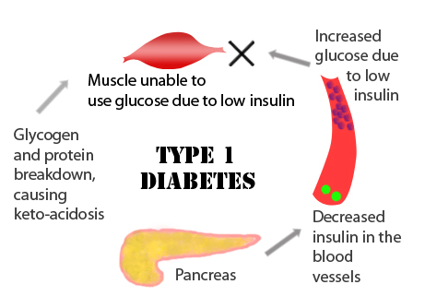
Notes:
Because the immune (defense) system of the body attacks the Pancreas, this causes the severe decrease in Insulin production, which brings about an increase of glucose (blood sugar), and the muscles being unable to use the glucose due to the low or 0 zero levels of Insulin. Most think that this is irreversible, but there are cases of even Type I Diabetes being reversed, and the Pancreas beginning to function normally again. One such case is ex-martial artist Eric Wilson with Isaiah Ministries. Please see His powerful Testimony online in His series The Dragon Revealed Down Under.

Slide 12
Notes:
Here are the warning signs for Type I Diabetes:
Increased Thirst or Hunger
Heavy Breathing
Drowsiness or Stupor
Nausea
Frequent Urination
Sudden Change in Vision (Loss, Blurry)
Fruity Breath
Sudden Weight Loss
If you have several of these warning signs, then it is time, right now, to consider your options in reversing them.

Slide 13
A Look at the Type II
Type II – “… is a metabolic disorder that results in hyperglycemia (high blood glucose levels) due to the body:
Being ineffective at using the insulin (resistance)
Being unable to produce enough insulin” – Diabetes.Co.Uk/TypeII
Notes:
A Look at the Type II diabetes.
Type II – “… is a metabolic disorder that results in hyperglycemia (high blood glucose levels) due to the body:
Being ineffective at using the insulin (resistance)
Being unable to produce enough insulin” – Diabetes.Co.Uk/TypeII

Slide 14
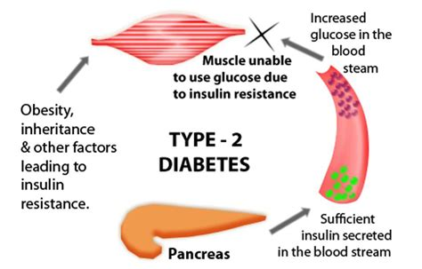
Notes:
Type II is the more common “Diabetes”. Here, the Pancreas is functioning normally, and produces enough insulin into the blood stream, but because of either too much fat in the cell, or other factors, the cell does not receive the glucose (sugar) required, and it simply circulates in the blood stream, which the muscles cannot use up. Obesity (over weight, fat) is the primary cause of this type of Diabetes.

Slide 15
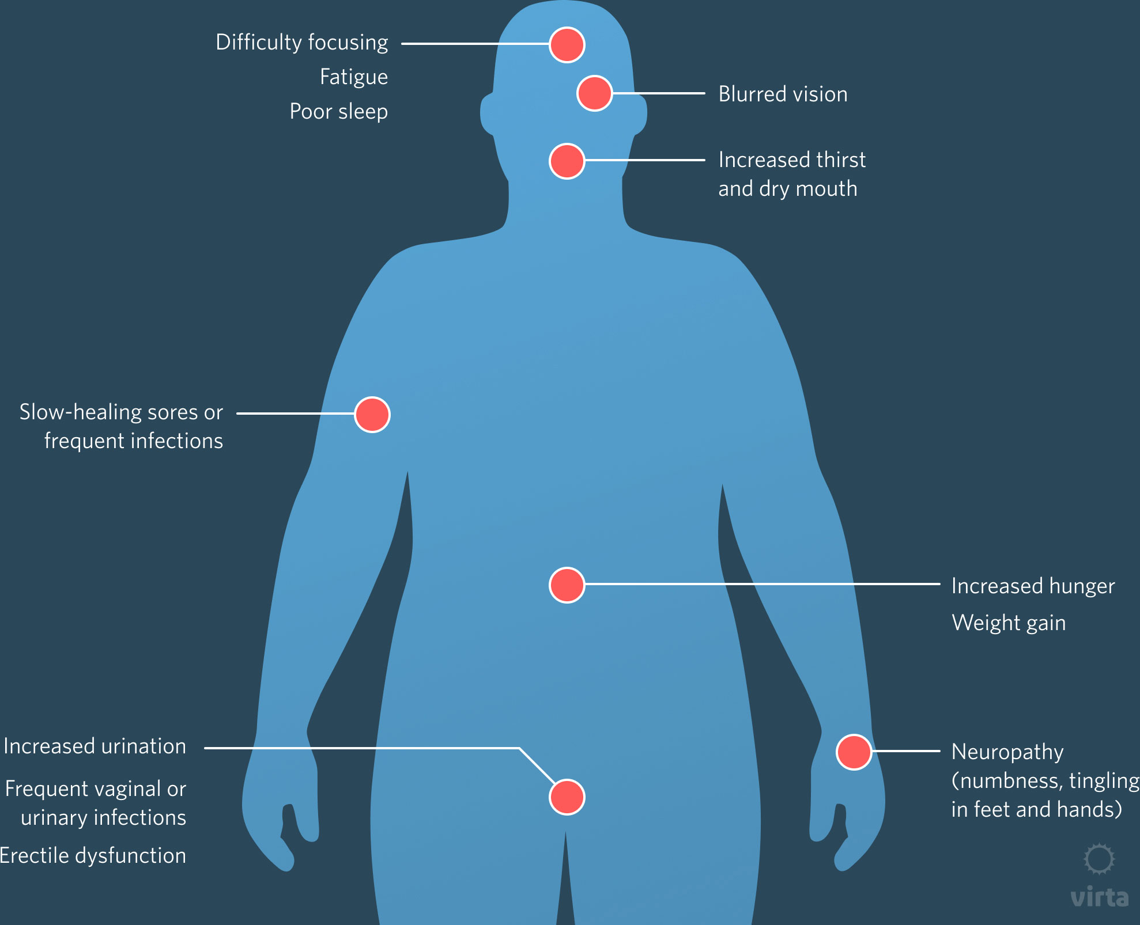
Notes:
Here are the warning signs for Type I Diabetes:
Difficulty Focusing, Foggy Brain, Poor Sleep
Blurred Vision
Increased Thirst for Water
Slow Healing Sores, Frequent Infections
Increased Hunger, Weight Gain
Neuropathy or Loss of feeling, resulting in Numbness, Tingling
Increased Urination (PolyUria)
Erectile Dysfunction (Male) or increased of Vaginal (Female) or Urinary Tract Infections
If you have several of these warning signs, then it is time, right now, to consider your options in reversing them. Type II is completely reversible with a complete change in Diet and Lifestyle, which we will talk about in another presentation.

Slide 16
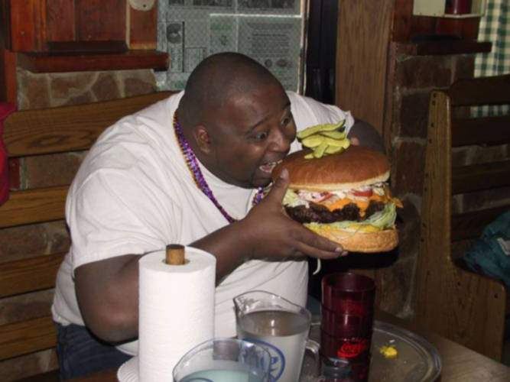
Notes:
Being this obese is no laughing matter inspite of all the “I’m not fat, I’m big-boned.” excuses. It is very deadly dangerous.

Slide 17
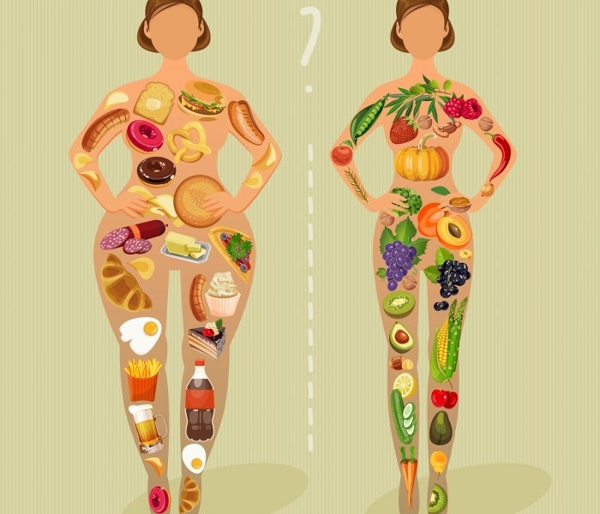
Notes:
Ladies, You just have to ask yourself, which do you want?

Slide 18
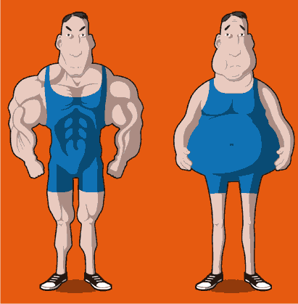
Notes:
Men, same question, Which do you want?

Slide 19
Notes:
Is it really that you are “Lovin’’ it”, or that you are really addicted to it and hate that you feel the way you do right now? Do you like being pricked with needles, having to test your sugar levels every few hours, having to stop for a bathroom break every few minutes, being unable to see your family very well, unable to keep up with the grandkids, being worried about ‘crashing’, losing feeling in the extremities, and even the possibility of losing toes, feet, limbs?

Slide 20
Notes:
There is a plan that has been around from the beginning, already given from the greatest Physician ever known, and it has never failed to produce results. Do you want to know what that Plan is? Come to the next presentation, to begin your journey to the fullness of life, and the abundance of peace.

Slide 21
TO FIND OUT MORE, GO TO:
https://sdamaranathachurch.org/resources/healing-health-diet-more

