Slide 1
Depression
Notes:
Good evening friends and family. I’d like to welcome you all to the last of our Health Spotlight talks. I hope that you’ve gained some health tips from the talks we had so far and that you put it to good use. Mental health is an important aspect of overall health. In order to be healthy our mind, body and soul must all be healthy together. That is the physical, mental, and spiritual aspects to health must all be considered. And so our health topic for tonight is on Mental Health, and we are going to learn about “Depression.” Amazing fact! The World Health Organization predicts that by the year 2020, depression will be ranked 2nd in global disease burdens.

Slide 3
What is depression?
Depression (major depressive disorder) is a common and serious medical illness that negatively affects how you feel, the way you think and how you act. Fortunately, it is also treatable.
Notes:
Depression is a common and serious medical illness that negatively affects how you feel, the way you think and how you act. You can only be diagnosed with depression if you have its symptoms (which will be discussed in the next few slides) most of the time on most days for two weeks. Fortunately, this disorder is treatable.

Slide 4
Depression symptoms
Sadness or emptiness
Apathy – lack of interest
Sleep disturbances
Notes:
Depression symptoms. In total, there are at least 9 common symptoms of depression.
Sadness or emptiness
Apathy or the lack of interest. An example is when you wake up in the morning and you have no real interest in doing anything. You may just do the things you know you are supposed to do, but you really have no interest in anything.
Sleep disturbances which could either mean you have trouble sleeping or you sleep too much

Slide 5
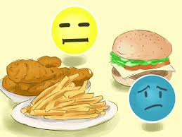
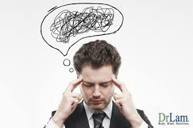
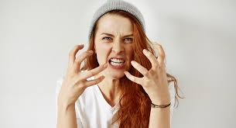
Depression symptoms
4. Irritability
5. Weight/ Appetite changes
6. Lack of concentration
Notes:
4. Irritability; you get irritated for little to no reason
5. Weight / appetite loss; this could mean that you are overeating or you eat less than normal, which would lead you to becoming anorexic
6. Lack of concentration; for example, you could read a whole book but after finishing it, you don’t remember what you just read.

Slide 6
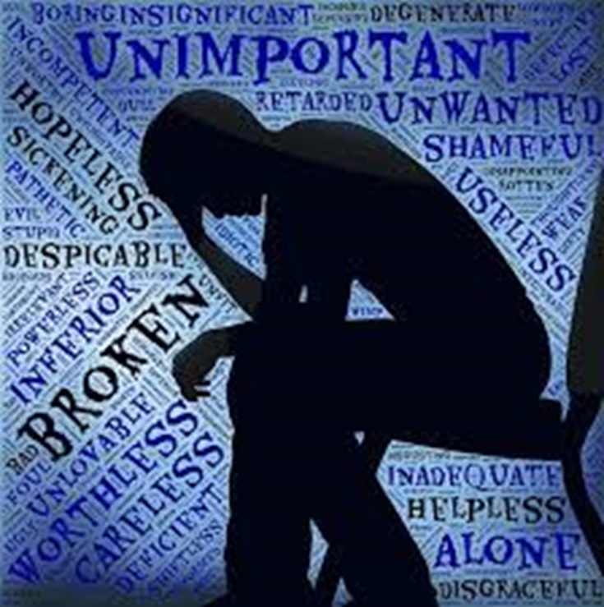
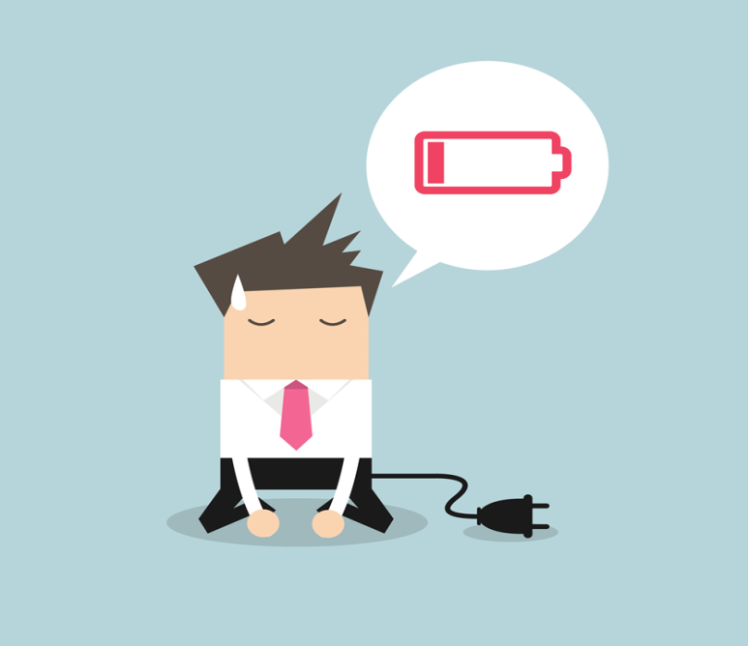
Depression symptoms
7. Feelings of worthlessness
8. Morbid thoughts/ Preoccupation with death
9. Fatigue
Notes:
7. Feelings of worthlessness; this is rather self explanatory.
8. Have morbid thoughts/ preoccupation with death; its when you surround yourself with death; this could be found in the type of music or movies that you watch/ listen to.
9. Fatigue; depression fatigue is different from normal fatigue. Depression fatigue is when you are tired for no reason.

Slide 7
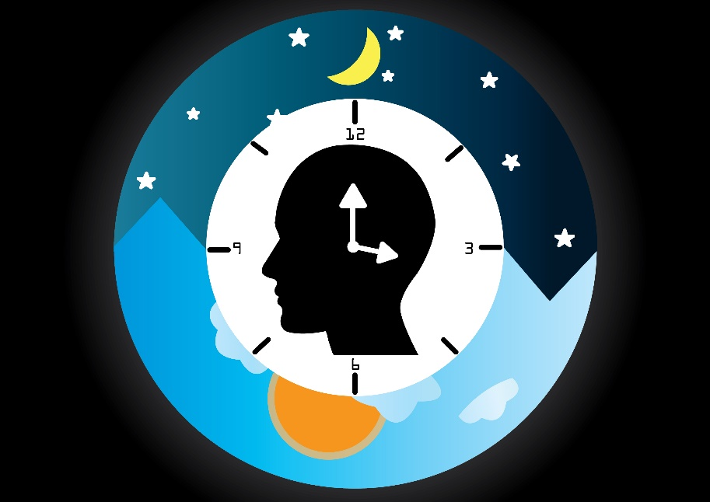
Depression CAUSES
Genetics
Our Development
Lifestyle
Circadian Rhythm
Addiction
Notes:
CAUSES; In total, there are 10 causes of depression. Having 1-3 of these causes doesn’t necessarily mean you have depression. Even though, if you can relate to at least 4 of these causes, then you most likely have depression. Now, the good news is that; of the 10 categories of causes, 7-8 can be REVERSED or treated, by making LIFESTYLE changes.
LIFESTYLE- Exercise, Light, Fresh Air
CIRCADIAN RHYTHM; our bodies are made to sleep at night and wake during the day. When this rhythm is not adhered to, it can interrupt our nomal sleep Wake cycles, leading to depression, but that can be corrected. By using the EARLY TO BED EARLY TO RISE rule. This decreases negative thoughts, can shift ur mood within 7 days. We get better sleep when we are exposed to bright light during the day. The best sleep is in the hours BEFORE midnight. So the more hours you sleep before midnight, the better sleep quality you will have.
ADDICTION- alcohol, tobacco, pornography, technology addiction

Slide 8
Depression CAUSES
Nutrition
Toxic
Social
Medical
Frontal Lobe suppressants
Notes:
Lack of nutrition. You aren’t getting enough nutrition. What you put in your body affects your mind.
Toxic substances like too much mercury, lead, pesticides,
Social Causes- social isolation, people with depression often isolate themselves. When you’re not sticking to your proper sleep pattern, you’ll feel isolated because no one else is awake.
Medical issues - thyroid, Post traumatic, viral,
Frontal lobe suppressants ties in with addiction- include alcohol, drugs, music, video games, and pornography, forms of entertainment, music, not reading spiritual material

Slide 9
Depression treatments
Medication – 28% success rate
Reverse Causes
Notes:
Treatment. In the medical and psychiatric profession only 28% of all cases of depression have been treated successfully with medication. And that is a very poor outcome. At that rate, there has been greater success at treating CANCER than depression.
Many patients have experienced reversal of depression by making simple healthy lifestyle modifications such as improvements in nutrition, exercise, getting fresh air, adequate sleep and keeping to the EARLY TO BED EARLY TO RISE rule.
Learning how the brain works, and making lifestyle changes can produce results within as little as 10 days. (a dramatic difference can be made in the treatment)
Exercizes for 1 hour each day can bring about change in 7 days. Exercise changes the brain chemistry, and improving circulation, serotonin and dopamine are going up. Norepinephrine levels are going up and these are the brains neurotransmitters. 1 hour of vigorous walking is recommended. It’s better to do it outdoors, and just dress for the weather.

Slide 10
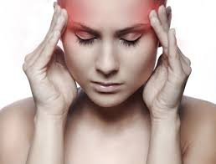
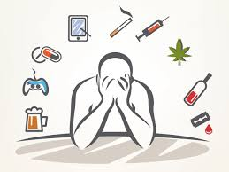
Depression effects
Headaches
Asthma
Memory Loss
Return to addiction
Notes:
Effects of depression can be listed as the following:
Frequent headaches, asthma, memory loss in where you tend to forgot a lot of things, returning back to ur addictions, whether it be alcohol, drugs, or other things….

Slide 11
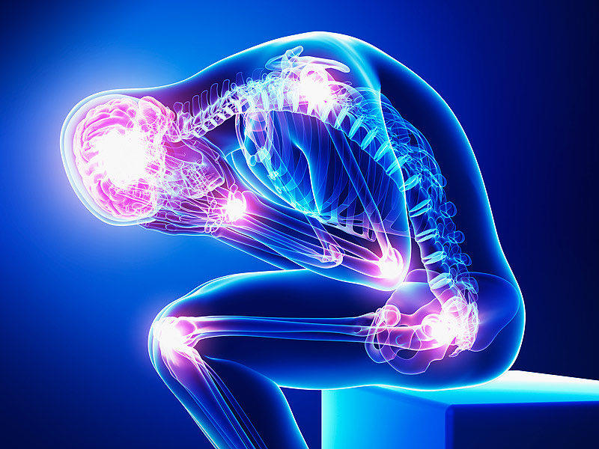
Depression Effects
5. Stroke and heart attack
6. Pneumonia and cancer
7. Chronic pain
8. Loss of bone density
Notes:
It could also lead to increasing levels of strokes, heart attacks, pneumonia, and cancer. It could lead to chronic pain and lastly, loss of bone density.

Slide 12
Notes:
In Philippians 4:8, Paul says, “…whatsoever things are true, whatsoever things are honest, whatsoever thing are just, whatsoever things are pure, whatsoever things are lovely, whatsoever things are of good report; if there be any virtue, and if there be any praise, think on these things.”
Spirituality is often ignored in the treatment of depression, however we know the frontal lobe is down in depressed individuals. The frontal lobe is also the seat of spirituality. So if you want to boost the frontal lobe you can do that by developing your spiritual life by doing things like reading the books of Daniel and Psalms. The BIBLE has the answers for the causes of depression. If you are looking for a treatment for depression, try opening your BIBLE, GOD has the treatment there for you.

