Slide 1
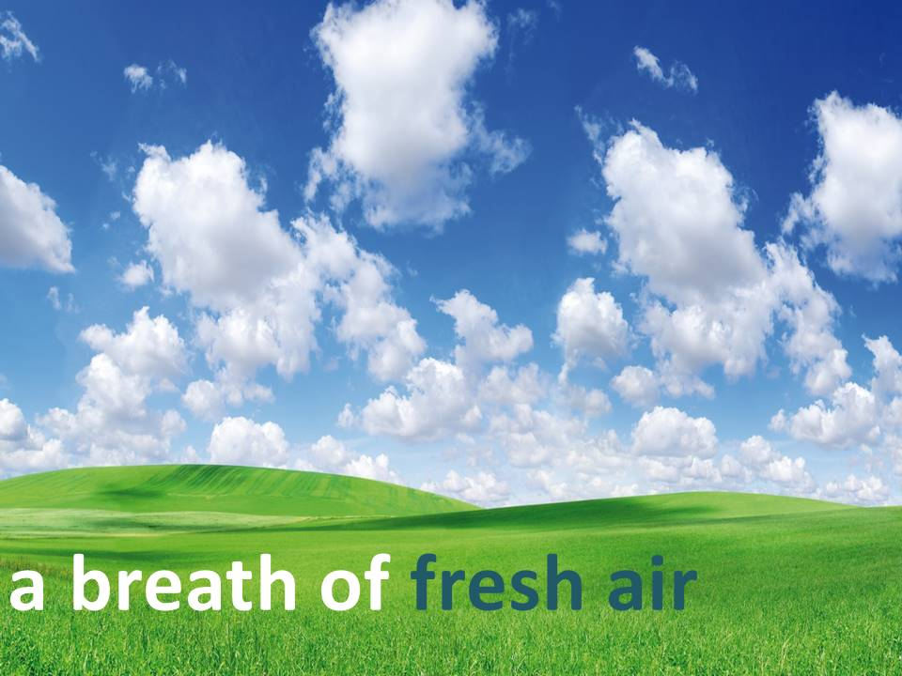
Air

Slide 2
3 John 1:2
“Beloved, I wish above all things that thou mayest prosper and be in health, even as thy soul prospereth.”

Slide 3
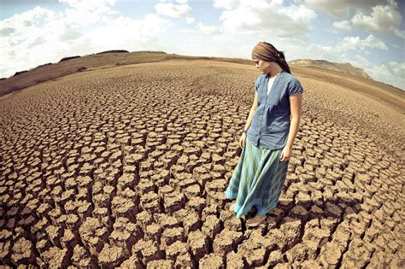

Slide 4
Fresh Air
You can survive without:
Food for weeks
Water for days
Yet …

Slide 5
Fresh Air
… without air you would be dead in minutes.
Air starvation is much more deadly than food starvation.

Slide 6
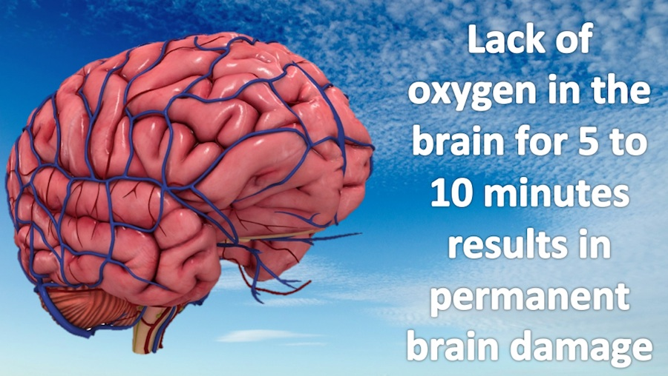

Slide 7
Benefits of Fresh Air
It improves the brain's ability to function, giving clarity to the mind, while improving concentration, and boosts learning abilities.

Slide 9
Benefits of Fresh Air
It gives a sense of happiness and well-being by altering brain levels of the hormone serotonin.

Slide 11
Benefits of Fresh Air
It promotes quality sleep

Slide 13
Benefits of Fresh Air
Kills bacteria and viruses in the air

Slide 14
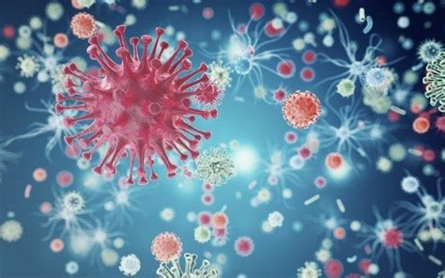

Slide 15
Benefits of Fresh Air
Boosts immune functions

Slide 16
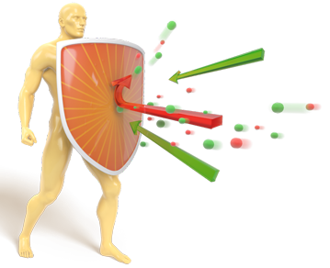

Slide 17
Benefits of Fresh Air
Air pollution, or unclean air, causes the loss of many of the benefits.

Slide 18
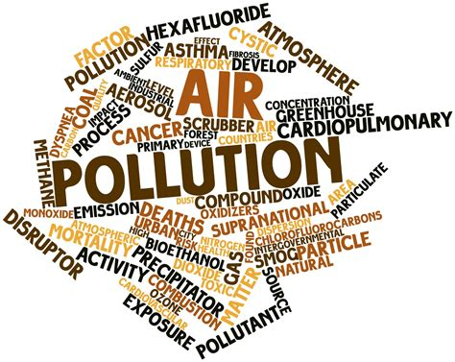

Slide 19
Fresh Air For the Sick
Breathing, when sick, releases toxins and poisons from the body.

Slide 20
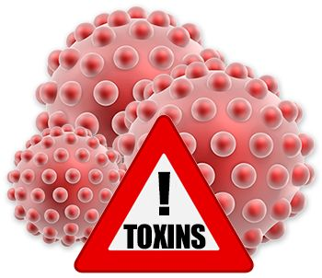

Slide 21
Fresh Air For the Sick
If the poisons remain and circulate in the room, without fresh air, the person will take longer to recover.

Slide 23
Fresh Air For the Sick
If a wound is not exposed to fresh clean air, it will take longer to heal.

Slide 25
Tips to Getting Fresh Air
Take time to BREATHE DEEPLY
(ready? Breathe in, fill the lungs)
(Exhale slowly)

Slide 27
Tips to Getting Fresh Air
Make sure rooms are well ventilated – air is circulating in the room (wind is allowed to flow into the room).

Slide 29
Tips to Getting Fresh Air
Spend time outside:
1. You can go for a walk outdoors
2. plant a Garden

Slide 30
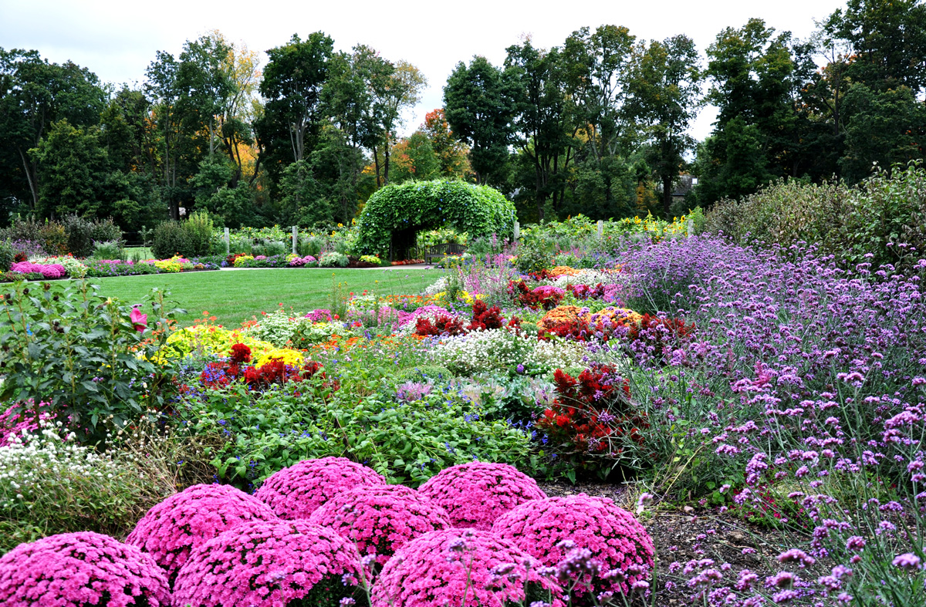

Slide 31
Tips to Getting Fresh Air
Spend time outside:
3. Take more activities outside
A. meetings
B. gatherings
C. picnics, etc.

