Slide 1
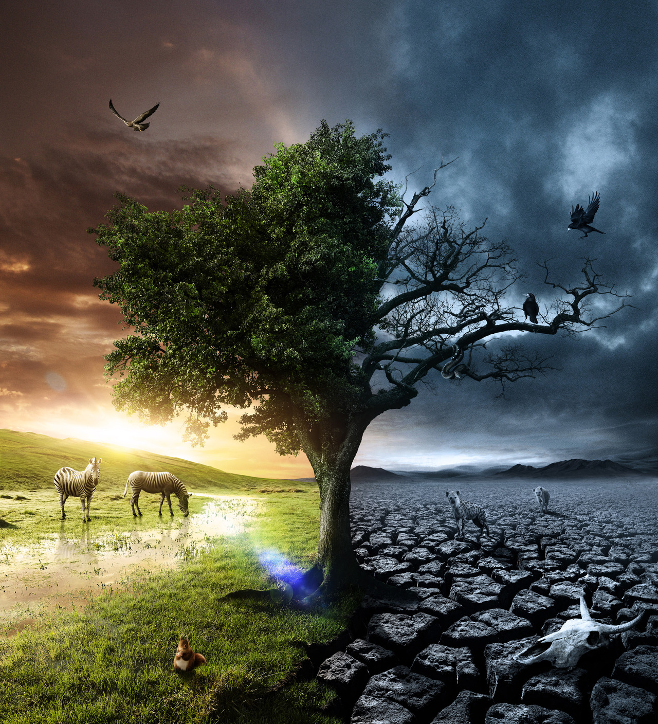
LIFE AND DEATH ISSUES
HOPE BEYOND THE GRAVE
Notes:
Tonight’s subject for presentation from the Bible, is “LIFE AND DEATH ISSUES, HOPE BEYOND THE GRAVE”.

Slide 2
Sin brought Death into the world
Notes:
In John 14:6 and John 17:3, the scripture tells us that God is eternal life.
And since God is Life, the question must be asked where then did death come from?, and what happens when a person dies?, and is there anything that we can do about it now?
The scripture tells us the truth, in Romans 5:12, that death came into the world through one man’s sin, and he was the first man, Adam,
“Wherefore, as by one man sin entered into the world, and death by sin; and so death passed upon all men, for that all have sinned:”
For God had warned Adam …

Slide 3
Genesis 2:17
“ … of the tree of the knowledge of good and evil, thou shalt not eat of it: for in the day that thou eatest thereof thou shalt surely die.”
Notes:
… as we read in Genesis 2:17,
“ … of the tree of the knowledge of good and evil, thou shalt not eat of it: for in the day that thou eatest thereof thou shalt surely die.”
And did Adam die once he ate of the forbidden fruit?

Slide 4
Genesis 5:5
“And all the days that Adam lived were nine hundred and thirty years: and he died.”
Notes:
Yes, Adam surely died, as we read in Genesis 5:5,
“And all the days that Adam lived were nine hundred and thirty years: and he died.”

Slide 5
First Death
(resurrection)
John 11:11-14;
Mat. 9:24; Mar. 5:39;
Luk. 8:52
Second Death
(no resurrection)
Rev. 2:11, 20:6,14, 21:8
Notes:
Yet, why didn’t Adam immediately die? And what happened when he did? Where did he go? Will he ever live again, or did he perish forever?
The scripture tells us the answers.
The Son of the Father promised to step into Adam’s place and take the full penalty for sin, which according to Romans 6:23, is death; and so by doing this (to offer His life a sacrifice and ransom), Jesus split death into two, offering Adam and all those in him, another chance.
This answers the first question, but what of the others? Let’s continue to follow sin and death in the scripture and see what Jesus’ plan was to eradicate them.

Slide 6
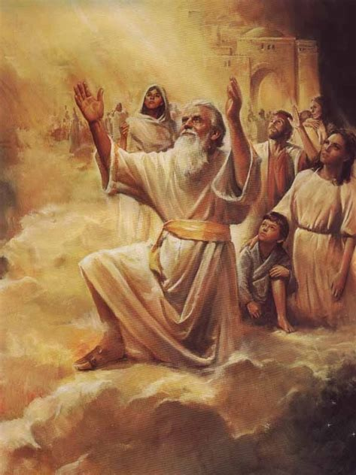
“And to Seth, to him also there was born a son; and he called his name Enos: then began men to call upon the name of the LORD.”
– Genesis 4:26
Notes:
After Adam, in the days of Seth and his son, Enos, when sin began to increase because of the children of Cain; men began to call upon the Name of the Lord that they might be saved from sin and death according to the promise of God given in Genesis 3:15, as read in Genesis 4:26. Those of mankind, since the beginning, who have desired to be delivered from sin and death, have called upon the name of the LORD, even as it is still to this very day.

Slide 7
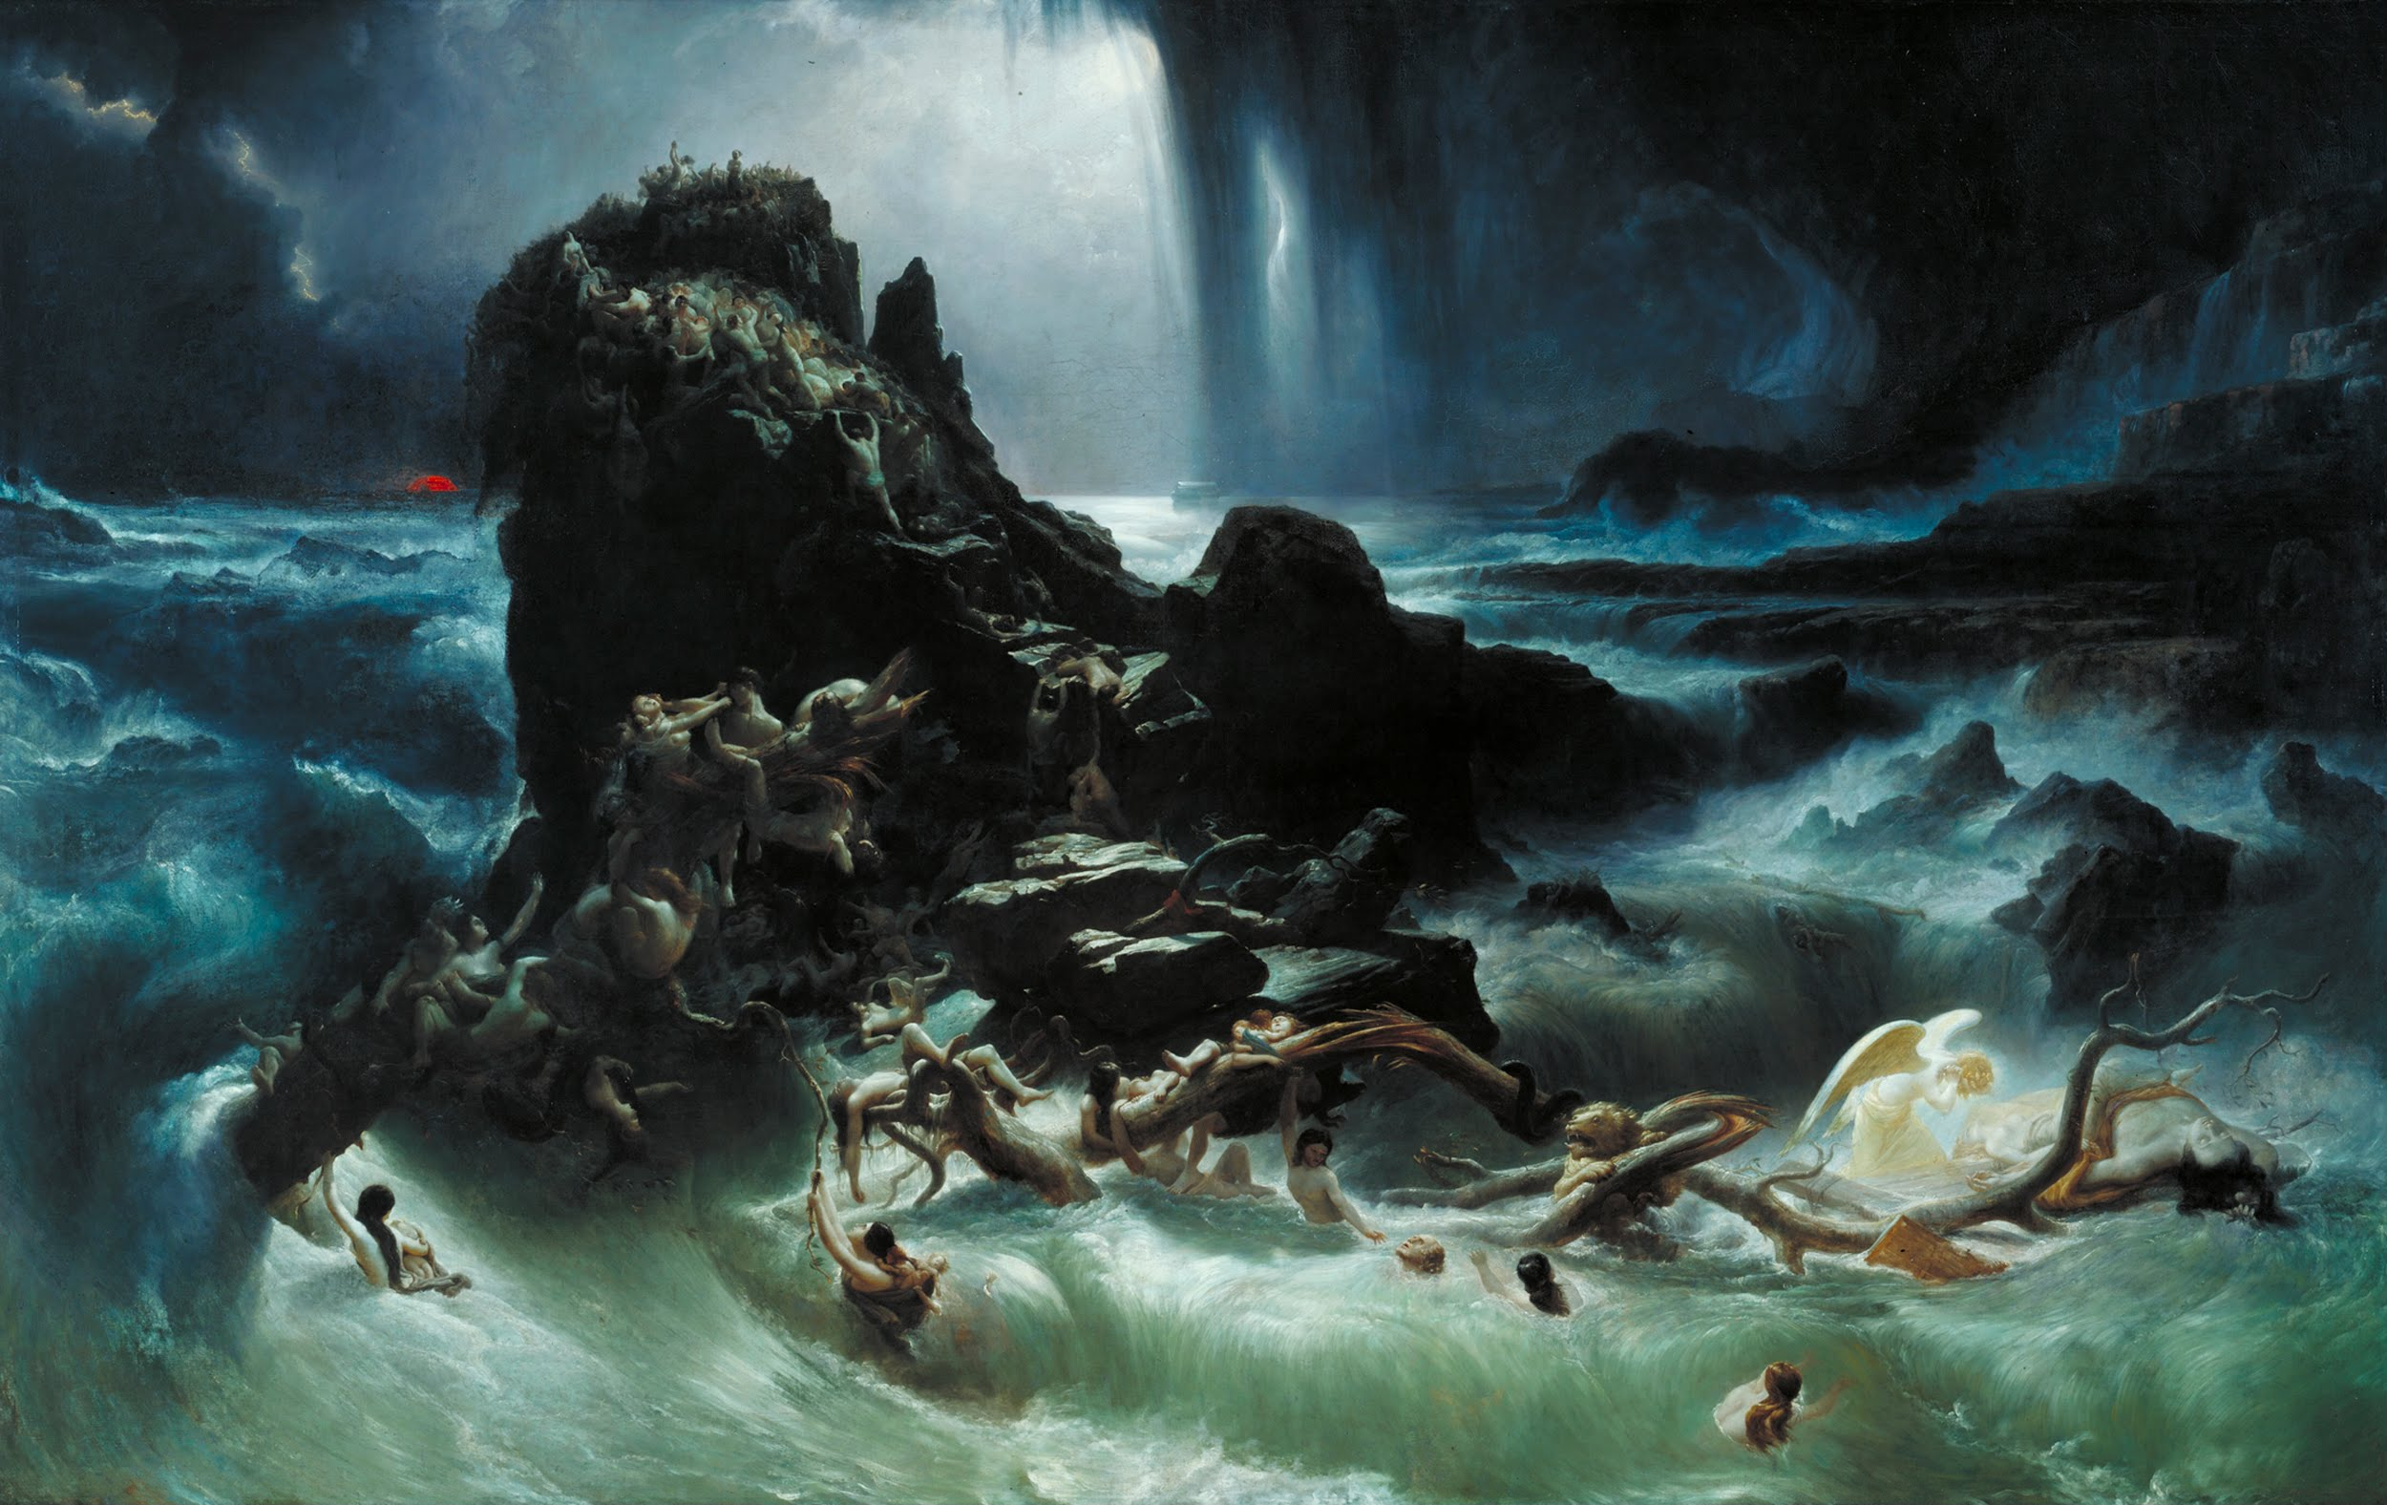
The Flood was sent in Noah’s day
Notes:
As time progressed, and mankind multiplied upon the face of the earth, sin had grown exceeding sinful by the generation of Noah, some 1,656 years from the time Adam had been created by the hand of God. While God was longsuffering and pleaded with those of mankind, who were prisoner to sin, by His Holy Spirit; He could not let sin run rampant, unless no flesh would be saved. So, God sent a warning to a man of faith, a preacher of righteousness, named Noah. God called for a global flood to come upon the whole earth, to wash away sin, and to begin anew – a global baptism by water wherein sin and sinners perished, being completely submerged, while only those in the Ark of the Son of God lived.

Slide 8
Notes:
The flood was truly amazing, for sin seemed forever cast into the depths of the sea. However, as time continued and mankind again multiplied, so too did sin. It wasn’t until the days of Moses that God gave the blueprints, in specific detail, as to how sin and death would be forever eradicated, so as not to rise up a second time. God gave the plans of the sanctuary in Exodus 25, in which were also the details for the altar of sacrifice and the laver of cleansing.

Slide 9
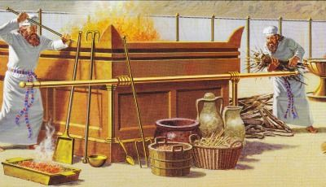
Altar of Burnt offering or sacrifice
Notes:
It was when the Psalmist Asaph went into the Tabernacle of God that he began to have understanding of what God’s perfect plan was for the elimination of sin and death on a permanent and eternal basis …

Slide 10
Psalms 73:17
“ … I went into the sanctuary of God; then understood I (the sinners) end.”
Notes:
… as we read in Psalms 73:17:
“… I went into the sanctuary of God; then understood I (the sinners) end.”
Jesus, the sacrificial Lamb, who was made to be sin for us, was to die in the sinners place, but what was to happen to the forgiven person, and what were they to do?

Slide 11
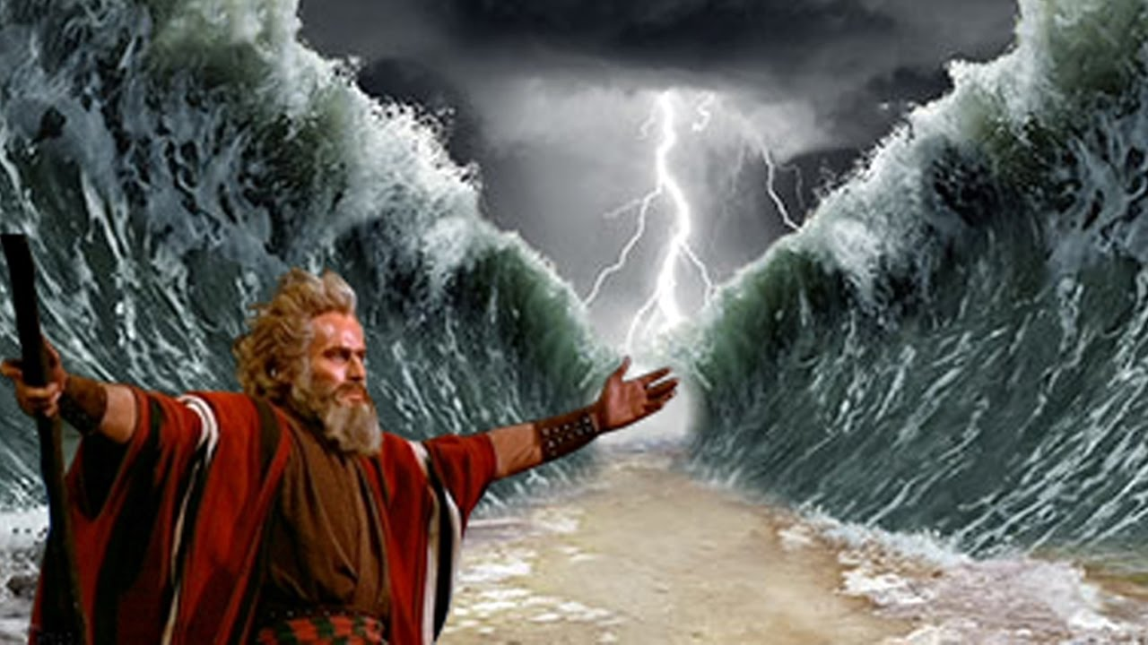
Go through the waters
Notes:
As God provided the Lamb in the days of Moses, and led the people out of the bondage of sin, God brought the forgiven people through the waters that towered above them …

Slide 12
1 Corinthians 10:2
“And were all baptized unto Moses in the cloud (the heavenly waters) and in the sea (the earthly waters);”
Notes:
… as we read in 1 Corinthians 10:2,
“And were all baptized unto Moses in the cloud (the heavenly waters) and in the sea (the earthly waters);”

Slide 13
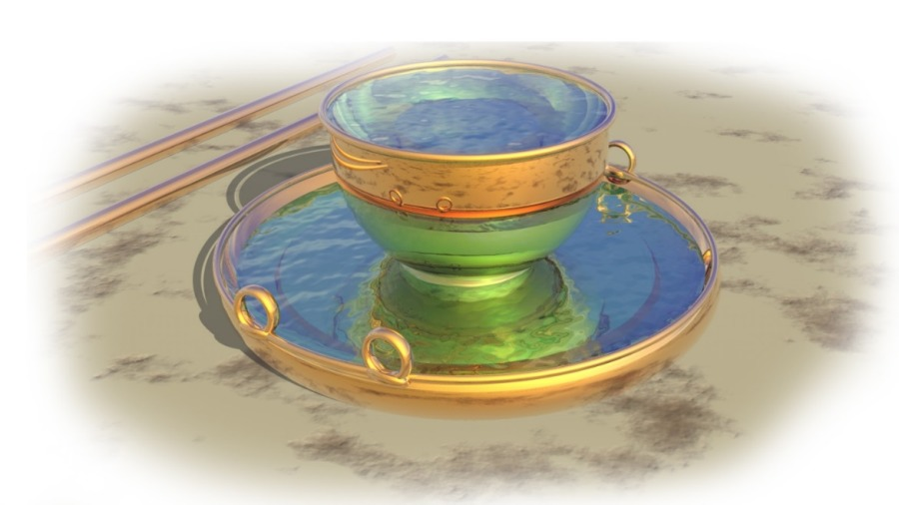
The waters of the Laver …
... or Brazen Sea
Notes:
And so, like Moses in the sea, the Sanctuary taught the same lesson, that the sinner must be fully washed in the water, and sin completely submerged …

Slide 14
Micah 7:19
“He will turn again, he will have compassion upon us; he will subdue our iniquities; and thou wilt cast all their sins into the depths of the sea.”
Notes:
… as we read in Micah 7:19
“He will turn again, he will have compassion upon us; he will subdue our iniquities; and thou wilt cast all their sins into the depths of the sea.”

Slide 15
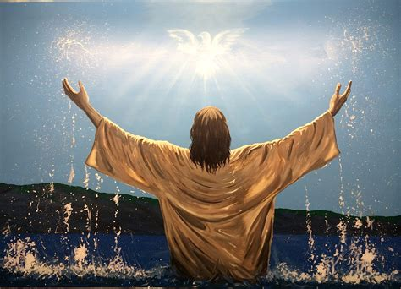
Jesus, our example, was immersed …
… completely in water,
and by the Holy Ghost.
Notes:
As the time came for John the Baptist to preach, he called many to repentance, that they might be baptized, and so John was found where, “… there was much water …” at the river Jordan.
Jesus Christ Himself then came, being our example for mankind, and was baptized in the water and by the Holy Ghost, as seen in Matthew 3:16,
“And Jesus, when he was baptized, went up straightway out of the water: and, lo, the heavens were opened unto him, and he saw the Spirit of God descending like a dove, and lighting upon him:”
Jesus went fully down into the water and then came up with the past behind Him, and His mission from His Father ahead of Him. Many would come to Him to know what was the answer to the problems of sin and death.

Slide 16
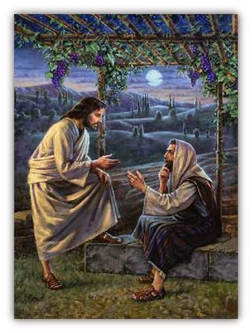
The learned Nicodemus, a very religious man, who thought he knew all of God’s will, came to Jesus by night …
Notes:
The learned Nicodemus, a very religious man, who thought he knew all of God’s will, came to Jesus by night to ask some very important questions. Jesus answered him …

Slide 17
John 3:3
“… Verily, verily, I say unto thee, Except a man be born again, he cannot see the kingdom of God.”
Notes:
… by saying, in John 3:3,
“… Verily, verily, I say unto thee, Except a man be born again, he cannot see the kingdom of God.”
What did Jesus mean? Shouldn’t have Nicodemus known, being a teacher in Israel? …

Slide 18
John 3:4
“… How can a man be born when he is old? can he enter the second time into his mother's womb, and be born? …”
Notes:
… Nicodemus said in the next verse:
“… How can a man be born when he is old? can he enter the second time into his mother's womb, and be born?”

Slide 19
John 3:5-7
“… Verily, verily, I say unto thee, Except a man be born of water and of the Spirit, he cannot enter into the kingdom of God. …”
Notes:
… Jesus, looking upon Nicodemus with love, responded, in John 3:5-7,
“… Verily, verily, I say unto thee, Except a man be born of water and of the Spirit, he cannot enter into the kingdom of God. …”
For Jesus, had already given this example in His own baptism, but each man which was able had to also follow Him through the waters, as Noah, Moses and the Israelites had.

Slide 20
John 3:5-7
“… That which is born of the flesh is flesh; and that which is born of the Spirit is spirit. …”
Notes:
“… That which is born of the flesh is flesh; and that which is born of the Spirit is spirit. …”

Slide 21
John 3:5-7
“… Marvel not that I said unto thee, Ye must be born again.”
Notes:
“… Marvel not that I said unto thee, Ye must be born again.”

Slide 22
Mark 16:16
“He that believeth and is baptized shall be saved; but he that believeth not shall be damned.”
Notes:
Jesus also later said in Mark 16:16,
“He that believeth and is baptized shall be saved; but he that believeth not shall be damned.”
Jesus words, are very serious and solemn words. To disobey the words of Jesus, which are Life, is sin, and so, death. We ought to consider carefully whether we have fully obeyed Him, for if we have not, then we have not forsaken all our sin, are dead therein, and need to come to Jesus in repentance yet still that we might live. Is there any commandments that we have not obeyed? Have we followed Christ Jesus fully and kept all His commandments by His grace and Holy Spirit? If not, we remember that the wages of sin is death, but also that the gift of God is eternal life in Christ Jesus!

Slide 23
Completely submerged
Notes:
Water Baptism is the symbol of the burial of the old man of sin, the old life of rebellion, crime and refusal to obey God in His commandments of love. It shows that all sin must perish and be forever buried. Listen to the words of Paul …

Slide 24
Romans 6:1-8
“What shall we say then? Shall we continue in sin, that grace may abound? …”
Notes:
… in Romans 6:1-8,
“What shall we say then? Shall we continue in sin, that grace may abound? …”

Slide 25
Romans 6:1-8
“… God forbid. How shall we, that are dead to sin, live any longer therein? …”
Notes:
“… God forbid. How shall we, that are dead to sin, live any longer therein? …”

Slide 26
Romans 6:1-8
“… Know ye not, that so many of us as were baptized into Jesus Christ were baptized into his death? …”
Notes:
“… Know ye not, that so many of us as were baptized into Jesus Christ were baptized into his death? …”

Slide 27
Romans 6:1-8
“… Therefore we are buried with him by baptism into death: that like as Christ was raised up from the dead by the glory of the Father, even so we also should walk in newness of life. …”
Notes:
“… Therefore we are buried with him by baptism into death: that like as Christ was raised up from the dead by the glory of the Father, even so we also should walk in newness of life. …”

Slide 28
Romans 6:1-8
“… For if we have been planted together in the likeness of his death, we shall be also in the likeness of his resurrection: …”
Notes:
“… For if we have been planted together in the likeness of his death, we shall be also in the likeness of his resurrection: …”

Slide 29
Romans 6:1-8
“… Knowing this, that our old man is crucified with him, that the body of sin might be destroyed, that henceforth we should not serve sin. …”
Notes:
“… Knowing this, that our old man is crucified with him, that the body of sin might be destroyed, that henceforth we should not serve sin. …”

Slide 30
Romans 6:1-8
“… For he that is dead is freed from sin. …”
Notes:
“… For he that is dead is freed from sin. …”

Slide 31
Romans 6:1-8
“… Now if we be dead with Christ, we believe that we shall also live with him:”
Notes:
“… Now if we be dead with Christ, we believe that we shall also live with him:”

Slide 32
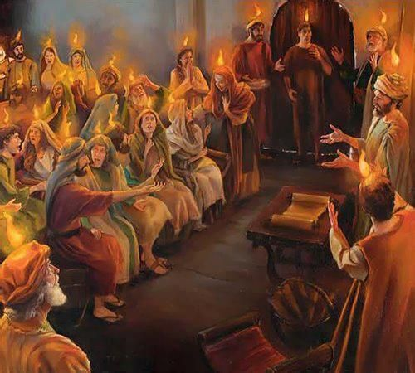
Pentecost, Holy Ghost and Water Baptism
Notes:
At Pentecost, the Holy Ghost was poured out from Heaven, and Peter and the other Apostles preached the good news, the everlasting gospel, about deliverance from sin and death through Jesus Christ. Thousands accepted the merciful offer of pardon and cleansing …

Slide 33
Acts 2:41
“Then they that gladly received his word were baptized: and the same day there were added unto them about three thousand souls.”
Notes:
… as we read in Acts 2:41,
“Then they that gladly received his word were baptized: and the same day there were added unto them about three thousand souls.”

Slide 34
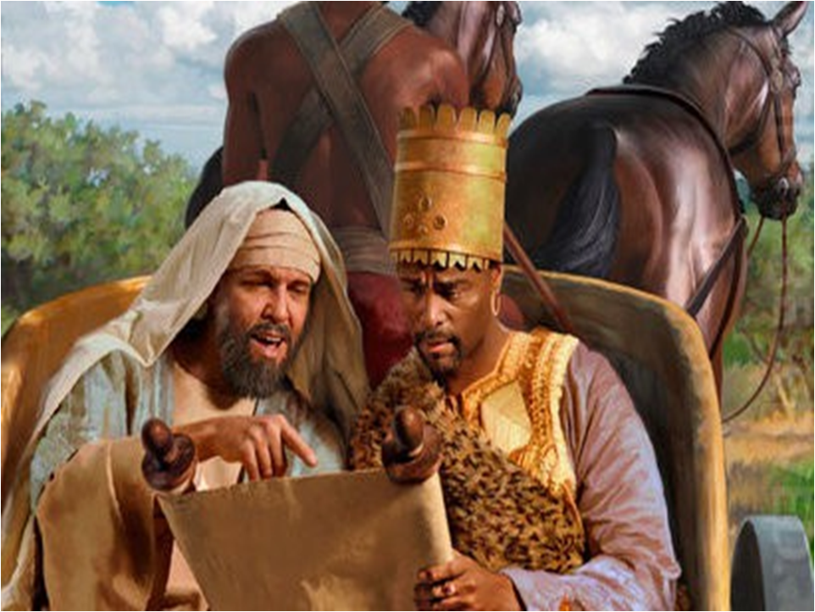
Many more would believe, repent, accept and be baptized.
The Ethiopian Eunuch
Notes:
Many more would come to believe through the word, repent, accept the offer in Christ Jesus, and be baptized. The Ethiopian Eunuch of Acts chapter 8 is one, who said:
“… See, here is water; what doth hinder me to be baptized? …”
And Philip responded:
“… If thou believest with all thine heart, thou mayest. …”
And so the Eunuch rejoiced saying,
“… I believe that Jesus Christ is the Son of God. …”
“And the Eunuch commanded the chariot to stand still: and they went down both into the water, both Philip and the eunuch; and Philip baptized him.”

Slide 35
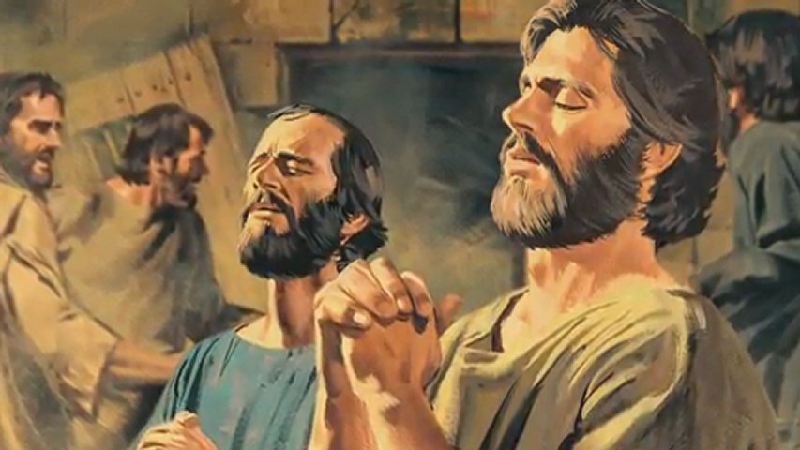
Many more would believe, repent, accept and be baptized.
The Philippian Gaoler of Paul
Notes:
Another one who accepted was the Philippian Jailer of Paul, whose heart was converted by the Holy Ghost, when he saw the faith and life and forgivenss of Paul in Acts 16:
The Jailer said, “… Sirs, what must I do to be saved? …”
“And they said, Believe on the Lord Jesus Christ, and thou shalt be saved, and thy house.”
“And they spake unto him the word of the Lord, and to all that were in his house.”
“And the Jailer took them the same hour of the night, and washed their stripes; and was baptized, he and all his, straightway … and rejoiced, believing in God with all his house.”

Slide 36
Psalms 116:13
“I will take the cup of salvation, and call upon the name of the LORD.”
Notes:
As we did read in Genesis 4:26, we likewise now read in Psalms 116:13,
“I will take the cup of salvation, and call upon the name of the LORD.”

Slide 37
Romans 10:13
“For whosoever shall call upon the name of the Lord shall be saved.”
Notes:
Paul, under inspiration of the Holy Ghost, said in Romans 10:13:
“For whosoever shall call upon the name of the Lord shall be saved.”
Saved from sin and eternal death!

Slide 38
Acts 22:16
“And now why tarriest thou? arise, and be baptized, and wash away thy sins, calling on the name of the Lord.”
Notes:
… for in Acts 22:16 we read,
And now why tarriest thou? arise, and be baptized, and wash away thy sins, calling on the name of the Lord.”

Slide 39
What happens … … to those who die the first death?
Notes:
Now that we have seen something of the plan of redemption, in type, in the days of Noah, in the Sanctuary, in the days of Moses, and in Christ Jesus the way, the truth and the life, let us re-consider the question, “What happens to those who die the first death?”, for we now know that Jesus split death into two by His own sacrifice.

Slide 40
Supernatural
Notes:
Today, there is an explosion of interest in the supernatural. Spiritism, occultism, Satanism, and witchcraft. Go to any large bookstore and you will find up to 200 such titles. Many people and religions, think that the dead are not really dead, echoing the words of the serpent in Eden, “… ye shall not surely die.”

Slide 41
Isaiah 8:19
“And when they say to you, seek those who are mediums and wizards, who whisper and mutter,...”
Notes:
But God’s word says in Isaiah 8:19,
“And when they say to you, seek those who are mediums and wizards, who whisper and mutter,…”

Slide 42
Isaiah 8:19
“... should not a people seek their God? Should they seek the dead on behalf of the living?”
Notes:
“… should not a people seek their God? Should they seek the dead on behalf of the living?”

Slide 43
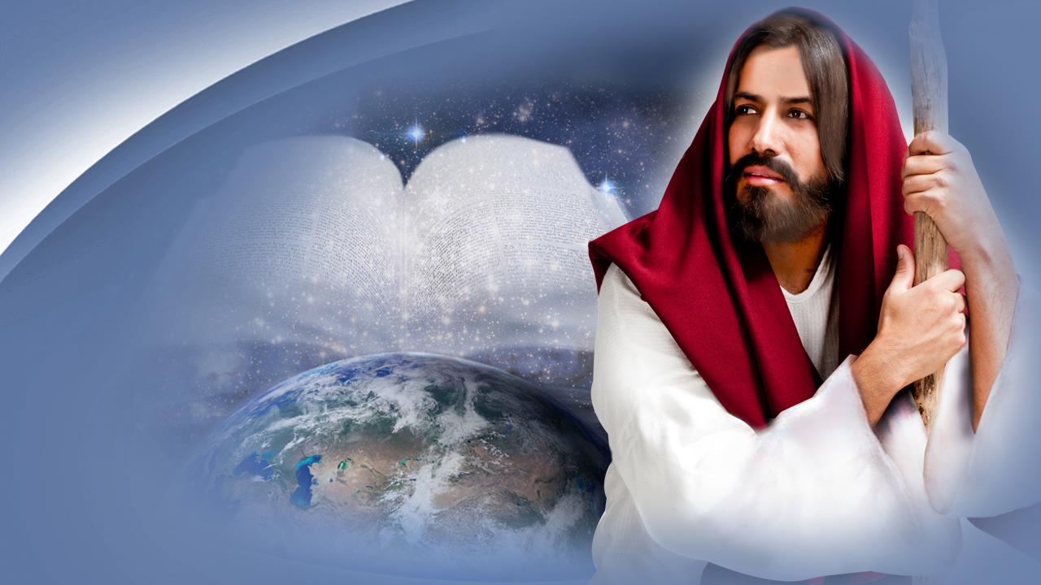
We need to trust in Him
Notes:
In other words, God says, we need to trust in Him and His Word for information about the unknown, for the next verse tells us …

Slide 44
Isaiah 8:20
“To the law and to the testimony! If they do not speak according to this word, it is because there is no light in them.”
Notes:
… in Isaiah 8:20,
“To the law and to the testimony! If they do not speak according to this word, it is because there is no light in them.”

Slide 45
Unwanted guest
Notes:
Death, like the chill of the cold night, is an unwelcomed, depressing fact of life. No sooner are we born than we begin to die. Whether we like it or not, sooner or later death is an uninvited, unwanted guest that inevitably knocks at everyone’s door. But, where does man go at death? If anywhere! Isn’t it a little frightening to take a journey, not knowing what the destination may be, or whether we will ever come back?

Slide 46
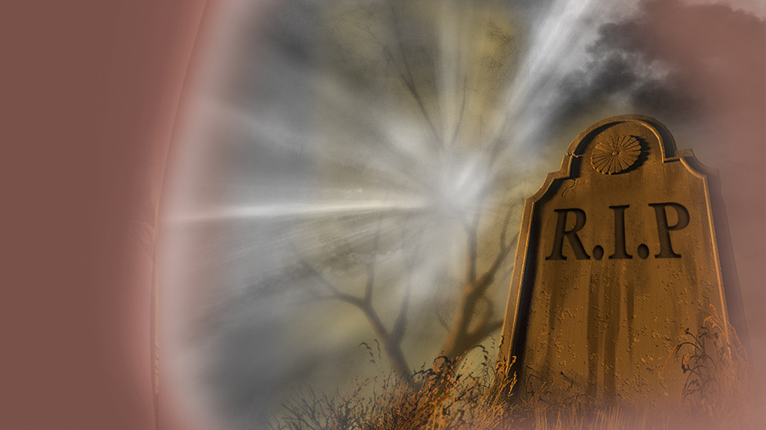
The uncertainty
Notes:
What a sad, uncertain way to end one’s life! Possibly the most frightening thing about death is the unknown. The uncertainty about what lies beyond.

Slide 47
Where are our beloved dead?
Notes:
Where does a man go when he dies? Heaven? Hell? Purgatory? Oblivion? Is death a great new adventure, or just endless silence? Are our goodbyes the final act, or is death just a pause between two eternities? Where are our beloved dead? Centuries ago, Job asked the question that every person asks himself or herself at sometime in his or her life …

Slide 48
Job 14:14
“If a man dies, shall he live again?”
Notes:
… in Job 14:14,
“If a man dies, shall he live again?”

Slide 49
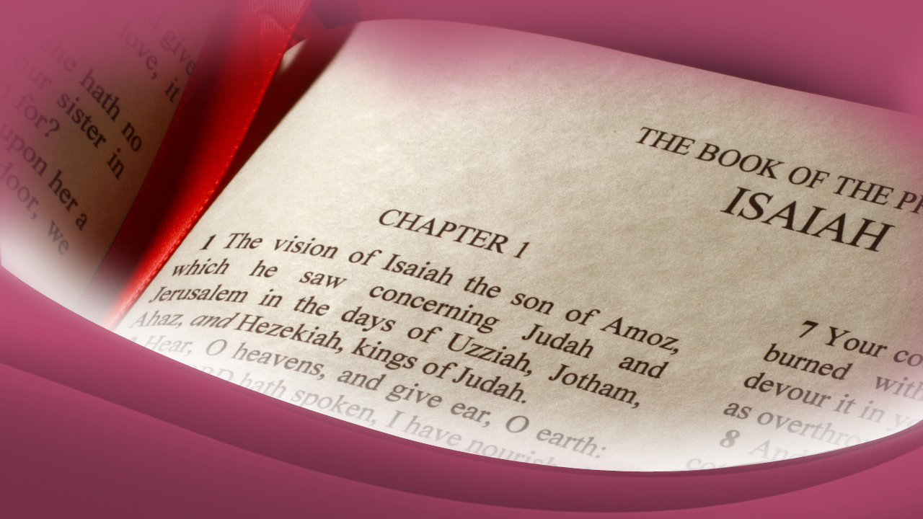
The Bible’s teaching on death
Notes:
Isn’t that the most important question to be answered about death? Let us turn to our only dependable source of information for the answer. The Bible’s teaching on death is consistent, not confusing. There may be some surprises, but its answers are both reasonable and satisfying and best of all, comforting! The Prophet wrote …

Slide 50
Isaiah 26:19
“Your dead shall live; together with my dead body they shall arise… And the earth shall cast out the dead.”
Notes:
… in Isaiah 26:29,
“Your dead shall live; together with my dead body they shall arise… And the earth shall cast out the dead.”

Slide 51
There is life beyond death
Notes:
Yes, there is a life beyond death! Our beloved dead will live again! But when? At the moment of death, or some later time? What happens when a man dies?
One of the most quoted passages of Scriptures concerning the dead is found in Ecclesiastes 12, which describes what happens to a man when he dies …

Slide 52
Ecclesiastes 12:7
“Then the dust will return to the earth as it was, and the spirit will return to God who gave it.”
Notes:
… as we read in Ecclesiastes 12:7,
“Then the dust will return to the earth as it was, and the spirit will return to God who gave it.”

Slide 53
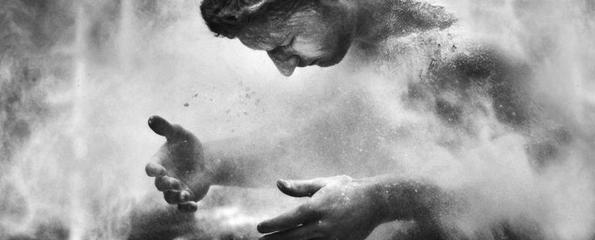
The body returns to dust,
and the spirit returns to God.
Notes:
In other words, when a man dies, his body, made up of elements of the earth, returns to dust, and his spirit returns to God. Of course, to fully understand what the “spirit” is, we need to look at creation and discover how God made man in the beginning.

Slide 54
Genesis 2:7
“And the Lord God formed man of the dust of the ground, and breathed into his nostrils the breath of life; and man became a living being.”
Notes:
… in Genesis 2:7 we read,
“And the Lord God formed man of the dust of the ground, and breathed into his nostrils the breath of life; and man became a living being.”

Slide 55
Notes:
God took the elements of the earth: carbon, hydrogen, oxygen, nitrogen, calcium, iron, phosphorous, sodium and so forth, and formed the body. Adam had a brain: but he was not thinking. He had a heart in his chest: but it was not beating. He had blood in his arteries and veins, but it was not circulating. He was ready to live, but he was not living. Then God breathed into his nostrils the breath of life, and man became a living soul or a living creature or living being.

Slide 56
Job 27:3
“As long as my breath is in me, and the breath of God in my nostrils.”
Notes:
… in Job 27:3, we read,
“As long as my breath is in me, and the breath of God in my nostrils.”

Slide 57
The “SPIRIT” or “BREATH”
is what keeps the body alive
Notes:
The “spirit” or breath is what keeps the body alive. …

Slide 58
James 2:26
“…the body without the spirit is dead...”
Notes:
… in James2:26 we read:
“…the body without the spirit is dead...”

Slide 59
DUST + SPIRIT =
A LIVING SOUL
Notes:
You see, we might illustrate it this way:
DUST + SPIRIT = A LIVING SOUL

Slide 60
THE ELEMENTS OF EARTH
+
BREATH
=
A LIVING BEING
Notes:
Or, more simply:
THE ELEMENTS OF EARTH + BREATH = A LIVING BEING

Slide 61
Then, what happens at death? Just the reverse:
DUST - SPIRIT = A CORPSE
DUST - SPIRIT =
A CORPSE
Notes:
Then, what happens at death? Just the reverse
DUST - SPIRIT = A CORPSE

Slide 62
ELEMENTS OF EARTH - BREATH =
A CORPSE
Notes:
Or, more simply:
ELEMENTS OF EARTH - BREATH = A CORPSE

Slide 63
Notes:
We can best understand this truth by the following illustration:
Connect a light bulb to electricity. What happens? We get light! No one puts the light in the bulb, the light comes on by uniting the two components:
bulb + electricity.

Slide 64
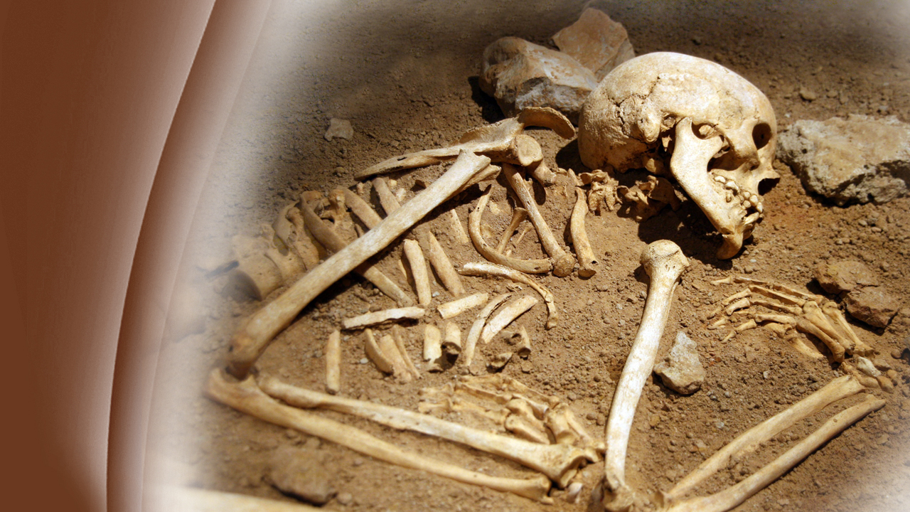
When you
disconnect
Notes:
When you disconnect the electricity, the light goes out. Just so at death. When the breath, or spark of life, goes back to the Creator, man dies. All that is left is the body, composed of the elements of Earth, which returns to dust. The living soul, or living being, simply ceases to exist at death. The Bible states …

Slide 65
Psalms 146:3, 4
“Do not put your trust in princes, or in a son of man, in whom there is no help. …”
Notes:
… in Psalms 146:3, 4,
“Do not put your trust in princes, or in a son of man, in whom there is no help. …”

Slide 66
Psalms 146:3, 4
“His spirit departs, he returns to his earth; in that very day his plans perish.”
Notes:
“… His spirit departs, he returns to his earth; in that very day his plans perish.”

Slide 67
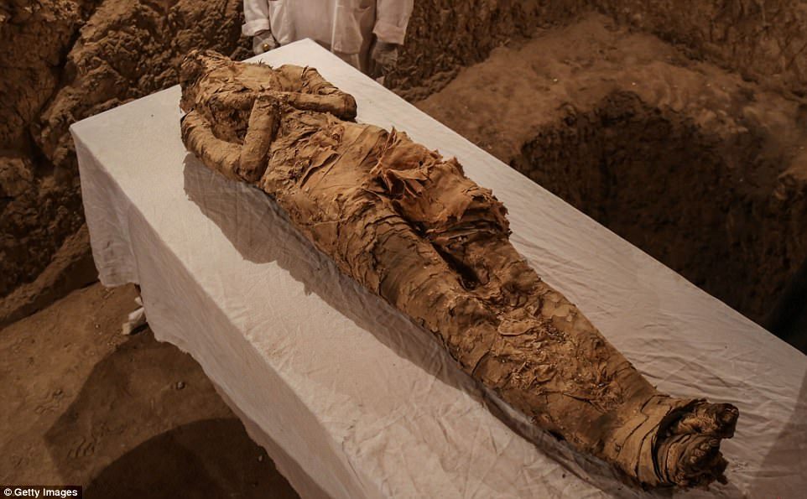
But, where...
Notes:
But, where do the dead spend their time between death and their resurrection? …

Slide 68
Job 17:13
“I wait for the grave as my house…”
Notes:
… in Job 17:13 we read:
“I wait for the grave as my house…”

Slide 69
According to the Bible
Notes:
According to the Bible, when a man dies, he does not go to Heaven. He does not go to hell. He does not go to purgatory. In fact, he does not live at all anywhere! Death is a cessation of life until the resurrection morning when body and breath are united again.

Slide 70
Ecclesiastes 9:5
“For the living know that they will die; but the dead know nothing.”
Notes:
Again, in Ecclesiastes 9:5 we read:
“For the living know that they will die; but the dead know nothing.”

Slide 71
The dead do not even know
Notes:
Evidently the dead do not even know what the living are doing, for the Bible says of the man who has died.

Slide 72
Job 14:21
“His sons come to honor, and he does not know it; they are brought low, and he does not perceive it.”
Notes:
In Job 14:21, we read:
“His sons come to honor, and he does not know it; they are brought low, and he does not perceive it.”

Slide 73
He rests quietly, undisturbed
Notes:
You see, one of the most comforting truths in God’s Word is that when a man dies, he rests quietly, undisturbed by the problems of life or concern for his loved ones until the call of the Lifegiver. Is it any wonder that the Bible likens death to a sleep?

Slide 74
2 Samuel 7:12
“When your days are fulfilled… you rest with your fathers…”
Notes:
The Prophet Nathan told King David in 2 Samuel 7:12,
“When your days are fulfilled… you rest with your fathers…”

Slide 75
“Sleep”
Notes:
In fact, Jesus himself called death a “sleep.” …

Slide 76
John 11:11
“Our friend Lazarus sleeps, but I go that I may wake him up.”
Notes:
… in John 11:11 Jesus said to the disciples:
“Our friend Lazarus sleeps, but I go that I may wake him up.”

Slide 77
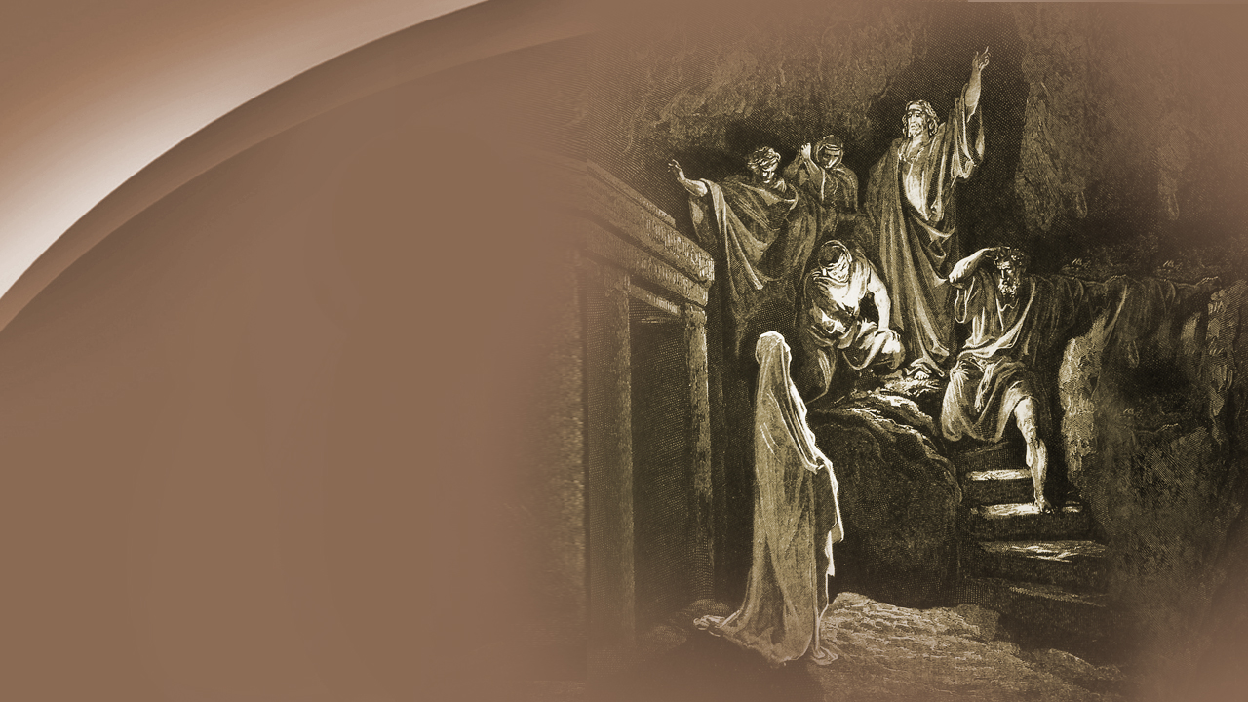
The disciples
were confused
Notes:
The disciples were confused by this statement. They knew Lazarus had been ill for some time. …

Slide 78
John 11:12-14
“Then His disciples said, Lord, if he sleeps he will get well. However, Jesus spoke of his death,…”
Notes:
… and in John 11:12-14 we read their reply to Jesus,
“Then His disciples said, Lord, if he sleeps he will get well. However, Jesus spoke of his death,…”

Slide 79
John 11:12-14
“…but they thought that He was speaking about taking rest in sleep. Then Jesus said to them plainly, Lazarus is dead.”
Notes:
“…but they thought that He was speaking about taking rest in sleep. Then Jesus said to them plainly, Lazarus is dead.”

Slide 80
They cried
Notes:
As Jesus and the disciples made their way to Bethany, Martha, the sister of Lazarus, rushed out to meet Jesus. …

Slide 81
John 11:21
“Lord, if You had been here, my brother would not have died.”
Notes:
… the women cried unto Him, saying,
“Lord, if You had been here, my brother would not have died.”

Slide 82
John 11:23
“Your brother will rise again.”
Notes:
No doubt she was right! Confidently, Jesus answered Martha in verse 23:
“Your brother will rise again.”

Slide 83
John 11:24
“I know that he will rise again in the resurrection at the last day.”
Notes:
Now, notice carefully Martha’s response, in verse 24:
“I know that he will rise again in the resurrection at the last day.”

Slide 84
The resurrection at the end?
Notes:
Martha was a close friend and follower of Jesus. She thought he was speaking of the resurrection at the end of the world. Often she had listened to Jesus teach and they knew the scriptures.

Slide 85
John 5:28, 29
“Do not marvel at this; for the hour is coming in which all who are in the graves will hear His voice and come forth...”
Notes:
… in John 5:28, 29 we read:
“Do not marvel at this; for the hour is coming in which all who are in the graves will hear His voice and come forth...”

Slide 86
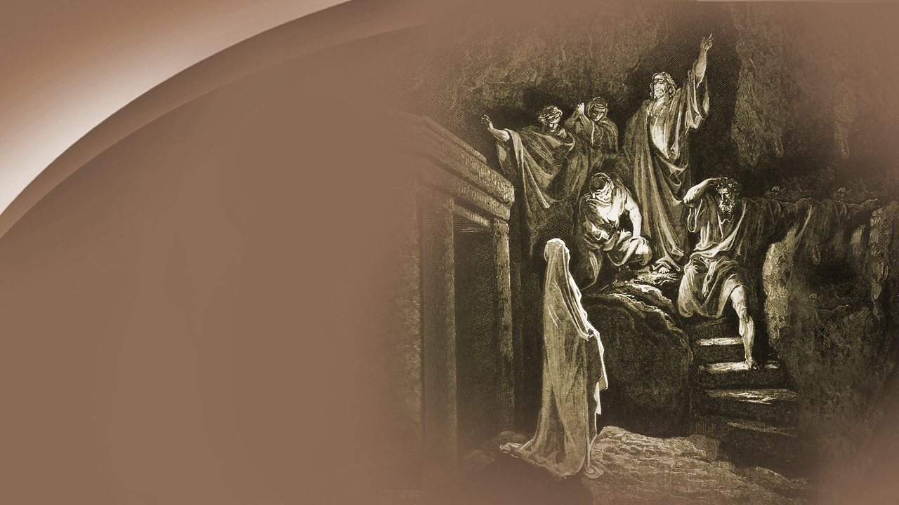
Take out the stone!
Notes:
Jesus had been speaking about His second coming, and Martha assured Jesus that she did expect to see Lazarus in the resurrection at the end of the world. However, Jesus was about to give a dramatic preview of that event. Coming to the cave where Lazarus’ tomb was, Jesus asked that the stone sealing the entrance be taken away. Concerned by such a request, Martha objected …

Slide 87
John 11:39
“Lord, by this time there is a stench, for he has been dead four days.”
Notes:
… in John 11:39,
“Lord, by this time there is a stench, for he has been dead four days.”

Slide 88
Lazarus, come forth!
Notes:
But the stone was rolled away, and Jesus cried out in a loud voice: “Lazarus, come forth!” And, Lazarus came forth! Someone has said it was well that Jesus specified He was speaking only to Lazarus, otherwise, every grave on earth would have opened! Lazarus came to life, but he was still wrapped in grave clothes, just the way he was laid in the tomb. And, although he was dead for four days, we have no record of Lazarus recounting experiences during death; which is in keeping with Biblical teaching that “the dead know nothing.” Jesus had simply called him forth from the sleep of death—a sleep that can only be broken by the call of the Lifegiver himself!

Slide 89
Job 14:15
“You shall call, and I will answer You.”
Notes:
This is the call that Job anticipated in Job 14:15,
“You shall call, and I will answer You.”

Slide 90
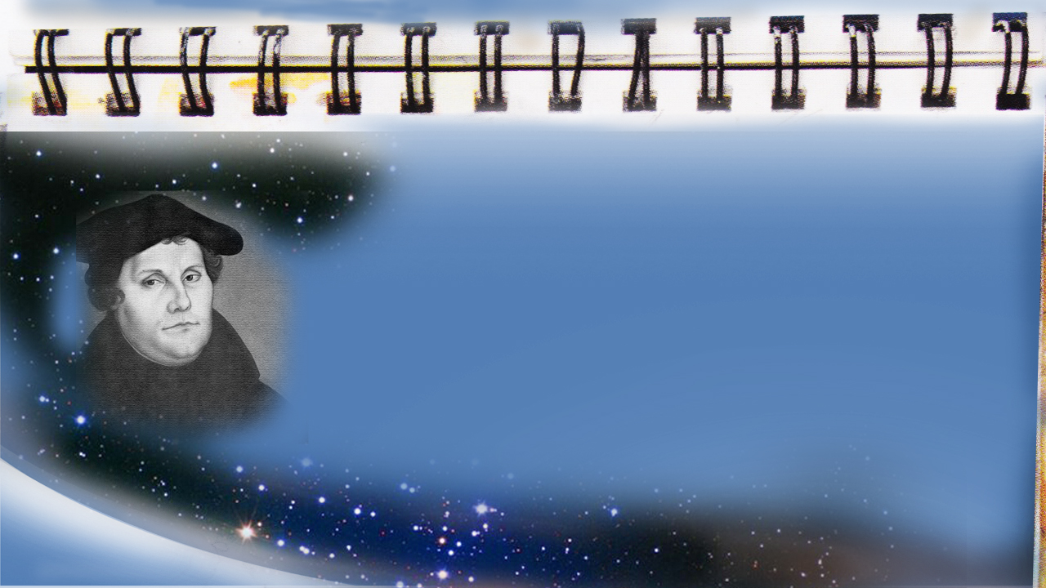
MARTIN LUTHER ,
The Christian Hope, page 37
“We shall sleep until he comes and knocks on the little grave and says. Doctor Martin, get up! …”
Notes:
Martin Luther said the same thing in the 16th century, in The book The Christian Hope, page 37,
“We shall sleep until he comes and knocks on the little grave and says. Doctor Martin, get up! …”

Slide 91
MARTIN LUTHER ,
The Christian Hope, page 37
“… Then I shall rise in a moment and be happy with Him forever.”
Notes:
“… Then I shall rise in a moment and be happy with Him forever.”

Slide 92
A message
of comfort
Notes:
What a wonderful hope Christians have of a life beyond the grave!
The Christian need not sorrow and grieve in utter despair like those who have no hope of being reunited with their loved ones. This is the message of comfort that the Apostle Paul shared with the early Christians.

Slide 93
1 Thessalonians 4:13
“But I do not want you to be ignorant, brethren, concerning those who have fallen asleep,...”
Notes:
… in 1 Thessalonians 4:13 Paul stated:
“But I do not want you to be ignorant, brethren, concerning those who have fallen asleep,…”

Slide 94
1 Thessalonians 4:13
“…lest you sorrow as others who have no hope.”
Notes:
“…lest you sorrow as others who have no hope.”

Slide 95
The real hope & victory
Notes:
The real hope, the real comfort for sorrowing, grieving hearts, is not in the seance chamber, or in the confused messages from the spirit world; it is in the Lord Jesus Christ! The message of Christianity that shook the pagan Roman Empire was the good news of the resurrection. The pagans had lost confidence in their religion and death seemed like a dark pit from which there was no hope of escape. Paul and the early Christians pointed to the resurrection as God’s answer to death—the grim enemy of all mankind. By Christ’s death on the cross, His burial in the tomb, and His glorious resurrection, He gained victory not only over sin, but over death itself! …

Slide 96
John 11:25
“I am the resurrection and the life. He who believes in Me, though he may die, he shall live.”
Notes:
… in John 11:25 Jesus triumphantly stated when He arose from the dead:
“I am the resurrection and the life. He who believes in Me, though he may die, he shall live.”

Slide 97
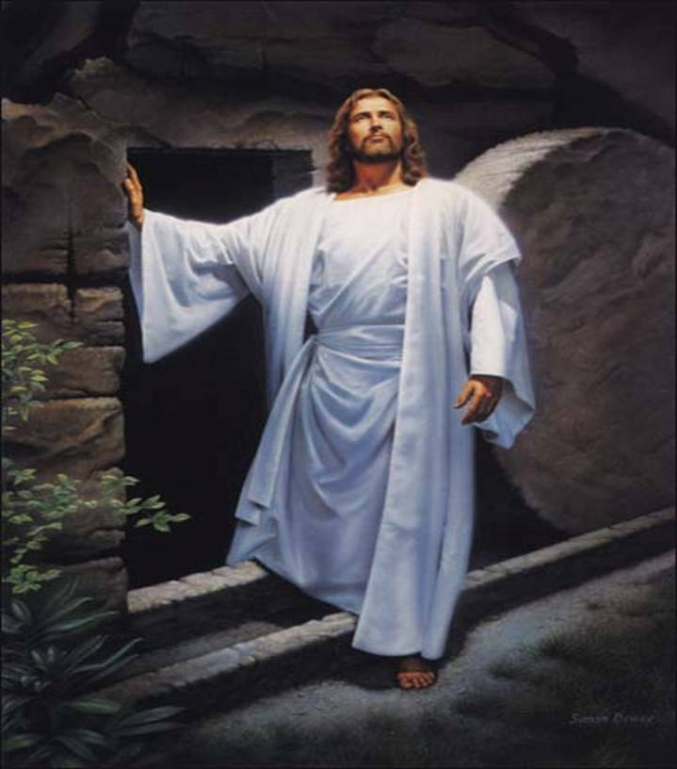
We, who are in Christ Jesus shall LIVE again and forever, even as He Himself was victorious over sin and death & eternally Lives.
Notes:
Yes, the resurrection of Christ’s followers is as certain as the resurrection of Christ himself!
When will this happy occasion take place? When will God’s sleeping children live again?

Slide 98
1 Corinthians 15:20, 22, 23
“But now Christ is risen from the dead, and has become the first fruits of those who have fallen asleep…”
Notes:
The Apostle Paul gives us the answer in 1 Corinthians 15:20, 22 & 23:
“But now Christ is risen from the dead, and has become the first fruits of those who have fallen asleep…”

Slide 99
1 Corinthians 15:20, 22, 23
“… For as in Adam all die, even so in Christ all shall be made alive… Christ the first fruits, afterward those who are Christ’s at His coming. ”
Notes:
“… For as in Adam all die, even so in Christ all shall be made alive… Christ the first fruits, afterward those who are Christ’s at His coming.”

Slide 100
Christ’s second coming
Notes:
Yes, the answer is clear: at Christ’s second coming!

Slide 101
1 Corinthians 15:51, 52
“Behold, I tell you a mystery: We shall not all sleep, but we shall all be changed in a moment, in the twinkling of an eye, at the last trumpet. …”
Notes:
… Paul declares in 1 Corinthians 15:51, 52:
“Behold, I tell you a mystery: We shall not all sleep, but we shall all be changed in a moment, in the twinkling of an eye, at the last trumpet. …”

Slide 102
1 Corinthians 15:51, 52
“… For the trumpet will sound, and the dead will be raised incorruptible, and we shall be changed.”
Notes:
“… For the trumpet will sound, and the dead will be raised incorruptible, and we shall be changed.”

Slide 103
1 Corinthians 15:53
“For this corruptible must put on incorruption, and this mortal must put on immortality.”
Notes:
… in verse 53:
“For this corruptible must put on incorruption, and this mortal must put on immortality.”

Slide 104
Our bodies will be changed
Notes:
Our bodies will be changed when Christ returns …

Slide 105
Philippians 3:20, 21
“For our citizenship is in heaven, from which we also eagerly wait for the Savior, the Lord Jesus Christ,...”
Notes:
… as we read in Philippians 3:20, 21:
“For our citizenship is in heaven, from which we also eagerly wait for the Savior, the Lord Jesus Christ, …”

Slide 106
Philippians 3:20, 21
“…who will transform our lowly body that it may be conformed to His glorious body…”
Notes:
“…who will transform our lowly body that it may be conformed to His glorious body…”

Slide 107
David said
Notes:
David said he would be satisfied when he awakes from the sleep of death.

Slide 108
Psalms 17:15
“I shall be satisfied when I awake in Your likeness.”
Notes:
… in Psalms 17:15, we read:
“I shall be satisfied when I awake in Your likeness.”

Slide 109
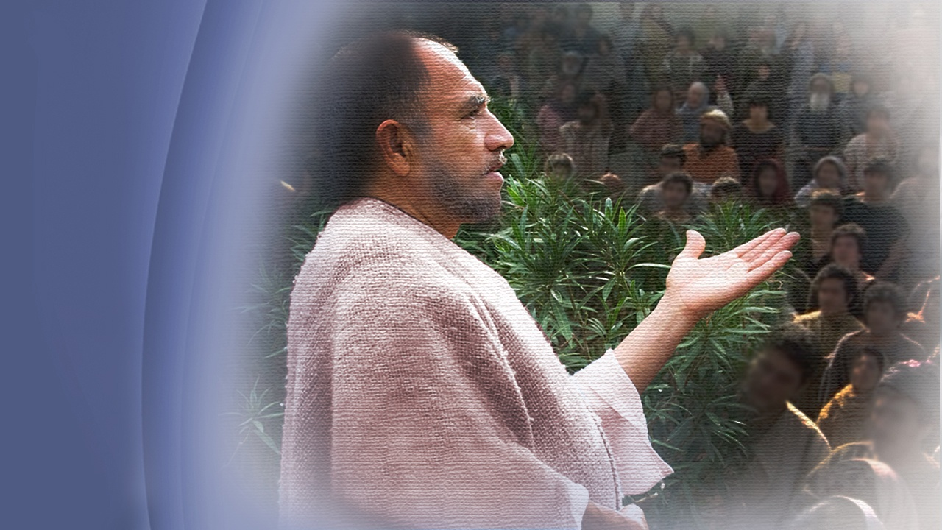
The Apostle Paul describes it
Notes:
We may not know exactly how our bodies will be changed, but whatever the change, we shall be satisfied!But what about the reunion with our beloved dead? The Apostle Paul describes it beautifully …

Slide 110
1 Thessalonians 4:15-17
“For this we say to you by the word of the Lord, that we who are alive...”
Notes:
… in 1 Thessalonians 4:15-17, saying:
“For this we say to you by the word of the Lord, that we who are alive …”

Slide 111
1 Thessalonians 4:15-17
“…and remain until the coming of the Lord will by no means precede those who are asleep. …”
Notes:
“…and remain until the coming of the Lord will by no means precede those who are asleep. …”

Slide 112
1 Thessalonians 4:15-17
“… For the Lord Himself will descend from heaven with a shout, with the voice of an archangel, and with the trumpet of God. And the dead in Christ will rise first …”
Notes:
“…and remain until the coming of the Lord will by no means precede those who are asleep. …”

Slide 113
1 Thessalonians 4:15-17
“… Then we who are alive and remain shall be caught up together with them in the clouds to meet the Lord in the air. …”
Notes:
“… Then we who are alive and remain shall be caught up together with them in the clouds to meet the Lord in the air. …”

Slide 114
1 Thessalonians 4:15-17
“… And thus we shall always be with the Lord.”
Notes:
“… And thus we shall always be with the Lord.”

Slide 115
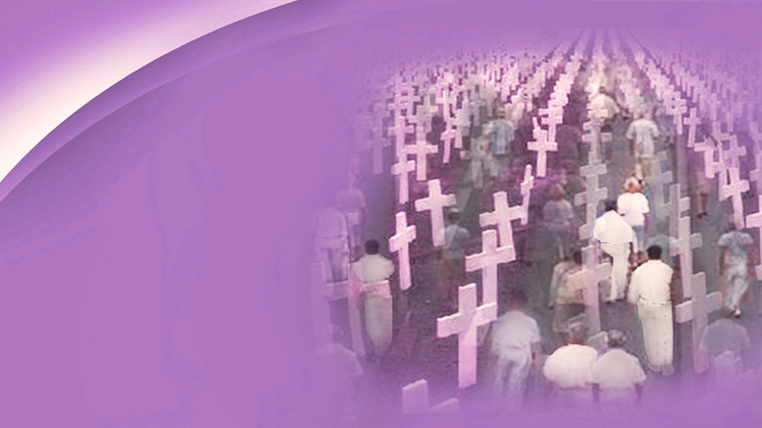
What a glorious hope!
Notes:
Could any words be more encouraging? What a glorious hope! When Jesus bursts through the blue and looks upon the dusty graves of His sleeping ones, His mighty voice will call out, just as he called to Lazarus: “Come forth.” And the graves on a thousand hillsides around the earth will burst open. The dead will hear His voice and come forth! Families and friends will be united, never to part again. What a day that will be! No pen can describe it!

Slide 116
Calvary has made it possible
Notes:
This is the future that Calvary has made possible: Seeing our Lord face to face, joining our loved ones who have fallen asleep in Jesus. What hope this message brings to the human heart! But the most important question of all to be answered is, how can we be certain today that we can have victory over death and the grave? God’s promise of eternal life is clear …

Slide 117
1 John 5:12
“He who has the Son has life; he who does not have the Son of God does not have life.”
Notes:
… for in 1 John 5:12 we read:
“He who has the Son has life; he who does not have the Son of God does not have life.”

Slide 118
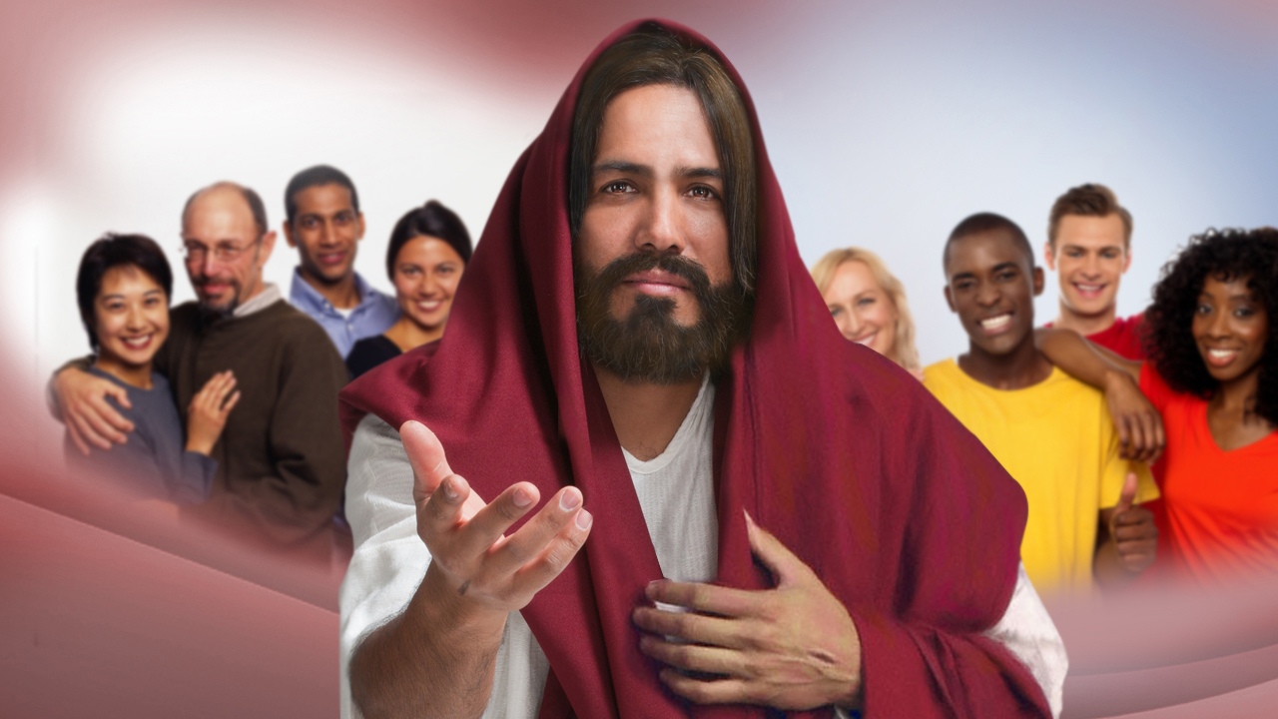
Notes:
Jesus is inviting us all to accept His sacrifice; to accept The Father’s offer of pardon, mercy and cleansing from sin. Have you clearly understood the wages of sin and how terrible a price is required? Have you understood the plan of redemption from sin and death? Is it now clear what happens to those who die, and why there are two deaths? If you understood tonight, and want to be delivered from all your sin, and by God’s grace keep His commandments, and enter into the fullness of His resurrected life, then please stand with me now.
While we are standing, I appeal for those who desire to be baptized into all the way, the truth and the life, come forward and we will have special prayer for you.

Slide 119
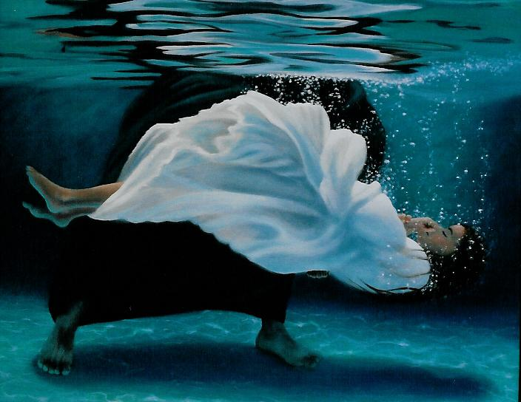
Notes:
If your heart’s desire is to be forever dead and buried to sin and the breaking of the heart of God, then please come forward. Take the steps forward as Israel of old through the waters. Get into the Ark of Christ as Noah. Come and be washed, renewed, born again, filled with the Holy Spirit. Let not your heart be troubled, ye believe in God, believe also in Me, said Jesus. There is nothing to fear, … come. …

Slide 120
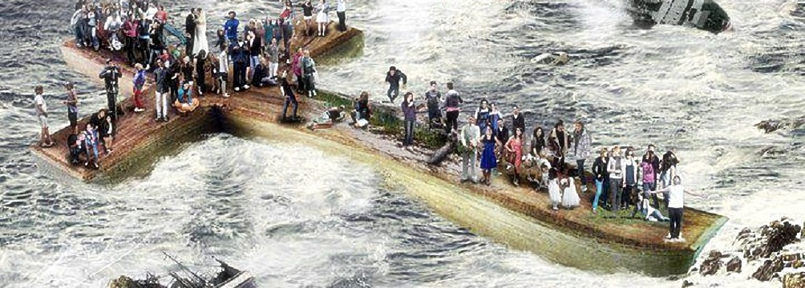
Notes:
Let us pray, and if any desire to come forward, please come, before the Door closes … forever.

