Slide 1
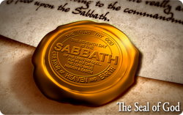
GOD’S SIGN OF HOPE
Notes:
Good evening everyone, and welcome back to our Prophesy series. Tonight is night number 9, and we have an important topic for you tonight but I think you’ll enjoy it. But it’s also a serious message, and we need God to open our minds and our hearts to accept it. So before we get into it, let’s pray.

Slide 2
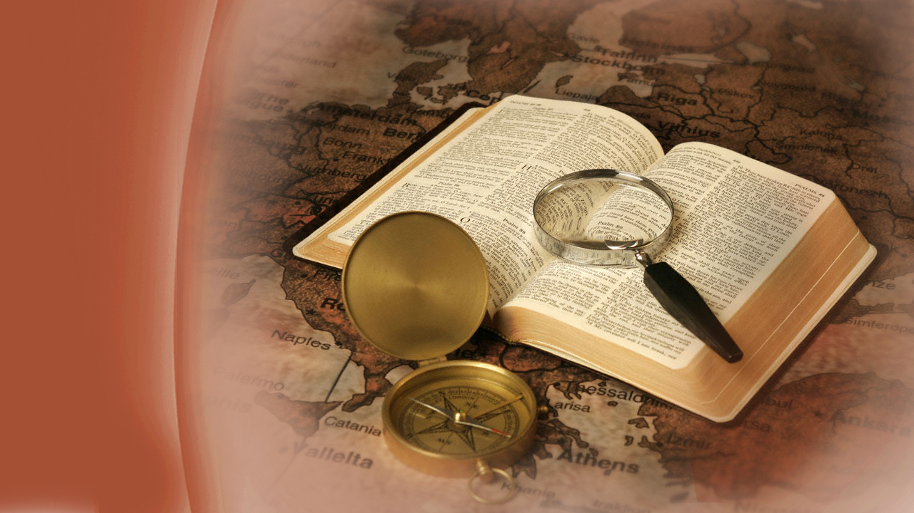
Predictions of
God’s Word
Notes:
We have seen in our studies together, from God’s word, the rise and fall of mighty nations, and the amazing details given long before they happened.

Slide 3
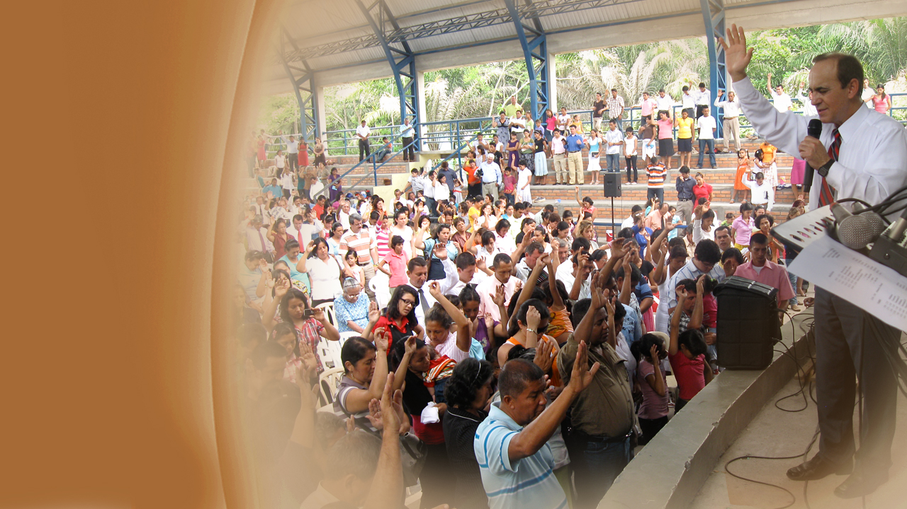
Preparing the
last generation
Notes:
Now let us study a great prophecy, in Revelation chapter 14, which tells of a special message that must be given to all the world before Jesus returns. …

Slide 4
Revelation 14:6, 7
“Then I saw another angel flying in the midst of heaven, having the everlasting gospel to preach to those who dwell on the earth...”
Notes:
In Revelation 14:6, 7 we read:
“Then I saw another angel flying in the midst of heaven, having the everlasting gospel to preach to those who dwell on the earth…”

Slide 5
Revelation 14:6, 7
“...to every nation, tribe, tongue, and people saying with a loud voice, fear God and give glory to Him, for the hour of His judgment is come;...”
Notes:
“…to every nation, tribe, tongue, and people saying with a loud voice, fear God and give glory to Him, for the hour of His judgment has come;…”

Slide 6
Revelation 14:6, 7
“...and worship Him who made heaven and earth, the sea and springs of water.”
Notes:
“…and worship Him who made heaven and earth, the sea and springs of water.”

Slide 7
All of us are called …
… to worship the Creator.
Notes:
Here, all of us are called to worship the judge of all mankind—God our Creator. This message is to go to the whole world just before the second coming of Jesus, reminding man of his Creator and his origin. God knew the end from the beginning, and foresaw that there would be great deception in the last days about this.

Slide 8
2 Timothy 3:13
“But evil men and seducers shall wax worse and worse, deceiving, and being deceived.”
Notes:
In 2 Timothy 3:13, we read:
“But evil men and seducers shall wax worse and worse, deceiving, and being deceived.”

Slide 9
How the
world began
Notes:
One of the most amazing truths of the Bible is that Jesus, the Son of the Father, who existed from all eternity, created the universe …

Slide 10
Ephesians 3:9
“…God who created all things through Jesus Christ.”
Notes:
… as we read in Ephesians 3:9,
“…God who created all things through Jesus Christ.”
And now, let us go back to the beginning, to Genesis, and see …

Slide 11
Day 1 …
Notes:
On the first day of creation God said in Genesis 1:3,
“Let there be light; and there was light.”

Slide 12
Day 2 …
Notes:
On the second day God divided the waters and created the sky and atmosphere.

Slide 13
Day 3 …
Notes:
On the third day God created the trees, herbs and grass.

Slide 14
Day 4 …
Notes:
On the fourth day God created the sun, moon, and stars and put them into their places.

Slide 15
Day 5 …
Notes:
On the fifth day God created all the moving creatures in the waters and fowls of the air.

Slide 16
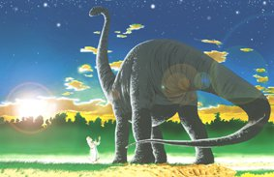
Day 6 …
Notes:
Then, on the sixth day God brought forth the beasts and creeping things and mankind, Adam, then Eve from Him. The Bible then says that God saw all of it, and it “was very good.” …

Slide 17
Genesis 2:1-3
“Thus the heavens and the earth, and all the host of them, were finished. …
Notes:
… for the Bible says in Genesis 2:1-3..

Slide 18
Genesis 2:-3
“And on the seventh day God ended His work which He had done, and He rested on the seventh day from all His work which He had done...”
Notes:
… for the Bible says in Genesis 2:1-3..

Slide 19
Genesis 2:2-3
…Then God blessed the seventh day and sanctified it, because in it He rested from all His work which God had created and made.”
Notes:
… for the Bible says in Genesis 2:1-3..

Slide 20
The 7th
Day
Notes:
… and as Genesis continues saying in verses 2-3:
“And on the seventh day God ended His work which He had done, and He rested on the seventh day from all His work which He had done. Then God blessed the seventh day and sanctified it, because in it He rested from all His work which God had created and made.”
Yes, God Himself, rested, not from weariness but from speaking Creation!

Slide 21
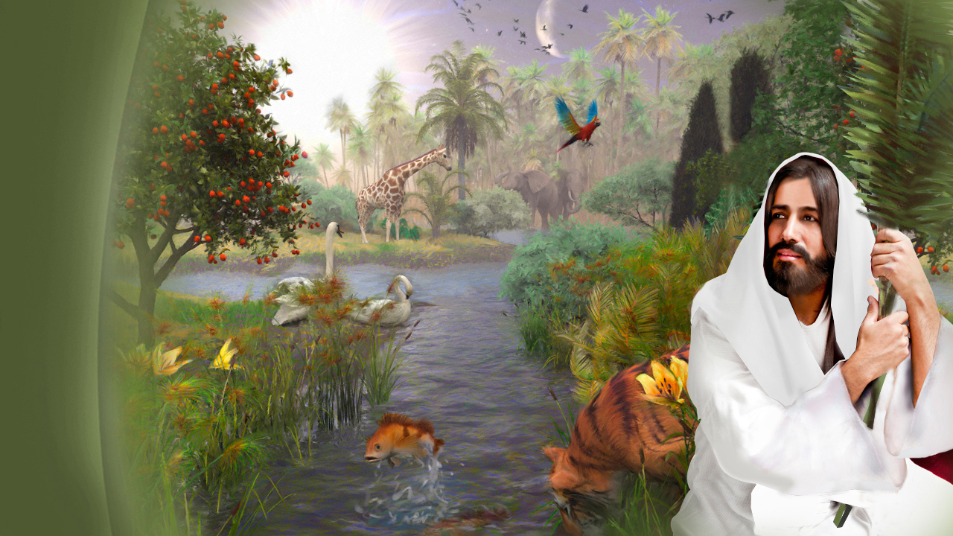
1. He rested upon it.
2. He blessed it.
3. He sanctified it.
Notes:
God did three things upon the seventh-day Sabbath:
He rested upon it, giving the example forAdam and his family to follow.
He blessed it, blessing it forever.
He sanctified it, setting it aside for Adam and all his family to come to have special time with God.

Slide 22
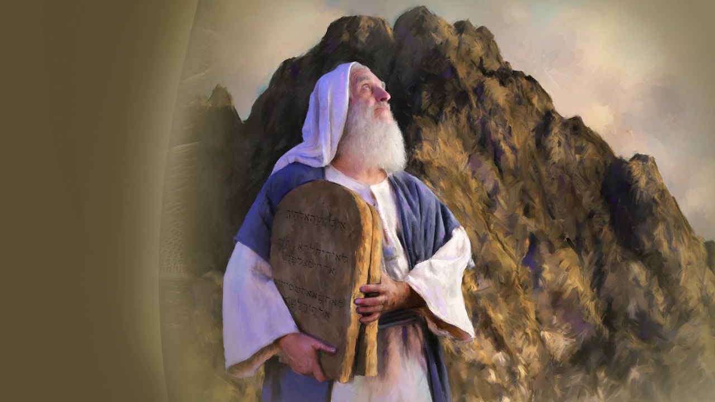
Long before
the Exodus
Notes:
So, you see, the Sabbath, the 7th day, was made in the beginning by God and which time was set aside for holy use by all mankind in honour of God their Creator. God’s Law has existed from Eternity, and later, after sin had so degraded mankind into forgetfulness of their Creator, that God personally came down upon Mt Sinai, both speaking and writing His Law on Tablets of Stone with His own Finger. Of this commandment, we read …

Slide 23
Exodus 20:8-11
“Remember the Sabbath day, to keep it holy. Six days you shall labor and do all your work, but the seventh day is the Sabbath of the Lord your God. …”
Notes:
… in Exodus 20:8-11,
“Remember the Sabbath day, to keep it holy. Six days you shall labor and do all your work, but the seventh day is the Sabbath of the Lord your God. …”

Slide 24
Exodus 20:8-11
“… In it you shall do no work: you, nor your son, nor your daughter, nor your male servant, nor your female servant, nor your cattle, nor your stranger who is within your gates. …”
Notes:
“… In it you shall do no work: you, nor your son, nor your daughter, nor your male servant, nor your female servant, nor your cattle, nor your stranger who is within your gates. …”

Slide 25
Exodus 20:8-11
“… For in six days the Lord made the heavens and the earth, the sea, and all that is in them, and rested the seventh day. …”
Notes:
“… For in six days the Lord made the heavens and the earth, the sea, and all that is in them, and rested the seventh day….” notice that the text says that the seventh day is the sabbath of the lord. It doesn’t say sabbath of the jews, or of the adventists….it says it is the LORDS OWN Sabbath

Slide 26
Exodus 20:8-11
“… Therefore the Lord blessed the Sabbath day and hallowed it.”
Notes:
“… Therefore the Lord blessed the Sabbath day and hallowed it.”

Slide 27
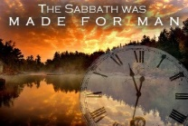
Notes:
God asks man to remember Him, the Creator, and to rest as He did in the seventh-day the Sabbath. It is an eternal memorial of Creation, and later we will see it also as a memorial of Redemption. An event that is locked in time, as a birthday or anniversary, and this special occasion was for everyone! …

Slide 28
Isaiah 58:6, 7,
“… Everyone who keeps from defiling the Sabbath… I will bring to My holy mountain, and make them joyful in My house of prayer… For My house shall be called a house of prayer for all nations.”
Notes:
… as we read in Isaiah 58:6, 7,
“… Everyone who keeps from defiling the Sabbath… I will bring to My holy mountain, and make them joyful in My house of prayer… For My house shall be called a house of prayer for all nations.”

Slide 29
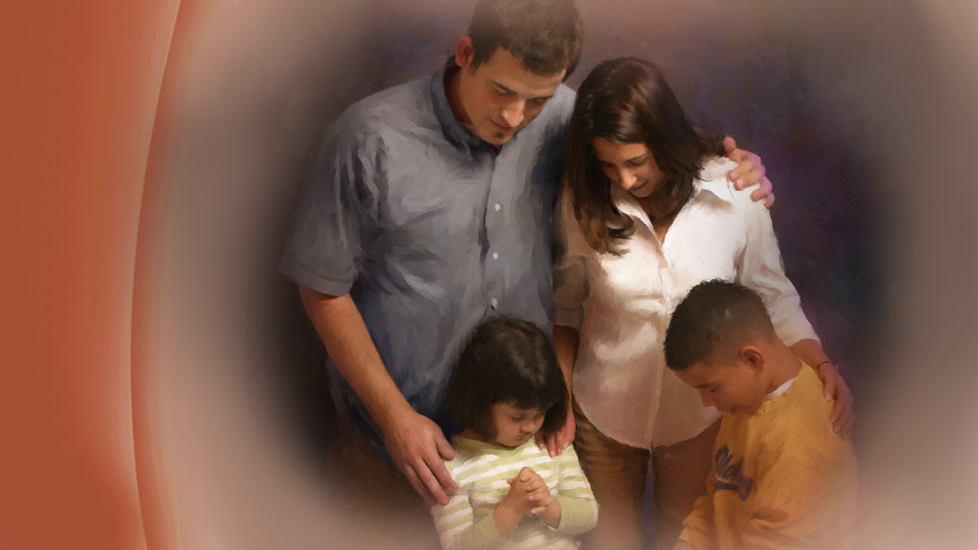
A day for all
Notes:
Some have thought that the Sabbath was only for “the Jews”, but this is never found in scripture, but instead we see that Jesus taught that it was a day for all mankind when He said …

Slide 30
Mark 2:27
“… The Sabbath was made for man, and not man for the Sabbath.”
Notes:
… in Mark 2:27,
“… The Sabbath was made for man, and not man for the Sabbath.”

Slide 31
Exodus 20:10
“…the seventh day is the Sabbath of the Lord your God.”
Notes:
… for in Exodus 20:10, we see that,
“…the seventh day is the Sabbath of the Lord your God.”

Slide 32
Isaiah 58:13
“… My [God’s] holy day … ”
Notes:
… in Isaiah 58:13, states that the 7th day the Sabbath is:
“My holy day.”

Slide 33
Matthew 12:8
“… Lord even of the Sabbath day.”
Notes:
.. For Jesus also said, in Matthew 12:8, the he is…
“… Lord even of the Sabbath.”

Slide 34
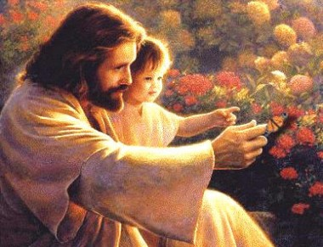
A sign between God and man
Notes:
The Sabbath is more than a memorial of creation and the Creator, it is a sign between God and man. …

Slide 35
Ezekiel 20:12
“Moreover I also gave them My Sabbaths, to be a sign between them and Me, that they might know that I am the Lord who sanctifies them.”
Notes:
… as we read in Ezekiel 20:12,
“Moreover I also gave them My Sabbaths, to be a sign between them and Me, that they might know that I am the Lord who sanctifies them.”

Slide 36
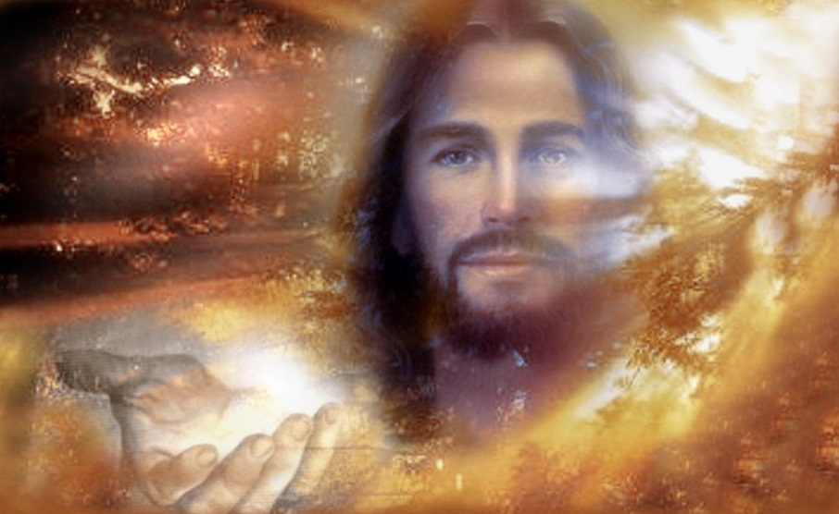
Our Creator is also our Savior
Notes:
The One who made the Sabbath holy during creation week is the same One who makes sinful people holy. This also requires creative power. Our Creator is also our Savior.

Slide 37
The Sabbath
forever
Notes:
To observe the Sabbath is our way of telling the world that the Lord is our Creator and God. The Sabbath was made and celebrated before sin of mankind, and the Sabbath will also be celebrated by recreated mankind after sin is forever banished from the universe. …

Slide 38
Isaiah 66:22, 23
“For as the new heavens and the new earth which I will make shall remain before Me, says the Lord, so shall your descendants and your name remain... ”
Notes:
… as Isaiah 66:22, 23 says:
“For as the new heavens and the new earth which I will make shall remain before Me, says the Lord, so shall your descendants and your name remain. …”

Slide 39
Isaiah 66:22, 23
“… And it shall come to pass that from one New Moon to another, and from one Sabbath to another, all flesh shall come to worship before Me, says the Lord.”
Notes:
“… And it shall come to pass that from one New Moon to another, and from one Sabbath to another, all flesh shall come to worship before Me, says the Lord.”

Slide 40
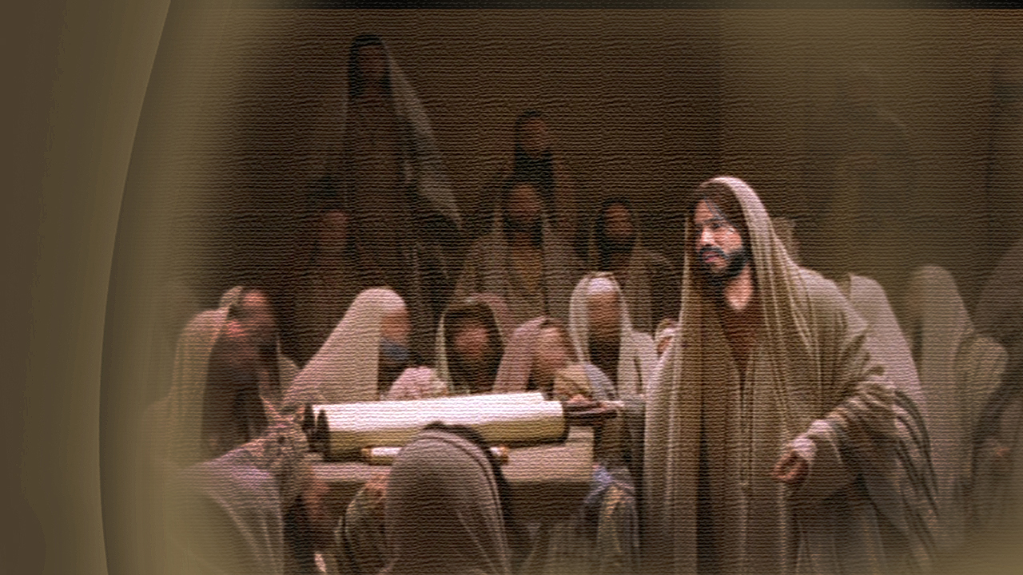
... As His continual practice was...
Notes:
If we have any questions about God and the 7th day, the Sabbath, we may look to Jesus, as our example of perfect obedient humanity, for He never sinned. …

Slide 41
Luke 4:16
“So He came to Nazareth, where He had been brought up. And as His continual practice was, He went into the synagogue on the Sabbath day, and stood up to read.”
Notes:
… in Luke 4:16 we read,
“So He came to Nazareth, where He had been brought up. And as His continual practice was, He went into the synagogue on the Sabbath day, and stood up to read.”

Slide 42
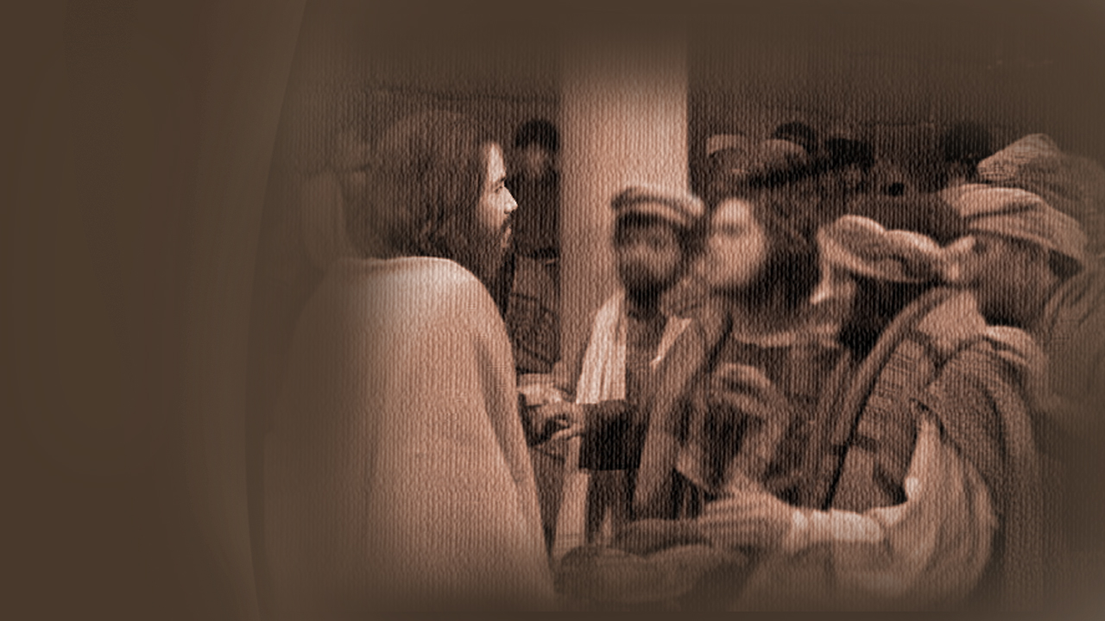
Go to the
Synagogue
(the place of gathering)
on Sabbath
Notes:
The Bible says it was Jesus’ custom to go to the synagogue, or the place of gathering of God’s people on the Sabbath. The purpose in so doing was to read the word of God together, study prophecy, as Jesus did, reading from Isaiah 61, obey His Father in His commandments, and also to fellowship with believers and preach the Everlasting Gospel.

Slide 43
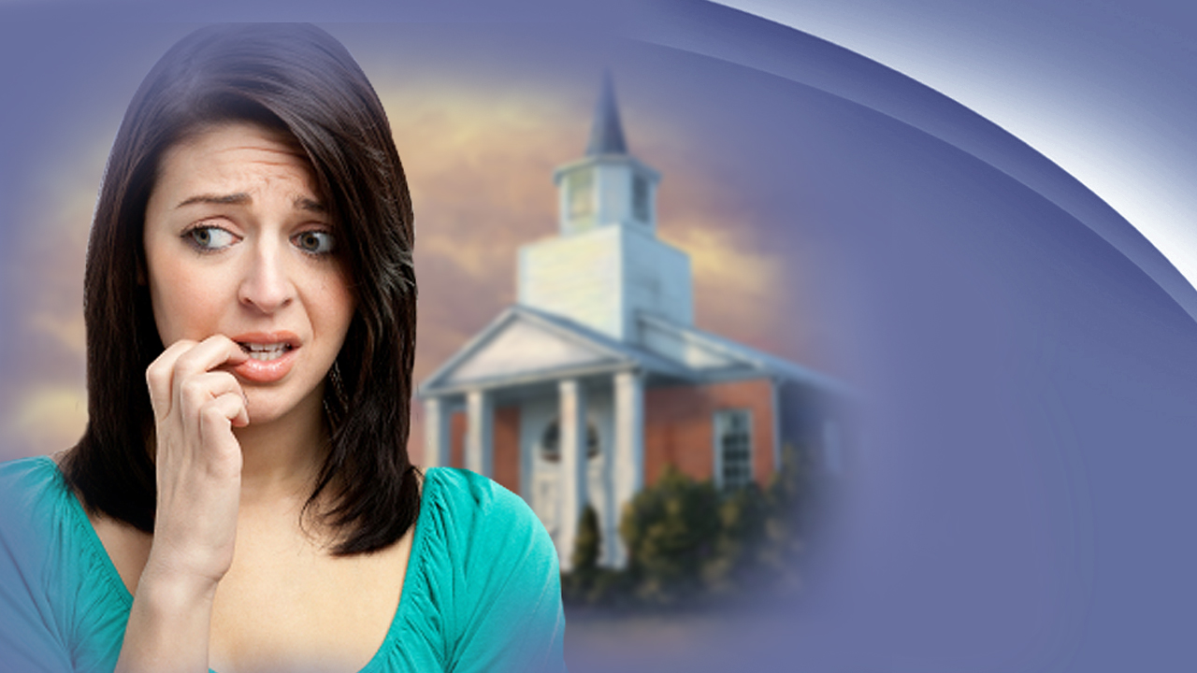
Which day is the Sabbath?
Notes:
But, you say, which day is the Sabbath? How can we be certain which day is the seventh? Jesus knew the right day, kept it, and never sinned, not transgressing His Father’s commandment even once. The Apostles and disciples knew what day the 7th day is, and continued to keep this day long after Jesus ascended back to heaven, both Jews and Gentiles.

Slide 44
Luke 23:54-56
“That day was the Preparation, and the Sabbath drew near. And the women who had come with Him from Galilee followed after,...”
Notes:
… in Luke 23:54-56, we read:
“That day was the Preparation, and the Sabbath drew near. And the women who had come with Him from Galilee followed after,…”

Slide 45
Luke 23:54-56
“...and they observed the tomb and how His body was laid. Then they returned … And they rested on the Sabbath according to the commandment [of Exodus 20].”
Notes:
“…and they observed the tomb and how His body was laid. Then they returned … And they rested on the Sabbath according to the commandment [of Exodus 20].”

Slide 46
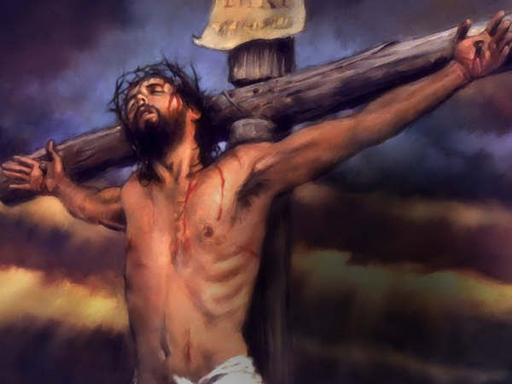
Jesus died on the cross at Calvary,
on the 6th day
Notes:
The day before the Sabbath the disciples witnessed Jesus dying a cruel death on the cross. Solemnly they buried him, and went home to keep the Sabbath, and rested all the 7th day. After the Sabbath was over, the women disciples returned on the first day of the week, and found something amazing …

Slide 47
Luke 24:1-2
“Now on the first day of the week, very early in the morning, they, and certain other women with them, came to the tomb … And they found the stone rolled away …”
Notes:
… in Luke 24:1,
“Now on the first day of the week, very early in the morning, they, and certain other women with them, came to the tomb … And they found the stone rolled away …”

Slide 48
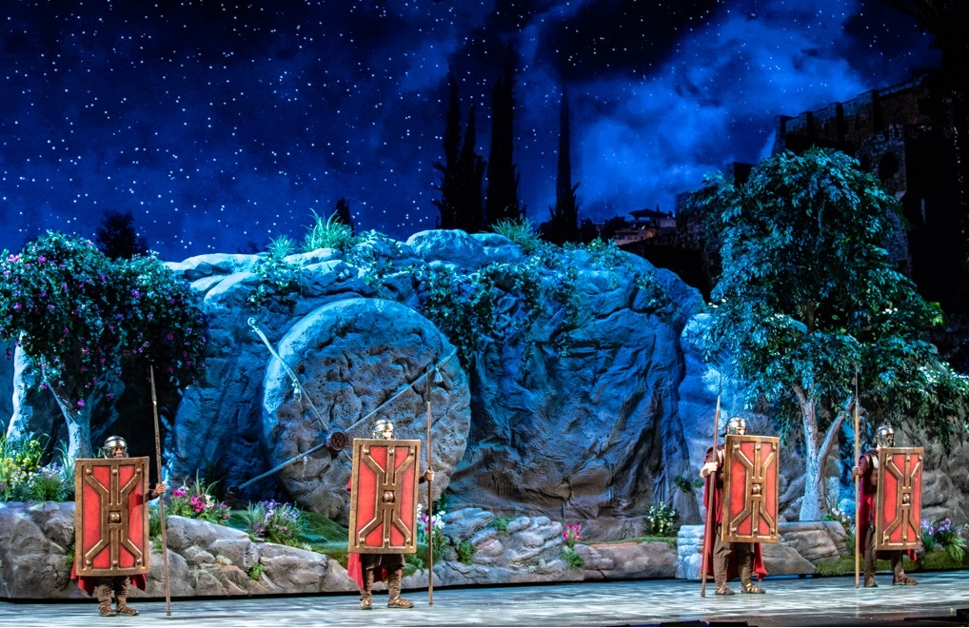
Jesus remained in the tomb on the 7th day, resting according to the commandment (Exodus 20:8-11)
Notes:
Jesus remained in the tomb on the 7th day, the sabbath, resting according to the commandment (Exodus 20:8-11).

Slide 49
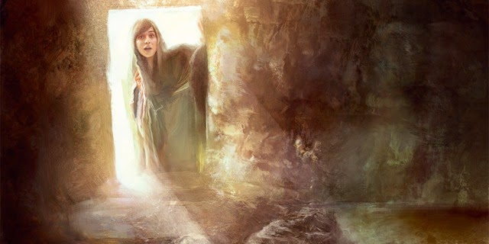
On the first
day of the week
Jesus is RISEN!
Notes:
On the 1st day of the week, the women disciples returned and found the stone rolled away from the tomb and Jesus arisen and alive!

Slide 50
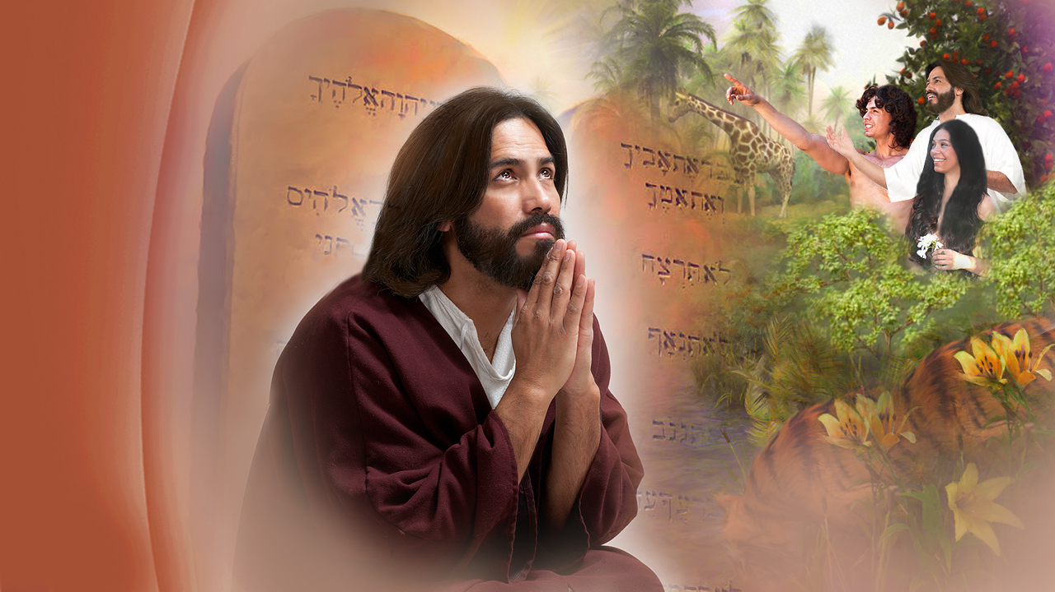
Still be keeping the Sabbath
Notes:
Jesus expected that the Christians, even in A.D. 70, when Jerusalem was destroyed, would still be keeping the His Sabbath Holy …

Slide 51
Matthew 24:20
“And pray that your flight may not be … on the Sabbath.”
Notes:
… as we read in Matthew 24:20,
“And pray that your flight may not be … on the Sabbath.”

Slide 52
Acts 17:1, 2
“…they came to Thessalonica, where there was a synagogue of the Jews. Then Paul, as his continual practice was,...”
Notes:
The disciples of Jesus, who became known as the Christians at Antioch, continued to keep God’s commandments and follow the example set forth by Jesus, the only person among mankind who was sinless, as we read in Acts 17:1, 2,
“… they came to Thessalonica, where there was a synagogue of the Jews. Then Paul, as his continual practice was,…”

Slide 53
Acts 17:1, 2
“…went in to them, and for three Sabbaths reasoned with them from the Scriptures.”
Notes:
“…went in to them, and for three Sabbaths reasoned with them from the Scriptures.”

Slide 54
Acts 13:42, 44
“The Gentiles begged that these words might be preached to them the next Sabbath… On the next Sabbath almost the whole city came together to hear the word of God. ”
Notes:
… and further in Acts 13:42, 44, we read of a whole city, Jews and Gentiles coming together on the 7th day, to hear the word of God:
“The Gentiles begged that these words might be preached to them the next Sabbath… On the next Sabbath almost the whole city came together to hear the word of God.”

Slide 55
Hebrews 4:9
“So there remains a Sabbath-keeping for God’s people.”
Notes:
… as it is written in Hebrews 4:9,
“So there remains a Sabbath-keeping for God’s people.”

Slide 56
A golden thread
Notes:
Yes, the Sabbath runs like a golden thread from Genesis to Revelation. The Book of Revelation describes those who are prepared to meet Jesus when He comes …

Slide 57
Revelation 14:12
“Here is the patience of the saints; here are those who keep the commandments of God and the faith of Jesus.”
Notes:
… in Revelation 14:12 we read:
“Here is the patience of the saints; here are those who keep the commandments of God and the faith of Jesus.”

Slide 58
John 14:15 (Exodus 20:6)
“If you love Me, keep My commandments.”
Notes:
Jesus, citing Exodus 20:6, said in John 14:15,
“If you love Me, keep My commandments.”

Slide 59
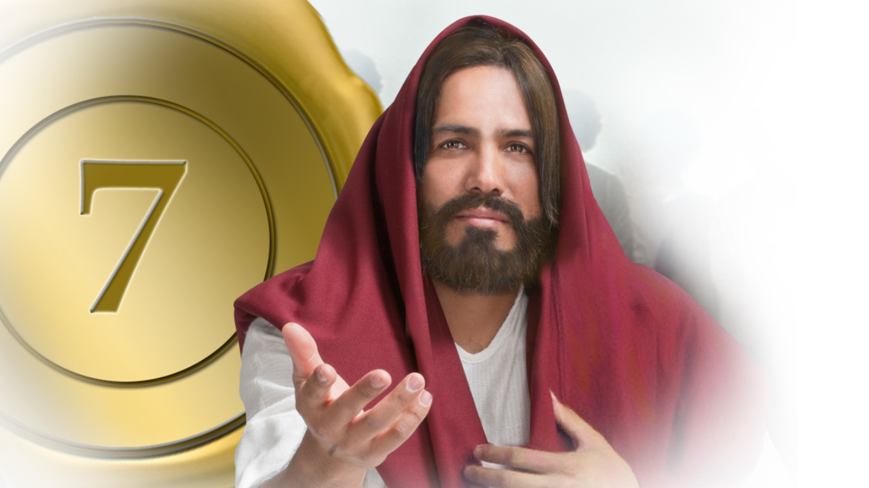
Follow me
Notes:
The same Jesus who asked you to “remember,” stretches out His hands to you, hands once nailed to the cross of Calvary for your sins, and gently calls, “FOLLOW ME.” Won’t you decide today to follow your Savior in keeping the commandments of God? For we are about to find out in prophecy that there are others who do not keep the commandments of God and claim to follow Jesus.

Slide 60
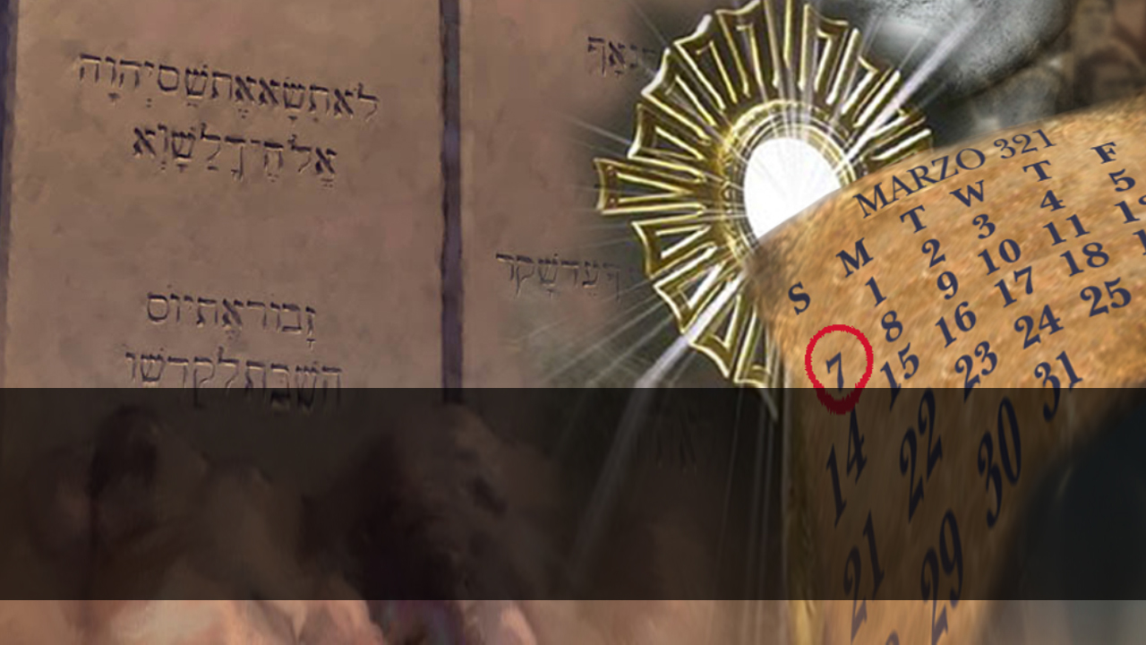
TAMPERING WITH HEAVEN’S CONSTITUTION
Notes:
Now that we understand God’s Holy Day, the 7th Day the Sabbath, let’s consider the prophecy which foretold that there would come a time when it would be tampered with.

Slide 61
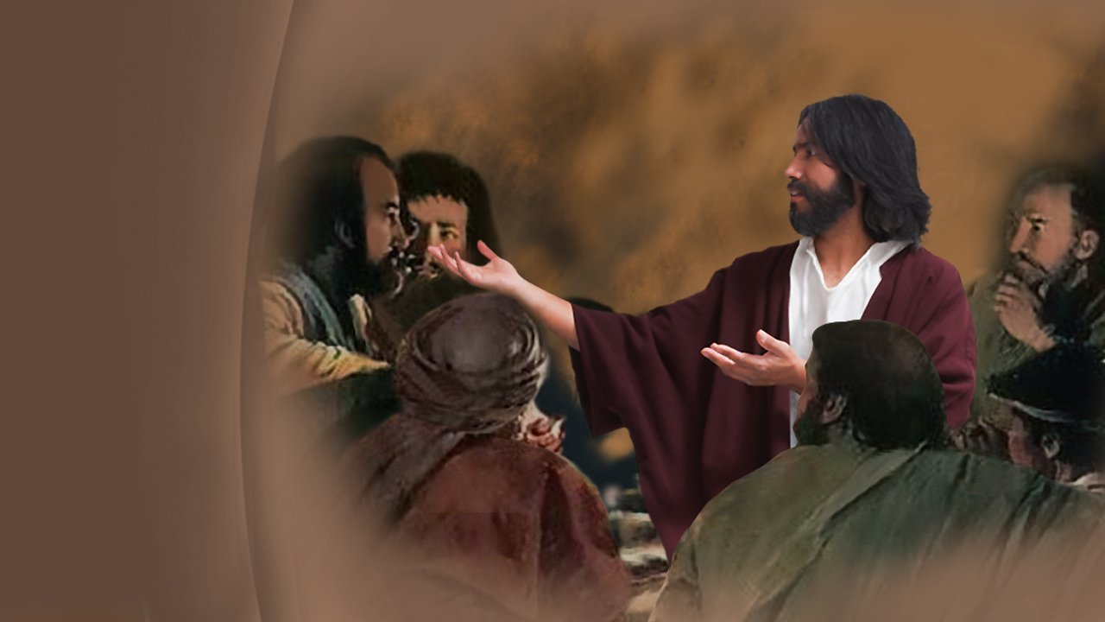
Daniel’s prophecies
Notes:
An understanding of God’s truth for Earth’s last hour demands study. The prophecies of Daniel and Revelation apply with particular force in our day. Jesus quoted the prophecies of Daniel and personally commanded that His disciples study them. The Bible tells us …

Slide 62
2 Timothy 2:15
“Study to shew thyself approved unto God, a workman that needeth not to be ashamed, rightly dividing the word of truth.”
Notes:
… in 2 Timothy 2:15,
“Study to shew thyself approved unto God, a workman that needeth not to be ashamed, rightly dividing the word of truth.”

Slide 63
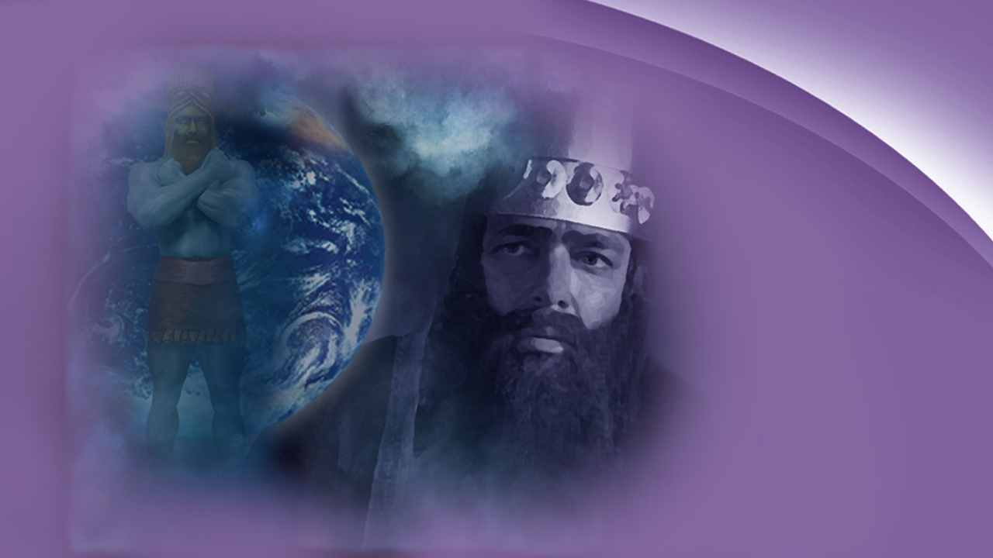
Daniel 2, 7, 8, 11
Notes:
In the book of Daniel, specifically chapters 2, 7, 8, and 11 there are prophecies that cover the same history, that is from the time of Babylon to the second coming of Jesus, through differing symbols.

Slide 64
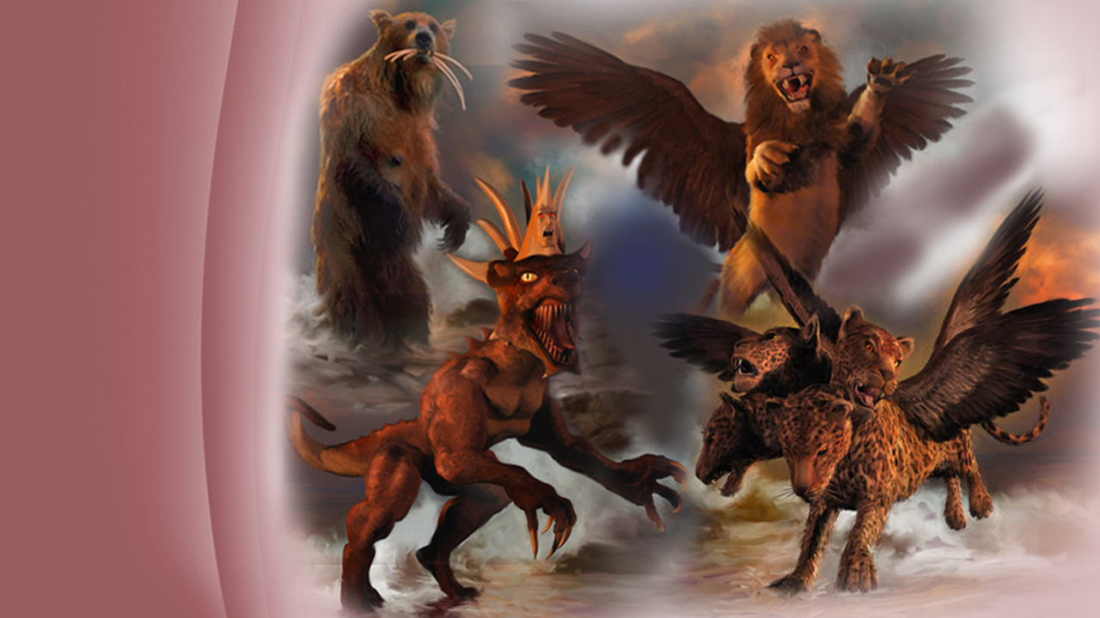
Prophetic
symbols
Notes:
In Daniel 7, we see four beasts rise up out of the wind-tossed sea,
a Lion with eagles wings,
a Bear raised up with three ribs in its mouth,
a Leopard with four heads and four wings
and the fourth beast dreadful and terrible having iron teeth and ten horns.
We are told in the Bible what these are …

Slide 65
Revelation 17:15
“The waters which you saw… are peoples, multitudes, nations, and tongues.”
Notes:
… in Revelation 17:15 we read:
“The waters which you saw… are peoples, multitudes, nations, and tongues.”

Slide 66
Daniel 7:17
“Those great beasts, which are four, are four kings which arise out of the earth.”
Notes:
… and in Daniel 7:17, we read that,
“Those great beasts, which are four, are four kings which arise out of the earth.”
These are the exact same kingdoms as portrayed in King Nebuchadnezzar’s dream in Daniel 2.

Slide 67
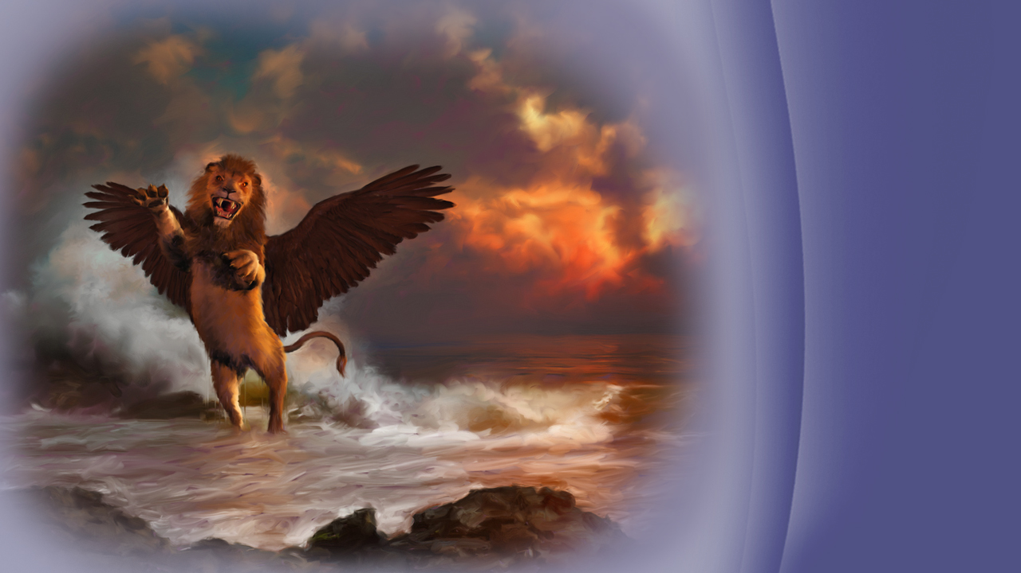
Babylon
Notes:
1. The lion with eagle’s wings, like the gold Head in the image of Daniel 2, represented the kingdom of Babylon.

Slide 68
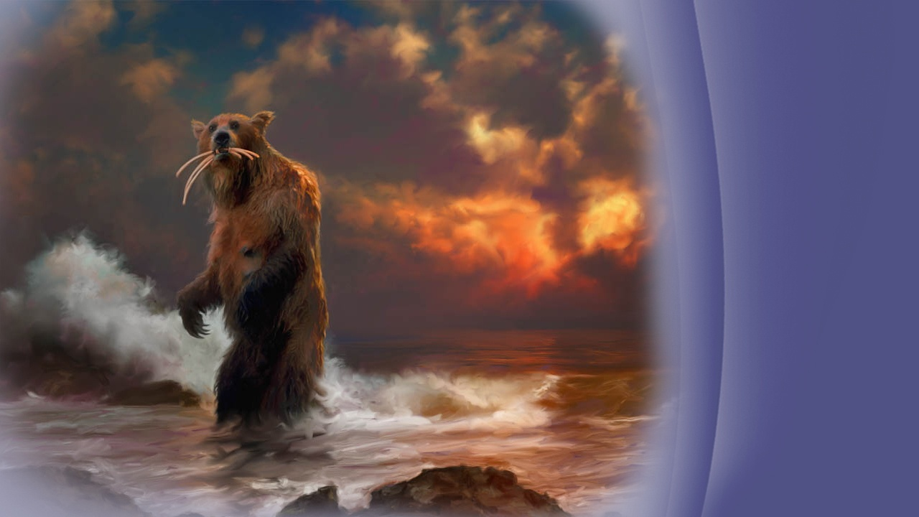
Medo-Persia,
Conquered,
Lydia
Babylon
Egypt
Notes:
2. The bear raised up, like unto the chest and arms of silver in Daniel 2, represented Medo-Persia, while the conquered remains of other nations, Lydia, Babylon and Egypt, were represented by the ribs in its mouth.

Slide 69
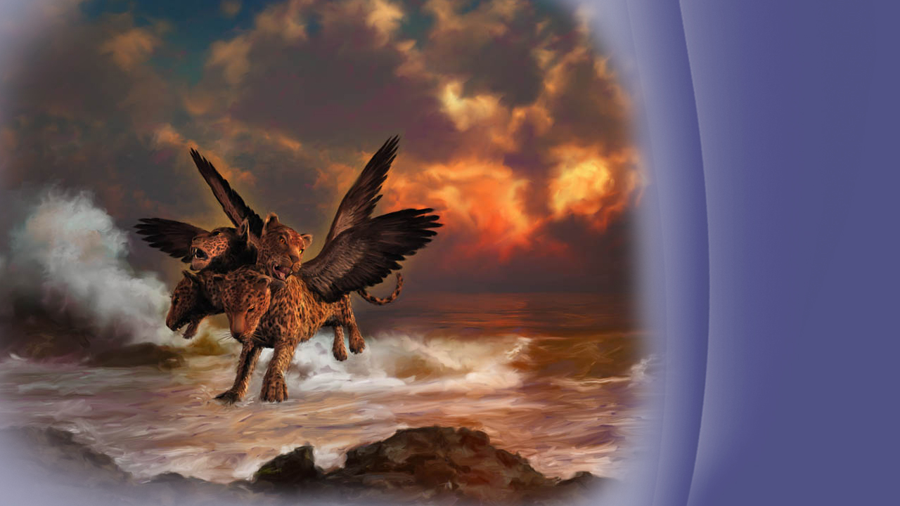
The Grecians conquer by Alexander the Great, but then comes division after his death
Notes:
The Leopard with 4 heads and 4 wings, like the belly and thighs of brass or bronze, represented the Kingdom of the Greecians as originally led by Alexander the Great. It would conquer swiftly and stealthily, but ultimately come to be ruled by Greek kings who were divided. The four heads are representative of the dynasties of:
Lysimachus (Lie-sim-uh-cuss)
Cassander (Kass-and-er)
Ptolemy (Toe-Lah-Me)
Seleucus (Sell-Lou-cuss)

Slide 70
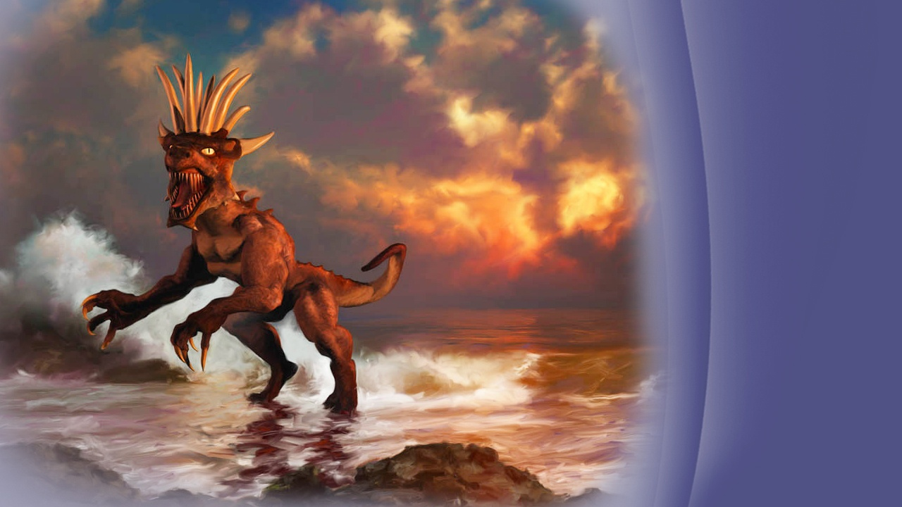
Rome
Notes:
4. The dreadful and Terrible Beast with Iron teeth and Ten Horns, like unto the legs of Iron of Daniel 2, represented the Roman Empire, and the ten horns it’s division into smaller portions after 476 A.D.

Slide 71
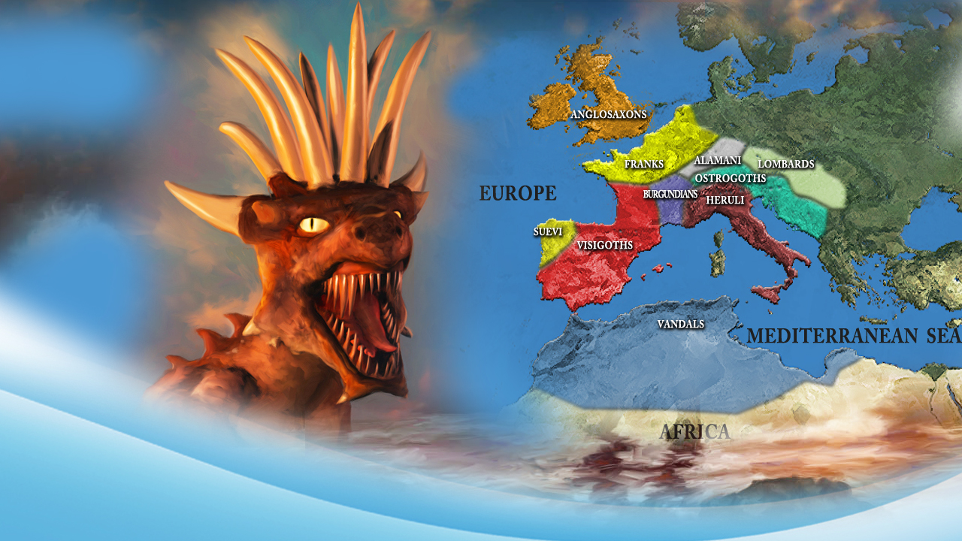
Ten horns = divided Roman Empire
Notes:
These divisions of the Roman Empire laid down the foundations of the modern European nations. However, there was prophesied another kingdom that would arise in the midst of them, one that would seek to change God’s holy Law, while claiming to honour God in them.

Slide 72
Daniel 7:8
“I was considering the horns, and there was another horn, a little one, coming up among them, before whom three of the first horns…”
Notes:
… in Daniel 7:8 we read:
“I was considering the horns, and there was another horn, a little one, coming up among them, before whom three of the first horns…”

Slide 73
Daniel 7:8
“…were plucked out by the roots. And there, in this horn, were eyes like the eyes of a man,…”
Notes:
“…were plucked out by the roots. And there, in this horn, were eyes like the eyes of a man,…”

Slide 74
Daniel 7:8, 24
“…and a mouth speaking pompous words. … And…he shall be different from the first ones, and shall subdue three kings.”
Notes:
“…and a mouth speaking pompous words…And… he shall be different from the first ones, and shall subdue three kings.”

Slide 75
Daniel 8
Notes:
Likewise, in Daniel 8, another vision is given to Daniel which reveals the little horn growing and becoming “exceedingly great,” and it would …

Slide 76
Daniel 8:12
“...cast truth down to the ground. He did all this and prospered.”
Notes:
… as we read in Daniel 8:12,
“Cast truth down to the ground. He did all this and prospered.”

Slide 77
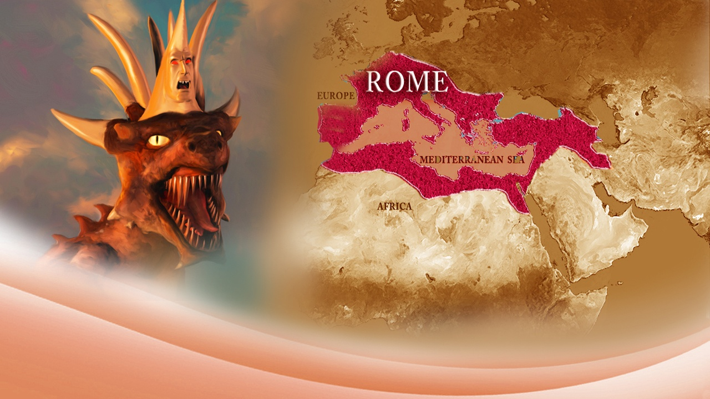
Identifying the Little Horn Power
Notes:
Let’s gather the identifying marks of this “little horn”, for it is the prominent power that affects God’s people in the last days.
1. It came up among the ten horns. That is, it would arise in the divided Roman Empire, coming out of the head.

Slide 78
A.D. 476
Notes:
2. It would arise after the ten horns. This means it would arise sometime after A.D. 476.

Slide 79
Different
Notes:
3. He shall be different from the first ten horns. The first ten horns were political in nature, but the little horn is also religious in nature, seeking to change God’s times and laws.

Slide 80
Three kingdoms
Notes:
4. Three of the ten kingdoms would be displaced in its rise to power. As we read that it, “Shall subdue three kings.”

Slide 81
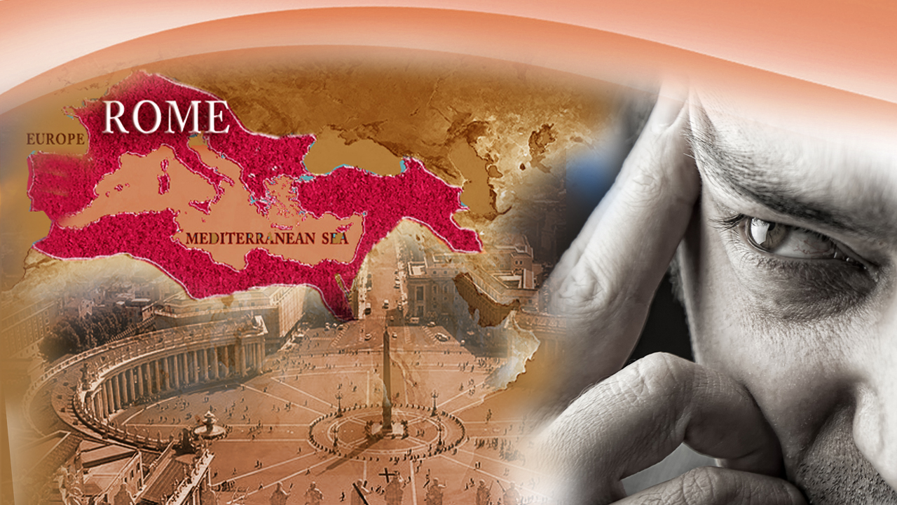
Eyes of man
Notes:
5. It would have “eyes like the eyes of man.” This horn has “eyes”, or wisdom, not of God but of man. It is guided by human intelligence, human leadership, and human authority, with a single man as a leader. It usurps God’s authority and claims to speak, with its “mouth” on behalf of God.

Slide 82
What
power it is?
Notes:
The question then is:
What power arose to prominence in the divided Roman Empire, known as Europe, around A.D. 476 by subduing three nations and was different in that it was both political and religious?

Slide 83
The papacy
Notes:
There is only one answer in all of history that fits these identifying marks, and all the others in the prophecies.
Papal Rome. Also known as the Papacy, for it is a religious - political state power. A combination of Church and State. It’s religion is Roman Catholicism.
Please keep in mind we are dealing with kingdoms as identified in prophecy.

Slide 84
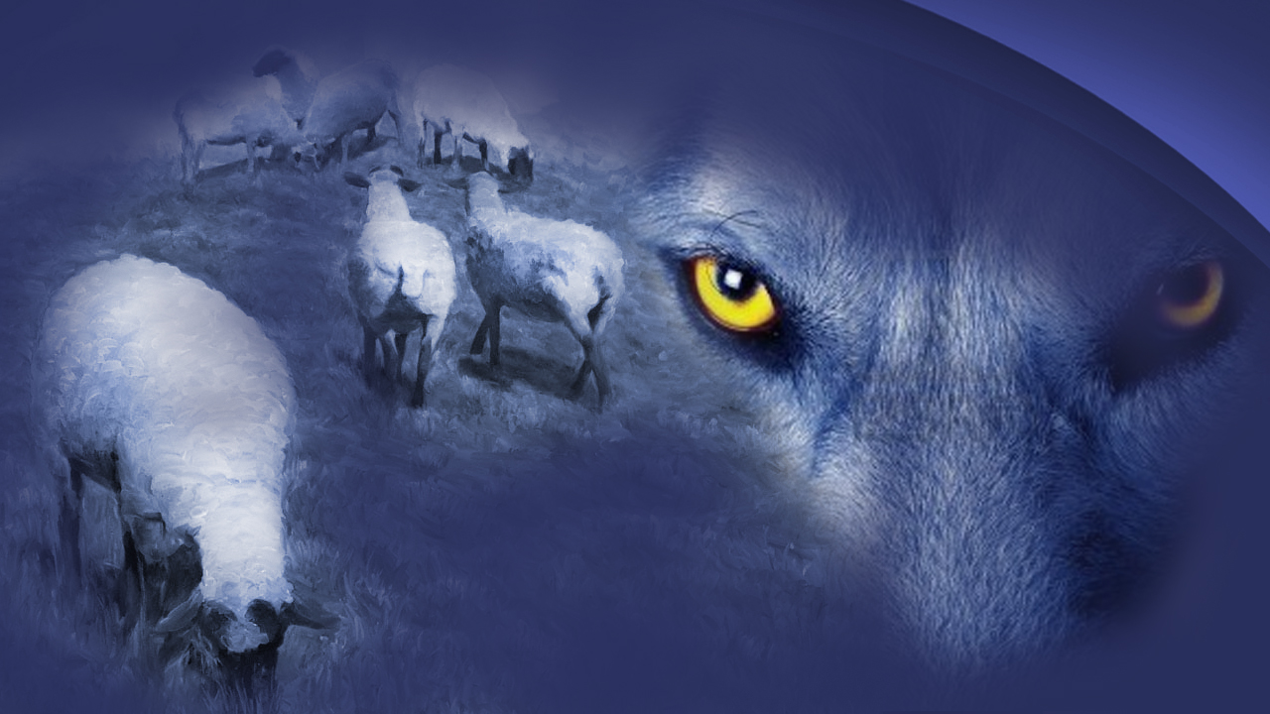
Prophecies given
by Paul
Notes:
A wolf, which was a symbol of Rome, known as the Capitoline Wolf, would be covered in sheep’s clothing , which was a symbol for the profession of Christianity.
Paul, knowing the prophecies of Daniel and personally instructed by Jesus and the Holy Spirit through visions and dreams, wrote to the elders of Ephesus …

Slide 85
Act 20:29-30
“For I know this, that after my departure savage wolves will come in among you, not sparing the flock. …”
Notes:
… in Acts 20:29-30, where we read:
“For I know this, that after my departure savage wolves will come in among you, not sparing the flock …”

Slide 86
Act 20:29-30
“… Also from among yourselves men will rise up, speaking perverse things, to draw away the disciples after themselves.”
Notes:
“… Also from among yourselves men will rise up, speaking perverse things, to draw away the disciples after themselves.”

Slide 87
2 Thessalonians 2:7
“For the mystery of lawlessness is already at work.”
Notes:
Furthermore, Paul told those in Thessalonica, in 2 Thessalonians 2:7,
“For the mystery of lawlessness is already at work.”

Slide 88
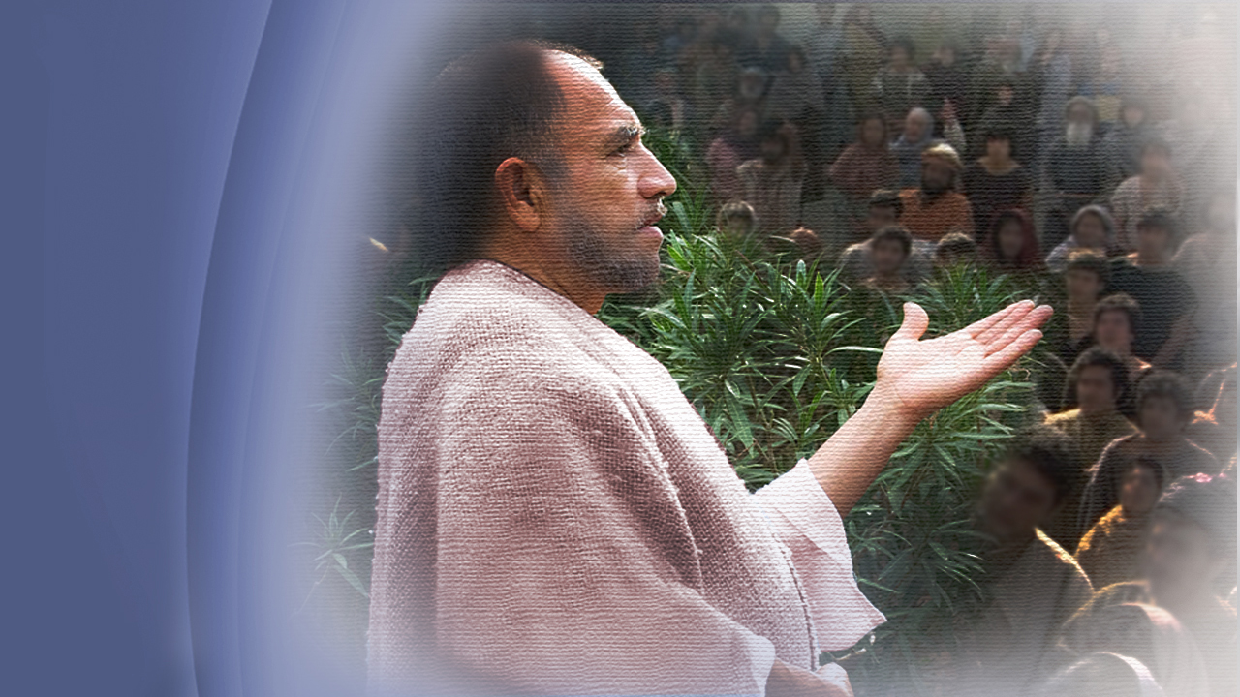
Opposition outside
Apostasy within
Departing from the Truth
Notes:
Three things troubled Paul about the future:
There would be opposition from without.
Apostasy from within.
3. Departing from the Truth

Slide 89
2 Thessalonians 2:3
“Let no one deceive you by any means; for that Day will not come unless the falling away comes first, and the man of sin is revealed, the son of perdition.”
Notes:
Again, to those in Thessalonica, we read in 2 Thessalonians 2:3,
“Let no one deceive you by any means; for that Day will not come unless the falling away comes first, and the man of sin is revealed, the son of perdition.”

Slide 90
Son of perdition
Notes:
The phrase “son of perdition” is only used twice in the New Testament.
1. It referred to Judas, a betrayer from within. This disciple claimed to follow Jesus, yet did not obey the commandments of God, but wanted Jesus to demonstrate His power politically.
2. It refers to the Kingdom we have identified, that little horn, that, like Judas, also betrays Jesus with a kiss, drawing near with their lips, but having a heart far from God and rooted in political maneuvers, transgressing God’s commandments with commandments of its own.

Slide 91
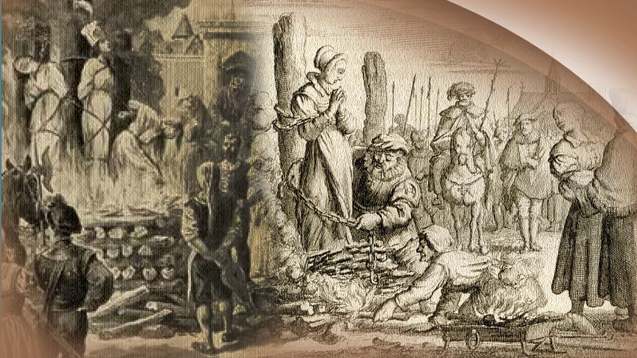
Religious
persecution
backed by
state
authority
Notes:
This apostasy from the Truth, would undermine the authority of God, and seek to change God’s times and laws. The 7th Day Sabbath of the 4th Commandment deals with both, time and law!
Not all would willingly go along with the cloaked rebellion and so, just as Jesus was persecuted, His true followers would also be persecuted for righteousness’ sake, as it is said of the little horn:
“He... shall persecute the saints of the most High.”
Religious persecution backed by state authority.

Slide 92
Revelation 14:7
“Fear God and give glory to Him, for the hour of His judgment is come; and worship Him who made heaven and earth, the sea and springs of water.”
Notes:
Yet in Revelation 14:7, we read of God calling all to worship Him in spirit and in truth, and to not partake of the rebellion, as it says:
“Fear God and give glory to Him, for the hour of His judgment has come; and worship Him who made heaven and earth, the sea and springs of water.”
That last portion is a direct citation from the Law of God, Exodus 20:11, the 4th Commandment, which deals with the 7th day the Sabbath.

Slide 93
Psalms 89:34
“My covenant I will not break, nor alter the word that has gone out of My lips.”
Notes:
God says He will not change his eternal law which He spoke aloud with His own mouth! For in Psalms 89:34 we read:
“My covenant I will not break, nor alter the word that has gone out of My lips.”
It is a written transcript of God’s own character.

Slide 94
Eternal &
Unchanging
Notes:
God’s Law, just as His own Character, is Eternal and Unchanging.
Now the question comes:
Has the Papacy, the Roman Catholic church sought to change God’s holy times and laws?
Yes and it boldly admits doing so… for now, let’s consider some general history.

Slide 95
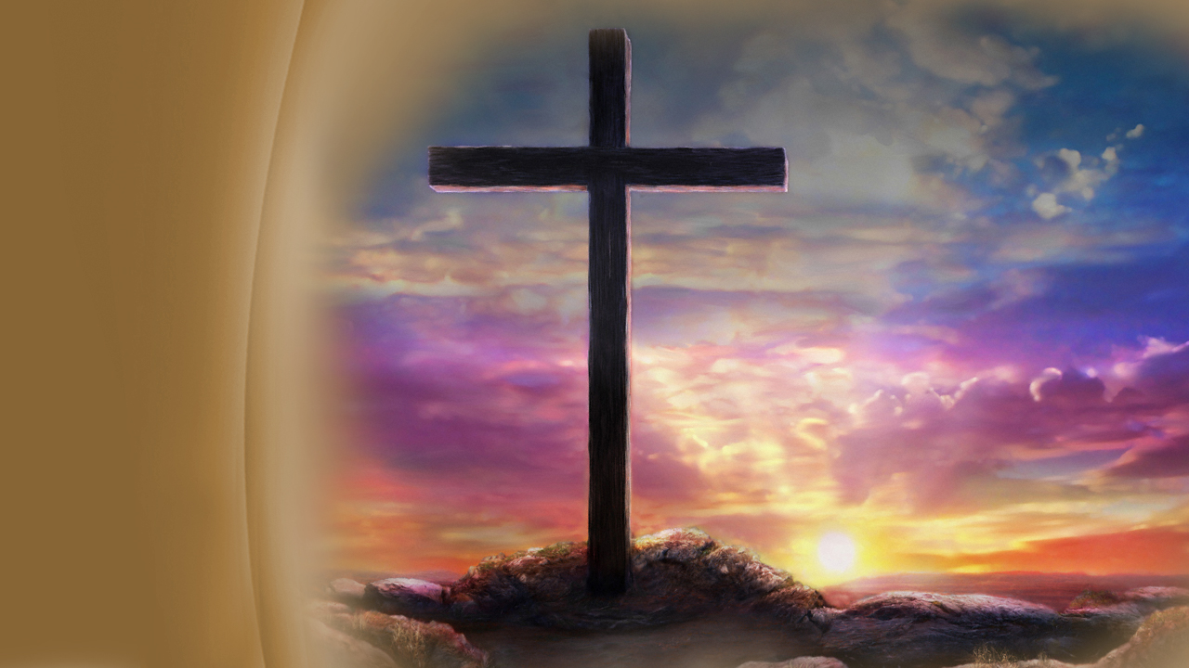
The change came slowly over time
Notes:
The change came not all at once, but slowly over time, and that, almost unable to be perceived. Immediately once persecution by the Roman Empire began, so too the falling away from the Truth.

Slide 96
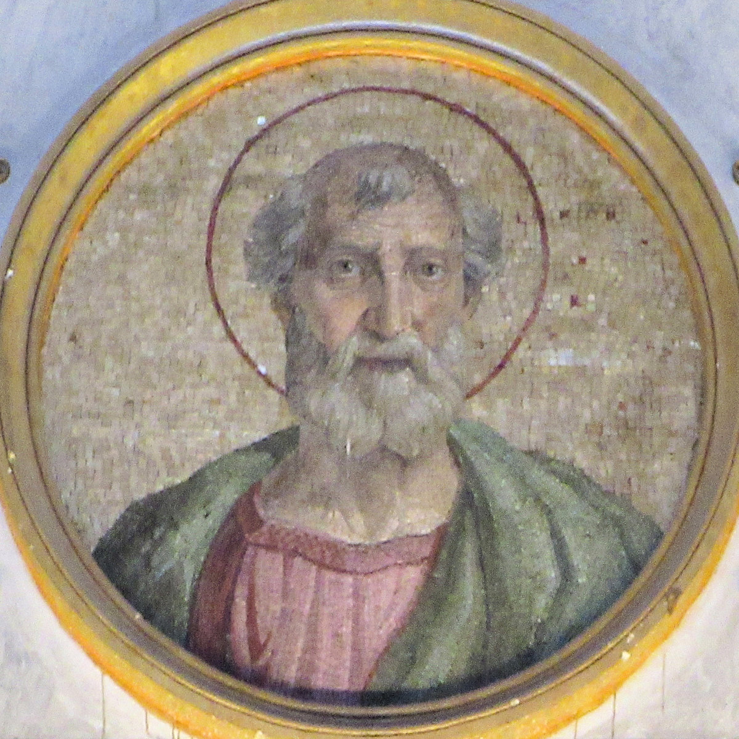
Sixtus I
Notes:
Sixtus the first, a bishop of a congregation in Rome, circa. A.D. 115, began the gradual process that ended in a transference of the day of worship. He led Christians of Rome to celebrate the resurrection, and to observe the first day of the week, then called ‘Sunday’, and not the Death of Christ, which took place on the Passover, falling on differing days of the week each year. At first it was not a weekly but rather an annual observance.

Slide 97
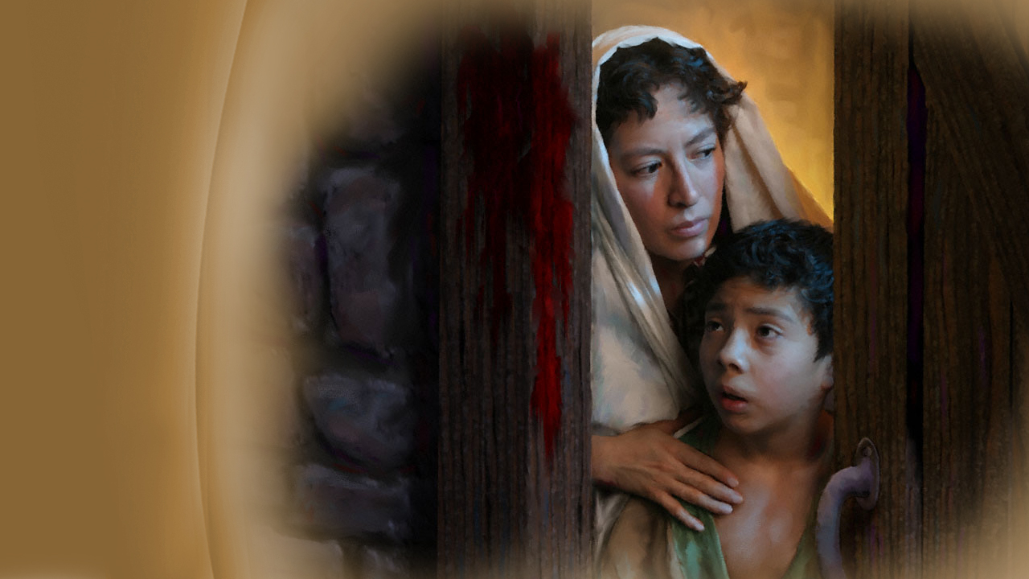
Confused
with the Jews
Notes:
The Christians in the city of Rome dreaded being confused with the religion of Judaism, which had become extremely unpopular because of a series of Jewish revolts against Roman rule. By changing this celebration to Sunday and applying it to the resurrection, they hoped to avoid persecution.

Slide 98
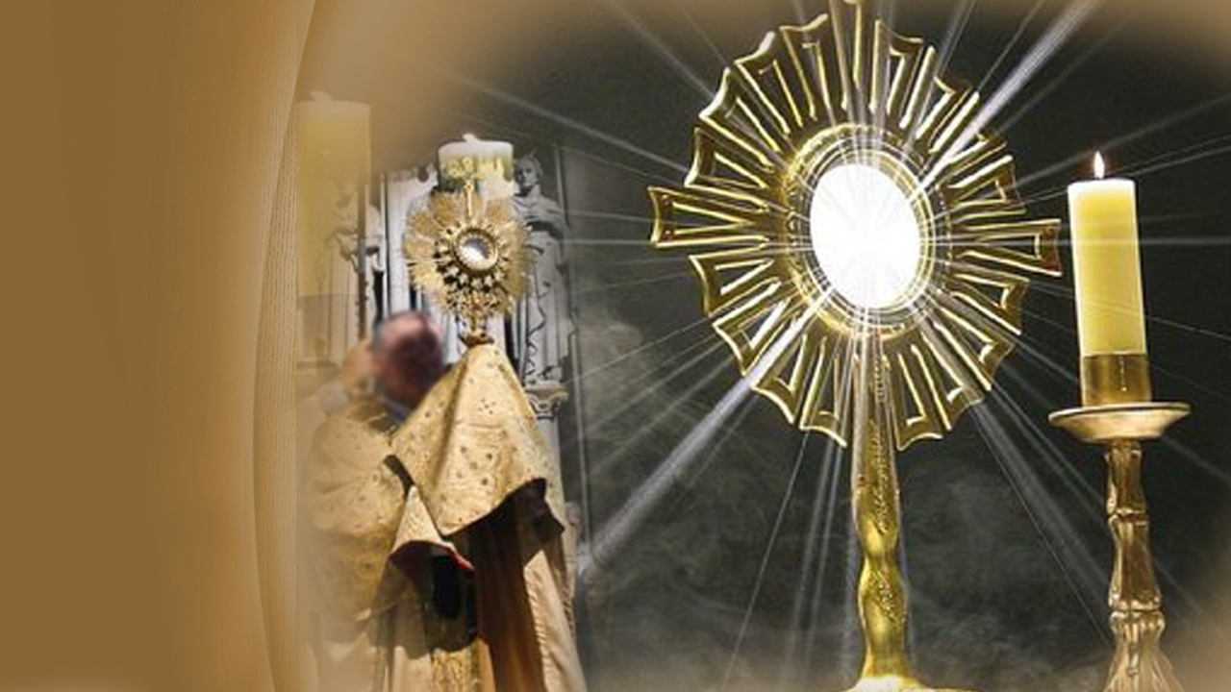
In honor of the sun
Notes:
Another interesting factor was that the first day of the week was a joyous festival in the Roman Empire in honor of the sun, and so the purpose to mix this with the resurrection day of Jesus, was to win converts from paganism to Christianity, but in actual effect, brought confusion, and falling away from the Truth.

Slide 99
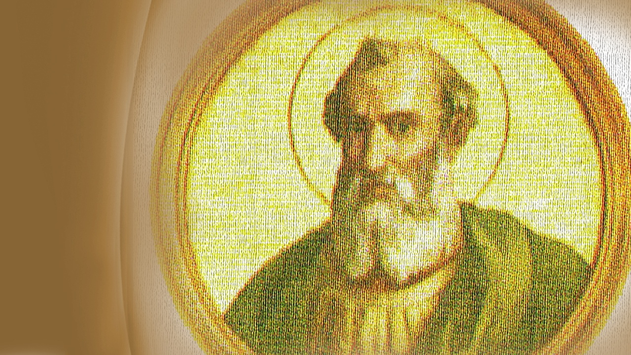
Victor I
A.D. 200
Notes:
The next important act in the drama came in A.D. 200 when Victor the first, another bishop of a Roman congregation, sought to enforce the annual observance of resurrection Sunday. He ordered all bishops excommunicated who would not follow this edict.

Slide 100
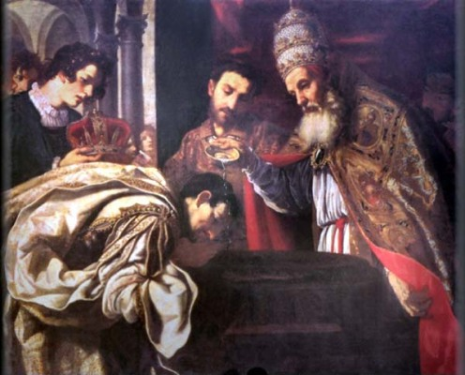
Sylvester I
circa A.D. 315-335
Notes:
Circa A.D. 315-335, Sylvester the first, yet another bishop of a congregation at Rome, decreed that the rest of the Sabbath should be transferred rather to the first day of the week, in order that on that day we should rest from worldly works for the praise of God, as opposed to the 7th day the Sabbath of the Lord. …

Slide 101
Constantine
A.D. 321
Notes:
… Then in A.D. 321 the first known state law commanding persons to rest on the first day of the week, was given by the Emperor Constantine. He had claimed to convert to Christianity after seeing a vision. We read of this law …

Slide 102
Codex Justinianus, lib. 3, tit. 12, 3 (translated)
“On the venerable Day of the Sun let the magistrates and people residing in cities rest, and let all workshops be closed...”
Notes:
… In the Codex Justinianus, liber 3, titulus 12, #3, we read, as translated into English:
“On the venerable Day of the Sun let the magistrates and people residing in cities rest, and let all workshops be closed...”

Slide 103
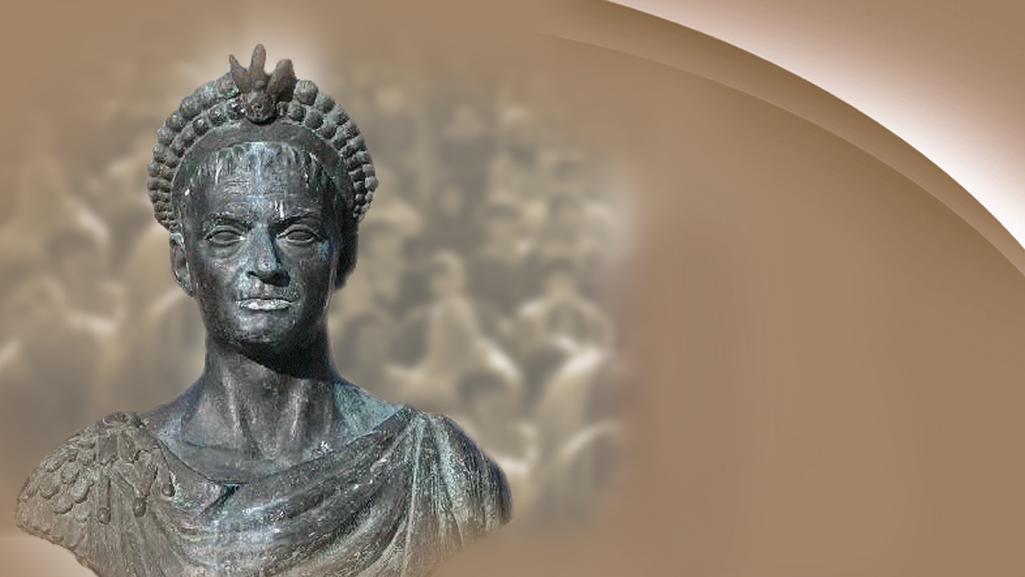
Theodosius I
A.D. 386
Notes:
As the landslide into apostasy predicted by Paul and Daniel gained momentum, so did the process of changing the times of Christian worship.

Slide 104
Theodosius I, A.D. 386
“No person shall demand payment of either a public or private debt [on Sunday].”
Notes:
In the year A.D. 386, Theodosius I forbade payment of public and private debt the first day of the week (Sunday), as we read:
“No person shall demand payment of either a public or private debt [on Sunday].”
This is still practiced in many places all over the globe.

Slide 105
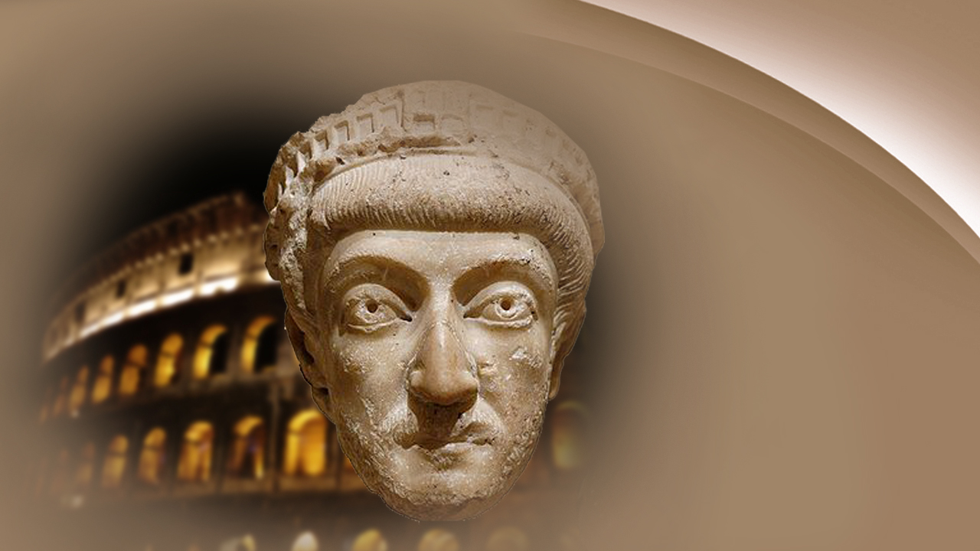
Theodosius II, A.D. 425
Notes:
Theodosius II, in the year A.D. 425, turned his attention to the sporting activities of his people and forbade all amusements, both circuses and theaters, on the first day of the week (Sundays).
Thus we can see, by this brief look into history, that the solemnity of the 7th day the Sabbath was changed to the first day of the week (aka: Sunday) by gradual process over several centuries, by persons who professed to follow Jesus Christ.

Slide 106
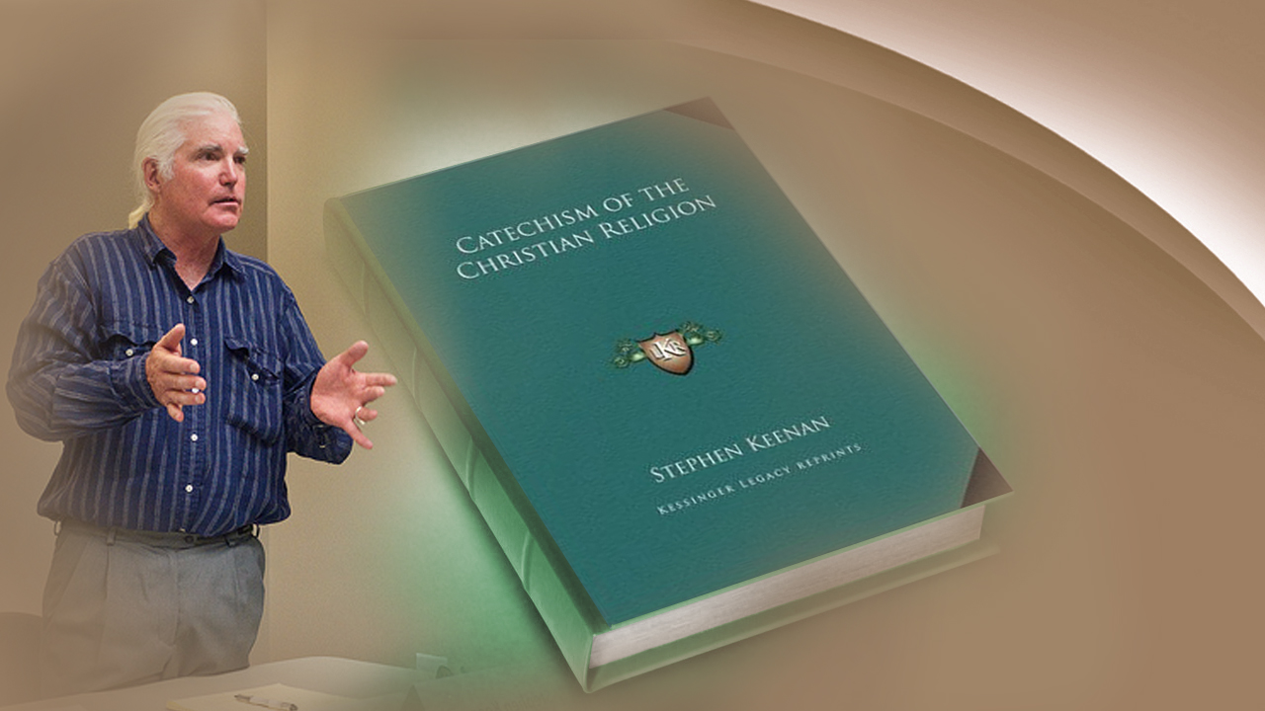
From
Roman
Catholic writings
Notes:
Examples of this thought are found in the following statements taken from officially sanctioned Roman Catholic writings.

Slide 107
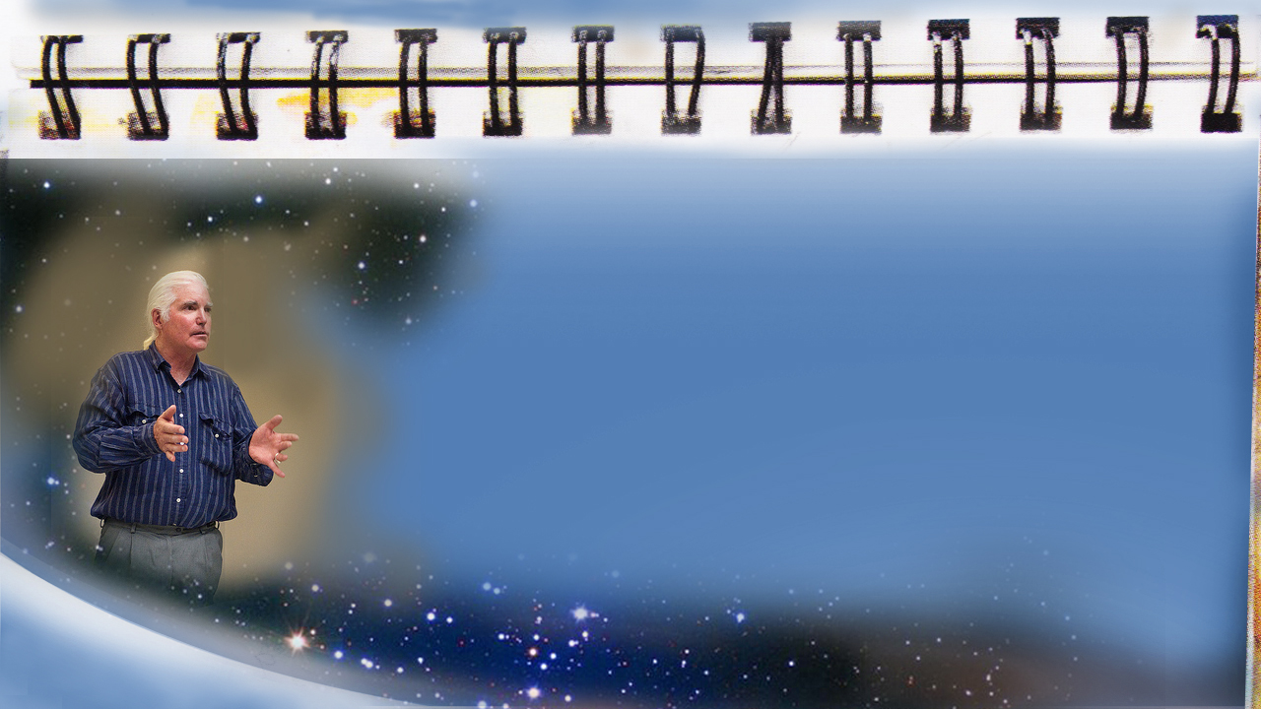
Stephen Keenan, A Doctrinal Catechism, p. 174.
Q.: “Have you any other way of proving that the church has power to institute festivals of precept? …”
Notes:
For instance, In Stephen Keenan’s, A Doctrinal Catechism, p. 174, we read:
Question: “Have you any other way of proving that the church has power to institute festivals of precept? …”

Slide 108
Stephen Keenan, A Doctrinal Catechism, p. 174.
“… A.: “Had she not such power, she could not have done that in which all modem religionists agree with her—...”
Notes:
“… Answer: “Had she not such power, she could not have done that in which all modem religionists agree with her—…”

Slide 109
Stephen Keenan, A Doctrinal Catechism, p. 174.
“…she could not have substituted… the observance of Sunday the first day of the week,...”
Notes:
“…she could not have substituted… the observance of Sunday the first day of the week,…”

Slide 110
Stephen Keenan, A Doctrinal Catechism, p. 174.
“…for the observance of Saturday the seventh day, a change for which there is no Scriptural authority.”
Notes:
“…for the observance of Saturday the seventh day, a change for which there is no Scriptural authority.”
Friends, this is entirely clear. God through the prophet Daniel predicted the change, and the Papacy admits doing the very thing foretold.
In fact, she proudly points to this change as a proof of her power in all matters of faith and practice.

Slide 111
A proof of her power
Notes:
And so it is very much more than a matter of a day, the First or the Seventh.
It becomes a matter of who we actually obey, honour and worship. God or man.

Slide 112
Romans 6:16
“Know ye not, that to whom ye yield yourselves servants to obey, his servants ye are to whom ye obey; whether of sin unto death, or of obedience unto righteousness?”
Notes:
In Romans 6:16 we read:
“Know ye not, that to whom ye yield yourselves servants to obey, his servants ye are to whom ye obey; whether of sin unto death, or of obedience unto righteousness?”

Slide 113
Loyalty
Notes:
God has sent a message to the last generation to prepare men and women for His soon return. The issue in this final conflict -- is loyalty.
The choice is between the commandments of God and the traditions of men.

Slide 114
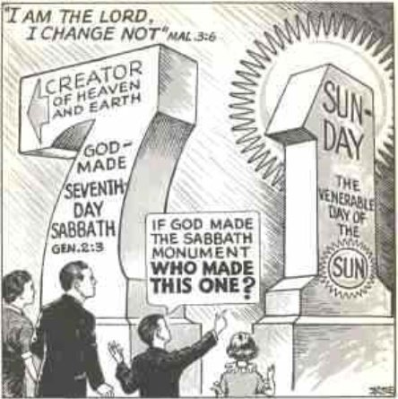
Which is the
True Sign of the
Follower of Jesus?
Notes:
My friends, this is Jesus’ message of love to you right now. A message of hope and of warning.
We have shown from the Bible that the seventh day Sabbath is the sign of the Creator’s power. We have also made it plain that Jesus Christ planned no change whatsoever in the day of worship, but have seen in history the gradual change and from where it came from
It was predicted by the prophet Daniel and the Roman Papacy admits to doing the very thing foretold.
Therefore, I implore each of the followers of the Creator and Redeemer, today, as Joshua of old did …

Slide 115
Joshua 24:15
“…choose for yourselves this day whom you will serve.”
Notes:
… in Joshua 24:15,
“…choose for yourselves this day whom you will serve.”

Slide 116
Remember the Sabbath day,
The Seventh Day
Notes:
Jesus is asking you to choose whom you will serve today. Will you honor Him as the Lord of the Sabbath and the Lord of your heart? The Sabbath was made for man, God set aside a special time to spend with us. He’s made a special appointment each week that he wants to spend with you. Are we willing to spend time with Him? Are we living by Jesus’s example? Are we honoring God in our worship?

Slide 117
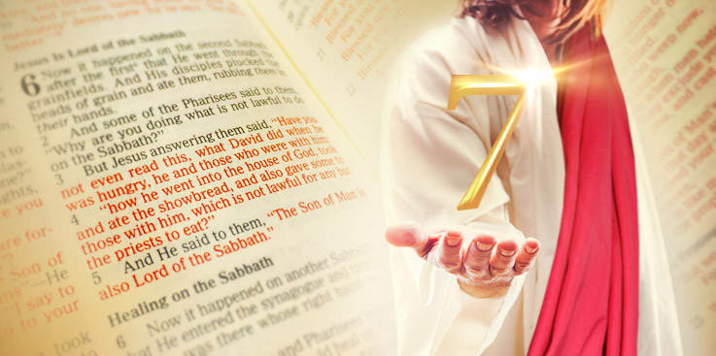
Notes:
How many are ready, right now, to say with me, “I choose Jesus and the commandments of God. I will, by His grace from this day on, ‘Remember the Sabbath day (the seventh day), to keep it holy.’” If this is your desire tonight, I invite you to stand with me for prayer.

