Slide 1
AMAZING DISCOVERIES PROVE THE BIBLE TRUTH

Slide 2
Skeptics and critics
Notes:
Through the ages, skeptics and critics have mocked the Bible's scientific statements, made fun of its statements about history, scoffed at its prophecies, and laughed at its spiritual authority.

Slide 3
Many have died for it!
Notes:
The journey of the Bible through the centuries has been a fascinating one all the way. Never has there been a book like it! Some have denied it. Some have outlawed it. Some have burned it, while many others have died for it!

Slide 4
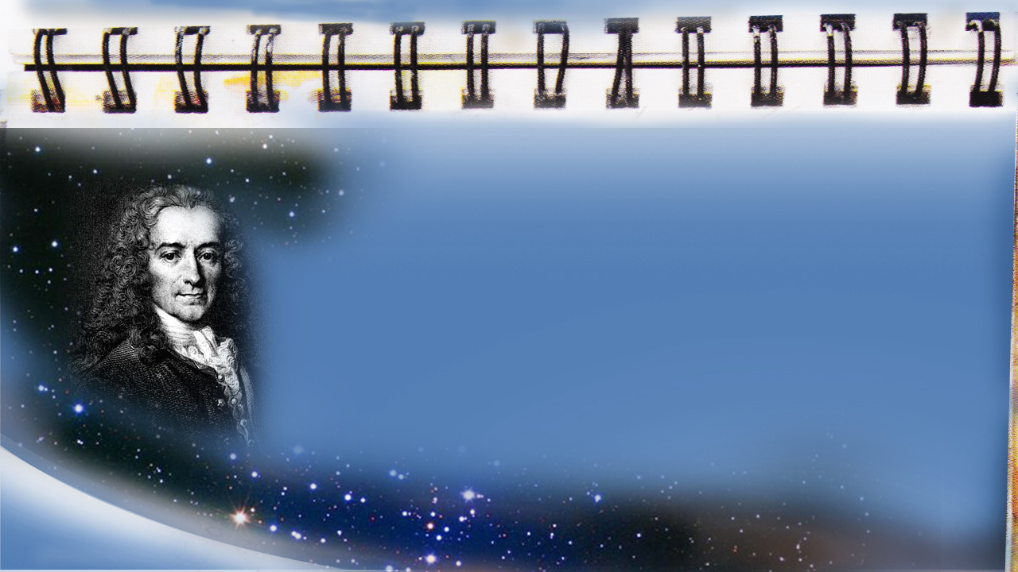
Voltaire. Hammers in the Fire, p. 15.
“I am weary of hearing people repeat that twelve men established the Christian religion...”
Notes:
Voltaire, a Bible doubter, once boasted in his work, Hammers in the Fire, page 15:
“I am weary of hearing people repeat that twelve men established the Christian religion. …”

Slide 5
Voltaire. Hammers in the Fire, p. 15.
“...I will prove that one man may suffice to overthrow it.”
Notes:
“… I will prove that one man may suffice to overthrow it.”

Slide 6
Voltaire
was wrong
Notes:
The centuries came and went. What about Voltaire's boast? Is Christianity dead and the Bible an unknown book? Today there is a Bible book house stacked with thousands of Bibles on the very spot where Voltaire made his prediction!

Slide 7
The Bestseller
Notes:
Never in the history of mankind have so many books been written. The bookstores are flooded with a torrent of books on every subject! Some true, most fiction. Every year billions of dollars are spent on books. Yet, many of today's bestsellers will be thrown away tomorrow! And still, heading the list of bestsellers worldwide, year in and year out, is the Bible!

Slide 8
The Oath
Notes:
Kings and queens and even presidents take their oath of office on the sacred Word. What kind of book is it that captures the admiration and loyalty of so many? What lies behind the Bible's obvious power? What does it claim to be? Let's open its pages and let it speak for itself.

Slide 9
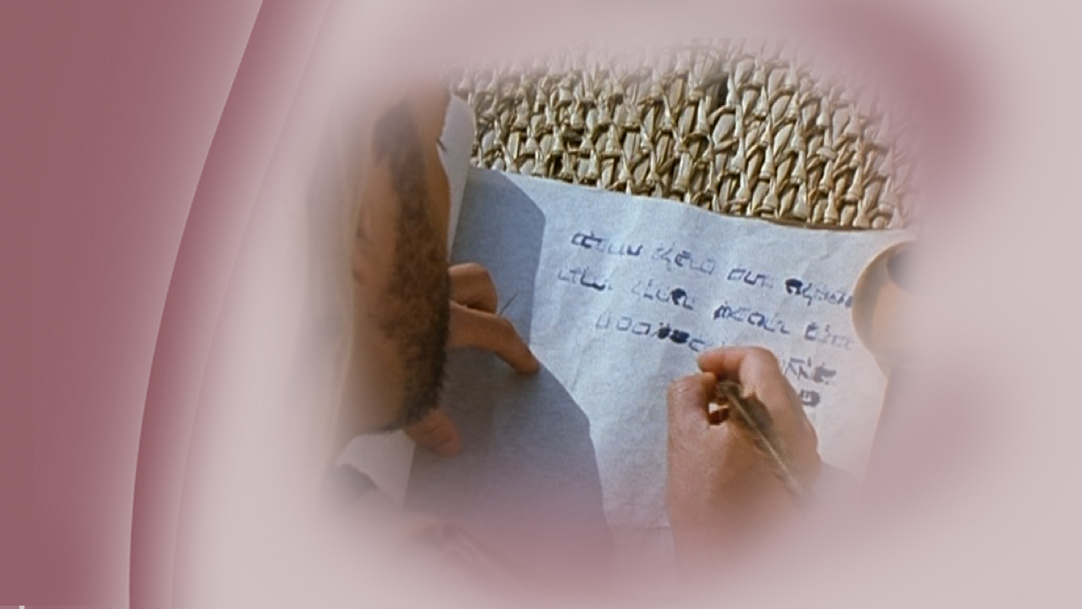
Inspired by God
Notes:
First, it claims to be inspired by God. This is a very rare claim about authorship! Most books give all the credit to the authors. But all the Bible writers gave credit to God …

Slide 10
2 Timothy 3:16
“All Scripture is given by inspiration of God…”
Notes:
… for we read in 2 Timothy 3:16,
“All Scripture is given by inspiration of God…”

Slide 11
Inspired by the Holy Ghost
Notes:
Next, it claims to be written by chosen men who were inspired by the Holy Ghost who is the One who represents God to men upon this earth in Jesus’ place. The Holy Spirit is the one who inspires the writers of scripture. …

Slide 12
2 Peter 1:21
“For prophecy never came by the will of man, but holy men of God spoke as they were moved by the Holy Spirit. ”
Notes:
… as we read in 2 Peter 1:21,
“For prophecy never came by the will of man, but holy men of God spoke as they were moved by the Holy Spirit.”

Slide 13
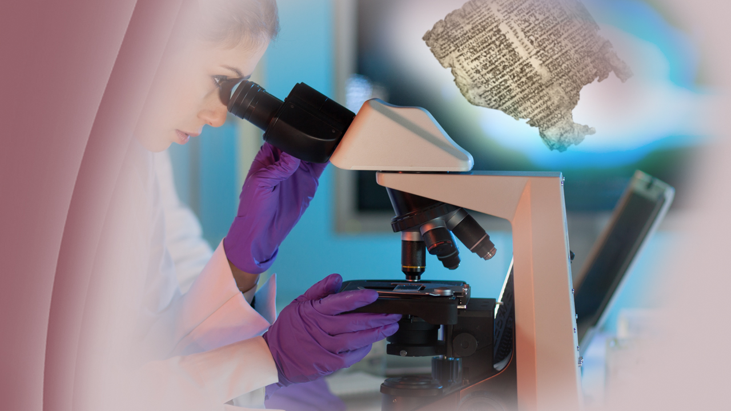
Notes:
These claims are either true or untrue. If they are true, then there is no greater authority on earth! If they are untrue—well, then it is just another book. However, science confirms that the Bible is true!

Slide 14
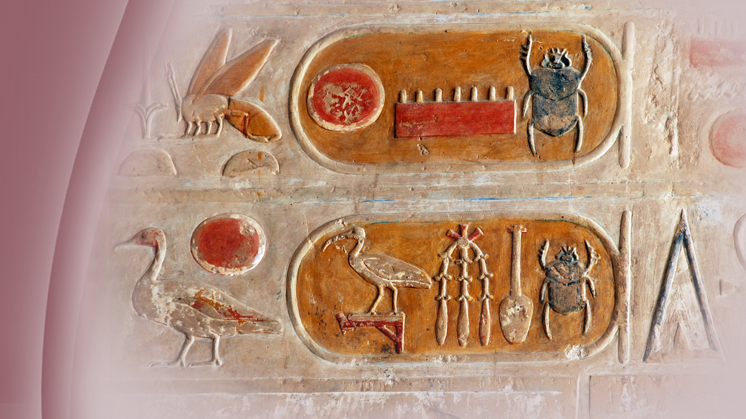
Notes:
Until the 19th century, little was known about the distant past except for the Biblical record. Its history seemed locked forever behind strange picture-writings—the hieroglyphics (Hi-roe-gliff-icks) of Egypt. For there was not a person in Egypt, nor anyone in the world, that understood them.

Slide 15
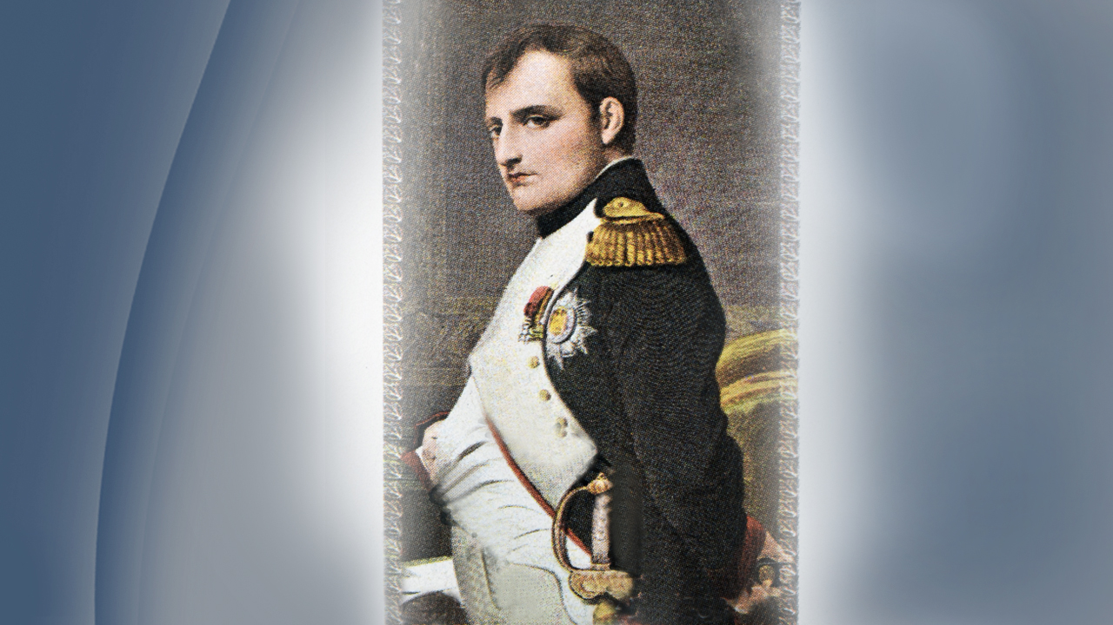
Napoleon
1798
Notes:
Then, in 1798, Napoleon travelled into Egypt. With his 38,000 soldiers, Napoleon took a hundred artists, language experts, and scientists to help him better understand the history of that mysterious land.

Slide 16
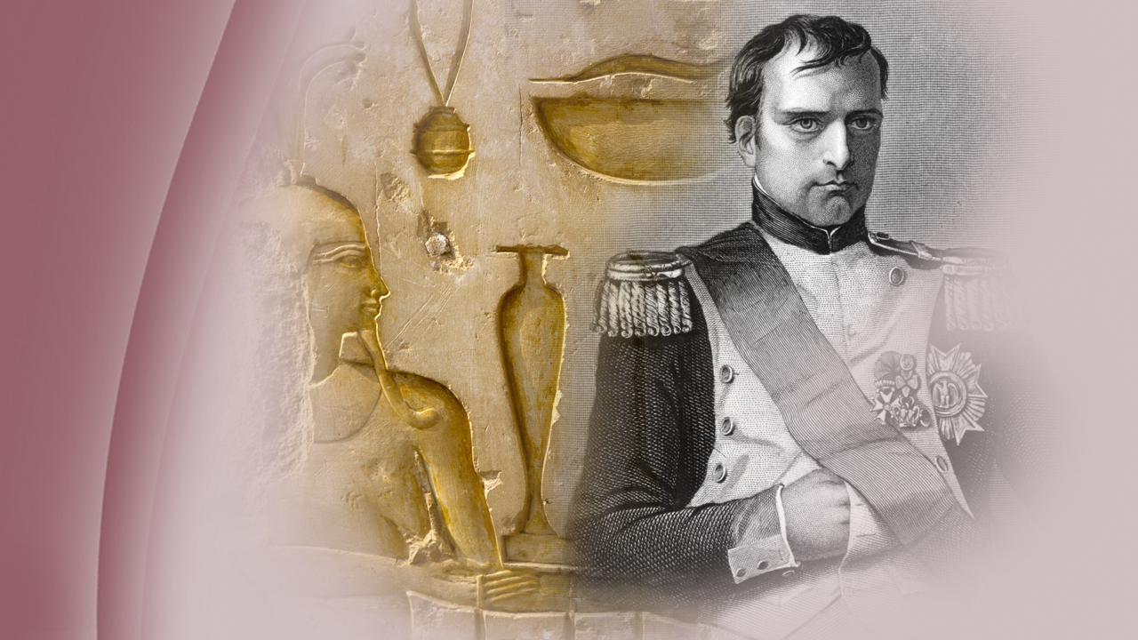
Notes:
Everywhere they saw relics of the past, strange writings, decorated monuments and temple walls. Napoleon and his scholars wondered what secret messages those picture-writings contained.

Slide 17
1799
Rosetta Stone
Notes:
A year later, in 1799, the most significant of all discoveries of archaeology happened. One of Napoleon's soldiers unearthed a black stone four feet long and two and a half feet wide that would unlock the mystery of the picture-writing and reveal secrets hidden for centuries. The stone, known as the Rosetta (Rose-Eta) Stone, is housed in the British Museum. This rock slab, uncovered near the Delta town of Rosetta (Rose-Eta) , bore an old decree in three different scripts: hieroglyphic (Hi-roe-gliff-ick), cursive Egyptian, and Greek.

Slide 18
Jean Francois Champollion
Notes:
Of course, scholars could quickly translate the Greek text, but not the picture-writing. However, 20 years later, in 1822, a brilliant young Frenchman by the name of Jean Francois Champollion (John Fran-swah Sham-poe-Li-own) , startled the world by decoding the pictures on the Stone. He discovered that all three statements were the same, so he used the Greek to decipher the others. Now the vast treasures of Egypt's distant past opened to the scholars of the world. They discovered that the stones cried out to the world that what the Bible says is true!

Slide 19
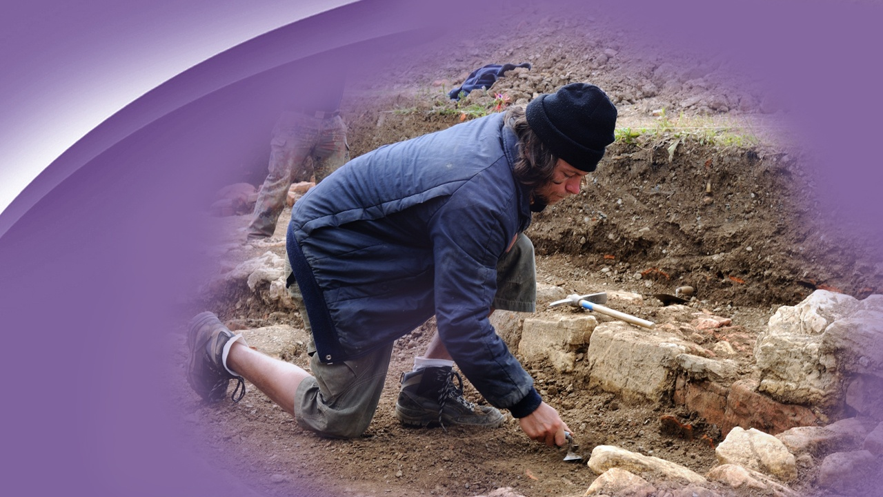
Notes:
The more the archaeologist digs, the more evidence he finds to confirm Bible history with historical records of past nations.

Slide 20
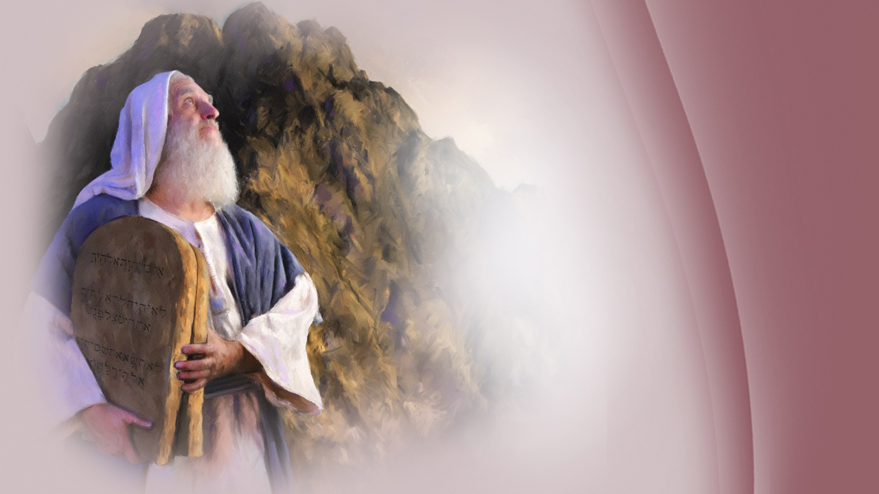
The Hebrews
Notes:
You see, historians which doubted the Bibles record questioned whether the Hebrews had developed the art of writing by the time of Moses, the author of the first five books of the Bible, and it wasn’t until the 19th century that God mercifully gave them more evidence.

Slide 21
Ebla Tablets
Notes:
However, the Ebla (Ebb-Lah) Tablets and other finds date back far beyond the lifetime of Moses. Entire libraries have been dug up by the archaeologists that date back way before Moses lived. This clearly proved that the art of writing did exist long before the time of Moses. The Ebla (Ebb-Lah) Tablets also revealed the story of creation, the flood, names and places familiar to all Bible students: Abraham, Esau, Israel, Sinai, and the two "sin cities," Sodom and Gomorrah.

Slide 22
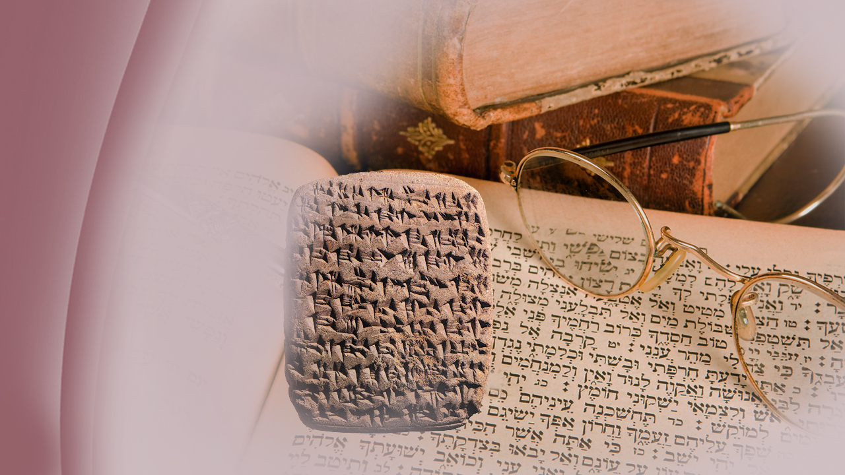
Notes:
Before the discovery of these tablets, many doubted the Bibles recorded history and were considered to be just folklore. However, these findings do, indeed, prove that the language and geographical names of that day as written in the Bible are accurate. Genesis is more than old shepherd songs and legends. The discoveries at Ebla (Ebb-Lah) and elsewhere have confirmed the Bible’s record.

Slide 23
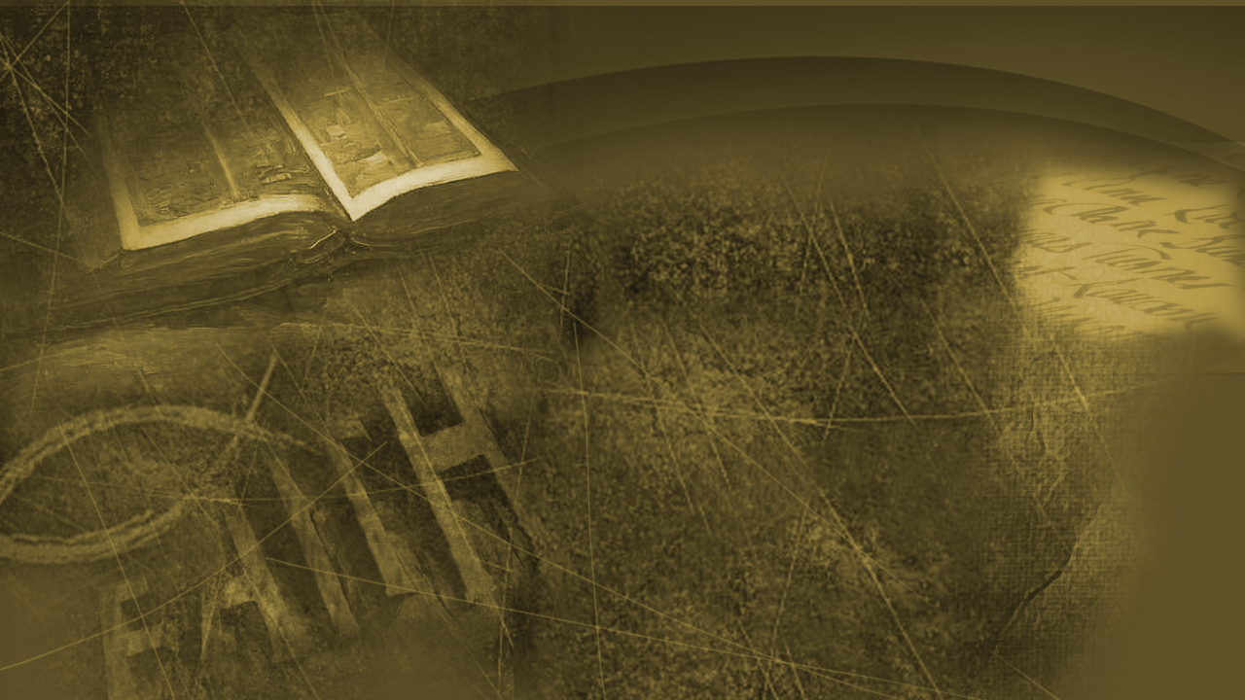
Psalms 119:160
“Thy word is true from the beginning …”
Notes:
David said in Psalms 119:160,
“Thy word is true from the beginning …”

Slide 24
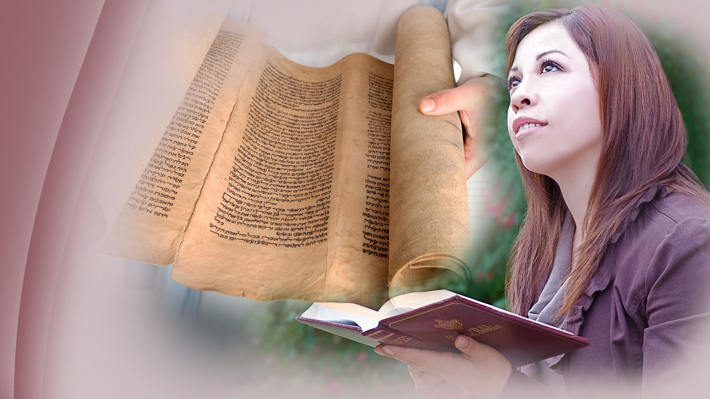
Has survived
Notes:
But how can we know that our Bible today speaks the same message that it did thousands of years ago? No other book in history has survived so many perils; yet, by a miracle of God, it has come down through all that time intact.

Slide 25
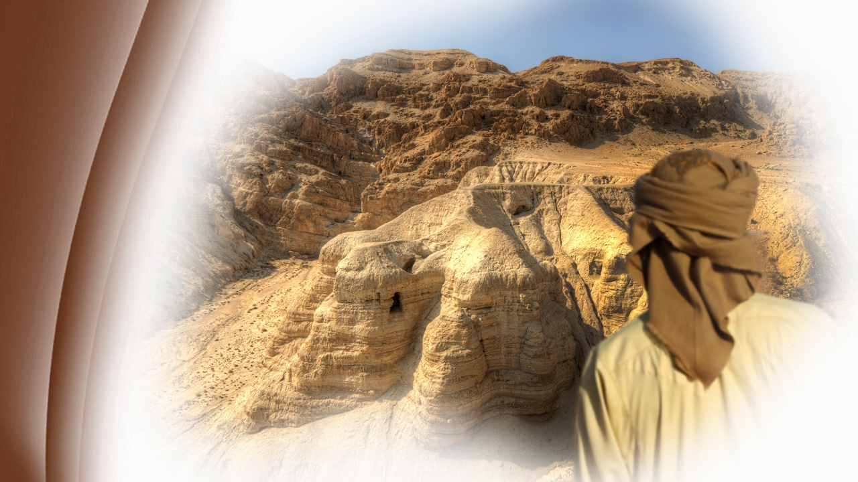
1947
Dead Sea
Notes:
In the summer of 1947, a Bedouin (Bed-ooh-In) boy, looking for a lost goat near the northwest shores of the Dead Sea, idly tossed a stone through a hole in a cliff. He was startled to hear the sound of breaking pottery!

Slide 26
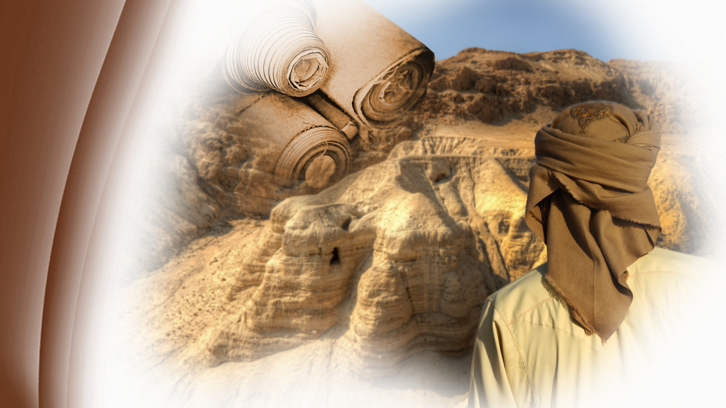
Dead Sea
Scroll
Notes:
This was one of the most important discoveries of all times. Muhammed ed-Dhib (Moo-Hom-Ed -- Ed -- Deeb) had stumbled upon the first of the treasures now known as the Dead Sea Scrolls. Other caves nearby revealed more pottery, more scrolls. Portions of every book of the Old Testament, except the book of Esther, were found.

Slide 27
Isaiah
Notes:
Among the scrolls found in the caves was the Isaiah scroll, 24 feet in length and well preserved. Complete from verse one to the last. An extraordinary find 1,000 years older than any complete biblical Hebrew manuscript in existence. Some scholars believed that Isaiah had been written by several men over a long time period; that it was actually more than one book. However, the Dead Sea Scrolls give excellent evidence that the book of Isaiah has always been one book with one author—that bearing his name.

Slide 28
The accuracy
Notes:
Scholars around the world were amazed to learn that the Old Testament has come down to us through so many years unchanged! They say dead men do not tell tales. But they do! Their long-kept secrets are more interesting than novels or fiction, confirming God’s word to the letter.

Slide 29
Nebuchadnezzar
Notes:
Until the 19th century, some scholars believed that Queen Semiramis (Sem-Me-Raam-Iss) built Babylon. Yet in the Bible, Daniel quoted Nebuchadnezzar as saying: …

Slide 30
Daniel 4:30
“Is not this great Babylon, that I have built for a royal dwelling by my mighty power and for the honor of my majesty?”
Notes:
… in Daniel 4:30,
“Is not this great Babylon, that I have built for a royal dwelling by my mighty power and for the honor of my majesty?”
Who was right?

Slide 31
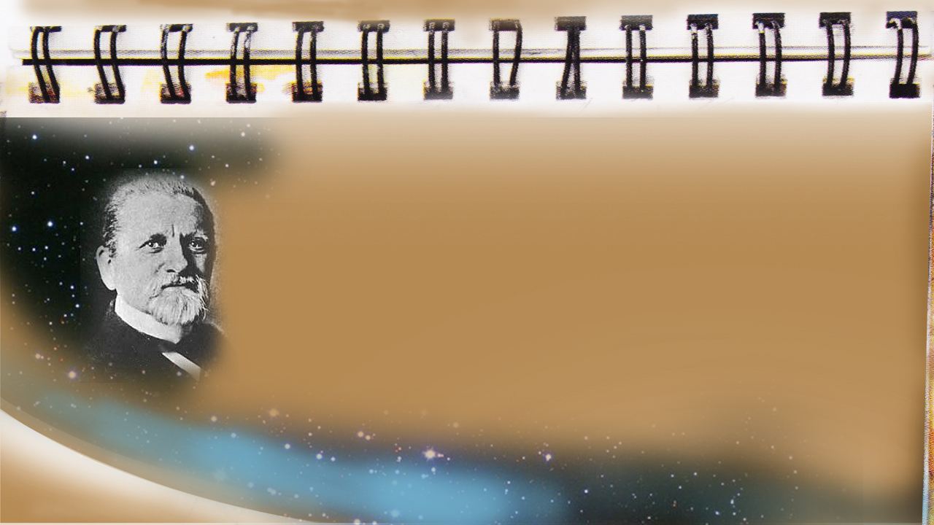
Robert Koldewey . 1899.
“...unearthing tens of thousands of kiln-baked bricks, all bearing the stamp of King Nebuchadnezzar”
Notes:
In 1899, Robert Koldewey (Robert Cold-E-Way) began un-earthing the old ruins of Babylon, revealing tens of thousands of baked bricks, all bearing the stamp of King Nebuchadnezzar the 2nd, all taken from the walls and temples of the city.

Slide 32
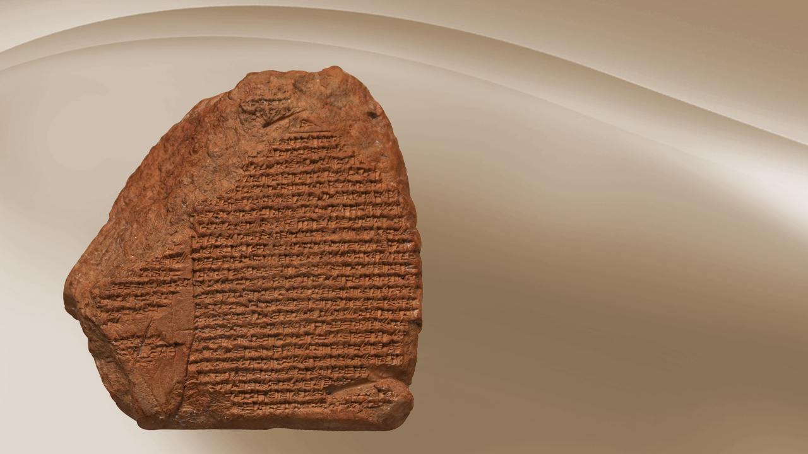
“Is not this great Babylon, that I have built?”
Notes:
A cuneiform (Cuun-A-E-Form) tablet, relating Nebuchadnezzar's achievements, was found by archaeologists at Babylon. On it Nebuchadnezzar asks,
"Is this not Babylon the great which I have built?"

Slide 33
In the East of India
Notes:
The East India House inscription, now in London, devotes six columns of Babylonian writing to a description of the huge building projects of Nebuchadnezzar. The spade again confirmed the accuracy of God's Word. Another mystery of secular history was the absence of the name of Belshazzar as a ruler of Babylon. The Bible named Belshazzar as the ruler. Isn't it interesting that in the closing chapter of Daniel it says …

Slide 34
Daniel 12:4
“But you, Daniel, shut up the words, and seal the book until the time of the end; many shall run to and fro, and knowledge shall increase.”
Notes:
… in Daniel 12:4,
“But you, Daniel, shut up the words, and seal the book until the time of the end; many shall run to and fro, and knowledge shall increase.”

Slide 35
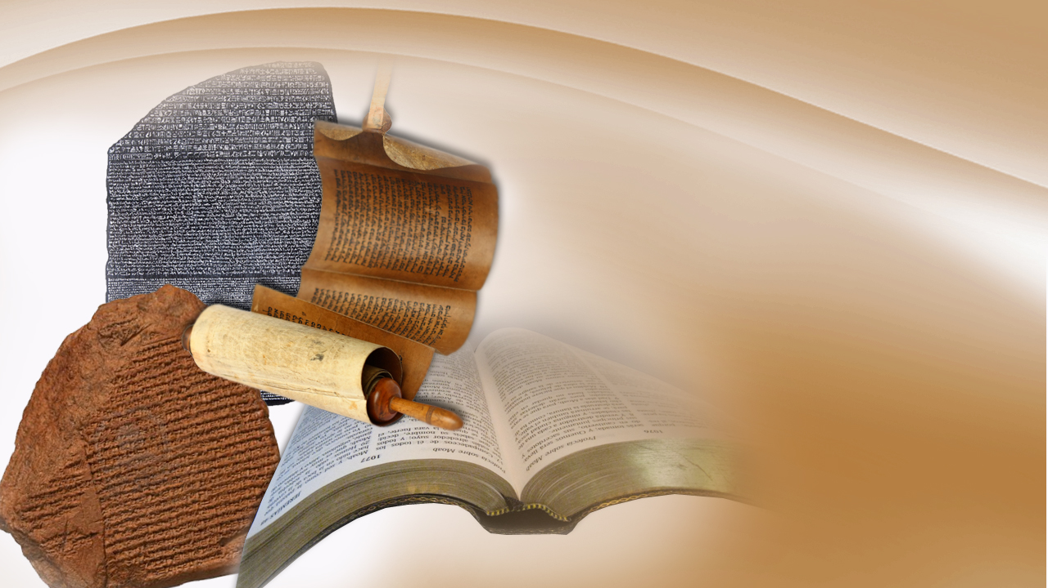
What the Bible says is true
Notes:
Knowledge would be increased, not only in the scientific world, but knowledge that would shed light on the accuracy of God's Word. Bricks and cylinders, tablets and manuscripts dug up by archaeologists where Bible characters walked in ages past, are confirming the Bible yet again.

Slide 36
Cyrus cilinder
Notes:
An artifact, called the Cyrus cylinder, now housed in a London museum, confirms that Belshazzar ruled co-jointly with his father Nabonidus (Nah-Bo-Need-Us) in Babylon, just as the Bible said.

Slide 37
Foretell the future
Notes:
Another compelling evidence that the Bible is God's Inspired Word is its statements about future events.

Slide 38
People are concerned
about
the future
Notes:
The psychics (Sigh-Kicks), astrologers and fortune-tellers have all failed to give accurate forecasts concerning future events. We live at a time when leading scientists, economists (Econ-O-Mists), professors, those who study politics, psychologists (Sigh-Call-O-Jists) and leading thinkers of our age are concerned about the future.
God says, …

Slide 39
Isaiah 46:9, 10
“For I am God, and there is no other; I am God, and there is none like Me,... ”
Notes:
… In Isaiah 46:9, 10,
“… For I am God, and there is no other; I am God, and there is none like Me, declaring the end from the beginning,…”
Therefore, remember the former things of old, …

Slide 40
Isaiah 46:9, 10
“...declaring the end from the beginning; And from ancient times things that are not yet done… ”
Notes:
… for God has been,
“… declaring the end from the beginning; And from ancient times things that are not yet done…”

Slide 41
AN ANCIENT DREAM
REVEALS WORLD’S HISTORY
Notes:
Let’s look at a specific Prophecy God gave to a Hebrew named Daniel which shows how accurate God is in telling the future.

Slide 42
God draws back the curtain
Notes:
As God draws back the curtain that hides the future, we see an amazing promise from God's Holy Word …

Slide 43
Amos 3:7
“Surely the Lord God does nothing, unless He reveals His secret to His servants the prophets. …”
Notes:
… in Amos 3:7, we read:
“Surely the Lord God does nothing, unless He reveals His secret to His servants the prophets. …”

Slide 44
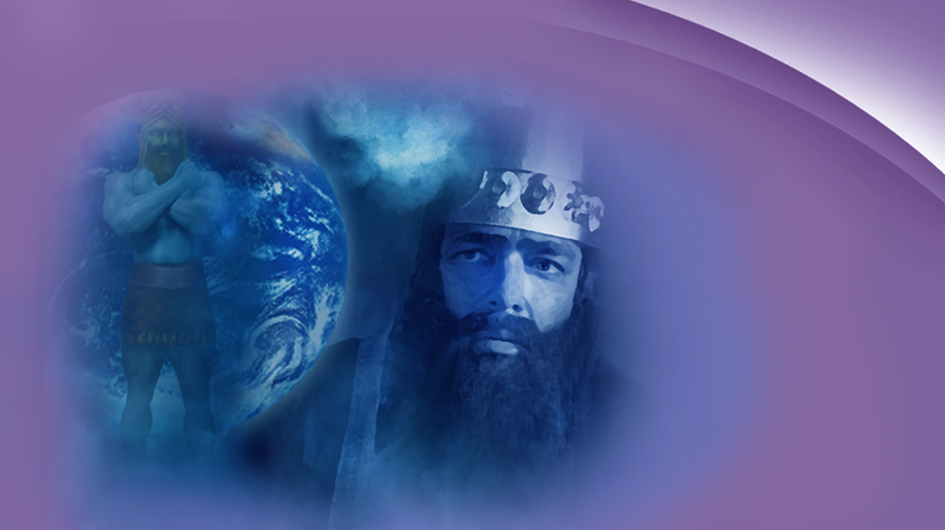
Babylon, 606 B.C.
Notes:
One night a king who lived in the city of Babylon in 606 B.C., was thinking about the future, wondering what it might hold for him and his kingdom. God gave him a remarkable dream outlining world history for over 2500 years (2 thousand, 500 hundred years) —from his day until the end of time.

Slide 45
Notes:
When he awoke he was very troubled because he couldn't remember his dream, yet the Bible records …

Slide 46
Daniel 2:2
“Then the king gave the command to call the magicians, the astrologers, the sorcerers, and the Chaldeans to tell the king his dreams.”
Notes:
… in Daniel 2:2,
“Then the king gave the command to call the magicians, the astrologers, the sorcerers, and the Chaldeans to tell the king his dreams.”

Slide 47
Notes:
The king’s wise men were anxious to hear the dream from God …

Slide 48
Daniel 2:3
“And the king said to them, I have had a dream, and my spirit is anxious to know the dream.”
Notes:
… as we read in Daniel 2:3,
“And the king said to them, I have had a dream, and my spirit is anxious to know the dream.”

Slide 49
Notes:
They were unable to tell the dream and quickly admitted that only the true God could tell what the king asked. However, they did not know God and stalled for time showing to the king that these men were frauds. In great anger the king commanded: "Execute them! Execute all the wise men of Babylon."

Slide 50
Notes:
Daniel and his three friends were listed among the wise men of Babylon and were also subject to the king's death decree. …

Slide 51
Daniel 2:16
“So Daniel went in and asked the king to give him time, that he might tell the king the interpretation.”
Notes:
… as we read in Daniel 2:16,
“So Daniel went in and asked the king to give him time, that he might tell the king the interpretation.”

Slide 52
Notes:
God answered their prayer…

Slide 53
Daniel 2:27, 28
“The secret which the king has demanded, the wise men, the astrologers, the magicians, and the soothsayers cannot declare to the king. …”
Notes:
… and Daniel went before the King, saying in chapter 2 verses 27 and 28,
“… The secret which the king has demanded, the wise men, the astrologers, the magicians, and the soothsayers cannot declare to the king. …”

Slide 54
Daniel 2:27, 28
“… But there is a God in heaven who reveals secrets, and He has made known to King Nebuchadnezzar what will be in the latter days.
Notes:
“… But there is a God in heaven who reveals secrets, and He has made known to King Nebuchadnezzar what will be in the latter days.”

Slide 55
Daniel 2:31, 33
“You, O king, were watching; and behold, a great image! …”
Notes:
… and in Daniel 2:31, and 33, it continues by saying,
“… You, O king, were watching; and behold, a great image! …”

Slide 56
Daniel 2:31, 33
“…This image’s head was of fine gold, its chest and arms of silver, its belly and thighs of bronze, its legs of iron, its feet partly of iron and partly of clay.”
Notes:
“…This image’s head was of fine gold, its chest and arms of silver, its belly and thighs of bronze, its legs of iron, its feet partly of iron and partly of clay.”

Slide 57
Daniel 2:34, 35
“You watched while a stone was cut out without hands, which struck the image on its feet of iron and clay, and broke them in pieces…”
Notes:
… further in verses 34 and 35,
“You watched while a stone was cut out without hands, which struck the image on its feet of iron and clay, and broke them in pieces…”

Slide 58
Daniel 2:34, 35
“… And the stone that struck the image became a great mountain and filled the whole earth.”
Notes:
“… And the stone that struck the image became a great mountain and filled the whole earth.”

Slide 59
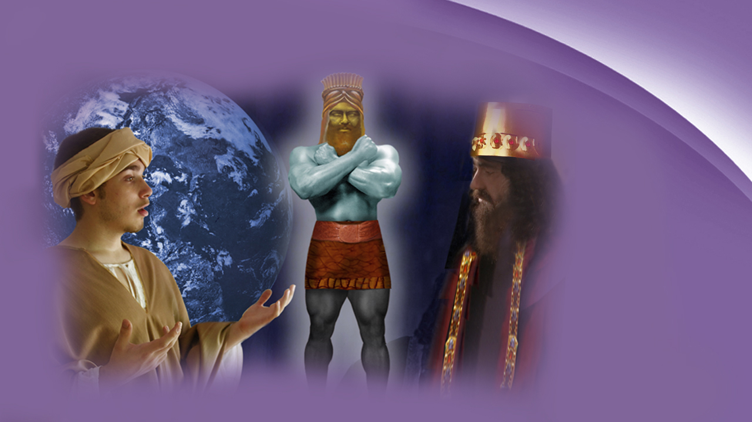
Notes:
King Nebuchadnezzar and Daniel found themselves looking down through history for all time to come. The king now desired the interpretation. What could it all mean? …

Slide 60
Daniel 2:38
…you are this head of gold.
Notes:
… In Daniel 2:38 we read:
“…you are this head of gold.”

Slide 61
“…May it last forever” -
Nebuchadnezzar
Notes:
Babylon the head! Babylon a nation of pure gold!

Slide 62
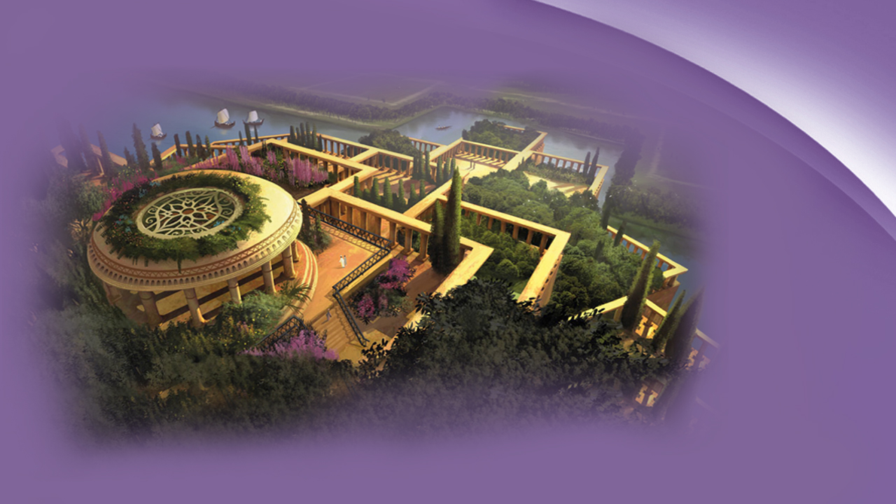
Notes:
The military conquests and the splendor of Babylon’s buildings were unsurpassed, but more than this, Nebuchadnezzar himself would be converted to worship the True God, for God took this pagan man and made him more precious than fine gold!

Slide 63
Notes:
Daniel had a message that God wanted revealed to the world, not just for his time, but a message that would be relevant to the end of Earth's history …

Slide 64
Daniel 2:39
“But after you shall arise another kingdom inferior to yours.”
Notes:
… in Daniel 2:39 we continue reading,
“But after you shall arise another kingdom inferior to yours.”

Slide 65
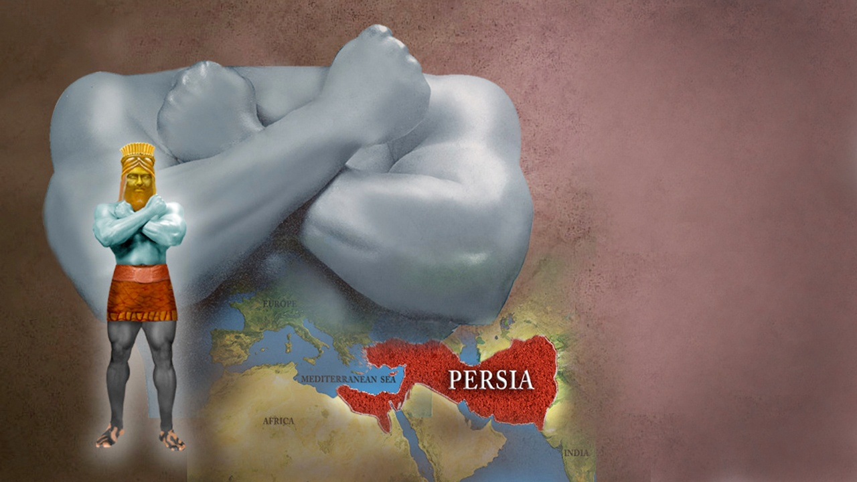
October 13,
539 B.C.
Notes:
Daniel lived to see that prophecy of the silver kingdom replacing the gold one. For on October 13, 539 B.C., the golden kingdom of Babylon came to its end.

Slide 66
Notes:
During the reign of Belshazzar, Nebuchadnezzar's proud and arrogant grandson, it was then that Cyrus the Mede laid siege (Seej) to Babylon. Feeling secure in his capital, King Belshazzar arranged a great feast for a thousand of his nobles to show his defiance to the God of Heaven. He commanded that the golden vessels taken from the temple in Jerusalem be brought to his table. …

Slide 67
Daniel 5:3,4
“…and the king and his lords, his wives, and his concubines drank from them. …”
Notes:
… as we read in Daniel 5:3, 4,
“…and the king and his lords, his wives, and his concubines drank from them. …”

Slide 68
Daniel 5:3,4
“… They drank wine, and praised the gods of gold and silver, bronze and iron, wood and stone.”
Notes:
“… They drank wine, and praised the gods of gold and silver, bronze and iron, wood and stone.”

Slide 69
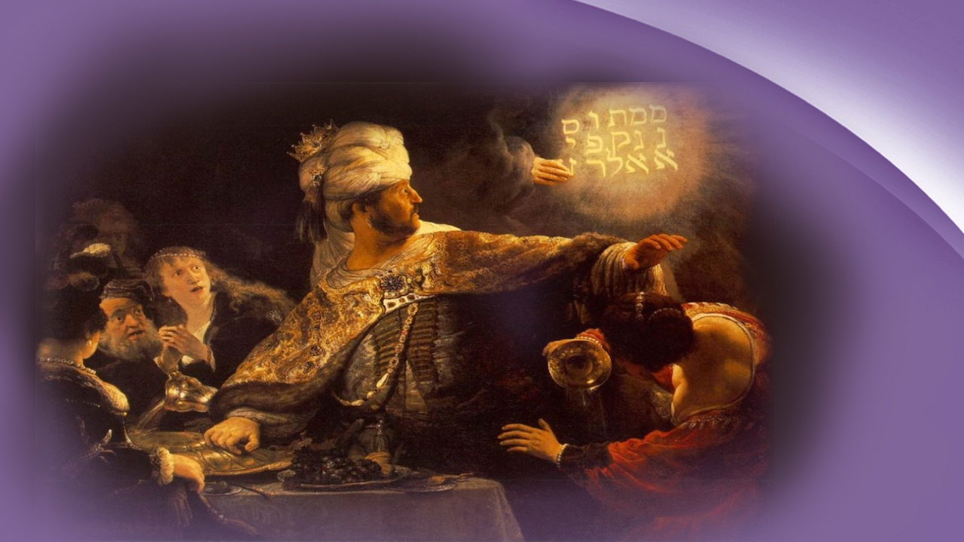
Notes:
In the middle of this God sent a message in a most dramatic way for a bloodless hand wrote on the wall across from the light …

Slide 70
Daniel 5:25-28
“MENE, MENE, TEKEL, UPHARSIN… God has numbered your kingdom, and finished it… Your kingdom has been divided, and given to the Medes and Persians.”
Notes:
… in verses 25 to 28, we read,
“… MENE (Meanie), MENE (Meanie), TEKEL (Tea-Kel), UPHARSIN (You-Far-Sin)… God has numbered your kingdom, and finished it… Your kingdom has been divided, and given to the Medes and Persians.”

Slide 71
Notes:
As the solemn words ended, a messenger came with the news that river Euphrates (You-Fray-Tease) was lowered and the city had been taken by the Medo-Persian soldiers coming in through the channels just as Isaiah the prophet foretold 150 years earlier …

Slide 72
Isaiah 45:1
“Thus says the Lord to His anointed, to Cyrus, whose right hand I have held—to subdue nations before him and loose the armor of kings...”
Notes:
… as we read in Isaiah 45:1,
“Thus says the Lord to His anointed, to Cyrus, whose right hand I have held—to subdue nations before him and loose the armor of kings,…”

Slide 73
Isaiah 45:1
“...to open before him the double doors, so that the gates will not be shut.”
Notes:
“… to open before him the double doors, so that the gates will not be shut.:

Slide 74
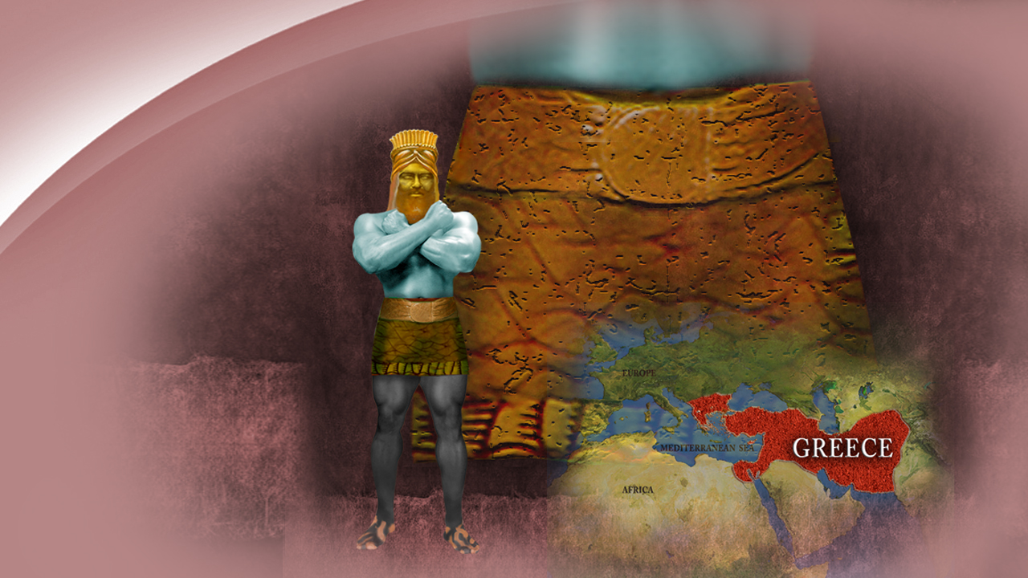
Chest and
arms of silver
Notes:
Yet the kingdom represented by the chest and arms of silver would not rule forever. Notice what was written to happen next …

Slide 75
Daniel 2:39
“…then another, a third kingdom of bronze, which shall rule over all the earth.”
Notes:
… as we read in Daniel 2:39,
“…then another, a third kingdom of bronze, which shall rule over all the earth.”

Slide 76
Alexander the Great
Notes:
The brilliant young general, Alexander the Great, defeated Darius the 3rd of Persia, in the battle of Arbela (Are-Bee-Lah), 331 B.C. At just the age of 23, Alexander became ruler over the most extensive empire the world had known.

Slide 77
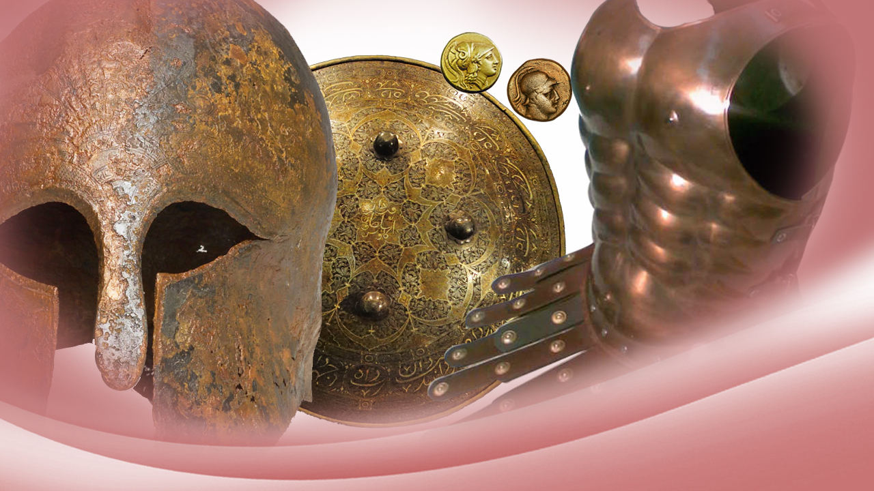
Notes:
Much of the armor worn by Greek infantry was made of brass. The historian Herodotus (Hair-Roe-Dote-Us) described Greek pirates as "men of bronze coming from the sea."

Slide 78
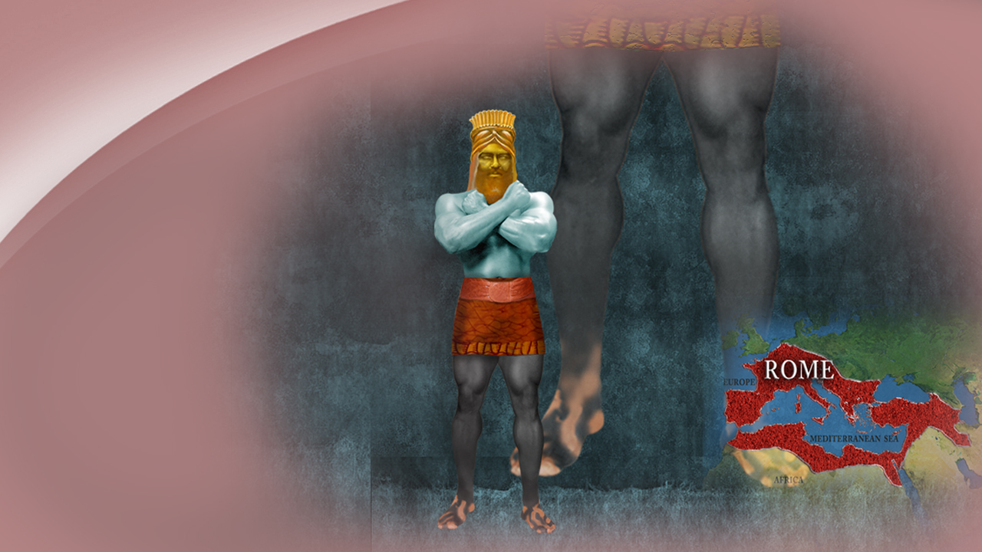
The legs of iron
Notes:
The Bible said there would be a fourth world empire—an empire represented by the legs of iron. The interpretation of the dream continnued …

Slide 79
Daniel 2:40
“And the fourth kingdom shall be as strong as iron…and like iron that crushes, that kingdom will break in pieces and crush all the others.”
Notes:
… in Daniel 2:40 as we read,
“And the fourth kingdom shall be as strong as iron…and like iron that crushes, that kingdom will break in pieces and crush all the others.”

Slide 80
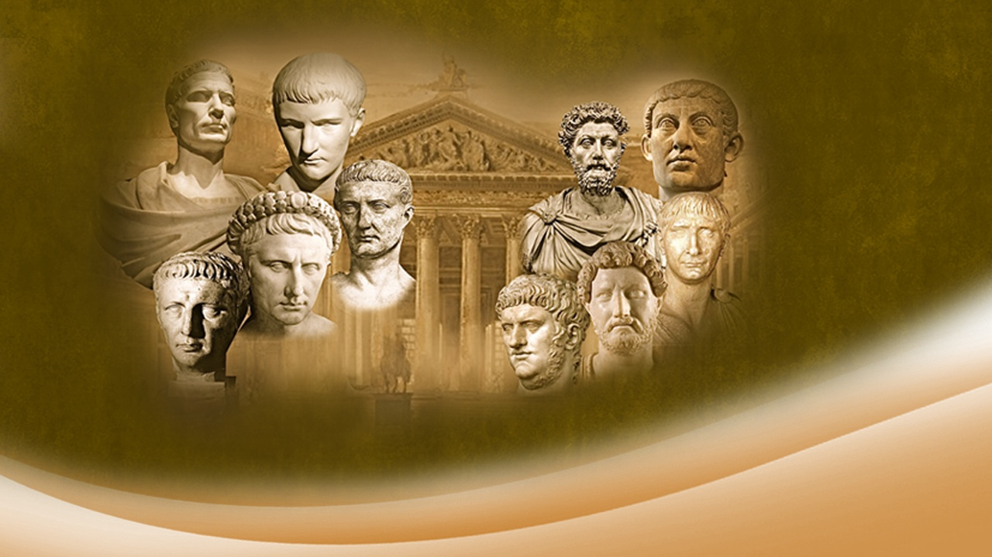
Caesars and emperors from 168 B.C to A.D. 476
Notes:
What great empire overthrew Greece? What nation ruled during the life of Christ? It was the Roman Empire, the fourth world empire, ruled by the Caesars (Sees-Erz) and emperors from 168 B.C to A.D. 476

Slide 81
Theodor Mounsen's History of Rome, Book 3, Chapter 10.
“On June 22, 168 B.C., at the battle of Pydna, perished the empire of Alexander the Great, 144 years after his death.”
Notes:
In Theodor Mounsen’s (Mon-Sens) History of Rome, Book 3, Chapter 10, we read:
“On June 22, 168 B.C., at the battle of Pydna (Pid-Nah), perished the empire of Alexander the Great, 144 years after his death.” …

Slide 82
Daniel 2:41-43
“Whereas you saw the feet and toes, partly of potter’s clay and partly of iron, the kingdom shall be divided…”
Notes:
… and so God’s word continues in Daniel 2:41-43,
“Whereas you saw the feet and toes, partly of potter’s clay and partly of iron, the kingdom shall be divided…”

Slide 83
Daniel 2:41-43
“…but they will not adhere to one another, just as iron does not mix with clay.”
Notes:
“…but they will not adhere to one another, just as iron does not mix with clay.”

Slide 84
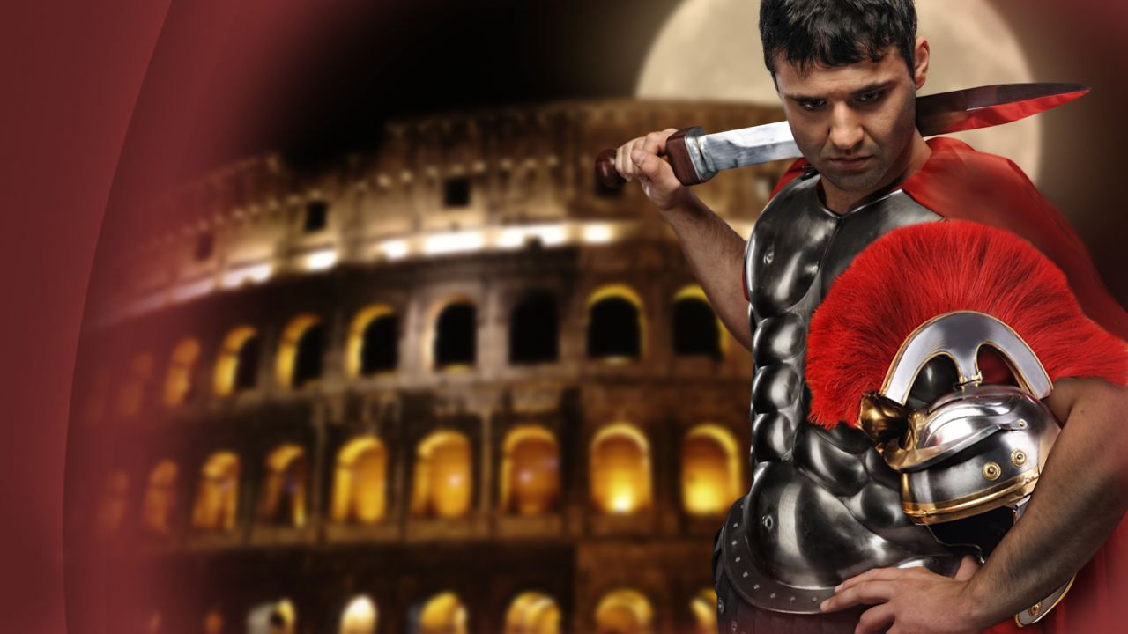
Notes:
Rome was a ruthless nation ruling with the Iron sword. Her rulers called themselves gods and demanded worship and obedience from all men. She was the longest lived of the four world empires.

Slide 85
Daniel 2:41
“Whereas you saw the feet and toes, partly of potter’s clay and partly of iron, the kingdom shall be divided.”
Notes:
Yet no worldly empire was to conquer Rome. Instead, it was to be divided, as we read in Daniel 2:41,
“Whereas you saw the feet and toes, partly of potter’s clay and partly of iron, the kingdom shall be divided.”

Slide 86
21st century
Notes:
Yet the prophecy doesn’t end there, but continues to show the future unto the final events of this world’s history …

Slide 87
Daniel 2:43
“As you saw iron mixed with ceramic clay, they will mingle with the seed of men;...”
Notes:
… as we read in Daniel 2:43,
“As you saw iron mixed with ceramic clay, they will mingle with the seed of men;…”

Slide 88
Daniel 2:43
“…but they will not adhere to one another, just as iron does not mix with clay.”
Notes:
“…but they will not adhere to one another, just as iron does not mix with clay.”

Slide 89
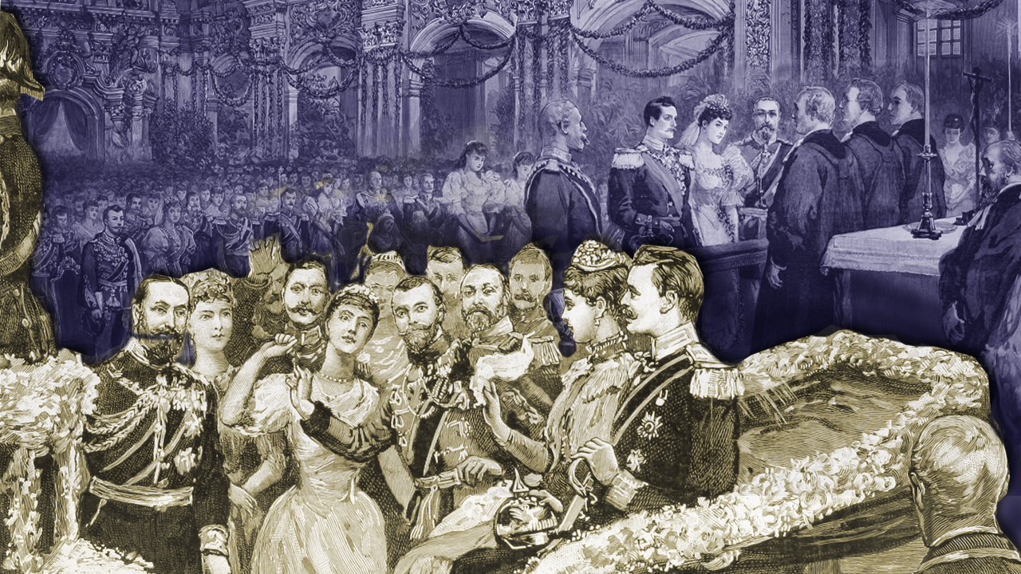
Notes:
Many world rulers have tried to combine the nations of Europe together by royal marriages, "mingling themselves with the seed of men." By the first part of the 20th century, nearly every crowned head of Europe was related, but that didn't prevent the World Wars to come. …

Slide 90
Daniel 2:43
“… they will not adhere to one another, just as iron does not mix with clay.”
Notes:
… for we read in Daniel 2:43,
“… they will not adhere (Ad-Hear) to one another, just as iron does not mix with clay.”

Slide 91
Charlemagne, Charles V and Louis XIV
Notes:
Charlemagne (Shar-Lah-Maine) tried and failed. Charles the 5th and Louis (Lou-E) the 14th tried and failed. …

Slide 92
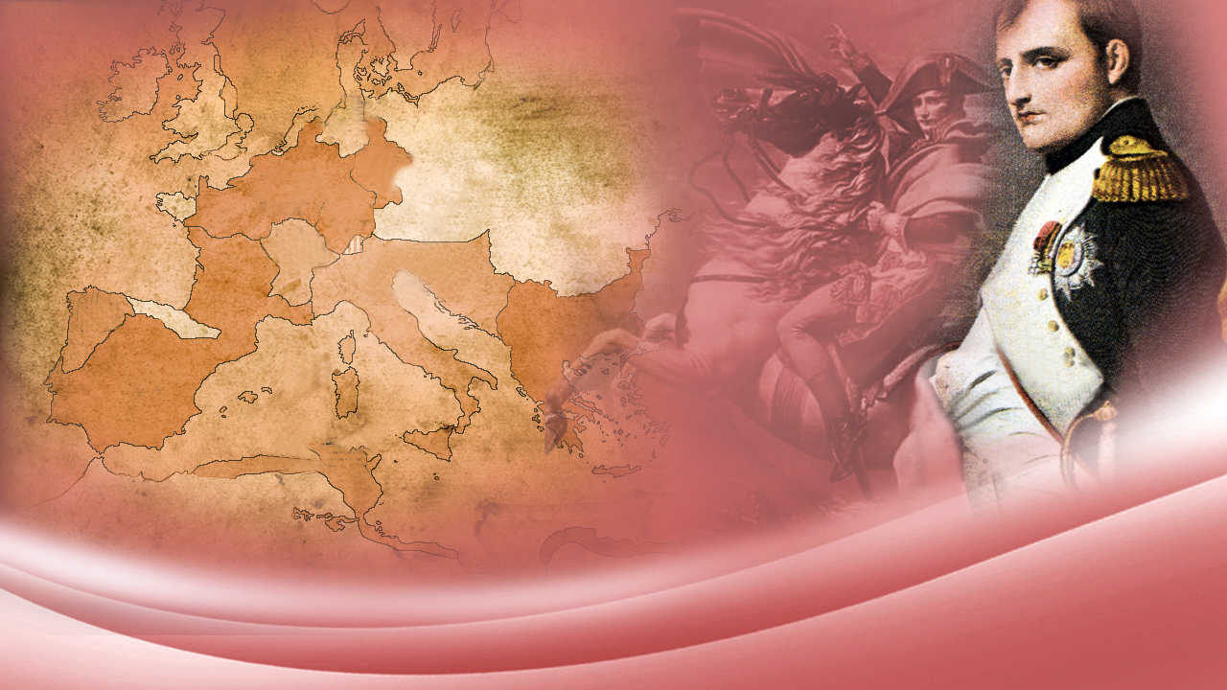
Napoleon Bonaparte
Notes:
… and not even the great Napoleon Bonaparte (Bone-Ah-Part-A) could make the broken parts of the Roman Empire to come together.

Slide 93
Kaiser Wilhelm and later Hitler
Notes:
Kaiser Wilhelm (Kai-Sir – Vil-Helm) of Germany and later Hitler tried to marshal the world under one flag, but both ended in defeat.

Slide 94
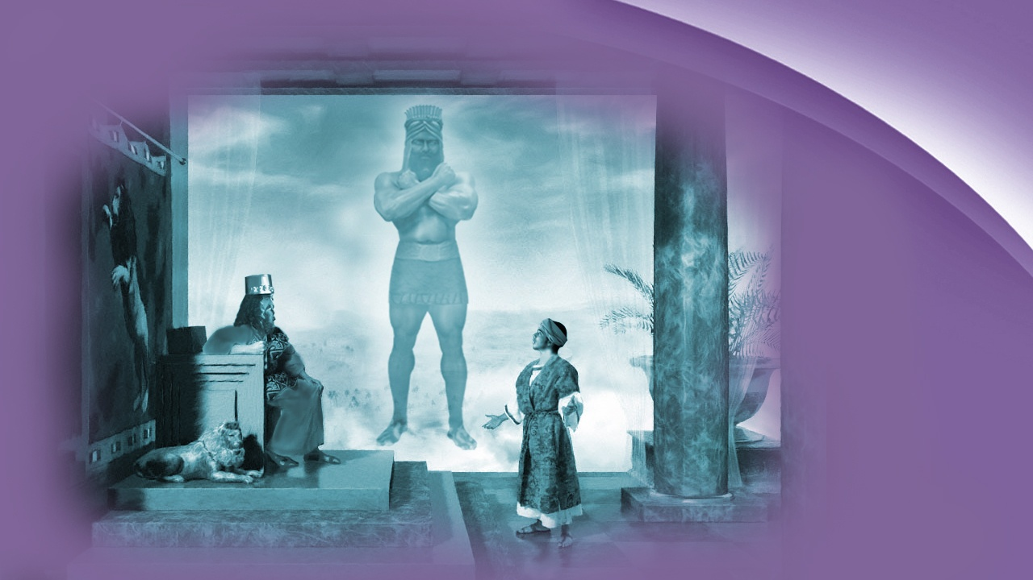
Notes:
What was to happen next? …

Slide 95
Daniel 2:44
“And in the days of these kings the God of heaven will set up a kingdom which shall never be destroyed; and the kingdom shall not be left to other people. …”
Notes:
… the interpretation continues in Daniel 2:44-45, where we read,
“And in the days of these kings the God of heaven will set up a kingdom which shall never be destroyed; and the kingdom shall not be left to other people ….”

Slide 96
Daniel 2:45
“... [and] The dream is certain, and its interpretation is sure.”
Notes:
“… [and] The dream is certain, and its interpretation is sure.”

Slide 97
Isaiah 40:8
“…the word of our God stands forever”
Notes:
… it is written in Isaiah 40:8,
“…the word of our God stands forever.”

Slide 98
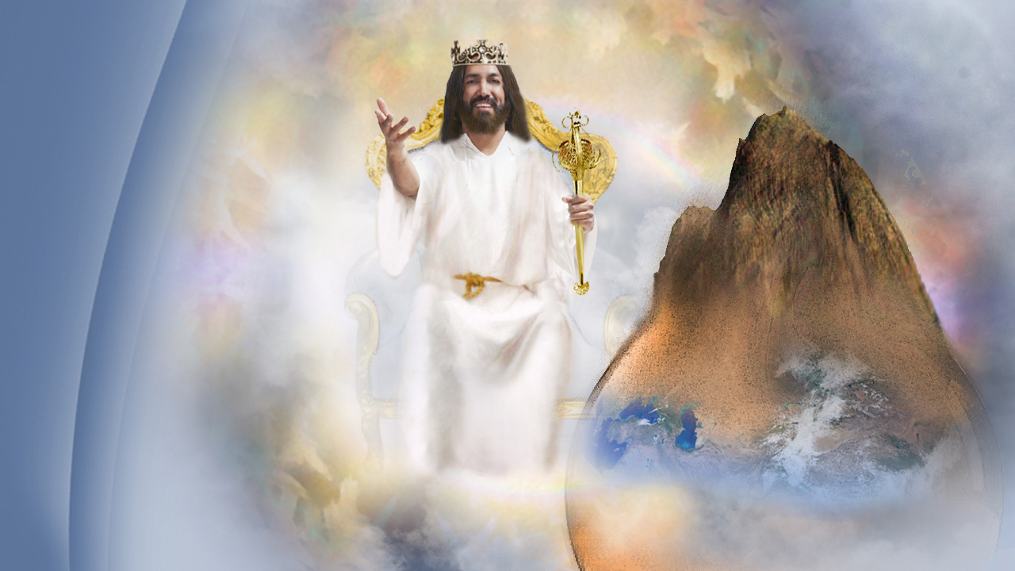
The Second Coming of Jesus
Notes:
The next great event on the stage of human history will be the Second Coming of Jesus! The establishment of His kingdom, represented by the stone "cut out without hands." A kingdom founded not by the hands of men, but by the mighty hand of God.

Slide 99
Revelation 11:15
The kingdoms of this world have become the kingdoms of our Lord and of His Christ, and He shall reign forever and ever!”
Notes:
A kingdom that will fill the whole Earth! Then will be fulfilled the prophecy in Revelation 11:15,
“The kingdoms of this world have become the kingdoms of our Lord and of His Christ, and He shall reign forever and ever!”

Slide 100
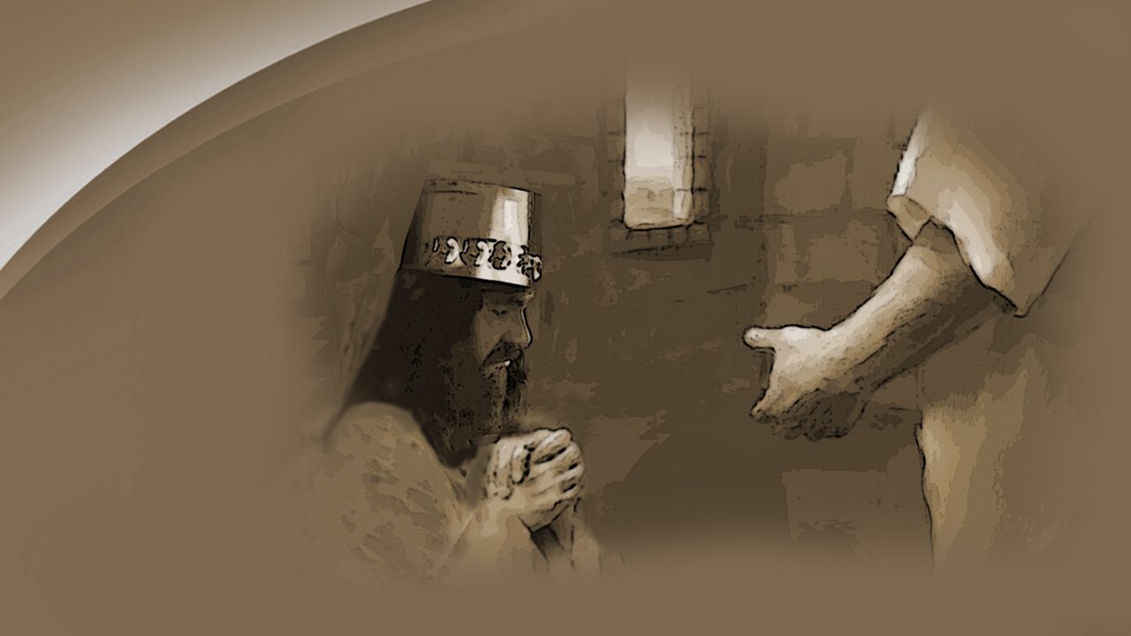
Notes:
When Daniel finished the interpretation from God, King Nebuchadnezzar bowed himself before Daniel in honor of JEHOVAH, whose wisdom and power had been so greatly revealed. He acknowledged …

Slide 101
Daniel 2:47
“Truly your God is the God of gods, the Lord of kings, and a revealer of secrets…”
Notes:
… in Daniel 2:47,
“Truly your God is the God of gods, the Lord of kings, and a revealer of secrets…”
Friends, isn’t this your own hearts cry?
God reveals the future, but also reveals to men their own hearts!

Slide 102
Notes:
God unveiled the future from Daniels’ day for thousands of years to come by the dream given to the king of Babylon.

Slide 103
Where are we living today?
Notes:
Don’t you desire to be in that eternal Kingdom of God? As these studies of the scripture continue, we will show the way, the truth and the Life!
God’s invitation to you today is found in …

Slide 104
Revelation 22:17
“And the Spirit and the bride say, Come. And let him that heareth say, Come. And let him that is athirst come. And whosoever will, let him take the water of life freely.”
Notes:
… Revelation 22:17, where we read:
“And the Spirit and the bride say, Come. And let him that heareth say, Come. And let him that is athirst come. And whosoever will, let him take the water of life freely.”

Slide 105
More than just authentic history.
It’s all about Jesus!,
The Alpha and Omega of Prophecy.
Notes:
The Bible is more than just authentic history, more than scientific facts, more than prophecies fulfilled. If it were not, it would not matter what men did with it. The theme of the Book, the heart of it all, is the account of what happened on the rugged hill of Calvary outside of Jerusalem more than 19 centuries ago. And it makes a difference what we believe about that!

Slide 106
That power is wrapped up in one person
Notes:
The greatest evidence that the Bible is what it claims to be, is the power in the Word of God to change lives, just as it did for Nebuchadnezzar. That power is wrapped up in one person—Jesus Christ! Jesus said …

Slide 107
John 5:39
“Search the Scriptures, for in them you think you have eternal life; and these are they which testify of Me. ”
Notes:
… in John 5:39,
“Search the Scriptures, for in them you think you have eternal life; and these are they which testify of Me.”

Slide 108
Change
the hearts
Notes:
Yes, the power of God's Word today can change the hearts of men and women as it did for that king of Babylon. But God's Word can only change those who are willing to accept the Man of Prophecy—Jesus Christ!

Slide 109
Change
the lives
Notes:
Never has there been a book that can so dramatically change the lives of men. That power can make all the difference in your life. As you personally read God’s word, letting it speak to your mind and heart, the more you will be convinced that it comes from the very heart of God, and that it is God who speaks to you therein.

Slide 110
The Book
Notes:
You see, friend, it makes a difference what we do with the Book. It's more than just a Book to carry to church. It is more than a Book to decorate tables. It is more than helpful information or useful advice—it is God speaking to our hearts. It is His love letter to His children on Planet Earth. In it is the secret of eternal life, everlasting happiness, and peace of mind.
And thank God He has told us how to use this book.

Slide 111
Notes:
Friends and Families, like King David says in the book of Psalms chapter 119 verse 105, “Your Word is the Lamp to my feet and a light to my path …”
King David is also telling us tonight that God’s word is our light that will direct our path to the eternal Life that Jesus has prepared for us.
If you believe, as I do, that the bible is perfectly trustworthy in all that it reveals, would you please rise as we close with a prayer to the God of that word.

