Slide 1
Sincerely Dead
http://www.pearltrees.com/awhn

Slide 2
Scripture Reading: Deut. 18:9-13 KJB
Deu 18:9 When thou art come into the land which the LORD thy God giveth thee, thou shalt not learn to do after the abominations of those nations.
Deu 18:10 There shall not be found among you any one that maketh his son or his daughter to pass through the fire, or that useth divination, or an observer of times, or an enchanter, or a witch,
Deu 18:11 Or a charmer, or a consulter with familiar spirits, or a wizard, or a necromancer.
Deu 18:12 For all that do these things are an abomination unto the LORD: and because of these abominations the LORD thy God doth drive them out from before thee.
Deu 18:13 Thou shalt be perfect with the LORD thy God.

Slide 3
Question:
What is a Necromancer?
Who knows the answer?

Slide 4
Necromancer defined:
Hebrew (Deut. 18:11) (<----- read this way):
ודרשׁ אל־המתים׃
Hebrew with Strong’s Numbering & meaning:
ודרשׁ H1875 (dârash) – speak, ask, inquire or worship
אל H413 ('êl) – near, with, unto, according to
המתים׃ H4191 (ha (the) mûth) – kill, die, dead, death
Hebrew Transliterated (read this way ---->):
dorësh el-haMëtiym
English equivalent:
Literally – “(one who speaks/asks/inquires) (of/with/for/to) (the) (dead/deceased)”

Slide 5
… thus:
In a more fully defined fashion, Necromancy/er means who one speaks to, or converses with the dead, or consults the dead, or even worships the dead, seeking to gain something, such as information, power, influence and/or experience, from the dead.

Slide 6
Question:
Why is Necromancy forbidden by God?
What should we know about the Dead from the Bible?

Slide 7
What do the dead know? The dead know …
Ecc 9:5 For the living know that they shall die : but the dead know not any thing, neither have they any more a reward; for the memory of them is forgotten.
Ecc 9:6 Also their love, and their hatred, and their envy, is now perished; neither have they any more a portion for ever in any thing that is done under the sun.
Ecc 9:10 Whatsoever thy hand findeth to do, do it with thy might; for there is no work, nor device, nor knowledge, nor wisdom, in the grave, whither thou goest.

Slide 8
Question:
So, How much does a dead person know according to the Bible?
According to Ecclesiastes (written by the wisest man, Solomon, under inspiration of the Holy Ghost (2 Tim. 3:16-17; Ecc. 12:9-11 KJB)),
They “know not anything”, right?
And that person is then “in the grave” right?
This would include then, all “their love, their hatred, and their envy”, because it too is now “perished”, right? … Right?

Slide 9
Why? How did God form man in the beginning?
Gen 2:7 And the LORD God formed man of the dust of the ground, and breathed into his nostrils the breath of life; and man became a living soul.
1. “dust of the ground”
+ “and”
2. the “breath of life (of God)”, “breathed into his (man’s) nostrils”
= “became”
3. “a living soul (being/creature)”

Slide 10
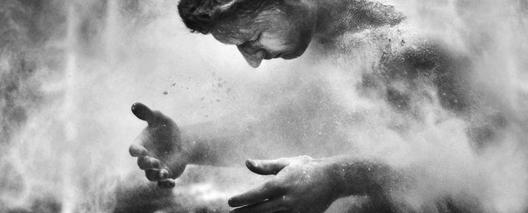

Slide 12
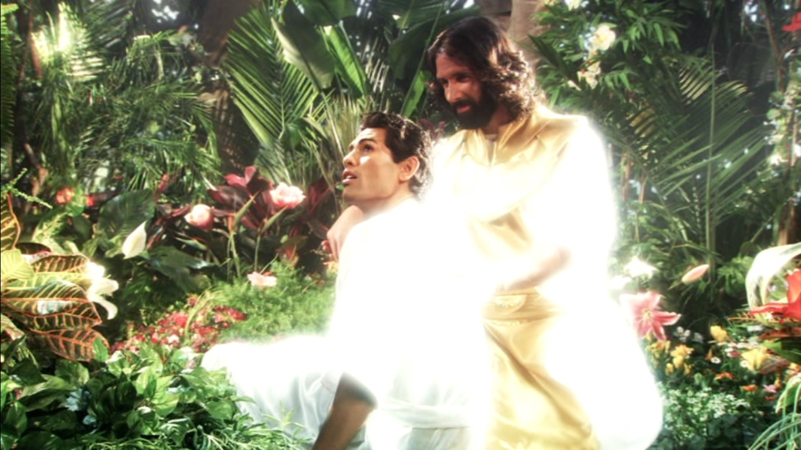

Slide 15
Why?
Gen 2:7 And the LORD God formed man of the dust of the ground, and breathed into his nostrils the breath of life; and man became a living soul.
Gen 2:17 But of the tree of the knowledge of good and evil, thou shalt not eat of it: for in the day that thou eatest thereof thou shalt surely die.
Gen 3:19 In the sweat of thy face shalt thou eat bread, till thou return unto the ground; for out of it wast thou taken: for dust thou art, and unto dust shalt thou return.

Slide 16
Return unto Dust? Are we certain?
Psa 104:29 Thou hidest thy face, they are troubled: thou takest away their breath, they die, and return to their dust.
Psa 104:30 Thou sendest forth thy spirit, they are created: and thou renewest the face of the earth.
Ecc 12:7 Then shall the dust return to the earth as it was: and the spirit shall return unto God who gave it.

Slide 17
Return unto Dust? Are we certain?
Job 34:14 If he (JEHOVAH God) set his heart upon man, if he gather unto himself his spirit and his breath;
Job 34:15 All flesh shall perish together, and man shall turn again unto dust.
Psa 90:3 Thou turnest man to destruction (H1793; crushed to dust); and sayest, Return, ye children of men.

Slide 18
Return unto Dust? Are we certain?
Job 4:19 How much less in them that dwell in houses of clay, whose foundation is in the dust, which are crushed before the moth?
Job 7:21 And why dost thou not pardon my transgression, and take away mine iniquity? for now shall I sleep in the dust; and thou shalt seek me in the morning, but I shall not be.
Job 20:11 His bones are full of the sin of his youth, which shall lie down with him in the dust.

Slide 19
Return unto Dust? Are we certain?
Ecc 3:19 For that which befalleth the sons of men befalleth beasts; even one thing befalleth them: as the one dieth, so dieth the other; yea, they have all one breath; so that a man hath no preeminence above a beast: for all is vanity.
Ecc 3:20 All go unto one place; all are of the dust, and all turn to dust again.
Psa 146:4 His breath goeth forth, he returneth to his earth; in that very day his thoughts perish.

Slide 20
Return unto Dust? Are we certain?
Job 17:13 If I wait, the grave is mine house: I have made my bed in the darkness.
Job 17:14 I have said to corruption, Thou art my father: to the worm, Thou art my mother, and my sister.
Job 17:15 And where is now my hope? as for my hope, who shall see it?
Job 17:16 They shall go down to the bars of the pit, when our rest together is in the dust.

Slide 21
Return unto Dust? Are we certain?
Gen 18:27 And Abraham answered and said, Behold now, I have taken upon me to speak unto the Lord, which am but dust and ashes:
Dan 12:2 And many of them that sleep in the dust of the earth shall awake, some to everlasting life, and some to shame and everlasting contempt.

Slide 22
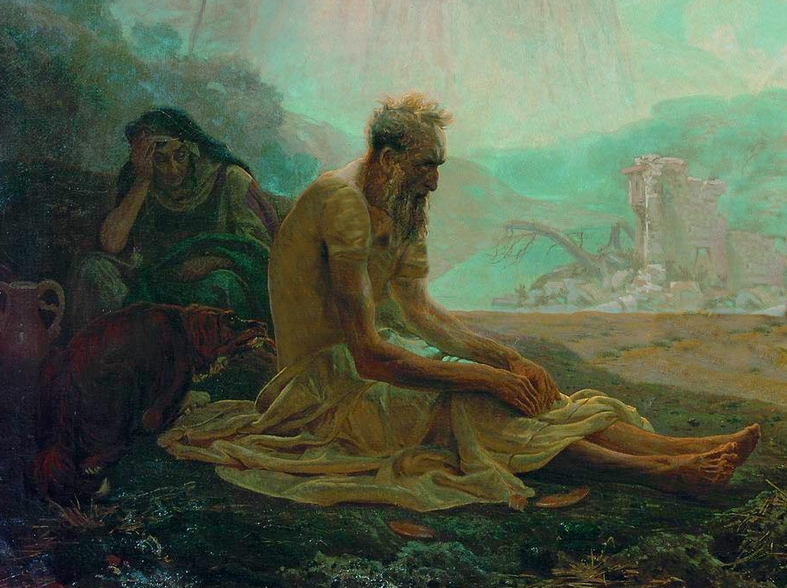

Slide 23
Return unto Dust? Are we certain?
Job 14:5 Seeing his days are determined, the number of his months are with thee, thou hast appointed his bounds that he cannot pass;
Job 14:6 Turn from him, that he may rest, till he shall accomplish, as an hireling, his day.
Job 14:7 For there is hope of a tree, if it be cut down, that it will sprout again, and that the tender branch thereof will not cease.

Slide 24
Return unto Dust? Are we certain?
Job 14:8 Though the root thereof wax old in the earth, and the stock thereof die in the ground;
Job 14:9 Yet through the scent of water it will bud, and bring forth boughs like a plant.
Job 14:10 But man dieth, and wasteth away: yea, man giveth up the ghost, and where is he?

Slide 25
Return unto Dust? Are we certain?
Job 14:11 As the waters fail from the sea, and the flood decayeth and drieth up:
Job 14:12 So man lieth down, and riseth not: till the heavens be no more, they shall not awake, nor be raised out of their sleep. (see “heaven”: Mat. 24:35; Mar. 13:31; Luk. 21:33; 2 Pet. 3:10; Isa. 34:4; Rev. 6:14.)
Job 14:13 O that thou wouldest hide me in the grave, that thou wouldest keep me secret, until thy wrath be past, that thou wouldest appoint me a set time, and remember me! (see “wrath” = 7 last plagues; Rev. 15:1, 16:1,19 KJB)

Slide 26
Return unto Dust? Are we certain?
Job 14:14 If a man die, shall he live again? all the days of my appointed time will I wait, till my change come. (see 1 Cor. 15:50-58; Luk. 14:14 KJB)
Job 14:15 Thou shalt call, and I will answer thee: thou wilt have a desire to the work of thine hands. (see “call”: 1 Thes. 4:16; Psa. 50:4; Isa. 25:8-9 KJB)
Job 14:16 For now thou numberest my steps: dost thou not watch over my sin?

Slide 27
Return unto Dust? Are we certain?
Job 14:17 My transgression is sealed up in a bag, and thou sewest up mine iniquity.
Job 14:18 And surely the mountain falling cometh to nought, and the rock is removed out of his place.
Job 14:19 The waters wear the stones: thou washest away the things which grow out of the dust of the earth; and thou destroyest the hope of man.

Slide 28
Return unto Dust? Are we certain?
Job 14:20 Thou prevailest for ever against him, and he passeth: thou changest his countenance, and sendest him away.
Job 14:21 His sons come to honour, and he knoweth it not; and they are brought low, but he perceiveth it not of them.

Slide 29
Ashes to ashes, dust to dust …

Slide 30
So, the dead know not anything …
Psa 146:4 His breath goeth forth, he returneth to his earth; in that very day his thoughts perish.
Psa 115:17 The dead praise not the LORD, neither any that go down into silence.
Isa 38:18 For the grave cannot praise thee, death can not celebrate thee: they that go down into the pit cannot hope for thy truth.
Isa 8:19 And when they shall say unto you, Seek unto them that have familiar spirits, and unto wizards that peep, and that mutter: should not a people seek unto their God? for the living to the dead?

Slide 31
Question:
Should we then as God's people ever practice Necromancy, or be as a Necromancer?

Slide 32
I hear:
“NO!”

Slide 33
Question:
Are you personally
sure?

Slide 34
I hear:
“Yes, God’s word said that practicing Necromancy
is an abomination!”

Slide 35
God’s word, also says (Luke 19:22 KJB):
“… Out of thine own mouth will I judge thee…”

Slide 36
Since it is the case, and all are agreed, based upon the foundation of Scripture (KJB), that God's own people are not to be practicing Necromancy, or be a Necromancer …

Slide 37
Question:
… What then, are God's people doing by practicing just those very things?

Slide 38
What?
That's outrageous!
Surely not, God's own people?

Slide 39
Yes.
Even God's own people.
And it is not what you are thinking right now.

Slide 40
There may be even some in this room having done or are doing this right now.
Maybe even everyone in this room ... at one time or another.

Slide 41
There is a problem, though …
The problem is, those that are doing it, do not know what they are doing.

Slide 42
There is a problem, though …
Rev 3:17 Because thou sayest, I am rich, and increased with goods, and have need of nothing; and knowest not that thou art wretched, and miserable, and poor, and blind, and naked:

Slide 43
Just four little words …

Slide 44
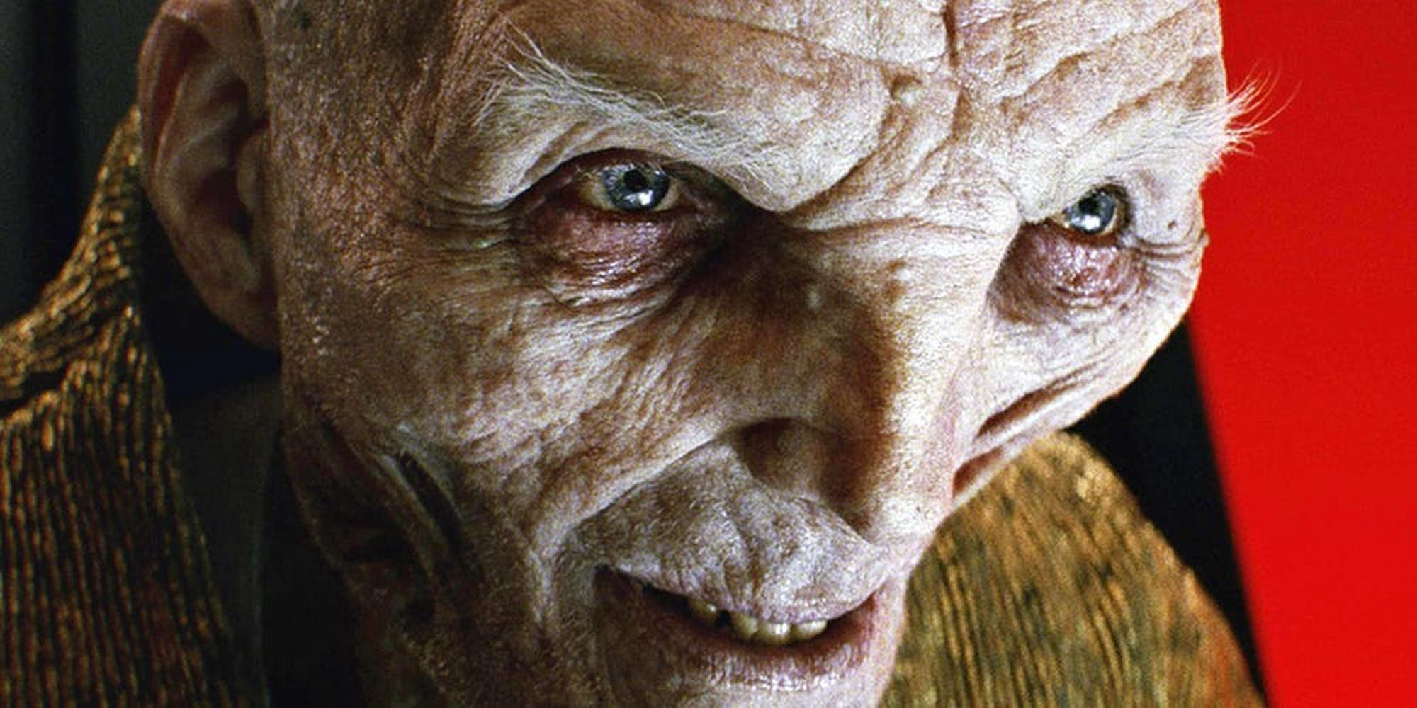
Old Man of Sin

Slide 45
You see.
All of us, at one point or another, have been in conversation with the
Old Man of Sin.
What we didn't realize, in so doing, is that we were attempting communication, a conversation, with a person who is [or should be] Dead.

Slide 46
Natural to Spiritual (1 Cor. 15:46 KJB)
While it might not be the image you were thinking of, in a séance type scenario with cloaked figure, like King Saul and the mysterious Witch of En Dor and a summoning, but it is none-the-less, Necromancy, by very definition.
Plain as day.
And do you know who uses it to get to us?
Satan...

Slide 47
Question:
What are the wages for sin, according to Romans 6:23?

Slide 48
Old Man of Sin …
Rom 6:23 For the wages of sin [is] death; but the gift of God [is] eternal life through Jesus Christ our Lord.

Slide 49
Old Man of Sin …
Eph 2:1 And you [hath he quickened], who were dead in trespasses and sins;
Col 2:13 And you, being dead in your sins and the uncircumcision of your flesh, hath he quickened together with him, having forgiven you all trespasses;

Slide 50
Old Man of Sin …
Rom 6:1 What shall we say then? Shall we continue in sin, that grace may abound?
Rom 6:2 God forbid. How shall we, that are dead to sin, live any longer therein?
Rom 6:3 Know ye not, that so many of us as were baptized into Jesus Christ were baptized into his death?
Rom 6:4 Therefore we are buried with him by baptism into death: that like as Christ was raised up from the dead by the glory of the Father, even so we also should walk in newness of life.

Slide 51
Old Man of Sin …
Rom 6:5 For if we have been planted together in the likeness of his death, we shall be also [in the likeness] of [his] resurrection:
Rom 6:6 Knowing this, that our old man is crucified with [him], that the body of sin might be destroyed, that henceforth we should not serve sin.
Rom 6:7 For he that is dead is freed from sin.

Slide 52
Old Man of Sin …
Rom 6:8 Now if we be dead with Christ, we believe that we shall also live with him:
Rom 6:9 Knowing that Christ being raised from the dead dieth no more; death hath no more dominion over him.
Rom 6:10 For in that he died, he died unto sin once: but in that he liveth, he liveth unto God.

Slide 53
Old Man of Sin …
Rom 6:11 Likewise reckon ye also yourselves to be dead indeed unto sin, but alive unto God through Jesus Christ our Lord.
Rom 6:12 Let not sin therefore reign in your mortal body, that ye should obey it in the lusts thereof.
Rom 6:13 Neither yield ye your members [as] instruments of unrighteousness unto sin: but yield yourselves unto God, as those that are alive from the dead, and your members [as] instruments of righteousness unto God.

Slide 54
Do we not know that the Scriptures tells us in …
Eph 4:22 That ye put off concerning the former conversation the old man, which is corrupt according to the deceitful lusts;

Slide 55
“Conversation”
Did you catch that phrase about “conversation”?
I love it!
That's the King James way of saying 'conduct', 'lifestyle', or 'walk', which includes even thought and speech.
The Old Man of Sin, the world-loving man, should be Dead, and not a little dead, not mostly dead, not even sleeping dead, but all-together dead.

Slide 56
The Old Man of Sin should be sincerely dead …
Lifestyle. Dead.
Dress. Dead.
Hunger. Dead.
Tastes. Dead.
Speech. Dead.
Thinking. Dead.
The Lust of the Flesh, Lust of the Eyes and the Pride of Life. Dead, Dead, Dead.

Slide 57
Are we still in conversation ...
Yet there may be some of us still clinging to the life in the Old Man, whom can never enter Heaven, and who will not be allowed to live much longer (he must either die now, or he will die later).
We should have nothing to do with that Old Man .
It is to be completely dead.
And since it is to be dead, it is unclean, a rotting corpse, and stinks to High Heaven!
Let it be severed - cut loose forever and separated from us!

Slide 58
How does the state of the Dead doctrine affect the Everlasting Gospel and victory over sin?
Think about what the Everlasting Gospel teaches.
Victory over sin. Victory over the Old Man of Sin, who is to be eternally Dead, and not even a little alive.
Now, what happens if I teach that the “dead” don’t really die, ie, ‘immortal soul theology”?
Natural to Spiritual.
Then the Old Man of Sin cannot ever really die, and will always linger, and so there is no victory over sin.
Deadly spiritualism.

Slide 59
Paul knew Laodicea’s struggle …
Rom 7:24 O wretched man that I am! who shall deliver me from the body of this death?

Slide 60
Who shall deliver indeed, and how?
By Jesus Christ, the Ever-Living Man!, even as He says of Himself,
“... I am alive for evermore, Amen ...” Rev. 1:18 KJB

Slide 61
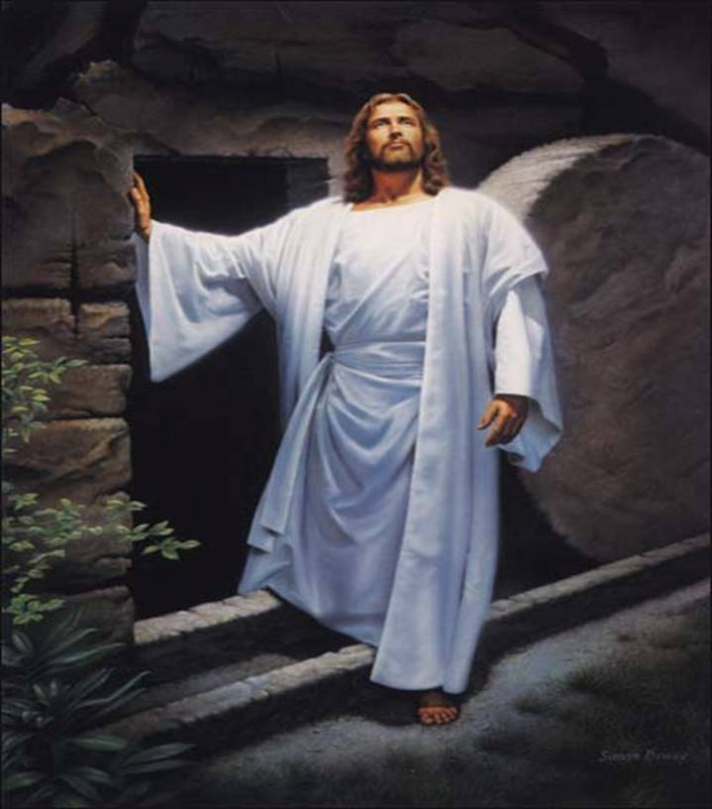

Slide 62
And so, as it is written in …
Rom 7:25 “… I thank God through Jesus Christ our Lord. …”
2Co 1:9 But we had the sentence of death in ourselves, that we should not trust in ourselves, but in God which raiseth the dead :
2Co 1:10 Who delivered us from so great a death, and doth deliver: in whom we trust that he will yet deliver us;

Slide 63
Question:
How does the Old Man of Sin die?

Slide 64
By Crucifixion!

Slide 65
By Crucifixion!
2 Cor 5:21 For he (God the Father) hath made him (Jesus, the Son) to be sin for us, who knew no sin; that we might be made the righteousness of God in him.

Slide 66
By Crucifixion!
Gal 2:20 I am crucified with Christ: nevertheless I live; yet not I, but Christ liveth in me: and the life which I now live in the flesh I live by the faith of the Son of God, who loved me, and gave himself for me.

Slide 67
By Crucifixion!

Slide 68
By Crucifixion!

Slide 69
By Crucifixion!

Slide 70
For it is only then, can the sin be purged.
Isa 22:14 And it was revealed in mine ears by the LORD of hosts, Surely (Gen. 2:17 KJB) this iniquity shall not be purged from you till ye die, saith the Lord GOD of hosts.

Slide 71
For it is only then, can the sin be purged.
Heb 1:3 Who being the brightness of his glory, and the express image of his person, and upholding all things by the word of his power, when he had by himself purged our sins, sat down on the right hand of the Majesty on high;

Slide 72
For it is only then, can the sin be purged.
1Co 15:36 Thou fool, that which thou sowest is not quickened, except it die :
Mar 10:21 Then Jesus beholding him loved him, and said unto him, One thing thou lackest: go thy way, sell whatsoever thou hast, and give to the poor, and thou shalt have treasure in heaven: and come, take up the cross, and follow me.
Luk 9:23 And he said to them all, If any man will come after me, let him deny himself, and take up his cross daily, and follow me. (see “follow”, John 21:19,21; 1 Pet. 2:21 KJB)
Luk 9:24 For whosoever will save his life shall lose it: but whosoever will lose his life for my sake, the same shall save it.

Slide 73
Since the Old Man of Sin is dead, let us be Born Again, Born from Heaven above!
Joh 3:3 Jesus answered and said unto him, Verily, verily, I say unto thee, Except a man be born again, he cannot see the kingdom of God.
Joh 3:5 Jesus answered, Verily, verily, I say unto thee, Except a man be born of water and of the Spirit, he cannot enter into the kingdom of God.
Joh 3:7 Marvel not that I said unto thee, Ye must be born again.

Slide 74
Since the Old Man of Sin is dead, let us be Born Again, Born from Heaven above!
Luk 1:35 And the angel answered and said unto her, The Holy Ghost shall come upon thee, and the power of the Highest shall overshadow thee: therefore also that holy thing which shall be born of thee shall be called the Son of God.
1Pe 1:23 Being born again, not of corruptible seed, but of incorruptible, by the word of God, which liveth and abideth for ever.

Slide 75
Not by …
Nationality
Gender
Rank
Status
Church Office
Paygrade
the Generation
the Forefathers Faith & Religion

Slide 76
It must be by our own personal death, and rebirth through Christ Jesus …
“... In a view given June 27, 1850, my accompanying angel said, “Time is almost finished. Do you reflect the lovely image of Jesus as you should?” Then I was pointed to the earth and saw that there would have to be a getting ready among those who have of late embraced the third angel’s message. Said the angel, “Get ready, get ready, get ready. Ye will have to die a greater death to the world than ye have ever yet died.” I saw that there was a great work to do for them and but little time in which to do it. …”

Slide 77
It must be by our own personal death, and rebirth through Christ Jesus …
“… Then I saw that the seven last plagues were soon to be poured out upon those who have no shelter; yet the world regarded them no more than they would so many drops of water that were about to fall. I was then made capable of enduring the awful sight of the seven last plagues, the wrath of God. I saw that His anger was dreadful and terrible, and if He should stretch forth His hand, or lift it in anger, the inhabitants of the world would be as though they had never been, or would suffer from incurable sores and withering [Page 64-65] plagues that would come upon them, and they would find no deliverance, but be destroyed by them. …”

Slide 78
It must be by our own personal death, and rebirth through Christ Jesus …
“… Terror seized me, and I fell upon my face before the angel and begged of him to cause the sight to be removed, to hide it from me, for it was too dreadful. Then I realized, as never before, the importance of searching the Word of God carefully, to know how to escape the plagues which that Word declares shall come on all the ungodly who shall worship the beast and his image and receive his mark in their foreheads or in their hands. It was a great wonder for me that any could transgress the law of God and tread down His holy Sabbath, when such awful threatenings and denunciations were against them. ...” – Early Writings (1882); pages 64.1-64.2

Slide 79
The prophet Habakkuk saw what sister White saw, notice what he desired:
Hab 3:16 When I heard, my belly trembled; my lips quivered at the voice: rottenness entered into my bones, and I trembled in myself, that I might rest in the day of trouble: when he cometh up unto the people, he will invade them with his troops.

Slide 80
Remember what was said about “conversation”? We should not be in “conversation” with the Old Man of Sin, but we cannot live without being in “conversation” with Jesus Christ, the Man of Righteousness.
Php 3:20 For our conversation is in heaven; from whence also we look for the Saviour, the Lord Jesus Christ:
1Pe 1:15 But as he which hath called you is holy, so be ye holy in all manner of conversation;
2Pe 3:11 Seeing then that all these things shall be dissolved, what manner of persons ought ye to be in all holy conversation and godliness,
Heb 13:5 Let your conversation be without covetousness; and be content with such things as ye have: for he hath said, I will never leave thee, nor forsake thee. (We were given Jesus Christ, John 3:16)

Slide 81
Our only portion …
“… Young and old have a conflict and warfare before them. They should not sleep for a moment. A wily foe is constantly on the alert to lead them astray and overcome them. Believers in present truth must be as watchful as their enemy, and manifest wisdom in resisting Satan. Will they do this? Will they persevere in this warfare? Will they be careful to depart from all iniquity? Christ is denied in many ways. …”

Slide 82
Our only portion …
“… We may deny him in our words, by speaking contrary to truth, or by speaking evil of others, or by foolish talking or jesting, or by words that are idle. In these things we manifest but little shrewdness or wisdom. We make ourselves weak, and our efforts are feeble to resist our great enemy, and we are conquered. From the abundance of the heart the mouth speaketh, and through lack of watchfulness we confess that Christ is not in us. Those who will hesitate to devote themselves unreservedly to God, make poor work of following Christ. They follow him at such a distance that they do not really know half the time whether they are following his footprints, or the footsteps of their great enemy. …”

Slide 83
Our only portion …
“… Why are we so slow to give up our interest in the things of this world, and take Christ for our only portion? Why should we wish to keep the friendship of our Lord's enemies, and follow their customs, and be led by their opinions? There must be an entire, unreserved surrender to God, a forsaking and turning away from the love of the world and earthly things, or we cannot be his disciples. …” – The (Advent) Review and (Sabbath) Herald; August 31, 1886, par. 10

Slide 84
A message from Jesus to the young people …
“... I would ask the youth of today who profess to believe present truth, wherein they deny self for the truth’s sake. When they really desire an article of dress, or some ornament or convenience, do they lay the matter before the Lord in prayer to know if His Spirit would sanction this expenditure of means? In the preparation of their clothing, are they careful not to dishonor their profession of faith? Can they seek the Lord’s blessing upon the time thus employed? …”

Slide 85
A message from Jesus to the young people …
“… It is one thing to join the church, and quite another thing to be united to Christ. Unconsecrated, world-loving professors of religion are one of the most serious causes of weakness in the church of Christ. …” – Messages to Young People (1930); page 357.1 & The (Advent) Review and (Sabbath) Herald; December 6, 1881, par. 8

Slide 86
The Old Man of Sin
Pro 21:16 The man that wandereth out of the way (Psa. 77:13; Jhn. 14:6 KJB) of understanding shall remain in the congregation of the dead.

Slide 87
Christ Jesus, “... not my will, but thine, be done. ...” – Luk. 22:42 KJB

Slide 88
Question:
In Christ's death, where was He when finally the sun was set, so beginning the Sabbath of the LORD?

Slide 89
He was in the tomb. Dead.
Yes, dead to world, the flesh and the devil, but alive unto God ...

Slide 90
Old things are passed away …
Heb 9:14 How much more shall the blood of Christ, who through the eternal Spirit offered himself without spot to God, purge your conscience from dead works to serve the living God?
2Co 5:17 Therefore if any man be in Christ, he is a new creature: old things are passed away; behold, all things are become new.

Slide 91
Why talk to a corpse, when we can talk to the ever-living Jesus Christ?
Since it (the Old Man of Sin) is passed away, it is dead and gone.
He has nothing to offer, no advice, no example, no experience, no wisdom, no strength, no wealth, no life to impart.
Let us cease from all Necromancy and have a Living relationship, a daily living “conversation” with the ever Living God!

Slide 92
Jesus in Gethsemane. No way of escape …
“... His decision is made. He will save man at any cost to Himself. He accepts His baptism of blood, that through Him perishing millions may gain everlasting life. He has left the courts of heaven, where all is purity, happiness, and glory, to save the one lost sheep, the one world that has fallen by transgression. And He will not turn from His mission. He will become the propitiation of a race that has willed to sin. His prayer now breathes only submission: “If this cup may not pass away from Me, except I drink it, Thy will be done.” …”

Slide 93
Jesus in Gethsemane. No way of escape …
“… Having made the decision, He fell dying to the ground from which He had partially risen. Where now were His disciples, to place their hands tenderly beneath the head of their fainting Master, and bathe that brow, marred indeed more than the sons of men? The Saviour trod the wine press alone, and of the people there was none with Him. …”

Slide 94
Jesus in Gethsemane. No way of escape …
“… But God suffered with His Son. Angels beheld the Saviour’s agony. They saw their Lord enclosed by legions of satanic forces, His nature weighed down with a shuddering, mysterious dread. There was silence in heaven. No harp was touched. Could mortals have viewed the amazement of the angelic host as in silent grief they watched the Father separating His beams of light, love, and glory from His beloved Son, they would better understand how offensive in His sight is sin. ...” – The Desire of Ages (1898); pages 693.1-693.2

Slide 95
Jesus in Gethsemane. No way of escape …
“… No way of escape was found for the Son of God …” – The Desire of Ages (1898); pages 693.3

Slide 96
Question:
There was no escape for Jesus, who was without sin, yet took our sins upon Himself.
How shall we think our Old Man of Sin will escape the judgment of God?

Slide 97
Our conversation with The Old Man of Sin must cease!
Psa 48:14 For this God is our God for ever and ever: he will be our guide even unto death.
Php 2:8 And being found in fashion as a man, he humbled himself, and became obedient unto death, even the death of the cross.

Slide 98
Our conversation with The Old Man of Sin must cease!
Luk 24:5 And as they were afraid, and bowed down their faces to the earth, they said unto them, Why seek ye the living among the dead?
Isa 8:19 And when they shall say unto you, Seek unto them that have familiar spirits, and unto wizards that peep, and that mutter: should not a people seek unto their God? for the living to the dead?

Slide 99
The Ever-Living …
Christ Jesus cannot be found in anything the Old Man of Sin desires.
We ought to seek (inquire of, be in conversation with) the Living, among the Living.

Slide 100
Question:
Do you (personally) want to test to see if you are truly DEAD unto this world, and alive unto God?

Slide 101
From Jesus to us with love …
“… “I am instructed to bear a message to all our people on the subject of health reform, for many have backslidden from their former loyalty to health reform principles, the light that God has given is being disregarded. {PH128 1.1} …
... Those who have received instructions regarding the evils of the use of flesh meats, tea and coffee, and rich and unhealthful food preparations, and who are determined to make a covenant with God by sacrifice will not continue to indulge their appetites for food they know to be unhealthful. God demands that the appetites be cleansed and self-denial be practised in regard to these things which are not good. This is a work that will have to be done before his people can stand before him a perfect people. {PH128 1.1} …” (Italics in Original)

Slide 102
From Jesus to us with love …
“… The Lord has given clear light regarding the nature of the food that is to compose our diet: he has instructed us concerning the effect of unhealthful food upon the disposition and character. Shall we respond to the counsels and cautions given? Who among our brethren will Sign a Pledge to dispense with Flesh Meats, tea, coffee, and all injurious foods and become health reformers in the truest sense of the term? If we could be benefitted by indulging the desire for flesh meats, I would not make this appeal to you; but I know that we can not. They are injurious to the physical well being and we should learn to do [Page 1-2] without them. {PH128 1.2} …”

Slide 103
From Jesus to us with love …
“… In this experience of backsliding from the principles of reform, our people have been repeating the experience of the children of Israel in the wilderness during the forty years of travel. Those who continue to follow their own course in this respect, eating, drinking, as they please, will gradually grow careless of the instructions the Lord has given regarding other phases of the present truth; they surely reap as they have sown. I have been instructed that the students in our schools are not to be served with flesh foods, or with food preparations that will cause disturbances of the stomach. {PH128 1.2} ...” – Pamphlets 128 – Backsliding in Health Reform (1908); par. 1-2.

Slide 104
Scripture Reading (again): Deut. 18:9-13 KJB
Deu 18:9 When thou art come into the land which the LORD thy God giveth thee, thou shalt not learn to do after the abominations of those nations.
Deu 18:10 There shall not be found among you any one that maketh his son or his daughter to pass through the fire, or that useth divination, or an observer of times, or an enchanter, or a witch,
Deu 18:11 Or a charmer, or a consulter with familiar spirits, or a wizard, or a necromancer.
Deu 18:12 For all that do these things are an abomination unto the LORD: and because of these abominations the LORD thy God doth drive them out from before thee.
Deu 18:13 Thou shalt be perfect with the LORD thy God.

Slide 105
Final Question:
Is my (your) Old Man of Sin sincerely dead, or am I (you) still in conversation with it?

Slide 106
I don’t know about you, but my desire is for Christ Jesus and for conversation with Him who lives.

