Slide 1
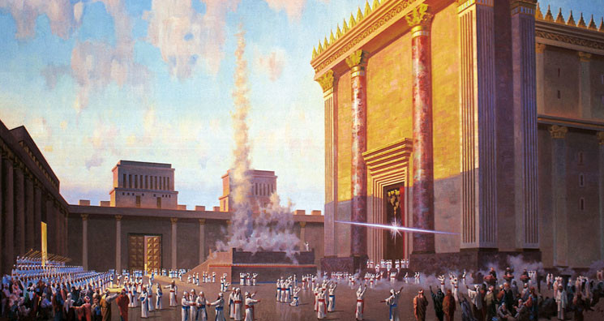
Typology - Solomon
http://www.pearltrees.com/awhn

Slide 2
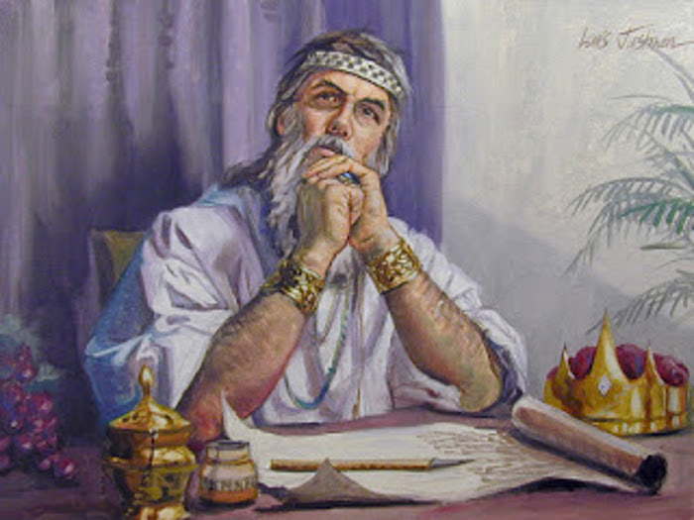

Slide 3
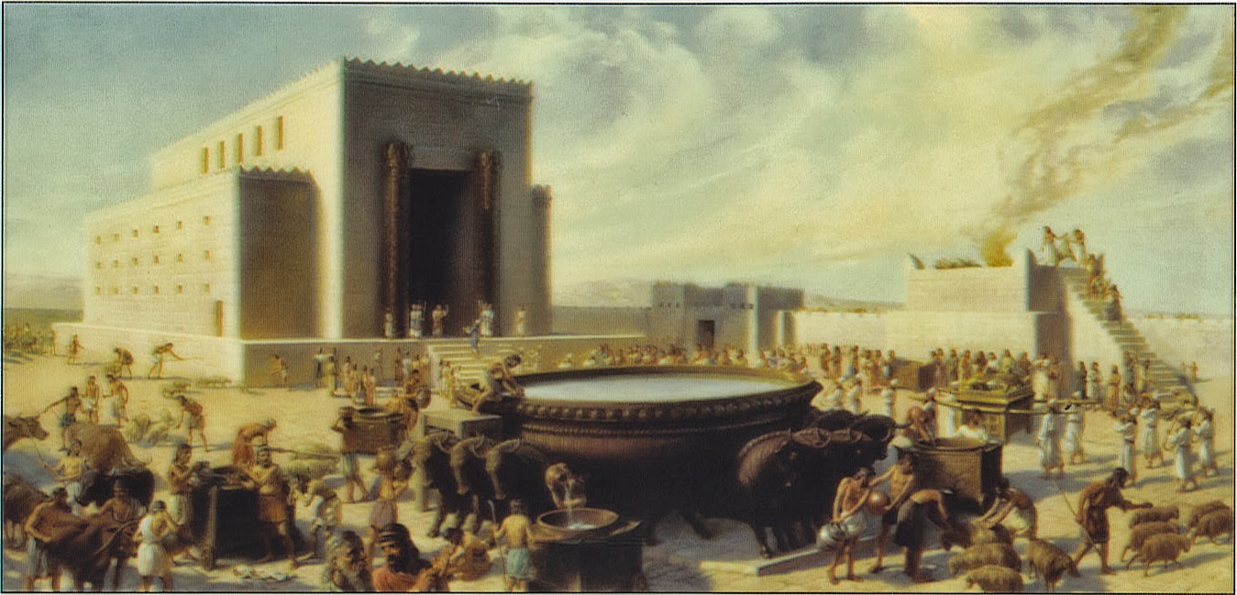

Slide 4
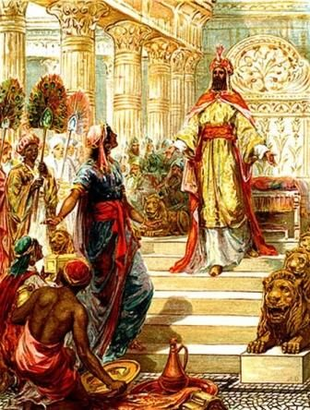

Slide 5
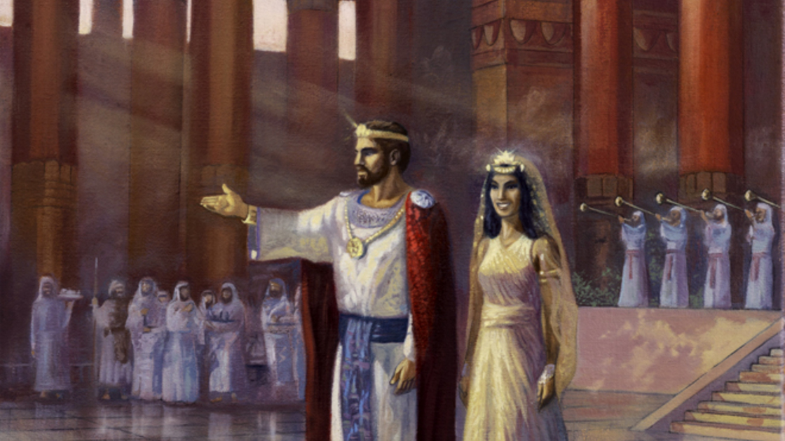

Slide 6
Solomon, the Type of Christ Jesus
Solomon - King of Israel (1 Ki. 1:13,34,37,39,43,46-48,51,53, 2:12,17,19,22,23,25,29,45,46; 3:4,6,7, 4:1,7,27, 5:1,5,7,13, 6:1,2, 7:13,14,40,51, 8:1,2,5,20,62,63, 9:1,10,11,15,26,28, 10:3,9,10,13,16,21,23,26,28, 11:1,26,27,42, 12:2; 2 Ki. 23:13, 24:13; 1 Chr. 17:11, 23:1, 29:22,23,24,25; 2 Chr. 1:11,14, 2:11, 4:11,16, 5:6, 6:10, 7:5,11; 8:6,18, 9:9,12,15,20,22,25,26,30, 10:2; Neh. 13:26; Psa. 72:1, Pro. 25:1; Ecc. 1:1,12; Song. 3:9,11; Jer. 52:20)
  Jesus - King & Ruler ("Prince") (Isa. 9:6, 22:21-22; Dan. 8:11,25, 9:25,26, 11:22; Mic. 5:2; Zec. 9:9; Mat. 2:2, 21:5, 27:11,29,37, 28:18; Mar. 15:2,9,12,18,26; Luk. 14:31, 23:3,37,38; 18:33,39, 19:38; Jhn. 12:13,15, 19:3,14,19,21; Rev. 1:5, 17:14, 19:16, see also "Lord" and "Master"; too many to list)

Slide 7
Solomon, the Type of Christ Jesus
Solomon - associated with a Nathan (2 Sam. 12:25; 1 Ki. 1:10,22,32-34,38,44,45; 1 Chr. 17:1-15; 2 Chr. 9:29)
  Jesus - associated with a Nathanael (Jhn. 1:45-49, 21:2)
Solomon - prophecy associated with his birth (1 Chr. 17:3-15,23)
  Jesus - prophecies associated with His birth (Isa. 7:14, 9:6, 22:21-22; Mic. 5:2; Luk. 1:35, 2:11)
Solomon - prophecies about His life (1 Ki. 11:29-40, 12:15; 2 Chr. 9:29,10:15)
  Jesus - prophecies about His life (Psa. 40:7; Mat. 26:24,31; Mar. 9:12, 14:21,27; Luk. 4:16-21, 18:31, 20:17, 22:37, 24:27,44,46; Jhn. 2:17, 5:39, 6:45, 12:14-16, 15:25; Act. 3:18, 13:29, 15:14-17, 24:14, 26:22-23; Rom. 9:33, 11:26, 15:3,9; 1 Cor. 15:45; Gal. 3:13; Heb. 10:7; Rev. 1:1, 12:1-5, etc)

Slide 8
Solomon, the Type of Christ Jesus
Solomon - fled with His father, as a child, and his life was in danger (2 Sam. 12:24-25, 13:38 (3 years), 14:28 (2 years, thus 5 years), 15:14,16,17,33, 16:5-14, 17:1)
  Jesus - fled, as a child, with his earthly guardian, Joseph, and his life was in danger (Hos. 11:1; Mat. 2:13-22)
Solomon - fleeing with His father, crossed the brook Kidron (2 Sam. 15:23)
  Jesus - He crossed the brook Kidron ("Cedron") (Jhn. 18:1)
Solomon - fleeing with His father, was ministered unto in the wilderness (2 Sam. 16:1-2, 17:28-29)
  Jesus - He was ministered unto in the wilderness (Mat. 4:11; Mar. 1:13)

Slide 9
Solomon, the Type of Christ Jesus
Solomon - fleeing with His father, ascended the Mount Olivet (2 Sam. 15:30,32, 16:1)
  Jesus - He was upon the Mount of Olives (Mat. 21:1,17, 24:3, 26:6,30; Mar. 11:1,11,12, 13:3, 14:3,26; Luk. 19:29,37, 21:37, 22:39, 24:50; Jhn. 8:1, 11:1,18, 12:1; Act. 1:12), and will be again in His third Advent (Isa. 24:22; Zec. 14:4; Rev. 20:7-15)
Solomon - having fled with His Father, went down into Jordan and crossed it (2 Sam. 17:16,20-22)
  Jesus - went down into the Jordan for Baptism (Mat. 3:13; Mar. 1:9; Luk. 4:1; Jhn. 3:26, 10:40)

Slide 10
Solomon, the Type of Christ Jesus
Solomon - returned with His father over the Jordan river, coming from the East victoriously (2 Sam. 19:14-18,37-41)
  Jesus - In His 2nd Advent, He comes from the east (Mat. 24:27; Rev. 16:12)
Solomon - an enemy of His father, hung himself (2 Sam. 17:23)
  Jesus - an enemy (Judas Iscariot) of His father, hung himself (Mat. 27:5; Mar. 14:21; Act. 1:18-20,25)
Solomon - associated with "acts" (2 Chr. 9:29)
  Jesus - associated with "acts" (Psa. 103:7, 106:2, 145:4,6,12, 150:2; Jhn. 21:25; Act. 1:1-28:31)

Slide 11
Solomon, the Type of Christ Jesus
Solomon - associated with the words 'first and last' (2 Chr. 9:29)
  Jesus - associated with the words 'first and last' (Isa. 41:4, 44:6, 48:12; Rev. 1:11,17, 2:8, 22:13)
Solomon - 10 and 2 (1 Ki. 11:30-32,35-36)
  Jesus - 10 and 2 (Mat. 20:20-28; Mar. 10:35-45)
Solomon - Beloved of God (Neh. 13:26)
  Jesus - Beloved of God (Mat. 3:17, 12:18, 17:5; Mar. 1:11, 9:7; Luk. 3:22, 9:35, 20:13; Jhn. 3:35, 5:20; Eph. 1:6; 2 Pet. 1:17)

Slide 12
Solomon, the Type of Christ Jesus
Solomon - Had another name, meaning "Beloved of JEHOVAH" (2 Sam. 12:25)
  Jesus - Has many other names, like Emmanuel/Immanuel (Isa. 7:14, 8:8; Mat. 1:23), Michael (Dan. 10:13,21, 12:1; Jud. 1:9; Rev. 12:7), David (Psa. 89:3,20; Jer. 30:9; Eze. 34:23,24, 37:24,25; Hos. 3:5), etc (Rev. 19:12)
Solomon - Prince of princes (1 Chr. 22:17, 29:24)
  Jesus - Prince of Princes (Dan. 8:25)
Solomon - Prince of Peace (1 Ki. 4:24, 5:4; 1 Chr. 22:9)
  Jesus - Prince of Peace (Isa. 9:6)

Slide 13
Solomon, the Type of Christ Jesus
Solomon - Wore a crown (Song. 3:11)
  Jesus - wore a crown of thorns, and many crowns (Psa. 8:5; Mat. 27:29; Mar. 15:17; Jhn. 19:2,5; Heb. 2:9; Rev. 19:12)
Solomon - Every knee bowed unto Him (1 Ki. 1:53; 1 Chr. 29:24)
  Jesus - Every knee shall bow unto Him to the glory of God the Father (Psa. 72:11; Isa. 45:22-25; Mat. 27:29; Mar. 15:19; Rom. 14:11; Php. 2:10)
Solomon - Magnified and glorified by God (1 Chr. 29:25; 2 Chr. 1:1; Mat. 6:29; Luk. 12:27)
  Jesus - Magnified and Glorified by God (Mat. 17:2,5; Mar. 9:2,3; Luk. 9:29; Jhn. 7:39, 11:4, 12:16,23,28, 13:31,32, 17:10; Act. 3:13, 7:37; 2 Thes. 1:10,12; Heb. 5:5; 1 Pet. 4:14; 2 Pet. 1:16-18)

Slide 14
Solomon, the Type of Christ Jesus
Solomon - God spake directly to Him (1 Ki. 3:5,11-14, 9:2-9, 11:9-13; 2 Chr. 1:7-12, 7:12-22)
  Jesus - God spake directly to Him (Mat. 3:17; Mar. 1:11; Luk. 3:22; Jhn. 12:28; 2 Pet. 1:17,18)
Solomon - Preacher (Ecc. 1:1,2,12, 12:8-10)
  Jesus - Preacher (Ecc. 1:1,2,12, 12:8-10; Mat. 4:23, 9:35, 11:5, 24:14; Mar. 1:14, 2:2; Luk. 3:18, 4:44, 7:22, 8:1, 16:16, 20:1; Act. 10:36; Rom. 10:14, 15:8)
Solomon - taught truth and knowledge (Ecc. 12:9,10,13-14)
  Jesus - He is the Truth and taught knowledge (Mat. 4:23, 5:2, 7:29, 9:35, 13:54, 21:23; Mar. 1:21,22, 2:13, 4:2, 6:6, 9:31, 10:1, 11:17, 12:35, 14:49; Luk. 4:15,31, 5:3,17, 6:6, 11:1, 13:10, 19:47, 20:1, 21:37, 23:5; Jhn. 1:17, 6:45,59, 7:14,28, 8:2,20,28, 14:6, 18:20,37; Rom. 15:8; Eph. 4:1; 1 Thes. 4:9; 1 Jhn. 2:27)

Slide 15
Solomon, the Type of Christ Jesus
Solomon - Wise (1 Ki. 2:6,9, 3:28, 4:29-34, 5:7,12, 10:1,3,8,24; 1 Chr. 22:12; 2 Chr. 1:11, 9:1,20,22,23, 12:2; Ecc. 1:13,16-18, 2:9,12-14,19,26, 4:13, 12:9; Mat. 12:42; Luk. 11:31)
  Jesus - He is Wisdom itself (Pro. 8:22-36; Mat. 12:42, 13:54; Mar. 6:2; Luk. 1:17, 2:40,52, 7:35, 11:31; Act. 6:10; 1 Cor. 1:24,30; Col. 2:2-3; Rev. 5:12)
Solomon - a man of sorrows (Ecc. 2:23)
  Jesus - the man of sorrows (Isa. 53:3; Luk. 19:41; Jhn. 11:35,38; Heb. 5:7)
Solomon - eats honeycomb (Song. 5:1)
  Jesus - eats honeycomb (Luk. 24:42-43)

Slide 16
Solomon, the Type of Christ Jesus
Solomon - Proverbs, Dark Sayings, Parables (1 Ki. 4:32; Pro. 1:1~, 10:1, 25:1; Ecc. 1:1-12:14, 12:9)
  Jesus - Proverbs, Dark Sayings, Parables (Psa. 78:2; Mat. 13:3,10,13,18,24,31,33,34-36,53, 15:15, 20:1-1, 21:33,45, 22:1-14, 24:32; Mar. 3:23, 4:2,10,11,13,33,34, 7:17, 12:1,12, 13:28; Luk. 5:36, 6:39, 8:4,9-11, 12:16, 12:41, 13:6, 14:7, 15:3, 18:1,9, 19:11, 20:9,19, 21:29; Jhn. 10:6, 16:25,29)
Solomon - spake parables of trees and of beasts (1 Ki. 4:33; Ecc. 9:12)
  Jesus - spake parables of trees and of beasts (Mat. 13:1-50, 24:32, 25:31-46; Mar. 13:28; Luk. 13:6, 21:29)
Solomon - is compared to a tree (Song. 2:3)
  Jesus - is compared to a tree (Isa. 11:1; Jer. 23:5, 33:15; Zec. 3:8, 6:12; Luk. 23:31; Jhn. 15:1-8; Rom. 11:16-24)

Slide 17
Solomon, the Type of Christ Jesus
Solomon - Judge (1 Ki. 3:16-28, 7:7, 10:9; 2 Chr. 1:11)
  Jesus - Judge (Luk. 19:22; Jhn. 5:30, 7:24, 8:16,26, 12:48; Act. 10:42, 17:31; Rom. 2:16, 14:10; 2 Cor. 5:10; 2 Tim. 4:1,8; Jam. 5:9; 1 Pet. 4:5; Rev. 19:11)
Solomon - Investigative Judgment (1 Ki. 3:16-28)
  Jesus - Investigative Judgment (Gen. 18:21; Rev. 14:6-7)
Solomon - Richest (1 Ki. 3:13, 10:14,23; 2 Chr. 9:13-20; Ecc. 2:7,9)
  Jesus - Richest (Rom. 9:23; Eph. 1:18, 3:16; Php. 4:19; Col. 1:27; Rev. 5:12)
Solomon - Rides a mule (1 Ki. 1:33,38,44)
  Jesus - Rides on a colt the foal of an ass (Zec. 9:9; Mat. 21:2-5; Mar. 11:2-7; Luk. 19:30-35)

Slide 18
Solomon, the Type of Christ Jesus
Solomon - Anointed (1 Ki. 1:34,39, 5:1; 1 Chr. 29:22; 2 Chr. 6:42)
  Jesus - Anointed (Messiah/Christ, means 'anointed') (Psa. 2:2, 45:7; Isa. 61:1; Luk. 4:18, 7:38,46; Jhn. 1:41, 11:2, 12:3; Act. 4:27, 10:38; Heb. 1:9)
Solomon - People rejoiced around him, the whole city of Jerusalem being in an uproar (1 Ki. 1:40-41,45)
  Jesus - People rejoiced around him, the whole city of Jerusalem being in an uproar (Mat. 21:8-11; Jhn. 12:19)
Solomon - Made King twice (1 Chr. 23:1, 29:22)
  Jesus - Made King twice, throne of Grace (Heb. 4:16), throne of Power and Glory (Mat. 19:28, 25:31)

Slide 19
Solomon, the Type of Christ Jesus
Solomon - Throne (1 Ki. 1:13,37,46-48, 2:12,19,22,45,46, 5:5, 7:7, 8:20, 10:18-20; 1 Chr. 17:14, 28:5, 29:23; 2 Chr. 6:10; Song. 3:7 ("bed"))
  Jesus - Throne (Psa. 45:6; Dan. 7:14; Zec. 6:13; Mat. 19:28, 25:31; Luk. 1:32; Act. 2:30; Rom. 14:10; 2 Cor. 5:10; Eph. 1:20; Heb. 1:8, 4:16, 12:2,5; Rev. 3:21, 22:1,3)
Solomon - Sits on the Throne of the LORD (1 Chr. 17:14, 28:5, 29:23)
  Jesus - Sits on the Throne of the LORD (Eph. 1:20; Heb. 8:1, 12:2; Rev. 3:21, 5:6, 7:17, 12:2,5, 22:1,3)
Solomon - Chosen of God (1 Chr. 28:5,6, 29:1)
  Jesus - Chosen of God (Isa. 42:1; Mat. 12:18; Luk. 23:35; 1 Pet. 2:4,6)

Slide 20
Solomon, the Type of Christ Jesus
Solomon - Gave commandments (Neh. 12:45)
  Jesus - Gave commandments (Mat. 5:19, 8:4,18, 10:5, 11:1, 14:19, 15:35, 21:6, 28:20; Mar. 1:44, 5:43, 6:8,39, 8:6,7, 10:49, 11:6, 13:34; Luk. 5:14, 8:29,55, 9:21, 14:22, 17:9,10, 18:40, 19:15; Jhn. 14:15,21, 15:10,14; Act. 1:2,4, 10:42; 1 Cor. 14:37; 1 Thes. 4:2; 1 Jhn. 2:3,4, 3:22-24, 5:3; 2 Jhn. 1:6)
Solomon - son of God (1 Chr. 17:13)
  Jesus - Son of God (Dan. 3:25; Mat. 4:3,6, 8:29, 14:33, 16:16, 26:63, 27:40,43,54; Mar. 1:1, 3:11, 14:61, 15:39; Luk. 1:32,35, 3:38, 4:3,9,41, 8:28, 22:70; Jhn. 1:34,49, 3:18, 5:25, 6:69, 9:35, 10:36, 11:4,27, 19:7, 20:31; Act. 8:37, 9:20; Rom. 1:4; 2 Cor. 1:19; Gal. 2:20; Eph. 4:13; Heb. 4:14, 6:6, 7:3, 10:29; 1 Jhn. 3:8, 4:15, 5:5,10,12,13,20; Rev. 2:18)

Slide 21
Solomon, the Type of Christ Jesus
Solomon - Son of an Ancient of days (1 Ki. 1:1,15; 1 Chr. 23:1, 29:28)
  Jesus - Son of the Ancient of Days (Dan. 7:9,13,22)
Solomon - Son of David (2 Sam. 5:14, 12:24; 1 Ki. 1:12,13,17,21, 2:1,12,24,26,44,45, 3:6,7, 5:3,5,7, 7:51, 8:15,17-20,24-26, 9:5, 11:4,6,27; 2 Ki. 21:7; 1 Chr. 3:5, 14:4, 17:11, 22:5-7,9,11,18, 23:1, 28:5,6,9,11,20, 29:1,19,22,23; 2 Chr. 1:1,8,9, 2:3,7, 5:1, 6:4,7,8-10,12,15,16, 7:17, 30:26, 35:3,4; Neh. 12:45; Psa. 72:1; Ecc. 1:1; Mat. 1:6)
  Jesus - Son of David (Amo. 9:11; Mat. 1:1,17,20, 9:27, 12:23, 15:22, 20:30,31, 21:9,15, 22:42,45; Mar. 10:47,48, 12:35,37; Luk. 1:27,32,69, 2:4,11, 3:31, 18:38,39, 20:41,44; Jhn. 7:42; Act. 13:34, 15:16; Rom. 1:3; 2 Tim. 2:8; Rev. 5:5, 22:16)

Slide 22
Solomon, the Type of Christ Jesus
Solomon - son of man (1 Ki. 2:2)
  Jesus - Son of Man (Dan. 7:13; Mat. 8:20, 9:6, 10:23, 11:19, 12:8,32,40, 13:37,41, 16:13,27,28, 17:9,12,22, 18:11, 19:28, 20:18,28, 24:27,30,37,39,44, 25:13,31, 26:2,24,45,64; Mar. 2:10,28, 8:31,38, 9:9,12,31, 10:33,45, 13:26,34, 14:21,41,62; Luk. 5:24,6:5,22, 7:34, 9:22,26,44,56,58, 11:30, 12:8,10,40, 17:22,24,26,30, 18:8,31, 19:10, 21:27,36, 22:22,48,69, 24:7; Jhn. 1:51, 3:13,14, 5:27, 6:27,53,62, 8:28, 12:23,34, 13:31; Act. 7:56; Rev. 1:13, 14:14)
Solomon - given Gifts by His Father (1 Ki. 7:51)
  Jesus - Given gifts by His Father (Isa. 8:18; Jhn. 3:35, 5:26,36, 6:39, 13:3, 17:11,24, 18:11; Heb. 2:13)

Slide 23
Solomon, the Type of Christ Jesus
Solomon - Kept God's commandments (1 Ki. 2:3; 1 Chr. 29:9, 29:19; Psa. 72:1; Ecc. 12:13-14)
  Jesus - Kept His Father's commandments (Jhn. 8:29, 15:10; Php. 2:8)
Solomon - loved God (1 Ki. 3:3)
  Jesus - Loves His Father (Jhn. 14:31)
Solomon - celebrated the Feasts (1 Ki. 8:2; 2 Chr. 5:3, 7:8,9, 8:13)
  Jesus - celebrated the Feasts (Mat. 26:2,5, 26:17, 27:15; Mar. 14:1,2, 15:6; Luk. 2:41,42, 23:17; Jhn. 2:23, 4:45, 5:1, 6:4, 7:2,8,10,11,14,37, 10:22, 11:56, 12:12,20, 13:1,29)

Slide 24
Solomon, the Type of Christ Jesus
Solomon - son of Bathsheba (daughter of 7 (oath/promise; even the 'handmaid' (1 Ki. 1:17)) (2 Sam. 12:24; 1 Ki. 1:11,17,21,28,30, 2:13,19) (see Rev. 1-3 & 12))
  Jesus - son of the 'handmaid' (Luk. 1:38) and of the woman of 7 (Rev. 1:12,20, 12:1-2,5)
Solomon - a woman sat on His right hand, upon a seat (1 Ki. 2:19)
  Jesus - a woman (church) will sit at Jesus right hand upon a seat (Rev. 3:21)
Solomon - Servant (1 Ki. 1:19,26, 3:7-9, 8:28-30,59; 2 Chr. 6:14,19,20)
  Jesus - Servant (Isa. 41:8,9, 42:1,19, 49:3, 52:13; Eze. 34:23,24, 37:24,25; Zec. 3:8; Mat. 12:18)

Slide 25
Solomon, the Type of Christ Jesus
Solomon - Intercessory prayer (1 Ki. 8:22-54,59; 2 Chr. 6:12-42, 7:1)
  Jesus - Intercessory Prayer (Luk. 23:34; Jhn. 17:1-26; Rev. 8:3-4)
Solomon – Fire comes from Heaven in response to His prayer (2 Chr. 7:1,3)
  Jesus – Fire comes from Heaven in response to His prayer (Psa. 133:1-3; Luk. 24:49; Act. 1:1-4,33; Rev. 5:6)
Solomon - Blessed the people (1 Ki. 8:55)
  Jesus - Blessed the people (Mar. 10:16; Luk. 2:28, 24:50,51; Act. 3:26; Gal. 3:8; Eph. 1:3)

Slide 26
Solomon, the Type of Christ Jesus
Solomon - Told people to keep God's commandments (1 Ki. 8:58,60-61)
  Jesus - Told people to Keep God's commandments (Mat. 5:19, 19:17)
Solomon - Had brothers and sisters (2 Sam. 3:2-5, 5:13-16, 13:1,4,20,22-30,32,34,38,39, 14:1,21,23-25,27-33, 15:1-4,6,7,10-14,31,34,37, 16:8,15-18,20-23, 17:1,4-7,9,14,15,18,20,24-26, 18:5,9,10,12,14,15,17,18,29,32,33, 19:1,4,6,9,10, 20:6; 1 Ki. 1:5-9,11,13,18,24,25,41-43,49-51, 2:7,13,15,19,21-24,28; 1 Chr. 3:1-9, 14:3-7, 17:11, 28:5; 2 Chr. 11:20,21; Psa. 3:1)
  Jesus - Has 'brothers' and 'sisters' (Mat. 12:46-50, 13:56; Mar. 3:31-35, 6:3; Luk. 8:19-21; Rom. 8:5,23; Gal. 1:19, 4:5; Eph. 1:5; Heb. 2:11)

Slide 27
Solomon, the Type of Christ Jesus
Solomon - Counted as offender by brethren (1 Ki. 1:5,9,11,21,25,51)
  Jesus - Counted as offender by brethren (Mat. 9:34, 12;24, 20:19, 27:3,31; Mar. 3:22-30, 14:64, 15:13,14,20, 15:27; Luk. 7:39, 11:15,18, 18:33, 19:7, 23:21, 24:20; Jhn. 7:20, 8:48,52, 9:16,24,25, 10:20, 11:53, 18:31, 19:6,10,15; Act. 3:13-15)
Solomon - Had Adversaries (1 Ki. 1:5,9,11,25, 2:13,26,28,36-46, 11:14,23-25,26-27)
  Jesus - Has Adversaries (Psa. 2:2; Mat. 2:1-18,22; Luk. 13:17; Act. 4:26; Rev. 6:15, 12:3-4,7-17, 16:14, 17:12-14, 19:19)

Slide 28
Solomon, the Type of Christ Jesus
Solomon - His brethren tried to entrap Him by His words to strip the kingdom from Him through treachery (1 Ki. 1:5,9,11,25, 2:13,17,22)
  Jesus - His brethren tried to entrap Him by His words to strip the Kingdom from Him through treachery (Mat. 2:1-18, 10:4, 12:14, 17:22, 20:18, 21:38, 22:15, 26:2,16,24,25,45,48, 27:3,4; Mar. 3:6,19, 11:18, 12:7, 14:1,10,11,21,41,44; Luk. 20:14, 21;16, 22:2,4,6,22; Jhn. 6:64,71, 12:4, 13:2,11, 18:2,5; Act. 1:16,18, 7:52; 1 Cor. 11:23)
Solomon - Merciful (1 Ki. 1:51-53, 2:7,26,36-39)
  Jesus - Merciful (Mat. 9:27, 15:22, 17:15, 20:30,31; Mar. 10:47,48; Luk. 17:13, 18:38,39, 23:34; Jhn. 5:14, 8:11; 1 Tim. 1:2,13,16; 2 Tim. 1:2,18; Tit. 1:4; Jam. 5:11; Jud. 1:21)

Slide 29
Solomon, the Type of Christ Jesus
Solomon - Time of Probation given to enemies (1 Ki. 1:51-53, 2:23,26,36-39)
  Jesus - Time of Probation given to enemies (Ecc. 3:17, 8:11; Dan. 9:24-27; Mat. 18:22; Act. 7:56; 1 Cor. 4:5; Rev. 14:6-12)
Solomon - Cast out corrupt priests (1 Ki. 1:25, 2:22,26,27,35)
  Jesus - Cast out the corrupt priests and moneychangers (Mat. 21:12-13; Mar. 11:15-18; Luk. 19:45-46; Jhn. 2:14-17)
Solomon - Just (1 Ki. 2:6,9,23-26,29,31-34,42-46)
  Jesus - Just (Jer. 23:5; Zec. 9:9; Mat. 27:19,24; Luk. 1:17; Jhn. 5:30; Act. 3:14, 7:52, 22:14; 1 Pet. 3:18)

Slide 30
Solomon, the Type of Christ Jesus
Solomon - Generous, gave gifts to a woman (1 Ki. 10:13; 2 Chr. 9:12)
  Jesus - Generous, gave gifts to a woman (church) (Psa. 68:18; Act. 2:38, 8:20, 10:45, 11:17; 1 Cor. 1:7, 7:7, 13:2; Eph. 4:8; 1 Tim. 4:14; Heb. 6:4; 1 Pet. 4:10)
Solomon - associated with myrrh and frankincense (Song. 3:6, 4:6,14, 5:1,5,13)
  Jesus - associated with myrrh and frankincense (Mat. 2:11; Mar. 15:23; Jhn. 19:39)
Solomon - said to be without spot (Song. 4:7)
  Jesus - is without spot (Heb. 9:14; 1 Pet. 1:19)

Slide 31
Solomon, the Type of Christ Jesus
Solomon - Servants who obey and carry out His word (1 Ki. 2:25,29,46, 3:15, 5:6,13-17, 9:22, 11:14; 1 Chr. 29:23,24; 2 Chr. 2:2, 8:18; Ezr. 2:55,58; Neh. 7:57,60, 11:3; Ecc. 2:7)
  Jesus - Servants who obey and carry out His word (Mat. 8:8-13, 10:25; Luk. 7:6-10, 13:25, 14:21; Jhn. 13:13,14)
Solomon - Servants (Jeroboam) who betrayed Him (1 Ki. 11:26,27,40, 12:2; 2 Chr. 10:2)
  Jesus - Servants (Judas, High priests, peoples of Israel, etc) who betrayed Him (Mat. 10:4, 17:22, 20:18, 26:2,24,25,45,48, 27:3,4; Mar. 3:19, 14:21,41,44; Luk. 22:22; Jhn. 18:2,5; Act. 1:16,18; 1 Cor. 11:23)

Slide 32
Solomon, the Type of Christ Jesus
Solomon - Servants traveled into foreign (Gentile) lands and brought back precious gold, silver, etc (1 Ki. 3:1, 5:14-17, 9:28; 2 Chr. 8:18)
  Jesus - Servants traveled into foreign (Gentile) lands and brought back precious gold, silver, etc (Mat. 24:14, 28:19-20; Mar. 16:15; Act. 1:8, 8:1, 13:46, 26:20, for the real 'gold' and 'silver' are people (Exo. 19:5; Isa. 13:12; Mal. 3:3; Mat. 10:31; Luk. 12:7; 2 Tim. 2:20; 1 Pet. 1:7-8))
Solomon - marries (Song. 3:11)
  Jesus - marrying (Mat. 9:15, 25:1,5,6,10; Mar. 2:19,20; Luk. 5:34,35; Jhn. 3:29; Rev. 18:23, 21:2,9, 22:17)

Slide 33
Solomon, the Type of Christ Jesus
Solomon - Marries a woman from the world (Egypt) (1 Ki. 3:1, 9:16,24, 11:1,3,8; 2 Chr. 8:11)
  Jesus - Marries a woman taken from out of the world (spiritual Egypt) (2 Cor. 6:17; Eph. 5:23-33; 1 Pet. 2:9; Rev. 12:1-2)
Solomon - Had many children (1 Ki. 4:11,15, 9:6, 12:6,23; 1 Chr. 3:10; 2 Chr. 9:31, 10:6, 11:3,7, 13:7; Mat. 1:7)
  Jesus - Has many children (Isa. 8:18; Jhn. 13:33, 17:6,12; Heb. 2:13-14)
Solomon - Loved many women (1 Ki. 11:1,2,3,8)
  Jesus - Loved many women (Luk. 7:47-50; Jhn. 11:5; Act. 16:14-15; Eph. 5:25; Rev. 1:12,20, 3:19)

Slide 34
Solomon, the Type of Christ Jesus
Solomon - Built the House (Temple/Sanctuary) of the LORD (1 Ki. 3:1, 5:5,17-18, 6:1-38, 7:13-51, 8:1-13,20-22,43,44,48, 9:1,10,15,25; 2 Ki. 24:13; 1 Chr. 6:10,32, 17:12, 18:8, 22:5,6,9-11,19, 28:6,11,12,20; 2 Chr. 2:1,4-6,9,12, 3:1-17, 4:1-22, 5:1, 6:2,7,9-11, 7:5,11, 8:1,16, 35:3; Psa. 127:1; Jer. 52:20; Jhn. 10:23; Act. 3:11, 5:12, 7:47)
  Jesus - builds the Sanctuary, He being the Temple and Foundation (Isa. 8:14, 28:16; Zec. 3:9, 4:7; Mat. 21:42-44, 26:61, 27:40; Mar. 12:10, 14:58, 15:29; Luk. 14:28-30, 20:17-18; Jhn. 2:19-21, 4:34, 19:30; Act. 4:11; 1 Cor. 3:11,16-17, 6:19; 2 Cor. 6:16; Eph. 2:20-21; 2 Thes. 2:4; 1 Pet. 2:4-8; Rev. 3:12, 5:6, 11:1-2, 21:22)
Solomon - had men in Joppa working for Him (2 Chr. 2:17)
  Jesus - had men in Joppa working for Him (Act. 9:36-11:18)

Slide 35
Solomon, the Type of Christ Jesus
Solomon - in the fourth year was the foundation of the Temple laid (1 Ki. 6:1,37; 2 Chr. 3:2)
  Jesus - in the fourth year (he died in the 3 1/2 year, which is midway through the fourth year) was the foundation of the Temple laid (Isa. 8:14, 28:16; Zec. 3:9, 4:7; Mat. 21:42-44; Luk. 20:17-18; Jhn. 4:34, 19:30; Act. 4:11; 1 Cor. 3:11; Eph. 2:20; 1 Pet. 2:4-8; Rev. 5:6)
Solomon - Vessels of Gold (1 Ki. 10:21; 2 Ki. 24:13; 2 Chr. 9:20)
  Jesus - Vessels of Gold (Mat. 25:4; Act. 9:15; Rom. 9:23; 1 Thes. 4:4; 2 Tim. 2:20-21)

Slide 36
Solomon, the Type of Christ Jesus
Solomon - Offered sacrifices (1 Ki. 3:4,15, 8:5,62-64, 9:25; 2 Chr. 1:6, 2:6, 5:6, 7:4,5,7, 8:12,13)
  Jesus - Offered sacrifices (Psa. 54:6; Eph. 5:2; Heb. 7:27, 9:26, 10:12)
Solomon - 12 Officers over Israel (1 Ki. 4:7-19,27; 1 Chr. 27:1-15)
  Jesus - 12 Apostles (Mat. 10:2; Luk. 6:13, 22:14; Act. 1:13,26; Rev. 21:14)
Solomon - Had elders and a council (1 Ki. 12:6,8,13; 2 Chr. 10:6)
  Jesus - Has elders and a council (Act. 11:30, 14:23, 15:2-32, 16:4, 20:17, 21:18, 22:5; 1 Tim. 5:1,17,19; Tit. 1:5; Jam. 5:14; 1 Pet. 5:1; 2 Jhn. 1:1; 3 Jhn. 1:1; Rev. 4:4,10, 5:5,6,8,11,14, 7:11,13, 11:16, 14:3, 19:4, see also “ancients”: Isa. 24:23)

Slide 37
Solomon, the Type of Christ Jesus
Solomon - Gentiles came to and worked for Him (1 Ki. 5:1, 7:13,14,40,45, 9:11; 2 Chr. 2:3,8,11,17-18, 4:11,16)
  Jesus - Gentiles came to and work for Him (Isa. 11:10, 42:1, 49:6, 56:1-8, 60:5, 62:2, 66:12,19; Jer. 16:19; Mal. 1:11; Mat. 4:15-16, 12:18,21; Luk. 2:32; Jhn. 10:16, 12:20-26; Act. 9:15, 10:1-11:18, 14:1, 17:4,12, 18:4,17, 19:10,17, 20:21; 1 Cor. 1:24; Gal. 3:28; Eph. 2:14-15; Col. 3:11; Rev. 5:9, 10:11, 14:6, etc.)
Solomon - Gentiles rejoiced at His words (1 Ki. 5:7, 10:1-13)
  Jesus - Gentiles rejoiced at Him and His words (Mat. 2:9-10; Act. 8:39, 16:34; Rom. 12:12, 15:10; Php. 1:26)

Slide 38
Solomon, the Type of Christ Jesus
Solomon - His people were happy, rejoicing (1 Ki. 10:8; 2 Chr. 9:7)
  Jesus - His people were happy, rejoicing (Psa. 144:15, 146:5; Luk. 1:47,58, 13:17; Jhn. 8:56, 13:17; Act. 5:41, 15:31, 26:2; Rom. 5:2, 14:22, 15:10; 2 Cor. 1:12, 6:10, 7:7; Gal. 4:27; Php. 1:18, 2:16-18, 3:1,3, 4:4,10; 1 Thes. 5:16; Heb. 3:6; 1 Pet. 1:6, 3:14, 4:13; 2 Jhn. 1:4; 3 Jhn. 1:3; Rev. 12:12)
Solomon - gave Wheat, Wine and Oil to the Gentiles (1 Ki. 5:11; 2 Chr. 2:10,15)
  Jesus - gave Wheat (bread/word of God), Wine (good doctrine), Oil (Holy Ghost) to the Gentiles (Act. 10:34-48, 11:15, 18:11, 19:20; 1 Thes. 2:13; 1 Tim. 4:6; Rev. 6:6)

Slide 39
Solomon, the Type of Christ Jesus
Solomon - causes Jews and Gentiles to work together (1 Ki. 5:6,18; 2 Chr. 2:8, 8:18)
  Jesus - causes Jews and Gentiles to work together (Act. 13:42-44, 14:1, 16:1,3, 17:12, 18:4; Rom. 2:10; 1 Cor. 1:24; Gal. 2:3, 3:28; Col. 3:11)
Solomon - Was known in distant places by foreign (Gentile) rulers (1 Ki. 4:34, 5:1, 10:1-13; 2 Chr. 9:1-12; Mat. 12:42; Luk. 11:31)
  Jesus - Was known in distant places by foreign (Gentile) rulers (Mat. 2:1-16)
Solomon - Foreigners (Gentiles) brought to Him Gold, Spices, etc (1 Ki. 4:21, 10:10,11,25,29; 2 Chr. 9:1-14)
  Jesus - Foreigners (Gentiles) brought to Him Gold, Spices, etc (Mat. 2:11)

Slide 40
Solomon, the Type of Christ Jesus
Solomon - Had an Army (1 Ki. 4:26-28, 5:13, 9:22, 10:26,28; 2 Chr. 1:14,16, 8:9, 9:25)
  Jesus - Has an Army (Mat. 22:7, 26:53; Eph. 6:10-20; 2 Tim. 2:3-4; Heb. 2:10; Rev. 12:7, 19:14,19)
Solomon - Horsemen and Horses (1 Ki. 4:26,28, 10:26,28; 2 Chr. 1:14,16, 9:25,28)
  Jesus - Horsemen and Horses (churches/God's people) (Neh. 3:28; Psa. 45:4; Isa. 63:11-14; Zec. 1:7-17, 6:1-8, 10:4; Rev. 6:2, 19:11-19)
Solomon - In Jerusalem (1 Ki. 3:15, 8:1; 2 Ki. 23:13; 2 Chr. 1:14, 8:6, 9:25; Ecc. 1:1,12,16, 2:7,9)
  Jesus - In Jerusalem (Mat. 16:21, 20:17; Mar. 11:11,15; Luk. 2:43, 23:38; Jhn. 2:13, 5:1, 12:12)

Slide 41
Solomon, the Type of Christ Jesus
Solomon - Had writings (2 Chr. 35:4; Pro. 10:1, 25:1; Ecc. 12:10)
  Jesus - Had writings (The Law and the Scriptures) (Exo. 20:1-17; Isa. 8:20; Jhn. 8:6,8, 16:13; 2 Tim. 3:16; Rev. 13:8, 21:27)
Solomon - connected with Galilee (1 Ki. 9:11)
  Jesus - connected with Galilee (Isa. 9:1; Mat. 2:22, 3:13, 4:12,15,18,23,25, 15:29, 17:22, 19:1, 21:11, 26:32, 26:69, 27:55, 28:7,10,16; Mar. 1:9,14,16,28,39, 3:7, 6:21, 7:31, 9:30, 14:28, 15:41, 16:7; Luk. 1:26, 2:4,39, 3:1, 4:14,31,44, 5:17, 8:26, 17:11, 23:5,6,49,55, 24:6; Jhn. 1:43, 2:1,11, 4:3,43,45-47,54, 6:1, 7:1,9,41,52, 12:21, 21:2; Act. 1:11, 9:31, 10:37, 13:31)

Slide 42
Solomon, the Type of Christ Jesus
Solomon - A navy of Ships (1 Ki. 5:9, 9:26,27, 10:22; 2 Chr. 8:18, 9:21)
  Jesus - A Navy of Ships (churches) (Mat. 4:19, 13:47; Mar. 1:17, 4:36; Luk. 5:3; Act. 27:1-44; Rev. 8:9)
Solomon - Planted and Keeps a vineyard (Ecc. 2:4; Song. 2:13,15, 8:11,12)
  Jesus - Planted and Keeps a vineyard (Isa. 5:1-7; Mat. 20:1-16, 21:28-46; Mar. 12:1-12; Luk. 20:9-16; Jhn. 15:5; 1 Cor. 9:7)
Solomon - Let out the vineyard to keepers (Song. 8:11)
  Jesus - Let out the vineyard to keepers (Isa. 5:1-7; Jer. 12:10; Mat. 20:1-16, 21:28-46; Mar. 12:1-12; Luk. 20:9-16; Jhn. 15:5; 1 Cor. 9:7)

Slide 43
Solomon, the Type of Christ Jesus
Solomon - Sins (1 Ki. 11:1-11; 2 Ki. 23:13; Neh. 13:26)
  Jesus - Sinless, but took upon Himself our sins (Mat. 1:21; 1 Cor. 15:3; 2 Cor. 5:21; Gal. 1:4; Heb. 9:28, 10:12; 1 Pet. 2:24, 3:18; 1 Jhn. 2:2,12, 3:5, 4:10)
Solomon - God was angry (wroth) with Him (1 Ki. 11:9)
  Jesus - God was angry (wroth) with Him for our sakes (Psa. 22:1; Mat. 27:46; Mar. 15:34; Rom. 1:18; 1 Pet. 2:24, 3:18)
Solomon - Dies (1 Ki. 11:40,43; 2 Chr. 9:31)
  Jesus - Dies (Mat. 27:50; Mar. 15:37,39; Luk. 23:46; Jhn. 19:30; Rom. 5:6,8, 8:34, 14:9,15; 1 Cor. 8:11, 15:3; 2 Cor. 5:14; 1 Thes. 4:14)

Slide 44
Solomon, the Type of Christ Jesus
Solomon - When he died, Israel rebelled, but a remnant of the tribe of Judah and Benjamin remained (1 Ki. 12:19)
  Jesus - When He died, Israel rebelled, but a spiritual remnant of the tribe of the Lion of Juda (Rev. 5:5) and the Son of God's Right Hand remained (Mat. 28:16-20; Mar. 16:1-20; Luk. 24:1-53; Jhn. 20:1-21:25; Act. 1:1-2:4)
Solomon - associated with 666 (1 Ki. 10:14,19-20; 2 Chr. 9:13,18-19)
  Jesus - associated with 666 (sanctuary) (Psa. 77:13; Exo. 25:32,33,35,37:18,19,21, 26:35; Jhn. 6:57; Rev. 1:4, 3:1, 4:5, 5:6, 22:17; 2 Pet. 1:19; Rev. 19:10; 2 Pet. 1:20-21; Gen. 1:26-31; Rev. 3:21) and in the prophecy of Revelation (Rev. 13:18)

Slide 45
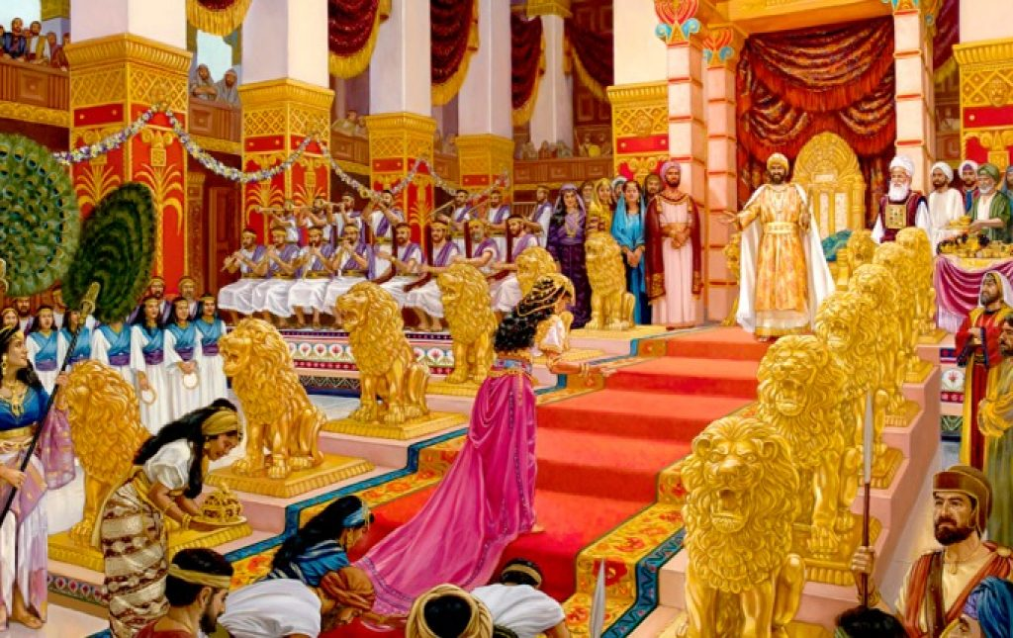

Slide 46
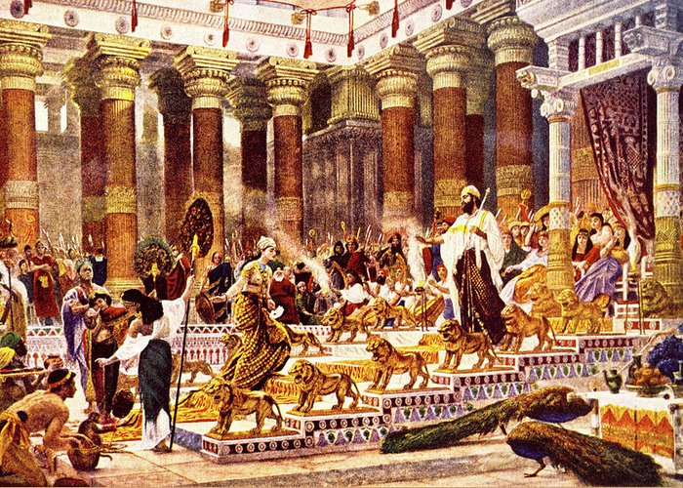

Slide 47
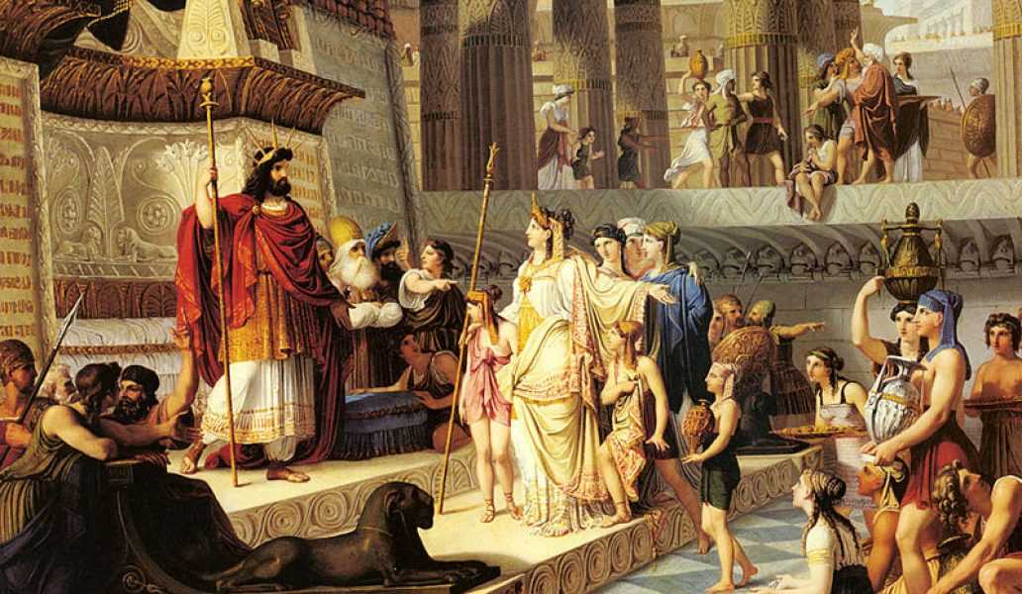

Slide 48
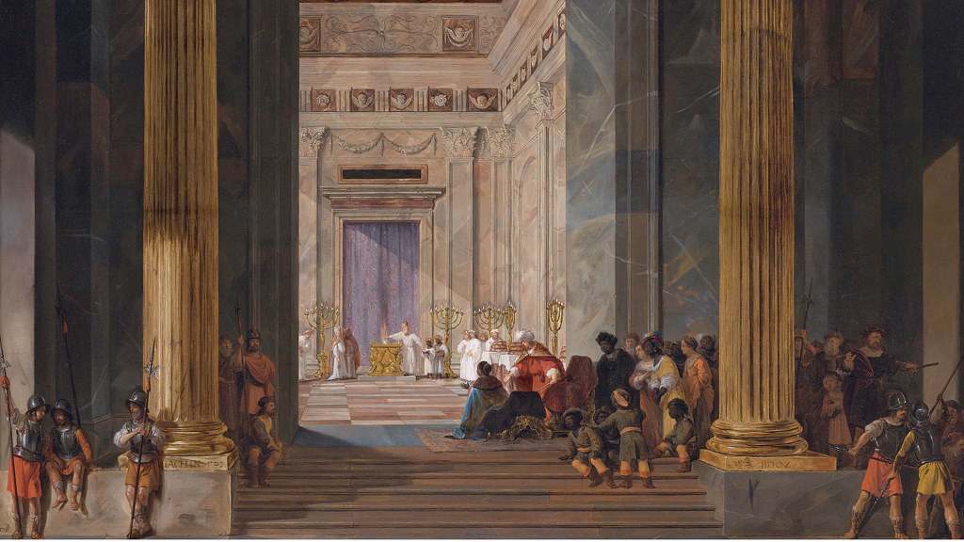

Slide 49
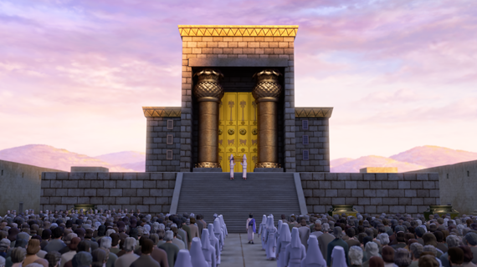

Slide 50
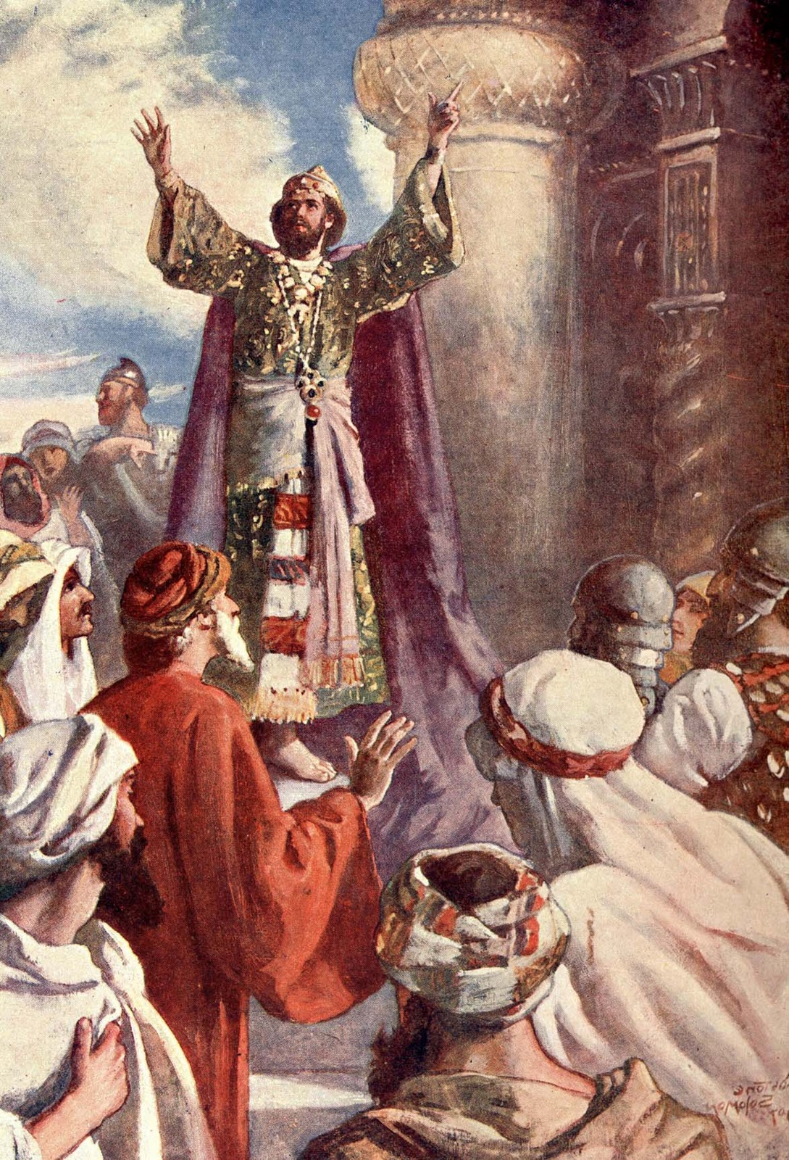

Slide 51
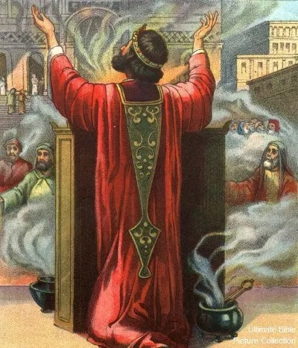

Slide 52
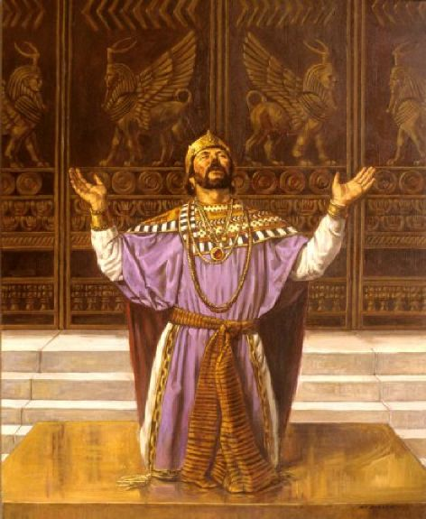

Slide 53
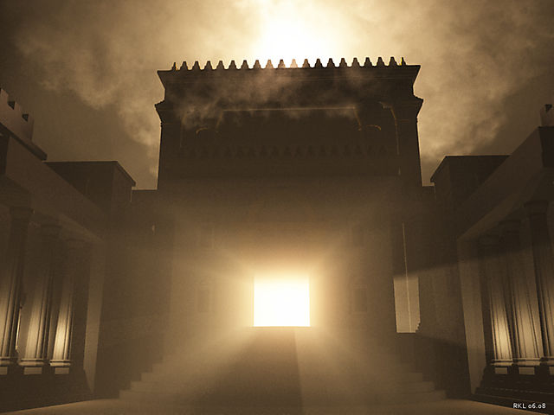

Slide 54
