Slide 1
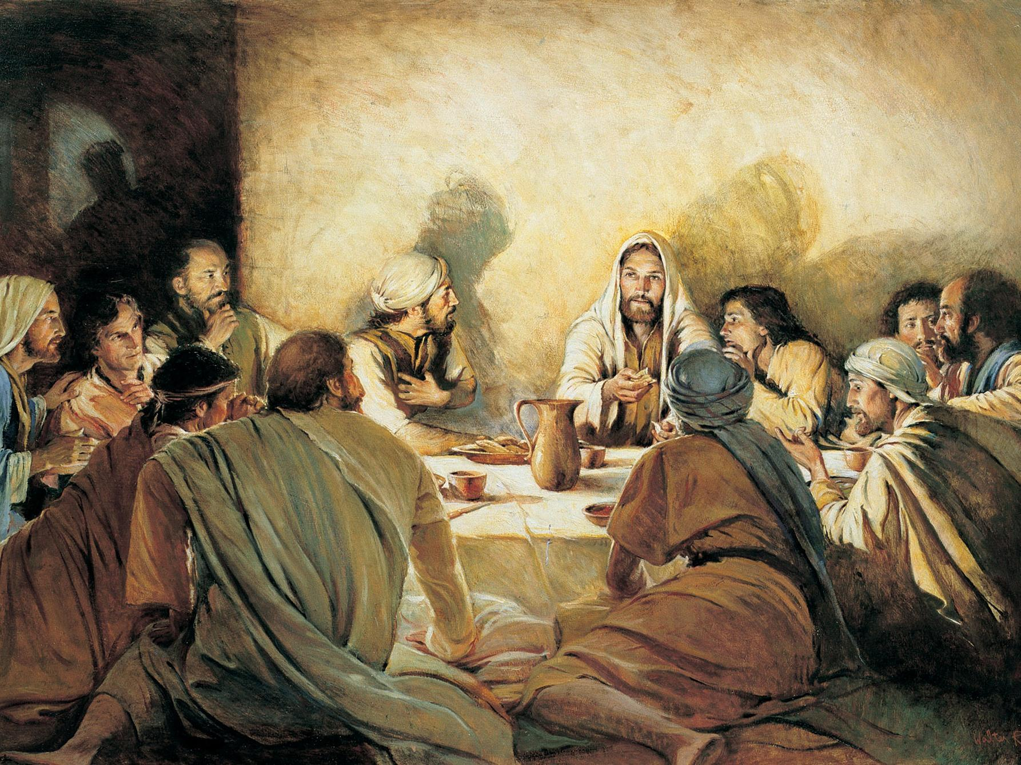
The Feasts Of The LORD
http://www.pearltrees.com/awhn

Slide 2
The Feasts of the LORD
Lev. 23:2 Speak unto the children of Israel, and say unto them, Concerning the feasts of the LORD, which ye shall proclaim to be holy convocations, even these are my feasts.
Lev. 23:4 These are the feasts of the LORD, even holy convocations, which ye shall proclaim in their seasons.
Lev. 23:37 These are the feasts of the LORD, which ye shall proclaim to be holy convocations, to offer an offering made by fire unto the LORD, a burnt offering, and a meat offering, a sacrifice, and drink offerings, every thing upon his day:
Lev. 23:38 Beside the sabbaths of the LORD, and beside your gifts, and beside all your vows, and beside all your freewill offerings, which ye give unto the LORD.
Lev. 23:44 And Moses declared unto the children of Israel the feasts of the LORD.

Slide 3
Question:
What are the names of the 7 major Feasts of the LORD, and when were they to be celebrated?

Slide 4
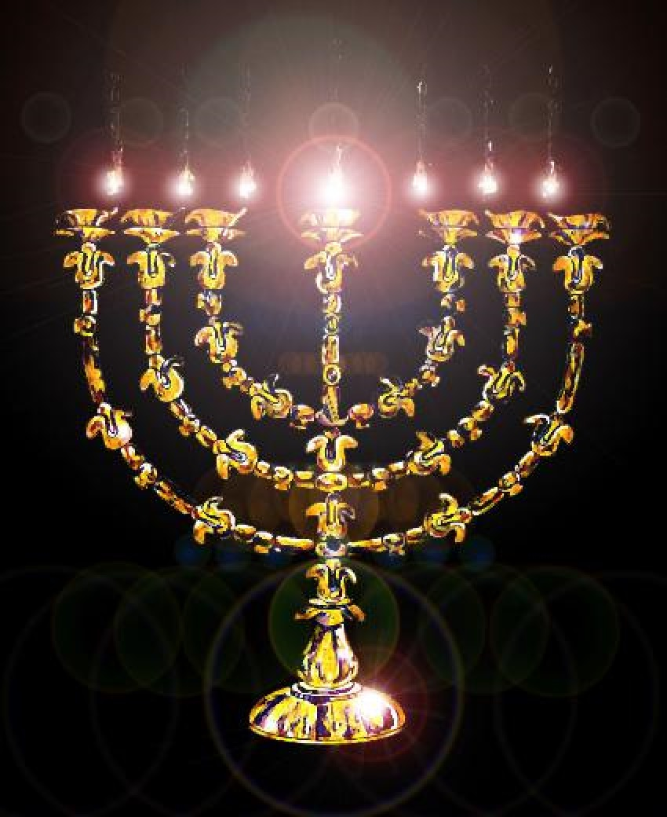
The Feasts of the LORD – Leviticus 23
23:4-5 | 23:6-8 | 23:10-14 | 23:15-22 | 23:24-25 | 23:27-32 | 23:34-44
Passover (1st), (14th) | Unleavened Bread (1st), (15th-21st) | Firstfruits or Wavesheaf (1st), (16th) | Pentecost (3rd), (50th day from Firstfruits) | Trumpets (7th), (1st) | Atonement (7th), (10th) | Tabernacles (7th), (15th-21st,22nd)

Slide 5
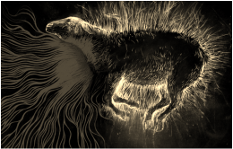

Slide 6
First Feast of the LORD
Lev. 23:5 In the fourteenth day of the first month at even is the LORD'S passover.

Slide 7
First Feast of the LORD
PASSOVER
When:
Season – Spring
Month – 1st Month (Abib; Exo. 12:2, 13:4, 23:15, 34:18)
Day – 14th Day of Abib
Hour – at Even
Type – Lev. 23:5; Num. 28:16; Deut. 16:1-2; Jos. 5:10
Anti-type – 1 Cor. 5:7; Christ Jesus in His sacrifice is the Passover

Slide 8
First Feast of the LORD
1 Cor. 5:7 Purge out therefore the old leaven, that ye may be a new lump, as ye are unleavened. For even Christ our passover is sacrificed for us:
1 Cor. 5:8 Therefore let us keep the feast, not with old leaven, neither with the leaven of malice and wickedness; but with the unleavened bread of sincerity and truth.

Slide 9
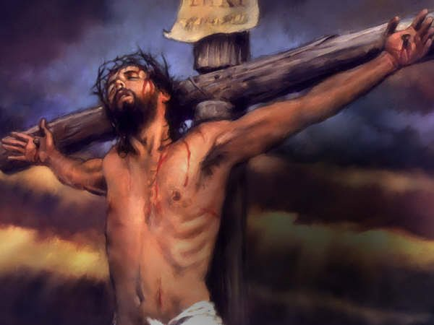

Slide 10
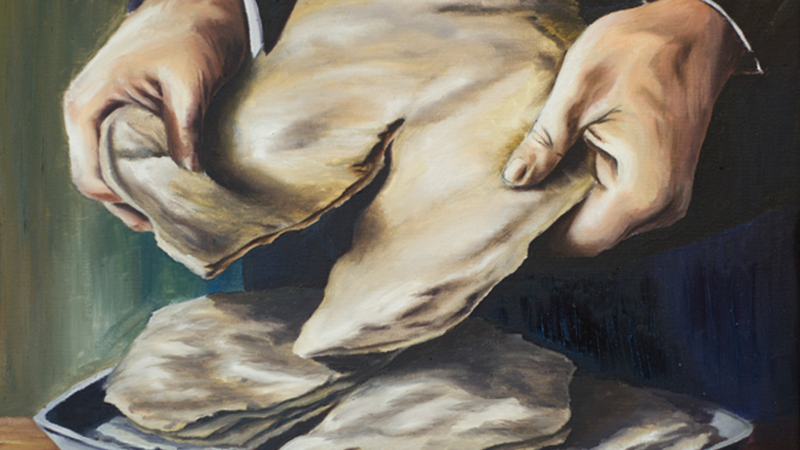

Slide 11
Second Feast of the LORD
Lev. 23:6 And on the fifteenth day of the same month is the feast of unleavened bread unto the LORD: seven days ye must eat unleavened bread.
Lev. 23:7 In the first day ye shall have an holy convocation: ye shall do no servile work therein.
Lev. 23:8 But ye shall offer an offering made by fire unto the LORD seven days: in the seventh day is an holy convocation: ye shall do no servile work therein.

Slide 12
Second Feast of the LORD
UNLEAVENED BREAD
When:
Season – Spring
Month – 1st Month (Abib; Exo. 12:2, 13:4, 23:15, 34:18)
Days – 15th Day to 21st Day of Abib (7 days)
Type – Exo. 13:3-8; Lev. 23:6-8; Num. 28:17-25; Deut. 16:3-8; Jos. 5:11
Anti-type – 1 Cor. 5:6-8; Jesus was buried, and He lived without sin, as we are to

Slide 13
Second Feast of the LORD
1 Cor. 5:6 Your glorying is not good. Know ye not that a little leaven leaveneth the whole lump?
1 Cor. 5:7 Purge out therefore the old leaven, that ye may be a new lump, as ye are unleavened. For even Christ our passover is sacrificed for us:
1 Cor. 5:8 Therefore let us keep the feast, not with old leaven, neither with the leaven of malice and wickedness; but with the unleavened bread of sincerity and truth.

Slide 14
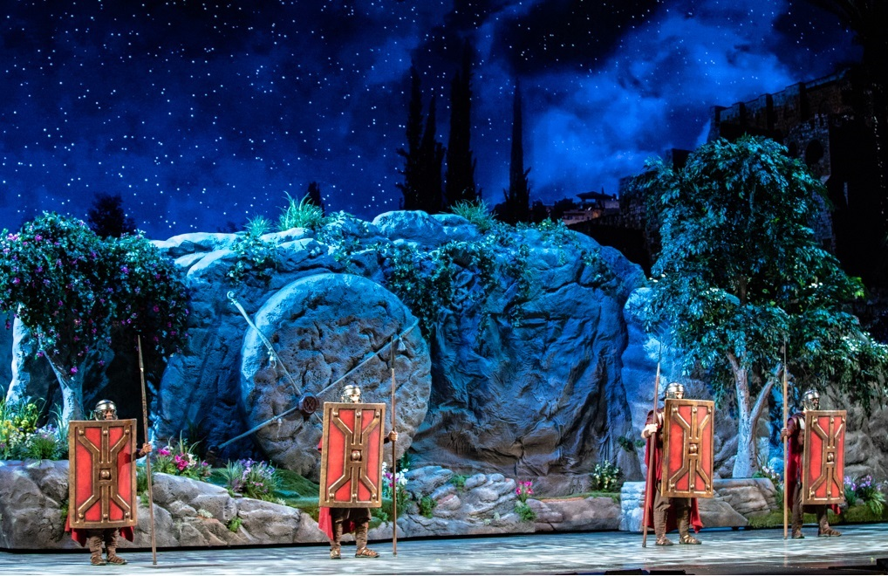

Slide 15
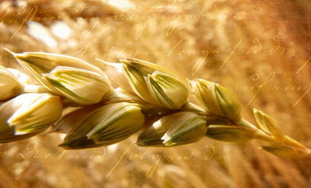

Slide 16
Third Feast of the LORD
Lev. 23:10 Speak unto the children of Israel, and say unto them, When ye be come into the land which I give unto you, and shall reap the harvest thereof, then ye shall bring a sheaf of the firstfruits of your harvest unto the priest:
Lev. 23:11 And he shall wave the sheaf before the LORD, to be accepted for you: on the morrow after the sabbath the priest shall wave it.
Lev. 23:12 And ye shall offer that day when ye wave the sheaf an he lamb without blemish of the first year for a burnt offering unto the LORD.

Slide 17
Third Feast of the LORD
Lev. 23:13 And the meat offering thereof shall be two tenth deals of fine flour mingled with oil, an offering made by fire unto the LORD for a sweet savour: and the drink offering thereof shall be of wine, the fourth part of an hin.
Lev. 23:14 And ye shall eat neither bread, nor parched corn, nor green ears, until the selfsame day that ye have brought an offering unto your God: it shall be a statute for ever throughout your generations in all your dwellings.

Slide 18
Third Feast of the LORD
FIRSTFRUITS/WAVESHEAF
When:
Season – Spring
Month – 1st Month (Abib; Exo. 12:2, 13:4, 23:15, 34:18)
Day – 16th Day of Abib
Type – Exo. 23:16; Lev. 23:9-14; Num. 28:26-31; Jos. 5:12
Anti-type – 1 Cor. 15:20,23; Christ Jesus is the firstfruits of the dead, in His resurrection

Slide 19
Third Feast of the LORD
1 Cor. 15:20 But now is Christ risen from the dead, and become the firstfruits of them that slept.
1 Cor. 15:21 For since by man came death, by man came also the resurrection of the dead.
1 Cor. 15:22 For as in Adam all die, even so in Christ shall all be made alive.
1 Cor. 15:23 But every man in his own order: Christ the firstfruits; afterward they that are Christ's at his coming.

Slide 20
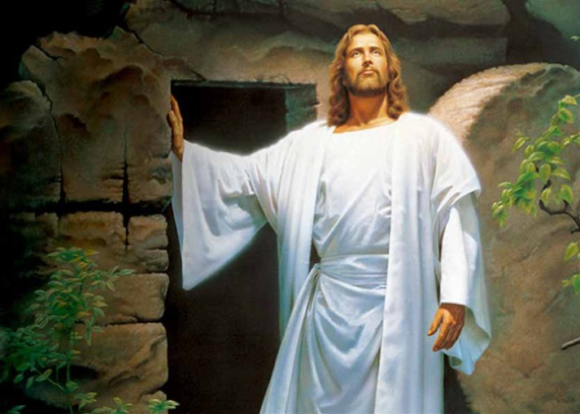

Slide 21
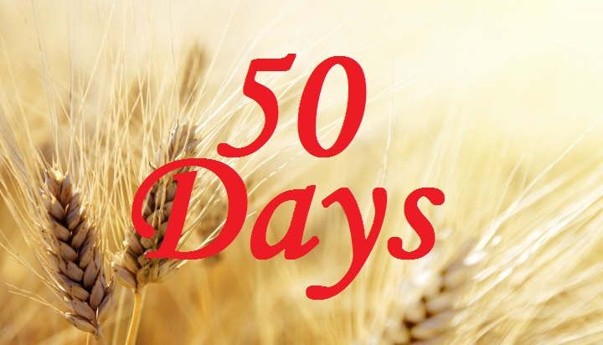

Slide 22
Fourth Feast of the LORD
Lev. 23:15 And ye shall count unto you from the morrow after the sabbath, from the day that ye brought the sheaf of the wave offering; seven sabbaths shall be complete:
Lev. 23:16 Even unto the morrow after the seventh sabbath shall ye number fifty days; and ye shall offer a new meat offering unto the LORD.
Lev. 23:17 Ye shall bring out of your habitations two wave loaves of two tenth deals: they shall be of fine flour; they shall be baken with leaven; they are the firstfruits unto the LORD.
Lev. 23:18 And ye shall offer with the bread seven lambs without blemish of the first year, and one young bullock, and two rams: they shall be for a burnt offering unto the LORD, with their meat offering, and their drink offerings, even an offering made by fire, of sweet savour unto the LORD.

Slide 23
Fourth Feast of the LORD
Lev. 23:19 Then ye shall sacrifice one kid of the goats for a sin offering, and two lambs of the first year for a sacrifice of peace offerings.
Lev. 23:20 And the priest shall wave them with the bread of the firstfruits for a wave offering before the LORD, with the two lambs: they shall be holy to the LORD for the priest.
Lev. 23:21 And ye shall proclaim on the selfsame day, that it may be an holy convocation unto you: ye shall do no servile work therein: it shall be a statute for ever in all your dwellings throughout your generations.
Lev. 23:22 And when ye reap the harvest of your land, thou shalt not make clean riddance of the corners of thy field when thou reapest, neither shalt thou gather any gleaning of thy harvest: thou shalt leave them unto the poor, and to the stranger: I am the LORD your God.

Slide 24
Fourth Feast of the LORD
of WEEKS/PENTECOST
When:
Season – Spring
Month – 3rd Month (Sivan; Est. 8:9)
Days – Number from the 16th Day of Abib (Firstfruits), count 50 days, or seven Sabbaths, then the following day after (est. 4th – 6th day of Sivan)
Type – Exo. 34:22; Lev. 23:15-22; Deut. 16:9-12
Anti-type – Exo. 29:7; Lev. 8:12; Psa. 133:1-3; Act. 1:1-26, 2:1-4,17-18,33; Rev. 5:6; Christ Jesus anointed as Great High Priest in Heaven, after His ascension (Psa. 24:1-10); and also needed to be 12, Exo. 28:21-22, 29:5, 39:14.

Slide 25
Fourth Feast of the LORD
Exo. 29:7 Then shalt thou take the anointing oil, and pour it upon his head, and anoint him.
Lev. 8:12 And he poured of the anointing oil upon Aaron's head, and anointed him, to sanctify him.
Rev. 5:6 And I beheld, and, lo, in the midst of the throne and of the four beasts, and in the midst of the elders, stood a Lamb as it had been slain, having seven horns and seven eyes, which are the seven Spirits of God sent forth into all the earth.

Slide 26
Fourth Feast of the LORD
Psa. 133:1 A Song of degrees of David. Behold, how good and how pleasant it is for brethren to dwell together in unity!
Psa. 133:2 It is like the precious ointment upon the head, that ran down upon the beard, even Aaron's beard: that went down to the skirts of his garments;
Psa. 133:3 As the dew of Hermon, and as the dew that descended upon the mountains of Zion: for there the LORD commanded the blessing, even life for evermore.

Slide 27
Fourth Feast of the LORD
Act. 1:1 The former treatise have I made, O Theophilus, of all that Jesus began both to do and teach,
Act. 1:2 Until the day in which he was taken up, after that he through the Holy Ghost had given commandments unto the apostles whom he had chosen:
Act. 1:3 To whom also he shewed himself alive after his passion by many infallible proofs, being seen of them forty days, and speaking of the things pertaining to the kingdom of God:
Act. 1:4 And, being assembled together with them, commanded them that they should not depart from Jerusalem, but wait for the promise of the Father, which, saith he, ye have heard of me.
Act. 1:5 For John truly baptized with water; but ye shall be baptized with the Holy Ghost not many days hence.

Slide 28
Fourth Feast of the LORD
Act. 1:8 But ye shall receive power, after that the Holy Ghost is come upon you: and ye shall be witnesses unto me both in Jerusalem, and in all Judaea, and in Samaria, and unto the uttermost part of the earth.
Act. 1:12 Then returned they unto Jerusalem from the mount called Olivet, which is from Jerusalem a sabbath day's journey.
Act. 1:13 And when they were come in, they went up into an upper room, where abode both Peter, and James, and John, and Andrew, Philip, and Thomas, Bartholomew, and Matthew, James the son of Alphaeus, and Simon Zelotes, and Judas the brother of James.
Act. 1:14 These all continued with one accord in prayer and supplication, with the women, and Mary the mother of Jesus, and with his brethren.

Slide 29
Fourth Feast of the LORD
Act. 2:1 And when the day of Pentecost was fully come, they were all with one accord in one place.
Act. 2:2 And suddenly there came a sound from heaven as of a rushing mighty wind, and it filled all the house where they were sitting.
Act. 2:3 And there appeared unto them cloven tongues like as of fire, and it sat upon each of them.
Act. 2:4 And they were all filled with the Holy Ghost, and began to speak with other tongues, as the Spirit gave them utterance.

Slide 30
Fourth Feast of the LORD
Act. 2:16 But this is that which was spoken by the prophet Joel;
Act. 2:17 And it shall come to pass in the last days, saith God, I will pour out of my Spirit upon all flesh: and your sons and your daughters shall prophesy, and your young men shall see visions, and your old men shall dream dreams:
Act. 2:18 And on my servants and on my handmaidens I will pour out in those days of my Spirit; and they shall prophesy:
Act. 2:33 Therefore being by the right hand of God exalted, and having received of the Father the promise of the Holy Ghost, he hath shed forth this, which ye now see and hear.

Slide 31
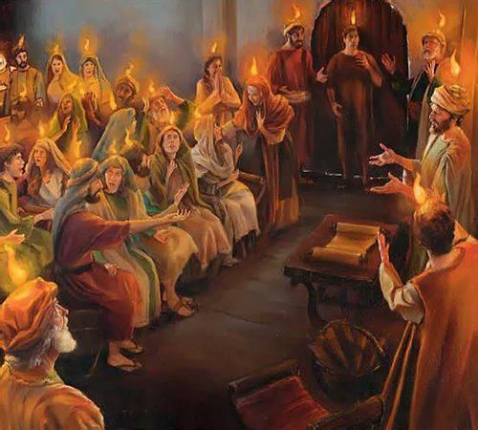

Slide 32
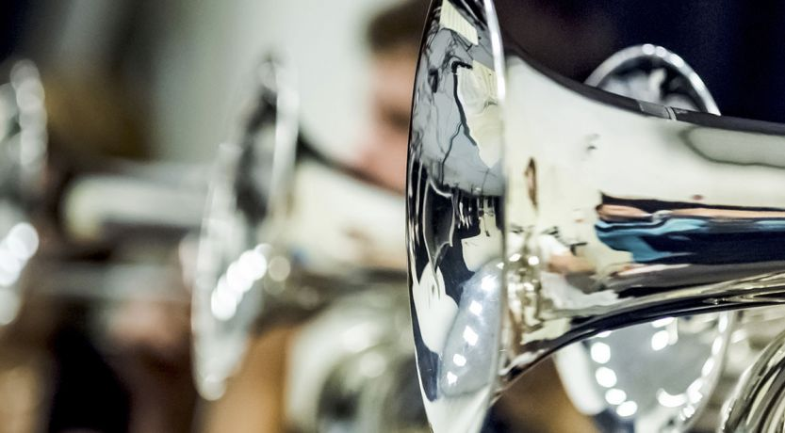

Slide 33
Fifth Feast of the LORD
Lev. 23:24 Speak unto the children of Israel, saying, In the seventh month, in the first day of the month, shall ye have a sabbath, a memorial of blowing of trumpets, an holy convocation.
Lev. 23:25 Ye shall do no servile work therein: but ye shall offer an offering made by fire unto the LORD.

Slide 34
Fifth Feast of the LORD
TRUMPETS
When:
Season – Fall
Month – 7th Month (Ethanim; 1Ki. 8:2)
Day – 1st Day of Ethanim (aka ‘Tishrei’)
Type – Lev. 23:23-25; Num. 29:1-6
Anti-type – Rev. 9:5,6,10 (five months); the difference between Pentecost (3rd Month) and Trumpets (7th Month), is exactly “five months” inclusive (3rd, 4th, 5th, 6th, 7th); see the typology of Zacharias, Elizabeth and John in Luk. 1:5-24; Jhn. 4:35; see the typology in Gen. 7:24, 8:3; from AD 31 to AD 1833/34 anti-typically, for the last John/Elijah was coming (Mal. 4:4-6; Rev. 10:11, 14:6-12)

Slide 35
Fifth Feast of the LORD
Rev. 9:5 And to them it was given that they should not kill them, but that they should be tormented five months: and their torment was as the torment of a scorpion, when he striketh a man.
Rev. 9:6 And in those days shall men seek death, and shall not find it; and shall desire to die, and death shall flee from them.
Rev. 9:10 And they had tails like unto scorpions, and there were stings in their tails: and their power was to hurt men five months.

Slide 36
Fifth Feast of the LORD
Gen. 7:24 And the waters prevailed upon the earth an hundred and fifty days.
Gen. 8:3 And the waters returned from off the earth continually: and after the end of the hundred and fifty days the waters were abated.

Slide 37
Fifth Feast of the LORD
Luk. 1:5 There was in the days of Herod, the king of Judaea, a certain priest named Zacharias, of the course of Abia: and his wife was of the daughters of Aaron, and her name was Elisabeth.
Luk. 1:6 And they were both righteous before God, walking in all the commandments and ordinances of the Lord blameless.
Luk. 1:7 And they had no child, because that Elisabeth was barren, and they both were now well stricken in years.

Slide 38
Fifth Feast of the LORD
Luk. 1:8 And it came to pass, that while he executed the priest's office before God in the order of his course,
Luk. 1:9 According to the custom of the priest's office, his lot was to burn incense when he went into the temple of the Lord.
Luk. 1:10 And the whole multitude of the people were praying without at the time of incense.
Luk. 1:11 And there appeared unto him an angel of the Lord standing on the right side of the altar of incense.

Slide 39
Fifth Feast of the LORD
Luk. 1:12 And when Zacharias saw him, he was troubled, and fear fell upon him.
Luk. 1:13 But the angel said unto him, Fear not, Zacharias: for thy prayer is heard; and thy wife Elisabeth shall bear thee a son, and thou shalt call his name John.
Luk. 1:14 And thou shalt have joy and gladness; and many shall rejoice at his birth.
Luk. 1:15 For he shall be great in the sight of the Lord, and shall drink neither wine nor strong drink; and he shall be filled with the Holy Ghost, even from his mother's womb.

Slide 40
Fifth Feast of the LORD
Luk. 1:16 And many of the children of Israel shall he turn to the Lord their God.
Luk. 1:17 And he shall go before him in the spirit and power of Elias, to turn the hearts of the fathers to the children, and the disobedient to the wisdom of the just; to make ready a people prepared for the Lord.
Luk. 1:18 And Zacharias said unto the angel, Whereby shall I know this? for I am an old man, and my wife well stricken in years.
Luk. 1:19 And the angel answering said unto him, I am Gabriel, that stand in the presence of God; and am sent to speak unto thee, and to shew thee these glad tidings.

Slide 41
Fifth Feast of the LORD
Luk. 1:20 And, behold, thou shalt be dumb, and not able to speak, until the day that these things shall be performed, because thou believest not my words, which shall be fulfilled in their season.
Luk. 1:21 And the people waited for Zacharias, and marvelled that he tarried so long in the temple.
Luk. 1:22 And when he came out, he could not speak unto them: and they perceived that he had seen a vision in the temple: for he beckoned unto them, and remained speechless.

Slide 42
Fifth Feast of the LORD
Luk. 1:23 And it came to pass, that, as soon as the days of his ministration were accomplished, he departed to his own house.
Luk. 1:24 And after those days his wife Elisabeth conceived, and hid herself five months, saying,
Luk. 1:25 Thus hath the Lord dealt with me in the days wherein he looked on me, to take away my reproach among men.

Slide 43
Fifth Feast of the LORD
Zacharias was a priest, after the order of Aaron, and His wife, Elisabeth, was also a daughter of Aaron. He represents Jesus, going into the Holy Place at the time of incense, while she represents the Church. Jesus had ascended, and went to minister in the Holy Place (Rev. 1:10-20) and also specifically at the Golden Altar of Incense in Heaven (Rev. 8:3-5). The people of God were outside (on earth, in the courtyard) praying. Jesus received a message for His people and sent it:
Hidden 5 Months, 4 more (pregnant), then the Harvest (Jhn. 4:35):
  Jhn. 4:35 Say not ye, There are yet four months, and then cometh harvest? behold, I say unto you, Lift up your eyes, and look on the fields; for they are white already to harvest.

Slide 44
Fifth Feast of the LORD
Rev. 8:3 And another angel came and stood at the altar, having a golden censer; and there was given unto him much incense, that he should offer it with the prayers of all saints upon the golden altar which was before the throne.
Rev. 8:4 And the smoke of the incense, which came with the prayers of the saints, ascended up before God out of the angel's hand.
Rev. 8:5 And the angel took the censer, and filled it with fire of the altar, and cast it into the earth: and there were voices, and thunderings, and lightnings, and an earthquake.

Slide 45
Fifth Feast of the LORD
Just as Zacharias, could not directly speak to the people or his wife, he could send a writing. Jesus, having ascended to Heaven, could send messengers and writings (Bible). Once the message was received by the woman (Church), it began to be pregnant for 5 months, though being hid (wilderness period, just as Noah was hid in the Ark), but a time would approach, being 4 more months (9 months for pregnancy), and the Last Elijah message, the Last John the Baptist message, the final Heralding message of the 2nd Advent, would appear, Rev. 10:1-11, 14:6-12.
Jesus sent warning in the Great Awakening and Advent movement, sounding the Trumpet for the alarm, for the battle, and for the gathering.

Slide 46
Fifth Feast of the LORD
From Pentecost (AD 31), which takes place in the 3rd Month Sivan, we count 5 months, inclusive:
  3rd Month Sivan (Pentecost; AD 31) – 1 Months
  4th Month ‘Tammuz’ (No feast) – 2 Months
  5th Month ‘Av’ (No feast) – 3 Months
  6th Month Elul (No feast) – 4 Months
  7th Month Ethanim (1st Day, Trumpets; AD 1833/34) – 5 Months
The Great Awakening …

Slide 47
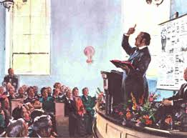

Slide 48
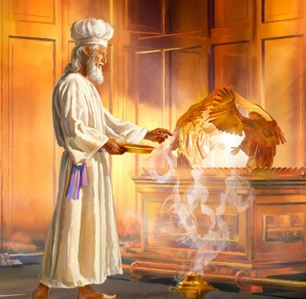

Slide 49
Sixth Feast of the LORD
Lev. 23:27 Also on the tenth day of this seventh month there shall be a day of atonement: it shall be an holy convocation unto you; and ye shall afflict your souls, and offer an offering made by fire unto the LORD.
Lev. 23:28 And ye shall do no work in that same day: for it is a day of atonement, to make an atonement for you before the LORD your God.
Lev. 23:29 For whatsoever soul it be that shall not be afflicted in that same day, he shall be cut off from among his people.

Slide 50
Sixth Feast of the LORD
Lev. 23:30 And whatsoever soul it be that doeth any work in that same day, the same soul will I destroy from among his people.
Lev. 23:31 Ye shall do no manner of work: it shall be a statute for ever throughout your generations in all your dwellings.
Lev. 23:32 It shall be unto you a sabbath of rest, and ye shall afflict your souls: in the ninth day of the month at even, from even unto even, shall ye celebrate your sabbath.

Slide 51
Sixth Feast of the LORD
DAY OF ATONEMENT
When:
Season – Fall
Month – 7th Month (Ethanim; 1Ki. 8:2)
Day – 10th Day of Ethanim (aka ‘Tishrei’)
Type – Lev. 16:1-34, 23:26-32; Num. 29:7-11
Anti-type – Dan. 8:13-14,26; Rev. 9:13-15, 10:1-6, 14:6-7; the hour of His judgment is come, the 10th Day, the Day of Atonement, of the 7th Month, Ethanim, the year AD 1843/44 (ten days/years after Trumpets (AD 1833/34)); see the typology of Zacharias, Elizabeth and John in Luk. 1:5-24; Jhn. 4:35; and see the typology in Gen. 7:24, 8:3

Slide 52
Sixth Feast of the LORD
Dan. 8:13 Then I heard one saint speaking, and another saint said unto that certain saint which spake, How long shall be the vision concerning the daily sacrifice, and the transgression of desolation, to give both the sanctuary and the host to be trodden under foot?
Dan. 8:14 And he said unto me, Unto two thousand and three hundred days; then shall the sanctuary be cleansed.
Dan. 8:26 And the vision of the evening and the morning which was told is true: wherefore shut thou up the vision; for it shall be for many days.

Slide 53
Sixth Feast of the LORD
Rev. 9:13 And the sixth angel sounded, and I heard a voice from the four horns of the golden altar which is before God,
Rev. 9:14 Saying to the sixth angel which had the trumpet, Loose the four angels which are bound in the great river Euphrates.
Rev. 9:15 And the four angels were loosed, which were prepared for an hour, and a day, and a month, and a year, for to slay the third part of men.

Slide 54
Sixth Feast of the LORD
The Hour: The Hour of His Judgment is come (Rev. 14:7)
The Day: 10th Day (Day of Atonement; Lev. 16:1-34, 23:26-32); aka, 22nd
The Month: 7th Month (Ethanim; 1 K. 8:2; Lev. 23:27); aka October.
The Year: AD 1844 (end of the 2,300, from 457 BC; Ezr. 6:14; Dan. 8:13-14,26, 9:24-25, “the commandment” (of God) as accomplished in Cyrus II The Great, Darius I Hystaspes the Persian, Artaxerxes I Longimanus/Machrocheir (Ezr. 7:1-28).
  Ezr 6:14 And the elders of the Jews builded, and they prospered through the prophesying of Haggai the prophet and Zechariah the son of Iddo. And they builded, and finished it, according to the commandment of the God of Israel, and according to the commandment of Cyrus, and Darius, and Artaxerxes king of Persia.

Slide 55
Sixth Feast of the LORD
Rev. 10:1 And I saw another mighty angel come down from heaven, clothed with a cloud: and a rainbow was upon his head, and his face was as it were the sun, and his feet as pillars of fire:
Rev. 10:2 And he had in his hand a little book open: and he set his right foot upon the sea, and his left foot on the earth,
Rev. 10:3 And cried with a loud voice, as when a lion roareth: and when he had cried, seven thunders uttered their voices.

Slide 56
Sixth Feast of the LORD
Rev. 10:4 And when the seven thunders had uttered their voices, I was about to write: and I heard a voice from heaven saying unto me, Seal up those things which the seven thunders uttered, and write them not.
Rev. 10:5 And the angel which I saw stand upon the sea and upon the earth lifted up his hand to heaven,
Rev. 10:6 And sware by him that liveth for ever and ever, who created heaven, and the things that therein are, and the earth, and the things that therein are, and the sea, and the things which are therein, that there should be time no longer:

Slide 57
Sixth Feast of the LORD
Rev. 10:11 And he said unto me, Thou must prophesy again before many peoples, and nations, and tongues, and kings.
Rev. 14:6 And I saw another angel fly in the midst of heaven, having the everlasting gospel to preach unto them that dwell on the earth, and to every nation, and kindred, and tongue, and people,
Rev. 14:7 Saying with a loud voice, Fear God, and give glory to him; for the hour of his judgment is come: and worship him that made heaven, and earth, and the sea, and the fountains of waters.

Slide 58
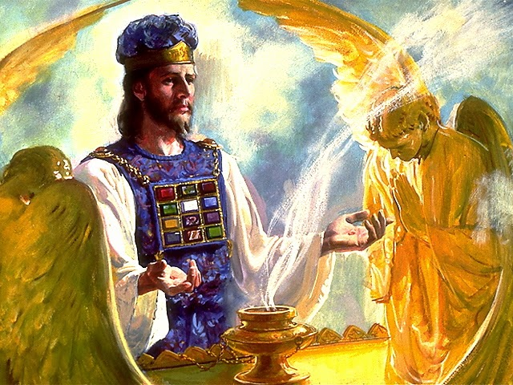

Slide 59
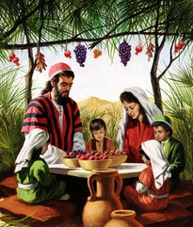

Slide 60
Seventh Feast of the LORD
Lev. 23:34 Speak unto the children of Israel, saying, The fifteenth day of this seventh month shall be the feast of tabernacles for seven days unto the LORD.
Lev. 23:35 On the first day shall be an holy convocation: ye shall do no servile work therein.
Lev. 23:36 Seven days ye shall offer an offering made by fire unto the LORD: on the eighth day shall be an holy convocation unto you; and ye shall offer an offering made by fire unto the LORD: it is a solemn assembly; and ye shall do no servile work therein.

Slide 61
Seventh Feast of the LORD
Lev. 23:37 These are the feasts of the LORD, which ye shall proclaim to be holy convocations, to offer an offering made by fire unto the LORD, a burnt offering, and a meat offering, a sacrifice, and drink offerings, every thing upon his day:
Lev. 23:38 Beside the sabbaths of the LORD, and beside your gifts, and beside all your vows, and beside all your freewill offerings, which ye give unto the LORD.
Lev. 23:39 Also in the fifteenth day of the seventh month, when ye have gathered in the fruit of the land, ye shall keep a feast unto the LORD seven days: on the first day shall be a sabbath, and on the eighth day shall be a sabbath.

Slide 62
Seventh Feast of the LORD
Lev. 23:40 And ye shall take you on the first day the boughs of goodly trees, branches of palm trees, and the boughs of thick trees, and willows of the brook; and ye shall rejoice before the LORD your God seven days.
Lev. 23:41 And ye shall keep it a feast unto the LORD seven days in the year. It shall be a statute for ever in your generations: ye shall celebrate it in the seventh month.

Slide 63
Seventh Feast of the LORD
Lev. 23:42 Ye shall dwell in booths seven days; all that are Israelites born shall dwell in booths:
Lev. 23:43 That your generations may know that I made the children of Israel to dwell in booths, when I brought them out of the land of Egypt: I am the LORD your God.
Lev. 23:44 And Moses declared unto the children of Israel the feasts of the LORD.

Slide 64
Seventh Feast of the LORD
BOOTHS/TABERNACLES
When:
Season – Fall
Month – 7th Month (Ethanim; 1Ki. 8:2)
Days – 15th Day to 21st Day, & 22nd Day of Ethanim (aka ‘Tishrei’)
Type – Lev. 23:33-44; Num. 29:12-40; Deut. 16:13-15
Anti-type – Rev. 7:9, 11:15, 14:13-20, the very harvest and bringing in the sheaves, for the '3 Angels' (Rev. 14:6-12; yea, the 4th also, Rev. 18:1-5) are the reapers (Mat. 13:39) … soon, and very soon …

Slide 65
Seventh Feast of the LORD
Rev. 7:9 After this I beheld, and, lo, a great multitude, which no man could number, of all nations, and kindreds, and people, and tongues, stood before the throne, and before the Lamb, clothed with white robes, and palms in their hands;
Rev. 11:15 And the seventh angel sounded; and there were great voices in heaven, saying, The kingdoms of this world are become the kingdoms of our Lord, and of his Christ; and he shall reign for ever and ever.

Slide 66
Seventh Feast of the LORD
Rev. 14:13 And I heard a voice from heaven saying unto me, Write, Blessed are the dead which die in the Lord from henceforth: Yea, saith the Spirit, that they may rest from their labours; and their works do follow them.
Rev. 14:14 And I looked, and behold a white cloud, and upon the cloud one sat like unto the Son of man, having on his head a golden crown, and in his hand a sharp sickle.
Rev. 14:15 And another angel came out of the temple, crying with a loud voice to him that sat on the cloud, Thrust in thy sickle, and reap: for the time is come for thee to reap; for the harvest of the earth is ripe.
Rev. 14:16 And he that sat on the cloud thrust in his sickle on the earth; and the earth was reaped.

Slide 67
Seventh Feast of the LORD
Rev. 14:17 And another angel came out of the temple which is in heaven, he also having a sharp sickle.
Rev. 14:18 And another angel came out from the altar, which had power over fire; and cried with a loud cry to him that had the sharp sickle, saying, Thrust in thy sharp sickle, and gather the clusters of the vine of the earth; for her grapes are fully ripe.
Rev. 14:19 And the angel thrust in his sickle into the earth, and gathered the vine of the earth, and cast it into the great winepress of the wrath of God.
Rev. 14:20 And the winepress was trodden without the city, and blood came out of the winepress, even unto the horse bridles, by the space of a thousand and six hundred furlongs.

Slide 68
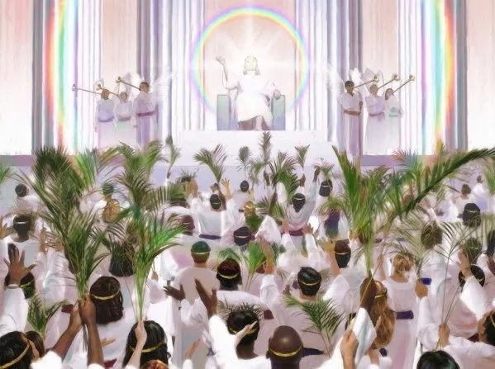

Slide 69
