Slide 1
The Sea of Glass
http://www.pearltrees.com/awhn

Slide 2
Scripture Reading: Rev. 15:1-2 KJB
Rev 15:1 And I saw another sign in heaven, great and marvellous, seven angels having the seven last plagues; for in them is filled up the wrath of God.
Rev 15:2 And I saw as it were a sea of glass mingled with fire: and them that had gotten the victory over the beast, and over his image, and over his mark, and over the number of his name, stand on the sea of glass, having the harps of God.

Slide 3
What is the purpose of understanding the book of Daniel, and the book of Revelation?
Is it to merely identify end-time powers?

Slide 4
No?
Then what is their purpose?

Slide 5
What does Daniel’s name mean?
Who is the Revelation of?

Slide 6
Daniel’s name comes from “Dan” (judge, see Gen. 49:16) and “el” (God, see Gen. 28:17,19), which means, “Judgment of God”, or “God is my Judge”.
The Revelation is of Jesus Christ and His character (see Rev. 1:1).

Slide 7
Therefore, we can draw from these two things, that in the Judgment, God is looking to see who reveals the character of Jesus Christ, having been conformed to the image of His Son by the Holy Ghost through the Everlasting Gospel.

Slide 8
Notice:
“... The central theme of the Bible, the theme about which every other in the whole book clusters, is the redemption plan, the restoration in the human soul of the image of God. From the first intimation of hope in the sentence pronounced in Eden to that last glorious promise of the Revelation, “They shall see His face; and His name shall be in their foreheads” (Revelation 22:4), the burden of every book and every passage of the Bible is the unfolding of this wondrous theme,—man’s uplifting,—the power of God, “which giveth us the victory through our Lord Jesus Christ.” 1 Corinthians 15:57. ...” – Education (1903); page 125.2

Slide 9
Notice:
“...Those who think of the result of hastening or hindering the gospel think of it in relation to themselves and to the world. Few think of its relation to God. Few give thought to the suffering that sin has caused our Creator. All heaven suffered in Christ’s agony; but that suffering did not begin or end with His manifestation in humanity. The cross is a revelation to our dull senses of the pain that, from its very inception, sin has brought to the heart of God. Every departure from the right, every deed of cruelty, every failure of humanity to reach His ideal, brings grief to Him. When there came upon Israel the calamities that were the sure result of separation from God,—subjugation by their enemies, cruelty, and death,—it is said that “His soul was grieved for the misery of Israel.” “In all their affliction He was afflicted: ... and He bare them, and carried them all the days of old.” Judges 10:16; Isaiah 63:9. ...” – Education (1903); page 263.1

Slide 10
Notice:
“... Rich blessings will come to him who reads and hears the words of this prophecy, and keeps those things which are written therein.
We have the commandments of God and the testimony of Jesus Christ, which is the Spirit of prophecy. Priceless gems are to be found in the Word of God. Those who search this Word should keep the mind clear. Never should they indulge perverted appetite in eating and drinking. If they do this, the brain will be confused; they will be unable to bear the strain of digging deep to find out the meaning of those things which relate to the closing scenes of this earth’s history. …”

Slide 11
Notice:
“… When the books of Daniel and Revelation are better understood, believers will have an entirely different religious experience. They will be given such glimpses of the open gates of heaven that heart and mind will be impressed in regard to the character all must develop in order to realize the blessedness which is to be the reward of the pure in heart. The Lord will bless all who will seek humbly and meekly to understand that which is revealed in the Revelation. This book contains so much that is large with immortality and full of glory that all who read and search it earnestly receive the blessing to those “that hear the words of this prophecy, and keep those things which are written therein.” …”

Slide 12
Notice:
One thing will certainly be understood from the study of Revelation—that the connection between God and His people is close and decided. ...” – (MR) Manuscript Releases, Volume 18 [Nos. 1301-1359] (1990), MR No. 1304, Daniel and Revelation Have Been Unsealed, and Should Be Studied; Improved Experience Will Result, pages 23.3-24.3

Slide 13
Notice, Jesus Himself:
“... The officers who were sent to take Jesus reported that never man spake like this man. But the reason of this was that never man lived like this man; for if he had not so lived, he could not so have spoken. His words bore with them a convincing power, because they came from a heart pure and holy, full of love and sympathy, beneficence and truth. There is eloquence beyond that of words, in the quiet, consistent life of a pure, true Christian. We shall have temptations as long as we are in this world, but instead of injuring us, they will only turn to our advantage, if resisted. The bounds are placed where Satan cannot pass. He may prepare the furnace, but instead of working injury, it will only consume the dross, and bring forth the gold of the character, purer than before the trial. ...” – Gospel Workers (1892); page 244.1

Slide 14
How then are we to understand
the Sea of Glass?

Slide 15
If a person were to understand the following verse, they would have one of the very keys in scripture to unlock the wisdom of God, for therein is every teaching of God in the plan of redemption:
Psa 77:13 Thy way, O God, is in the sanctuary: who is so great a God as our God?

Slide 17
Joh 14:6 Jesus saith unto him, I am the way, the truth, and the life: no man cometh unto the Father, but by me.

Slide 18
Let’s consider again our texts in that light, and also give an additional verse which adds some further detail:
Rev 15:1 And I saw another sign in heaven, great and marvellous, seven angels having the seven last plagues; for in them is filled up the wrath of God.
Rev 15:2 And I saw as it were a sea of glass mingled with fire: and them that had gotten the victory over the beast, and over his image, and over his mark, and over the number of his name, stand on the sea of glass, having the harps of God.
Rev 4:6 And before the throne there was a sea of glass like unto crystal: and in the midst of the throne, and round about the throne, were four beasts full of eyes before and behind.

Slide 19
What, then, is this the Sea of Glass?
What does it mean?, and what does it have to do with the Sanctuary, and them that had gotten the victory?

Slide 20
In Revelation 15:2 we see the ultimate triumph of the saints of God, in the expression “them that had gotten the victory”, over 4 things:

Slide 21
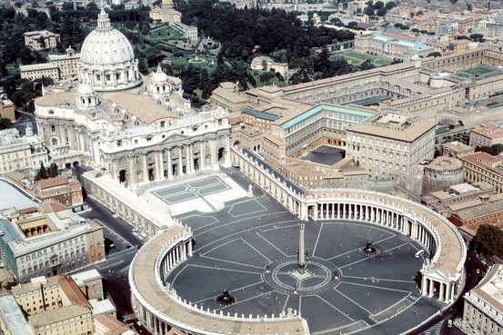
Victory: 1. over “the beast” (Rev. 13:1-10)
Papal Rome, or the Papacy

Slide 22
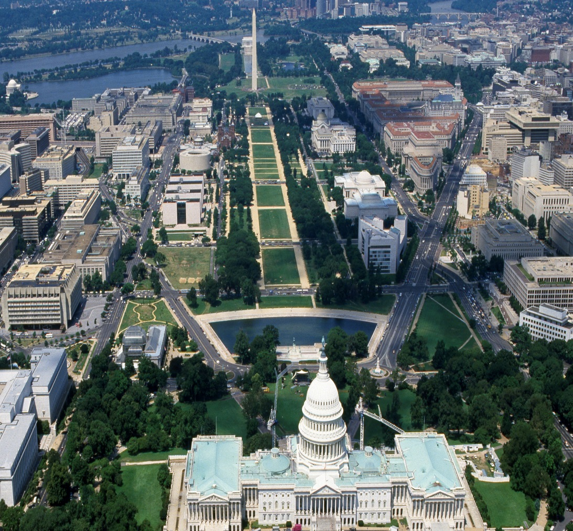
Victory: 2. over his “image” (Rev. 13:11-17)
United Church & State in
Apostate Protestantism, USA

Slide 23
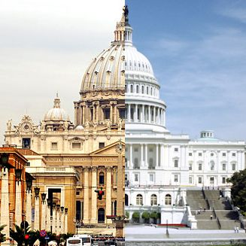
“the Beast” and his “Image”
Rome, Vatican & Washington, D.C.

Slide 24
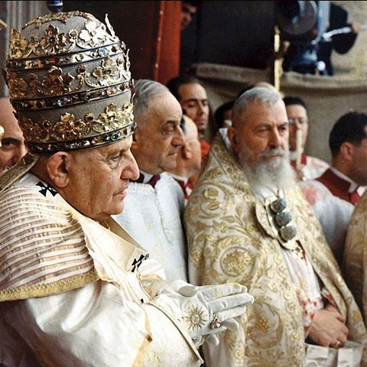
“the Beast” and his “Image”
Old (World) & New (World)
Holy Roman Empire

Slide 25
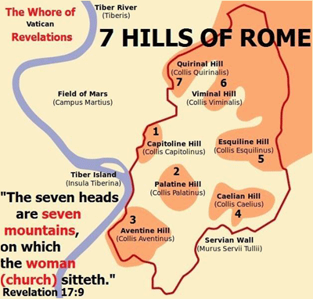
“the Beast” and his “Image”
Vatican is in Rome, the City of 7 Hills; Washington, D.C. sits between “Virginia” & “Mary-Land”

Slide 26
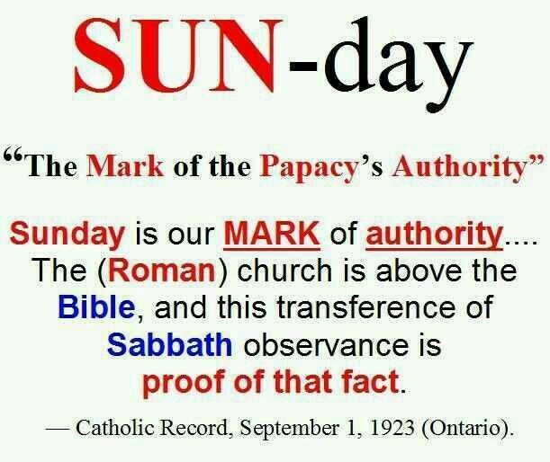
Victory: 3. over the “mark” of “the beast” (Rev. 13:16,17, 14:9,11, 15:2, 16:2, 19:20, 20:4)
The “mark” of Papal Rome’s (Sea Beast) authority is it’s official claim to change “the times and laws” of the Most High God, especially in the Sabbath commandment, altering the “solemnity” from the 7th Day (Sabbath) to the 1st Day of the week (Sunday).

Slide 27
Victory: 3. over the “mark” of “the beast” (Rev. 13:16,17, 14:9,11, 15:2, 16:2, 19:20, 20:4)
"... Now in the matter of Sabbath observance the Protestant rule of Faith is utterly unable to explain the substitution of the Christian Sunday for the Jewish Saturday. It has been changed. The Bible still teaches that the Sabbath or Saturday should be kept holy. There is no authority in the New Testament for the substitution of Sunday for Saturday. Surely it is an important matter. It stands there in the Bible as one of the Ten Commandments of God. There is no authority in the Bible for abrogating this Commandment, or for transferring its observance to another day of the week. For Catholics it is not the slightest difficulty. "All power is given Me in heaven and on earth; as the Father sent Me so I also send you," said our Divine Lord in giving His tremendous commission to His Apostles. "He that heareth you heareth Me." We have in the authoritative voice of the Church the voice of Christ Himself. The Church is above the Bible; and this transference of Sabbath observance to Sunday is proof positive of that fact. Deny the authority of the Church and you have no adequate or reasonable explanation or justification for the substitution of Sunday for Saturday in the Third - Protestant Fourth - Commandment of God. ..."(1.) (1.) The Catholic Record of London, Saturday, September 1st, 1923 edition, Ontario, Canada, Volume XLV, #2342, appearing on page 4, section "Sabbath Observance", Column 2, -- Editor -- Rev. James T. Foley, D.D. ... The CATHOLIC RECORD has been approved and recommended by Archbishops Falconio and Sbaretti, late Apostolic Delegates to Canada, the Archbishops of Toronto, Kingston, Ottawa, and St. Boniface, the Bishops of London, Hamilton, Peterborough and Ogdensburg, N.Y., and the Clergy throughout the Dominion.", Column 1 - http://biblelight.net/Sources/Catholic-Record-6-shade.gif
The “mark” of Papal Rome’s (Sea Beast) authority is it’s official claim to change “the times and laws” of the Most High God, especially in the Sabbath commandment, altering the “solemnity” from the 7th Day (Sabbath) to the 1st Day of the week (Sunday).

Slide 28
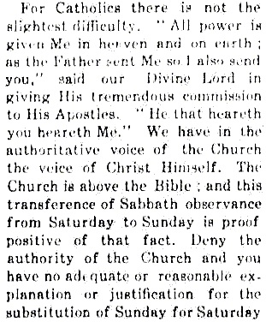
Victory: 3. over the “mark” of “the beast” (Rev. 13:16,17, 14:9,11, 15:2, 16:2, 19:20, 20:4)
The “mark” of Papal Rome’s (Sea Beast) authority is it’s official claim to change “the times and laws” of the Most High God, especially in the Sabbath commandment, altering the “solemnity” from the 7th Day (Sabbath) to the 1st Day of the week (Sunday).

Slide 29
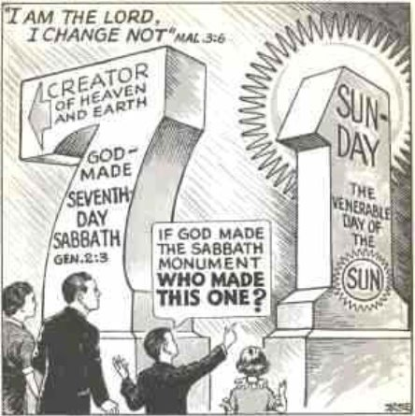
Victory: 3. over the “mark” of “the beast” (Rev. 13:16,17, 14:9,11, 15:2, 16:2, 19:20, 20:4)
The “mark” of Papal Rome’s (Sea Beast) authority is it’s official claim to change “the times and laws” of the Most High God, especially in the Sabbath commandment, altering the “solemnity” from the 7th Day (Sabbath) to the 1st Day of the week (Sunday).

Slide 30
Victory: 3. over the “mark” of “the beast” (Rev. 13:16,17, 14:9,11, 15:2, 16:2, 19:20, 20:4)
[English] "... Pope Sylvester ['pope' from A.D. 314 to his death in A.D. December 31, 335] first among the Romans ordered that the names of the days [of the week], which they previously called after the name of their gods, that is, [the day] of the Sun, [the day] of the Moon, [the day] of Mars, [the day] of Mercury, [the day] of Jupiter, [the day] of Venus, [the day] of Saturn, they should call feriae thereafter, that is the first feria, the second feria, the third feria, the fourth feria, the fifth feria, the sixth feria, because that in the beginning of Genesis it is written that God said concerning each day: on the first, "Let there be light:; on the second, "Let there be a firmament"; on the third, "Let the earth bring forth verdure"; etc. But he [Sylvester] ordered [them] to call the Sabbath by the ancient term of the law, [to call] the first feria the "Lord's day," because on it the Lord rose [from the dead], Moreover, the same pope decreed that the rest of the Sabbath should be transferred rather to the [counterfeit] Lord's day [Sunday], in order that on that day we should rest from worldly works for the praise of God.7 ..." - http://biblelight.net/sylvester-I.htm
The “mark” of Papal Rome’s (Sea Beast) authority is it’s official claim to change “the times and laws” of the Most High God, especially in the Sabbath commandment, altering the “solemnity” from the 7th Day (Sabbath) to the 1st Day of the week (Sunday).

Slide 31
Victory: 3. over the “mark” of “the beast” (Rev. 13:16,17, 14:9,11, 15:2, 16:2, 19:20, 20:4)
[Latin] "... Similiter et feriae a fando dicuntur, ob quam causam Silvester papa primus apud Romanos constituit ut dierum nomina quae antea secundum nomina deorum suorum vocabant, id est, Solis, Lunae, Martis, Mercurii, Veneris, Saturni, feria deinceps vocarent, id est, prima feria, secunda feria, tertia feria, quarta feria, quinta feria, sexta feria, quia in principio Genesis scriptum est quod Deus per singulos dies dixerit : prima, Fiat Lux; secunda, Fiat firmamentum; tertia, Producat terra herbam virentem, similiter, etc. Sabbatum autem antiquo legis vocabulo vocare praecepit, et primam feriam diem Dominicam, eo quod Dominus in illa resurrexit. Statuit autem idem papa ut otium sabbati magis in [counterfeit] diem Dominicam [Sunday] transferretur, ut ea die a terrenis operibus ad laudandum Deum vacaremus, justa illud quod scriptum est : Vacate et videte, quoniam ego sum Deus (Psal. XLV). ..." - Beati Rabani Mauri, Fuldensis Abbatis et Moguntini Archiepiscopi, de Clericorum Institutione, ad Heistulphum Archiepiscopum; Libri Tres. (Anno 819.) Ad Fratres Fuldenses Epigramma Ejusdem; Liber Secundus, Caput XLVI. Column 361 (Left; PDF page 35) - http://www.documentacatholicaomnia.eu/02m/0788-0856,_Rabanus_Maurus,_De_Clericorum_Institutione_Ad_Heistulphum_Archiepiscopum_Libri_Tres,_MLT.pdf
The “mark” of Papal Rome’s (Sea Beast) authority is it’s official claim to change “the times and laws” of the Most High God, especially in the Sabbath commandment, altering the “solemnity” from the 7th Day (Sabbath) to the 1st Day of the week (Sunday).

Slide 32
Victory: 3. over the “mark” of “the beast” (Rev. 13:16,17, 14:9,11, 15:2, 16:2, 19:20, 20:4)
“... yet we find St. Cæsarius of Arles in the sixth century teaching that the holy Doctors of the Church had decreed that the whole glory of the Jewish Sabbath had been transferred to the Sunday, and that Christians must keep the Sunday holy in the same way as the Jews had been commanded to keep holy the Sabbath Day. … From the eight century the law began to be formulated as it exists at the present day, and the local councils forbade servile work, public buying and selling, pleading in the law courts, and the public and solemn taking of oaths. There is a large body of civil legislation on the Sunday rest side by side with the ecclesiastical. ...” [Roman Catholic Online Encyclopedia; section “S”, Sunday] - http://www.newadvent.org/cathen/14335a.htm
The “mark” of Papal Rome’s (Sea Beast) authority is it’s official claim to change “the times and laws” of the Most High God, especially in the Sabbath commandment, altering the “solemnity” from the 7th Day (Sabbath) to the 1st Day of the week (Sunday).

Slide 33
Victory: 3. over the “mark” of “the beast” (Rev. 13:16,17, 14:9,11, 15:2, 16:2, 19:20, 20:4)
“... Jesus exercised his sovereign power to abrogate the sabbath law in at least some way. … The sabbath command is the only one of the Ten Commandments which can be altered in any way, because only it is a part of the ceremonial law. This is taught by the Roman Catechism issued after the Council of Trent:
The other commandments of the Decalogue are precepts of the natural law, obligatory at all times and unalterable. Hence, after the abrogation of the Law of Moses, all the Commandments contained in the two tables are observed by Christians, not indeed because their observance is commanded by Moses, but because they are in conformity with nature which dictates obedience to them. This Commandment about the observance of the sabbath, on the other hand, considered as to the time appointed for its fulfillment, is not fixed and unalterable, but susceptible of change and belongs not to the moral, but the ceremonial law. Neither is it a principle of the natural law; we are not instructed by nature to give external worship to God on that day, rather than on any other. And in fact the sabbath was kept holy only from the time of Israel from the bondage of Pharaoh. The observance of the sabbath was to be abrogated at the same time as the other Hebrew rites and ceremonies, that is, at the death of Christ. . . .” [Roman Catholic Online Library; Quick Questions (1994)] - http://www.newadvent.org/library/almanac_thisrock94.htm
The “mark” of Papal Rome’s (Sea Beast) authority is it’s official claim to change “the times and laws” of the Most High God, especially in the Sabbath commandment, altering the “solemnity” from the 7th Day (Sabbath) to the 1st Day of the week (Sunday).

Slide 34
Victory: 3. over the “mark” of “the beast” (Rev. 13:16,17, 14:9,11, 15:2, 16:2, 19:20, 20:4)
“... Today Jews and other groups who keep the sabbath, such as the Seventh-Day Adventists, continue to celebrate it from sundown Friday to sundown Saturday. This way of reckoning time was not the only one in the ancient world. For example, the Romans reckoned days from midnight to midnight--the system we use today. … Sunday is often spoken of as "the Christian sabbath," but this is not a technical description. Sunday is not a strict replacement for the sabbath (which has been abolished), but a day the Church instituted to fulfill a parallel function. ...” [Roman Catholic Online Library; Quick Questions (1994)] - http://www.newadvent.org/library/almanac_thisrock94.htm
The “mark” of Papal Rome’s (Sea Beast) authority is it’s official claim to change “the times and laws” of the Most High God, especially in the Sabbath commandment, altering the “solemnity” from the 7th Day (Sabbath) to the 1st Day of the week (Sunday).

Slide 35
Victory: 3. over the “mark” of “the beast” (Rev. 13:16,17, 14:9,11, 15:2, 16:2, 19:20, 20:4)
“...With regard to the exposition of this commandment, the faithful are to be carefully taught in what it accords with, and in what it differs from the others, in order that they may understand why Christians observe not the Sabbath, but the Lord's day. … all the commandments contained in the two tables are observed by Christians … whereas this commandment, if considered as to the time of its fulfillment, is not fixed and unalterable, but is susceptible of change, and belongs not to the moral but ceremonial Law. … ” [The Catechism of the Council of Trent published by command of Pope Pius The Fifth, translated into English by the Rev. J. Donovon, Professor, &c Royal College, Maynooth; Baltimore: Published by Lucas Brothers. No. 170 Market Street; Printed By James Young, Baltimore; On The Third Commandment; pg 264] - http://www.archive.org/stream/thecatechismofth00donouoft#page/n269/mode/2up/search/sabbath
The “mark” of Papal Rome’s (Sea Beast) authority is it’s official claim to change “the times and laws” of the Most High God, especially in the Sabbath commandment, altering the “solemnity” from the 7th Day (Sabbath) to the 1st Day of the week (Sunday).

Slide 36
Victory: 3. over the “mark” of “the beast” (Rev. 13:16,17, 14:9,11, 15:2, 16:2, 19:20, 20:4)
“...But the [Roman Catholic] Church of God has in her wisdom ordained that the celebration of the Sabbath should be transferred to “the [counterfeit] Lord's day:” …” [The Catechism of the Council of Trent; On The Third Commandment; pg 267] -http://www.archive.org/stream/thecatechismofth00donouoft#page/n271/mode/2up/search/sabbath
The “mark” of Papal Rome’s (Sea Beast) authority is it’s official claim to change “the times and laws” of the Most High God, especially in the Sabbath commandment, altering the “solemnity” from the 7th Day (Sabbath) to the 1st Day of the week (Sunday).

Slide 37
Victory: 3. over the “mark” of “the beast” (Rev. 13:16,17, 14:9,11, 15:2, 16:2, 19:20, 20:4)
“...Now the Scriptures alone do not contain all the truths which a Christian is bound to believe, nor do they explicitly enjoin all the duties which he is obliged to practice. Not to mention other examples, is not every Christian obliged to sanctify Sunday and to abstain on that day from unnecessary servile work? Is not the observance of this law among the most prominent of our sacred duties? But you may read the Bible from Genesis to Revelation, and you will not find a single line authorizing the sanctification of Sunday. The Scriptures enforce the religious observance of Saturday, a day which we never sanctify. ...” [The Faith Of Our Fathers “Being a Plain Exposition and Vindication of the Church Founded by Our Lord Jesus Christ” By James Cardinal Gibbons; Archbishop of Baltimore, Ninety-third Carefully Revised and Enlarged Edition; John Murphy Company; Publishers; Baltimore, MD. New York; R. & T. Washbourne, Ltd.; 10 Paternoster Row, London, and at Manchester.; Birmingham and Glascow; 1917; Chapter VIII [8]. The Church And The Bible; Online Pg 97, also side notation pagination as [089]] - www.gutenberg.org/files/27435/27435-pdf.pdf
The “mark” of Papal Rome’s (Sea Beast) authority is it’s official claim to change “the times and laws” of the Most High God, especially in the Sabbath commandment, altering the “solemnity” from the 7th Day (Sabbath) to the 1st Day of the week (Sunday).

Slide 38
Victory: 3. over the “mark” of “the beast” (Rev. 13:16,17, 14:9,11, 15:2, 16:2, 19:20, 20:4)
[English] "... 30. The Pope is of so great authority and power, that he may even modify, declare or interpret divine laws... Hence it is said, that the pope can declare against [in opposition to] the divine law, by limiting at any time, or declaring, etc., ... the pope can modify divine law, since his own power is not of man, but of [from] God, and acts as the vicegerent of God upon earth with most ample power over his sheep by binding and loosing... the pope by intent [reason] can interpret and limit divine law, as they all commonly say...“[Lucius Ferraris, in “Prompta Bibliotheca Canonica, Juridica, Moralis, Theologica, Ascetica, Polemica, Rubristica, Historica”; Prompta Bibliotheca Vol. 6; "P-R", “Papa”, Article 2; page 218] - https://books.google.as/books?id=Su1VAAAAcAAJ&printsec=frontcover#v=onepage&q&f=false
The “mark” of Papal Rome’s (Sea Beast) authority is it’s official claim to change “the times and laws” of the Most High God, especially in the Sabbath commandment, altering the “solemnity” from the 7th Day (Sabbath) to the 1st Day of the week (Sunday).

Slide 39
Victory: 3. over the “mark” of “the beast” (Rev. 13:16,17, 14:9,11, 15:2, 16:2, 19:20, 20:4)
[Latin] "... 30. Papa tantae est auctoritatis et potestatis, ut possit quoque leges divinas modificare, declarare, vel interpretari … Hinc dicimus, quod Papa potest contra legem divinam aliquando venire limitando, declarando, etc., … Papa ius divinum potest modificare, cum eius potestas non sit ex homine, sex ex Deo, et in terris Dei vices fungitur cum amplissima potestate oves suas ligandi et solvendi … Papa potest interpretari, et ex causa limitare ius divinum, ut tradunt communiter omnes …” [Lucius Ferraris, in “Prompta Bibliotheca Canonica, Juridica, Moralis, Theologica, Ascetica, Polemica, Rubristica, Historica”; Prompta Bibliotheca Vol. 6; "P-R", “Papa”, Article 2; page 218] - https://books.google.as/books?id=Su1VAAAAcAAJ&printsec=frontcover#v=onepage&q&f=false
The “mark” of Papal Rome’s (Sea Beast) authority is it’s official claim to change “the times and laws” of the Most High God, especially in the Sabbath commandment, altering the “solemnity” from the 7th Day (Sabbath) to the 1st Day of the week (Sunday).

Slide 40
Victory: 3. over the “mark” of “the beast” (Rev. 13:16,17, 14:9,11, 15:2, 16:2, 19:20, 20:4)
"... Sunday as a Mark of Christian Unity ...
... In order to fully appreciate Sunday as a mark of Christian unity we must expand our definition of unity." [by Rev. Dr. Demetrios E. Tonias – Dean, Annunciation Greek Orthodox Cathedral of New England] - http://www.ldausa.org/lda/sunday-as-a-mark-of-christian-unity/
The “mark” of Papal Rome’s (Sea Beast) authority is it’s official claim to change “the times and laws” of the Most High God, especially in the Sabbath commandment, altering the “solemnity” from the 7th Day (Sabbath) to the 1st Day of the week (Sunday).

Slide 41
Victory: 4. over “the number of his name”, being “six hundred threescore and six” (Rev. 13:17-18, 14:11, 15:2)
The “number” of “his name” is “χξς”, which is
“(χ) 600 + (ξ) 60 + (ς) 6” = “666”.

Slide 42
Victory: 4. over “the number of his name”, being “six hundred threescore and six” (Rev. 13:17-18, 14:11, 15:2)
A “name” in scripture is associated with one’s character, - Exodus 20:5-6, 33:12-23, 34:1-9.
Exo 34:5 And the LORD descended in the cloud, and stood with him there, and proclaimed the name of the LORD.
Exo 34:6 And the LORD passed by before him, and proclaimed, The LORD, The LORD God, merciful and gracious, longsuffering, and abundant in goodness and truth,
Exo 34:7 Keeping mercy for thousands, forgiving iniquity and transgression and sin, and that will by no means clear the guilty; visiting the iniquity of the fathers upon the children, and upon the children's children, unto the third and to the fourth generation.
The “number” of “his name” is “χξς”, which is
“(χ) 600 + (ξ) 60 + (ς) 6” = “666”.

Slide 43
Victory: 4. over “the number of his name”, being “six hundred threescore and six” (Rev. 13:17-18, 14:11, 15:2)
Mat 1:21 And she shall bring forth a son, and thou shalt call his name JESUS [JEHOVAH is Saviour/Salvation]: for he shall save his people from their sins.
1 Sam 25:25 “… for as his name is, so is he …”
The “number” of “his name” is “χξς”, which is
“(χ) 600 + (ξ) 60 + (ς) 6” = “666”.

Slide 44
Victory: 4. over “the number of his name”, being “six hundred threescore and six” (Rev. 13:17-18, 14:11, 15:2)
Lower Case Greek |  | Upper Case Greek |  | Greek Letter Name |  | Transliteration |  |  |  | Isopsephic Value
α |  | Α |  | Alpha |  | a |  | A |  | 1
β |  | Β |  | Beta |  | b |  | B |  | 2
γ |  | Γ |  | Gamma |  | g |  | G |  | 3
δ |  | Δ |  | Delta |  | d |  | D |  | 4
ε |  | Ε |  | Epsilon |  | e |  | E |  | 5
ϝ | ϛ | Ϝ | Ϛ | Digamma | Stigma | w | st | W | ST | 6
ζ |  | Ζ |  | Zeta |  | z |  | Z |  | 7
η |  | Η |  | Eta |  | ē |  | Ē |  | 8
θ |  | Θ |  | Theta |  | th |  | TH |  | 9
The “number” of “his name” is “χξς”, which is
“(χ) 600 + (ξ) 60 + (ς) 6” = “666”.

Slide 45
Victory: 4. over “the number of his name”, being “six hundred threescore and six” (Rev. 13:17-18, 14:11, 15:2)
Lower Case Greek | Upper Case Greek | Greek Letter Name | Transliteration |  | Isopsephic Value
ι | Ι | Iota | i | I | 10
κ | Κ | Kappa | k | K | 20
λ | Λ | Lambda | l | L | 30
μ | Μ | Mu | m | M | 40
ν | Ν | Nu | n | N | 50
ξ | Ξ | Xi | x | X | 60
ο | Ο | Omicron (“O” small – micro) | o | O | 70
π | Π | Pi | p | P | 80
ϙ | Ϙ | Koppa | q | Q | 90
The “number” of “his name” is “χξς”, which is
“(χ) 600 + (ξ) 60 + (ς) 6” = “666”.

Slide 46
Victory: 4. over “the number of his name”, being “six hundred threescore and six” (Rev. 13:17-18, 14:11, 15:2)
Lower Case Greek |  | Upper Case Greek | Greek Letter Name | Transliteration |  | Isopsephic Value
ρ |  | Ρ | Rho | r | R | 100
σ | ς (Ending) | Σ | Sigma | s | S | 200
τ |  | Τ | Tau | t | T | 300
υ |  | Υ | Upsilon | y | Y | 400
φ |  | Φ | Phi | ph | PH | 500
χ |  | Χ | Chi | ch | CH | 600
ψ |  | Ψ | Psi | ps | PS | 700
ω |  | Ω | Omega (“O” large – mega) | ō | Ō | 800
ϡ |  | Ϡ | Sampi | ts | TS | 900
The “number” of “his name” is “χξς”, which is
“(χ) 600 + (ξ) 60 + (ς) 6” = “666”.

Slide 47
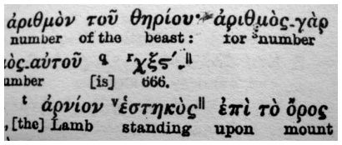
Victory: 4. over “the number of his name”, being “six hundred threescore and six” (Rev. 13:17-18, 14:11, 15:2)
The “number” of “his name” is “χξς”, which is
“(χ) 600 + (ξ) 60 + (ς) 6” = “666”.

Slide 48
Victory: 4. over “the number of his name”, being “six hundred threescore and six” (Rev. 13:17-18, 14:11, 15:2)
The very numerals themselves in Rev. 13:18 KJB, the “... Six hundred threescore and six.” have a [koine] Greek meaning for each numeral:
666; chi-xi-stigma χξς:​
χ: the G22nd (agamos ἄγαμος unmarried, unwedded, single),​
ξ: G14th (agathoergeō ἀγαθοεργέω to work good, to do good, to do well, act rightly)​
ς: and an obsolete letter (4742 [stigma, mark, stick, prick] as a cross) of the Greek alphabet (intermediate between the G5th (abba ἀββα Abba = "father") and G6th (Habel Ἅβελ Abel = "vanity (that is: transitory)")), used as numbers” [Strong's Concordance].​
The meaning is “unmarried [single] father [man, calling himself ‘Abba’ (Father God)] who is ‘marked’ [as Cain] by claiming good works [claims good fruits], but all that he does is unlasting vanity [coming to a sudden end; as the fig tree with only pretensious leaves; Mat. 21:19; Mar. 11:13; or as Cain, killeth those like Abel; thinking he doeth God’s service]”. See also Mat. 6:5, 23:5 ; Jhn. 16:2 KJB, etc. The very position of popery, son of perdition, man of sin, Judas, Cain, Lucifer.
The “number” of “his name” is “χξς”, which is
“(χ) 600 + (ξ) 60 + (ς) 6” = “666”.

Slide 49
Victory: 4. over “the number of his name”, being “six hundred threescore and six” (Rev. 13:17-18, 14:11, 15:2)
The “number” of “his name” is “χξς”, which is
“(χ) 600 + (ξ) 60 + (ς) 6” = “666”.

Slide 50
Victory: 4. over “the number of his name”, being “six hundred threescore and six” (Rev. 13:17-18, 14:11, 15:2)
The “number” of “his name” is “χξς”, which is
“(χ) 600 + (ξ) 60 + (ς) 6” = “666”.

Slide 51
Having briefly covered those 4 things, let us return unto consideration of the Sea of Glass:

Slide 52
Where is the Sea of Glass located?
Rev 4:6 – “And before the throne there was a sea of glass like unto crystal …”
Locationally, it is said that it is “before the throne (of God)” (Rev. 4:6), and the word “before” means across from, or infront of, or positionally opposite from, sometimes positively, othertimes negatively (see Gen. 6:11, 7:1, 10:9, 13:9; Mat. 2:9, 5:24; Mar. 5:33; Luk. 1:6).
This is important in connection with Psalms 77:13.

Slide 53
What is a Sea?
Gen 1:10 And God called the dry land Earth; and the gathering together of the waters called he Seas: and God saw that it was good.
Gen 1:22 And God blessed them, saying, Be fruitful, and multiply, and fill the waters in the seas, and let fowl multiply in the earth.
The “Sea” is the place of the “gathering together of the waters”.

Slide 54
What is a Sea?
Psa 104:5 Who laid the foundations of the earth, that it should not be removed for ever.
Psa 104:6 Thou coveredst it with the deep as with a garment: the waters stood above the mountains.
Psa 104:7 At thy rebuke they fled; at the voice of thy thunder they hasted away.
Psa 104:8 They go up by the mountains; they go down by the valleys unto the place which thou hast founded for them.
Psa 104:9 Thou hast set a bound that they may not pass over; that they turn not again to cover the earth.

Slide 55
This is important to understand, as the “waters” actually “cover” the Sea.
Isa 11:9 They shall not hurt nor destroy in all my holy mountain: for the earth shall be full of the knowledge of the LORD, as the waters cover the sea.
Hab 2:14 For the earth shall be filled with the knowledge of the glory of the LORD, as the waters cover the sea.
The “waters” which are thus “gathered together” “cover” and fill the “sea”, which is the basin/bowl.

Slide 56
This is important to understand, as the “waters” actually “cover” the Sea.

Slide 57
Yet, the Sea is more than is revealed in Gen. 1:10, as we also know it is connected to the Sanctuary, as per Psa. 77:13.

Slide 58
Yet, the Sea is more than is revealed in Gen. 1:10, as we also know it is connected to the Sanctuary, as per Psa. 77:13.
In the Sanctuary of the wilderness, the Sea is also called the “laver” of brass (Exo. 30:18,28, 31:9, 35:16, 38:8, 39:39, 40:7,11,30; Lev. 8:11; 1 Ki. 7:30,38; 2 Ki. 16:17) in which was placed “water”:
Exo 30:18 Thou shalt also make a laver of brass, and his foot also of brass, to wash withal: and thou shalt put it between the tabernacle of the congregation and the altar, and thou shalt put water therein.
Exo 40:7 And thou shalt set the laver between the tent of the congregation and the altar, and shalt put water therein.

Slide 59
Yet, the Sea is more than is revealed in Gen. 1:10, as we also know it is connected to the Sanctuary, as per Psa. 77:13.
In the Temple of Solomon, there were Ten “lavers” of brass (each containing 40 ‘baths’) and a giant central one, held up & supported by 12 oxen, called the “brasen” Sea, in which was placed “water” (containing, at one time “two thousand baths” (1 Ki. 7:26) and at another time “three thousand baths” (2 Chr. 4:5); see 1 Ki. 7:23,24,25,39,44; 2 Ki. 16:17, 25:13,16; 1 Chr. 18:8; 2 Chr. 4:2,3,4,6,10,15; Jer. 52:17,20):
1 Ki 7:23 And he made a molten sea, ten cubits from the one brim to the other: it was round all about, and his height was five cubits: and a line of thirty cubits did compass it round about.
1 Chr 18:8 Likewise from Tibhath, and from Chun, cities of Hadarezer, brought David very much brass, wherewith Solomon made the brasen sea, and the pillars, and the vessels of brass.

Slide 60
Yet, the Sea is more than is revealed in Gen. 1:10, as we also know it is connected to the Sanctuary, as per Psa. 77:13.

Slide 61
Yet, the Sea is more than is revealed in Gen. 1:10, as we also know it is connected to the Sanctuary, as per Psa. 77:13.

Slide 62
Yet, the Sea is more than is revealed in Gen. 1:10, as we also know it is connected to the Sanctuary, as per Psa. 77:13.
Thus the Sea is the brass bowl or deep basin in which waters were to be gathered together, in which the blood of the sacrifice upon the hands of the priests would be washed into, and flow to the bottom (blood and water, like the Red Sea (Psa. 77:19; 1 Cor. 10:2; Heb. 11:29), like birth and rebirth (John 3), like baptism (1 Jhn. 5:6,8), like the book of Acts (the book of the Laver), like at the cross (Jhn. 19:34; 1 Jhn. 5:6,8), like death, burial and resurrection (Rom. 6:1-11; Gal. 3:27; 1 Pet. 3:21), and our sins are cast into the depth of the sea (Mic. 7:19)).

Slide 63
What then are the “waters” that “cover” the Sea?
The “waters” are:
Rev 17:15 – “… the waters which thou sawest … are peoples, and multitudes, and nations, and tongues …”
Psa 65:7 Which stilleth the noise of the seas, the noise of their waves, and the tumult of the people.
Isa 17:12 Woe to the multitude of many people, which make a noise like the noise of the seas; and to the rushing of nations, that make a rushing like the rushing of mighty waters!
Isa 17:13 “The nations shall rush like the rushing of many waters …”
Jer 51:41 “How is Sheshach taken! … how is Babylon become an astonishment among the nations!”
Jer 51:42 The sea is come up upon Babylon: she is covered with the multitude of the waves thereof.

Slide 64
There are two kinds of “waters”:
Earthly, carnal, evil, impure and bitter waters:
Peoples of the nations that served the devil, and issued forth at his command, see 2 Sam. 22:5; Psa. 18:3-4, 32:6, 89:9-10, 93:3-4, 98:7-9, 124:1-5; Son. 8:7; Isa. 8:7, 17:12-13, 28:2, 59:19; Jer. 46:8, 47:2, 51:13; Eze. 31:15; Dan. 9:26, 11:22; Amo. 8:8, 9:5; Mat. 7:25,27; Jud. 1:13; Rev. 17:1,15.

Slide 65
There are two kinds of “waters”:
Heavenly, spiritual, good, clean and sweet waters:
even as Abraham (who was to be made into a nation) was called out of Babylon and the peoples thereof, and so God divided the waters, with a space between them, just as in Gen. 1:6-7 (more on this another time, for all of human history is found in Gen. 1-2), and Jacob (Israel), Christians, etc.
Gen 12:2 And I will make of thee a great nation, and I will bless thee, and make thy name great; and thou shalt be a blessing:
Gen 35:10 And God said unto him, Thy name is Jacob: thy name shall not be called any more Jacob, but Israel shall be thy name: and he called his name Israel.
Gen 35:11 And God said unto him, I am God Almighty: be fruitful and multiply; a nation and a company of nations shall be of thee, and kings shall come out of thy loins;
1 Pet 2:9 But ye are a chosen generation, a royal priesthood, an holy nation, a peculiar people; that ye should shew forth the praises of him who hath called you out of darkness into his marvellous light:

Slide 66
The “waters” of the “laver” or brasen Sea, deal with God’s people, who are Heavenly minded, for the unrepentant do not wash therein.

Slide 67
The Bible says that this Sea is made of “glass” (Rev. 4:6, 15:2), what then is this “glass”?

Slide 68
The Bible says that this Sea is made of “glass” (Rev. 4:6, 15:2), what then is this “glass”?
It is a “looking glass”, or a mirror, of which the brass Laver of the Tabernacle was made of the polished brass glass (mirrors) of the women (a symbol of the church, even the church in the wilderness (Act. 7:38)):
Exo 38:8 And he made the laver of brass, and the foot of it of brass, of the lookingglasses of the women assembling, which assembled at the door of the tabernacle of the congregation.

Slide 69
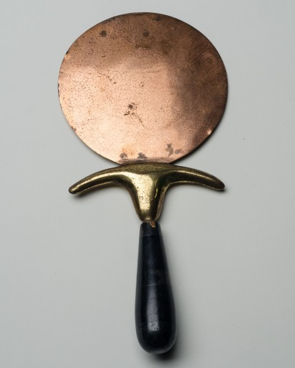
The “glass” of the Sea is made of the mirrors of the women of the “camp of the saints”:

Slide 70
The Bible says that this Sea is made of “glass” (Rev. 4:6, 15:2), what then is this “glass”?
Look and Sea :
Job 37:18 Hast thou with him spread out the sky, which is strong, and as a molten looking glass?
1 Cor 13:12 For now we see through a glass, darkly; but then face to face: now I know in part; but then shall I know even as also I am known.
2 Cor 3:18 But we all, with open face beholding as in a glass the glory of the Lord, are changed into the same image from glory to glory, even as by the Spirit of the Lord.

Slide 71
The Bible says that this Sea is made of “glass” (Rev. 4:6, 15:2), what then is this “glass”?
Look and Sea :
Jam 1:23 For if any be a hearer of the word, and not a doer, he is like unto a man beholding his natural face in a glass:
Rev 21:18 And the building of the wall of it was of jasper: and the city was pure gold, like unto clear glass.
Rev 21:21 And the twelve gates were twelve pearls; every several gate was of one pearl: and the street of the city was pure gold, as it were transparent glass.

Slide 72
Yet this Sea is like unto “crystal”, what then is this “crystal” and what is it related to?

Slide 73
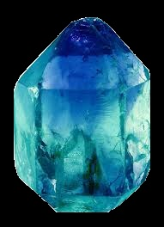
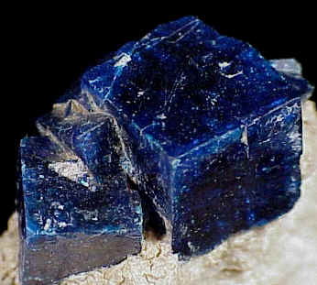
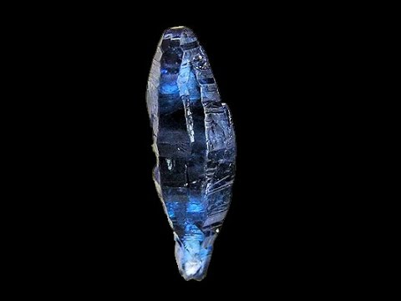
Yet this Sea is like unto “crystal”, what then is this “crystal” and what is it related to?
Eze 1:22 And the likeness of the firmament upon the heads of the living creature was as the colour of the terrible crystal, stretched forth over their heads above.

Slide 74
Yet this Sea is like unto “crystal”, what then is this “crystal” and what is it related to?
Eze 1:26 And above the firmament that was over their heads was the likeness of a throne, as the appearance of a sapphire stone: and upon the likeness of the throne was the likeness as the appearance of a man above upon it.
Eze 10:1 Then I looked, and, behold, in the firmament that was above the head of the cherubims there appeared over them as it were a sapphire stone, as the appearance of the likeness of a throne.

Slide 75
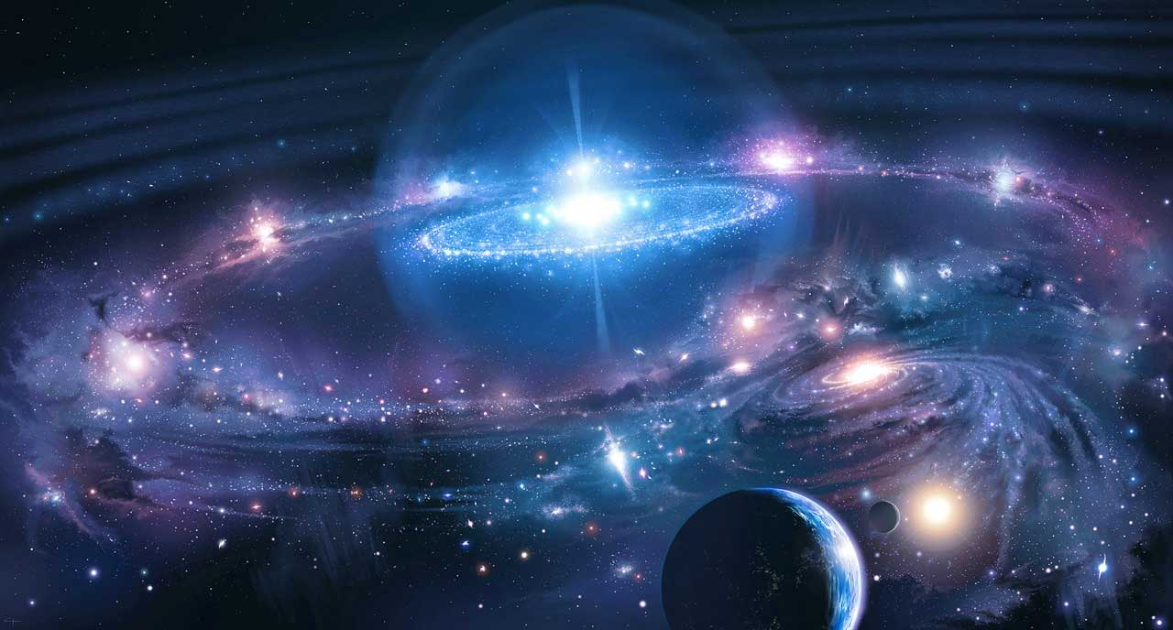
God’s sapphire Throne:

Slide 76
Yet this Sea is like unto “crystal”, what then is this “crystal” and what is it related to?
The sapphire stone on which is the Law of God, the Ten Commandments:
Exo 24:10 And they saw the God of Israel: and there was under his feet as it were a paved work of a sapphire stone, and as it were the body of heaven in his clearness.
Exo 24:12 And the LORD said unto Moses, Come up to me into the mount, and be there: and I will give thee tables of stone, and a law, and commandments which I have written; that thou mayest teach them.
Exo 24:12 HOT Translit. waYomer y'hwäh el-mosheh álëh ëlay hähäräh weh'yëh-shäm w'eT'näh l'khä et-luchot häeven w'haTôräh w'haMitz'wäh ásher Kätav'Tiy l'hôrotäm
Thus 'tables of the stone' (Exodus 24:10,12), cut from the sapphire (blue) foundation of the Throne of God itself.

Slide 77
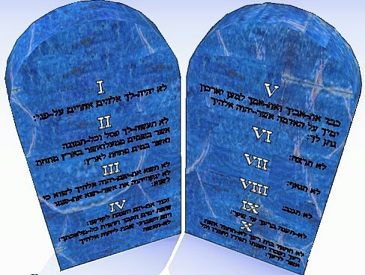
God’s sapphire Law of Ten Commandments:

Slide 78
Yet this Sea is like unto “crystal”, what then is this “crystal” and what is it related to?
The sapphire stone on which is the Law of God, the Ten Commandments, which are the foundation of God's government and Kingdom, the heart of His own Character transcribed (Exo. 20:5-6, 33:12-23, 34:1-9; Psa. 40:8), as written: Exo. 28:28,31,37, 31:18, 32:16, see also the “blue” lace on the priests, Exo. 39:21-22,31):
Exo 32:16 And the tables were the work of God, and the writing was the writing of God, graven upon the tables.

Slide 79
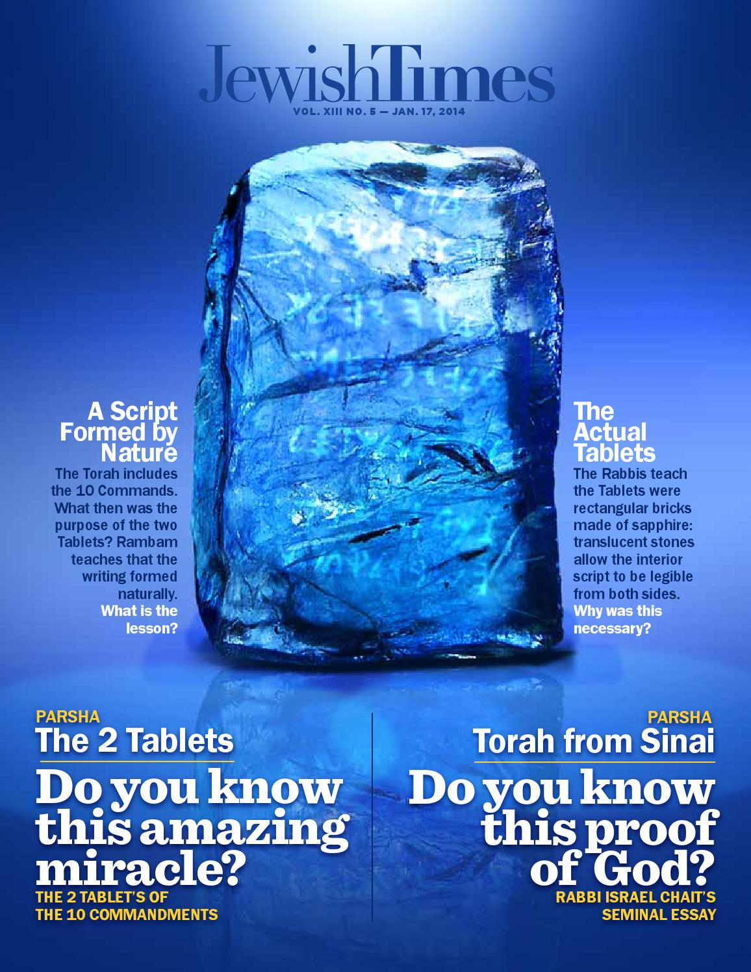
Even according to non-scriptural sources, such as the Legends of the Jews, by Louis Ginzberg, picked up on this,

Slide 80
Even according to non-scriptural sources, such as the Legends of the Jews, by Louis Ginzberg, picked up on this,
“...Moses departed from the heavens with the two tables on which the Ten Commandments were engraved, and just the words of it are by nature Divine, so too are the tables on which they are engraved. These were created by God's own hand in the dusk of the first Sabbath at the close of the creation, and were made of a sapphire-like stone. ...” - Legends of the Jews, Volume 3, page 258 - https://archive.org/stream/legendsofthejews02881gut/3lotj10.txt
"...state that the sapphire employed for the tables was taken from the throne of Glory..." - Legends of the Jews, Volume 6; page 49 [see also page 59] - https://books.google.nl/books?ei=UWHXUd6CFYepiALN64CoDA&id=ifcLAAAAIAAJ&dq=Legends+of+the+Jews+volume+6&q=sapphire&redir_esc=y&hl=nl#search_anchor

Slide 81
Even according to the ‘Targum’:
“... Then it was said to Moses: 83 "Ascend to the firmament and I will give you two tables of stone, 84 hewn from the sapphire of the throne of My glory, 85 gleaming like fine gold, arranged in lines 86 and written by My finger. 87 Engraved on them are the Ten Words, 88 refined more than silver that has been refined seven times seven [ways] -- that is the sum total of the principles ...” - The Aramiac Bible, the Targums; by Phillip Alexander, page 89-90 [especially see Note 85] - https://books.google.nl/books?id=hDwnbqLbwqgC&printsec=frontcover&redir_esc=y#v=onepage&q&f=false

Slide 82
Even the priests were to wear the “blue” ribband, to remind them of keeping God’s Law in all things:
Numbers 15:38 Speak unto the children of Israel, and bid them that they make them fringes in the borders of their garments throughout their generations, and that they put upon the fringe of the borders a ribband of blue:
Numbers 15:39 And it shall be unto you for a fringe, that ye may look upon it, and remember all the commandments of the LORD, and do them; and that ye seek not after your own heart and your own eyes, after which ye use to go a whoring:
Numbers 15:40 That ye may remember, and do all my commandments, and be holy unto your God.

Slide 83
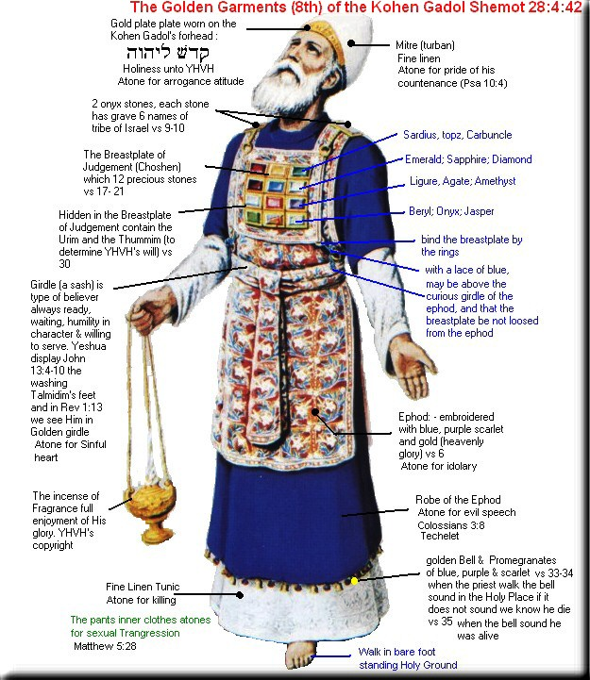
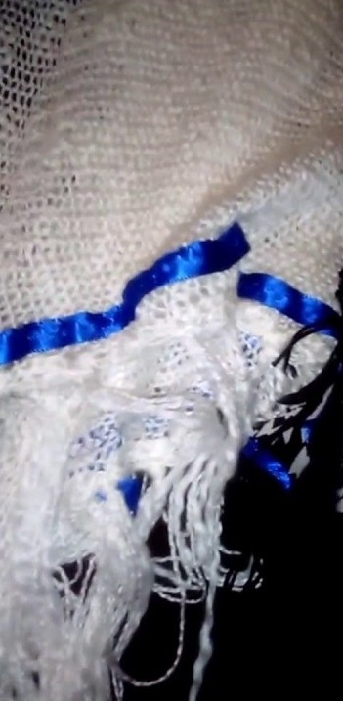
Even the priests were to wear the “blue” ribband, to remind them of keeping God’s Law in all things:

Slide 84
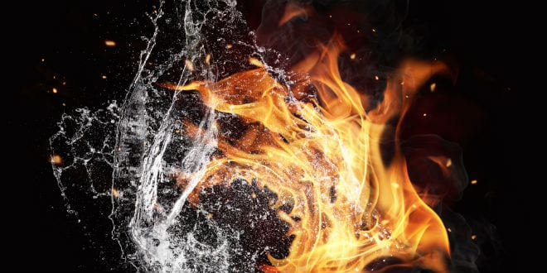
This “Sea of glass”, that was “like unto crystal” was “mingled with fire”, what is this “fire” which is “mingled” with it?

Slide 85
This “Sea of glass”, that was “like unto crystal” was “mingled with fire”, what is this “fire” which is “mingled” with it?
First, it is the indwelling of the Holy Ghost, the fulness (Jhn. 3:34, 20:21-22) of the pure and holy fire of God's perfect love (Gal. 5:22-23), for as water cleanses only the external, this holy fire of the sanctuary cleanses all within, internal, through and through, leaving nothing untouched.
Deut 4:24 For the LORD thy God is a consuming fire, even a jealous God.
Deut 9:3 Understand therefore this day, that the LORD thy God is he which goeth over before thee; as a consuming fire he shall destroy them, and he shall bring them down before thy face: so shalt thou drive them out, and destroy them quickly, as the LORD hath said unto thee.
Song 8:7 Many waters cannot quench love, neither can the floods drown it: if a man would give all the substance of his house for love, it would utterly be contemned.

Slide 86
This “Sea of glass”, that was “like unto crystal” was “mingled with fire”, what is this “fire” which is “mingled” with it?

Slide 87
This “Sea of glass”, that was “like unto crystal” was “mingled with fire”, what is this “fire” which is “mingled” with it?
The bitter and cold waters (for the heathen did rage and imagine a vain thing) surrounded Christ Jesus upon the Cross, seeking to crush out love, to wash away the Rock, to blot out the Light of God’s holy fire, yet they could not quench His Love, but the righteous Branch was cast into them, turning many of them sweet, with the Gospel of the Father's Love, the Tree of Life bore sacred fruit, and continues to bear Holiness unto the LORD upon the good soil of Calvary, which is of the mind/heart, the place of the skull.

Slide 88
This “Sea of glass”, that was “like unto crystal” was “mingled with fire”, what is this “fire” which is “mingled” with it?

Slide 89
This “Sea of glass”, that was “like unto crystal” was “mingled with fire”, what is this “fire” which is “mingled” with it?
Isa 10:17 And the light of Israel shall be for a fire, and his Holy One for a flame: and it shall burn and devour his thorns and his briers in one day;
Mat 3:11 I indeed baptize you with water unto repentance: but he that cometh after me is mightier than I, whose shoes I am not worthy to bear: he shall baptize you with the Holy Ghost, and with fire:
Luk 3:16 John answered, saying unto them all, I indeed baptize you with water; but one mightier than I cometh, the latchet of whose shoes I am not worthy to unloose: he shall baptize you with the Holy Ghost and with fire:

Slide 90
This “Sea of glass”, that was “like unto crystal” was “mingled with fire”, what is this “fire” which is “mingled” with it?
Heb 12:29 For our God is a consuming fire.
1 Jhn 4:8 He that loveth not knoweth not God; for God is love.
1 Jhn 4:15 Whosoever shall confess that Jesus is the Son of God, God dwelleth in him, and he in God.

Slide 91
This “Sea of glass”, that was “like unto crystal” was “mingled with fire”, what is this “fire” which is “mingled” with it?

Slide 92
This “Sea of glass”, that was “like unto crystal” was “mingled with fire”, what is this “fire” which is “mingled” with it?
1 Jhn 4:16 And we have known and believed the love that God hath to us. God is love; and he that dwelleth in love dwelleth in God, and God in him.
1 Jhn 4:17 Herein is our love made perfect, that we may have boldness in the day of judgment: because as he is, so are we in this world.
1 Jhn 4:18 There is no fear in love; but perfect love casteth out fear: because fear hath torment. He that feareth is not made perfect in love.

Slide 93
It is written that those who obtain the “victory” stand on the Sea of glass.

Slide 94
What does it mean to stand on the Sea of glass?
To STAND is the opposite of to fall, or be fallen (Gen. 4:6,7; as sin; Psa. 20:8, 36:12; Isa. 14:12; Psa. 1:5, 5:5, 130:3; Lam. 5:16; Hos. 14:1; Mat. 7:26-27; Luk. 6:49; Gal. 5:4; Rev. 2:5, 9:1; as Lucifer fell, as Adam fell, but God had made man/Adam in His own image, He made man “upright” (Ecc. 7:29), STANDING in righteousness and without sin (Psa. 4:4, 20:8, 24:3-4; Pro. 12:7, 19:21; Isa. 46:10; Mal. 3:2; Mat. 7:24-25; Luk. 6:46-48, 21:36; Rom. 5:2, 14:4; Eph. 6:13; Col. 4:12), to be resurrected from the spiritually dead and living unto God, having a kingdom (a King's (Psa. 8:5; Heb. 2:9) dominion in stewardship, even over himself first, in submission to God)), it is overcoming, even victory over all things that beset us (1 Jhn. 5:4,5; Rev. 2:7,11,17,26, 3:5,12,21, 12:11, 21:7).

Slide 95
What does it mean to stand on the Sea of glass?
Therefore, as the great Spiritual Laver/ Sea, filled with the Spiritual waters (the redeemed peoples) of Heaven, the children of God, who are indwelt with the fullness of the Holy Ghost, the indwelling of God, who is Love, having victory over all things, having the law of God written in the heart by the Holy Ghost, having their Father's name, His perfect Character in their foreheads, shall STAND upon the Sea (covering/filling it as waters do), and thus are before (in front of) the Throne of God, and as God looks down at His purchased people, looking into His mirror, whom are all filled with the perfect Peace of God, the Gospel (the great mystery of God) revealed in their lives, God sees His own face (as it is in Christ Jesus, 2 Cor. 4:4-6), perfectly reflected and returned back to Himself – Love.

Slide 96
God looks down at His redeemed …

Slide 97
… sees His own likeness of character – Love.
Proverbs 27:19 As in water face answereth to face, so the heart of man to man.

Slide 98
Yet, the wicked are not so …
Isa 57:20 But the wicked are like the troubled sea, when it cannot rest, whose waters cast up mire and dirt.
A troubled Sea, the finally impenitent and unrepentant sinners only stir up the mire and dirt of sin of their own hearts from the depths below, darkening the waters, raging and foaming out their own shame (Jud. 1:13), distorting the image that was to be perfectly reproduced through Christ Jesus, and so cannot reflect the love of God back to Him who is Love, and shall never stand, but are brought down, only to remain forever fallen.

Slide 99
… sees His own likeness of character – Love.
“... The image of God is restored to the soul, and day by day he is strengthened and renewed by grace, and is enabled more and more perfectly to reflect the character of Christ in righteousness and true holiness. {RH, September 17, 1895 par. 7}...” – The (Advent) Review and (Sabbath) Herald; September 17, 1895 par. 7
Proverbs 27:19 As in water face answereth to face, so the heart of man to man.

Slide 100
… sees His own likeness of character – Love.
“... Christ's true disciples follow Him through sore conflicts, enduring self-denial and experiencing bitter disappointment; but this teaches them the guilt and woe of sin, and they are led to look upon it with abhorrence. Partakers of Christ's sufferings, they are destined to be partakers of His glory. In holy vision the prophet saw the ultimate triumph of God's remnant church. He writes: {AA 590.2}
"I saw as it were a sea of glass mingled with fire: and them that had gotten the victory . . . stand on the sea of glass, having the harps of God. And they sing the song of Moses the servant of God, and the song of the Lamb, saying, Great and marvelous are Thy works, Lord God Almighty; just and true are Thy ways, Thou King of saints." Revelation 15:2, 3. {AA 590.3} …”
Proverbs 27:19 As in water face answereth to face, so the heart of man to man.

Slide 101
… sees His own likeness of character – Love.
“… "And I looked, and, lo, a Lamb stood on the Mount Sion, and with Him a hundred forty and four thousand, having [591] His Father's name written in their foreheads." Revelation 14:1. In this world their minds were consecrated to God; they served Him with the intellect and with the heart; and now He can place His name "in their foreheads." "And they shall reign for ever and ever." Revelation 22:5. They do not go in and out as those who beg a place. They are of that number to whom Christ says, "Come, ye blessed of My Father, inherit the kingdom prepared for you from the foundation of the world." He welcomes them as His children, saying, "Enter thou into the joy of thy Lord." Matthew 25:34, 21. {AA 590.4} ...” - Acts of the Apostles (1911), pages 590.2-590.4
Proverbs 27:19 As in water face answereth to face, so the heart of man to man.

Slide 102
Do you want that sacred fire of the Holy Spirit (Character) of – Love
to be able to STAND for the right, even though the Heavens fall?

Slide 103
Is your answer:
Yea, LORD, give me a DOUBLE portion of thy Holy Spirit!

Slide 104
… then it’s time to take Jesus by the hand …

Slide 105
… and walk with Him day by day, and you shall be able to stand, for it is written: …
Rom 14:4 “… Yea, he shall be holden up: for God is able to make him stand.”

Slide 106
… and walk with Him day by day, and you shall be able to stand, for it is written: …
Rom 14:4 “… Yea, he shall be holden up: for God is able to make him stand.”

