Slide 1
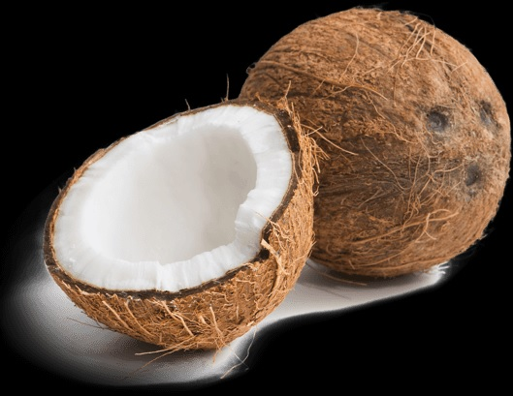
Object Lessons – Coconut Theology
http://www.pearltrees.com/awhn

Slide 2
From the Natural to the Spiritual
“… In Christ's parable teaching the same principle is seen as in His own mission to the world. That we might become acquainted with His divine character and life, Christ took our nature and dwelt among us. Divinity was revealed in humanity; the invisible glory in the visible human form. Men could learn of the unknown through the known; heavenly things were revealed through the earthly; God was made manifest in the likeness of men. So it was in Christ's teaching: the unknown was illustrated by the known; divine truths by earthly things with which the people were most familiar. {COL 17.1} …”

Slide 3
From the Natural to the Spiritual
“… The Scripture says, "All these things spake Jesus unto the multitude in parables; . . . that it might be fulfilled which was spoken by the prophet, saying, I will open My mouth in parables; I will utter things which have been kept secret from the foundation of the world." Matthew 13:34, 35. Natural things were the medium for the spiritual; the things of nature and the life-experience of His hearers were connected with the truths of the written word. Leading thus from the natural to the spiritual kingdom, Christ's parables [18] are links in the chain of truth that unites man with God, and earth with heaven. {COL 17.2} …”

Slide 4
From the Natural to the Spiritual
“… In His teaching from nature, Christ was speaking of the things which His own hands had made, and which had qualities and powers that He Himself had imparted. In their original perfection all created things were an expression of the thought of God. To Adam and Eve in their Eden home nature was full of the knowledge of God, teeming with divine instruction. Wisdom spoke to the eye and was received into the heart; for they communed with God in His created works. As soon as the holy pair transgressed the law of the Most High, the brightness from the face of God departed from the face of nature. The earth is now marred and defiled by sin. Yet even in its blighted state much that is beautiful remains. God's object lessons are not obliterated; rightly understood, nature speaks of her Creator. {COL 18.1} …”

Slide 5
From the Natural to the Spiritual
“… In the days of Christ these lessons had been lost sight of. Men had well-nigh ceased to discern God in His works. The sinfulness of humanity had cast a pall over the fair face of creation; and instead of manifesting God, His works became a barrier that concealed Him. Men "worshiped and served the creature more than the Creator." Thus the heathen "became vain in their imaginations, and their foolish heart was darkened." Romans 1:25, 21. So in Israel, man's teaching had been put in the place of God's. Not only the things of nature, but the sacrificial service and the Scriptures themselves--all given to reveal God--were so perverted that they became the means of concealing Him. {COL 18.2} …”

Slide 6
From the Natural to the Spiritual
“… Christ sought to remove that which obscured the truth. The veil that sin has cast over the face of nature, He came [19] to draw aside, bringing to view the spiritual glory that all things were created to reflect. His words placed the teachings of nature as well as of the Bible in a new aspect, and made them a new revelation. {COL 18.3} …” – Christ’s Object Lessons (1900), pages 17.1-18.3

Slide 7
From the Natural to the Spiritual
“… So wide was Christ's view of truth, so extended His teaching, that every phase of nature was employed in illustrating truth. The scenes upon which the eye daily rests were all connected with some spiritual truth, so that nature is clothed with the parables of the Master. {COL 20.1} …” – Christ’s Object Lessons (1900), page 20.1

Slide 8
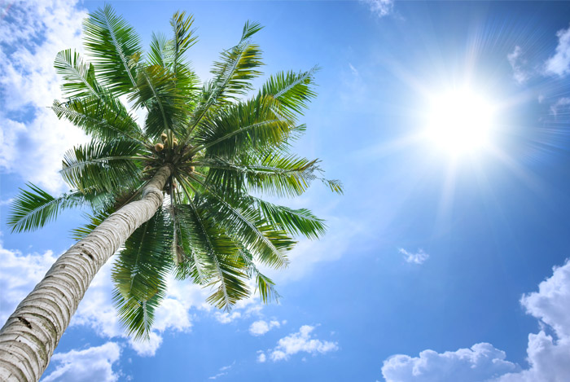
The Coconut Palm Tree

Slide 9
From the Natural to the Spiritual
Isa. 61:3 To appoint unto them that mourn in Zion, to give unto them beauty for ashes, the oil of joy for mourning, the garment of praise for the spirit of heaviness; that they might be called trees of righteousness, the planting of the LORD, that he might be glorified.
Psa. 92:12 The righteous shall flourish like the palm tree: he shall grow like a cedar in Lebanon.
Jer. 10:5 “… upright as the palm tree …”

Slide 10

A Coconut, is found on the Palm tree of Righteousness, which are standing tall, strong & upright for God (Malo).

Slide 11
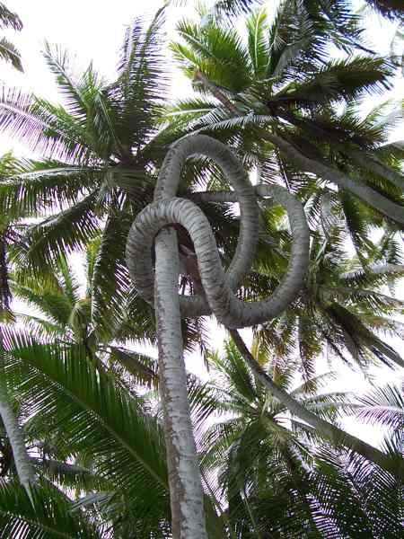
A Coconut palm tree may sometimes get sidetracked on its journey upward, even as we Christians do sometimes …

Slide 12
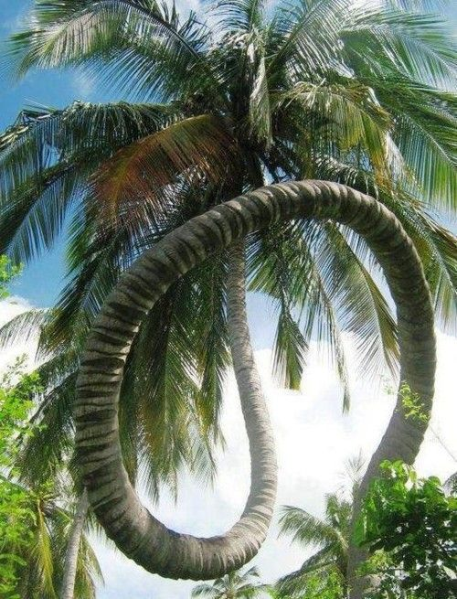
… but if continually striving, by God’s grace, to reach the truest potential and wave the palms of victory over sin, we will make it, for the LORD is able to make the path of our way straight.

Slide 13

A Coconut palm tree, reaches up to the Sun of Righteousness (Mal. 4:2), excelling ever onward and upward, striving towards the perfection of Heaven (taumafai e agai atu i le atoatoa o le Lagi).

Slide 14
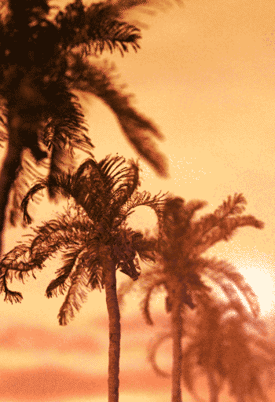
A Coconut palm tree, moves with the wind in the morning, as a Christian moves with the Holy Spirit when they arise from bed, and waves ‘good morning’ to God & their neighbours (Manuia le taeao).

Slide 15
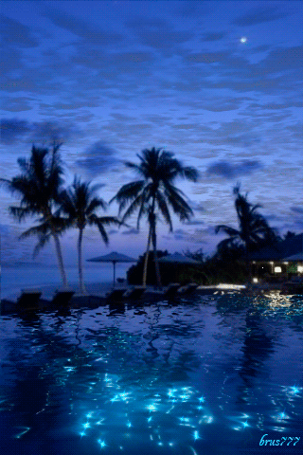
A Coconut palm tree, moves with the wind in the evening, as a Christian moves with the Holy Spirit when they get ready for bed, and waves ‘good night’ to God & their neighbours (Manuia le po).

Slide 16
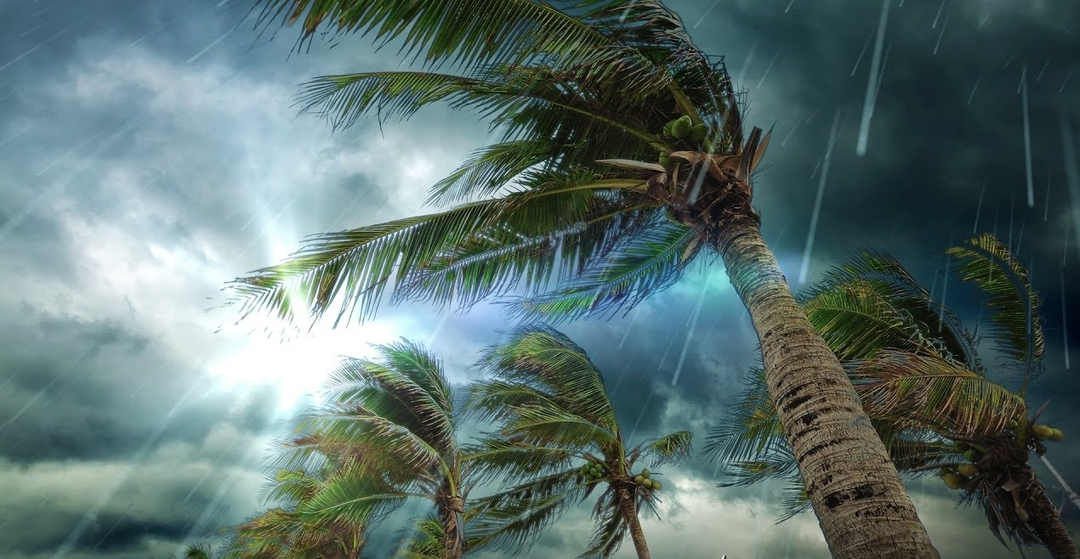
A Coconut palm tree, experiences all kinds of weather, even as a Christian experiences in life.

Slide 17
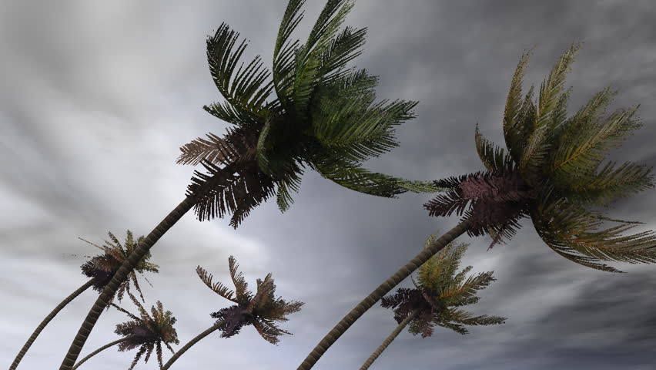
A Coconut palm tree, humbles itself, bending down before the might and majesty of God, as a Christian ought to do (Tulou).

Slide 18
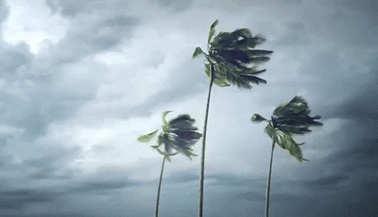
A Coconut palm tree, bears the raging storms of life but remains firmly rooted upon the Rock.

Slide 19
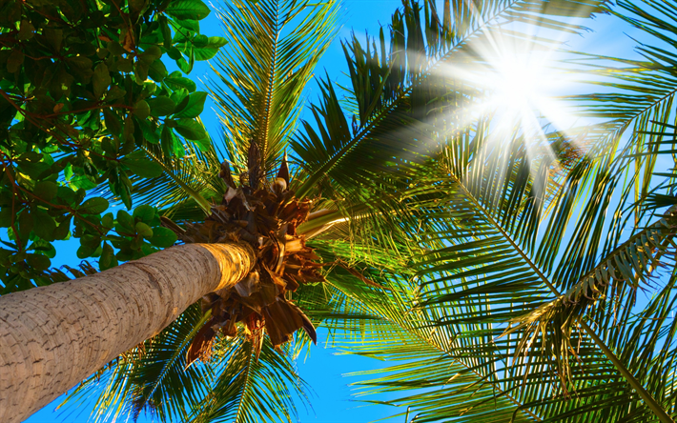
A Coconut palm tree, is a shade by day to the weary traveler, even as a Christ is our shade from the heat of the wrath of satan. A Christian is to also refresh the weary.

Slide 20
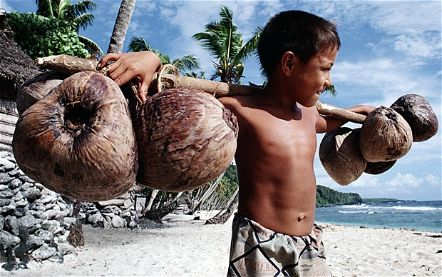
As a Coconut palm tree bears many burdens, so too Christ bore our burdens. A Christian therefore so ought to be a help and bear one another’s burdens.

Slide 21
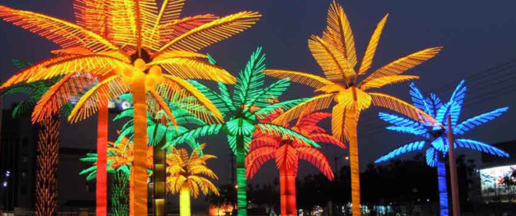
There are true & false Coconut palms in life, and Christians ought be those of the true, lest those seeking the fruit of righteousness come and find nothing but vain show.

Slide 22
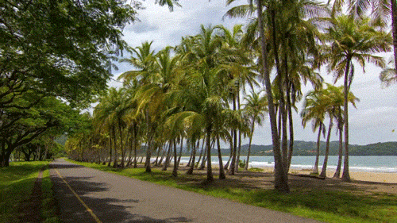
Christians should not be so busy in life, that we rush past the peaceful moments in life, but rather we ought to take time to enjoy and meditate on the blessings that God has provided for mankind in His Creation.

Slide 23
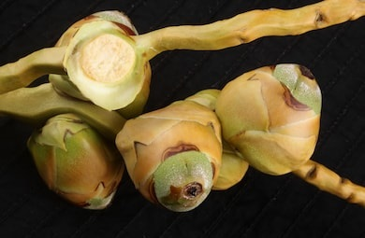
A Coconut starts out as a small seed, fruit or nut, even as Jesus came as a ‘babe’ (pepe) in Bethlehem.

Slide 24
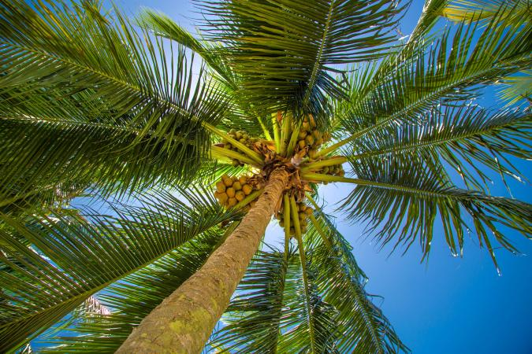
We must look up to see the blessing and gift of the tree, even as a Christian must lift up their heads, and look up by Faith unto God in Heaven, looking for the fruit of Salvation (Faaolataga) from above.

Slide 25
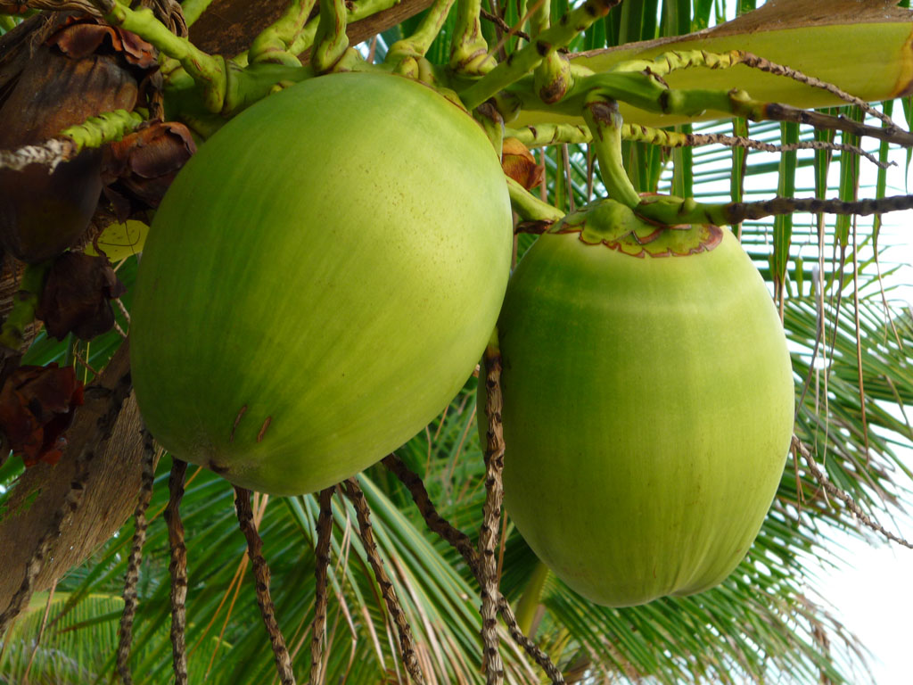
A Coconut hangs upon a tree in the prime of its life, even as Jesus, too, hung upon the Tree in the prime of His life.

Slide 26
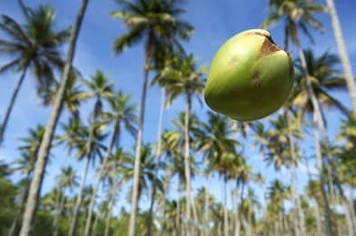
A Coconut begins up in the air of Heaven, but comes down as food, water and life, even as Jesus Christ came from above, coming down, bringing His word, His faith and everlasting Life (ola e faavavau).

Slide 27
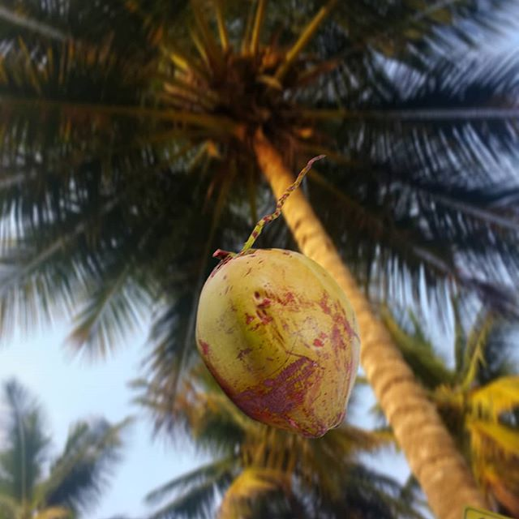
A Coconut leaves its place above, where it was with others like itself and descends downward, even as Jesus left His heavenly home in the atmosphere of Heaven and the angels there to come down here.

Slide 28
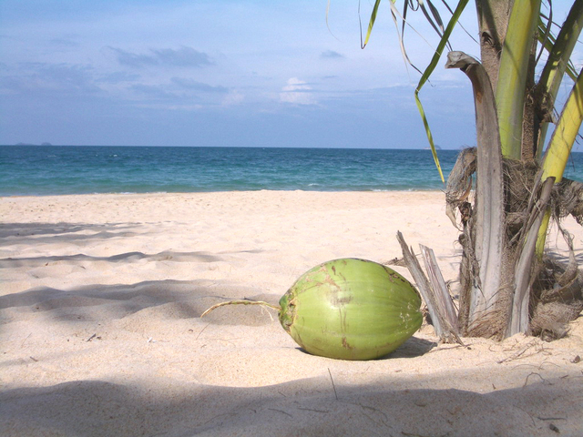
A Coconut that separates itself from the Tree, is never very far from its parent, even as Jesus Christ having left His Father above, was always near to Him in His heart crying Abba, Father (Ava, le Tamā e).

Slide 29
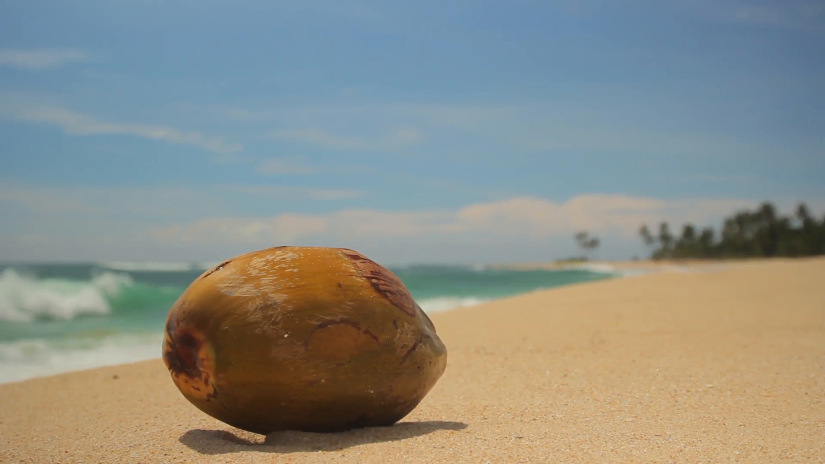
A Coconut comes all the way down to the earth, making direct contact with the soil, even as the Son of God did, Divinity taking upon himself our nature, and touching earthly humanity.

Slide 30
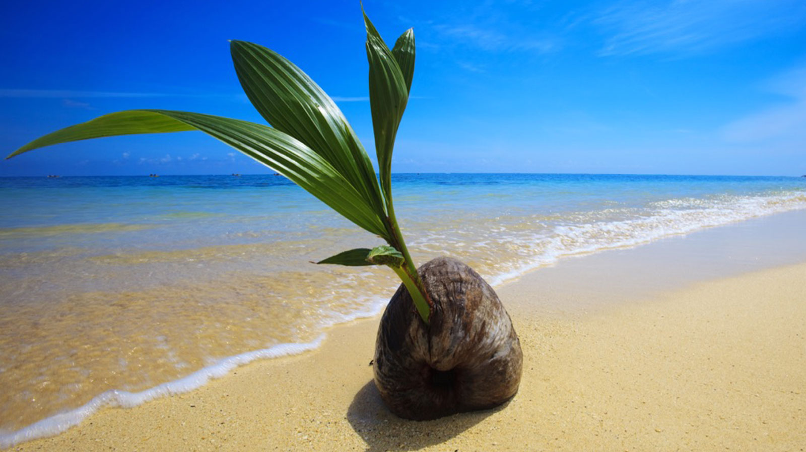
A Coconut is found close to the earth and waters, just as Christ Jesus came to be close to the people whom He loves, ready for mankind to experience together, share, enjoy and fellowship with.

Slide 31
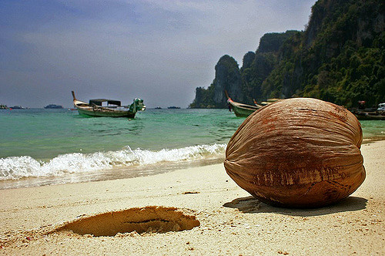
The outer husk of the Coconut is rather undesirable and common, even as Jesus had no outward appearance to be desired, and was with the common people.

Slide 32
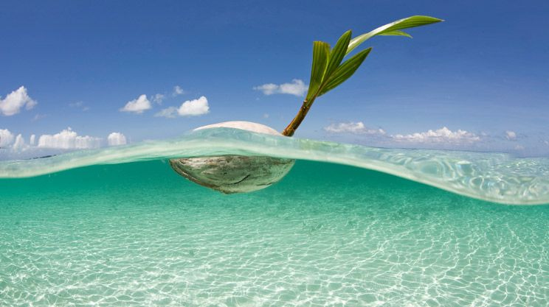
A Coconut will sometimes travel great distances that life may appear where there was only desolation, even as Christ Jesus came from far and travelled much to reach those in isolation.

Slide 33
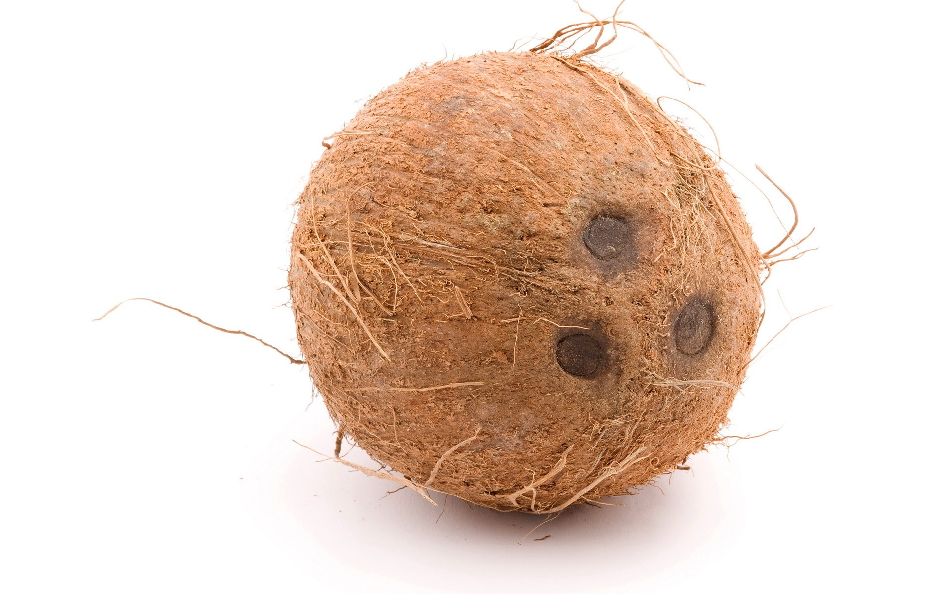
A coconut has 3 holes, just as Christ Jesus was pierced together in the feet (1 nail), and one nail (2) in each hand.

Slide 34
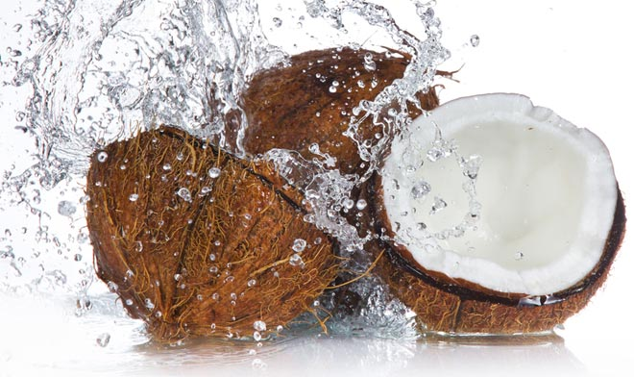
In order to experience the water of life inside the Coconut in full it must be split open and pierced, just as Jesus was pierced in the side, and from there poured out water and life.

Slide 35
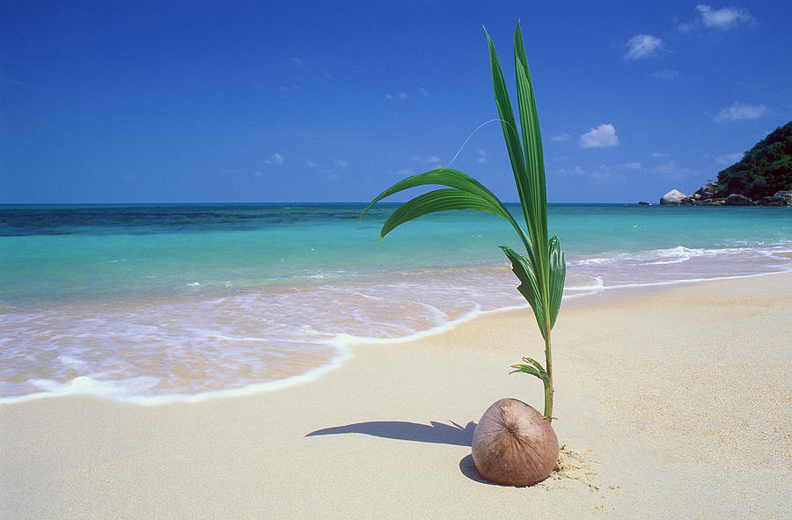
A Coconut that falls to the ground will die, but from it will spring newness of life, even as Jesus Christ died and was resurrected to Life.

Slide 36
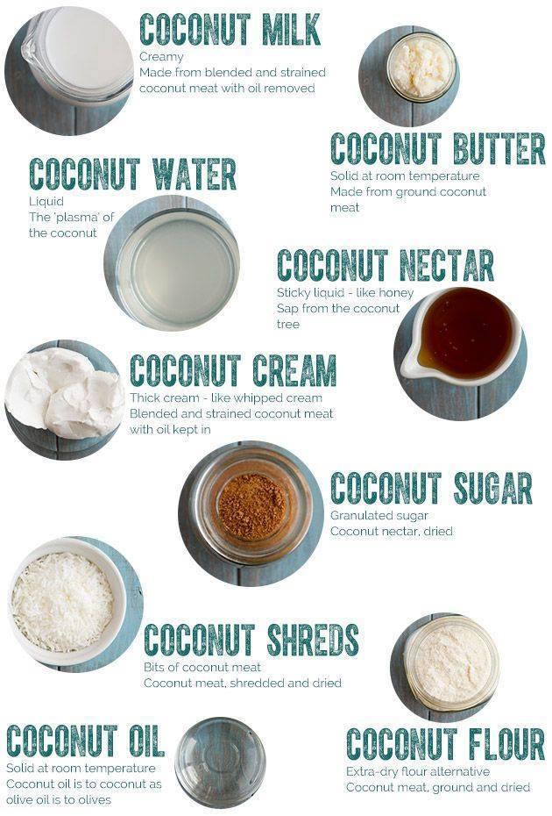
A Coconut was made by God for a purpose and has many wonderful uses, and so a Christian is also made with a purpose, and is to be for the service of all.

Slide 37
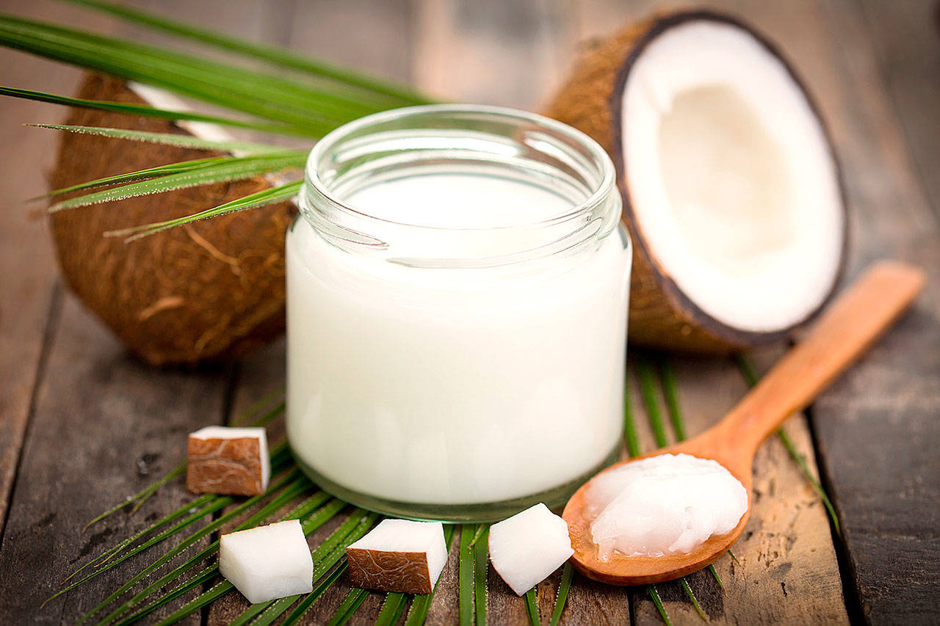
Coating all the inside of the Coconut is the Coconut oil, even as the Holy Ghost is to fill all the Christian with His sweet goodness.

Slide 38
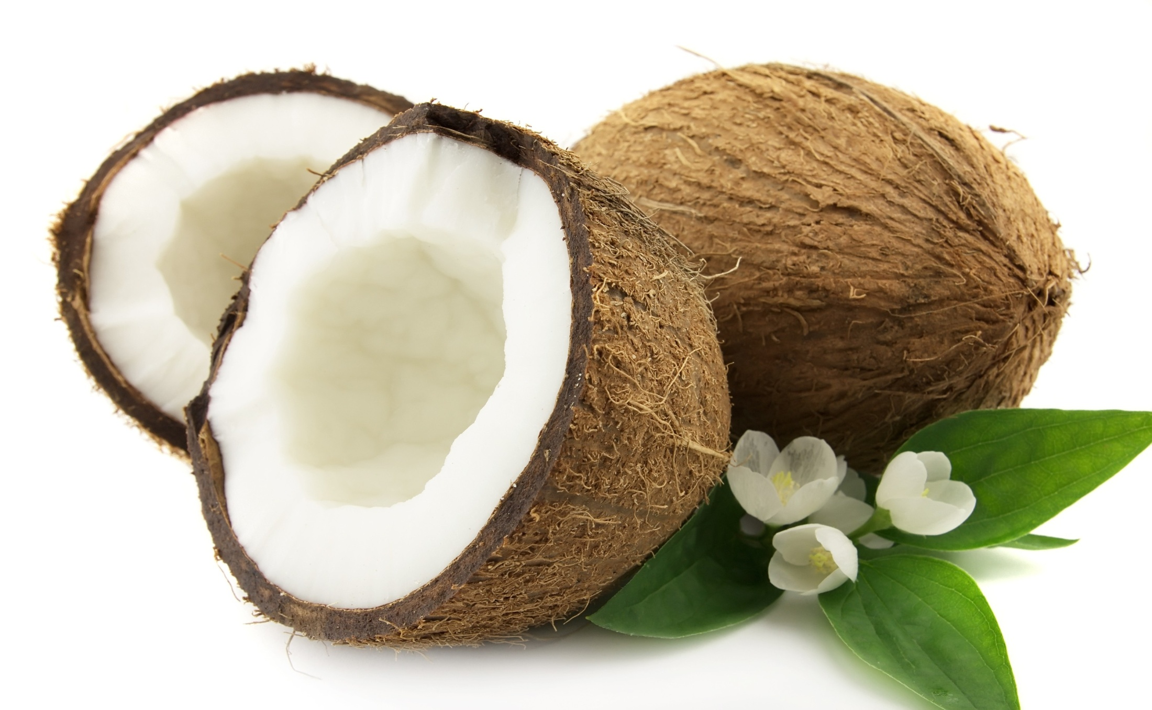
Inside of the Coconut is the pure white ‘meat’, rich in taste, as the perfect character of Jesus is pure holiness, and whose every word word man is to live by …

Slide 39
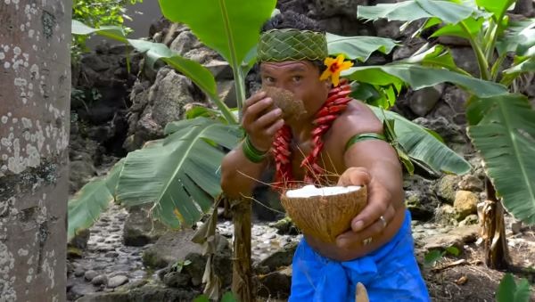
– (Psa. 34:8) “O taste and see that the LORD is good …”

Slide 40

Jesus said (John 10:10) – “… I am come that they might have life, and that they might have it more abundantly.”

