Slide 1
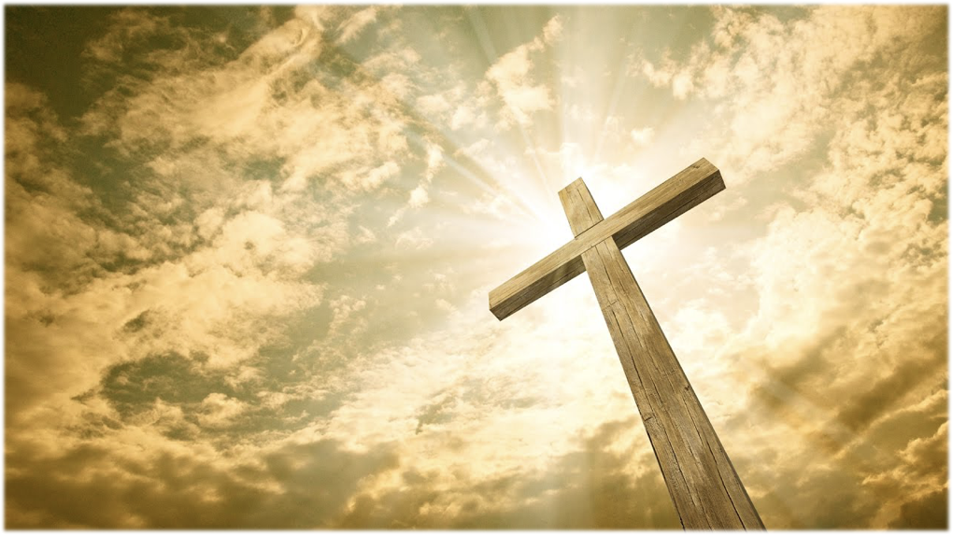
“Show me thy Glory”

Slide 2
Exodus 33:18-19
“I beseech thee, shew me thy glory.”
“I will make all my goodness pass before thee, and I will proclaim the name of the LORD before thee;”

Slide 3
Exodus 34:6
“And the LORD passed by before him, and proclaimed, The LORD, The LORD God, merciful and gracious, longsuffering, and abundant in goodness and truth, Keeping mercy for thousands, forgiving iniquity and transgression and sin, and that will by no means clear the guilty…

Slide 4
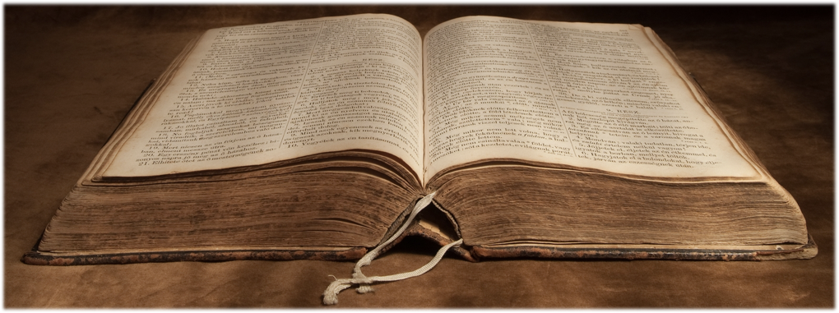
Revelation 18:1-5

Slide 5
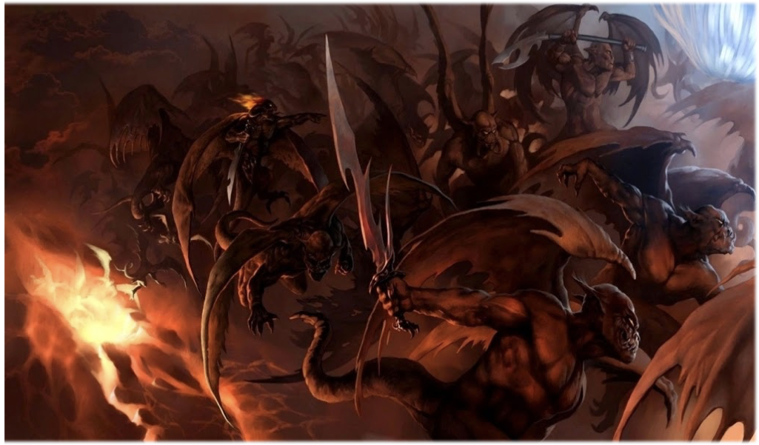

Slide 6
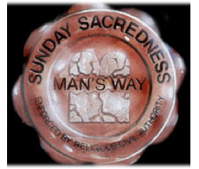
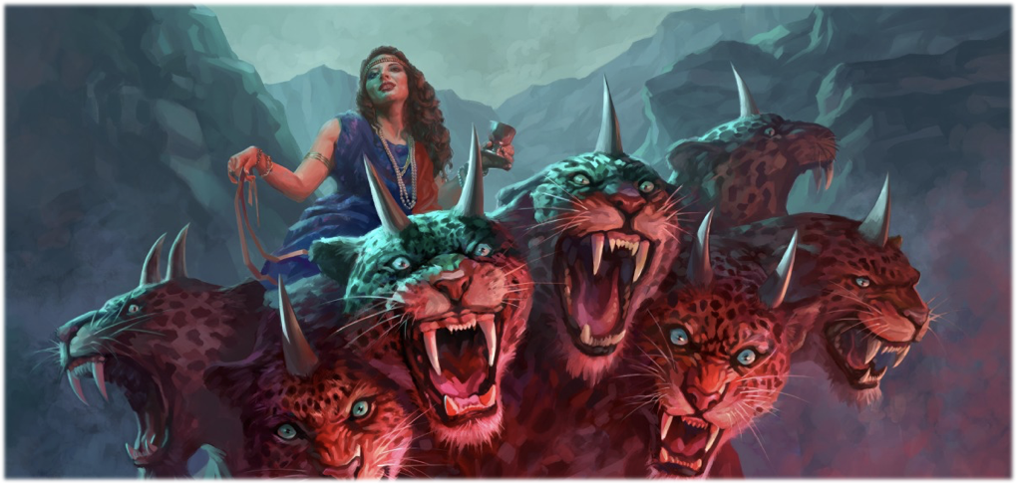

Slide 7
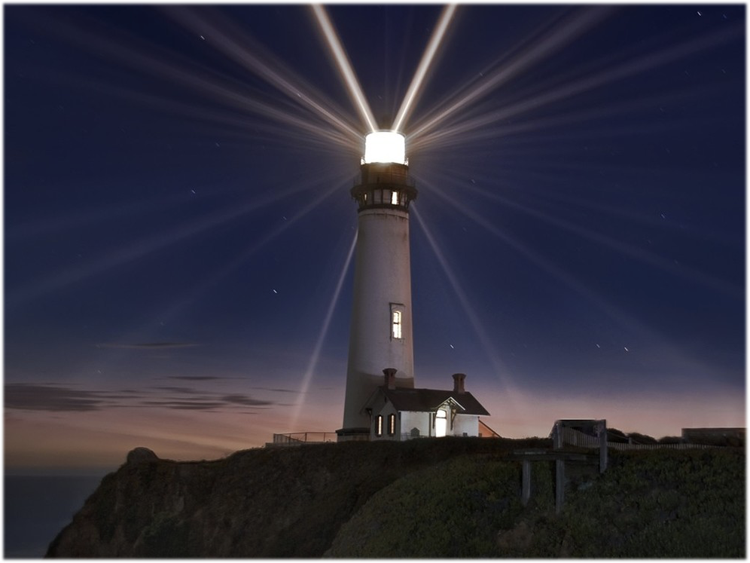

Slide 8
Galatians 5:22-23

Slide 9
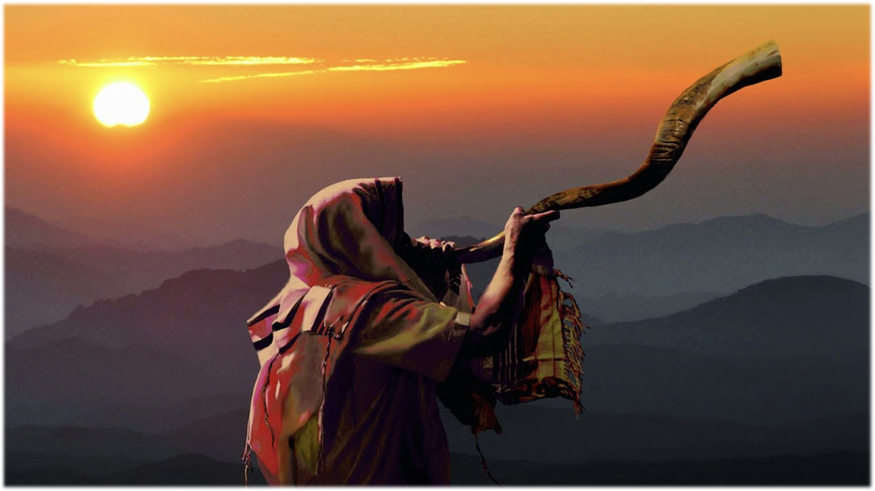

Slide 10
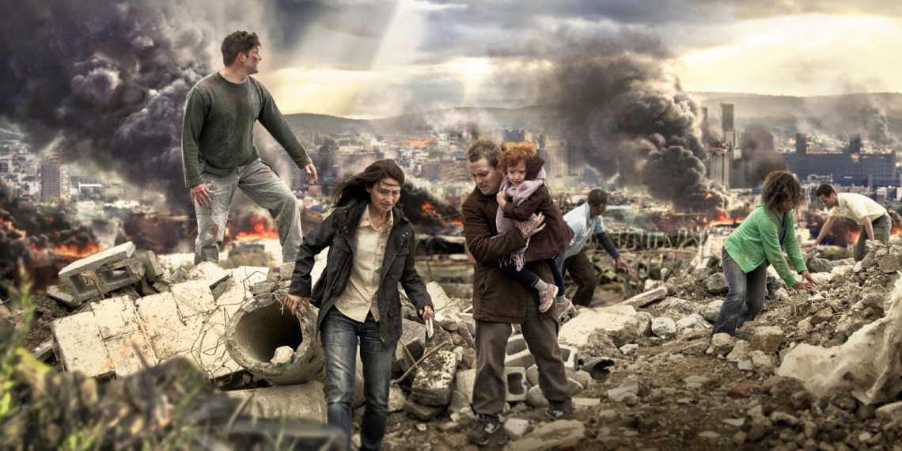

Slide 11
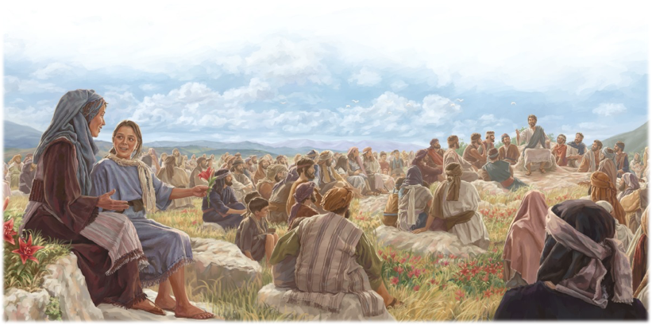
Matthew 5:44
“Love your enemies, bless them that curse you, do good to them that hate you, and pray for them which despitefully use you, and persecute you.”

Slide 12
Love
Joy
Peace
Long-suffering
Gentleness
Goodness
Faith
Meekness
Temperance

Slide 13
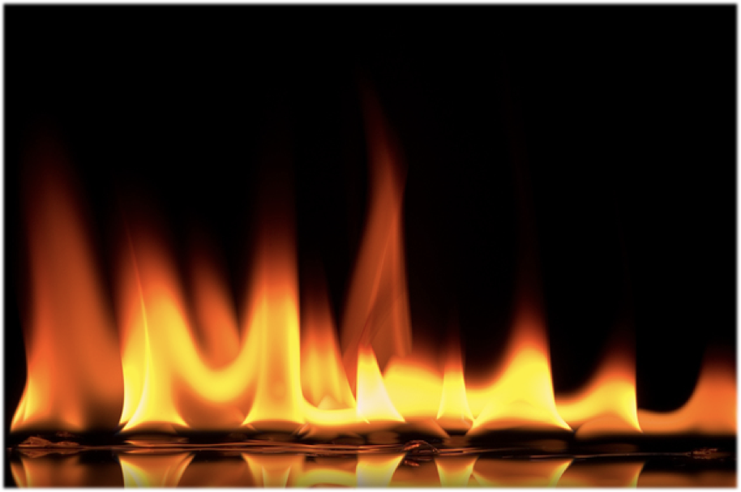
COL 412
“It is in a crisis that character is revealed.”
1 Corinthians 3:13

Slide 14
Church and State
Betrayal
Abandonment
Falsely accused
Persecuted
Put to death as a criminal

Slide 15
Church and State
Betrayal
Abandonment
Falsely accused
Persecuted
Put to death as a criminal

Slide 16
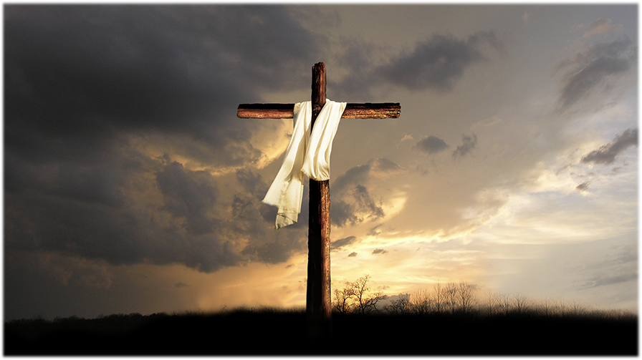
Temperance
Long-suffering
Joy
Goodness
Peace
Meekness
Faith
Gentleness
Love

Slide 17
If Christ doesn’t show up NOW he won’t show up THEN

Slide 18
“A cheap Christian character works more harm in the world than the character of a worldling; for professed Christians mislead others by professing to represent Him whose name they assume.”
-LT 2, 1895

Slide 19
What makes something cheap?

Slide 21
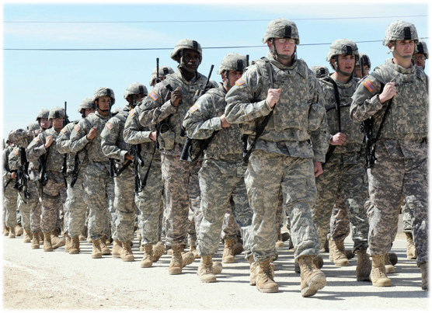
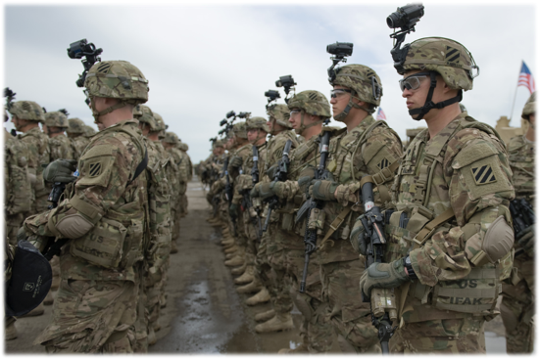

Slide 23
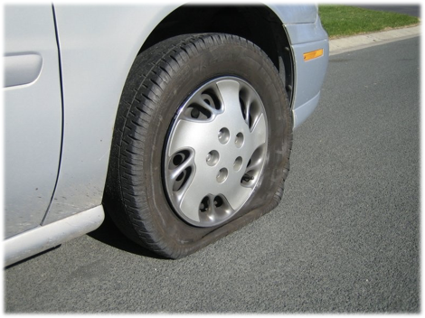

Slide 24
How is perfection of Character attained?

Slide 25
James 1:2-4

Slide 26
“Perfection of character is attained through exercise of the faculties of the mind, in times of supreme test, by obedience to every requirement of God's law.”
- MS 85, 1906

Slide 27
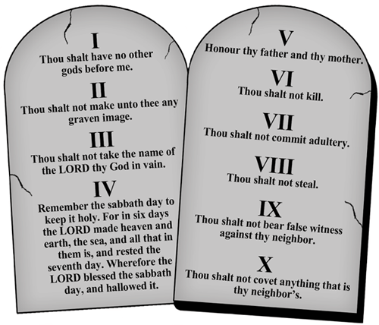

Slide 28
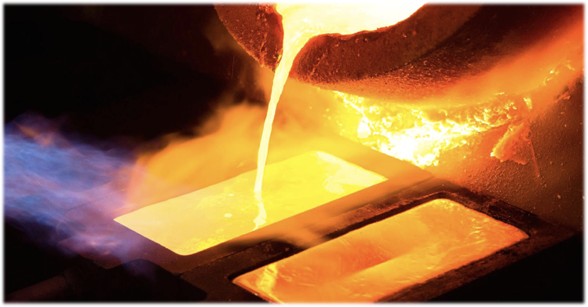
Revelation 3:18
“I counsel thee to buy of me gold tried in the fire, that thou mayest be rich;”

Slide 29
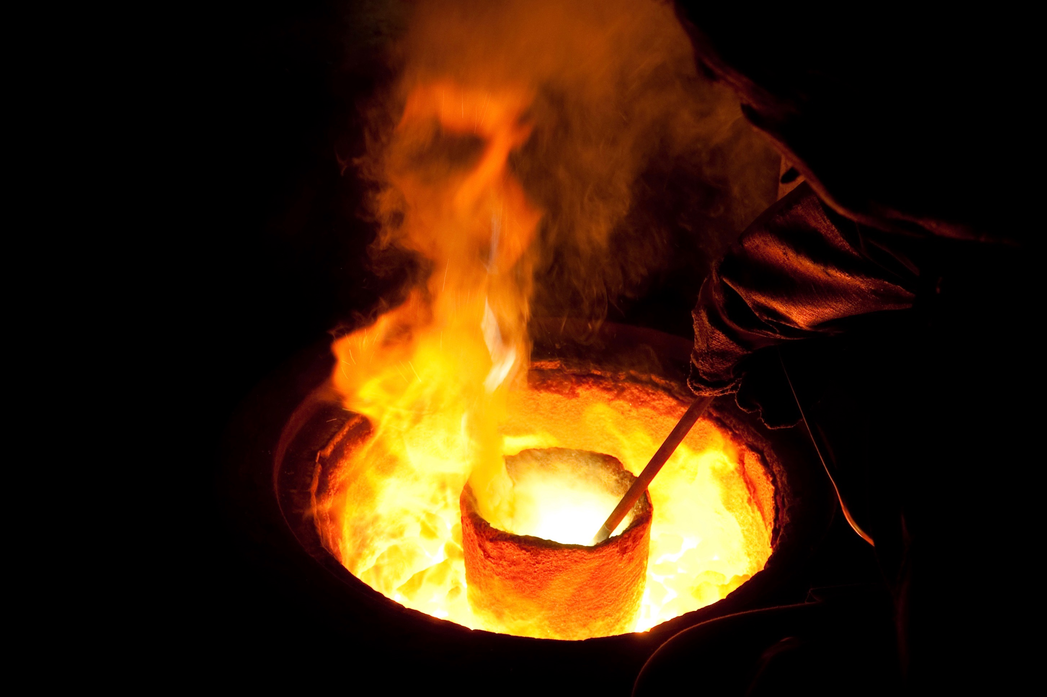
1 Peter 1:7
“That the trial of your faith, being much more precious than of gold that perisheth, though it be tried with fire, might be found unto praise and honour and glory at the appearing of Jesus Christ:”

Slide 30
Revelation 3:18
“I counsel thee to buy of me gold tried in the fire, that thou mayest be RICH;”

Slide 31
Romans 2:4
“Or despisest thou the RICHES of his goodness and forbearance and longsuffering; not knowing that the goodness of God leadeth thee to repentance?”

Slide 32
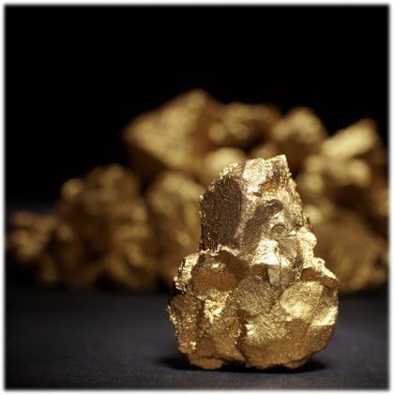
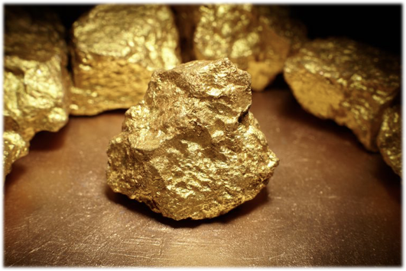
Ephesians 3:16
“That he would grant you, according to the RICHES of his glory, to be strengthened with might by his Spirit in the inner man;”

Slide 33
Revelation 3:18
“I counsel thee to buy of me gold tried in the fire, that thou mayest be RICH;”

Slide 34
1 Peter 4:12

Slide 35
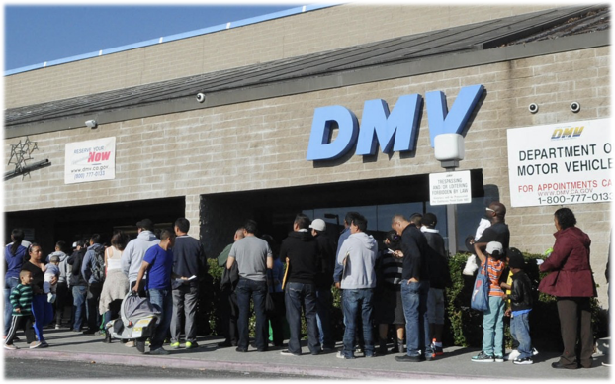
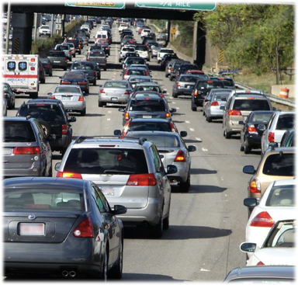
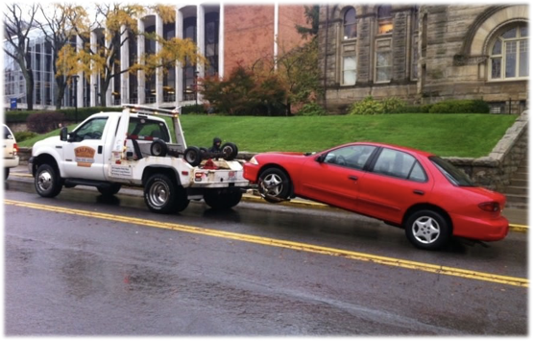

Slide 37
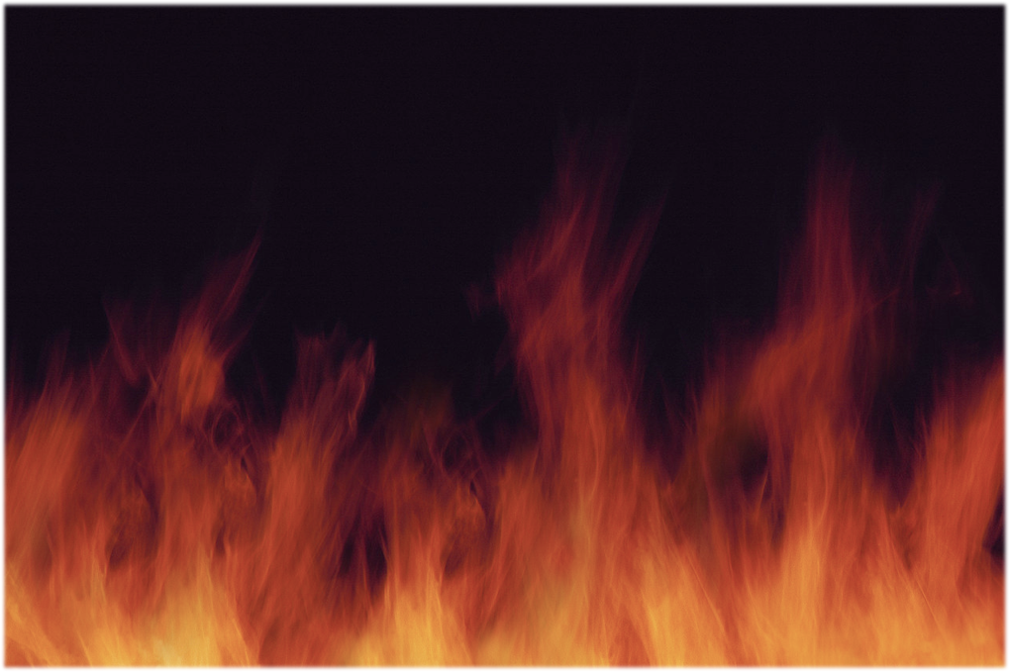
Malachi 3:3
“And he shall sit as a refiner and purifier of silver: and he shall purify the sons of Levi, and purge them as gold and silver, that they may offer unto the LORD an offering in righteousness.”

Slide 38
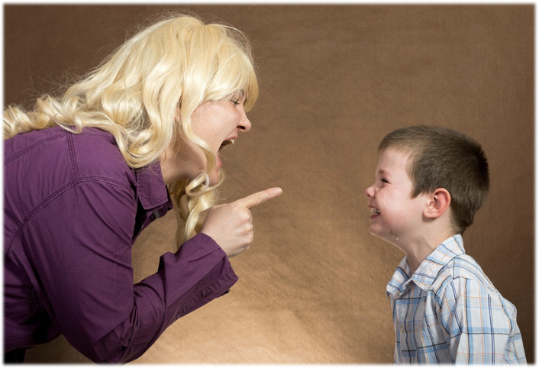
“Every time Parents lose self-control and speak and act impatiently, they sin against God.”- CHILD GUIDANCE, PAGE 283

Slide 39
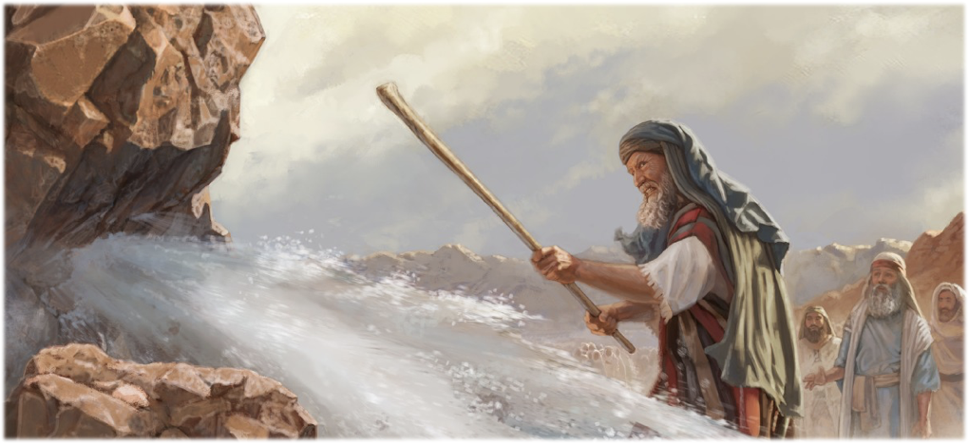
“Moses lost his self-control, and smiting the rock in anger and impatience, said, “Shall we bring you water out of this rock?” It was God’s design that Moses should represent His character to the people, that through Moses His name should be glorified.”
Ms 31, 1903

Slide 40
This is our Struggle
SELF

Slide 41
Where do we find the strength?

Slide 42
Hebrews 12:1-4

Slide 43
2 Corinthians 3:18
But we all, with open face beholding as in a glass the glory of the Lord, are changed into the same image from glory to glory, even as by the Spirit of the Lord.

Slide 44
Proverbs 23:7
“For as he thinketh in his heart, so is he.”

Slide 45
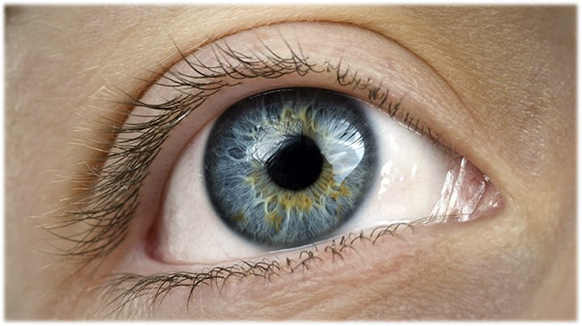
“By beholding Jesus we receive a living, expanding principle in the heart, and the Holy Spirit carries on the work, and the believer advances from grace to grace, from strength to strength, from character to character. He conforms to the image of Christ, until in spiritual growth he attains unto the measure of the full stature in Christ Jesus.”— TRUE REVIVAL, PAGE 34

Slide 46
“Those who behold Jesus become changed to his image, become assimilated to his nature; and the glory of God that shines in the face of Jesus, is reflected in the lives of his followers. More and more the Christian is changed from glory to glory as by the Spirit of the Lord, and he becomes the light of the world. The more he looks on Christ, the more he loves and longs to look again; and the more light and love and glory he sees in Christ, the more his light increases unto the perfect day.”— RH October 7, 1890

Slide 47
Really?

Slide 48
When we see Jesus, a Man of Sorrows and acquainted with grief, working to save the lost, slighted, scorned, derided, driven from city to city till His mission was accomplished; when we behold Him in Gethsemane, sweating great drops of blood, and on the cross dying in agony—when we see this, self will no longer clamor to be recognized. Looking unto Jesus, we shall be ashamed of our coldness, our lethargy, our self-seeking. We shall be willing to be anything or nothing, so that we may do heart service for the Master. We shall rejoice to bear the cross after Jesus, to endure trial, shame, or persecution for His dear sake.
- The Faith I live By Pg 107

Slide 49
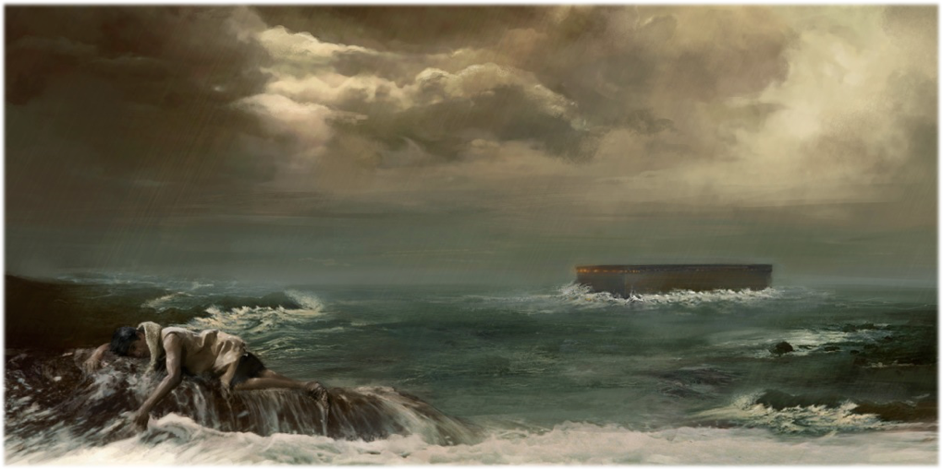
Genesis 6:5
And GOD saw that the wickedness of man was great in the earth, and that every imagination of the thoughts of his heart was only evil continually.

Slide 50
“There is no influence in our land more powerful to poison the imagination, to destroy religious impressions, and to blunt the relish for the tranquil pleasures and sober realities of life than theatrical amusements. The love for these scenes increases with every indulgence, as the desire for intoxicating drink strengthens with its use.”
- CHRISTIAN EDUCATION, PAGE 35

Slide 51
Isaiah 26:3

Slide 52
“it is by daily, hourly, beholding the character of Christ that we become changed into His image.”
LT 47, 1893

Slide 53
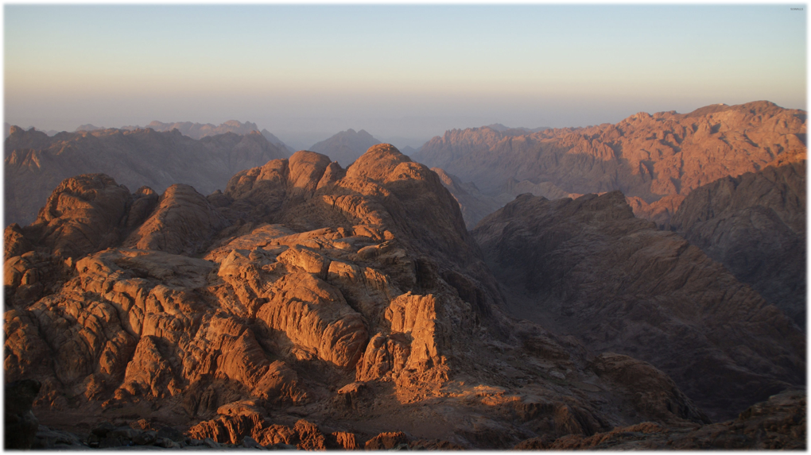
Exodus 34:1-4

Slide 54
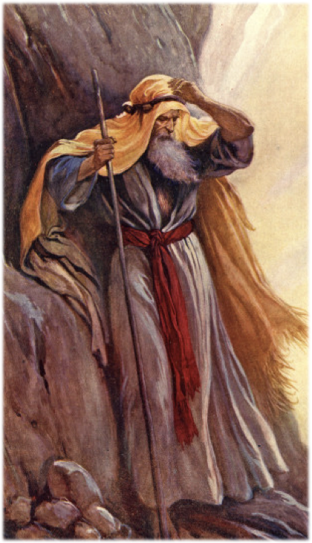
Exodus 33:18-23
“I beseech thee, shew me thy glory.”

Slide 55
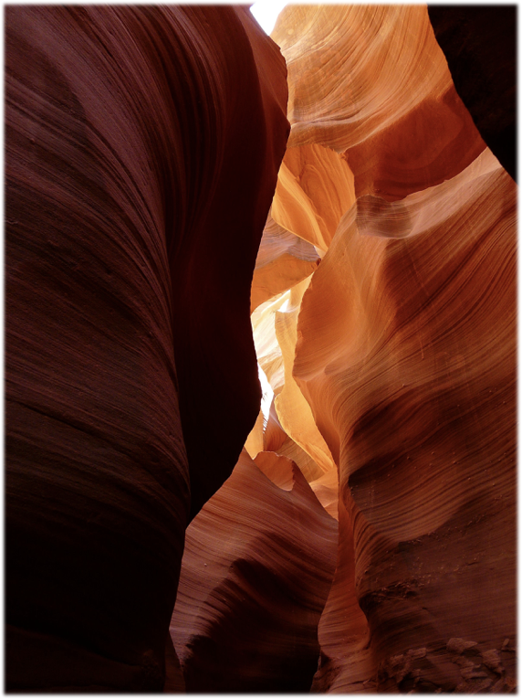
Exodus 34:5-7

Slide 56
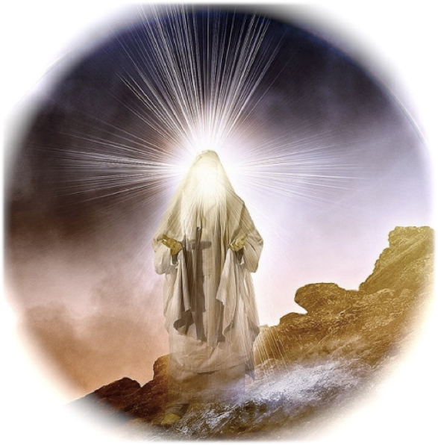
Exodus 34:28-30

Slide 57
“The glory that shone on the face of Moses was a reflection of the righteousness of Christ in the law…. In the mount, when the law was given to Moses, the Coming One was shown to him also. He saw Christ’s work, and His mission to earth, when the Son of God should take upon Himself humanity, and become a teacher and a guide to the world, and at last give Himself a ransom for their sins. ”

Slide 58
“Show me thy Glory”

Slide 59
“As Moses saw the day of Christ, and the new and living way of salvation that was to be opened through His blood, he was captivated and entranced. The praise of God was in his heart, and the divine glory that attended the giving of the law was so strikingly revealed in his countenance when he came down from the mount to walk with Israel, that the brightness was painful.”
{1BC 1110.1}

Slide 60
Trials and Tribulations

Slide 61
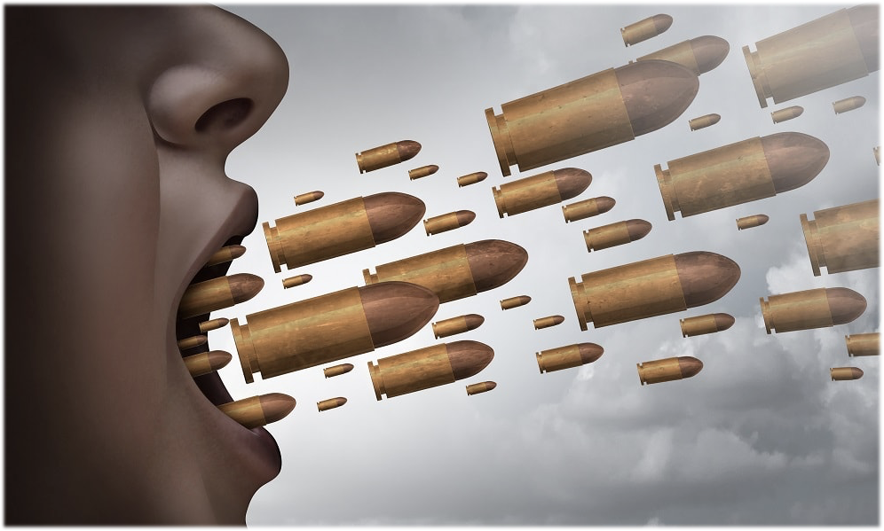

Slide 63
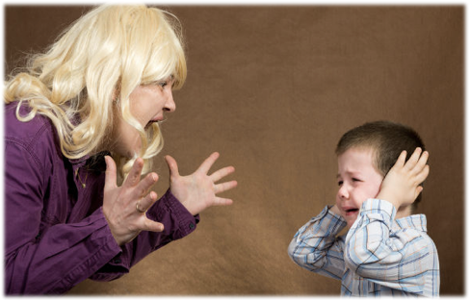

Slide 65
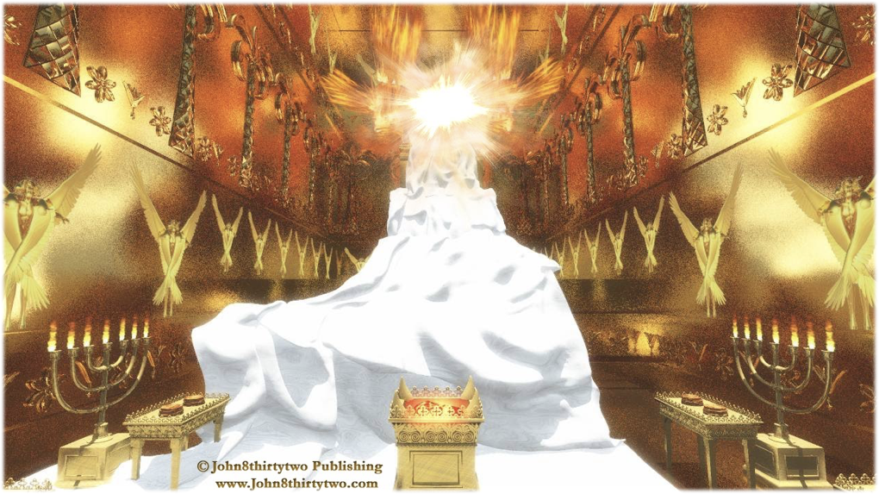

Slide 66
Daniel 10:8
“my comeliness was turned in me into corruption”

Slide 67
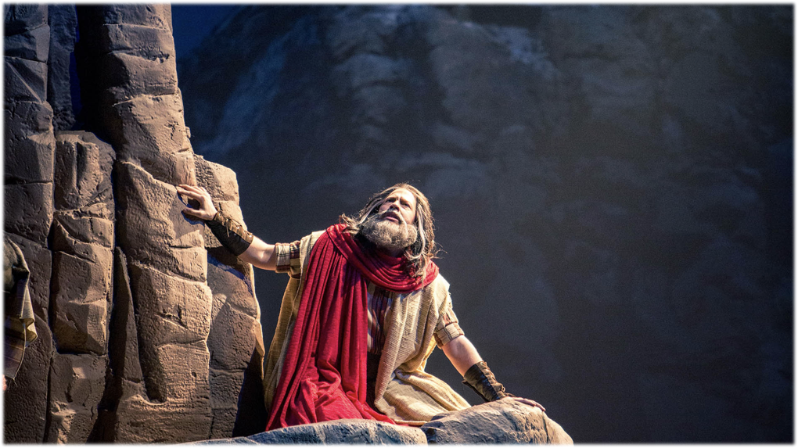
Numbers 12:3
“Now the man Moses was very meek, above all the men which were upon the face of the earth”

Slide 68
Unforgiveness
Unkind
Pride
No self control
Complaining
Anger
Impatience

Slide 71
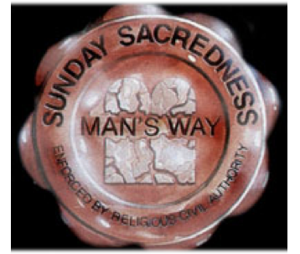

Slide 74
Revelation 18:1
“And the earth was lightened with his glory.”

Slide 75
Temperance
Long-suffering
Joy
Goodness
Peace
Meekness
Faith
Gentleness
Love

Slide 77
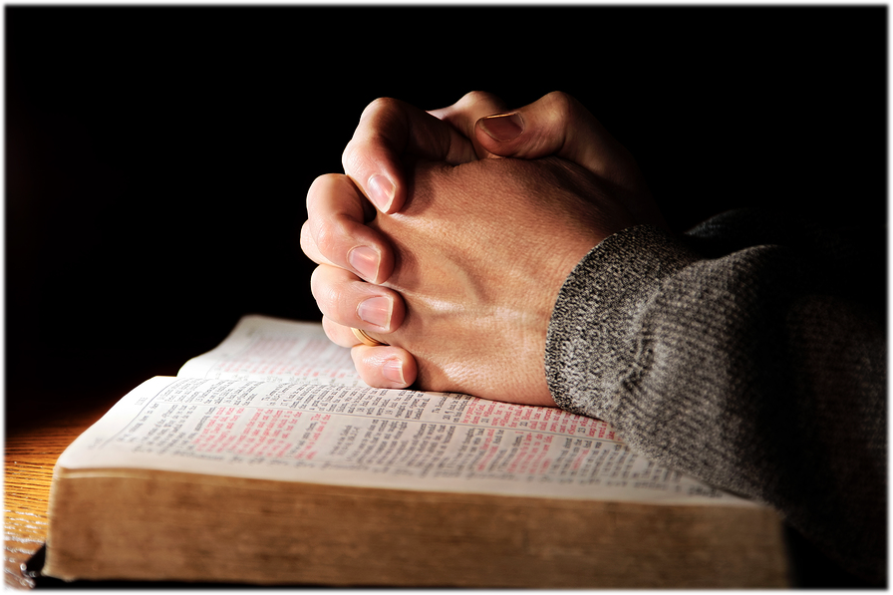

Slide 80
