Slide 2
The Colporteur Evangelist p. 25.3
“… We are in the shaking time, the time when everything that can be shaken will be shaken. …”

Slide 3
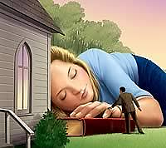

Slide 4
Selected Messages Book 1 p. 124
“… There is nothing that Satan fears so much as that the people of God shall clear the way by removing every hindrance, so that the Lord can pour out His Spirit upon a languishing church and an impenitent congregation. If Satan had his way, there would never be another awakening, great or small, to the end of time. …”

Slide 5
Luke 22:31-32 NKJV
³¹ And the Lord said, “Simon, Simon! Indeed, Satan has asked for you, that he may sift you as wheat. ³² But I have prayed for you, that your faith should not fail; and when you have returned to Me, strengthen your brethren.”
³³ But he said to Him, “Lord, I am ready to go with You, both to prison and to death.”
³⁴ Then He said, “I tell you, Peter, the rooster shall not crow this day before you will deny three times that you know Me.”

Slide 7
1 Peter 1:6 NKJV
⁶ In this you greatly rejoice, though now for a little while, if need be, you have been grieved by various trials, that the genuineness of your faith, … though it is tested by fire, may be found to praise, honor, and glory at the revelation of Jesus Christ.

Slide 8
1 Peter 1:6 Samoan
⁶ O lea ua outou olioli ai, e ui lava ona faanoanoa o outou i nai aso nei, (pe afai e tatau ai,) i tofotofoga eseese. O le tofotofo foi o lo outou faatuatua, e silisili ona aoga i le auro e faaumatia, e ui lava ina tofotofoina i le afi, e avea ma mea e iu i le viiga, ma le mamalu, ma le manuia pe a faalia mai Iesu Keriso.

Slide 9
Ezekiel 37:1-6 NKJV
¹ The hand of the Lord came upon me and brought me out in the Spirit of the Lord, and set me down in the midst of the valley; and it was full of bones. ² Then He caused me to pass by them all around, and behold, there were very many in the open valley; and indeed they were very dry. ³ And He said to me, “Son of man, can these bones live?”
So I answered, “O Lord God, You know.”
⁴ Again He said to me, “Prophesy to these bones, and say to them, ‘O dry bones, hear the word of the Lord! ⁵ Thus says the Lord God to these bones: “Surely I will cause breath to enter into you, and you shall live. ⁶ I will put sinews on you and bring flesh upon you, cover you with skin and put breath in you; and you shall live. Then you shall know that I am the Lord.” ’ ”

Slide 10
Ezekiel 37:7-10 NKJV
⁷ So I prophesied as I was commanded; and as I prophesied, there was a noise, and suddenly a shaking; and the bones came together, bone to bone. ⁸ Indeed, as I looked, the sinews and the flesh came upon them, and the skin covered them over; but there was no breath in them.
⁹ Also He said to me, “Prophesy to the breath, prophesy, son of man, and say to the breath, ‘Thus says the Lord God: “Come from the four winds, O breath, and breathe on these slain, that they may live.” ’ ” ¹⁰ So I prophesied as He commanded me, and breath came into them, and they lived, and stood upon their feet, an exceedingly great army.

Slide 11
Testimonies For the Church Vol. 1 p. 181.1
“… I asked the meaning of the shaking I had seen, and was shown that it would be caused by the straight testimony called forth by the counsel of the True Witness to the Laodiceans. This will have its effect upon the heart of the receiver, and will lead him to exalt the standard and pour forth the straight truth. Some will not bear this straight testimony. They will rise up against it, and this will cause a shaking among God’s people. …”

Slide 12
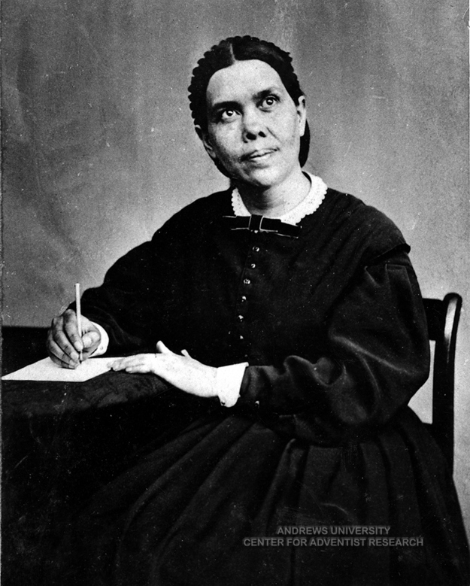
Early Writings p. 63.1
“… There are many precious truths contained in the Word of God, but it is “present truth” that the flock needs now. I have seen the danger of the messengers running off from the important points of present truth, to dwell upon subjects that are not calculated to unite the flock and sanctify the soul. Satan will here take every possible advantage to injure the cause. But such subjects as the sanctuary, ...”

Slide 13
Early Writings p. 63.1
“… in connection with the 2300 days, the commandments of God and the faith of Jesus, are perfectly calculated to explain the past Advent movement and show what our present position is, establish the faith of the doubting, and give certainty to the glorious future. These, I have frequently seen, were the principal subjects on which the messengers should dwell. …”

Slide 14
Deuteronomy 6:24 KJB
²⁴ And the LORD commanded us to do all these statutes, to fear the LORD our God, for our good always, that he might preserve us alive, as it is at this day.

Slide 15
Psalms 40:11 KJB
¹¹ Withhold not thou thy tender mercies from me, O LORD: let thy lovingkindness and thy truth continually preserve me.

Slide 16
Psalms 61:7 KJB
⁷ He shall abide before God for ever: O prepare mercy and truth, which may preserve him.

Slide 17
Psalms 86:2 KJB
² Preserve my soul; for I am holy: O thou my God, save thy servant that trusteth in thee.

Slide 18
Psalms 121:7 KJB
⁷ The LORD shall preserve thee from all evil: he shall preserve thy soul.

Slide 19
Proverbs 20:28 KJB
²⁸ Mercy and truth preserve the king: and his throne is upholden by mercy.

Slide 20
2 Corinthians 4:3-7 NKJV
³ But even if our gospel is veiled, it is veiled to those who are perishing, ⁴ whose minds the god of this age has blinded, who do not believe, lest the light of the gospel of the glory of Christ, who is the image of God, should shine on them. ⁵ For we do not preach ourselves, but Christ Jesus the Lord, and ourselves your bondservants for Jesus’ sake. ⁶ For it is the God who commanded light to shine out of darkness, who has shone in our hearts to give the light of the knowledge of the glory of God in the face of Jesus Christ. ⁷ But we have this treasure (oa) in earthen vessels (ipu omea), that the excellence of the power may be of God and not of us.

Slide 21
2 Corinthians 4:8-11 NKJV
⁸ We are hard-pressed (puapuagatia) on every side, yet not crushed; we are perplexed (fememeai), but not in despair; ⁹ persecuted (sauaina), but not forsaken; struck down (lafotuina i lalo), but not destroyed— ¹⁰ always carrying about in the body the dying of the Lord Jesus, that the life of Jesus also may be manifested in our body. ¹¹ For we who live are always delivered to death (tuuina atu pea lava i le oti) for Jesus’ sake, that the life of Jesus also may be manifested in our mortal flesh.

Slide 22
NOTE:
The Gospel preserves.
The Gospel is a preservative.
The Gospel can be found in a vessel.
The vessel can be “shaken”.
Therefore, the Gospel is a preservative found in a vessel that can be shaken.

Slide 23
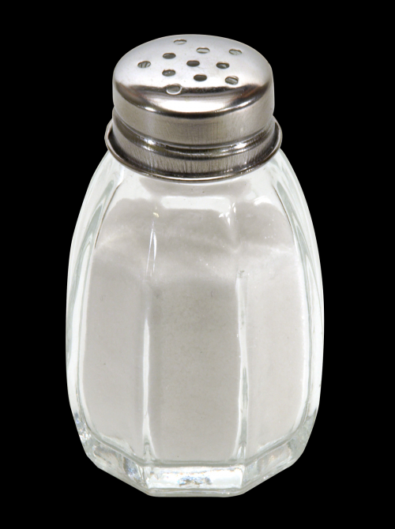

Slide 24
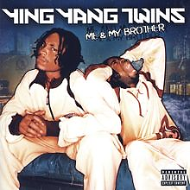
SALT SHAKER (counterfeit)
[Hook]
…
The contents of the filthy lyrics, contain:
“… Shake it like a salt shaker (shake it like a salt shaker)
Shake it like a salt shaker (shake it like a salt shaker) …”

Slide 25
The Devil wants you to SHAKE IT like a SALT SHAKER,
But God wants you to be SHAKEN like a SALT SHAKER!

Slide 26
Matthew 5:13 NKJV
¹³ “You are the salt of the earth; but if the salt loses its flavor, how shall it be seasoned? It is then good for nothing but to be thrown out and trampled underfoot by men.

Slide 27
Mark 9:49-50 KJB
⁴⁹ For every one shall be salted with fire, and every sacrifice shall be salted with salt.
⁵⁰ Salt is good: but if the salt have lost his saltness, wherewith will ye season it? Have salt in yourselves, and have peace one with another.

Slide 28
Mark 16:15 KJB
¹⁶ And he said unto them, Go ye into all the world, and preach the gospel to every creature.

Slide 29
Acts 14:21-22 NKJV
²¹ And when they had preached the gospel to that city and made many disciples, they returned to Lystra, Iconium, and Antioch, ²² strengthening the souls of the disciples, exhorting them to continue in the faith, and saying, “We must through many tribulations enter the kingdom of God.”

Slide 30
Desire of Ages p. 439.2
“… In the ritual service, salt was added to every sacrifice. This, like the offering of incense, signified that only the righteousness of Christ could make the service acceptable to God. Referring to this practice, Jesus said, “Every sacrifice shall be salted with salt.” “Have salt in yourselves, and have peace one with another.” All who would present themselves “a living sacrifice, holy, acceptable unto God” (Romans 12:1), must receive the saving salt, the righteousness of our Saviour. Then they become “the salt of the earth,” restraining evil among men, as salt preserves from corruption. Matthew 5:13. …”

Slide 31
Desire of Ages p. 439.2
“… But if the salt has lost its savor; if there is only a profession of godliness, without the love of Christ, there is no power for good. The life can exert no saving influence upon the world. Your energy and efficiency in the upbuilding of My kingdom, Jesus says, depend upon your receiving of My Spirit. You must be partakers of My grace, in order to be a savor of life unto life. Then there will be no rivalry, no self-seeking, no desire for the highest place. You will have that love which seeks not her own, but another’s wealth. …”

Slide 32
Mount of Blessings p. 37.1
“… Unless the Holy Spirit can use us as agents through whom to communicate to the world the truth as it is in Jesus, we are as salt that has lost its savor and is entirely worthless. …”

Slide 33
2 Kings 2:19-22 KJB
¹⁹ And the men of the city said unto Elisha (man of double portion of God’s Holy Spirit), Behold, I pray thee, the situation of this city is pleasant, as my lord seeth: but the water (people, faith) is naught, and the ground (soil of the heart) barren.
²⁰ And he said, Bring me a new cruse (vessel, conainer), and put salt therein. And they brought it to him.
²¹ And he went forth unto the spring of the waters, and cast the salt in there, and said, Thus saith the LORD, I have healed these waters; there shall not be from thence any more death or barren land.
²² So the waters were healed unto this day, according to the saying of Elisha which he spake.

Slide 34
Therefore, be shaken together:
Luk 6:38 KJB Give, and it shall be given unto you; good measure, pressed down, and shaken together, and running over, shall men give into your bosom. For with the same measure that ye mete withal it shall be measured to you again.
Therefore, measure to others with the measurement of God’s love towards you…

