Slide 2
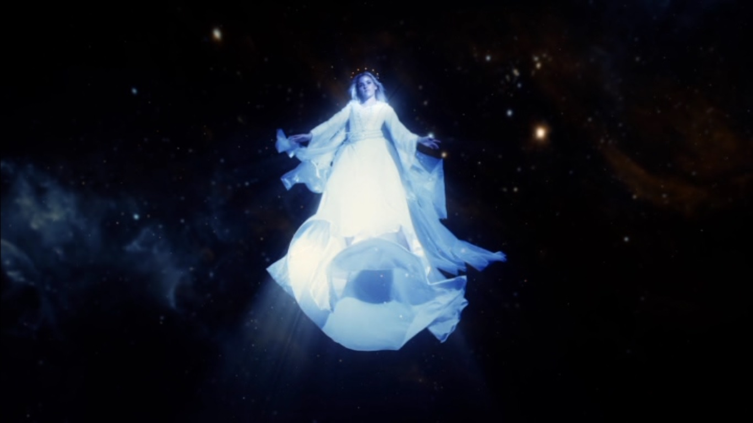
The real Wonder Woman – Rev. 12

Slide 3
Ezekiel 20:12, 19
Eze 20:12 Moreover also I gave them my sabbaths, to be a sign between me and them, that they might know that I am the LORD that sanctify them.
Eze 20:19 I am the LORD your God; walk in my statutes, and keep my judgments, and do them;

Slide 4
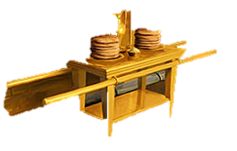
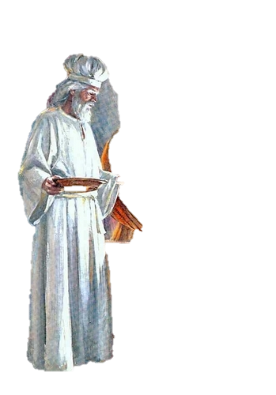
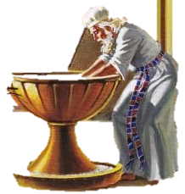
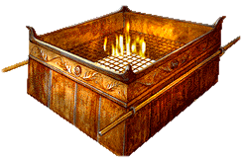
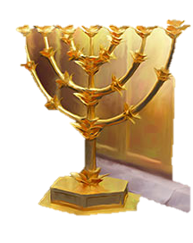
REDEMPTION PLAN
GLORIFICATION
SANCTIFICATION
JUSTIFICATION
IRREDUCIBLE-COMPLEX SYSTEM

Slide 5
Genesis 1:1-2:3 (Overview)
Day 1 – God separated Light from Darkness.
Day 2 – God separated Heavenly Waters from Earthly Waters.
Day 3 – God separated the Earth from the Seas, and made distinction between plants, herbs, and trees bearing fruit.

Slide 6
Genesis 1:1-2:3 (Overview)
Day 4 – God made distinction between the Greater Light, the Lesser Light and the stars, which was to shine upon all the earth.
Day 5 – God made distinction between Birds of the air and Fishes of the Sea.
Day 6 – God made distinction between Beasts of the earth and Mankind (Adam), and between Man and Woman.

Slide 7
Genesis 1:1-2:3 (Overview)
Day 7 – God made distinction between Common time and work and Holy/Sacred time and rest.

Slide 8
Genesis 1:1-2:3 (Gospel)
Day 1 – God separated Light from Darkness.

Slide 9
1 Peter 2:9 KJB
But ye are a chosen generation, a royal priesthood, an holy nation, a peculiar people; that ye should shew forth the praises of him who hath called you out of darkness into his marvellous light.

Slide 10
Genesis 1:1-2:3 (Gospel)
Day 2 – God separated Heavenly Waters from Earthly Waters (See Rev. 17:15).

Slide 11
2 Corinthians 6:17 KJB
Wherefore come out from among them, and be ye separate, saith the Lord, and touch not the unclean thing; and I will receive you.

Slide 12
Genesis 1:1-2:3 (Gospel)
Day 3 – God separated the Earth from the Seas, and made distinction between plants, herbs, and trees bearing fruit.

Slide 13
Galatians 5:13,16, 22-23 NKJV
¹³ For you, brethren, have been called to liberty; only do not use liberty as an opportunity for the flesh, but … ¹⁶ Walk in the Spirit, and you shall not fulfill the lust of the flesh. … ²² But the fruit of the Spirit is love, joy, peace, longsuffering, kindness, goodness, faithfulness, ²³ gentleness, self-control …

Slide 14
Genesis 1:1-2:3 (Gospel)
Day 4 – God made distinction between the Greater Light, the Lesser Light and the stars, which was to shine upon all the earth.

Slide 15
Matthew 5:14,16 NKJV
¹⁴ “You are the light of the world. … ¹⁶ Let your light so shine before men, that they may see your good works and glorify your Father in heaven.

Slide 16
Genesis 1:1-2:3 (Gospel)
Day 5 – God made distinction between Birds of the air and Fishes of the Sea, and a beast is a symbol of a nation (See Dan. 7:23).

Slide 17
Matthew 28:19,20 KJB
¹⁹ Go ye therefore, and teach all nations, baptizing them in the name of the Father, and of the Son, and of the Holy Ghost:
²⁰ “Teaching them to observe all things whatsoever I have commanded you ...”

Slide 18
Genesis 1:1-2:3 (Gospel)
Day 6 – God made distinction between Beasts of the earth and Mankind (Adam), and between Man and Woman, a New Creation.

Slide 19
2 Corinthians 5:17 NKJV
Therefore, if anyone is in Christ, he is a new creation; old things have passed away; behold, all things have become new.

Slide 20
Genesis 1:1-2:3 (Gospel)
Day 7 – God made distinction between Common time and work and Holy/Sacred time and rest.

Slide 21
Matthew 11:28-29 NKJV
²⁸ Come to Me, all you who labor and are heavy laden, and I will give you rest.
²⁹ Take My yoke upon you and learn from Me, for I am gentle and lowly in heart, and you will find rest for your souls.

Slide 22
What did we notice in Genesis?
Separation - distinction

Slide 23
Numbers 6:1-4 … NKJV
¹ Then the Lord spoke to Moses, saying, ² “Speak to the children of Israel, and say to them: ‘When either a man or woman consecrates an offering to take the vow of a Nazirite, to separate himself to the Lord, ³ he shall separate himself from wine and similar drink; he shall drink neither vinegar made from wine nor vinegar made from similar drink; neither shall he drink any grape juice, nor eat fresh grapes or raisins. ⁴ All the days of his separation he shall eat nothing that is produced by the grapevine, from seed to skin. …

Slide 24
Numbers 6:5-8 NKJV
⁵ ‘All the days of the vow of his separation no razor shall come upon his head; until the days are fulfilled for which he separated himself to the Lord, he shall be holy. Then he shall let the locks of the hair of his head grow. ⁶ All the days that he separates himself to the Lord he shall not go near a dead body. ⁷ He shall not make himself unclean even for his father or his mother, for his brother or his sister, when they die, because his separation to God is on his head. ⁸ All the days of his separation he shall be holy to the Lord.

Slide 25
Day 4
Genesis 1:14-16 KJB
¹⁴ And God said, Let there be lights in the firmament of the heaven to divide the day from the night; and let them be for signs, and for seasons … ¹⁵ let them be for lights in the firmament of the heaven to give light upon the earth … ¹⁶ And God made two great lights; the greater light to rule the day, and the lesser light to rule the night: he made the stars also.

Slide 26
Day 4
Genesis 1:14-16 KJB
¹⁴ And God said, Let there be lights in the firmament (atmosphere) of the heaven (See Matt. 6:22-23) to divide the day from the night;
and let them be for signs (distinguishing mark), and for seasons (an appointed time) …
¹⁵ let them be for lights in the firmament (atmosphere) of the heaven to give light (illuminate) upon the earth …
¹⁶ And God made two great lights; the greater light to rule the day, and the lesser light to rule the night: he made the stars also.

Slide 27
Sun, Moon, and Stars
“And there appeared a great wonder in heaven; a woman clothed with the sun, and the moon under her feet, and upon her head a crown of twelve stars”
– (Revelation 12:1 KJB)
“There will be no one saved in heaven with a starless crown. If you enter, there will be some soul in the courts of glory that has found an entrance there through your instrumentality.” - ST, June 6, 1892

Slide 28
Ephesians 6:14-17 NKJV
Stand therefore, having girded (encircle) your waist with truth, having put on the breastplate of righteousness, ¹⁵ and having shod your feet with the preparation of the gospel of peace; ¹⁶ above all, taking the shield of faith with which you will be able to quench all the fiery darts of the wicked one. ¹⁷ And take the helmet of salvation, and the sword of the Spirit, which is the word of God;
She was created to give POWER to WOMEN OR to EMPOWER a WOMAN.

Slide 29
Sun, Moon, and Stars
“And there appeared a great wonder in heaven; a woman clothed with the sun, and the moon under her feet, and upon her head a crown of twelve stars” – (Rev. 12:1 KJB)
The
REAL “WOMAN” (em)POWER
THE GREATEST ‘WONDER’ OF THE WORLD!

Slide 30
Great Controversy p. 648
And they sing “a new song” before the throne, a song which no man can learn save the hundred and forty and four thousand. It is the song of Moses and the Lamb—a song of deliverance. None but the hundred and forty-four thousand can learn that song; for it is the song of their experience—an experience such as no other company have ever had.

Slide 31
Ecclesiastes 3:1-8,17
Times, Seasons, Signs & Wonders

Slide 32
Ecclesiastes 3:1-8,17 KJB
Ecclesiastes 3:1 To every thing there is a season, and a time to every purpose under the heaven:
Ecclesiastes 3:2 A time to be born, and a time to die; a time to plant, and a time to pluck up that which is planted;
A time to be born again. A time to die to the old man. A time to plant the seed of Christ into the heart. A time to uproot the old man of sins ways. As it is written:
Matthew 15:13 But he answered and said, Every plant, which my heavenly Father hath not planted, shall be rooted up.

Slide 33
Ecclesiastes 3:1-8,17 KJB
Ecclesiastes 3:3 A time to kill, and a time to heal; a time to break down, and a time to build up;
A time to kill lusts of the flesh. A time to heal the heart. A time to break down barriers of doubt, discouragment and selfish works. A time to edify, and be built up in Christ Jesus.

Slide 34
Ecclesiastes 3:1-8,17 KJB
Ecclesiastes 3:4 KJB - A time to weep, and a time to laugh; a time to mourn, and a time to dance;
A time to weep over our sins. A time to laugh/rejoice in God's deliverance. A time to mourn for the breaking of God's heart through our sin. A time to dance, and leap for joy, shouting our Salvation, Christ Jesus!

Slide 35
Ecclesiastes 3:1-8,17 KJB
Ecclesiastes 3:5 KJB - A time to cast away stones, and a time to gather stones together; a time to embrace, and a time to refrain from embracing;
A time to cast away stones for the stoning of others, pointing at their sins. A time to gather stones, for the destruction of sin, see Psalms 149:1-9 KJB. A time to embrace and kiss the Son, and a time to cease from carrying around the body of this death.

Slide 36
Ecclesiastes 3:1-8,17 KJB
Ecclesiastes 3:6 KJB - A time to get, and a time to lose; a time to keep, and a time to cast away;
A time to get God's righteousness and character. A time to lose the practices of sin. A time to keep that which God freely gave. A time to cast away our filthy rags.

Slide 37
Ecclesiastes 3:1-8,17 KJB
Ecclesiastes 3:7 KJB - A time to rend, and a time to sew; a time to keep silence, and a time to speak;
A time to rend the heart for having hurt our Father in Heaven. A time to sew to the Spirit of God, rather than to the flesh. A time to keep silence before God in listening to Him speak by His Holy Spirit through His word. A time to speak forth the Everlasting Gospel as found therein.

Slide 38
Ecclesiastes 3:1-8,17 KJB
Ecclesiastes 3:8 KJB - A time to love, and a time to hate; a time of war, and a time of peace.
A time to love, which always is. A time to hate sin, which always is. A time of war, against the flesh, the world and the devil, even satan, sin and selfishness. A time of peace and atonement with God, having been brought back into relationship with Him through His Son, Christ Jesus, and by/through the Holy Ghost. The Gospel is Peace, and it only goes out so long, and the offers of mercy extend only so long, for God is long-suffering, not endlessly suffering and will not have those whom He loves, endlessly suffering. There is a "time" ...

Slide 39
Matthew 24:3, 14 NKJV
³ …the disciples came to Him privately, saying, “Tell us, when will these things be? And what will be the sign of Your coming, and of the end of the world?” …
¹⁴ And this gospel of the kingdom will be preached in all the world as a witness to all the nations, and then the end will come.

Slide 40
WHEN THE CHURCH REFLECTS PERFECTLY CHRIST’S CHARACTER,
SHE BECOMES THE SIGN AND WONDER
WHICH TELLS US
THE SEASON - THE END IS COME.

Slide 41
Matthew 12:1-42 (Summary)

Slide 42
Matthew 12:1-42 KJB (Summary)
Matthew 12:1-8 – Jesus teaches about the real Sabbath, compared to the false sabbath as corrupted by the Pharisees.

Slide 43
Matthew 12:1-42 KJB (Summary)
Matthew 12:9-14 – Jesus continues this teaching, by healing a man’s right hand (a symbol/sign of righteous work) upon the Sabbath of the LORD, which confronts the false sabbath and wicked hearts of the pharisees (who plotted murder upon it, vs. 14).

Slide 44
Matthew 12:1-42 KJB (Summary)
Matthew 12:15-21 – Jesus continues this teaching, by showing the work of the Messiah/Christ from the OT prophet Isaiah (Esaias) 42:1-4, in that even the Gentiles would come to believe and repent of their sins while the wicked in physical Israel refused.

Slide 45
Matthew 12:1-42 KJB (Summary)
Matthew 12:22-32 – Jesus, in calling people to repentance, casts out devils, and the Pharisees accused Jesus of doing this by the devil, and speaking of the unpardonable sin. In the last days, the same things will occur, but satan will flip the script upon God’s true people.

Slide 46
Matthew 12:1-42 KJB (Summary)
Matthew 12:33-37 – Jesus, shoes how a good tree and a bad tree are know, by their fruits, not by their miraculous works, for in the last days even the devil will counterfeit the miracles of God (Revelation 13:13, 16:14, 19:20), and the saints will only be able to tell, by Isaiah 8:20.

Slide 47
Matthew 12:1-42 KJB (Summary)
Matthew 12:38-42 – Jesus is asked by the Pharisees for a miraculous sign/wonder. Jesus tells them that the ONLY sign that they shall receive is THE SIGN of JONAH, which is the sign of repentance towards God through Christ Jesus.

Slide 48
Luke 11:30 NKJV
³⁰ For as Jonah became a sign to the Ninevites, so also the Son of Man will be to this generation.

Slide 49
Luke 2:34
³⁴ Then Simeon blessed them, and said to Mary His mother, “Behold, this Child is destined for the fall and rising of many in Israel, and for a sign which will be spoken against

Slide 50
Revelation 13:11-14 NKJV
¹¹ Then I saw another beast coming up out of the earth, and he had two horns like a lamb and spoke like a dragon. ¹² And he exercises all the authority of the first beast in his presence, and causes the earth and those who dwell in it to worship the first beast, whose deadly wound was healed. ¹³ He performs great signs, so that he even makes fire come down from heaven on the earth in the sight of men. ¹⁴ And he deceives those who dwell on the earth by those signs which he was granted to do

Slide 51
Great Controversy p. 624, 625
“Fearful sights of a supernatural character will soon be revealed in the heavens, in token of the power of miracle-working demons. The spirits of devils will go forth to the kings of the earth and to the whole world, to fasten them in deception, and urge them on to unite with Satan in his last struggle against the government of heaven. By these agencies, rulers and subjects will be alike deceived. … They will perform wonderful miracles of healing and will profess to have revelations from heaven contradicting the testimony of the Scriptures. …”

Slide 52
Great Controversy p. 624, 625
“… As the crowning act in the great drama of deception, Satan himself will personate Christ. The church has long professed to look to the Saviour’s advent as the consummation of her hopes. Now the great deceiver will make it appear that Christ has come. In different parts of the earth, Satan will manifest himself among men as a majestic being of dazzling brightness, resembling the description of the Son of God given by John in the Revelation. (Revelation 1:13-15). The glory that surrounds him is unsurpassed by anything that mortal eyes have yet beheld. The shout of triumph rings out …”

Slide 53
Great Controversy p. 624, 625
“… upon the air: “Christ has come! Christ has come!” The people prostrate themselves in adoration before him, while he lifts up his hands and pronounces a blessing upon them, as Christ blessed His disciples when He was upon the earth. His voice is soft and subdued, yet full of melody. In gentle, compassionate tones he presents some of the same gracious, heavenly truths which the Saviour uttered; he heals the diseases of the people, and then, in his assumed character of Christ, he claims to have changed the Sabbath to Sunday, and commands all to hallow the day which he has blessed. He …”

Slide 54
Great Controversy p. 624, 625
“… declares that those who persist in keeping holy the seventh day are blaspheming his name by refusing to listen to his angels sent to them with light and truth. This is the strong, almost overmastering delusion. …
But the people of God will not be misled. The teachings of this false Christ are not in accordance with the Scriptures. …Only those who have been diligent students of the Scriptures and who have received the love of the truth will be shielded from the powerful delusion that takes the world captive. By the Bible testimony these will detect the deceiver in his disguise. To all the testing time will come. …”

Slide 55
Christian Service p. 50.2
This earth has almost reached the place where God will permit the destroyer to work his will upon it. The substitution of the laws of men for the law of God, the exaltation, by merely human authority, of Sunday in place of the Bible Sabbath, is the last act in the drama. When this substitution becomes universal, God will reveal Himself. He will arise in His majesty to shake terribly the earth.

Slide 56
Thousands Converted in a Day
“Thousands in the eleventh hour will see and acknowledge the truth.... These conversions to truth will be made with a rapidity that will surprise the church, and God’s name alone will be glorified.”
—Selected Messages 2:16 (1890). {LDE 212.1}
“There will be thousands converted to the truth in a day who at the eleventh hour see and acknowledge the truth and the movements of the Spirit of God.”
—EGW’88 755 (1890). {LDE 212.2}

Slide 57
Acts 13:40-41 KJB
Act 13:40 Beware therefore, lest that come upon you, which is spoken of in the prophets;
Act 13:41 Behold, ye despisers, and wonder, and perish: for I work a work in your days, a work which ye shall in no wise believe, though a man declare it unto you.

Slide 58
Isaiah 8:18 NKJV
Here am I and the children whom the Lord has given me! We are for signs and wonders in Israel From the Lord of hosts, Who dwells in Mount Zion.

