Slide 1
“Portals to the Soul”

Slide 2
“Satan is ever seeking to imbue men with his own spirit and attributes, and those whose hearts are not subdued by the grace of Christ will be guided by the same spirit that decoyed the angels from the heavenly courts.”
- Signs of the Times March 28, 1900

Slide 3
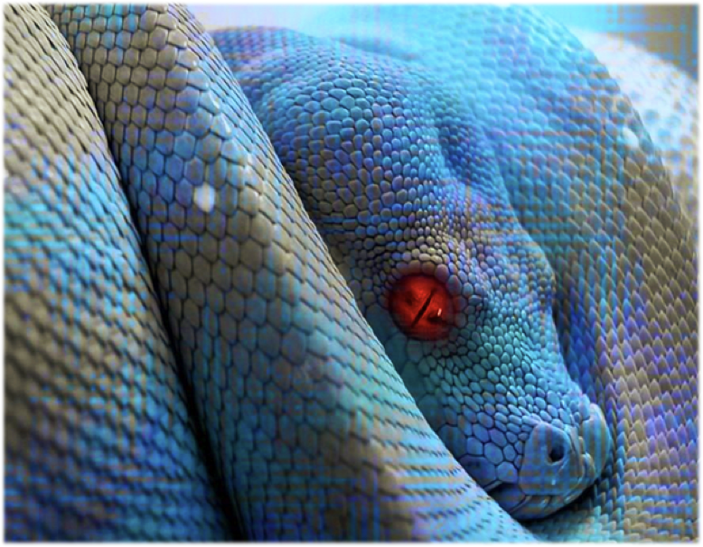

Slide 4
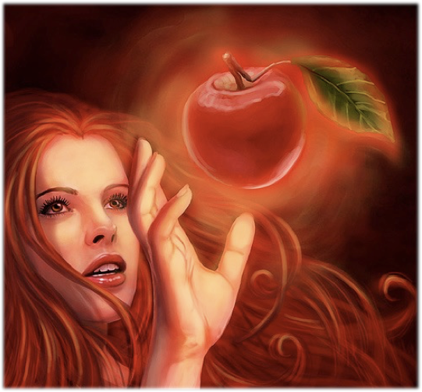
DISOBEDIENCE

Slide 5
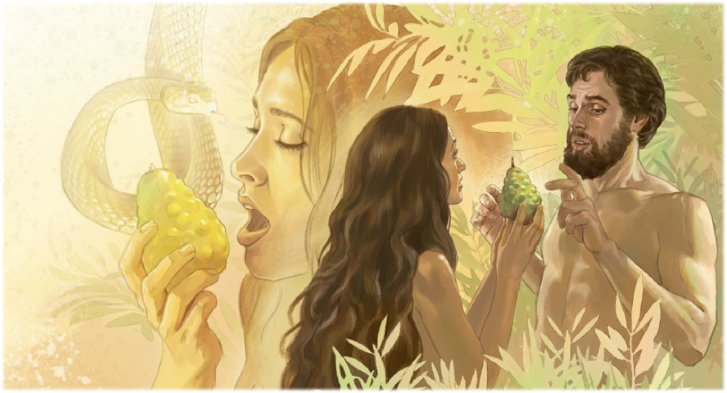

Slide 6
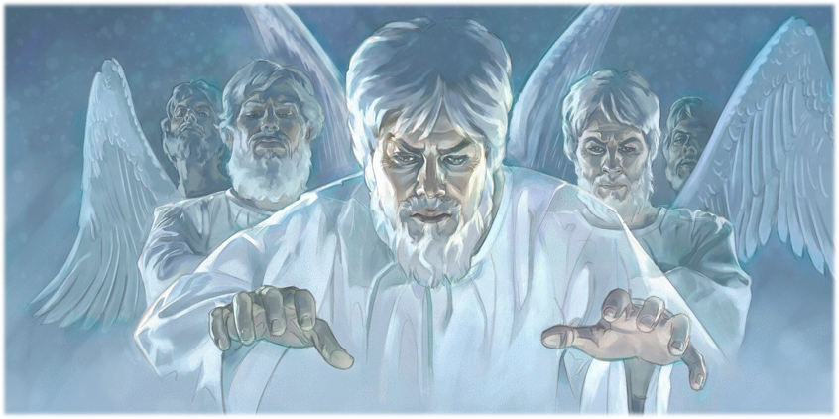
Ephesians 2:2
“Wherein in time past ye walked according to the course of this world, according to the prince of the power of the air, the spirit that now worketh in the children of disobedience:

Slide 7
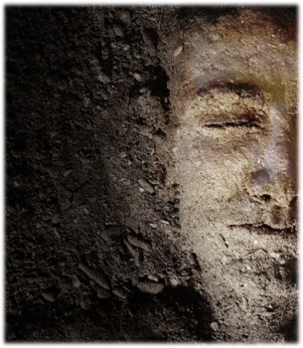
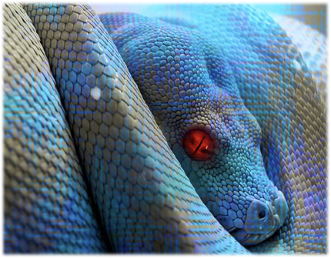
Genesis 3:15 “And the LORD God said unto the serpent, Because thou hast done this, thou art cursed above all cattle, and above every beast of the field; upon thy belly shalt thou go, and dust shalt thou eat all the days of thy life:”
Genesis 3:19 “In the sweat of thy face shalt thou eat bread, till thou return unto the ground; for out of it wast thou taken: for dust thou art, and unto dust shalt thou return.”

Slide 8
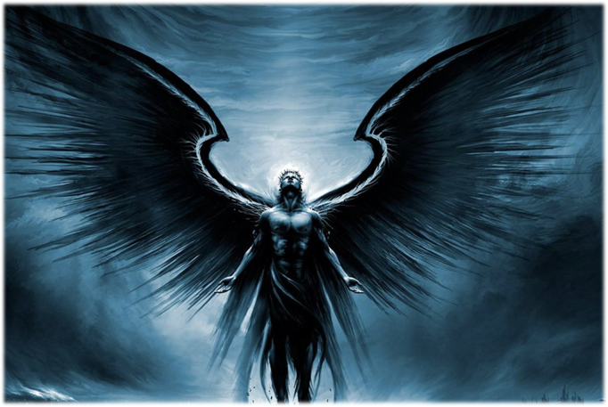
Matthew 12:43
When the unclean spirit is gone out of a man, he walketh through dry places, seeking rest, and findeth none.

Slide 9
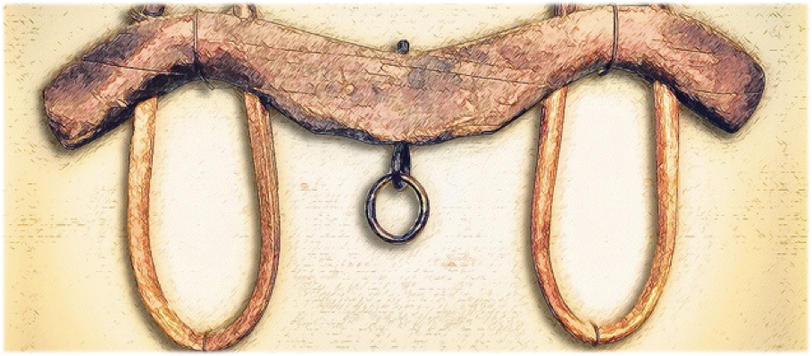
Matthew 11:29
“Take my yoke upon you, and learn of me; for I am meek and lowly in heart: and ye shall find rest unto your souls. For my yoke is easy, and my burden is light.”

Slide 10
Matthew 12:43
When the unclean spirit is gone out of a man, he walketh through dry places, seeking rest, and findeth none.

Slide 11
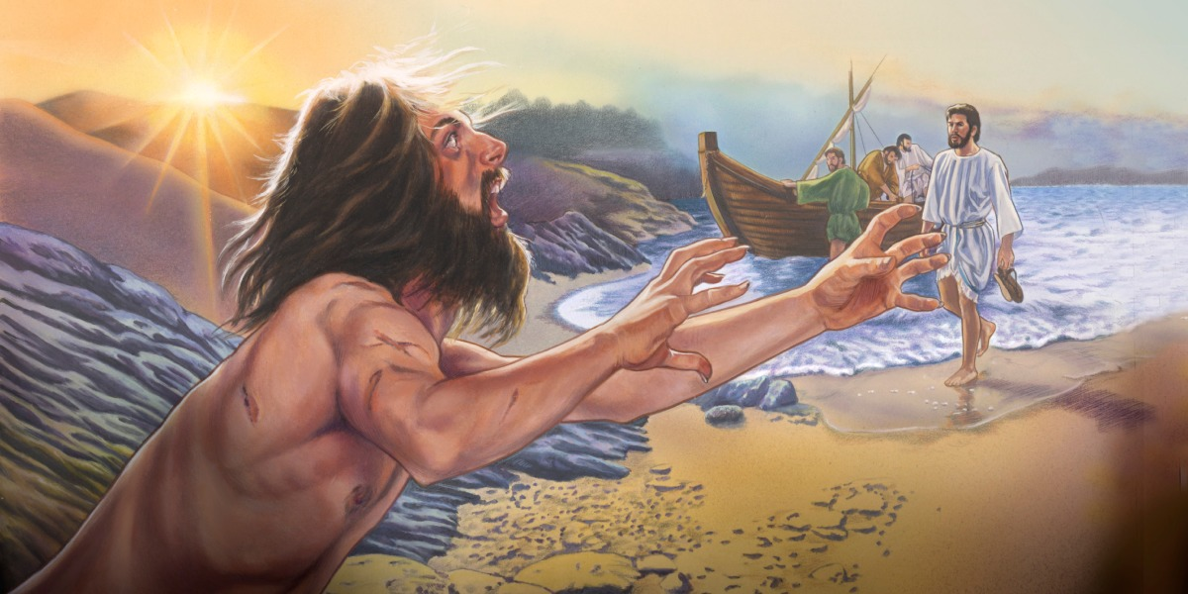

Slide 12
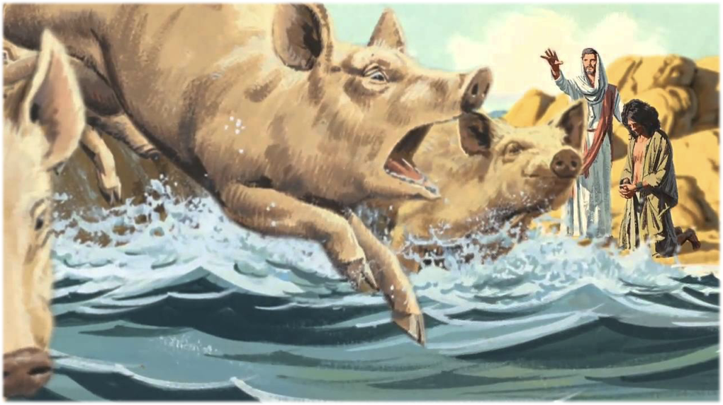

Slide 13
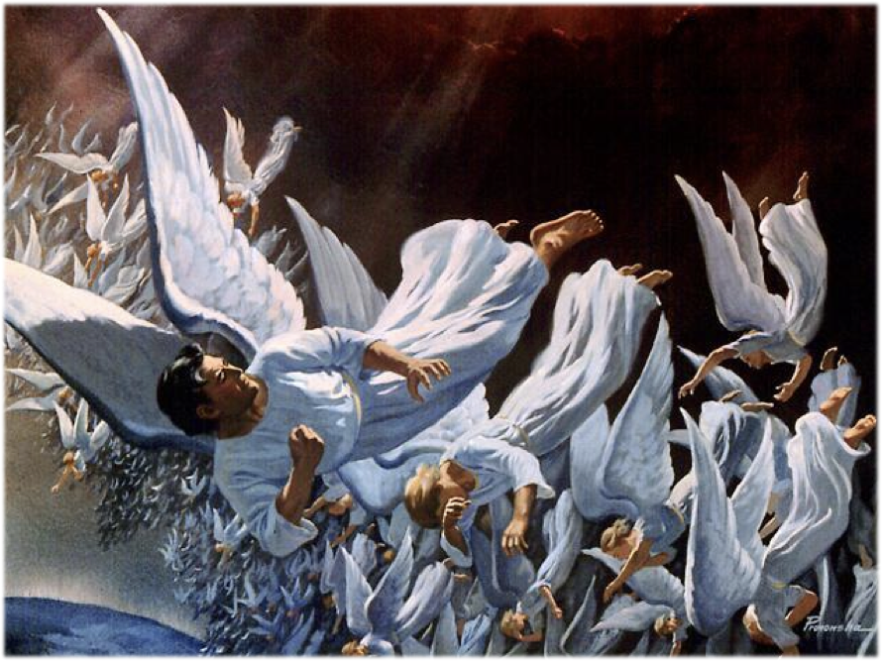

Slide 14
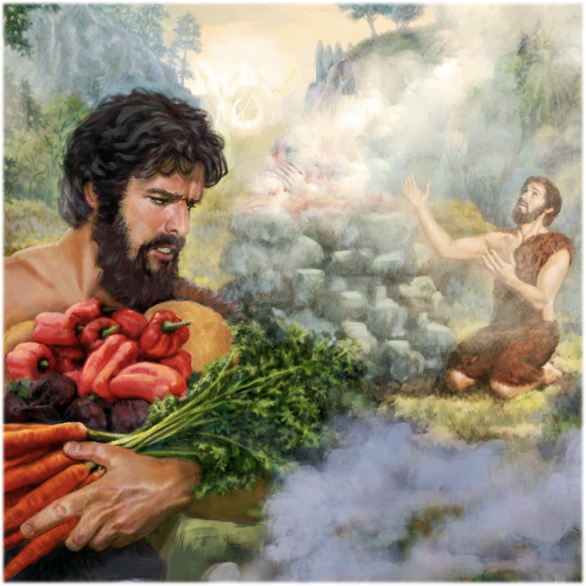

Slide 15
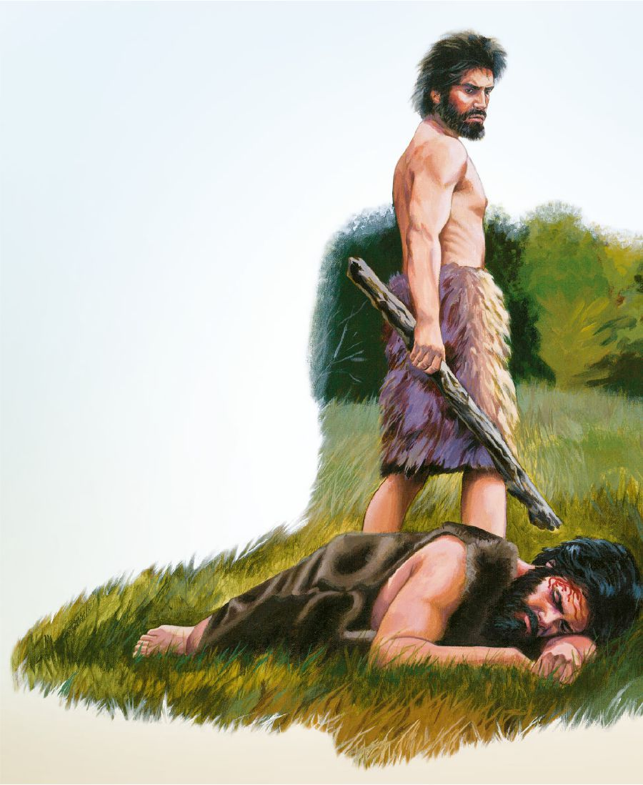

Slide 16
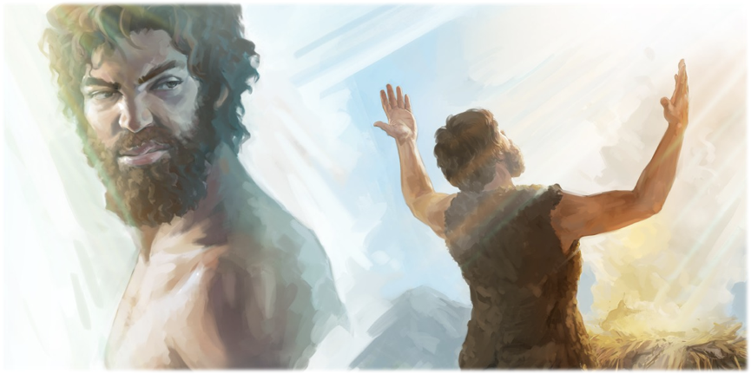
“But Cain lived only to harden his heart, to encourage rebellion against the divine authority, and to become the head of a line of bold, abandoned sinners.”
Patriarchs and Prophets pg. 78
Faith I live by, pg. 56
”

Slide 18
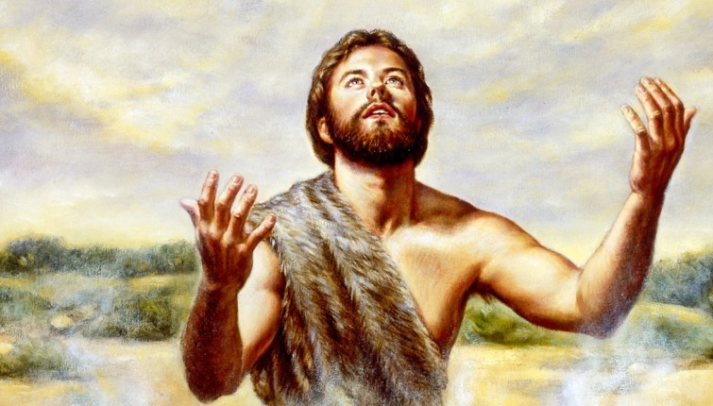
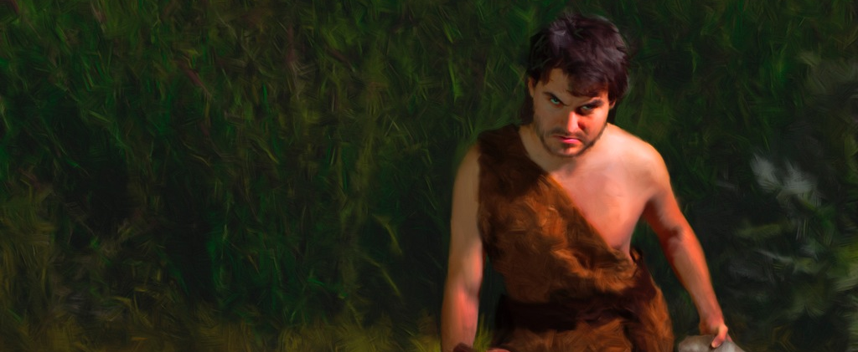
Seed of the Woman
Seed of Satan
Moved by the Holy Spirit
through Good Angels
Influenced and manipulated
by Evil Angels

Slide 19
Seed of the Woman
Seed of Satan

Slide 20
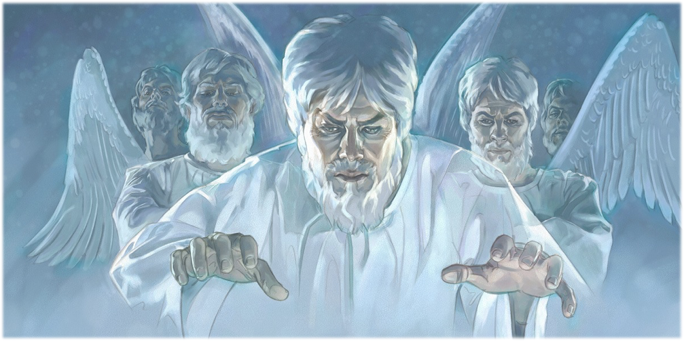

Slide 21
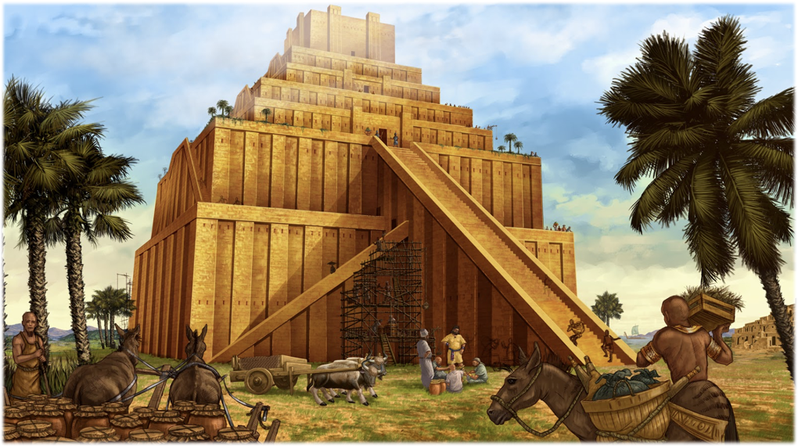
Genesis 4:16

Slide 22
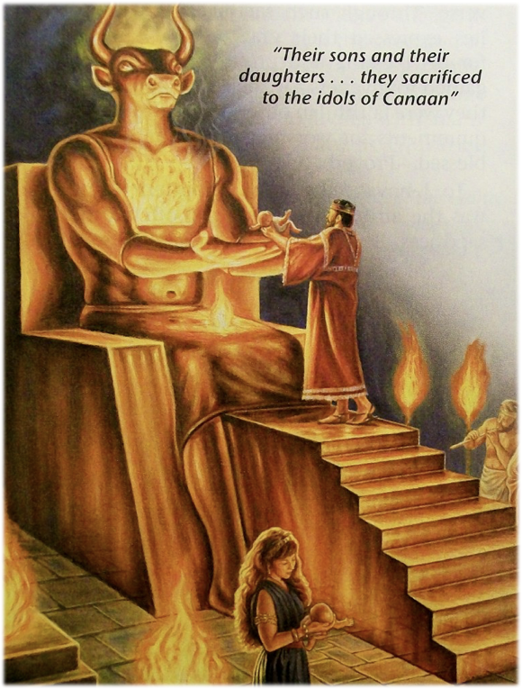
Genesis 6:12
“And God looked upon the earth, and, behold, it was corrupt; for all flesh had corrupted his way upon the earth.”

Slide 23
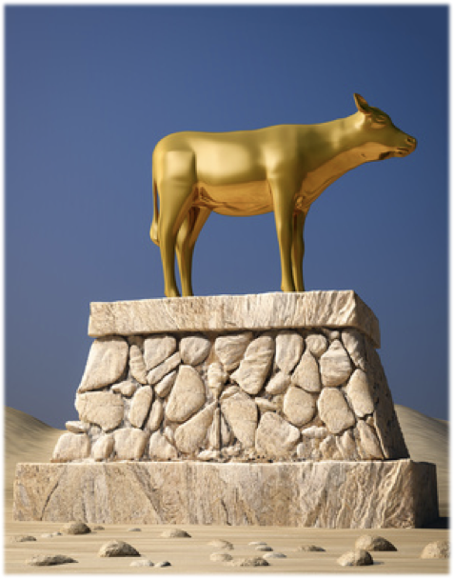
Deuteronomy 4:15-16
&
Exodus 32:7
Corruption = Idolatry

Slide 24
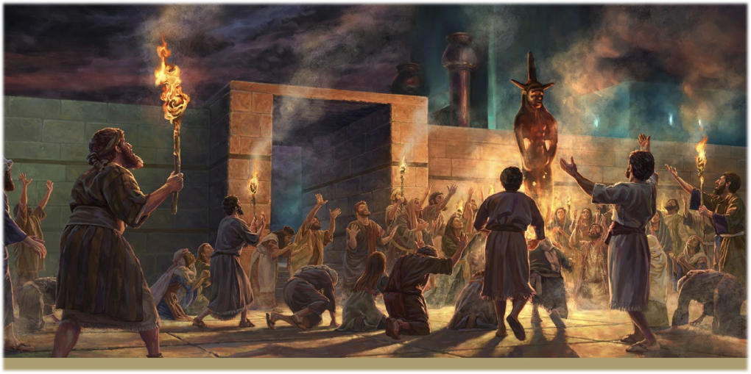

Slide 25
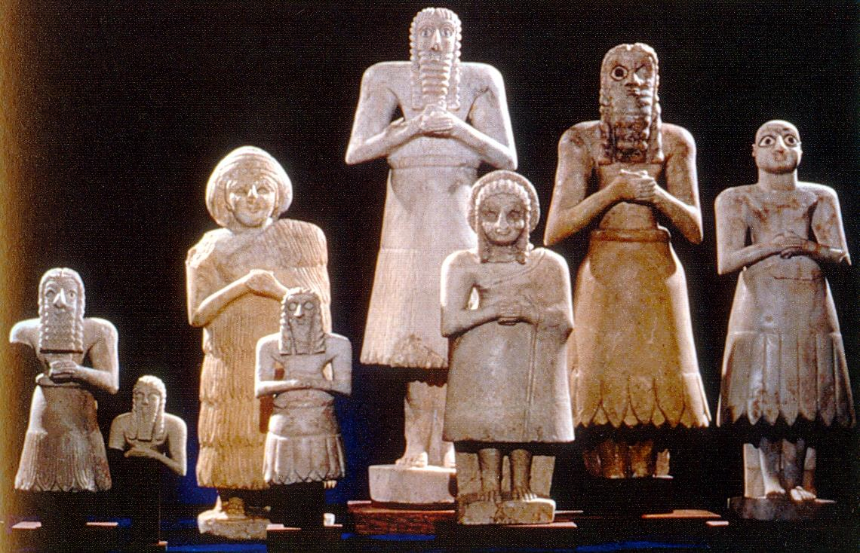
I Corinthians 10:20
“But I say, that the things which the Gentiles sacrifice, they sacrifice to devils, and not to God: and I would not that ye should have fellowship with devils.”

Slide 27
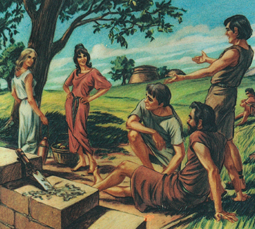
Genesis 6:2-3
“The sons of God saw the daughters of men that they were fair; and they took them wives of all which they chose. And the LORD said, My spirit shall not always strive with man,”

Slide 28
Matthew 6:22-23
“The light of the body is the eye: if therefore thine eye be single, thy whole body shall be full of light. But if thine eye be evil, thy whole body shall be full of darkness.”

Slide 29
Genesis 6:5
“And GOD saw that the wickedness of man was great in the earth, and that every imagination of the thoughts of his heart was only evil continually.”

Slide 30
It all started by what they SAW!

Slide 32
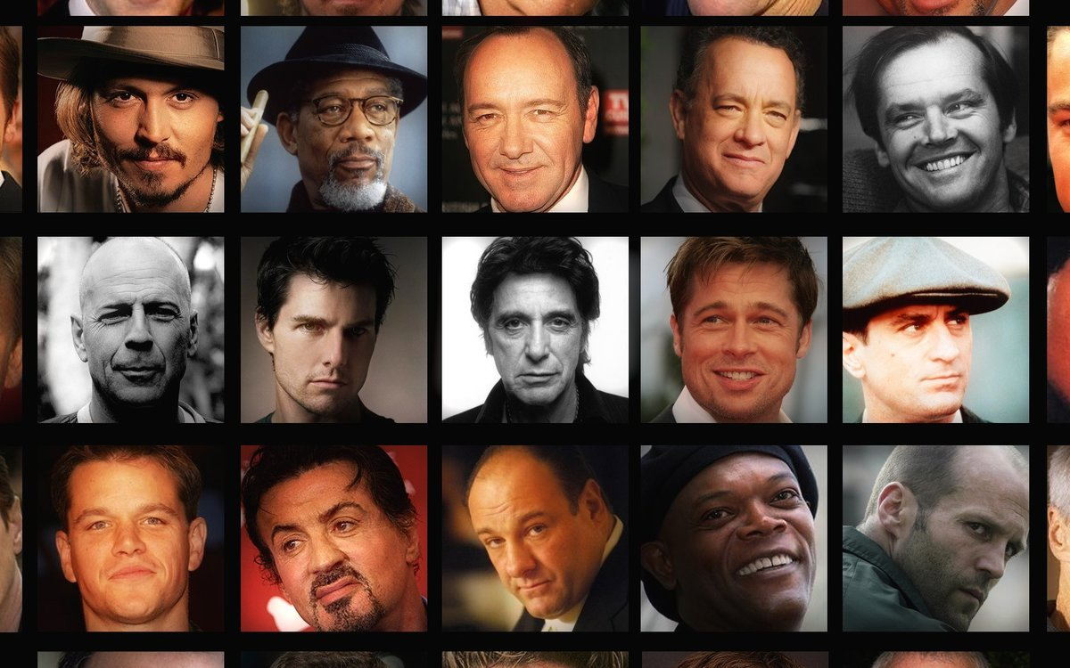

Slide 34
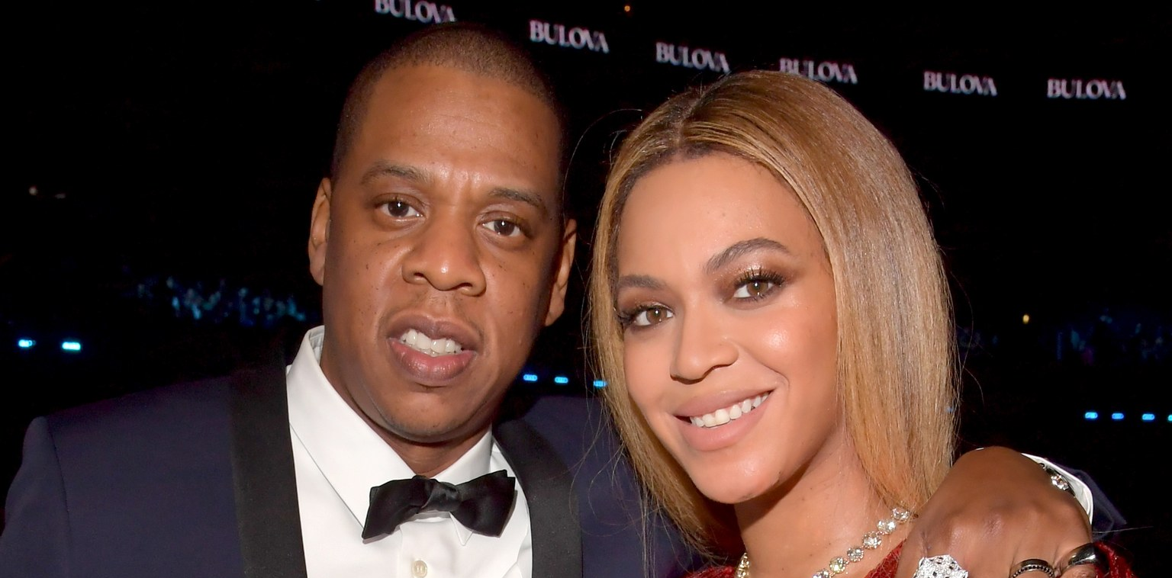
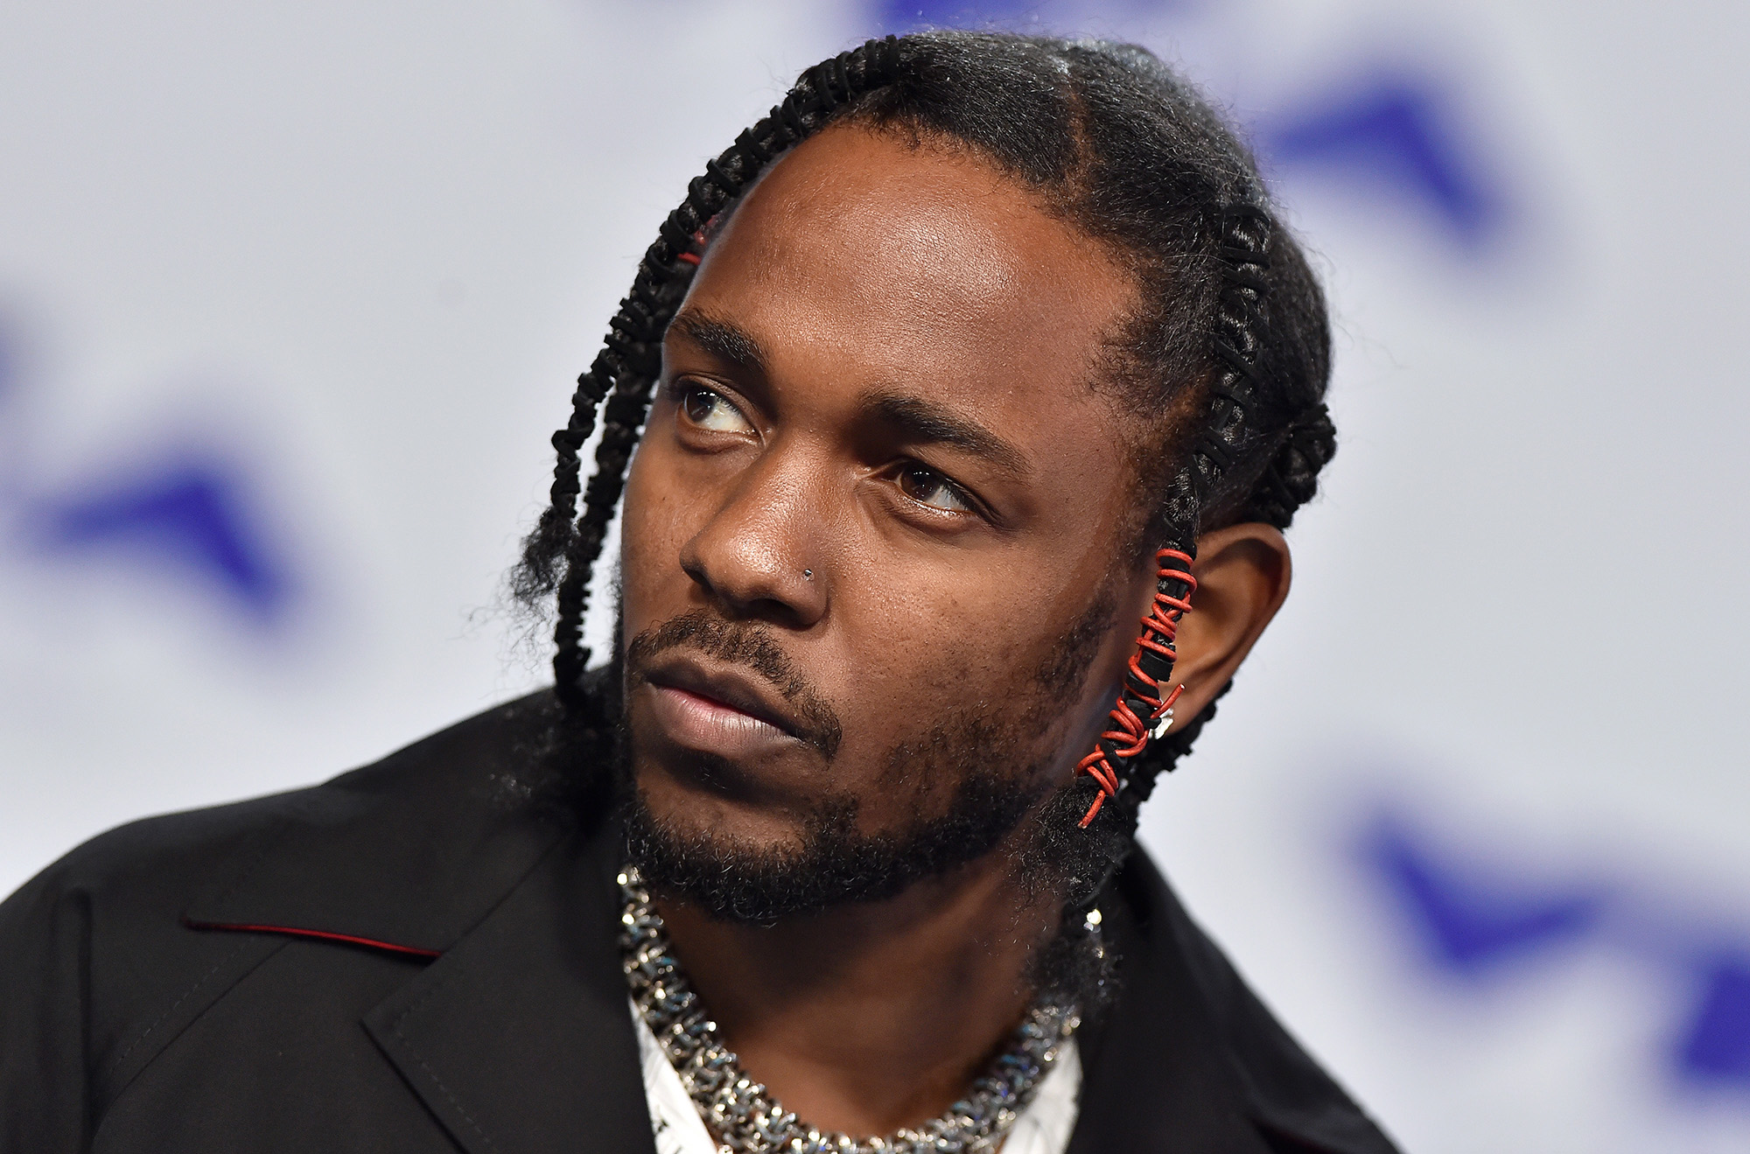
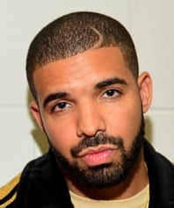

Slide 35
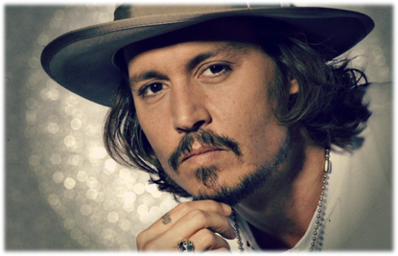
Beholding Demons
“Sometimes I feel like I’m possessed with a multitude of demons. I know I have demons. I’m 30 different people sometimes. Once my job is done on the film, it’s just not any of my business. I stay as far as I could as possible. I don’t like watching myself. He’s up there (demon).”
- Johnny Depp

Slide 36
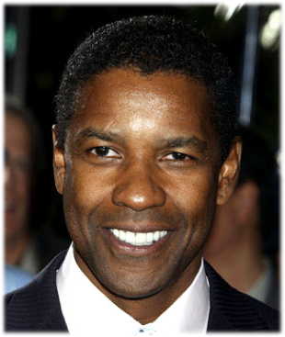
Beholding Demons
“I got on my knees and sort of communicated with the spirits. When I came out, I was in charge. I couldn’t have acted that, I couldn’t have written that.”
- Denzel Washington

Slide 37
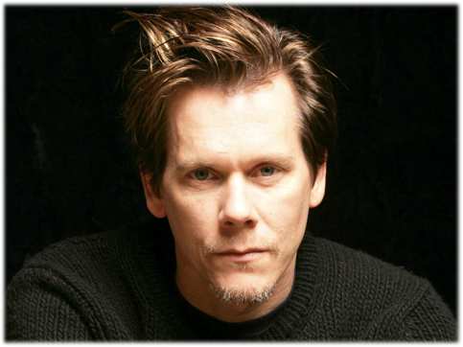
Beholding Demons
“Part of acting is to lose yourself in the moment, to let the chaos or the muse come and just enter and happen organically. Demons under the surface.” - Kevin Bacon

Slide 38
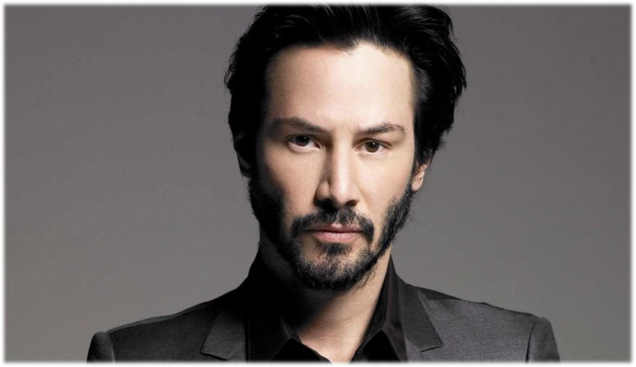
Beholding Demons
“I attempt to connect with my muse and go on demon rides.”
- Keanu Reeves

Slide 39
Beholding Demons
“Yeah! Literally, it’s like possession ‑ all of a sudden you’re in, and because it’s in front of a live audience, you just get this energy that just starts going…But there’s also that thing ‑ it is possession. In the old days you’d be burned for it…But there is something empowering about it. I mean, it is a place where you are totally ‑ it is Dr. Jekyll and Mr. Hyde, where you really can become this other force. Maybe that’s why I don’t need to play evil characters [in movies], ’cause sometimes onstage you can cross that line and come back.

Slide 40
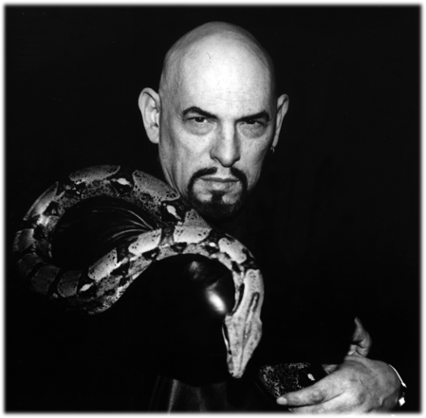
“The Tv set is the Satanic family altar.” Read mo
“Television is the major mainstream infiltration for the new satanic religion.” - Anton LaVey
Read mo

Slide 41
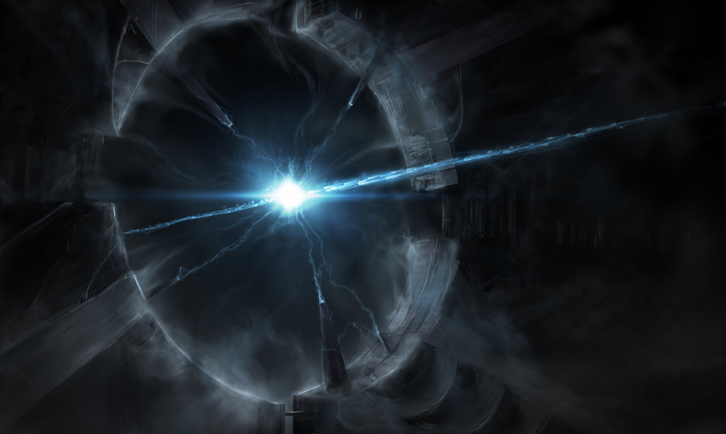

Slide 44
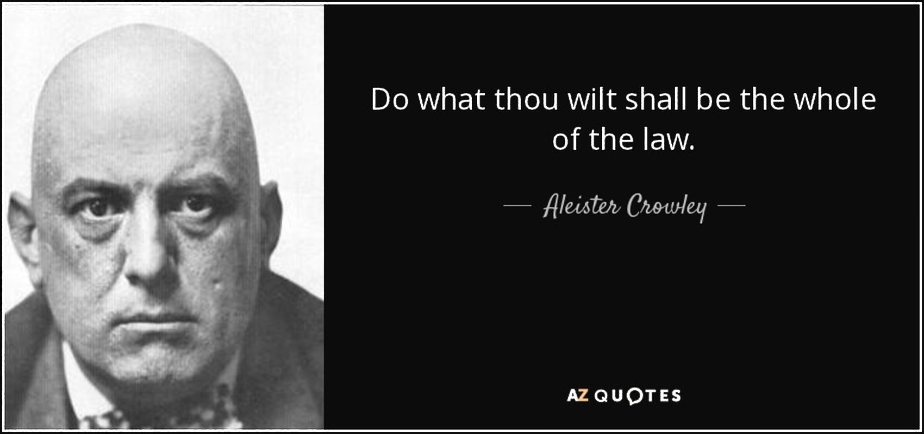

Slide 45
And it’s not just Movies!

Slide 46
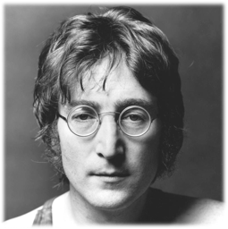
(Music)
“It’s like being possessed: like a psychic or a medium. I felt like a hollow temple filled with many spirits, each one passing through me, each inhabiting me for a little time and then leaving to be replaced by another. It’s amazing that it just came to me in a dream. That’s why I don’t profess to know anything. I think music is very mystical. When the real music comes to me, it has nothing to do with me ‘cause I’m just a channel. It’s given to me and I transcribe it.” - John Lennon

Slide 47
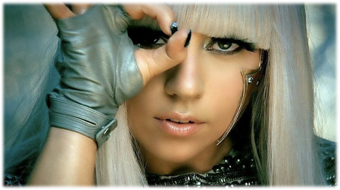
(Music)
“I have no relation to the lyrical content of my music. I am just a vessel. I realized my father’s sister Joanne, who died at 19 had instilled her spirit in me. Judas is the demon I cling to. The devil’s trying to take me. I do have morbid dreams. But I put them in the show. A lot of the work I do is an exorcism for the fans but also for myself.” - Lady Gaga

Slide 48
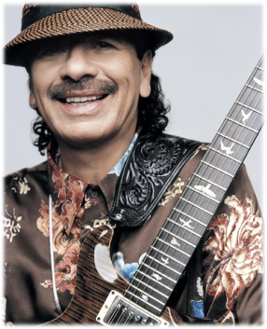
(Music)
“There’s an invisible radio that Jimi Hendrix tuned into, and when you there, you start channeling other music. You meditate and you got the candles, you got the incense and you’ve been chanting, and all of a sudden you hear this voice: ‘Write this down.”
- Carlos Santana

Slide 49
(Music)
“I asked him [Roman] to leave. But he can’t. He’s here for a reason. People have brought him out. Roman is my alter ego. He’s mean. *He says the things I can’t say. People have conjured him up. Now he won’t leave.” - Nicki Minaj

Slide 52
By Beholding we become changed!

Slide 53
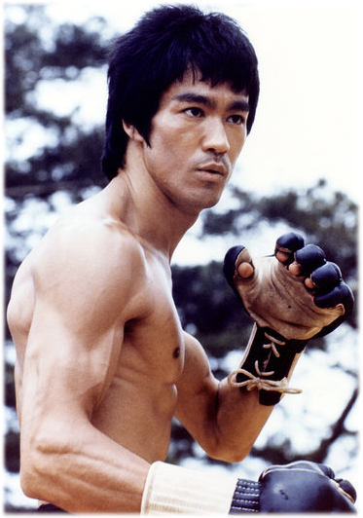
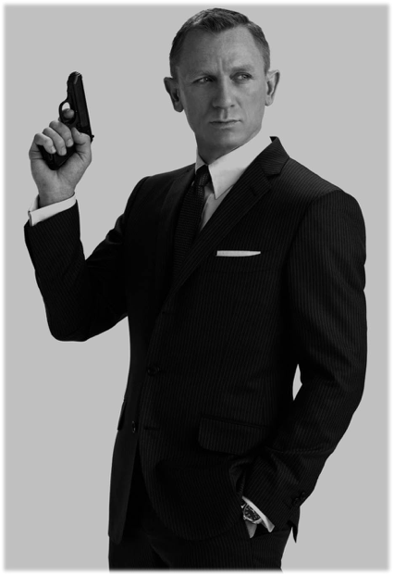
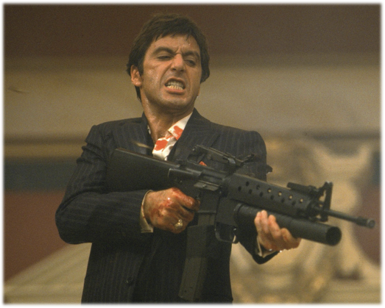

Slide 54
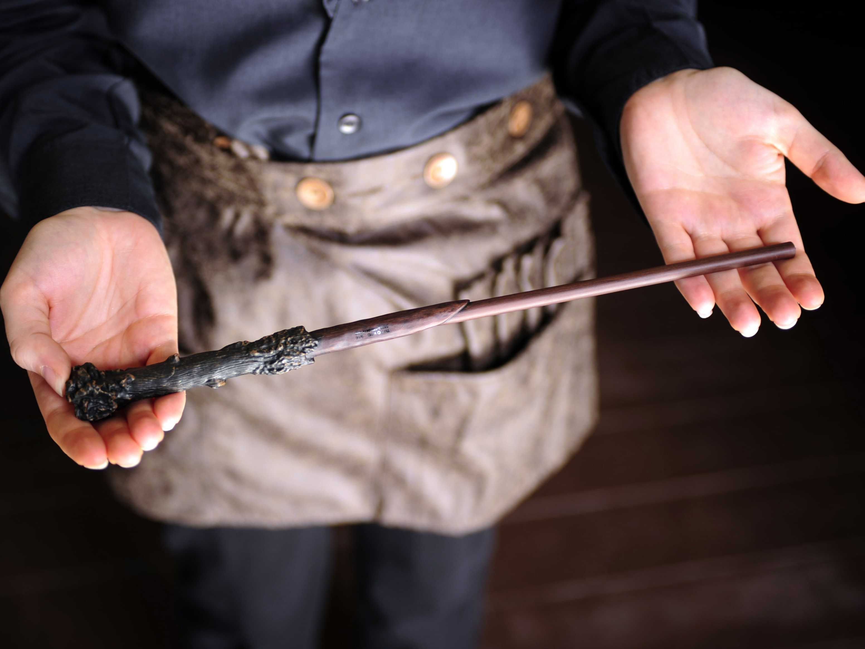

Slide 55
“There is no influence in our land more powerful to poison the imagination, to destroy religious impressions, and to blunt the relish for the tranquil pleasures and sober realities of life than theatrical amusements. The love for these scenes increases with every indulgence, as the desire for intoxicating drink strengthens with its use.”
- CHRISTIAN EDUCATION, PAGE 35

Slide 56
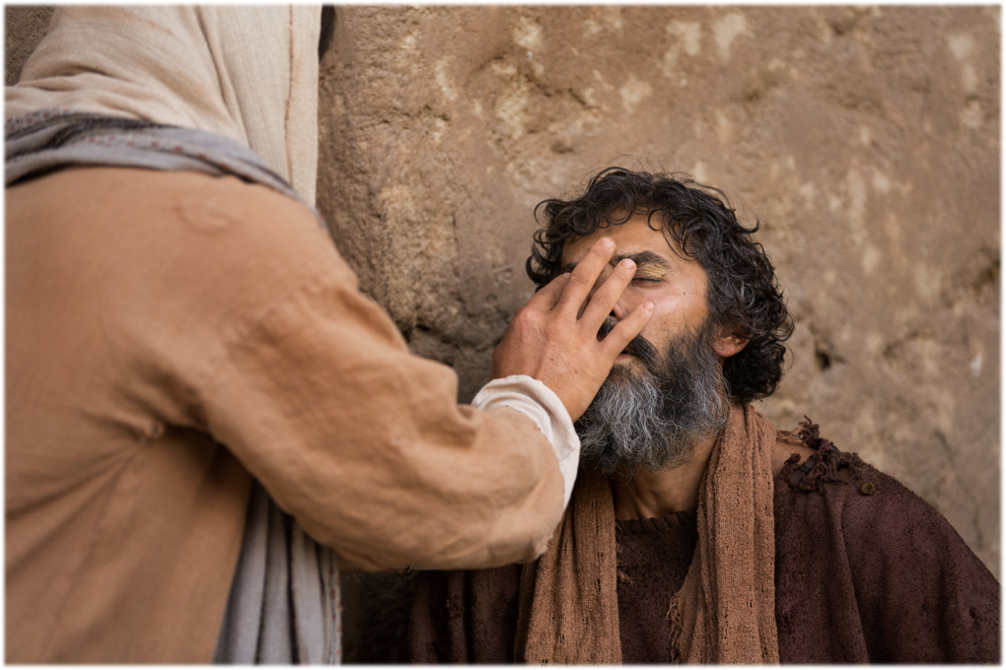

Slide 57
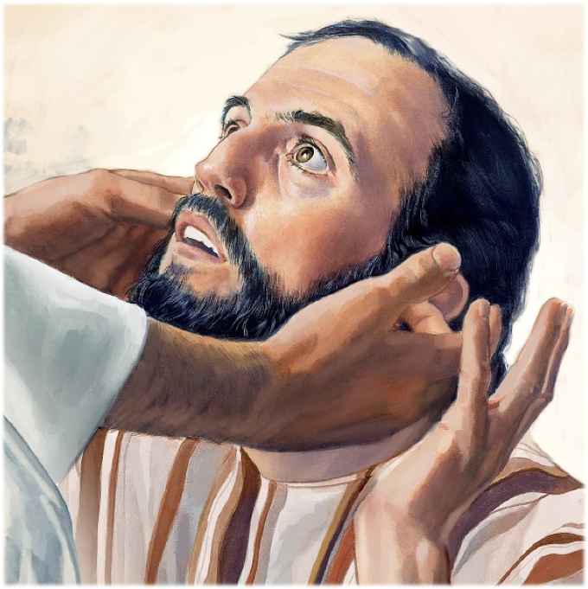

Slide 58
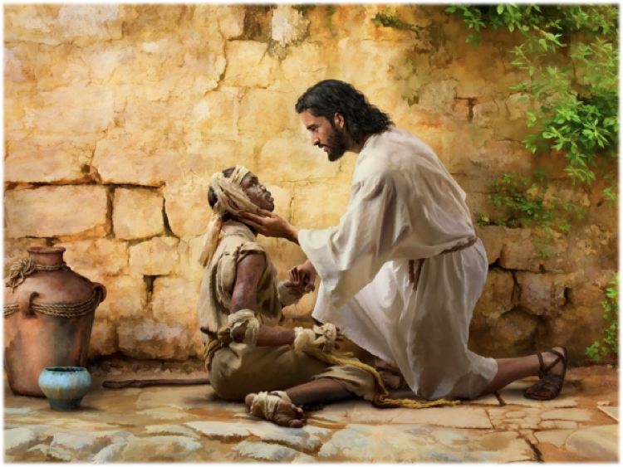

Slide 59
Ezekiel 36:25
“Then will I sprinkle clean water upon you, and ye shall be clean: from all your filthiness, and from all your idols, will I cleanse you.”
(Philippians 2:13)

Slide 60
“Man is Satan’s captive and is naturally inclined to follow his suggestions and do his bidding. He has in himself no power to oppose effectual resistance to evil. It is only as Christ abides in him by living faith, influencing his desires and strengthening him with strength from above, that man may venture to face so terrible a foe. Every other means of defense is utterly vain. It is only through Christ that Satan’s power is limited. This is a momentous truth that ALL should understand. ”
Testimonies Vol. 5 pg. 293 - 294

Slide 61
1 John 3:8
“For this purpose the Son of God was manifested, that he might destroy the works of the devil.”

Slide 62
What should we behold?

Slide 63
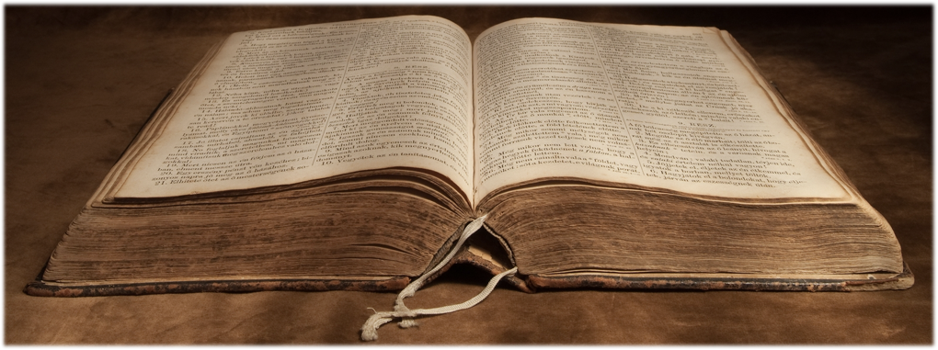
2 Corinthians 3:18
But we all, with open face beholding as in a glass the glory of the Lord, are changed into the same image from glory to glory, even as by the Spirit of the Lord.

Slide 64
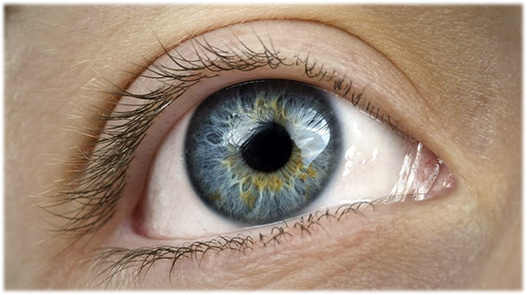
“By beholding Jesus we receive a living, expanding principle in the heart, and the Holy Spirit carries on the work, and the believer advances from grace to grace, from strength to strength, from character to character. He conforms to the image of Christ, until in spiritual growth he attains unto the measure of the full stature in Christ Jesus.”— TRUE REVIVAL, PAGE 34

Slide 65
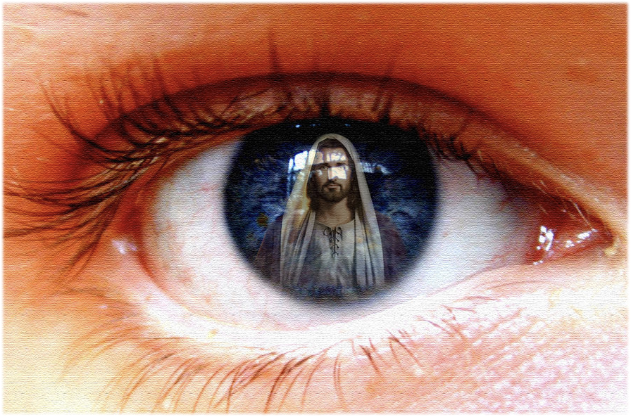

Slide 67
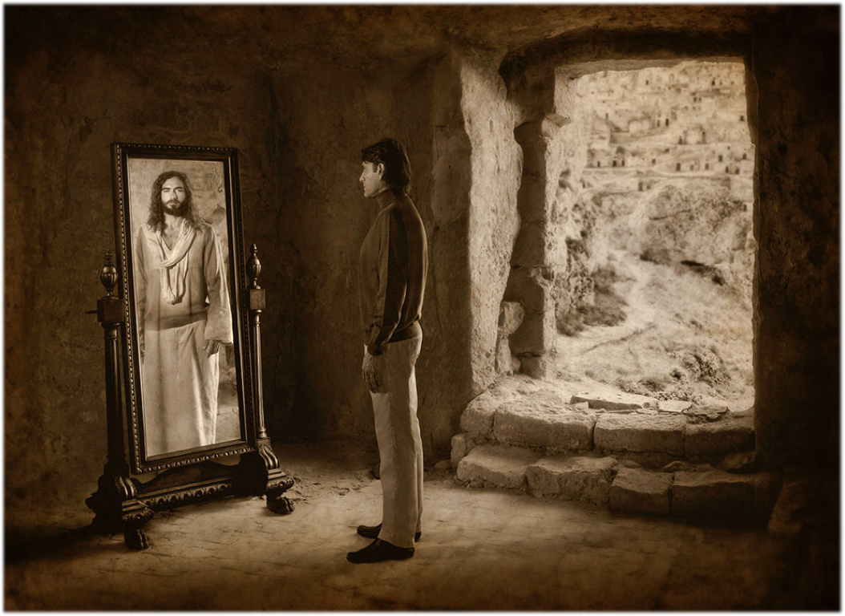
Love
Joy
Peace
Long-suffering
Gentleness
Goodness
Faith
Meekness
Temperance

Slide 68
End

