Slide 2
Cross-Over Xperience - Part 3

Slide 3
Before we literally cross over to the Heavenly Caanan,
We must have a crossing-over experience!

Slide 4
Focus: Joshua 3:1-17

Slide 5
Joshua 3:1-5 KJB
Jos 3:1 And Joshua rose early in the morning; and they removed from Shittim, and came to Jordan, he and all the children of Israel, and lodged there before they passed over.
Jos 3:2 And it came to pass after three days, that the officers went through the host;
Jos 3:3 And they commanded the people, saying, When ye see the ark of the covenant of the LORD your God, and the priests the Levites bearing it, then ye shall remove from your place, and go after it.
Jos 3:4 Yet there shall be a space between you and it, about two thousand cubits by measure: come not near unto it, that ye may know the way by which ye must go: for ye have not passed this way heretofore.
Jos 3:5 And Joshua said unto the people, Sanctify yourselves: for to morrow the LORD will do wonders among you.

Slide 8
What is an Irreducible-Complex System?

Slide 9
What is an Irreducible-Complex System?

Slide 11
You cannot sanctify yourself without first being JUSTIFIED!

Slide 12
John 12:32-33 NKJV
³² And I, if I am lifted up from the earth, will draw all peoples to Myself.” ³³ This He said, signifying by what death He would die.

Slide 14
John 3:30 KJB
³⁰ He must increase,
but I must decrease.

Slide 15
More, more …
More about Jesus I would know …

Slide 16
Joshua 3:1 KJB
¹ And Joshua rose early in the morning; and they removed from Shittim, and came to Jordan, he and all the children of Israel, and lodged there before they passed over.
Mark 1:35 And in the morning, rising up a great while before day, he (Jesus) went out, and departed into a solitary place, and there prayed.
Mark 16:9 Now when Jesus was risen early the first day of the week, he appeared first to Mary Magdalene, out of whom he had cast seven devils.

Slide 17
In the OT, Joshua is a type of Jesus Christ …
Originally “Oshea” (Num. 13:8,16), aka “Hoshea” (Deut. 32:44) (both of which mean “deliverer”) is later named “Jehoshua” (Num. 13:16; 1 Chr. 7:27), aka “Joshua” (Deut. 34:9; 1 Ki. 16:34) (both of which means “JEHOVAH is salvation/saviour”), aka “Jesus” (dualistic: Acts 7:45; Heb. 4:8), and
the Son of God is also named “Jesus” (Mat. 1:21,25; Luke 1:31, 2:21; (dualistic:) Acts 7:45; Heb. 4:8), for it means, “he shall save his people from their sins.” (Mat. 1:21) for he is, JEHOVAH E/Immanuel the Saviour (Psa. 46:7,11; Isa. 7:14, 8:8,10; Mat. 1:23; Acts 13:23; Phil. 3:20; 2 Tim. 1:10; Tit. 1:4, 2:13, 3:6; 2 Pet. 1:1,11, 2:20, 3:18, etc), and in the OT, is also named “salvation”, aka [H3444] “yeshû‛âh” (Gen. 49:18; Exo. 14:13; 2 Chr. 20:17; Jon. 2:9; Psa. 119:174).

Slide 18
In the OT, Joshua is a type of Jesus Christ …
Joshua (the son of Nun (Non) (Num. 13:8,16; Deut. 32:44, 34:9; 1 Ki. 16:34; 1 Chr. 7:27), and “Nun/Non” means “perpetuity” (H5126; forever, eternal)) and
so Jesus is the Son of the eternal Father (Mark 14:61; John 6:69, 10:36, etc).

Slide 19
In the OT, Joshua is a type of Jesus Christ …
Joshua served/ministered (Exo. 17:9-10, 24:13, 33:11; Num. 11:28; Jos. 1:1, 14:7) under the elder Moses (as “god” to Pharaoh (Exo. 7:1), and whose face shone as the light (Exo. 34:29-30,35; 2 Cor. 3:7,13), and whose hair was hoary/white (Lev. 19:32), and whose name 'Moses', means to be from the midst of the waters (Exo. 2:10), and was very old, “his eye was not dim, nor his natural force abated.” (Deut. 34:7)) and
Jesus also ministered (Mat. 20:26,28; Mark 10:43,45; Rom. 15:8; Heb. 8:2) under His Father's instruction (Pro. 8:22-36; John 5:30, 17:4,8,14,16), who is “God” (Gen. 1:1; Jer. 10:10; John 1:1,18, 5:18, 6:27, 17:3; 1 Thes. 1:9; 1 John 5:20, etc), whose face shines as the light (Rev. 4:3), and whose hair is hoary/white (Dan. 7:9), and dwells amidst the waters (Job 9:8; Psa. 18:11, 29:3, 77:19, 93:4), and is the Ancient of Days (Job 12:12; Dan. 7:9,13,22).

Slide 20
In the OT, Joshua is a type of Jesus Christ …
Joshua was one of the twelve tribes (Num. 13:8),
so was Jesus (Mat. 2:6; Heb. 7:14; Rev. 5:5).
Joshua was connected to a “Joseph” (Gen. 41:52, 46:20, 48:1,5,13-14,17,20, 50:23; Num. 13:8, 26:28,37; Jos. 14:4, 16:4, 17:17 , etc),
so also Jesus (“Joseph”, the step-father (Mat. 1:16,18-20,24, 2:13,19; Luke 1:27, 2:4,16,33,43, 3:23; John 1:45, 6:42) and “Joseph” of Arimathea (Mat. 27:57,59; Mark 15:43,45; Luke 23:50; John 19:38) and other “Joseph” (Luke 3:24,26,30)).

Slide 21
In the OT, Joshua is a type of Jesus Christ …
Joshua was told to choose out men to combat the opposing forces (Exo. 17:9),
Jesus also (Luke 6:13; John 6:70; Rom. 1:1).
Joshua led the twelve tribes (Josh. 3:12, 4:2-4,8-9,20),
so too Jesus the twelve apostles (Luke 6:13; John 6:70).
Joshua was victorious over the adversaries (Exo. 17:13),
so too Jesus (Psa. 98:1-3; Col. 2:15).

Slide 22
In the OT, Joshua is a type of Jesus Christ …
Joshua went down into the Jordan river (Jos. 1:2, 3:8),
as did Jesus (Mat. 3:13,16; Mark 1:9; Luke 3:3,21; John 1:28-34).
God was with Joshua (Jos. 1:5,9,17, 3:10),
as with Jesus (John 8:29, 11:42, 16:32).
Joshua obeyed God's Commandments (Jos. 1:7-8, 11:14),
Jesus obeyed His Father's Commandments (Deut. 18:16,18; John 12:49-50, 15:10).

Slide 23
In the OT, Joshua is a type of Jesus Christ …
Whosoever would not hearken unto Joshua was to be put to death (Jos. 1:18),
and so likewise with Jesus (Deut. 18:15,19; Acts 3:22-23; Heb. 2:3, 12:25-26).
Joshua sent out men by two (Jos. 2:1,4,23),
so did Jesus (Mark 6:7; Luke 10:1).
Joshua came out of Egypt (Exo. 12:17; Jos. 2:10; Acts 7:40; Heb. 3:16, 8:9),
so did Jesus (Hos. 11:1; Mat. 2:13-15,19).

Slide 24
In the OT, Joshua is a type of Jesus Christ …
Joshua saves a remnant, a woman and her family, from a doomed populace (Jos. 2:13, 6:23,25),
so does Jesus (Mat. 1:21; Rom. 9:27, 11:5; Rev. 12:17).
All the land was given into the hand of Joshua (Jos. 2:24),
so too Jesus (John 13:3; Rev. 21:1,7).
Joshua was to cast out 7 wicked nations (Jos. 3:10),
Jesus casts out 7 wicked devils (Mark 16:9; Luke 8:2).

Slide 25
In the OT, Joshua is a type of Jesus Christ …
Miraculous events happened in the life of Joshua (Jos. 3:1-4:18, 10:12-14),
so too with Jesus (Mark 6:52; John 4:54, 6:14, etc).
Joshua was circumcised (Jos. 5:5),
so too Jesus (Luke 2:21).
Joshua meets Jesus (Jos. 5:13-15).

Slide 26
In the OT, Joshua is a type of Jesus Christ …
Joshua and the Trumpets 6 +7 (Jos. 6:1-16);
Jesus and the 6 Trumpets + 7 Plagues (the fullness of the 7th Trumpet) (Rev. 10:7, 11:15, 15:1-8, 16:1-21).
Joshua slays all the wicked in the city (Jericho), and everything therein and burns it by fire (Jos. 6:21,24),
and will Jesus (2 Thes. 1:8, 2:8).
Joshua had a covetous traitor in his ranks (Jos. 7:1-25, 22:20),
so too Jesus (Mat. 26:16; Mark 14:10-11; Luke 22:4,6,64,71; John 6:70, 12:4,6, 13:2,11; Acts 1:16-25).

Slide 27
In the OT, Joshua is a type of Jesus Christ …
All the nations fight against Joshua (Jos. 9:1-2, 11:4-5,20,23, 12:1-24),
so too Jesus (Rev. 17:12-14, 20:7-10).
Joshua had the people place their feet on their enemies (Jos. 10:24),
so will Jesus (Mal. 4:3).
Go find more of Jesus! …

Slide 28
In the OT, Joshua is a type of Jesus Christ …

Slide 29
Deuteronomy 7:1 KJB
¹ When the LORD thy God shall bring thee into the land whither thou goest to possess it, and hath cast out many nations before thee, the Hittites, and the Girgashites, and the Amorites, and the Canaanites, and the Perizzites, and the Hivites, and the Jebusites, seven nations greater and mightier than thou;

Slide 30
Leviticus 18:2-5 KJB
² Speak unto the children of Israel, and say unto them, I am the LORD your God.
³ After the doings of the land of Egypt, wherein ye dwelt, shall ye not do: and after the doings of the land of Canaan, whither I bring you, shall ye not do: neither shall ye walk in their ordinances.
⁴ Ye shall do my judgments, and keep mine ordinances, to walk therein: I am the LORD your God.
⁵ Ye shall therefore keep my statutes, and my judgments: which if a man do, he shall live in them: I am the LORD.

Slide 31
Leviticus 18:24-26 KJB
²⁴ Defile not ye yourselves in any of these things (Lev. 18:6-23): for in all these the nations are defiled which I cast out before you:
²⁵ And the land is defiled: therefore I do visit the iniquity thereof upon it, and the land itself vomiteth out her inhabitants.
²⁶ Ye shall therefore keep my statutes and my judgments, and shall not commit any of these abominations; neither any of your own nation, nor any stranger that sojourneth among you:

Slide 32
Leviticus 18:27-30 KJB
²⁷ (For all these abominations have the men of the land done, which were before you, and the land is defiled;)
²⁸ That the land spue not you out also, when ye defile it, as it spued out the nations that were before you.
²⁹ For whosoever shall commit any of these abominations, even the souls that commit them shall be cut off from among their people.
³⁰ Therefore shall ye keep mine ordinance, that ye commit not any one of these abominable customs, which were committed before you, and that ye defile not yourselves therein: I am the LORD your God.

Slide 33
Deuteronomy 6:17-19 KJB
¹⁷ Ye shall diligently keep the commandments of the LORD your God, and his testimonies, and his statutes, which he hath commanded thee.
¹⁸ And thou shalt do that which is right and good in the sight of the LORD: that it may be well with thee, and that thou mayest go in and possess the good land which the LORD sware unto thy fathers,
¹⁹ To cast out all thine enemies from before thee, as the LORD hath spoken.

Slide 34
Acts 7:45 KJB
⁴⁵ Which also our fathers that came after brought in with Jesus (G2424 – Iesous, Jesus & Joshua (Jos. 5:13-15)) into the possession of the Gentiles, whom God drave out before the face of our fathers, unto the days of David;

Slide 35
Acts 13:19 KJB
¹⁹ And when he (God) had destroyed seven nations in the land of Chanaan, he divided their land to them by lot.

Slide 36
Joshua, a Possessed, Cast out, 7
Mark 16:9 KJB Now when Jesus (the real Joshua) was risen early the first day of the week, he appeared first to Mary Magdalene, out of whom he had cast seven devils.
Luk 8:2 KJB And certain women, which had been healed of evil spirits and infirmities, Mary called Magdalene, out of whom went seven devils,

Slide 37
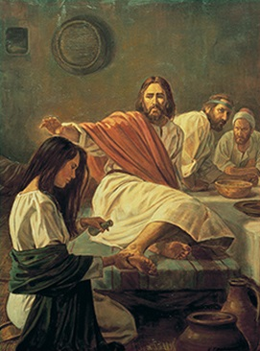
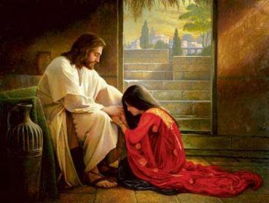
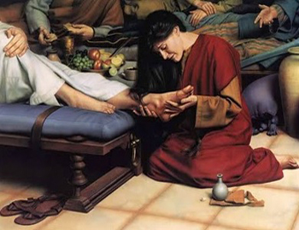
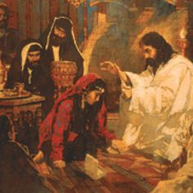
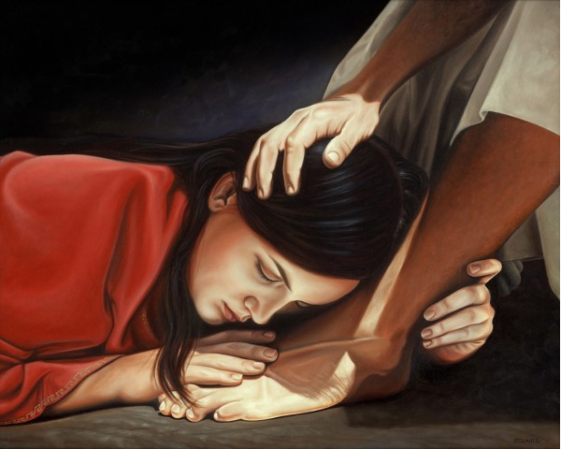
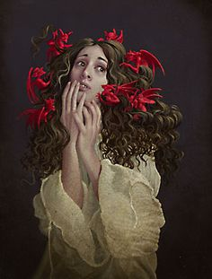
Joshua, a Possessed, Cast out, 7

Slide 38
So long as the 7 nations were not cast out, they would be a hindrance, temptation, and a scourge to Israel, slowly eating out the heart of the nation, so too in our own lives.

Slide 39
Termites illustration:
Wood (us) eaten by termites (sin). The Lord will drive away (cast out) termites from the wood. Renew the wood. Coat the wood with a special coating (righteousness of Jesus) that will keep the termites away from the clean and swept house.

Slide 40
Termites illustration - Deuteronomy 7:1 KJB
“… the Hittites, and the Girgashites, and the Amorites, and the Canaanites, and the Perizzites, and the Hivites, and the Jebusites …”
All just beyond the Shittim (Acacia grove) wood, ready to eat up the wood of the Ark of the heart (Psa. 40:8), unless it was covered in “pure gold” – the character of Jesus Christ.

Slide 41
Joshua 3:2 KJB
² And it came to pass after three days, that the officers went through the host;
Mat 27:63 KJB Saying, Sir, we remember that that deceiver said, while he was yet alive, After three days I will rise again.
Mar 8:31 KJB And he began to teach them, that the Son of man must suffer many things, and be rejected of the elders, and of the chief priests, and scribes, and be killed, and after three days rise again.
They camped before the Jordan, 3 days. Immerse yourself in the 3 days of Jesus from Gethsemane to Calvary to Victory over death and the grave.

Slide 42
Joshua 3:3 KJB
³ And they commanded the people, saying, When ye see the ark of the covenant of the LORD your God, and the priests the Levites bearing it, then ye shall remove from your place, and go after it.
Joh 8:12 KJB Then spake Jesus again unto them, saying, I am the light of the world: he that followeth me shall not walk in darkness, but shall have the light of life.
Joh 12:35 KJB Then Jesus said unto them, Yet a little while is the light with you. Walk while ye have the light, lest darkness come upon you: for he that walketh in darkness knoweth not whither he goeth.
When God stays, be still and know that He is God, and when God moves, step fast lest you lose the light of His countenance.

Slide 43
Joshua 3:4 KJB
⁴ Yet there shall be a space between you and it (Ark), about two thousand cubits by measure: come not near unto it (Ark), that ye may know the way by which ye must go: for ye have not passed this way heretofore.
Num 35:5 KJB And ye shall measure from without the city on the east side two thousand cubits, and on the south side two thousand cubits, and on the west side two thousand cubits, and on the north side two thousand cubits; and the city shall be in the midst: this shall be to them the suburbs of the cities.
The Ark is central to the City of God, at it’s center, the Light of God – His shining Character (Rev. 21:23), “… dwelling in the light which no man can approach unto …” (1 Tim. 6:16 KJB).

Slide 44
After 3 Days, Joshua (Jesus) was magnified!
Jos 3:5 And Joshua said unto the people, Sanctify yourselves: for to morrow the LORD will do wonders among you.
Jos 3:6 And Joshua spake unto the priests, saying, Take up the ark of the covenant, and pass (Cross) over before the people. And they took up the ark of the covenant, and went before the people.
Jos 3:7 And the LORD said unto Joshua, This day will I begin to magnify thee in the sight of all Israel, that they may know that, as I was with Moses, so I will be with thee.

Slide 45
Joshua 3:8-10 KJB
Jos 3:8 And thou shalt command the priests that bear the ark of the covenant, saying, When ye are come to the brink of the water of Jordan, ye shall stand still in Jordan.
Jos 3:9 And Joshua said unto the children of Israel, Come hither, and hear the words of the LORD your God.
Jos 3:10 And Joshua said, Hereby ye shall know that the living God is among you, and that he will without fail drive (cast) out from before you the Canaanites, and the Hittites, and the Hivites, and the Perizzites, and the Girgashites, and the Amorites, and the Jebusites.
All, the “7” termites will be ‘cast out’ …

Slide 46
Joshua 3:11-13 KJB
Jos 3:11 Behold, the ark of the covenant of the Lord of all the earth passeth over before you into Jordan.
Jos 3:12 Now therefore take you twelve men out of the tribes of Israel, out of every tribe a man.
Jos 3:13 And it shall come to pass, as soon as the soles of the feet of the priests that bear the ark of the LORD, the Lord of all the earth, shall rest in the waters of Jordan, that the waters of Jordan shall be cut off from the waters that come down from above; and they shall stand upon an heap.
Probation closes for the church first …

Slide 47
1 Peter 4:17 NKJV
For the time has come for judgment to begin at the house of God; and if it begins with us first, what will be the end of those who do not obey the gospel of God?

Slide 48
Ezekiel 8 & 9

Slide 49
Joshua 3:15 KJB (Harvest Time)
Jos 3:15 And as they that bare the ark were come unto Jordan, and the feet of the priests that bare the ark were dipped in the brim of the water, (for Jordan overfloweth all his banks all the time of harvest,)
See “harvest”: Lev. 23:33-44; (vs. 39, “… when ye have gathered in the fruit of the land …”); Mat. 13:39, “… the harvest is the end of the world; and the reapers are the (3) angels …”, and Rev. 14:1-5 (harvested firstfruits), 6-12 (reapers), 13 (reaped to follow), 14-20 (harvested field (world))

Slide 50
Joshua 3:16-17 KJB
Jos 3:16 That the waters which came down from above stood and rose up upon an heap very far from the city Adam, that is beside Zaretan: and those that came down toward the sea of the plain, even the salt sea, failed, and were cut off: and the people passed (Cross-ed) over right against Jericho.
Jos 3:17 And the priests that bare the ark of the covenant of the LORD stood firm on dry ground in the midst of Jordan, and all the Israelites passed (Cross-ed) over on dry ground, until all the people were passed clean over Jordan.

Slide 52
Joshua 3:16-17 KJB
The city of Adam (Jesus is the second/last Adam) was far to the North (Heaven), and the waters ceased (and stood up, as Michael (Dan. 12:1; Luke 13:35) for the harvest of souls was in, the water overflowed (Holy Spirit poured out)) allowing the peoples Israel to Cross-Over on dry ground, and yet there were waters that still flowed southward toward the Salt Sea (those who had no yet heard the message, but soon the waters would cease flowing there also, until all who would had “Crossed”- over).

Slide 53
Waters dried up. Usually in Scripture that was a bad thing symbolically or spiritually.
However, in this case it is a positive thing.
Jesus is the waters that was dried up and created dry land or bridge between heaven and earth so that we may cross over!
AMEN!!

Slide 54
