Slide 2
Cross-Over Xperience - Part 2

Slide 3
Remember
1. Israel was camping at Shittim (Acacia Groves) in Num. 25:1.
2. The Ark of the Covenant was made of Shittim (Acacia wood), in Exo. 25:10.
3. Israel was to be watchful as they entered the promised land.
4. Israel was deceived by the ‘friendly’ Moabites of Balak and Balaam.
5. Zimri (music) a leader in Israel and Cozbi (false, my lie) the Moabitess, suffered the penalty of death, for Zimri was unwilling to separate from his sin (Cozbi) and so was destroyed with it, to preserve the greater body.

Slide 4
1 Corinthians 10:6-8,11 NKJV
⁶ Now these things became our examples, to the intent that we should not lust after evil things as they also lusted. ⁷ And do not become idolaters as were some of them. As it is written, “The people sat down to eat and drink, and rose up to play.” ⁸ Nor let us commit sexual immorality, as some of them did, and in one day twenty-three thousand fell …
¹¹ Now all these things happened to them as examples, and they were written for our admonition, upon whom the ends of the world have come.

Slide 5
Remember
1. Know where you came from, where you are, and where you’re going.
2. Know your surroundings and its influences.
3. Who are your friends? Know who are your true friends and who are not.
4. Know that there will be false prophets in the last days!
5. Beware of leaders that lead you to apostasy!

Slide 6
From Eternity Past p. 323.4
“… Satan has studied with fiendish intensity for thousands of years, and through successive generations he has wrought to overthrow princes in Israel by the same temptations that were so successful at Baalpeor. As we approach the close of time, on the borders of the heavenly Canaan, Satan will redouble his efforts to prevent the people of God from entering the goodly land. …”

Slide 7
“THE CROSS OVER EXPERIENCE”

Slide 8
Redeemed #337
Redeemed—how I love to proclaim it!
Redeemed by the blood of the Lamb;
Redeemed through His infinite mercy,
His child, and forever, I am.
Redeemed, redeemed,
Redeemed by the blood of the Lamb;
Redeemed, redeemed,
His child, and forever, I am.

Slide 9
Revelation 15:2-4 NKJV
² And I saw something like a sea of glass mingled with fire, and those who have the victory over the beast, over his image and over his mark and over the number of his name, standing on the sea of glass, having harps of God. ³ They sing the song of Moses, the servant of God, and the song of the Lamb, saying: …
⁴ “Who shall not fear You, O Lord, and glorify Your name? For You alone are holy. For all nations shall come and worship before You, For Your judgments have been manifested.”

Slide 10
Revelation 14:6-7 KJB
⁶ And I saw another angel fly in the midst of heaven, having the everlasting gospel to preach unto them that dwell on the earth, and to every nation, and kindred, and tongue, and people,
⁷ Saying with a loud voice, Fear God, and give glory to him; for the hour of his judgment is come: and worship him that made heaven, and earth, and the sea, and the fountains of waters.

Slide 11
The Song of Moses & the Lamb is truly the Sabbath Psalm, of having entered into His rest, which He promised.
Mat 26:30 KJB And when they had sung an hymn, they went out into the mount of Olives.
Mar 14:26 KJB And when they had sung an hymn, they went out into the mount of Olives.
Psa 92:1 KJB A Psalm or Song for the sabbath day. It is a good thing to give thanks unto the LORD, and to sing praises unto thy name, O most High:

Slide 12
Great Controversy (1911) p. 648.3
“… And they sing “a new song” before the throne, a song which no man can learn save the hundred and forty and four thousand. It is the song of Moses and the Lamb—a song of deliverance. None but the hundred and forty-four thousand can learn that song; for it is the song of their experience—an experience such as no other company have ever had. …”

Slide 13
RH March 9, 1905, par. 4
“… Let us strive with all the power that God has given us to be among the hundred and forty-four thousand. …”

Slide 14
Great Controversy (1911) p. 648.3
“… Upon the crystal sea before the throne, that sea of glass as it were mingled with fire,—so resplendent is it with the glory of God,—are gathered the company that have “gotten the victory over the beast, and over his image, and over his mark, and over the number of his name.” With the Lamb upon Mount Zion, “having the harps of God,” they stand, the hundred and forty and four thousand that were redeemed from among men … “These are they which follow the Lamb whithersoever He goeth.” These, having been translated from the earth, from among the living, are counted as “the first fruits unto God and to the Lamb.”

Slide 15
A CROSSING-OVER EXPERIENCE

Slide 16
Exodus 13:9 KJB A Pass (Cross) – Over Xperience
⁹ And it shall be for a sign unto thee upon thine hand, and for a memorial between thine eyes, that the LORD'S law may be in thy mouth: for with a strong hand hath the LORD brought thee out of Egypt.

Slide 17
Elijah – Jehovah is God
Elisha – God is Salvation
²⁰ And hallow my sabbaths; and they shall be a sign (seal) between me and you, that ye may know that I am the Lord your God. (Ezekiel 20:20 KJB)
¹² Moreover also I gave them my sabbaths, to be a sign (seal) between me and them, that they might know that I am the Lord that sanctify them. (Ezekiel 20:12 KJB)

Slide 18
The Song of Moses

Slide 19
Deuteronomy 31:19-21 NKJV
¹⁹ “Now therefore, write down this song for yourselves, and teach it to the children of Israel; put it in their mouths, that this song may be a witness for Me against the children of Israel. ²⁰ When I have brought them to the land flowing with milk and honey, of which I swore to their fathers, and they have eaten and filled themselves and grown fat, then they will turn to other gods and serve them; and they will provoke Me and break My covenant. ²¹ Then it shall be, when many evils and troubles have come upon them, that this song will testify against them as a witness; for it will not be forgotten in the mouths of their descendants, for I know the inclination of their behavior today, even before I have brought them to the land of which I swore to give them.”

Slide 20
Deuteronomy 31:22-26 NKJV
²² Therefore Moses wrote this song the same day, and taught it to the children of Israel. ²³ Then He inaugurated Joshua the son of Nun, and said, “Be strong and of good courage; for you shall bring the children of Israel into the land of which I swore to them, and I will be with you.”
²⁴ So it was, when Moses had completed writing the words of this law in a book, when they were finished, ²⁵ that Moses commanded the Levites, who bore the ark of the covenant of the Lord, saying:
²⁶ “Take this Book of the Law, and put it beside the ark of the covenant of the Lord your God, that it may be there as a witness against you;

Slide 21
Deuteronomy 32:44-47 NKJV
⁴⁴ So Moses came with Joshua the son of Nun and spoke all the words of this song in the hearing of the people. ⁴⁵ Moses finished speaking all these words to all Israel, ⁴⁶ and he said to them: “Set your hearts on all the words which I testify among you today, which you shall command your children to be careful to observe—all the words of this law. ⁴⁷ For it is not a futile thing for you, because it is your life, and by this word you shall prolong your days in the land which you cross over the Jordan to possess.”

Slide 22
Deuteronomy 34:10 NKJV
¹⁰ But since then there has not arisen in Israel a prophet like Moses, whom the Lord knew face to face,

Slide 23
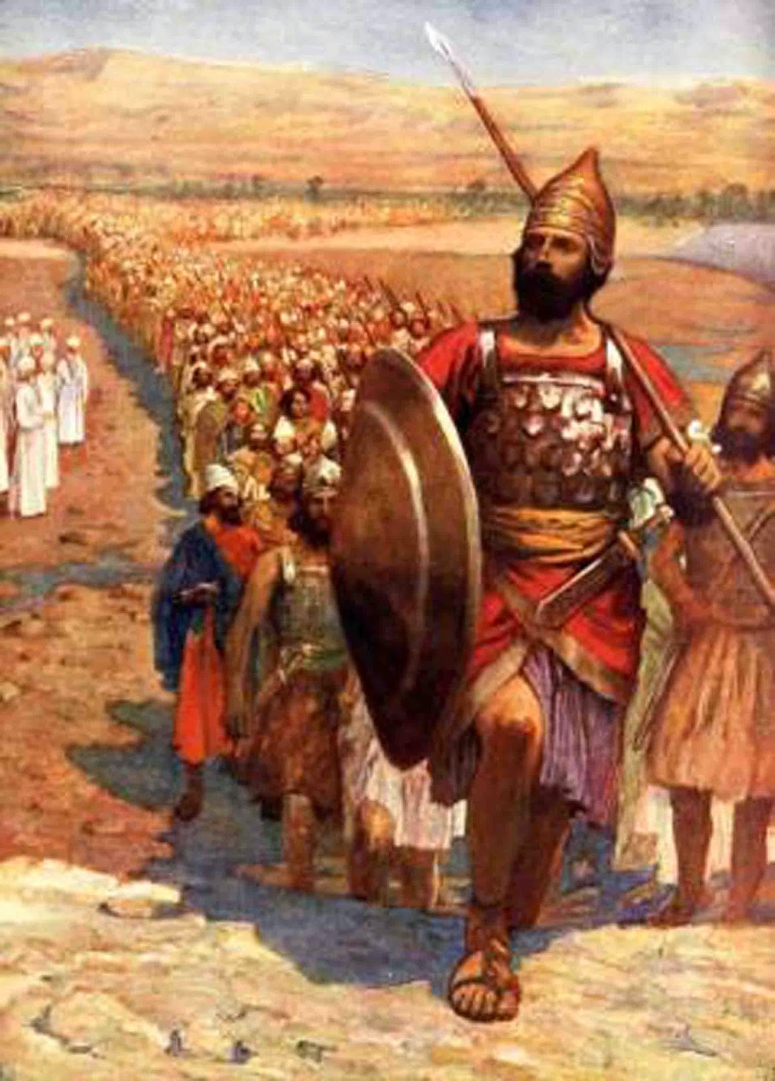
Are you ready and willing to Cross – Over?

Slide 24
Take up your Cross … and follow Jesus (our Joshua) today!

Slide 25
