Slide 2
Cross-Over Xperience - Part 1

Slide 3
Testimonies for the Church Vol. 9, p. 11.1
“… We are living in the time of the end. The fast-fulfilling signs of the times declare that the coming of Christ is near at hand. The days in which we live are solemn and important. The Spirit of God is gradually but surely being withdrawn from the earth. Plagues and judgments are already falling upon the despisers of the grace of God. The calamities by land and sea, the unsettled state of society, the alarms of war, are portentous. They forecast approaching events of the greatest magnitude. The agencies of evil are combining their forces and consolidating. They are strengthening for the last great crisis. Great changes are soon to take place in our world, and the final movements will be rapid ones. …”

Slide 4
“… the final movements will be rapid ones. …”

Slide 5
Matthew 24:11-12 KJB
¹¹ And many false prophets shall rise, and shall deceive many.
¹² And because iniquity shall abound, the love of many shall wax cold.

Slide 6
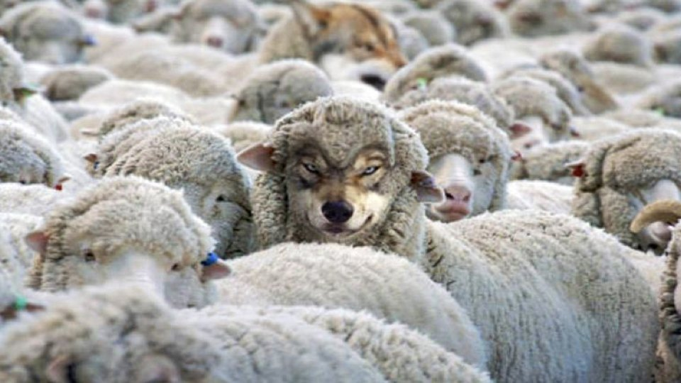
“… many false prophets shall rise …”

Slide 7
Acts 20:28-30 KJB
²⁸ Take heed therefore unto yourselves, and to all the flock, over the which the Holy Ghost hath made you overseers, to feed the church of God, which he hath purchased with his own blood.
²⁹ For I know this, that after my departing shall grievous wolves enter in among you, not sparing the flock.
³⁰ Also of your own selves shall men arise, speaking perverse things, to draw away disciples after them.

Slide 8
“… iniquity shall abound, the love of many shall wax cold …”

Slide 9
“… iniquity (G458 – anomia) shall abound, the love of many shall wax cold …”
Joh 14:15 KJB If ye love me, keep my commandments.
1Jn 3:4 KJB Whosoever committeth sin transgresseth also the law: for sin is the transgression of the law (G458 - anomia).

Slide 10
2 Timothy 3:1-5 NKJV
¹ But know this, that in the last days perilous times will come: ² For men will be lovers of themselves, lovers of money, boasters, proud, blasphemers, disobedient to parents, unthankful, unholy, ³ unloving, unforgiving, slanderers, without self-control, brutal, despisers of good, ⁴ traitors, headstrong, haughty, lovers of pleasure rather than lovers of God, ⁵ having a form of godliness but denying its power. And from such people turn away!

Slide 11
“… having a form of godliness but denying its power …”

Slide 12
2 Timothy 3:13 NKJV
¹³ But evil men and impostors will grow worse and worse, deceiving and being deceived.

Slide 13
Revelation 2:1-3 NKJV
¹ “To the angel of the church of Ephesus write, ‘These things says He who holds the seven stars in His right hand, who walks in the midst of the seven golden lampstands: ² “I know your works, your labor, your patience, and that you cannot bear those who are evil. And you have tested those who say they are apostles and are not, and have found them liars; ³ and you have persevered and have patience, and have labored for My name’s sake and have not become weary.

Slide 14
Revelation 2:4-5 NKJV
⁴ Nevertheless I have this against you, that you have left your first love. ⁵ Remember therefore from where you have fallen; repent and do the first works, or else I will come to you quickly and remove your lampstand from its place—unless you repent.

Slide 15
“To the angel of the church …”
The word “angel” (G32 – aggelos; H4397 – mal’ak) simply means “messenger”, “one sent with a message”, or even “ambassador”. It can apply to human beings, even leaders within the church or government of God, for instance:
Gal 4:14 KJB And my temptation which was in my flesh ye despised not, nor rejected; but received me (Paul) as an angel of God, even as Christ Jesus.
1Sa 29:9 KJB And Achish answered and said to David, I know that thou art good in my sight, as an angel of God: notwithstanding the princes of the Philistines have said, He shall not go up with us to the battle.

Slide 16
Numbers 25 – Crossing Paths With Moabites, Balak and Balaam

Slide 17
Numbers 25:1-3 KJB
Num 25:1 And Israel abode in Shittim, and the people began to commit whoredom with the daughters of Moab.
Num 25:2 And they called the people unto the sacrifices of their gods: and the people did eat, and bowed down to their gods.
Num 25:3 And Israel joined himself unto Baalpeor: and the anger of the LORD was kindled against Israel.

Slide 18
1. Know where you came from, where you are, and where you’re going.
“And Israel abode (or remained) in Shittim (H7851 – Acacia Acacia)…” Numbers 25:1 KJB
“…the victorious armies of Israel had returned from Bashan. They had already gained possession of a valuable territory, and they were confident of the immediate conquest of Canaan. Only the river Jordan lay between them and the Promised Land.” … here flourished the shittim, or acacia, tree, giving to the plain the name, “Vale of Shittim.” It was here that the Israelites encamped … During the time of their encampment beside Jordan, Moses was preparing for the occupation of Canaan. …” - (PP 453.1, 454.1)

Slide 19
1. Know where you came from, where you are, and where you’re going.
The Shittim (H7851 – Acacia tree wood) was what the Ark of the Covenant, beneath the golden exterior, was made of:
Exo 25:10 KJB And they shall make an ark of shittim wood: two cubits and a half shall be the length thereof, and a cubit and a half the breadth thereof, and a cubit and a half the height thereof.

Slide 20
1. Know where you came from, where you are, and where you’re going.
The Shittim (H7851 – Acacia tree wood) was what the Ark of the Covenant, beneath the golden exterior, was made of:
Israel was to abide in the truth of God’s Law of Love, keeping His commandments always (Deut. 6:7, 11:19), and they would live & be protected from all false teachers & teachings that led astray (Psa. 15:1-5, 61:4,7, 91:1).

Slide 21
2. Know your surroundings and its influences.
“But amid these attractive surroundings they were to encounter an evil more deadly than mighty hosts of armed men or the wild beasts of the wilderness. … In the public worship of Baal, the leading deity, the most degrading and iniquitous scenes were constantly enacted. On every side were places noted for idolatry and licentiousness … These surroundings exerted a polluting influence upon the Israelites.” - (PP 453.3, 453.4)

Slide 22
2. Know your surroundings and its influences.
Just as Israel was then in a grove of trees, they were to be aware of God’s express will (Psa. 40:8), and being careful to avoid any deviation from it, lest their own life be endangered, as it was in the Garden of Eden with Adam & Eve … where there was a subtil serpent in their midst. Eve, in wandering from the side of her husband, lost track of her surroundings, and was caught unawares. Watch and Pray!

Slide 23
2. Know your surroundings and its influences.

Slide 24
3. Who are your friends? Know who are your true friends and who are not.
“At first there was little intercourse between the Israelites and their heathen neighbors, but after a time Midianitish women began to steal into the camp. Their appearance excited no alarm, and so quietly were their plans conducted that the attention of Moses was not called to the matter. It was the object of these women, in their association with the Hebrews, to seduce them into transgression of the law of God, to draw their attention to heathen rites and customs, and lead them into idolatry. These motives were studiously concealed under the garb of friendship, so that they were not suspected, even by the guardians of the people.” - (PP 454.2)

Slide 25
3. Who are your friends? Know who are your true friends and who are not.
If Eve had been aware of her surroundings, and had noticed that her husband was no longer by her side, and hadn’t entered into ‘intercourse’ (conversation, dialogue, exchange) with the subtil serpent when he appeared, she would have been kept safe, so likewise the Israelites in their encounter with the daughters of Moab, Balak & Balaam.

Slide 26
Our real Friend, should be the same as Abrahams’ …
2Ch 20:7 KJB Art not thou our God, who didst drive out the inhabitants of this land before thy people Israel, and gavest it to the seed of Abraham thy friend for ever?
Isa 41:8 KJB But thou, Israel, art my servant, Jacob whom I have chosen, the seed of Abraham my friend.
Jas 2:23 KJB And the scripture was fulfilled which saith, Abraham believed God, and it was imputed unto him for righteousness: and he was called the Friend of God.

Slide 27
Our real Friend, should be the same as Moses’ …
Exo 33:11 And the LORD spake unto Moses face to face, as a man speaketh unto his friend. And he turned again into the camp: but his servant Joshua, the son of Nun, a young man, departed not out of the tabernacle.

Slide 28
Our real Friend, should be Jesus …
Joh 15:14 Ye are my friends, if ye do whatsoever I command you.

Slide 29
John 10:14 KJB
¹⁴ I am the good shepherd, and know my sheep, and am known of mine.

Slide 30
James 4:4 KJB
⁴ Ye adulterers and adulteresses, know ye not that the friendship of the world is enmity with God? whosoever therefore will be a friend of the world is the enemy of God.

Slide 31
4. Know that there will be false prophets in the last days!
“At Balaam’s suggestion, a grand festival in honor of their gods was appointed by the king of Moab, and it was secretly arranged that Balaam should induce the Israelites to attend. He was regarded by them as a prophet of God, and hence had little difficulty in accomplishing his purpose. Great numbers of the people joined him in witnessing the festivities. They ventured upon the forbidden ground, and were entangled in the snare of Satan. Beguiled with music and dancing, and allured by the beauty of heathen vestals, they cast off their fealty to Jehovah. As they united in mirth and feasting, indulgence in wine beclouded their senses and broke down the barriers of self-control.”- (PP 454.3)

Slide 32
4. Know that there will be false prophets in the last days!
“Passion had full sway; and having defiled their consciences by lewdness, they were persuaded to bow down to idols. They offered sacrifice upon heathen altars and participated in the most degrading rites.” - (PP 454.3)

Slide 33
Matthew 24:3-5,11 NKJV
³ Now as He sat on the Mount of Olives, the disciples came to Him privately, saying, “Tell us, when will these things be? And what will be the sign of Your coming, and of the end of the age?”
⁴ And Jesus answered and said to them: “Take heed that no one deceives you. ⁵ For many will come in My name, saying, ‘I am the Christ,’ and will deceive many.
¹¹ Then many false prophets will rise up and deceive many.

Slide 34
Revelation 13:11-14 KJB
¹¹ And I beheld another beast coming up out of the earth; and he had two horns like a lamb, and he spake as a dragon.
¹² And he exerciseth all the power of the first beast before him, and causeth the earth and them which dwell therein to worship the first beast, whose deadly wound was healed.
¹³ And he doeth great wonders, so that he maketh fire come down from heaven on the earth in the sight of men,
¹⁴ And deceiveth them that dwell on the earth by the means of those miracles which he had power to do

Slide 35
Revelation 19:20 KJB
²⁰ And the beast was taken, and with him the false prophet that wrought miracles before him, with which he deceived them that had received the mark of the beast, and them that worshipped his image. …

Slide 36
Revelation 16:13 KJB
¹³ And I saw three unclean spirits like frogs come out of the mouth of the dragon, and out of the mouth of the beast, and out of the mouth of the false prophet.

Slide 37
5. Beware of leaders that lead you to apostasy!
³ So Israel was joined to Baal of Peor, and the anger of the Lord was aroused against Israel.
⁴ Then the Lord said to Moses, “Take all the leaders of the people and hang the offenders before the Lord, out in the sun, that the fierce anger of the Lord may turn away from Israel.” - (Numbers 25:3,4 NKJV)
“The rulers and the leading men were among the first to transgress, and so many of the people were guilty that the apostasy became national. “Israel joined himself unto Baalpeor.”” - (PP 454.4)

Slide 38
Patriarchs and Prophets p. 455.2 …
“… While they were thus weeping before God, at the door of the tabernacle, while the plague was still doing its work of death, and the magistrates were executing their terrible commission, Zimri, one of the nobles of Israel, came boldly into the camp, accompanied by a Midianitish harlot, a princess “of a chief house in Midian,” whom he escorted to his tent. Never was vice bolder or more stubborn. Inflamed with wine, Zimri declared his “sin as Sodom,” and gloried in his shame. The priests and leaders had prostrated themselves in grief and …”

Slide 39
Patriarchs and Prophets p. 455.2
“… humiliation, weeping “between the porch and the altar,” and entreating the Lord to spare His people, and give not His heritage to reproach, when this prince in Israel flaunted his sin in the sight of the congregation, as if to defy the vengeance of God and mock the judges of the nation. …”

Slide 40
God wants to save people whom He loves, and destroy sin which He hates, but …
Zimri (music), a leader, was supposed to “slay” (Num. 25:5) the ‘sin’ and not allow it to live, but instead was intimately, even boldly, joined unto it (Cozbi (false, my lie), the Midianitish woman) on the borders of Canaan.
God, through Phinehas (a son of Eleazar, a son of Aaron), then in righteousness (Num. 25:4-5) slew both Zimri and Cozbi together, with a single javelin (spear), as Zimri would not be separated from his bold sin; thus ending the plague brought by it (for sin, left unchecked will spread and destroy many more, and so God in merciful judgment must act to save as many as He can).
If we refuse to separate from sin, by God’s grace, then we also will likewise perish with it, just as Zimri did.

Slide 41
1 Corinthians 10:6-8 KJB
⁶ Now these things were our examples, to the intent we should not lust after evil things, as they also lusted.
⁷ Neither be ye idolaters, as were some of them; as it is written, The people sat down to eat and drink, and rose up to play.
⁸ Neither let us commit fornication, as some of them committed, and fell in one day three and twenty thousand.

Slide 42
1 Corinthians 10:9-12 KJB
⁹ Neither let us tempt Christ, as some of them also tempted, and were destroyed of serpents.
¹⁰ Neither murmur ye, as some of them also murmured, and were destroyed of the destroyer.
¹¹ Now all these things happened unto them for ensamples: and they are written for our admonition, upon whom the ends of the world are come.
¹² Wherefore let him that thinketh he standeth take heed lest he fall.

Slide 43
Romans 5:20-21 NKJV
²⁰ Moreover the law entered that the offense might abound. But where sin abounded, grace abounded much more, ²¹ so that as sin reigned in death, even so grace might reign through righteousness to eternal life through Jesus Christ our Lord.

