Slide 2
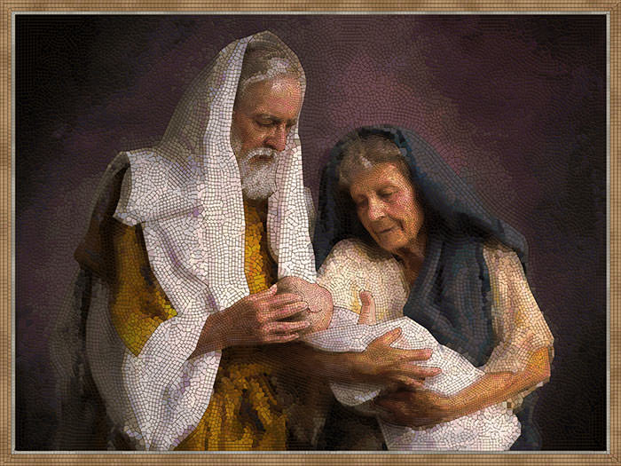
“CALLED to be CHOSEN”

Slide 3
Deuteronomy 7:1-4 NKJV
“¹ When the Lord your God brings you into the land which you go to possess, and has cast out many nations before you, the Hittites and the Girgashites and the Amorites and the Canaanites and the Perizzites and the Hivites and the Jebusites, seven nations greater and mightier than you…² You shall make no covenant with them…³ Nor shall you make marriages with them. You shall not give your daughter to their son, nor take their daughter for your son. ⁴ For they will turn your sons away from following Me, to serve other gods …

Slide 4
Deuteronomy 7:6 NKJV
⁶ “For you are a holy people to the Lord your God; the Lord your God has chosen you to be a people for Himself, a special treasure above all the peoples on the face of the earth.

Slide 5
1 Peter 2:9 NKJV
⁹ But you are a chosen generation, a royal priesthood, a holy nation, His own special people, that you may proclaim the praises of Him who called you out of darkness into His marvelous light.

Slide 6
Hosea 11:1 NKJV
“When Israel was a child, I loved him, And out of Egypt I called My son.

Slide 7
Matthew 22:14 KJB
¹⁴ “For many are called, but few are chosen.”

Slide 8
2 Peter 1:10 NKJV
¹⁰ Therefore, brethren, be even more diligent to make your calling and election sure, for if you do these things you will never fall

Slide 9
Messages to Young People p. 21, 22
“… God has given you an opportunity to fill a high destiny. Your influence may tell for the truth of God; you may be a colaborer with God in the great work of human redemption... [p. 21-22] O that young men might appreciate the high destiny to which they are called! …”

Slide 10
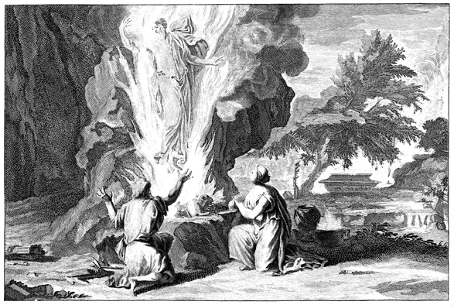
Samson - Judges 13:1-16:31

Slide 11
Judges 13:7,13-14 KJB
Jdg 13:7 But he said unto me, Behold, thou shalt conceive, and bear a son; and now drink no wine nor strong drink, neither eat any unclean thing: for the child shall be a Nazarite to God from the womb to the day of his death.
Jdg 13:13 And the angel of the LORD said unto Manoah, Of all that I said unto the woman let her beware.
Jdg 13:14 She may not eat of any thing that cometh of the vine, neither let her drink wine or strong drink, nor eat any unclean thing: all that I commanded her let her observe.

Slide 12
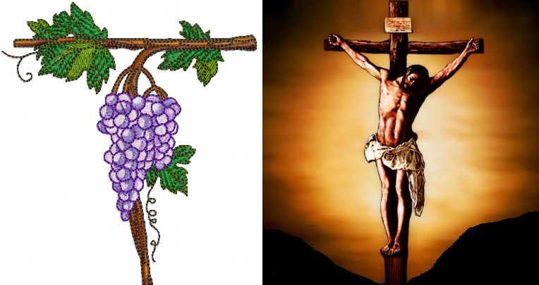
The Nazarite Vow

Slide 13
Numbers 6:1-4 … NKJV
¹ Then the Lord spoke to Moses, saying, ² “Speak to the children of Israel, and say to them: ‘When either a man or woman consecrates an offering to take the vow of a Nazirite, to separate himself to the Lord, ³ he shall separate himself from wine and similar drink; he shall drink neither vinegar made from wine nor vinegar made from similar drink; neither shall he drink any grape juice, nor eat fresh grapes or raisins. ⁴ All the days of his separation he shall eat nothing that is produced by the grapevine, from seed to skin. …

Slide 14
Numbers 6:5-8 … NKJV
⁵ ‘All the days of the vow of his separation no razor shall come upon his head; until the days are fulfilled for which he separated himself to the Lord, he shall be holy. Then he shall let the locks of the hair of his head grow. ⁶ All the days that he separates himself to the Lord he shall not go near a dead body. ⁷ He shall not make himself unclean even for his father or his mother, for his brother or his sister, when they die, because his separation to God is on his head. ⁸ All the days of his separation he shall be holy to the Lord.

Slide 15
Numbers 6:9 NKJV
⁹ ‘And if anyone dies very suddenly beside him, and he defiles his consecrated head, then he shall shave his head on the day of his cleansing; on the seventh day he shall shave it.

Slide 16
Samson – a ‘type’ of Christ
Hebrew word: shimshown – “like the sun”
- Nazarite
- Judge of Israel

Slide 17
Malachi 4:2 NKJV
But to you who fear My name
The Sun of Righteousness shall arise
With healing in His wings

Slide 18
Samson – Judges 14:1-3

Slide 19
Samson, What do we first see him doing?
Jdg 14:1 And Samson went down to Timnath, and saw a woman in Timnath of the daughters of the Philistines.
Jdg 14:2 And he came up, and told his father and his mother, and said, I have seen a woman in Timnath of the daughters of the Philistines: now therefore get her for me to wife.
Jdg 14:3 Then his father and his mother said unto him, Is there never a woman among the daughters of thy brethren, or among all my people, that thou goest to take a wife of the uncircumcised Philistines? And Samson said unto his father, Get her for me; for she pleaseth me well.

Slide 20
Translation: “… she pleaseth me well.”
She makes me happy.
It satisfies me.
That makes me feel good.

Slide 21
Samson, breaking the Nazarite vow, one small step at a time …
First, Samson places his parents into a position of choosing between God and their only miracle child, and then marries a daughter of the uncircumcised nation of the Philistines, in Timnath, though he, and they, knew better (Exo. 34:15,16).

Slide 22
Patriarchs and Prophets p. 562.2
“… But association with idolaters corrupted him. The town of Zorah being near the country of the Philistines, Samson came to mingle with them on friendly terms. Thus in his youth intimacies sprang up, the influence of which darkened his whole life. A young woman dwelling in the Philistine town of Timnath engaged Samson’s affections, and he determined to make her his wife. To his God-fearing parents, who endeavored to dissuade him from his purpose, his only answer was, “She pleaseth me well.” The parents at last yielded to his wishes, and the marriage took place. …”

Slide 23
Romans 6:16 KJB
Know ye not, that to whom ye yield yourselves servants to obey, his servants ye are to whom ye obey; whether of sin unto death, or of obedience unto righteousness?

Slide 24
Whom do we yield to?
Samson was supposed to “yield” to the instruction of his parents (Exo. 20:12; Deut. 5:16, 21:18-21; Pro. 30:17; Jer. 35:14; Eph. 6:1; Col. 3:20), and to the commandment by the Holy Messenger of God, but instead the parents “yielded” (becoming servants) to Samson’s desire (lusts), see 2 Pet. 1:4, “… the corruption that is in the world through lust.”

Slide 25
1 Corinthians 15:33 NKJV
³³ Do not be deceived: “Evil company corrupts good habits.”

Slide 26
Samson – a little leaven leaventh the whole …

Slide 27
Samson – Judges 14:5-6
Jdg 14:5 Then went Samson down, and his father and his mother, to Timnath, and came to the vineyards of Timnath: and, behold, a young lion roared against him.
Jdg 14:6 And the Spirit of the LORD came mightily upon him, and he rent him as he would have rent a kid, and he had nothing in his hand: but he told not his father or his mother what he had done.

Slide 28
Samson – Judges 14:5-6

Slide 29
Numbers 6:6 NKJV
⁶ All the days that he separates himself to the Lord he shall not go near a dead body.

Slide 30
Samson was involved with several unsanctified women, which turned his heart, one thought at a time, to one decision at a time, to one action at a time …

Slide 31
From the moment that Samson went after the ungodly, the unsanctified – it drew him further and further from God, until he didn’t know that, “… the LORD was departed from him.” (Judg. 16:20 KJB)
In Judges 14:8-9 – Samson eats Honey out of a dead Lion Carcase (Num. 6:6).
In Judges 14:10-20 – Samson enters into a contest with the unsanctified, and eventually kills to satisfy his debt, which came about through giving in to the unsanctified wife, who kept at him as satan does, until the flesh gives in.
In Judges 15:1-8 – Samson ends up getting his wife killed, and taking revenge.
In Judges 16:1-3 – Samson has a relationship with a harlot.
In Judges 16:4-31 – Samson obtains a new unsanctified woman, Delilah, and it is she, through continual persistence, as satan, to get Samson to finally break the vow totally, and give up the secret of his strength, which ends up getting Samson blinded, and enslaved.

Slide 32
Deuteronomy 7:1-4,6 KJB
“¹ 7 When the Lord thy God shall bring thee into the land whither thou goest to possess it, and hath cast out many nations before thee, … ² thou shalt make no covenant with them … ³ Neither shalt thou make marriages with them; thy daughter thou shalt not give unto his son, nor his daughter shalt thou take unto thy son. ⁴ For they will turn away thy son from following me, that they may serve other gods … ⁶ For thou art an holy people unto the Lord thy God: the Lord thy God hath chosen thee to be a special people unto himself, above all people that are upon the face of the earth.

Slide 33
Genesis 6:1-3 KJB
¹ And it came to pass, when men began to multiply on the face of the earth, and daughters were born unto them, ² That the sons of God saw the daughters of men that they were fair; and they took them wives of all which they chose. ³ And the Lord said, My spirit shall not always strive with man, for that he also is flesh …

Slide 34
Patriarchs and Prophets p. 81 …
“… For some time the two classes remained separate. The race of Cain, spreading from the place of their first settlement, dispersed over the plains and valleys where the children of Seth had dwelt; and the latter, in order to escape from their contaminating influence, withdrew to the mountains, and there made their home. So long as this separation continued, they maintained the worship of God in its purity. But in the lapse of time they ventured, little by little, to mingle with the inhabitants of the valleys. This association was productive of the worst results. “The sons of God saw the daughters of men …”

Slide 35
Patriarchs and Prophets p. 81 …
“… that they were fair.” The children of Seth, attracted by the beauty of the daughters of Cain’s descendants, displeased the Lord by intermarrying with them. Many of the worshipers of God were beguiled into sin by the allurements that were now constantly before them, and they lost their peculiar, holy character. Mingling with the depraved, they became like them in spirit and in deeds; the restrictions of the seventh commandment were disregarded, “and they took them wives of all which they chose.” The children of Seth went “in the way of Cain” (Jude 11); they fixed their minds …”

Slide 36
Patriarchs and Prophets p. 81
“… upon worldly prosperity and enjoyment and neglected the commandments of the Lord. Men “did not like to retain God in their knowledge;” they “became vain in their imaginations, and their foolish heart was darkened.” Romans 1:21. Therefore “God gave them over to a mind void of judgment.” Verse 28, margin. Sin spread abroad in the earth like a deadly leprosy. …”

Slide 37
Compare with the Genesis 6:2,4 KJB account:
See Abraham and Isaac in Genesis 24:3,37.
Gen 24:3 And I will make thee swear by the LORD, the God of heaven, and the God of the earth, that thou shalt not take a wife unto my son of the daughters of the Canaanites, among whom I dwell:
Gen 24:37 And my master made me swear, saying, Thou shalt not take a wife to my son of the daughters of the Canaanites, in whose land I dwell:

Slide 38
Compare with the Genesis 6:2,4 KJB account:
See Esau and Jacob in Genesis 26:34,35, 28:8,9 [comparing to Jacob in Genesis 27:46, 28:1,6 KJB], 36:2.
Gen 26:34 And Esau was forty years old when he took to wife Judith the daughter of Beeri the Hittite, and Bashemath the daughter of Elon the Hittite:
Gen 26:35 Which were a grief of mind unto Isaac and to Rebekah.
Gen 28:8 And Esau seeing that the daughters of Canaan pleased not Isaac his father;

Slide 39
Compare with the Genesis 6:2,4 KJB account:
See Isaac and Jacob in Genesis 27:46, 28:1,6 KJB.
Gen 27:46 And Rebekah said to Isaac, I am weary of my life because of the daughters of Heth: if Jacob take a wife of the daughters of Heth, such as these which are of the daughters of the land, what good shall my life do me?
Gen 28:1 And Isaac called Jacob, and blessed him, and charged him, and said unto him, Thou shalt not take a wife of the daughters of Canaan.
Gen 28:6 When Esau saw that Isaac had blessed Jacob, and sent him away to Padanaram, to take him a wife from thence; and that as he blessed him he gave him a charge, saying, Thou shalt not take a wife of the daughters of Canaan;

Slide 40
Compare with the Genesis 6:2,4 KJB account:
See Jacob and Hamor in Genesis 34:9,14 KJB.
Gen 34:9 And make ye marriages with us, and give your daughters unto us, and take our daughters unto you.
Gen 34:14 And they said unto them, We cannot do this thing, to give our sister to one that is uncircumcised; for that were a reproach unto us:

Slide 41
Compare with the Genesis 6:2,4 KJB account:
See Moses in Exodus 34:15,16 KJB.
Exo 34:15 Lest thou make a covenant with the inhabitants of the land, and they go a whoring after their gods, and do sacrifice unto their gods, and one call thee, and thou eat of his sacrifice;
Exo 34:16 And thou take of their daughters unto thy sons, and their daughters go a whoring after their gods, and make thy sons go a whoring after their gods.

Slide 42
Compare with the Genesis 6:2,4 KJB account:
See in Deuteronomy 17:17 KJB.
Deu 17:17 Neither shall he multiply wives to himself, that his heart turn not away: neither shall he greatly multiply to himself silver and gold.

Slide 43
Compare with the Genesis 6:2,4 KJB account:
See Balaam in Numbers 25:1,2,3 KJB.
Num 25:1 And Israel abode in Shittim, and the people began to commit whoredom with the daughters of Moab.
Num 25:2 And they called the people unto the sacrifices of their gods: and the people did eat, and bowed down to their gods.
Num 25:3 And Israel joined himself unto Baalpeor: and the anger of the LORD was kindled against Israel.

Slide 44
Compare with the Genesis 6:2,4 KJB account:
See in Judges 3:5,6,7 KJB.
Jdg 3:5 And the children of Israel dwelt among the Canaanites, Hittites, and Amorites, and Perizzites, and Hivites, and Jebusites:
Jdg 3:6 And they took their daughters to be their wives, and gave their daughters to their sons, and served their gods.
Jdg 3:7 And the children of Israel did evil in the sight of the LORD, and forgat the LORD their God, and served Baalim and the groves.

Slide 45
Compare with the Genesis 6:2,4 KJB account:
See Samson the Judge in Judges 14:1,2,3 KJB.
Jdg 14:1 And Samson went down to Timnath, and saw a woman in Timnath of the daughters of the Philistines.
Jdg 14:2 And he came up, and told his father and his mother, and said, I have seen a woman in Timnath of the daughters of the Philistines: now therefore get her for me to wife.
Jdg 14:3 Then his father and his mother said unto him, Is there never a woman among the daughters of thy brethren, or among all my people, that thou goest to take a wife of the uncircumcised Philistines? And Samson said unto his father, Get her for me; for she pleaseth me well.

Slide 46
Compare with the Genesis 6:2,4 KJB account:
See the Chronicles in 1 Chronicles 5:24,25 KJB.
1Ch 5:24 And these were the heads of the house of their fathers, even Epher, and Ishi, and Eliel, and Azriel, and Jeremiah, and Hodaviah, and Jahdiel, mighty men of valour, famous men, and heads of the house of their fathers.
1Ch 5:25 And they transgressed against the God of their fathers, and went a whoring after the gods of the people of the land, whom God destroyed before them.

Slide 47
Compare with the Genesis 6:2,4 KJB account:
See Ezra in Ezra 9:1,2,11,12 KJB.
Ezr 9:1 Now when these things were done, the princes came to me, saying, The people of Israel, and the priests, and the Levites, have not separated themselves from the people of the lands, doing according to their abominations, even of the Canaanites, the Hittites, the Perizzites, the Jebusites, the Ammonites, the Moabites, the Egyptians, and the Amorites.
Ezr 9:2 For they have taken of their daughters for themselves, and for their sons: so that the holy seed have mingled themselves with the people of those lands: yea, the hand of the princes and rulers hath been chief in this trespass.

Slide 48
Compare with the Genesis 6:2,4 KJB account:
See Ezra in Ezra 9:1,2,11,12 KJB.
Ezr 9:11 Which thou hast commanded by thy servants the prophets, saying, The land, unto which ye go to possess it, is an unclean land with the filthiness of the people of the lands, with their abominations, which have filled it from one end to another with their uncleanness.
Ezr 9:12 Now therefore give not your daughters unto their sons, neither take their daughters unto your sons, nor seek their peace or their wealth for ever: that ye may be strong, and eat the good of the land, and leave it for an inheritance to your children for ever.

Slide 49
Compare with the Genesis 6:2,4 KJB account:
See Nehemiah in Nehemiah 9:2, 10:28,29,30, 13:23,25,26,27 KJB.
Neh 9:2 And the seed of Israel separated themselves from all strangers, and stood and confessed their sins, and the iniquities of their fathers.
Neh 10:28 And the rest of the people, the priests, the Levites, the porters, the singers, the Nethinims, and all they that had separated themselves from the people of the lands unto the law of God, their wives, their sons, and their daughters, every one having knowledge, and having understanding;
Neh 10:29 They clave to their brethren, their nobles, and entered into a curse, and into an oath, to walk in God's law, which was given by Moses the servant of God, and to observe and do all the commandments of the LORD our Lord, and his judgments and his statutes;
Neh 10:30 And that we would not give our daughters unto the people of the land, nor take their daughters for our sons:

Slide 50
Compare with the Genesis 6:2,4 KJB account:
See Nehemiah in Nehemiah 9:2, 10:28,29,30, 13:23,25,26,27 KJB.
Neh 13:23 In those days also saw I Jews that had married wives of Ashdod, of Ammon, and of Moab:
Neh 13:24 And their children spake half in the speech of Ashdod, and could not speak in the Jews' language, but according to the language of each people.
Neh 13:25 And I contended with them, and cursed them, and smote certain of them, and plucked off their hair, and made them swear by God, saying, Ye shall not give your daughters unto their sons, nor take their daughters unto your sons, or for yourselves.
Neh 13:26 Did not Solomon king of Israel sin by these things? yet among many nations was there no king like him, who was beloved of his God, and God made him king over all Israel: nevertheless even him did outlandish women cause to sin.
Neh 13:27 Shall we then hearken unto you to do all this great evil, to transgress against our God in marrying strange wives?

Slide 51
Compare with the Genesis 6:2,4 KJB account:
See Solomon in 1 Kings 11:1,2,3,4,5,6,7,8 KJB.
1Ki 11:1 But king Solomon loved many strange women, together with the daughter of Pharaoh, women of the Moabites, Ammonites, Edomites, Zidonians, and Hittites;
1Ki 11:2 Of the nations concerning which the LORD said unto the children of Israel, Ye shall not go in to them, neither shall they come in unto you: for surely they will turn away your heart after their gods: Solomon clave unto these in love.
1Ki 11:3 And he had seven hundred wives, princesses, and three hundred concubines: and his wives turned away his heart.
1Ki 11:4 For it came to pass, when Solomon was old, that his wives turned away his heart after other gods: and his heart was not perfect with the LORD his God, as was the heart of David his father.

Slide 52
Compare with the Genesis 6:2,4 KJB account:
See Solomon in 1 Kings 11:1,2,3,4,5,6,7,8 KJB.
1Ki 11:5 For Solomon went after Ashtoreth the goddess of the Zidonians, and after Milcom the abomination of the Ammonites.
1Ki 11:6 And Solomon did evil in the sight of the LORD, and went not fully after the LORD, as did David his father.
1Ki 11:7 Then did Solomon build an high place for Chemosh, the abomination of Moab, in the hill that is before Jerusalem, and for Molech, the abomination of the children of Ammon.
1Ki 11:8 And likewise did he for all his strange wives, which burnt incense and sacrificed unto their gods.

Slide 53
Compare with the Genesis 6:2,4 KJB account:
Many “Sons of God” “looked”/“saw”
[“saw the daughters of men that they [were] fair” and “took them wives of all which they chose” [Genesis 6:2 KJB]]
and "beheld"
[Just as did Samson, “she pleaseth me well”, or King David who went after Bathsheba, the wife of Uriah the Hittite and his friend, through covetousness had Uriah killed in action “from the roof he saw a woman washing herself; and the woman [was] very beautiful to look upon” [2 Samuel 11:2, 12:9 KJB] and Solomon who “multiplied wives” and “loved many strange women” and all Israel who took of the “daughters of the land”],
and then “lusted and coveted” and so were ensnared being “Vex[ed], Beguiled, To Commit Trespass Against The LORD, Commit Fornication, Eat things sacrificed unto Idols, worshipped idols” [Numbers 25:18, 31:16; Revelation 2:14 KJB.

Slide 54
Compare with the Genesis 6:2,4 KJB account:
See also the words of Jesus, as it was in the days of Noah and Lot:
Job 21:7,14, 22:15,16,17; Matthew 24:37,38; Luke 17:26,27; 2 Peter 2:5, 3:3,6.
In the greater overall picture there is a like message and call for the “people of God” also today to “come out” of “Spiritual Babylon” [just as God had done with physical Babylon; Jeremiah 51:9; Isaiah 52:11 KJB] that “great Whore” [Revelation 17:1, 19:2 KJB]:
See 2 Corinthians 6:14,15,16,17,18; Revelation 18:4 KJB.

Slide 55
WHO YOU HOOK UP WITH, WILL AFFECT YOUR CALLING!

Slide 56
Adventist Home p. 52 …
“… The young are bewitched with the mania for courtship and marriage. Lovesick sentimentalism prevails. Great vigilance and tact are needed to guard the youth from these wrong influences. Daughters are not taught self-denial and self-control. They are petted, and their pride is fostered. They are allowed to have their own way, until they become headstrong and self-willed, and you are put to your wits’ end to know what course to pursue to save them from ruin. Satan is leading them on to be a proverb in the mouth of unbelievers …”

Slide 57
Adventist Home p. 52
“… because of their boldness, their lack of reserve and womanly modesty. The young boys are likewise left to have their own way. They have scarcely entered their teens before they are by the side of little girls of their own age, accompanying them home and making love to them. And the parents are so completely in bondage through their own indulgence and mistaken love for their children that they dare not pursue a decided course to make a change and restrain their too-fast children in this fast age. …”

Slide 58
Isaiah 47:9 KJB
But these two things shall come to thee in a moment in one day, the loss of children, and widowhood: they shall come upon thee in their perfection for the multitude of thy sorceries, and for the great abundance of thine enchantments.

Slide 59
Revelation 18:23 KJB
And the light of a candle shall shine no more at all in thee; and the voice of the bridegroom and of the bride shall be heard no more at all in thee: for thy merchants were the great men of the earth; for by thy sorceries were all nations deceived.

Slide 60
Ecclesiastes 8:11 NKJV
¹¹ Because the sentence against an evil work is not executed speedily, therefore the heart of the sons of men is fully set in them to do evil.

Slide 61
Hosea 4:17 NKJV
“Ephraim is joined to idols,
Let him alone.

Slide 62
Genesis 6:3 NKJV
³ And the Lord said, “My Spirit shall not strive with man forever, for he is indeed flesh …”

Slide 63
Ephesians 4:30 NKJV
³⁰ And do not grieve the Holy Spirit of God, by whom you were sealed for the day of redemption.

Slide 64
1 Thessalonians 5:19 NKJV
¹⁹ Do not quench the Spirit.

Slide 65
There is hope, for those who have gone so far in sin …
Repent, and Return unto God, even now, confessing every sin and known wrong, asking for mercy, pardon and cleansing from all unrighteousness, through the merits of the True Nazarite (the man from Nazareth, Jesus Christ) and let the “vow” made unto God (either in Baptism, or commitment) return to its former glory, and the Almighty strength of God, even the Holy Spirit shall be yours even now, it is promised by one who cannot lie, and there shall be slain all the enemies of righteousness, more now, than at the beginning.

Slide 66
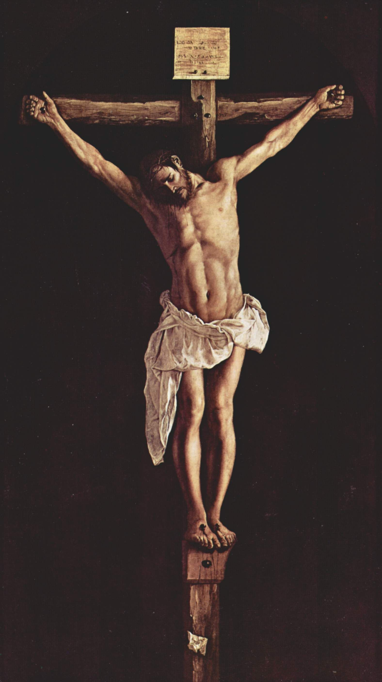
Break the chains and the chain-reactions of sin through the strength (Rom. 5:6; Rev. 12:10) provided at Calvary today …

