Slide 1
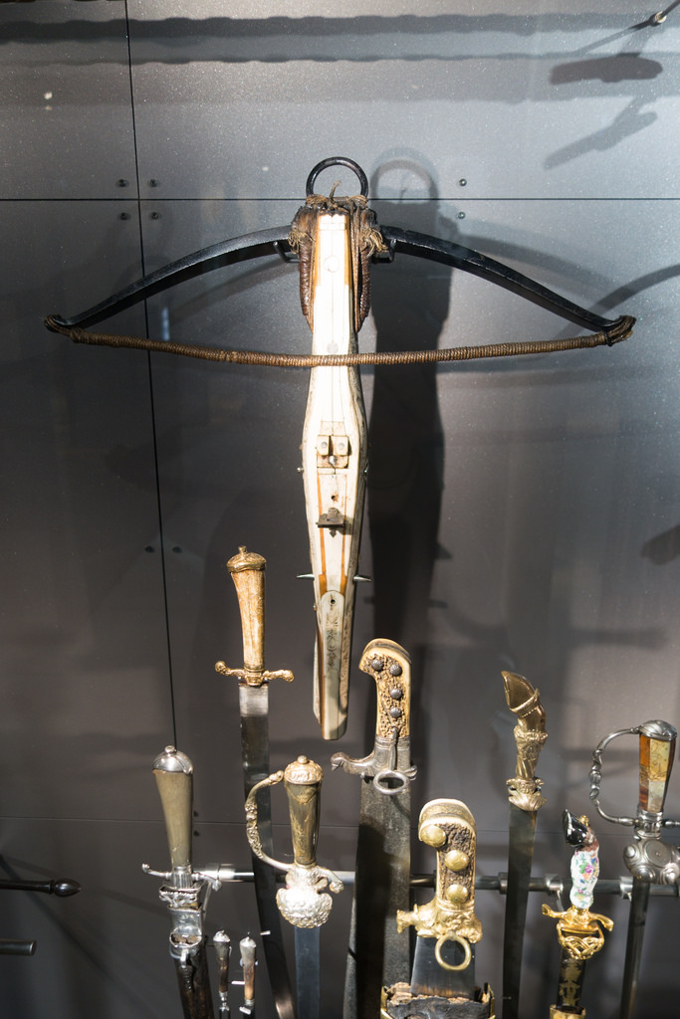
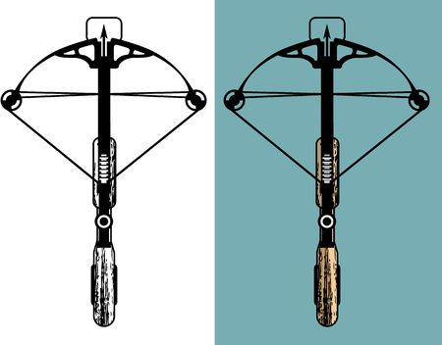
CROSS BOW
http://www.pearltrees.com/awhn

Slide 2
SCRIPTURE READING
Rev 6:1 And I saw when the Lamb opened one of the seals, and I heard, as it were the noise of thunder, one of the four beasts saying, Come and see.
Rev 6:2 And I saw, and behold a white horse: and he that sat on him had a bow; and a crown was given unto him: and he went forth conquering, and to conquer.

Slide 3
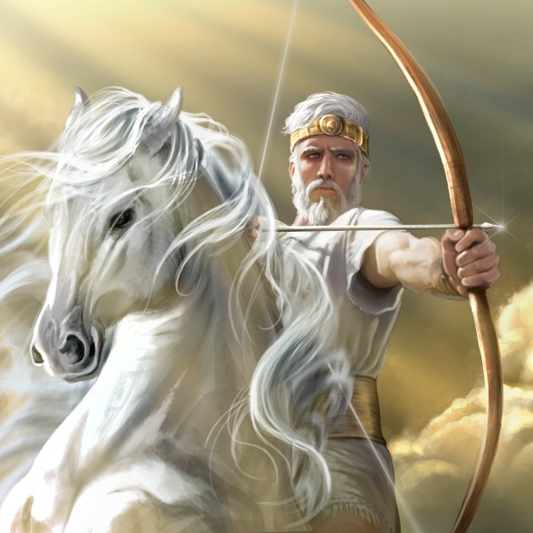
SCRIPTURE READING

Slide 4
MAN OF WAR
What do you think of when I say, “Man of War?”
What comes to your mind’s eye?
Describe this “Man of War”.

Slide 5
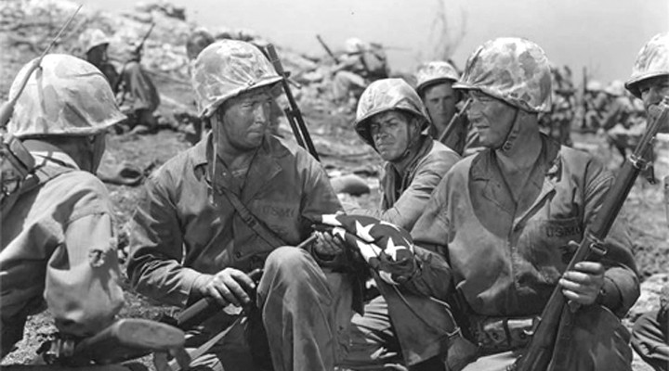
This?

Slide 6
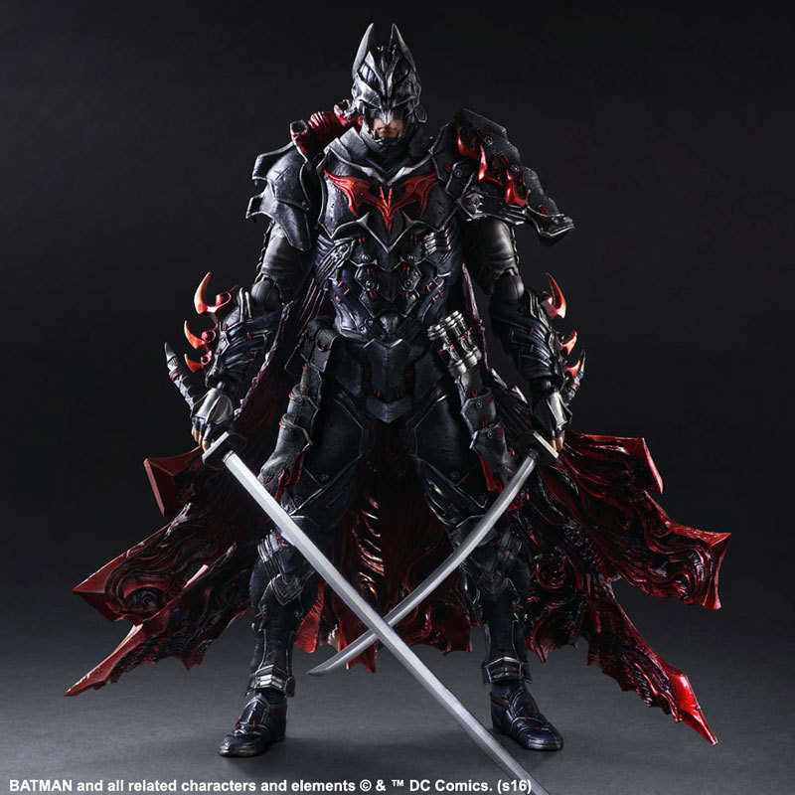
Or This?

Slide 7
The “Man of War” – Character.
Exo 15:3 The LORD is a man of war: the LORD is his name.

Slide 8
The “Man of War” – Character.
Isa 59:16 And he saw that there was no man, and wondered that there was no intercessor: therefore his arm brought salvation unto him; and his righteousness, it sustained him.
Isa 59:17 For he put on righteousness as a breastplate, and an helmet of salvation upon his head; and he put on the garments of vengeance for clothing, and was clad with zeal as a cloke.

Slide 9
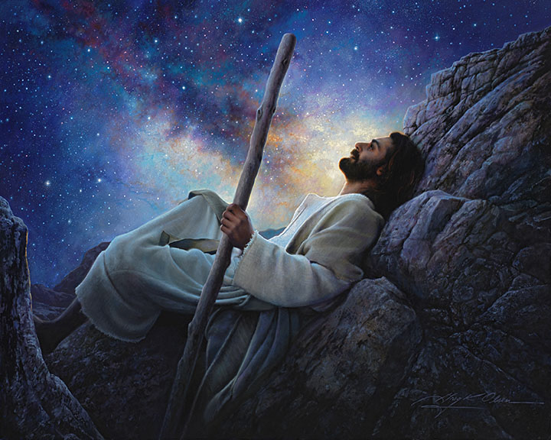
The “Man of War” – Character.

Slide 10
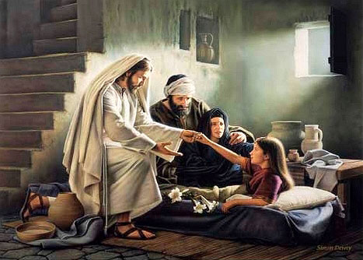
The “Man of War” – Character.

Slide 11
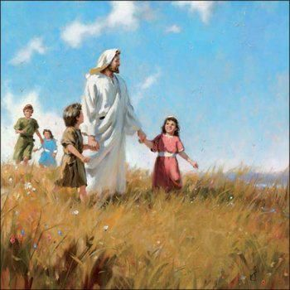
The “Man of War” – Character.

Slide 12
The “Man of War” – Character.
Isa 42:13 The LORD shall go forth as a mighty man, he shall stir up jealousy like a man of war: he shall cry, yea, roar; he shall prevail against his enemies.
Isa 42:14 I have long time holden my peace; I have been still, and refrained myself: now will I cry like a travailing woman; I will destroy and devour at once.
Isa 42:15 I will make waste mountains and hills, and dry up all their herbs; and I will make the rivers islands, and I will dry up the pools.
Isa 42:16 And I will bring the blind by a way that they knew not; I will lead them in paths that they have not known: I will make darkness light before them, and crooked things straight. These things will I do unto them, and not forsake them.

Slide 13
The “Man of War” – Character.
Rev 6:1 And I saw when the Lamb opened one of the seals, and I heard, as it were the noise of thunder, one of the four beasts saying, Come and see.
Rev 6:2 And I saw, and behold a white horse: and he that sat on him had a bow; and a crown was given unto him: and he went forth conquering, and to conquer.

Slide 14
The “Man of War” – Character.
Rev 19:11 And I saw heaven opened, and behold a white horse; and he that sat upon him was called Faithful and True, and in righteousness he doth judge and make war.
Rev 19:12 His eyes were as a flame of fire, and on his head were many crowns; and he had a name written, that no man knew, but he himself.
Rev 19:13 And he was clothed with a vesture dipped in blood: and his name is called The Word of God.

Slide 15
The “Man of War” – Character.
Rev 19:14 And the armies which were in heaven followed him upon white horses, clothed in fine linen, white and clean.
Rev 19:15 And out of his mouth goeth a sharp sword, that with it he should smite the nations: and he shall rule them with a rod of iron: and he treadeth the winepress of the fierceness and wrath of Almighty God.
Rev 19:16 And he hath on his vesture and on his thigh a name written, KING OF KINGS, AND LORD OF LORDS.

Slide 16
The “Man of War” – Character.
Psa 45:3 Gird thy sword upon thy thigh, O most mighty, with thy glory and thy majesty.
Psa 45:4 And in thy majesty ride prosperously because of truth and meekness and righteousness; and thy right hand shall teach thee terrible things.
Psa 45:5 Thine arrows are sharp in the heart of the king's enemies; whereby the people fall under thee.
Psa 45:6 Thy throne, O God, is for ever and ever: the sceptre of thy kingdom is a right sceptre.
Psa 45:7 Thou lovest righteousness, and hatest wickedness: therefore God, thy God, hath anointed thee with the oil of gladness above thy fellows.

Slide 17
What does the rider in Revelation 6:1-2 have in his hand?
a Bow

Slide 18
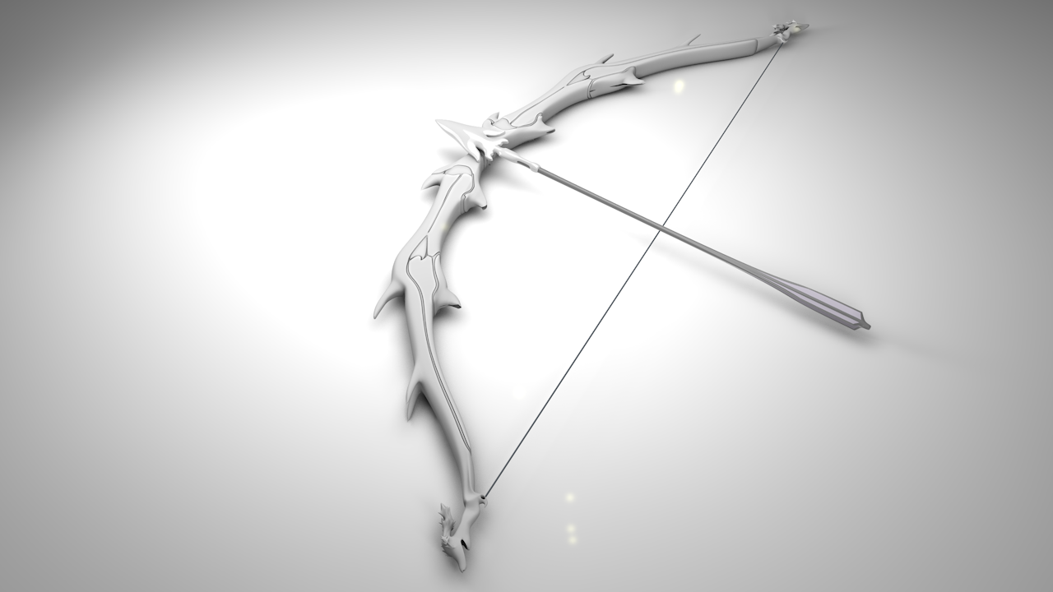
What does the rider in Revelation 6:1-2 have in his hand?

Slide 19
Let’s look at a “bow” in scripture.
Jer 9:3 And they bend their tongues like their bow for lies: but they are not valiant for the truth upon the earth; for they proceed from evil to evil, and they know not me, saith the LORD.

Slide 20
Let’s look at a “bow” in scripture.
Zec 9:9 Rejoice greatly, O daughter of Zion; shout, O daughter of Jerusalem: behold, thy King cometh unto thee: he is just, and having salvation; lowly, and riding upon an ass, and upon a colt the foal of an ass.
Zec 9:10 And I will cut off the chariot from Ephraim, and the horse from Jerusalem, and the battle bow shall be cut off: and he shall speak peace unto the heathen: and his dominion shall be from sea even to sea, and from the river even to the ends of the earth.
Zec 9:11 As for thee also, by the blood of thy covenant I have sent forth thy prisoners out of the pit wherein is no water.

Slide 21
Let’s look at a “bow” in scripture.
Zec 9:12 Turn you to the strong hold, ye prisoners of hope: even to day do I declare that I will render double unto thee;
Zec 9:13 When I have bent Judah for me, filled the bow with Ephraim, and raised up thy sons, O Zion, against thy sons, O Greece, and made thee as the sword of a mighty man.
Zec 9:14 And the LORD shall be seen over them, and his arrow shall go forth as the lightning: and the Lord GOD shall blow the trumpet, and shall go with whirlwinds of the south.

Slide 22
Let’s look at a “bow” in scripture.
Zec 9:15 The LORD of hosts shall defend them; and they shall devour, and subdue with sling stones; and they shall drink, and make a noise as through wine; and they shall be filled like bowls, and as the corners of the altar.
Zec 9:16 And the LORD their God shall save them in that day as the flock of his people: for they shall be as the stones of a crown, lifted up as an ensign upon his land.
Zec 9:17 For how great is his goodness, and how great is his beauty! corn shall make the young men cheerful, and new wine the maids.

Slide 23
Let’s look at a “bow” in scripture.
Hab 3:9 Thy bow was made quite naked, according to the oaths of the tribes, even thy word. Selah. Thou didst cleave the earth with rivers.
Hab 3:10 The mountains saw thee, and they trembled: the overflowing of the water passed by: the deep uttered his voice, and lifted up his hands on high.
Hab 3:11 The sun and moon stood still in their habitation: at the light of thine arrows they went, and at the shining of thy glittering spear.

Slide 24
Let’s look at a “bow” in scripture.
Job 29:20 My glory was fresh in me, and my bow was renewed in my hand.

Slide 25
Let’s look at a “bow” in scripture.
Lam 3:12 He hath bent his bow, and set me as a mark for the arrow.
Lam 3:13 He hath caused the arrows of his quiver to enter into my reins.

Slide 26
What is God’s Bow?
What is it made of?
Let’ take a look.

Slide 27
God’s Bow is – LIGHT!
Gen 9:8 And God spake unto Noah, and to his sons with him, saying,
Gen 9:9 And I, behold, I establish my covenant with you, and with your seed after you;
Gen 9:10 And with every living creature that is with you, of the fowl, of the cattle, and of every beast of the earth with you; from all that go out of the ark, to every beast of the earth.
Gen 9:11 And I will establish my covenant with you; neither shall all flesh be cut off any more by the waters of a flood; neither shall there any more be a flood to destroy the earth.

Slide 28
God’s Bow is – LIGHT!
Gen 9:12 And God said, This is the token of the covenant which I make between me and you and every living creature that is with you, for perpetual generations:
Gen 9:13 I do set my bow in the cloud, and it shall be for a token of a covenant between me and the earth.
Gen 9:14 And it shall come to pass, when I bring a cloud over the earth, that the bow shall be seen in the cloud:

Slide 29
God’s Bow is – LIGHT!
Gen 9:15 And I will remember my covenant, which is between me and you and every living creature of all flesh; and the waters shall no more become a flood to destroy all flesh.
Gen 9:16 And the bow shall be in the cloud; and I will look upon it, that I may remember the everlasting covenant between God and every living creature of all flesh that is upon the earth.
Gen 9:17 And God said unto Noah, This is the token of the covenant, which I have established between me and all flesh that is upon the earth.

Slide 30
God’s Bow is – LIGHT!
Eze 1:22 And the likeness of the firmament upon the heads of the living creature was as the colour of the terrible crystal, stretched forth over their heads above.
Eze 1:23 And under the firmament were their wings straight, the one toward the other: every one had two, which covered on this side, and every one had two, which covered on that side, their bodies.
Eze 1:24 And when they went, I heard the noise of their wings, like the noise of great waters, as the voice of the Almighty, the voice of speech, as the noise of an host: when they stood, they let down their wings.
Eze 1:25 And there was a voice from the firmament that was over their heads, when they stood, and had let down their wings.

Slide 31
God’s Bow is – LIGHT!
Eze 1:26 And above the firmament that was over their heads was the likeness of a throne, as the appearance of a sapphire stone: and upon the likeness of the throne was the likeness as the appearance of a man above upon it.
Eze 1:27 And I saw as the colour of amber, as the appearance of fire round about within it, from the appearance of his loins even upward, and from the appearance of his loins even downward, I saw as it were the appearance of fire, and it had brightness round about.
Eze 1:28 As the appearance of the bow that is in the cloud in the day of rain, so was the appearance of the brightness round about. This was the appearance of the likeness of the glory of the LORD. And when I saw it, I fell upon my face, and I heard a voice of one that spake.

Slide 32
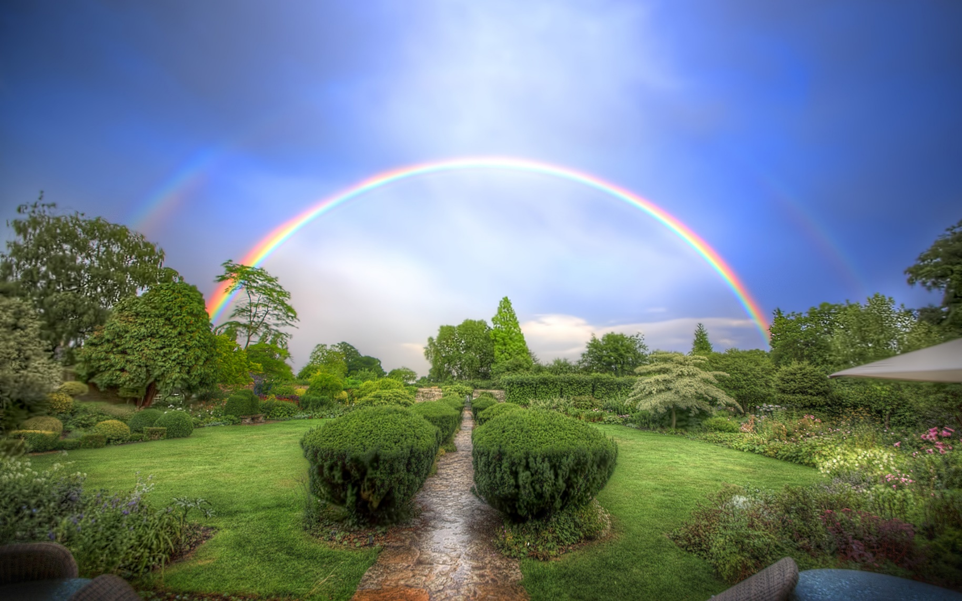
God’s Bow is – LIGHT!

Slide 33
What are the parts of the Bow?
Let’s take a look.

Slide 34
What is the part that is pulled?
The String

Slide 35
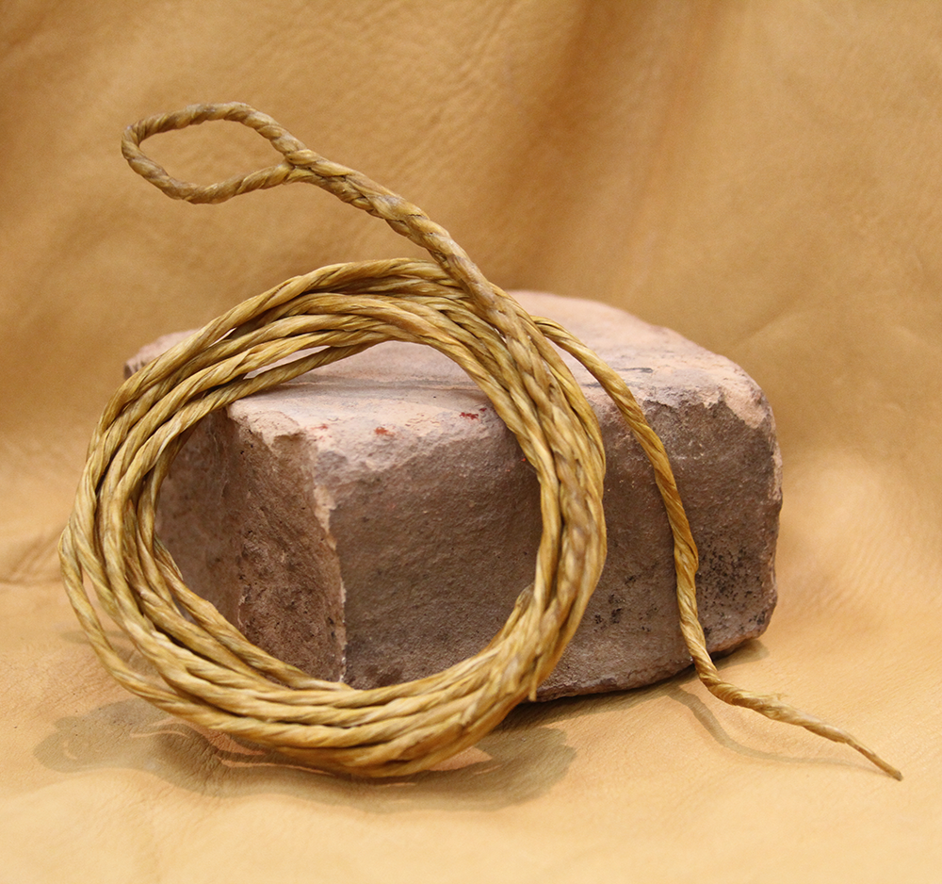
What is the part that is pulled?

Slide 36
The “Stringed” Bow
Did you know that our voice is both a wind and “stringed” instrument?
It is both “pipes” and “cords”.
Can we use our voices for evil and good?
Mat 12:34 O generation of vipers, how can ye, being evil, speak good things? for out of the abundance of the heart the mouth speaketh.
Luk 6:45 A good man out of the good treasure of his heart bringeth forth that which is good; and an evil man out of the evil treasure of his heart bringeth forth that which is evil: for of the abundance of the heart his mouth speaketh.

Slide 37
The “Stringed” Bow – the Wicked
Psa 11:2 For, lo, the wicked bend their bow, they make ready their arrow upon the string, that they may privily shoot at the upright in heart.

Slide 38
The “Stringed” Bow – the Wicked
Eze 28:13 Thou hast been in Eden the garden of God; every precious stone was thy covering, the sardius, topaz, and the diamond, the beryl, the onyx, and the jasper, the sapphire, the emerald, and the carbuncle, and gold: the workmanship of thy tabrets and of thy pipes was prepared in thee in the day that thou wast created.
Eze 28:14 Thou art the anointed cherub that covereth; and I have set thee so: thou wast upon the holy mountain of God; thou hast walked up and down in the midst of the stones of fire.
Eze 28:15 Thou wast perfect in thy ways from the day that thou wast created, till iniquity was found in thee.
Eze 28:16 By the multitude of thy merchandise they have filled the midst of thee with violence, and thou hast sinned: therefore I will cast thee as profane out of the mountain of God: and I will destroy thee, O covering cherub, from the midst of the stones of fire.

Slide 39
The “Stringed” Bow – the Righteous
The sweet sound of the Gospel Call.
  Psa 33:2 Praise the LORD with harp: sing unto him with the psaltery and an instrument of ten strings.
  Psa 92:3 Upon an instrument of ten strings, and upon the psaltery; upon the harp with a solemn sound.
  Psa 144:9 I will sing a new song unto thee, O God: upon a psaltery and an instrument of ten strings will I sing praises unto thee.
Ten – For the Whole “duty” of man (Adam) (Exo. 20:1-17; Ecc. 12:13-14), for even our voices are to glorify God in all things.

Slide 40
The “Stringed” Bow – the Righteous
The sweet sound of the Gospel call. God pulls the strings of the heart – praise comes forth!
  Mar 7:31 And again, departing from the coasts of Tyre and Sidon, he came unto the sea of Galilee, through the midst of the coasts of Decapolis.
  Mar 7:32 And they bring unto him one that was deaf, and had an impediment in his speech; and they beseech him to put his hand upon him.
  Mar 7:33 And he took him aside from the multitude, and put his fingers into his ears, and he spit, and touched his tongue;
  Mar 7:34 And looking up to heaven, he sighed, and saith unto him, Ephphatha, that is, Be opened.

Slide 41
The “Stringed” Bow – the Righteous
The sweet sound of the Gospel call. God pulls the strings of the heart – praise comes forth!
  Mar 7:35 And straightway his ears were opened, and the string of his tongue was loosed, and he spake plain.
  Mar 7:36 And he charged them that they should tell no man: but the more he charged them, so much the more a great deal they published it;
  Mar 7:37 And were beyond measure astonished, saying, He hath done all things well: he maketh both the deaf to hear, and the dumb to speak.

Slide 42
What is the word for ‘pulling’ the (Heart) String?
DRAW

Slide 43
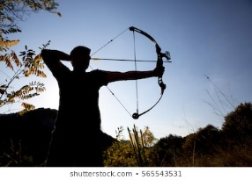
What is the word for ‘pulling’ the (Heart) String?

Slide 44
How does God “Draw” the Bow of Light?
Son 1:4 Draw me, we will run after thee: the king hath brought me into his chambers: we will be glad and rejoice in thee, we will remember thy love more than wine: the upright love thee.

Slide 45
How does God “Draw” the Bow of Light?
Hos 11:4 I drew them with cords of a man, with bands of love: and I was to them as they that take off the yoke on their jaws, and I laid meat unto them.

Slide 46
How does God “Draw” the Bow of Light?
Joh 6:44 No man can come to me, except the Father which hath sent me draw him: and I will raise him up at the last day.

Slide 47
How does God “Draw” the Bow of Light?
Joh 12:32 And I, if I be lifted up from the earth, will draw all men unto me.

Slide 48
Can Satan also draw us with Lie-ght? (Counterfeit)
Rev 12:4 And his tail drew the third part of the stars of heaven, and did cast them to the earth: and the dragon stood before the woman which was ready to be delivered, for to devour her child as soon as it was born.
Act 5:37 After this man rose up Judas of Galilee in the days of the taxing, and drew away much people after him: he also perished; and all, even as many as obeyed him, were dispersed.
Zep 3:2 She obeyed not the voice; she received not correction; she trusted not in the LORD; she drew not near to her God.

Slide 49
What is at the Head of an Arrow of God?
An Arrow Head
a Rock
a sharp pointed stone
a cutting message

Slide 50
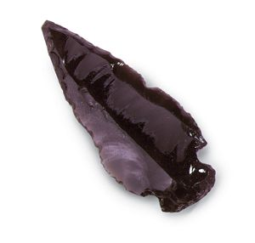
What is at the Head of an Arrow of God?

Slide 51
The Arrow Head of God
Isa 5:28 Whose arrows are sharp, and all their bows bent, their horses' hoofs shall be counted like flint, and their wheels like a whirlwind:

Slide 52
The Arrow Head of God
Gen 49:24 But his bow abode in strength, and the arms of his hands were made strong by the hands of the mighty God of Jacob; (from thence is the shepherd, the stone of Israel:)

Slide 53
The Arrow Head of God
Exo 24:12 And the LORD said unto Moses, Come up to me into the mount, and be there: and I will give thee tables of stone, and a law, and commandments which I have written; that thou mayest teach them.

Slide 54
The Arrow Head of God
Exo 24:12 And the LORD said unto Moses, Come up to me into the mount, and be there: and I will give thee tables of stone, and a law, and commandments which I have written; that thou mayest teach them.
Exo 31:18 And he gave unto Moses, when he had made an end of communing with him upon mount Sinai, two tables of testimony, tables of stone, written with the finger of God.

Slide 55
The Arrow Head of God
Deu 8:15 Who led thee through that great and terrible wilderness, wherein were fiery serpents, and scorpions, and drought, where there was no water; who brought thee forth water out of the rock of flint;
1Co 10:4 And did all drink the same spiritual drink: for they drank of that spiritual Rock that followed them: and that Rock was Christ.
Deu 32:4 He is the Rock, his work is perfect: for all his ways are judgment: a God of truth and without iniquity, just and right is he.

Slide 56
What is the body of the Arrow of God?
The SHAFT

Slide 57
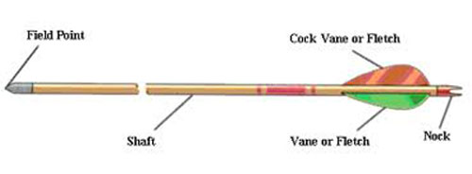
What is the body of the Arrow of God?

Slide 58
The “body” of the Arrow of God
Isa 49:2 And he hath made my mouth like a sharp sword; in the shadow of his hand hath he hid me, and made me a polished shaft; in his quiver hath he hid me;
Isa 49:3 And said unto me, Thou art my servant, O Israel, in whom I will be glorified.

Slide 59
The “body” of the Arrow of God
Joh 12:36 While ye have light, believe in the light, that ye may be the children of light. These things spake Jesus, and departed, and did hide himself from them.
Eph 5:8 For ye were sometimes darkness, but now are ye light in the Lord: walk as children of light:
1Th 5:5 Ye are all the children of light, and the children of the day: we are not of the night, nor of darkness.

Slide 60
What is the Shaft of an arrow made of?
a special kind of wood

Slide 61
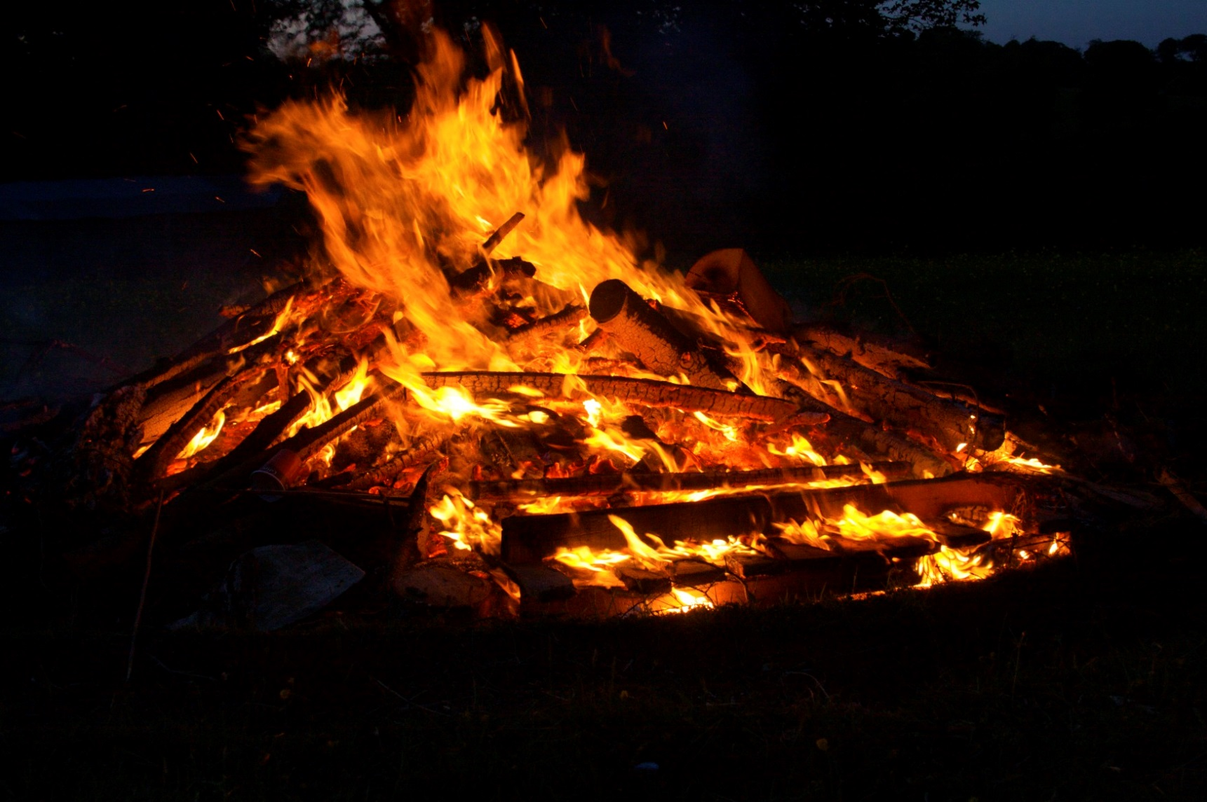
What is the Shaft of an arrow made of?

Slide 62
The special kind of wood for the Shaft
Zec 3:2 And the LORD said unto Satan, The LORD rebuke thee, O Satan; even the LORD that hath chosen Jerusalem rebuke thee: is not this a brand plucked out of the fire?

Slide 63
Let’s take a moment to look at these Arrows of God
Psa 38:1 A Psalm of David, to bring to remembrance. O LORD, rebuke me not in thy wrath: neither chasten me in thy hot displeasure.
Psa 38:2 For thine arrows stick fast in me, and thy hand presseth me sore.
Psa 38:3 There is no soundness in my flesh because of thine anger; neither is there any rest in my bones because of my sin.

Slide 64
Let’s take a moment to look at these Arrows of God
Psa 18:1 To the chief Musician, A Psalm of David, the servant of the LORD, who spake unto the LORD the words of this song in the day that the LORD delivered him from the hand of all his enemies, and from the hand of Saul: And he said, I will love thee, O LORD, my strength.
Psa 18:2 The LORD is my rock, and my fortress, and my deliverer; my God, my strength, in whom I will trust; my buckler, and the horn of my salvation, and my high tower.
Psa 18:3 I will call upon the LORD, who is worthy to be praised: so shall I be saved from mine enemies.
Psa 18:4 The sorrows of death compassed me, and the floods of ungodly men made me afraid.

Slide 65
Let’s take a moment to look at these Arrows of God
Psa 18:5 The sorrows of hell compassed me about: the snares of death prevented me.
Psa 18:6 In my distress I called upon the LORD, and cried unto my God: he heard my voice out of his temple, and my cry came before him, even into his ears.
Psa 18:7 Then the earth shook and trembled; the foundations also of the hills moved and were shaken, because he was wroth.
Psa 18:8 There went up a smoke out of his nostrils, and fire out of his mouth devoured: coals were kindled by it.

Slide 66
Let’s take a moment to look at these Arrows of God
Psa 18:9 He bowed the heavens also, and came down: and darkness was under his feet.
Psa 18:10 And he rode upon a cherub, and did fly: yea, he did fly upon the wings of the wind.
Psa 18:11 He made darkness his secret place; his pavilion round about him were dark waters and thick clouds of the skies.
Psa 18:12 At the brightness that was before him his thick clouds passed, hail stones and coals of fire.

Slide 67
Let’s take a moment to look at these Arrows of God
Psa 18:13 The LORD also thundered in the heavens, and the Highest gave his voice; hail stones and coals of fire.
Psa 18:14 Yea, he sent out his arrows, and scattered them; and he shot out lightnings, and discomfited them.
Psa 18:15 Then the channels of waters were seen, and the foundations of the world were discovered at thy rebuke, O LORD, at the blast of the breath of thy nostrils.

Slide 68
Let’s take a moment to look at these Arrows of God
Psa 18:16 He sent from above, he took me, he drew me out of many waters.
Psa 18:17 He delivered me from my strong enemy, and from them which hated me: for they were too strong for me.
(parallel in 2 Sam. 22:41-15)

Slide 69
Let’s take a moment to look at these Arrows of God
Zec 9:14 And the LORD shall be seen over them, and his arrow shall go forth as the lightning: and the Lord GOD shall blow the trumpet, and shall go with whirlwinds of the south.

Slide 70
Let’s take a moment to look at these Arrows of God
Deu 32:23 I will heap mischiefs upon them; I will spend mine arrows upon them.

Slide 71
Let’s take a moment to look at these Arrows of God
Job 6:4 For the arrows of the Almighty are within me, the poison whereof drinketh up my spirit: the terrors of God do set themselves in array against me.

Slide 72
Let’s take a moment to look at these Arrows of God
Psa 64:7 But God shall shoot at them with an arrow; suddenly shall they be wounded.

Slide 73
Let’s take a moment to look at these Arrows of God
Psa 7:11 God judgeth the righteous, and God is angry with the wicked every day.
Psa 7:12 If he turn not, he will whet his sword; he hath bent his bow, and made it ready.
Psa 7:13 He hath also prepared for him the instruments of death; he ordaineth his arrows against the persecutors.

Slide 74
Let’s take a moment to look at these Arrows of God
Psa 120:4 Sharp arrows of the mighty, with coals of juniper.

Slide 75
Let’s take a moment to look at these Arrows of God
Psa 127:3 Lo, children are an heritage of the LORD: and the fruit of the womb is his reward.
Psa 127:4 As arrows are in the hand of a mighty man; so are children of the youth.
Psa 127:5 Happy is the man that hath his quiver full of them: they shall not be ashamed, but they shall speak with the enemies in the gate.

Slide 76
Let’s take a moment to look at these Arrows of God
Psa 77:13 Thy way, O God, is in the sanctuary: who is so great a God as our God?
Psa 77:14 Thou art the God that doest wonders: thou hast declared thy strength among the people.
Psa 77:15 Thou hast with thine arm redeemed thy people, the sons of Jacob and Joseph. Selah.

Slide 77
Let’s take a moment to look at these Arrows of God
Psa 77:16 The waters saw thee, O God, the waters saw thee; they were afraid: the depths also were troubled.
Psa 77:17 The clouds poured out water: the skies sent out a sound: thine arrows also went abroad.
Psa 77:18 The voice of thy thunder was in the heaven: the lightnings lightened the world: the earth trembled and shook.

Slide 78
What is the purpose of an Arrow?
To be Sent (Apostle)

Slide 79
Jesus (the appointed) & Us
Heb 3:1 Wherefore, holy brethren, partakers of the heavenly calling, consider the Apostle and High Priest of our profession, Christ Jesus;
Heb 3:2 Who was faithful to him that appointed him, as also Moses was faithful in all his house.

Slide 80
Sent “Straight” – not crooked
Isa 66:19 And I will set a sign among them, and I will send those that escape of them unto the nations, to Tarshish, Pul, and Lud, that draw the bow, to Tubal, and Javan, to the isles afar off, that have not heard my fame, neither have seen my glory; and they shall declare my glory among the Gentiles.

Slide 81
Sent “Straight” – not crooked
Isa 6:8 Also I heard the voice of the Lord, saying, Whom shall I send, and who will go for us? Then said I, Here am I; send me.

Slide 82
Sent “Straight” – not crooked
Pro 4:25 Let thine eyes look right on, and let thine eyelids look straight before thee.
Pro 4:26 Ponder the path of thy feet, and let all thy ways be established.
Pro 4:27 Turn not to the right hand nor to the left: remove thy foot from evil.

Slide 83
Arrows of Lightning, enlightening the world
Psa 144:5 Bow thy heavens, O LORD, and come down: touch the mountains, and they shall smoke.
Psa 144:6 Cast forth lightning, and scatter them: shoot out thine arrows, and destroy them.

Slide 84
Arrows of Lightning, enlightening the world
Job 38:35 Canst thou send lightnings, that they may go, and say unto thee, Here we are?
  Dan 11:44 But tidings out of the east and out of the north shall trouble him: therefore he shall go forth with great fury to destroy, and utterly to make away many.
  Mat 24:27 For as the lightning cometh out of the east, and shineth even unto the west; so shall also the coming of the Son of man be.
  Luk 17:24 For as the lightning, that lighteneth out of the one part under heaven, shineth unto the other part under heaven; so shall also the Son of man be in his day.

Slide 85
What makes the Arrows fly?
Fletching, the 3 Feathers
3 Angels Messages

Slide 86
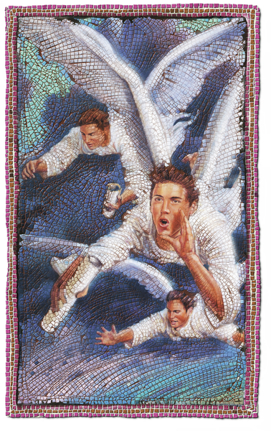
What makes the Arrows fly?

Slide 87
What makes the Arrows fly?
Rev 14:6 And I saw another angel fly in the midst of heaven, having the everlasting gospel to preach unto them that dwell on the earth, and to every nation, and kindred, and tongue, and people,
Rev 14:7 Saying with a loud voice, Fear God, and give glory to him; for the hour of his judgment is come: and worship him that made heaven, and earth, and the sea, and the fountains of waters.
Rev 14:8 And there followed another angel, saying, Babylon is fallen, is fallen, that great city, because she made all nations drink of the wine of the wrath of her fornication.

Slide 88
What makes the Arrows fly?
Rev 14:9 And the third angel followed them, saying with a loud voice, If any man worship the beast and his image, and receive his mark in his forehead, or in his hand,
Rev 14:10 The same shall drink of the wine of the wrath of God, which is poured out without mixture into the cup of his indignation; and he shall be tormented with fire and brimstone in the presence of the holy angels, and in the presence of the Lamb:
Rev 14:11 And the smoke of their torment ascendeth up for ever and ever: and they have no rest day nor night, who worship the beast and his image, and whosoever receiveth the mark of his name.
Rev 14:12 Here is the patience of the saints: here are they that keep the commandments of God, and the faith of Jesus.

Slide 89
What is the difference between 3 & 4 feathers?
3 feathers make an Arrow
add a 4th feather, and what do we get?
an Almighty Missile of God
A Weapon of Mass …

Slide 90
God’s Weapons of Mass …
DELIVERANCE
(((BOOM!)))
Thousands converted in a day

Slide 91
What holds the Arrows?
a QUIVER
(shake, rattle, tremble, vibrate)

Slide 92
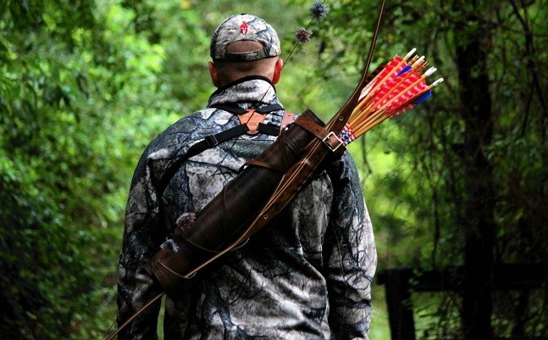
What holds the Arrows?

Slide 93
((( - Quiver - )))
Hab 3:16 When I heard, my belly trembled; my lips quivered at the voice: rottenness entered into my bones, and I trembled in myself, that I might rest in the day of trouble: when he cometh up unto the people, he will invade them with his troops.

Slide 94
((( - Quiver - )))
Psa 5:9 For there is no faithfulness in their mouth; their inward part is very wickedness; their throat is an open sepulchre; they flatter with their tongue.
Jer 5:16 Their quiver is as an open sepulchre, they are all mighty men.
Rom 3:13 Their throat is an open sepulchre; with their tongues they have used deceit; the poison of asps is under their lips:

Slide 95
((( - Quiver - ))) – God’s Children to be drawn for use
Psa 127:3 Lo, children are an heritage of the LORD: and the fruit of the womb is his reward.
Psa 127:4 As arrows are in the hand of a mighty man; so are children of the youth.
Psa 127:5 Happy is the man that hath his quiver full of them: they shall not be ashamed, but they shall speak with the enemies in the gate.

Slide 96
With what does God use to draw the Bow and Arrow?
His Almighty Arm

Slide 97
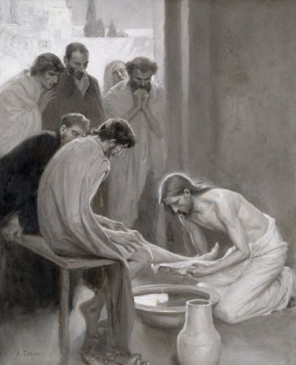
With what does God use to draw the Bow and Arrow?

Slide 98
The Almighty Arm of God
Psa 89:13 Thou hast a mighty arm: strong is thy hand, and high is thy right hand.

Slide 99
The Almighty Arm of God
Deu 26:8 And the LORD brought us forth out of Egypt with a mighty hand, and with an outstretched arm, and with great terribleness, and with signs, and with wonders:

Slide 100
The Almighty Arm of God
Isa 30:30 And the LORD shall cause his glorious voice to be heard, and shall shew the lighting down of his arm, with the indignation of his anger, and with the flame of a devouring fire, with scattering, and tempest, and hailstones.

Slide 101
With what does God hold the Arrow?
His Almighty Finger

Slide 102
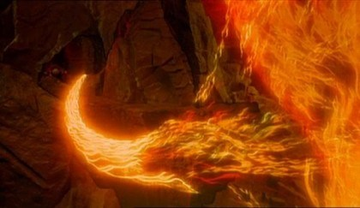
With what does God hold the Arrow?

Slide 103
The Almighty Finger of God
Exo 8:19 Then the magicians said unto Pharaoh, This is the finger of God: and Pharaoh's heart was hardened, and he hearkened not unto them; as the LORD had said.

Slide 104
The Almighty Finger of God
Exo 31:18 And he gave unto Moses, when he had made an end of communing with him upon mount Sinai, two tables of testimony, tables of stone, written with the finger of God.
Deu 9:10 And the LORD delivered unto me two tables of stone written with the finger of God; and on them was written according to all the words, which the LORD spake with you in the mount out of the midst of the fire in the day of the assembly.

Slide 105
The Almighty Finger of God
Luk 11:20 But if I with the finger of God cast out devils, no doubt the kingdom of God is come upon you.
Luk 11:21 When a strong man armed keepeth his palace, his goods are in peace:
Luk 11:22 But when a stronger than he shall come upon him, and overcome him, he taketh from him all his armour wherein he trusted, and divideth his spoils.

Slide 106
The Almighty Finger of God
Mat 12:28 But if I cast out devils by the Spirit of God, then the kingdom of God is come unto you.

Slide 107
Draw the Arrow towards the Eye, Mouth and the Ear
Eye
Psa 32:8 I will instruct thee and teach thee in the way which thou shalt go: I will guide thee with mine eye.
Mouth
Eze 3:17 Son of man, I have made thee a watchman unto the house of Israel: therefore hear the word at my mouth, and give them warning from me.
Ear
Isa 30:21 And thine ears shall hear a word behind thee, saying, This is the way, walk ye in it, when ye turn to the right hand, and when ye turn to the left.

Slide 108
God shoots the Arrow and doesn’t miss
Psa 64:7 But God shall shoot at them with an arrow; suddenly shall they be wounded.
Psa 64:8 So they shall make their own tongue to fall upon themselves: all that see them shall flee away.
Psa 64:9 And all men shall fear, and shall declare the work of God; for they shall wisely consider of his doing.
Psa 64:10 The righteous shall be glad in the LORD, and shall trust in him; and all the upright in heart shall glory.

Slide 109
In Revelation 19:11-16, who is Jesus riding with?
Kings

Slide 110
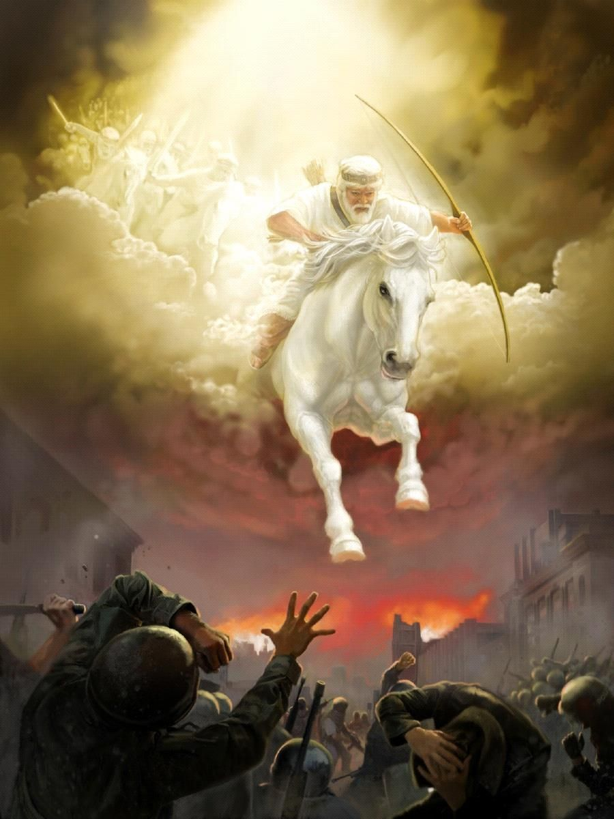
In Revelation 19:11-16, who is Jesus riding with?

Slide 111
The Kings & Priests of God
Psa 21:1 To the chief Musician, A Psalm of David. The king shall joy in thy strength, O LORD; and in thy salvation how greatly shall he rejoice!
Psa 21:2 Thou hast given him his heart's desire, and hast not withholden the request of his lips. Selah.
Psa 21:3 For thou preventest him with the blessings of goodness: thou settest a crown of pure gold on his head.
Psa 21:4 He asked life of thee, and thou gavest it him, even length of days for ever and ever.

Slide 112
The Kings & Priests of God
Psa 21:5 His glory is great in thy salvation: honour and majesty hast thou laid upon him.
Psa 21:6 For thou hast made him most blessed for ever: thou hast made him exceeding glad with thy countenance.
Psa 21:7 For the king trusteth in the LORD, and through the mercy of the most High he shall not be moved.
Psa 21:8 Thine hand shall find out all thine enemies: thy right hand shall find out those that hate thee.

Slide 113
The Kings & Priests of God
Psa 21:9 Thou shalt make them as a fiery oven in the time of thine anger: the LORD shall swallow them up in his wrath, and the fire shall devour them.
Psa 21:10 Their fruit shalt thou destroy from the earth, and their seed from among the children of men.
Psa 21:11 For they intended evil against thee: they imagined a mischievous device, which they are not able to perform.
Psa 21:12 Therefore shalt thou make them turn their back, when thou shalt make ready thine arrows upon thy strings against the face of them.
Psa 21:13 Be thou exalted, LORD, in thine own strength: so will we sing and praise thy power.

Slide 114
The Archers of God
Read:
Jeremiah 50:1-46, 51:1-16
Babylon is fallen, is fallen …

Slide 115
In order for us to be Arrows of Lightning, what is needed?
Thick Clouds (Water + Dust)
Moisture (Holy Ghost, favour, grace of God)
Electric Current (Earth to Heaven)
Thunder (Voice of God, speaking, answering)
Rain – 1 Kings 18:30-46, Zechariah 10:1-12, 12:1-14
The cycle of prayer to God as represented in nature
(1 Corinthians 15:46)

Slide 116
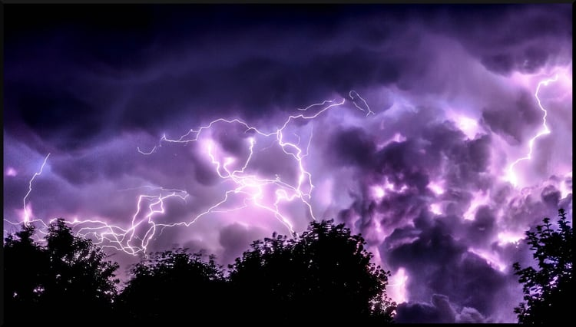
In order for us to be Arrows of Lightning, what is needed?

Slide 117
We are to be Arrows of LOVE (LIGHT), and NOT:
Counterfeit Arrows:
Cupid – Arrows of Lust
Zeus – Arrows of Revenge
Green Arrow – Arrows of Vengeance (that miss)

Slide 118
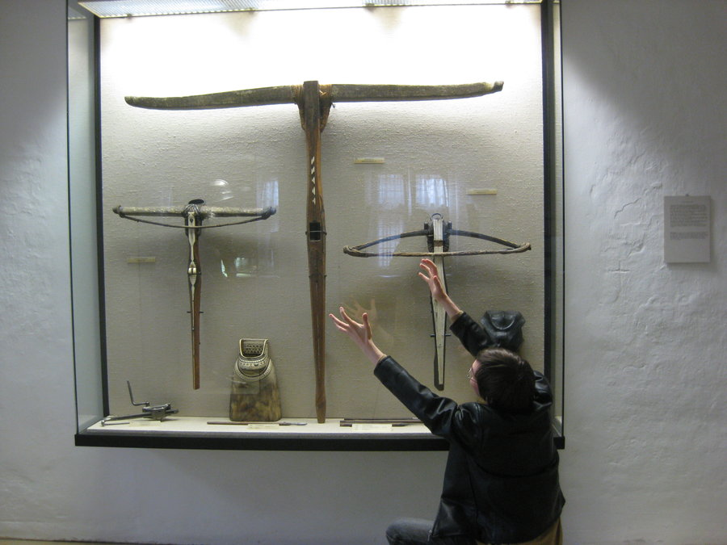
Do you now see?

Slide 119
Jesus that Arrow of LOVE (LIGHT), sent with Almighty Power from the Father, and Holy Spirit:
Isa 48:16 Come ye near unto me, hear ye this; I have not spoken in secret from the beginning; from the time that it was, there am I: and now the Lord GOD, and his Spirit, hath sent me.

Slide 120
God’s Weapons are AWESOME & Light, just as HIS Character!
His Bow is Light
His Arrows are Light
His Word is Light
His Character is Light
His Children are Light

Slide 121
God’s Weapons are AWESOME & Light, just as HIS Character!
Joh 20:21 Then said Jesus to them again, Peace be unto you: as my Father hath sent me, even so send I you.

Slide 122
God’s Weapons are AWESOME & Light, just as HIS Character!
Isa 6:8 Also I heard the voice of the Lord, saying, Whom shall I send, and who will go for us? Then said I, Here am I; send me.

Slide 123
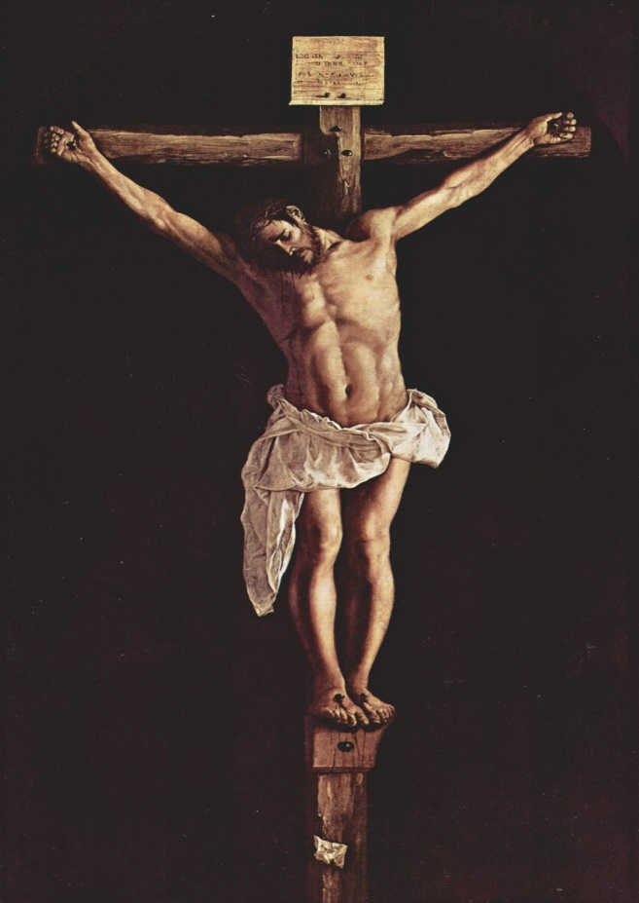
On the Cross – Bow, is the instrument called the “bolt” (of lightning)
CROSS – BOW
Eph 4:9 (Now that he ascended, what is it but that he also descended first into the lower parts of the earth?
Eph 4:10 He that descended is the same also that ascended up far above all heavens, that he might fill all things.)

