Slide 1
A Destructive Union

Slide 2
Genesis 1:27
“So God created man in his own image, in the image of God created he him; male and female created he them.”

Slide 3
Genesis 2:24
“Therefore shall a man leave his father and his mother, and shall cleave unto his wife: and they shall be one flesh.”

Slide 5
Genesis 3:1

Slide 6
How do you suppose the question that was asked in verse one made Eve Feel?

Slide 7
What did Eve have that Satan didn’t?

Slide 8
=

Slide 10
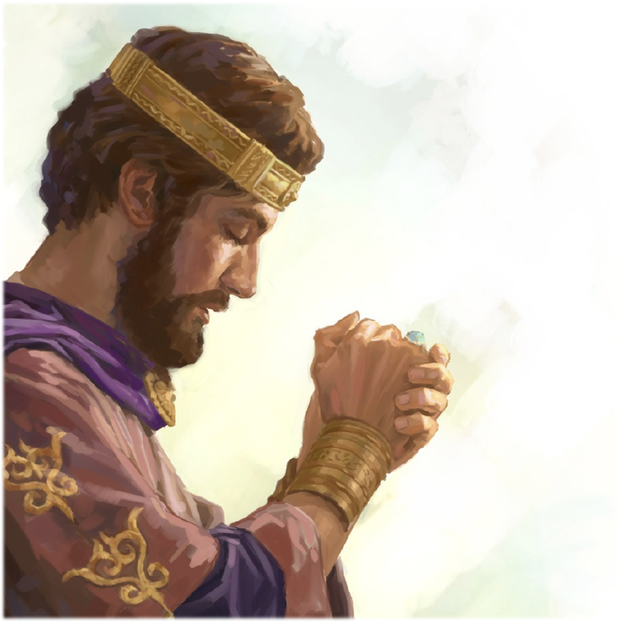
Ecc 1:14
“I have seen all the works that are done under the sun; and, behold, all is vanity and vexation of spirit.”

Slide 11
You’re missing out!

Slide 12
How does he spread these LIES now?

Slide 13
Ephesians 2:2
“Wherein in time past ye walked according to the course of this world, according to the prince of the power of the air, the spirit that now worketh in the children of disobedience:

Slide 15
“Cast out of heaven, Satan set up his kingdom in this world, and ever since, he has been untiringly striving to seduce human beings from their allegiance to God. He uses the same power that he used in heaven—the influence of mind on mind. Men become tempters of their fellow men.”
MR VOL 7 PG 63

Slide 16
“Every man, woman, and child that is not under the control of the Spirit of God is under the influence of Satan’s sorcery, and by his words and example he will lead others away from the path of truth.
Faith I live by 566

Slide 17
Satan has the greatest success working through Ungodly relationships

Slide 18
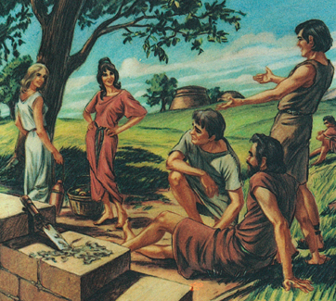
Genesis 6:2-3
“The sons of God saw the daughters of men that they were fair; and they took them wives of all which they chose. And the LORD said, My spirit shall not always strive with man,”

Slide 20
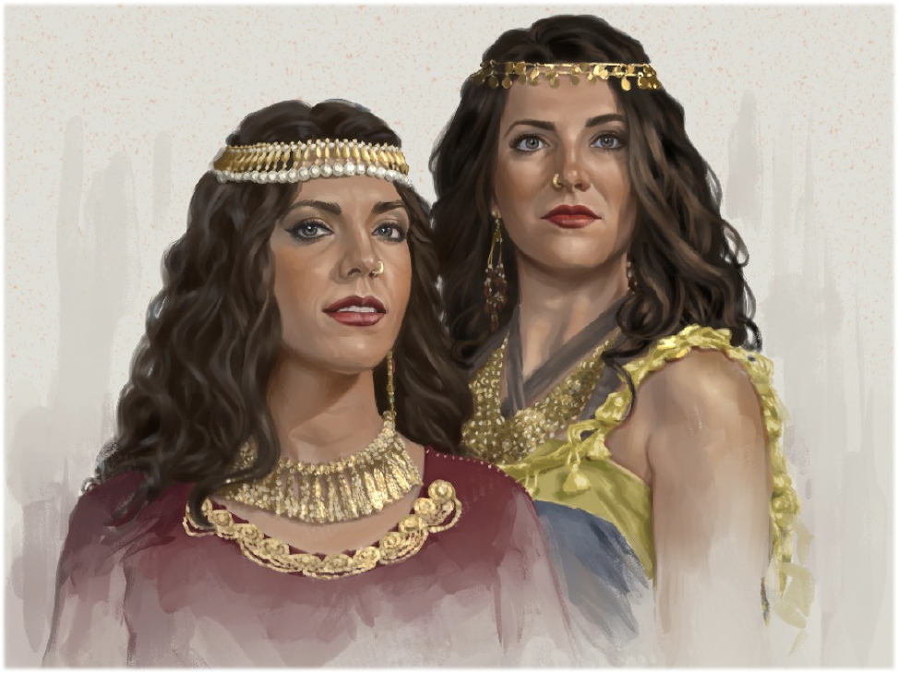

Slide 21
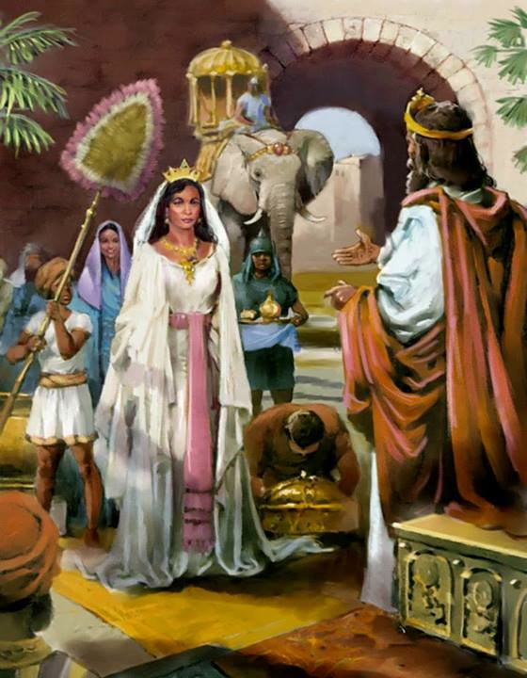
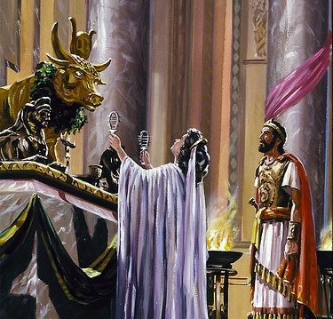

Slide 24
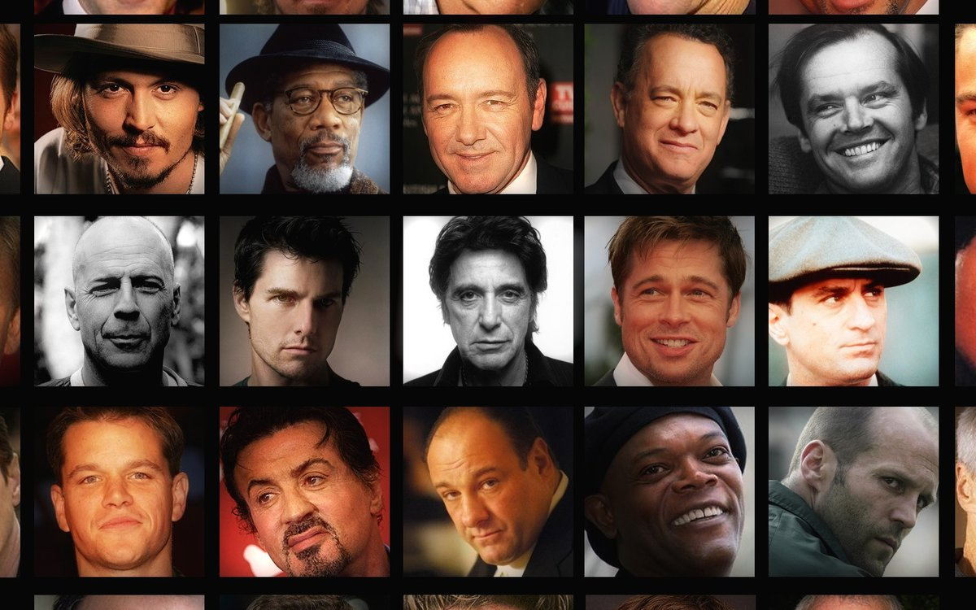

Slide 26
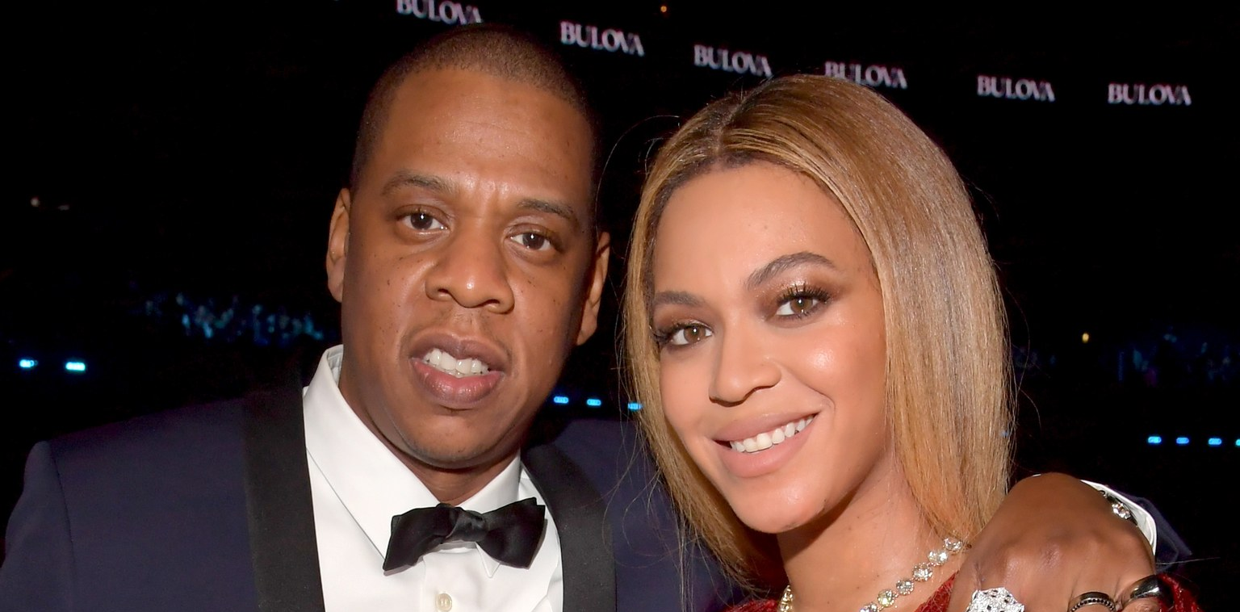

Slide 29
2 Corinthians 6:14
“Be ye not unequally yoked together with unbelievers.”

Slide 31
Where does “Dating” come from?

Slide 32
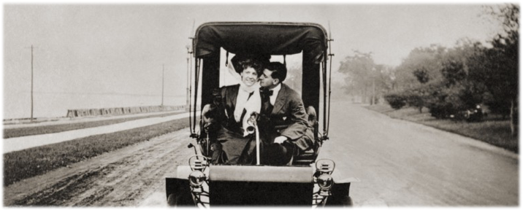
The concept of dating really began at the turn of the 20th century. Prior to the late early 1900s, courtship was a much more private, unemotional affair. Women would meet with several men, with her parents present, to whittle the pickings down to the most suitable match for marriage, which heavily relied on factors such as financial and social status. When a young woman decided on a man she wanted to see exclusively, their activities as a couple took place either in the household, or at social gatherings. At that time, there was no such thing as just two young lovers "going out on a date."

Slide 33
However, this began to change in the early years of the 20th century, when couples began to go out together in public and unsupervised. Still, the ultimate and very apparent goal was still that of marriage. This stands in stark contrast to today's dating world, when the topic of marriage may not be brought up for several years.

Slide 34
The first decade of the 20th century was marked by the figure of the “gentleman caller.” If a young man was interested in a young woman, he would follow the proper protocol of calling upon her, which meant that he would come to the family's home and (hopefully) be welcomed into their parlor. If he was invited back for subsequent visits, he would be free to come and call upon the young woman during hours specified by her parents.

Slide 35
As the years rolled on into the 1920s, however, this system quickly became outdated and unfavorable.Dating had almost completely replaced the old system of calling by the mid-1920s — and, in so doing, had transformed American courtship." This was a period of time when couples started going out on dates, which also meant they started paying for dates. This changed the relationship dynamic between a young man and a young woman, as now it was the man's duty to pay for the date, whereas before it was the woman who decided the terms of the visit.

Slide 36
What happened around the 1920’s to cause this drastic change?

Slide 38
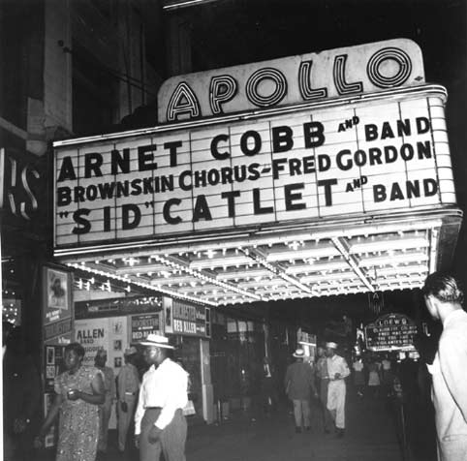
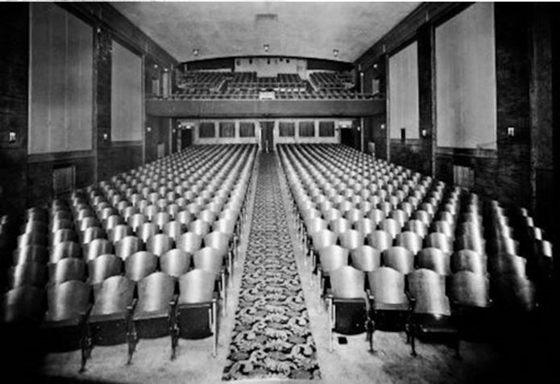

Slide 39
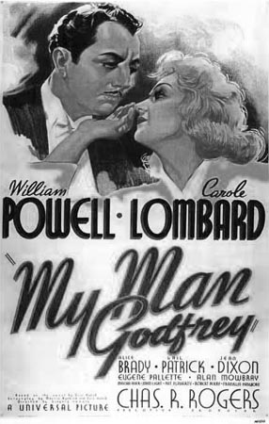
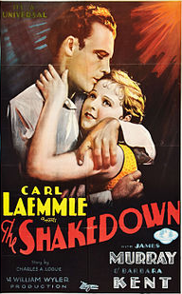

Slide 40
Before the 1900s, the only women who wore "painted faces" were actresses and prostitutes. (Previously, a natural look, it was said, demonstrated "clean living.") To make their product mainstream, the cosmetics industry renamed their goods "makeup," with the lofty, admirable goal of "making oneself up" to express femininity.
2 Kings 9:30

Slide 41
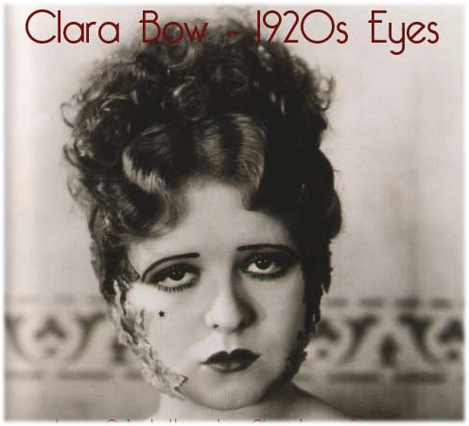
At the turn of last century, dating was still a new concept and law enforcement wasn't sure what to make of it—but they were sure something sordid was going on. A young man and woman meeting in public, him buying her food, drink, and gifts: well, it was veritable prostitution in the eyes of authorities, and women could be arrested for it.

Slide 42
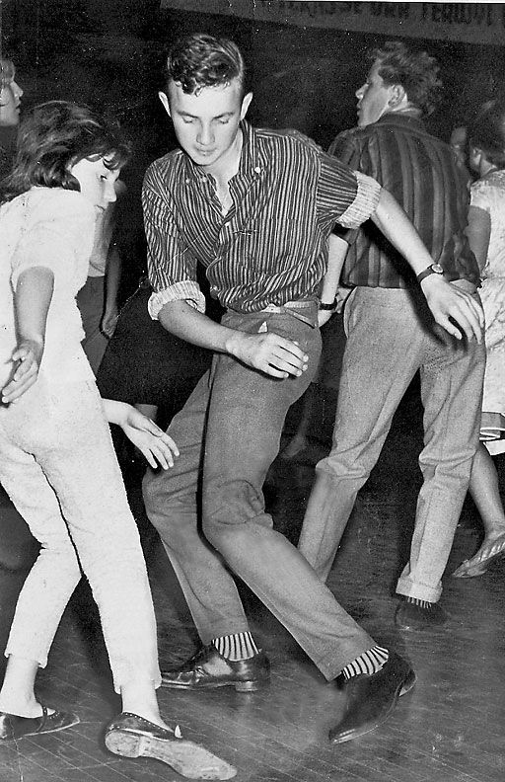

Slide 44
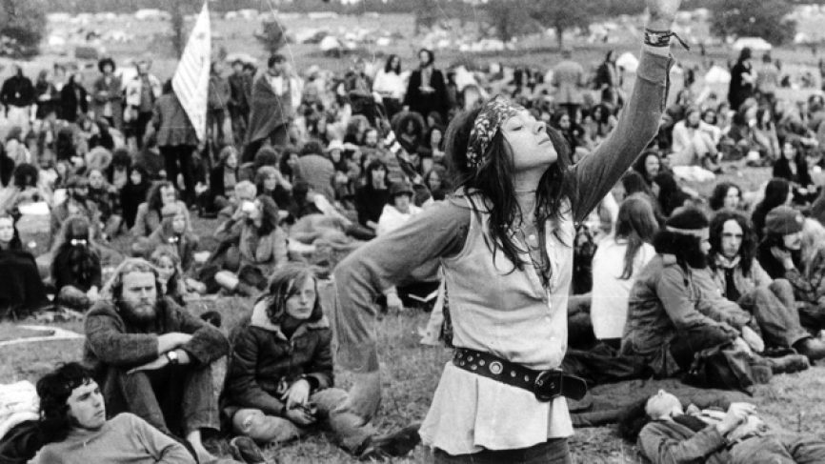
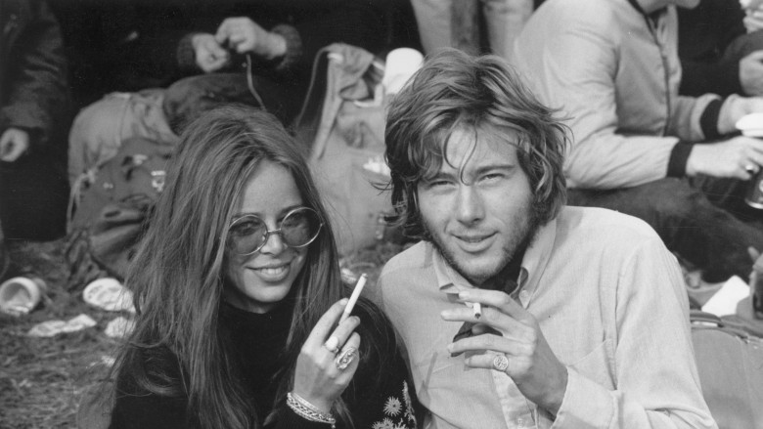

Slide 45
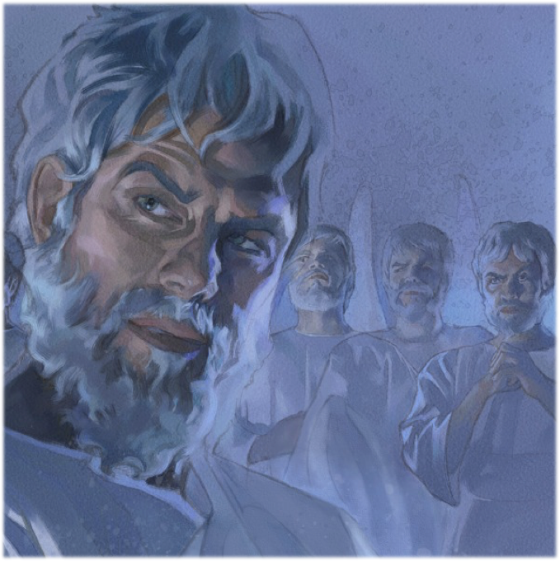

Slide 49
A Destructive Union

Slide 50
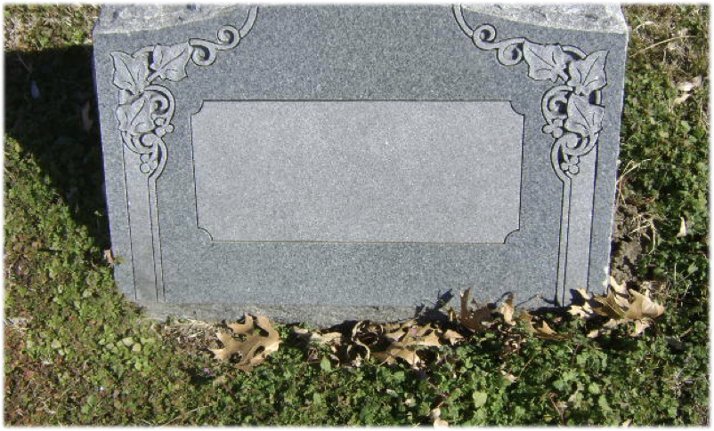
Spiritual Death

Slide 55
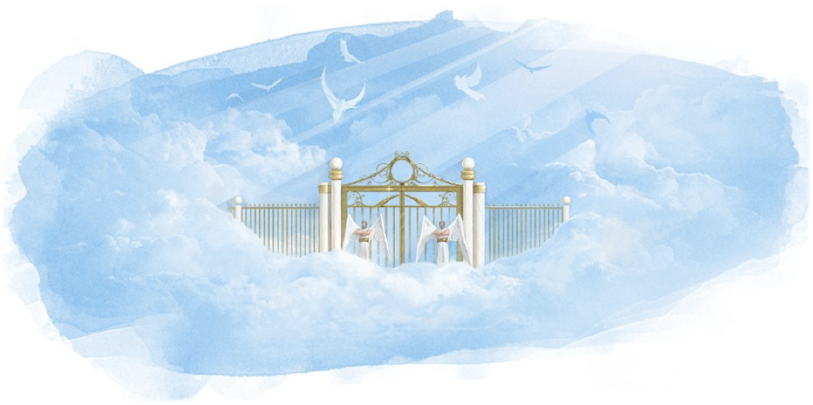

Slide 56
Questions?

Slide 57
Genesis 24

Slide 58
“Isaac was highly honoured by God in being made inheritor of the promises through which the world was to be blessed; yet when he was forty years of age, he submitted to his father's judgement in appointing his experienced, God-fearing servant to choose a wife for him. And the result of that marriage, as presented in the Scriptures, is a tender and beautiful picture of domestic happiness:”
-LT (100)

Slide 59
“A young man who enjoys the society and wins the friendship of a young lady unbeknown to her parents, does not act a noble Christian part toward her or toward her parents.”
-LT (107)

Slide 60
“Through secret communications and meetings he may gain an influence over her mind; but in so doing he fails to manifest that nobility and integrity of soul which every child of God will possess…..He who would lead a daughter away from duty, who would confuse her ideas of God's plain and positive commands to obey and honour her parents, is not one who would be true to the marriage obligations.”
-LT (107)

Slide 61
“If there is any subject which should be carefully considered and in which the counsel of older and more experienced persons should be sought, it is the subject of marriage; if ever the Bible was needed as a counselor, if ever divine guidance should be sought in prayer, it is before taking a step that binds persons together for life.”
-PP 175

